Slide 1
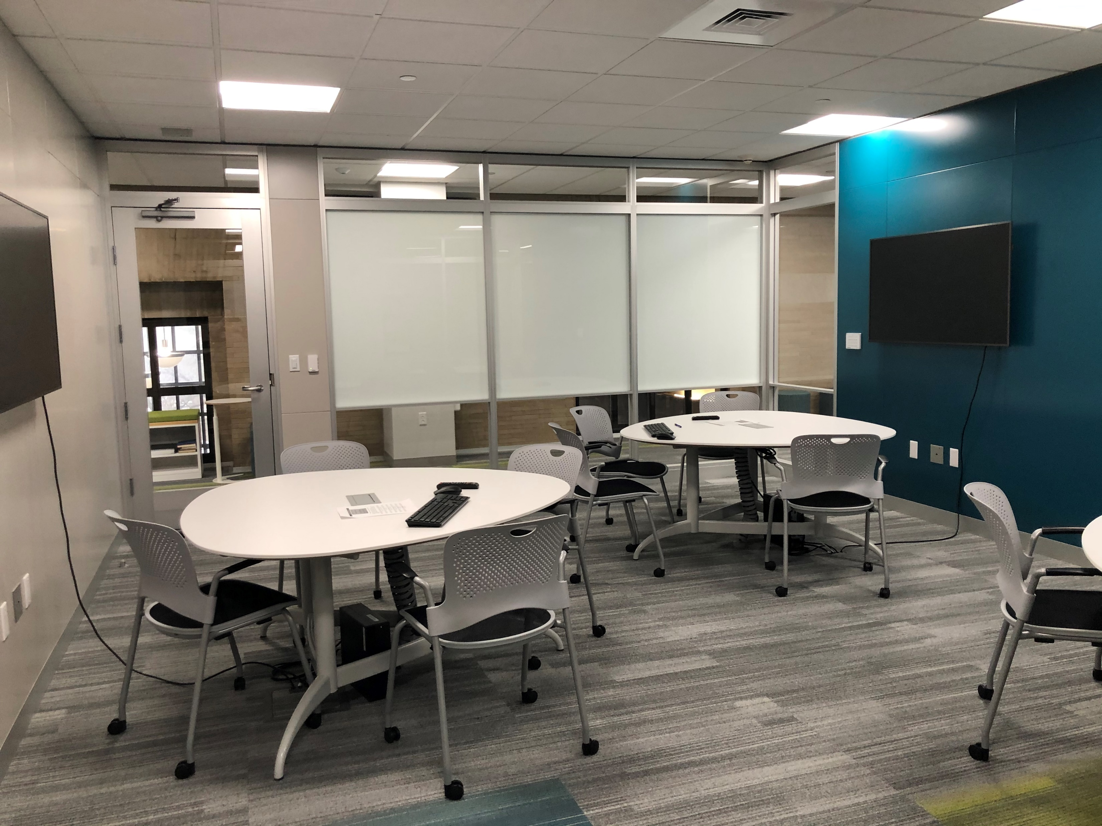

Building a Data Science Portfolio in Libraries
Xuying Xin, PhD
Data Analyst
(Certification: Power BI, Tableau)
Abstract
The advancement of data science methods and products has transformed many sectors, such as commerce, healthcare, government, education, and even academic libraries. As part of a top-tier research library, we have recently established a portfolio of data services to meet the increasing demand of data analysis and visualization techniques from the research community, including faculty, students and staff from various colleges at the university. To support and build a community of data science researchers and users, we have launched a Digital Lab to provide space, computers, and software tools for patrons to work on their data visualization projects. Workshops, consultations, and guest lectures have been provided to support research projects benefiting from the advanced data analytics and visualization techniques and services available in the university libraries. Statistical programming, such as R, STATA, SPSS, and software tools, such as Tableau, MS Power BI, and ArcGIS have been applied to this data service. In addition, the existing data analytics and visualization service is being extended to include Big Data Analytics. This poster will report on service development, challenges, and the community building initiatives more broadly.
Service Development Approach
In early 2019 members of the Research Informatics team undertook a University-wide landscape analysis of existing support for big data analytics and data science services and infrastructure. We applied a mixed-methods approach which began with a University-wide website review to identify potential stakeholders. Select stakeholders were then interviewed to understand extent of services, populations served, and goals for program development. From this review we developed the service portfolio below, with a focus on supporting graduate and undergraduate students.
Service Portfolio
Business Analytics Platform and Tools
MS SQL Server/BI
MS Access, Power BI
Tableau
Big Data Analytics Platform and Tools
Google Cloud Platform
TensorFlow
Python
Big Query
Service Modes of Delivery
Consultations
Workshops
Course integrations
Spaces: Advanced Analytics and Visualization Lab
This computer lab space is equipped with three laptop workstations and Solstice. Walk-in use for individual computer spaces or the entire digital lab space is available to Penn State students, staff, and faculty members during open library hours.
ArcGIS Pro
ArcGIS ArcMap
Python 3.7.x
SPSS
SAS/JMP
STATA
RStudio
Power BI Desktop
MS Access
MATLAB
Next Steps
Continue to collect data on services, identify gaps, and partner with colleagues, such as the Institute for Computational and Data Science.

Slide 2
