Slide 1

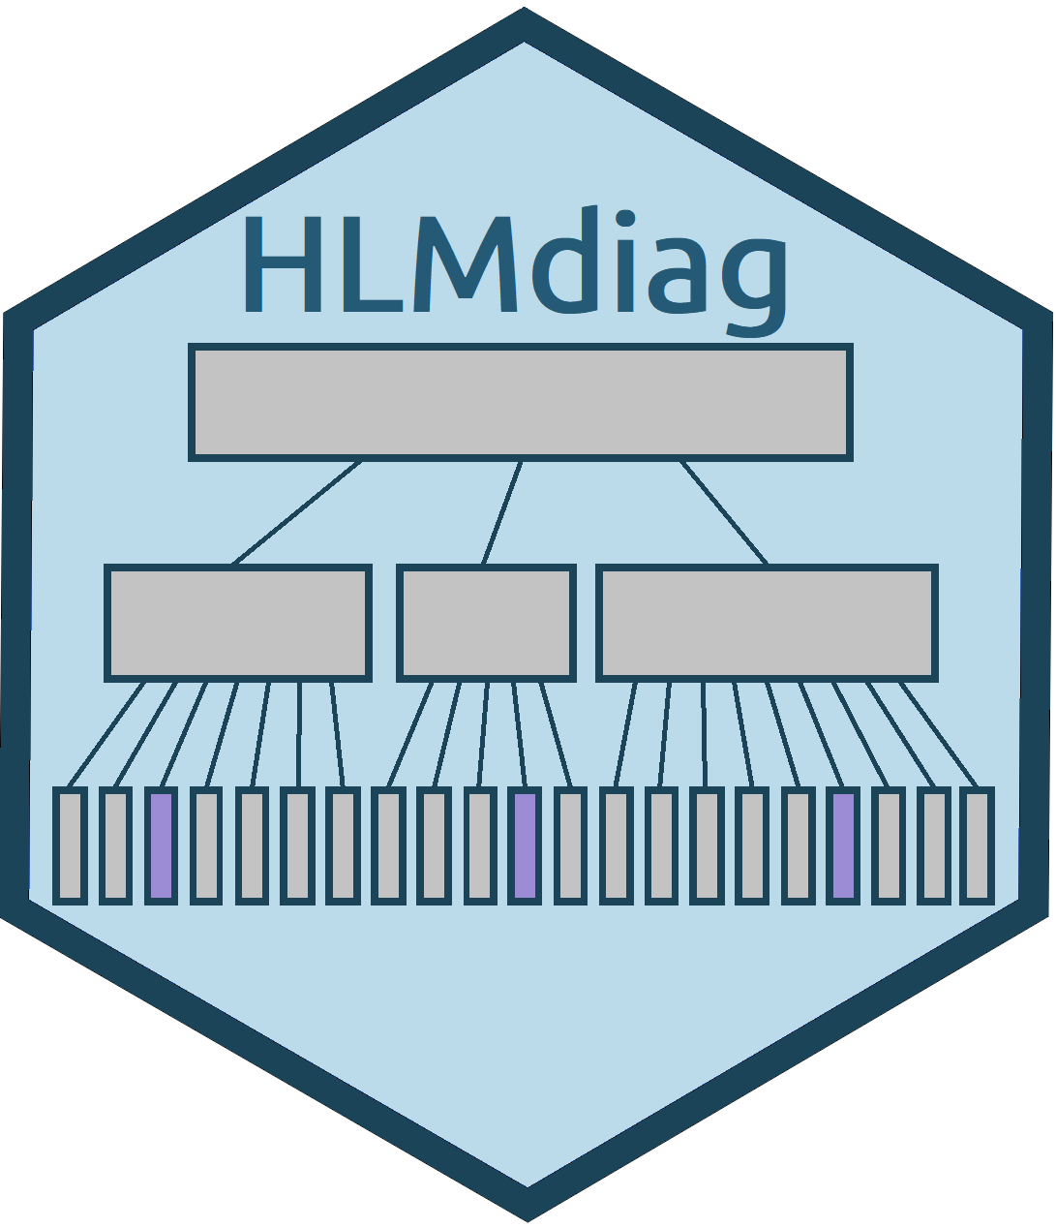
Updating the HLMdiag R Package
Presenter: Jaylin Lowe
Authors: Adam Loy, Jaylin Lowe, and Jack Moran
Carleton College
Background
Package Updates
Future Development
Hierarchical linear mixed models (HLMs) are models fit to data with multiple levels (for example, students within schools). This type of data violates the independence assumption necessary for multiple regression. HLMs consist of both fixed effects and random effects and help account for the correlation of observations within the same group.
The functions hlm_resid(), hlm_influence(), hlm_augment() have been added to HLMdiag. All three functions draw inspiration from the augment() function in broom and append diagnostics to the model frame.
The hlm_resid() function returns a tibble with residuals and predicted values from the model calculated using both Least Squares and Empirical Bayes methods appended to the data.
  For higher-level residuals, detects and returns only the group-level variables in the output tibble.
  Improves the efficiency of calculating LS residuals.
The hlm_influence() function returns a tibble with influence diagnostics (Cook’s distance, MDFFITS, covariance trace, covariance ratio, leverage and relative variance change) appended to the original data used to fit the model.
  This can be used with dotplot_diag() to easily create dotplots of different diagnostics.
Both hlm_resid() and hlm_influence() can be used with arrange() from the dplyr package to inspect the values of other diagnostics of influential observations.
They also respect the na.action argument from lme4 and nlme and will delete rows with NAs or pad them with NAs accordingly.
Residual and influence diagnostics are now available for lme objects fit using the nlme package. Previously, residual diagnostics were not implemented in nlme and only individual influence diagnostics functions using one step approximations were available for lme objects. In version 0.4.0, calculations of influence diagnostics using full refits of the model are available for lme objects through case_delete() and hlm_influence().
The new hlm_augment() function combines hlm_resid()and hlm_influence()to return influence diagnostics and residual values appended to the model frame.
Residual Analysis
  Implement deletion residuals
  Implement generalizations of least squares residuals to work with crossed models
  Implement a method to check if models are rank deficient at the group level
  Implement studentized residuals
Influence Analysis
  Implement a one step approximation to calculate relative variance change
  Implement methods to calculate leverage when multiple observations are deleted
General
  Implement a method to create a line-up protocol which uses visual inference to check residual and influence statistics
  Implement residual and influence procedures for other classes of models and models with crossed designs
Overview of HLMdiag
HLMdiag (standing for hierarchical linear model diagnostics), an R package originally developed in 2014, provides a unified framework to investigate diagnostics of hierarchical linear models. The functions in HLMdiag can be grouped into three distinct sections:
Residual Analysis
  HLMdiag contains functions which extract marginal, level-1, and higher-level residuals from a model using both Least Squares and Empirical Bayes methods of parameter estimation
Influence Analysis
  HLMdiag includes functions to calculate Cook’s distance, MDFFITS, covariance trace, covariance ratio, leverage, and relative variance change
Graphics
  HLMdiag also includes graphical functions aimed at making graphical assessment easier. These functions help create dotplots for influence diagnostics, and Q-Q plots for residual analysis.
Acknowledgements
I would like to thank Adam Loy for giving us the opportunity to work with him this summer. He stuck an amazing balance between letting us work independently and being there when we had questions and cared genuinely about us and our understanding.
I would like to thank Carleton for providing funding, and for hiring Adam Loy.
Goals
Update the package to conform to the tidyverse.
Improve efficiency
Add additional functionality for lme model objects from the nlme package
Add unit testing
Write package vignettes to introduce new functions, explain changes, and explore the differences between HLMdiag and other packages
References
A full list of references can be found in the package vignettes, on the HLMdiag website, or in Loy and Hoffman (2014).

