Slide 1



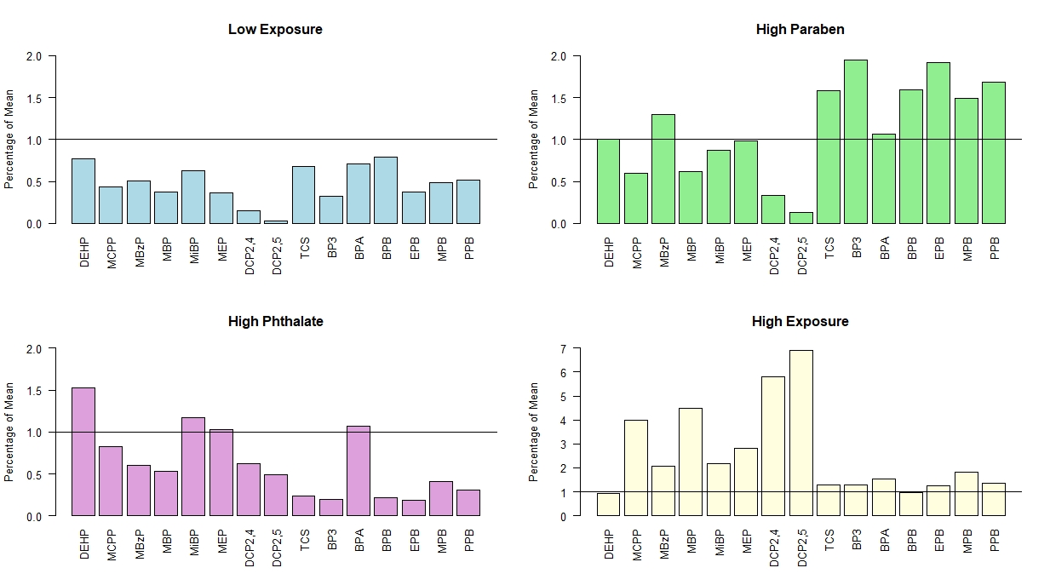
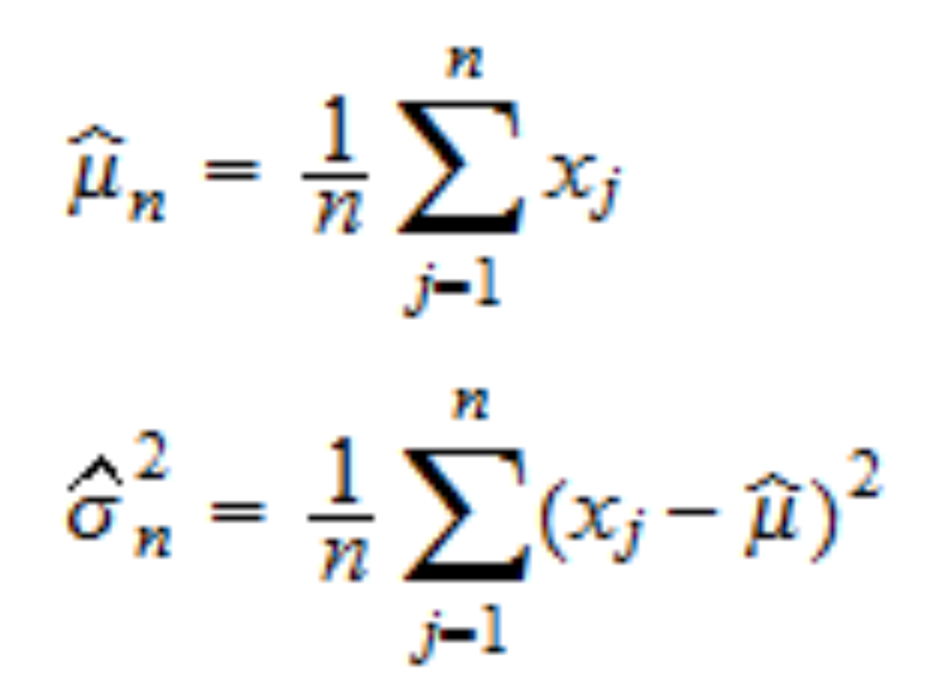
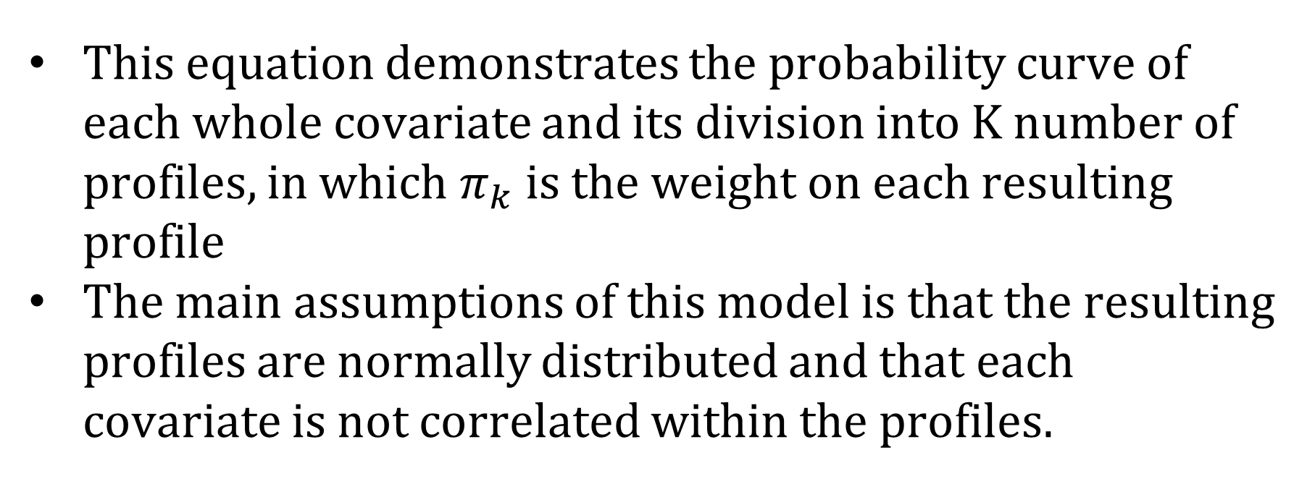
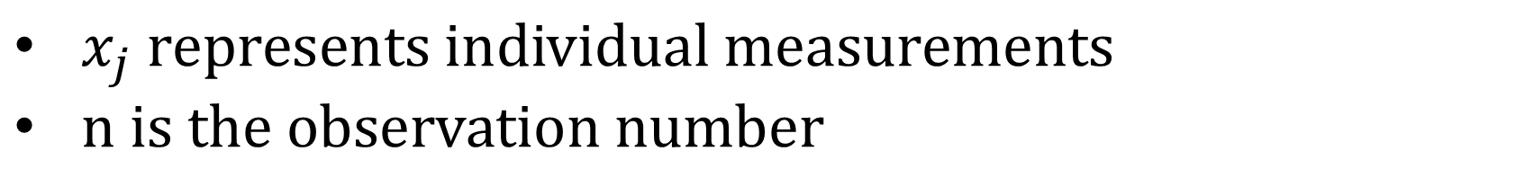
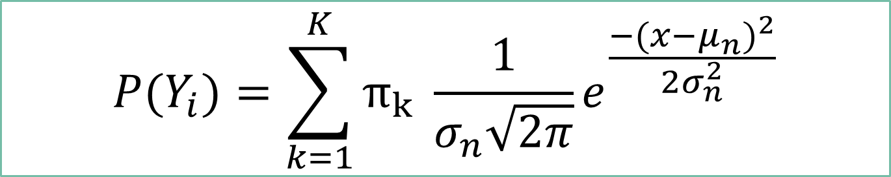
Latent Profile Analysis of Phthalate and Paraben Exposure in Pregnant Women
Roshni Patnayakuni
Smith College
Faculty Mentor: Rachel Carroll
Data Mining REU at University of North Carolina Wilmington
Introduction
Result
Experimental Design
Phthalates and parabens are widely used in products and especially personal care products. While phthalate and paraben exposure in pregnant individuals has previously been linked to adverse outcomes such as preterm birth, the use of a clustering model such as Latent Profile Analysis (LPA) will allow the grouping of women from the LIFECODES data set into exposure classes. The purpose of this analysis is to examine how chemical measures can be used to cluster pregnant women. This can be compared to personal information to understand the individuals most at risk and allow public health services to utilize prevention techniques to decrease exposure and therefore adverse effects.
LIFECODES Dataset
15 chemical measures
Demographic Information
2 oxidative stress biomarkers
Goodness of Fit
      Akaike information criterion (AIC)
      Bayesian information criterion (BIC)
      Interpretation
      Mean of each covariate in each profile compared to mean of each covariate in whole data
      Demographics in each profile were examined
Regression Model
8-OHdG
8-isoprostane
Latent Profile Analysis
Oxidative Stress
LPA can be used to identify unseen or unmeasured patterns in data.
A distribution of each covariate across the dataset is input into a model which is then divided into latent profiles.
≤
Low exposure and high paraben exposure individuals are more common than the other clusters within the control cases.
No relationship found between any profiles and 8-OHdG
Results only displayed for 8-isoprostane
LPA uses maximum likelihood estimation for the mean and the variance of each profile. The above 2 equations are used to estimate the mean and variance of the normal curve in the lower equation.
Distribution of Individuals in Latent Profiles
 | Slope Estimate
Low Exposure | Ref | -0.22* | -0.14 | -0.39*
High Paraben | 0.22* | Ref | 0.07 | -0.16
High Phthalate | 0.14 | -0.07 | Ref | -0.24
High Exposure | 0.39* | 0.16 | 0.24 | Ref
 | Demographic | Low Exposure | High Paraben | High Phthalate | High Exposure | Total
 | White | 98 (83.1%) | 69 (58.0%) | 28 (48.3%) | 7 (16.7%) | 202 (59.9%)
 | Black | 7 (6.0%) | 16 (13.4%) | 14 (24.1%) | 15 (35.7%) | 52 (15.4%)
 | Other | 13 (11.0%) | 34 (28.6%) | 16 (27.6%) | 20 (47.6%) | 83 (24.6%)
 | High School | 5 (4.2%) | 18 (15.1%) | 8 (13.8%) | 16 (38.1%) | 47 (13.9%)
 | Tech. College | 11 (9.3%) | 17 (14.3%) | 14 (24.1%) | 10 (23.8%) | 52 (15.4%)
 | Junior College | 40 (33.8%) | 34 (28.6%) | 18 (31.0%) | 7 (16.7%) | 99 (29.3%)
 | College Grad | 62 (52.5%) | 50 (42.0%) | 18 (31.0%) | 9 (21.4%) | 139 (41.2%)
 | <20 | 0 (0.0%) | 5 (4.2%) | 3 (5.2%) | 3 (7.1%) | 11 (3.3%)
 | 20-29 | 25 (21.2%) | 36 (30.3%) | 20 (3.4%) | 17 (40.4%) | 98 (29.1%)
 | 30-39 | 86 (72.9%) | 73 (61.3%) | 34 (58.6%) | 21 (50.0%) | 214 (63.5%)
 | 40-49 | 7 (5.9%) | 5 (4.2%) | 1 (1.7%) | 1 (23.8%) | 14 (4.2%)
 | 10-19 | 18 (15.3%) | 17 (14.3%) | 4 (6.9%) | 1 (2.4%) | 40 (11.9%)
 | 20-29 | 89 (75.4%) | 89 (74.8%) | 36 (62.1%) | 26 (61.9%) | 240 (71.2%)
 | 30-39 | 10 (8.5%) | 12 (10.1%) | 13 (22.4%) | 13 (30.9%) | 48 (14.2%)
 | 40+ | 1 (0.8%) | 1 (0.8%) | 5 (8.6%) | 2 (4.8%) | 9 (2.6%)
 | Total | 118 | 119 | 58 | 42 | 337
Race
$x_{j} represents individual measurements$
$n is the observation number$
Education
* - p value < 0.05 | Linear regression model adjusted for demographics
In comparison to model created with just demographic, worse goodness of fit but a statistically significant model
$$P(Y_{i})=\sum_{k=1}^{K}{π_{k} \frac{1}{σ_{n}\sqrt{2π}}}e^{\frac{−(x−μ_{n})^{2}}{2σ_{n}^{2}}}$$
Age
Conclusion
This equation demonstrates the probability curve of each whole covariate and its division into K number of profiles, in which $π_{k}$is the weight on each resulting profile
The main assumptions of this model is that the resulting profiles are normally distributed and that each covariate is not correlated within the profiles.
Latent profile analysis is able to create distinct classes with high posterior probabilities using chemical mixtures. These profiles can be used for further research to examine the relationship between other health issues in order to understand the full effects of chemical exposure. The demographic information can be used to understand varied effects to different groups and tailor prevention campaigns to groups most affected.
BMI
Acknowledgements
Resources
Special thanks to Dr. Carroll, Dr. Chen, and Dr. Wang from the UNCW math and statistics department as well as Summerlin Thompson for there guidance in the research experience. Additional thanks to Dr. McElrath and Dr. Ferguson for use of the LIFECODES data and to the NSF for funding this research with grant DMS-1659288.
Black individuals and individuals with a high school education or less are likely to be in the high exposure class. White individuals and those with at least a bachelor's degree were more likely to be in a low exposure.
Agresti A. Other Mixture Models for Categorical Data. In: Balding DJ, Bloomfield P, Cressie NAC, Fisher NI, Johnstone IM, Kadane JB, et al., editors. Categorical Data Analysis. Hoboken, NJ: Wiley; 2002. p. 538-75.
Carroll R, White AJ, Keil AP, Meeker JD, McElrath TF, Zhao S, and Ferguson KK. Latent classes for meaningful chemical mixtures analyses in epidemiology: An example using phthalate and phenol exposure biomarkers in pregnant women. 2019. [Submitted, under Revision]
Ferguson KK, McElrath TF, Meeker JD. Environmental phthalate exposure and preterm birth. JAMA Pediatr. 2014;168(1):61-7.
McElrath TF, Lim KH, Pare E, Rich-Edwards J, Pucci D, Troisi R, et al. Longitudinal evaluation of predictive value for preeclampsia of circulating angiogenic factors through pregnancy. Am J Obstet Gynecol. 2012;207(5):407 e1-7.
Oberski, D. (2016). Mixture Models: Latent Profile and Latent Class Analysis. Human–Computer Interaction Series Modern Statistical Methods for HCI,275-287.
Rosenberg, J. M., Beymer, P. N., Anderson, D. J., & Schmidt, J. A. (2018). TidyLPA: An R Package to Easily Carry Out Latent Profile Analysis (LPA) Using Open-Source or Commercial Software. Journal of Open Source Software,3(30), 978.

