Slide 1
Effectiveness of Community Guide Preventative Approaches to Promote Physical Activity
Hanh Pham
University of Iowa College of Public Health

Slide 2
Introduction
Active Ottumwa (AO) study is a community-wide intervention that promotes physical activity (PA) among residents of Ottumwa, IA.
AO uses lay health advisors to inform residents about PA, provide behavioral and social support, and advocate for social and environmental changes.
Project goal: Evaluate the effectiveness of the intervention via quantifying the population-level change in physical activity.

Slide 3

Methods
Calculate the 3-part PA composition of each participant at the baseline and 24-month visit. PA data comprises of Sedentary (SA), Light (LA), and Moderate/Vigorous Activity (MVPA).
2. Let $x_{1}$ and $x_{2}$ denote the compositions at baseline and 24-month. Evaluate changes in PA compositions using Aitchison geometry
$$\frac{1}{t}⊗ \left(x_{2}⊖x_{1}\right)=∁\left({\left(\frac{x_{21}}{x_{11}}\right)}^{1/t},{\left(\frac{x_{22}}{x_{12}}\right)}^{1/t},{\left(\frac{x_{23}}{x_{13}}\right)}^{1/t}\right)$$
where $∁$ is the closure operation.

Slide 4

Methods (cont.)
3. Apply the centered log-ratio (CLR) transformation as defined below to the slope composition and baseline compositions.
$CLR\left(x\right)=$ $\left(log\left(\frac{x_{1}}{g(x)}\right),log\left(\frac{x_{2}}{g(x)}\right),log\left(\frac{x_{3}}{g(x)}\right)\right)$
where $g\left(x\right)={(x_{1}x_{2}x_{3})}^{\frac{1}{3}}$ is the geometric mean.
4. Fit a MANCOVA model using age, gender, education, CLR- transformed baseline PA (MVPA, SA) to predict the CLR-transformed compositional slope. Center all covariates so the intercept reflects the global compositional change.

Slide 5
Results
MANCOVA
 | p-value | Sedentary |  |  | Light |  |  | Moderate/Vigorous
 |  | Estimate | 90% CI |  | Estimate | 90% CI |  | Estimate | 90% CI
Overall change | 0.029 | -0.073 | -0.14 | -0.0090 | 0.056 | 0.017 | 0.095 | 0.017 | -0.046 | 0.081
Age | 0.470 | 0.030 | -0.017 | 0.076 | 0.0004 | -0.028 | 0.029 | -0.030 | -0.076 | 0.016
Gender (Male) | 0.270 | -0.039 | -0.082 | 0.0039 | 0.0047 | -0.022 | 0.031 | 0.034 | -0.0081 | 0.077
Education level | 0.202
8th grade or less |  | -0.15 | -0.28 | -0.012 | 0.0069 | -0.074 | 0.088 | 0.14 | 0.0070 | 0.27
Some high school |  | -0.081 | -0.21 | 0.053 | 0.050 | -0.031 | 0.13 | 0.030 | -0.10 | 0.16
Graduated HS |  | 0.17 | 0.082 | 0.26 | -0.038 | -0.092 | 0.016 | -0.13 | -0.22 | -0.046
Initial MVPA | 0.039 | -0.053 | -0.17 | 0.063 | 0.14 | 0.066 | 0.21 | -0.084 | -0.20 | 0.032
Initial Sedentary | 0.006 | -0.12 | -0.23 | -0.0081 | 0.13 | 0.066 | 0.20 | -0.01 | -0.13 | 0.096

Slide 6
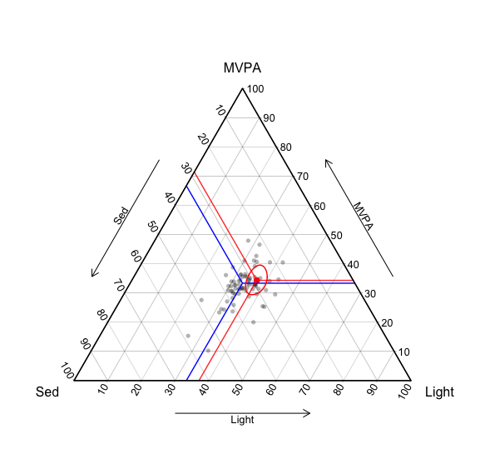
Results
Ternary Plot
Ternary plot shows the distribution of the compositional slopes.
The blue segments indicate the point of no change with the PA compositional slope being (⅓, ⅓, ⅓ ).
The red segments indicate the estimated global compositional slope from the MANCOVA model and the red spheroid gives the 90% confidence region.

Slide 7
Conclusion
Since demographic variables (age, gender, education) are not significant predictors of PA compositional slope, our results can be interpreted at population-level.
The change in PA compositions varies depending on individuals' initial PA level.
The global compositional change is statistically significant (p-value: 0.029). Controlling for demographics and the initial baseline compositions, there is a significant decrease in SA and increase in LPA over the course of the intervention.

Slide 8
References and Acknowledgements
Acknowledgements
My graduate research assistant advisor - Professor Daniel Sewell
The Active Ottumwa group
University of Iowa College of Public Health Biostatistics Department
References
Aitchison, J. (1982). The statistical analysis of compositional data. Journal of the Royal Statistical Society: Series B (Methodological), 44(2), 139-160.
Baquero, B., Kava, C., Ashida, S., Daniel-Ulloa, J., Laroche, H., Haines, H., ... & Sewell, D. (2018). Active Ottumwa: adapting evidence-based recommendations to promote physical activity in a micropolitan new destination community. International journal of environmental research and public health, 15(5), 917.
Matthews, K. A., Croft, J. B., Liu, Y., Lu, H., Kanny, D., Wheaton, A. G., ... & Eke, P. I. (2017). Health-related behaviors by urban-rural county classification—United States, 2013. MMWR Surveillance Summaries, 66(5), 1.

