Slide 1


Will Data Save Us?
Predicting the Future of Antibiotic Resistance
Smith College
Department of Biological Sciences
Program in Statistical and Data Sciences
Program in Neuroscience
Hannah Snell², Su Been Lee², Pratima Niroula³, Robert Dorit¹
Notes:
full names
Rob last

Slide 2
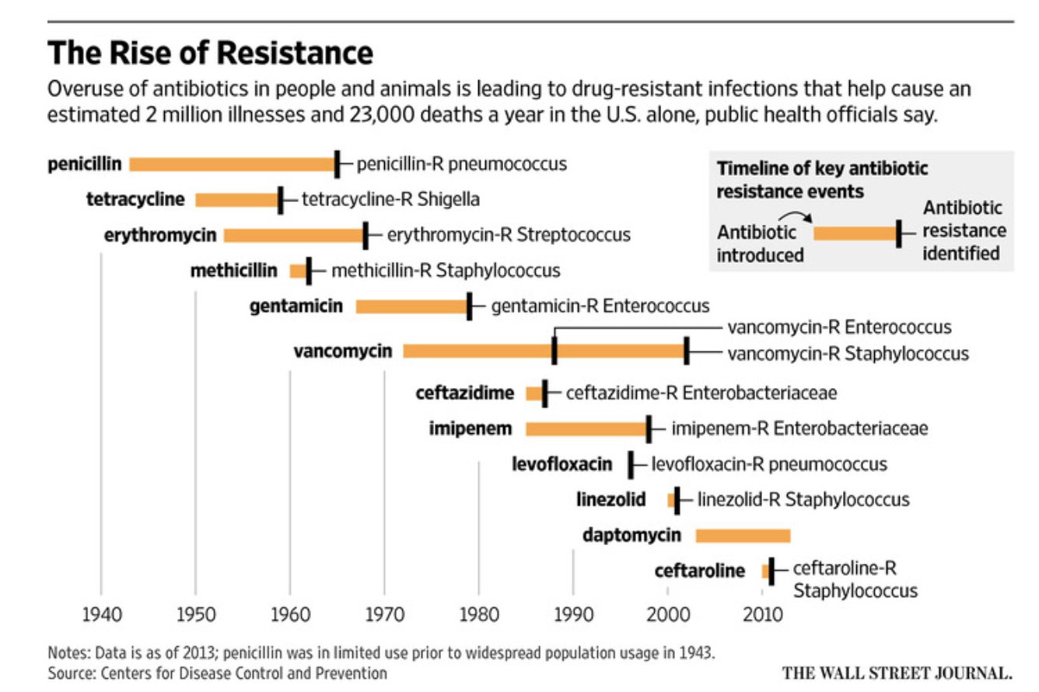
Background
The use of antibiotics for the treatment of bacterial infections has increased dramatically since the development of penicillin in 1940. (CDC)
This increased use has been accompanied by an increase in antibiotic resistance—a rise exacerbated by antibiotic overuse and misprescription, non-medical uses of antibiotics in food production, and the relative paucity of novel approaches against bacterial pathogens.
Although antibiotic use is the primary driver of resistance, this relationship is not easily discerned in the data.
We are adopting a data-driven approach to understand the determinants and the confounding variables underlying this major public health issue.
Notes:
Slide edits:
growing public health threat & individual healthcare
we do not have treatments available for all of this
minimal mechanism → more on population that we are looking at (introduce medicare population here instead)
Untreatable/extended treatments for infections
hospital associated infections
Mutations that provide resistance to antibiotic treatments will allow the growth of bacterial cells that are resistant to certain treatment, therefore making it dangerously ineffective.
Where bacteria can take up DNA from their environment (bacterial transformation), bacteria can directly transfer DNA to one another (bacterial conjugation), and bacteria can receive genetic information from bacteriophages, or bacterial viruses (bacterial transduction)

Slide 3
Research Questions
What is the quantitative relationship between antibiotic use and antibiotic resistance in the U.S.?
What are the primary determinants driving antibiotic prescribing in the U.S.?
Our Project | Future Steps
Identify the drivers of antibiotic use to build a predictive antibiotic prescribing model in the US Potential public health interventions to reduce antibiotic misuse | Discern the effect of viral epidemics or pandemics (COVID, H1N1 influenza) on antibiotic use Additional concerns about the aftermath of pandemics on public health
Notes:
we know that antibiotic resistance is driven by antibiotic use
we should be able to establish this relationship → but we can’t
figure:extent of antibiotic use/resistance on country by country basis
why is it difficult to show the relationship? → can’t capture metric or data availability
May be inapproriate antibiotic prescribing as a result of COVID

Slide 4



Methods Overview
Check out our Github Repo here!
Data Extraction
Cleaning & Preliminary Analysis
Control Group Addition
Extracted datasets from IQVIA, CMS.gov, and CDC
Datasets contained approximately 200 million prescribing records
Data covers years 2013 - 2017
Built a reference document with all unique antibiotic therapeutics mapped to their respective classes
Calculated Antibiotic Claims per capita based on Medicare beneficiaries (Part D)
Visualized prescribing rates per capita by region
Repeated our analyses done on the antibiotic classes for antipsychotic drug classes from the same dataset
Acts as a control to reveal antibiotic-specific trends
Notes:
Add screenshot of datasheet
methods slide 2?
flow chart instead?
Data Extraction and Cleaning:
Filter datasets specified for antibiotic generic drug names for all years
Variables Included: Antibiotic Classes, US Census Geographical Divisions(10 Divisions including Undefined), Part D Enrollment, Total Claim Count, and Year
Create a Per Capita calculation of number of prescriptions written based on Medicare beneficiary population per regional division
Create an Antibiotic Class variable based on class reference guide made by researching unique drugs and their respective classes
Preliminary Analysis: (clean this up)
Compared Total Claim count versus Divisional Region of all Antibiotic Classes
By Year, comparted total claim counts of top 6 antibiotic classes per divisional region
Compared Total claims per capita across divisional regions for the top 6 antibiotic classes
Comparison Drug Group: Antipsychotic (AP) Drugs specified by CMS
Use as a “control group” to assess whether the trends seen in antibiotic prescription counts

Slide 5
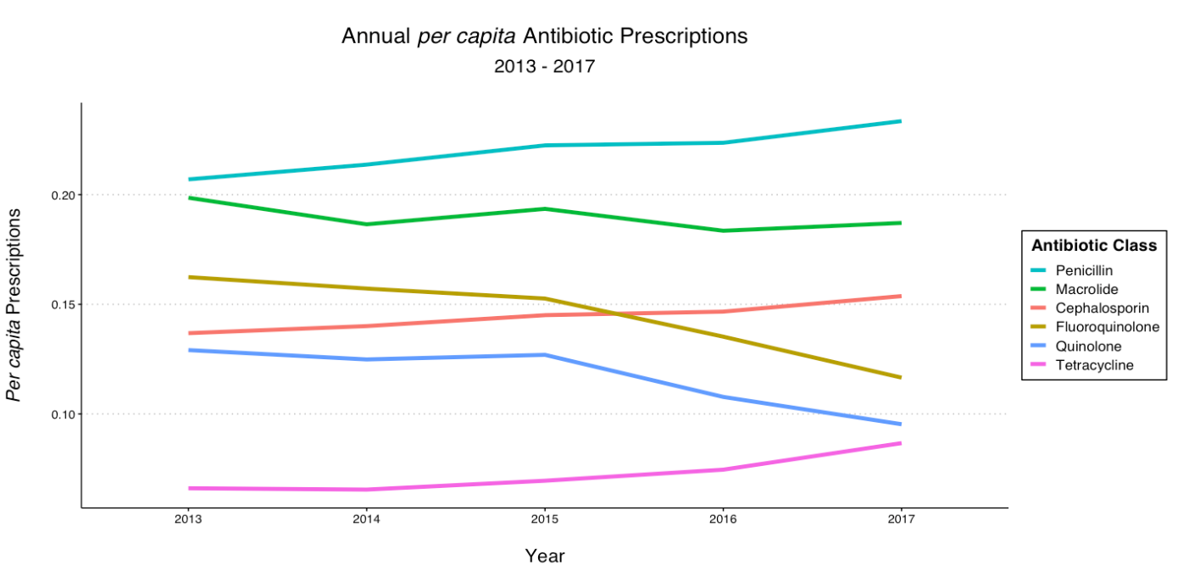
Results: Total Antibiotic Prescription Claims
Figure 1. Total antibiotic prescription claims per Part D Enrollee for the top six most prescribed antibiotic classes in 2013-2017.
Notes:
map of rough divisional regions
Including percapita enrollment and
bigger labels, lines thicker

Slide 6
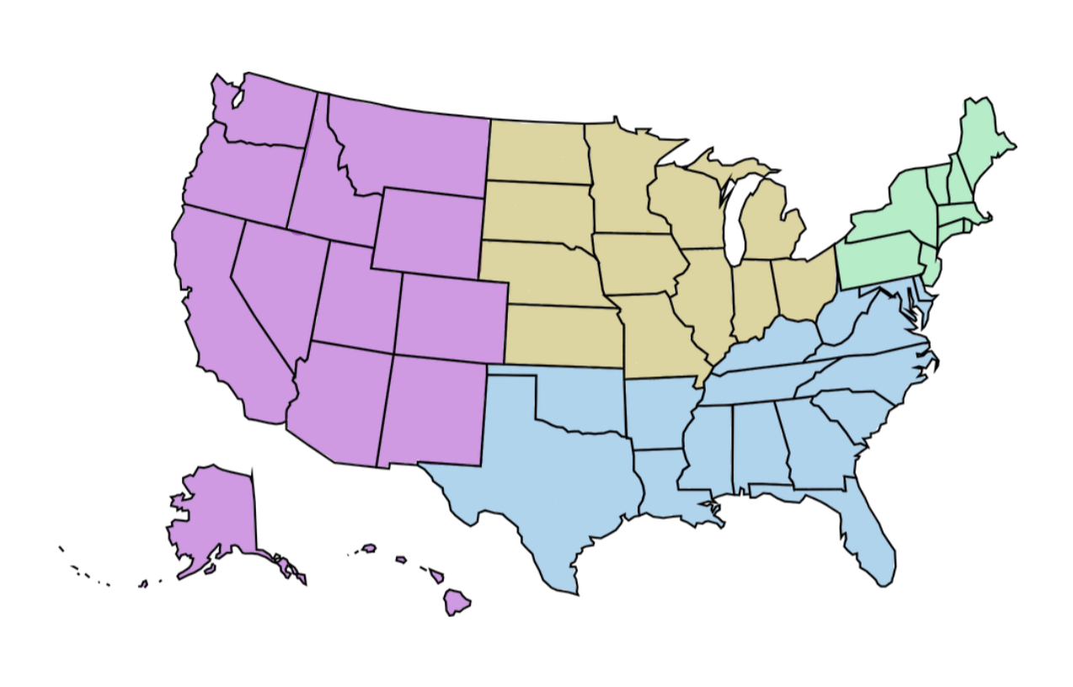
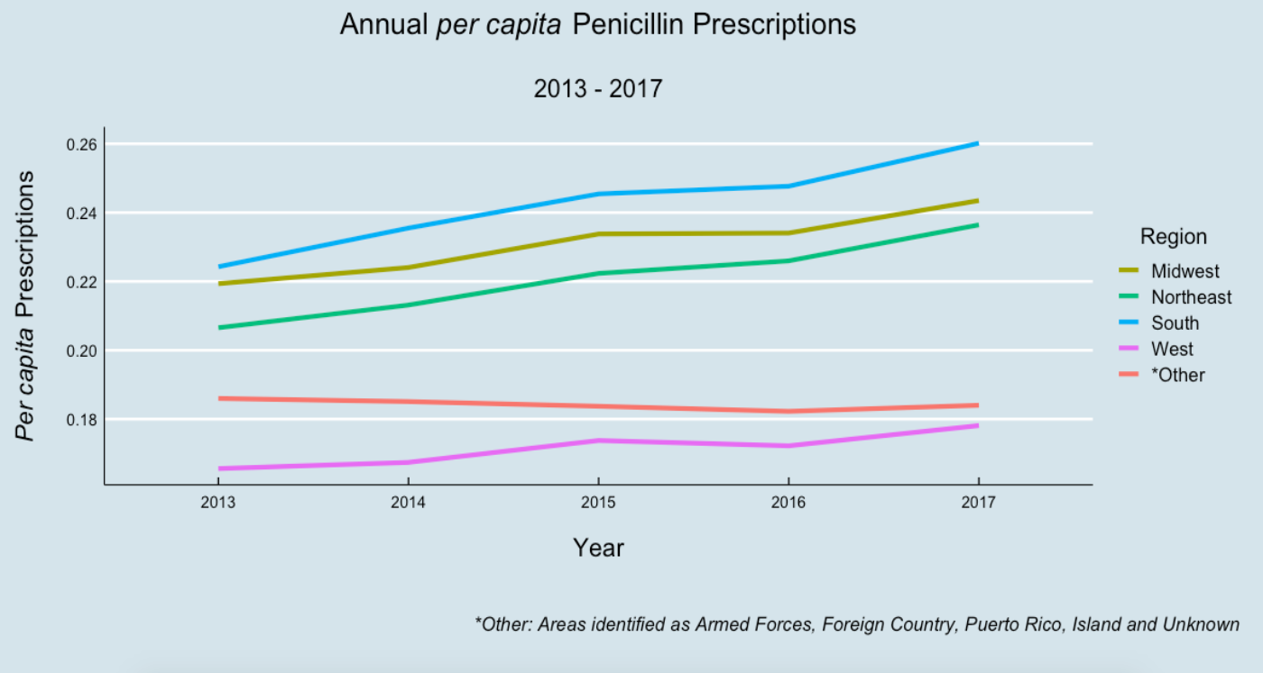
Results: Annual per capita Penicillin Claims by Region
Figure 2. Penicillin prescriptions per Part D Enrollee for Census defined US Regions in 2013-2017.
Notes:
Including percapita enrollment and by antibiotic classes
aggregate divisions to cut down colors
alternative: chloropleth maps showing “density” as per capita prescriptions

Slide 7
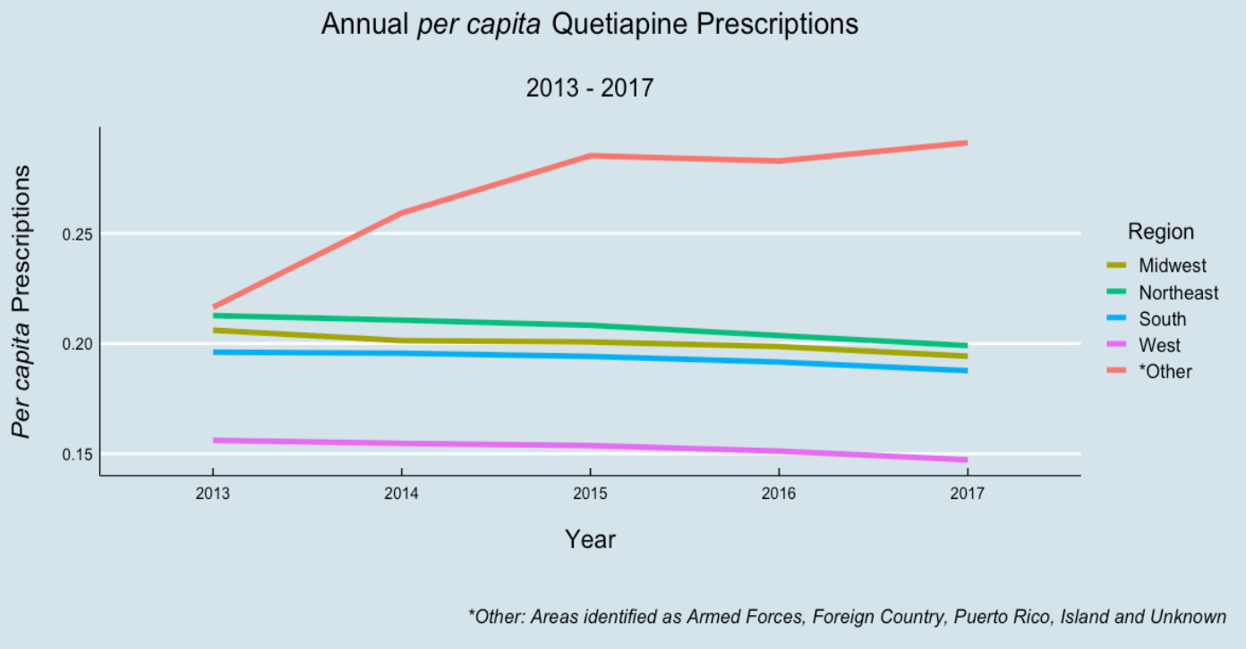
Comparison Drug Group: Antipsychotic Drugs
Figure 3. Quetiapine (the most commonly prescribed antipsychotic in this dataset), prescriptions per Part D Enrollee for Census defined US Regions in 2013-2017.
Notes:
Comparison to antipsychotic drugs
flip division and drug class
faceted plot with antipsychotics and antibiotics on it

Slide 8



Data Sources and Limitations
Data Source: Centers for Medicare & Medicaid Services (CMS)
Covers years 2013 to 2017 in prescribing data
Each annual dataset has 25 million prescription records covering three main drug categories: Opioids, Antibiotics, and Antipsychotics.
Rows correspond to individual prescriber records per Medicare beneficiary
Limitations:
Data Availability Medicare Beneficiaries, and Part D Enrollees in particular, are not a representative cross-section of the U.S. population. Nonetheless, this dataset provide insight into a population that accounts for a significant percentage (>20%) of antibiotic prescriptions in the U.S.
Measuring Antibiotic Resistance Medicare data has robust amounts of data for prescribing/antibiotic use, but does not explicitly track antibiotic resistance.
Notes:
List features of data
Data source:
PUF -- Public Use File
NPI -- National Provider Identifier
FROM CMS: The Part D Prescriber PUF is based on beneficiaries enrolled in the Medicare Part D prescription drug program who comprise approximately 70 percent of all Medicare beneficiaries.
Mention size of data here?
Also aware of underestimation: the Part D PrescriberPUF detail file does not include drugs with fewer than 11 Part D drug claims, so users should be aware that summing data in detail file willunderestimate the true Part D totals

Slide 9
Conclusions and Future Goals
Conclusions:
Data about antibiotic prescription use in the United States is generally inaccessible.
The number of annual antibiotic prescriptions dispensed to U.S. Medicare beneficiaries remains high, and varies significantly across geographic regions.
The Southern region of the U.S shows the highest rate of antibiotic prescription rates over the 5 year time period we examined; the West shows the lowest rate.
From 2013-2017, per capita prescriptions across several antibiotic classes have increased. A comparable trend is not seen for antipsychotic prescriptions.
Future Goals:
Identify and ascertain the relative contribution of geographic, demographic and specialty variables as potential determinants of antibiotic prescribing trends in the Medicare datasets.
Explore ways to connect resistance measures compiled by the CDC and other organizations with the usage data seen in the Medicare population.
Construct a predictive model for future prescription patterns, and identify possible interventions to reduce antibiotic use and the resulting resistance.

Slide 10




References & Acknowledgements
Hannah Snell
Smith College SDS & Biochemistry
Su Been Lee
Smith College SDS
Pratima Niroula
Smith College Neuroscience
Dr. Robert L. Dorit
Professor in Biological Sciences, Smith College
References
US Census Regions and Divisions
CMS PartD Utilization and Enrollee
CDC Antibiotic/Antimicrobial Resistance (AR/AMR)
Ventola et al., 2015
Burmeister et al., 2015
IQVIA
Thank You To:
Ben Baumer, Professor in SDS, Smith College
Notes:
need to format sources and insert footnotes
Data sources:
-- https://www.cms.gov/Research-Statistics-Data-and-Systems/Statistics-Trends-and-Reports/Medicare-Provider-Charge-Data/Part-D-Prescriber
US Census Regions and Divisions -- https://www2.census.gov/geo/pdfs/maps-data/maps/reference/us_regdiv.pdf

