Slide 1
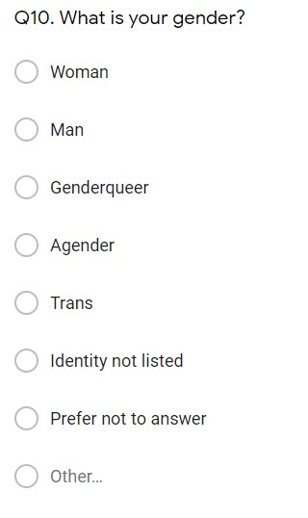
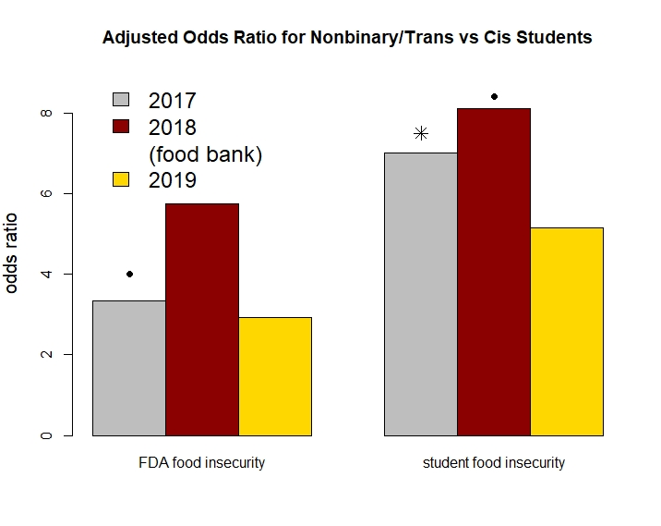
Demographic Inclusivity Illuminates Unique Food Insecurity Issues for Non-binary Students
Marta Shore¹, Susi Keefe², An Garagiola-Bernier³, Sam Schmitt⁴, Emma Kiley², and Jen England².
INTRODUCTION
In 2017, leadership at a small, liberal arts university highlighted their successful efforts to recruit a more diverse student body. The students argued that their recruitment would only be successful if they faced increasing food insecurity on campus.
Students at this university created a survey to understand the prevalence and type of food insecurity on their campus in 2017 to better understand food insecurity and its intersection with student demographics, including a non-binary measure of gender, as well as race, if the student had a disability, and housing insecurity.
Measuring Gender
• p-value < 0.1
* p-value < 0.05
While our non-cis participation was in line with statewide non-cis young adults, we saw a drop in participation overall in 2018, and for non-binary/trans students in particular. However, after conversations with student groups where food insecurity was more prevalent (including the non-binary and trans communities), students and faculty at Hamline were able to argue for and fund on-campus food resources. Once those resources were provided, student participation (and, to a lesser degree, participation from non-binary/trans students) increased.
The students decided to measure gender inclusively.
In 2017 and 2018, the question provided several options:
woman
man
genderqueer
agender
trans
prefer not to answer
open option for a gender not listed.
In 2019, in response to student feedback, gender was an open answer question.
We saw students who were non-binary and trans had much higher odds of both FDA-defined food insecurity when our research began in 2017 We also saw significantly higher impacts of that food insecurity on their studies: students who were non-binary and trans had over 7 times the odds of hunger affecting their studies as cis students, after adjusting for race, disability status, and housing insecurity.
In 2018, the odds of both FDA-defined food insecurity and student-specific food insecurity increased (although, due to the lower number of participants, these were not as significant.)
Only after a pop-up food shelf was added in 2019 did we see food insecurity decrease for non-binary and trans students.
Interestingly, although food insecurity and housing insecurity were highly associated on campus, non-binary and trans students did not show significant housing insecurity.
REFERENCES
https://www.ers.usda.gov/topics/food-nutrition-assistance/food-security-in-the-us/
https://hope4college.com/
Martinez SM, Webb K, Frongillo EA, Ritchie LD. Food insecurity in California’s public university system: What are the risk factors? Journal of Hunger & Environmental Nutrition. 2018;13(1):1-18
Keefe SA, Garagiola-Bernier A, Kiley E, Egnland J, Schmitt SR, Shore M. Campus food insecurity:Bringing private institutions into conversations on basic needs. Submitted.
Measuring Food insecurity
CONCLUSIONS
FDA food insecurity: 2 or more yes answers to the following:
The food I bought ran out and I didn’t have money to get more.
I couldn’t afford to eat nutritionally balanced meals one or more times.
I cut the size of meals or skipped meals because there wasn’t enough money for food.
I cut the size of meals or skipped meals due to lack of money 3 or more days in a week
I ate less than I felt I should because there wasn’t enough money for food
I experienced a situation where I was hungry but didn’t eat because there wasn’t enough money for food.
HOPE labs student food insecurity: one or more yes answers:
I experienced difficulty concentrating in class due to hunger
I was unable to focus while studying due to hunger
People do not expect to see food insecurity at a small, private, liberal-arts institution. But in our first survey, almost half of the students met the FDA criteria for food insecurity, and among non-binary and trans students, it was over 85%.
After identifying identities with higher food insecurity, researchers had conversations with those students, which led to the establishment of a food pantry on campus. As a result of this action, non-cis students had lower food insecurity, and participation in our survey from all students increased.
While our initial survey gave insight into who was most likely to have food insecurity on campus, insight without action led to a decrease in participation, raising concerns about bias. Only when we performed qualitative research and made changes did we see increased feedback.
FUNDING
This research was funded by a Sustainability Grant from Hamline University’s Office of Sustainability.
Affiliations
Biostatistics Division of UMN School of Public Health
Hamline University
UMN Herbert Humphrey School of Public Policy
Minnesota Coalition Against Sexual Assault and Augsburg College
CONTACT INFORMATION
Marta Shore
Lecturer, Biostatistics Division
shore007@umn.edu

