Slide 1

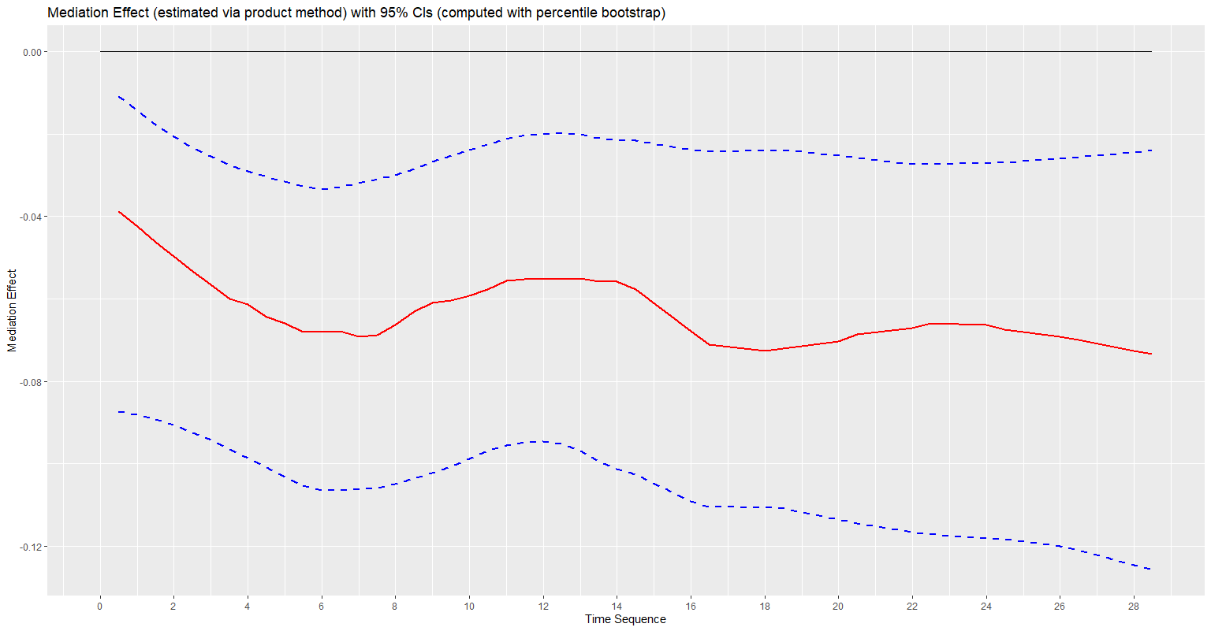
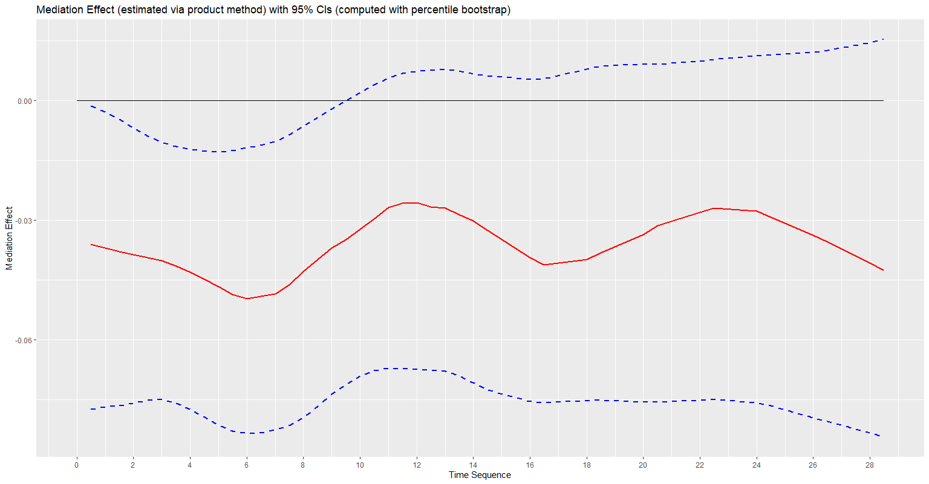
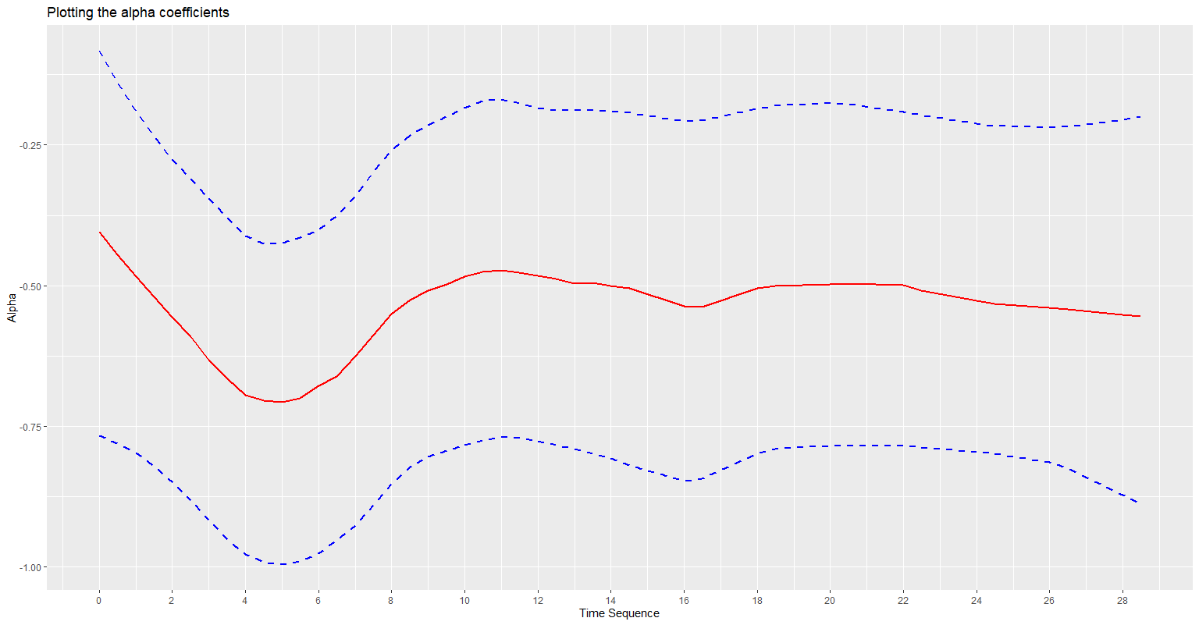
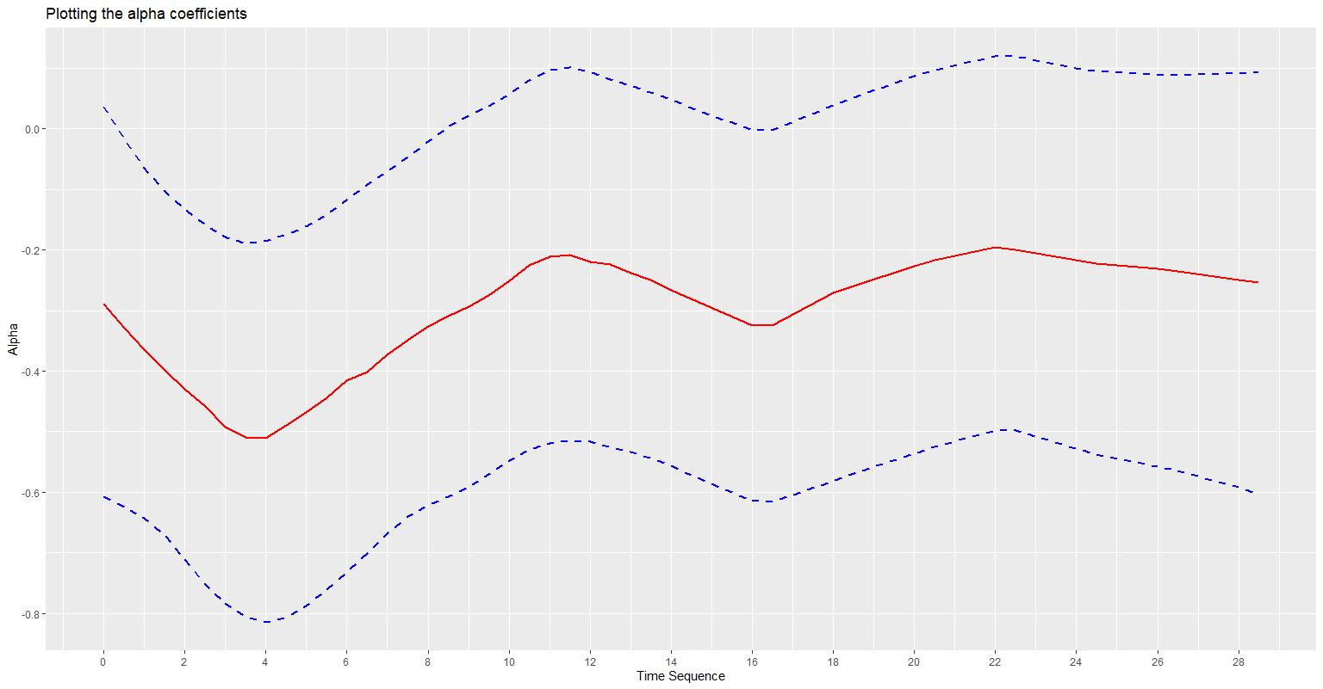
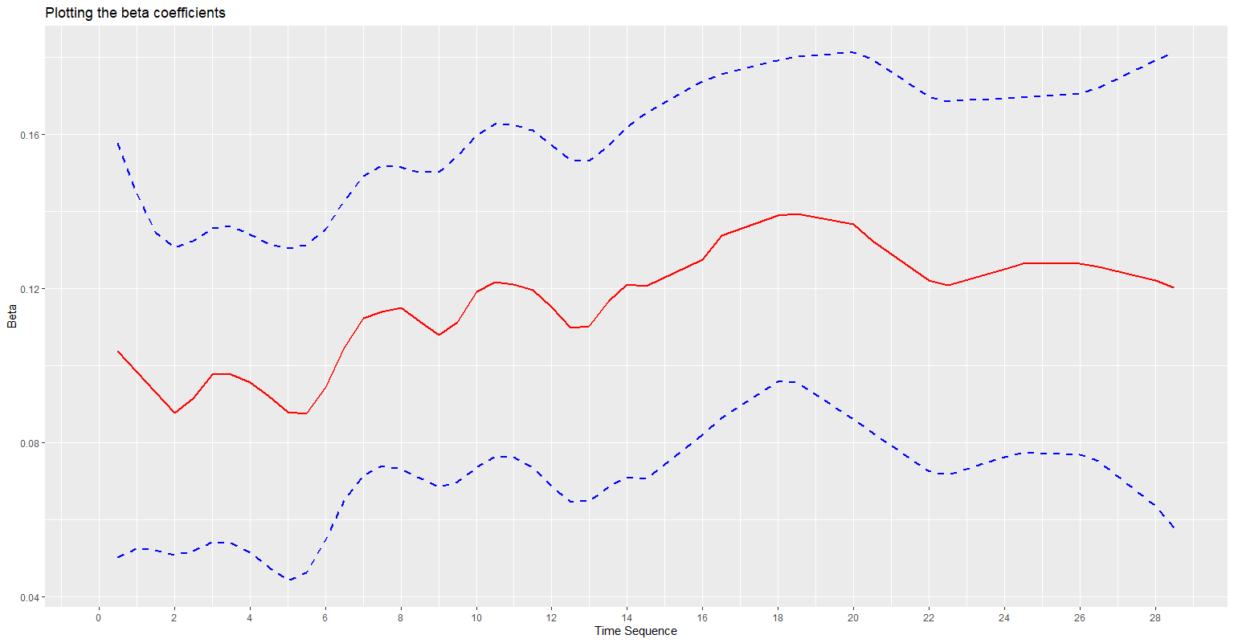
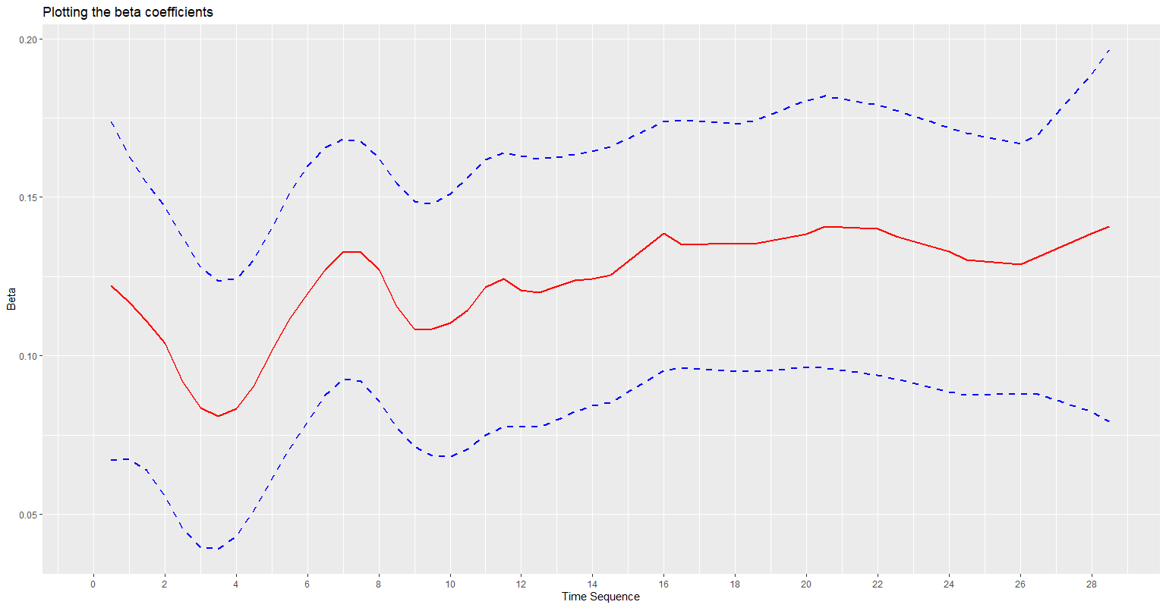
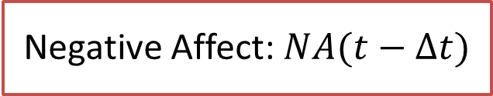
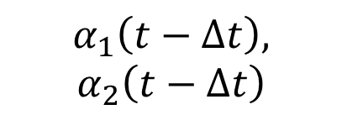

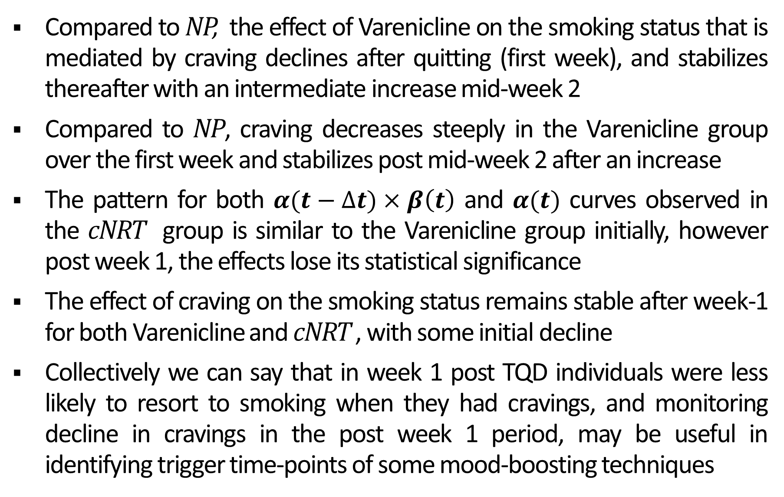
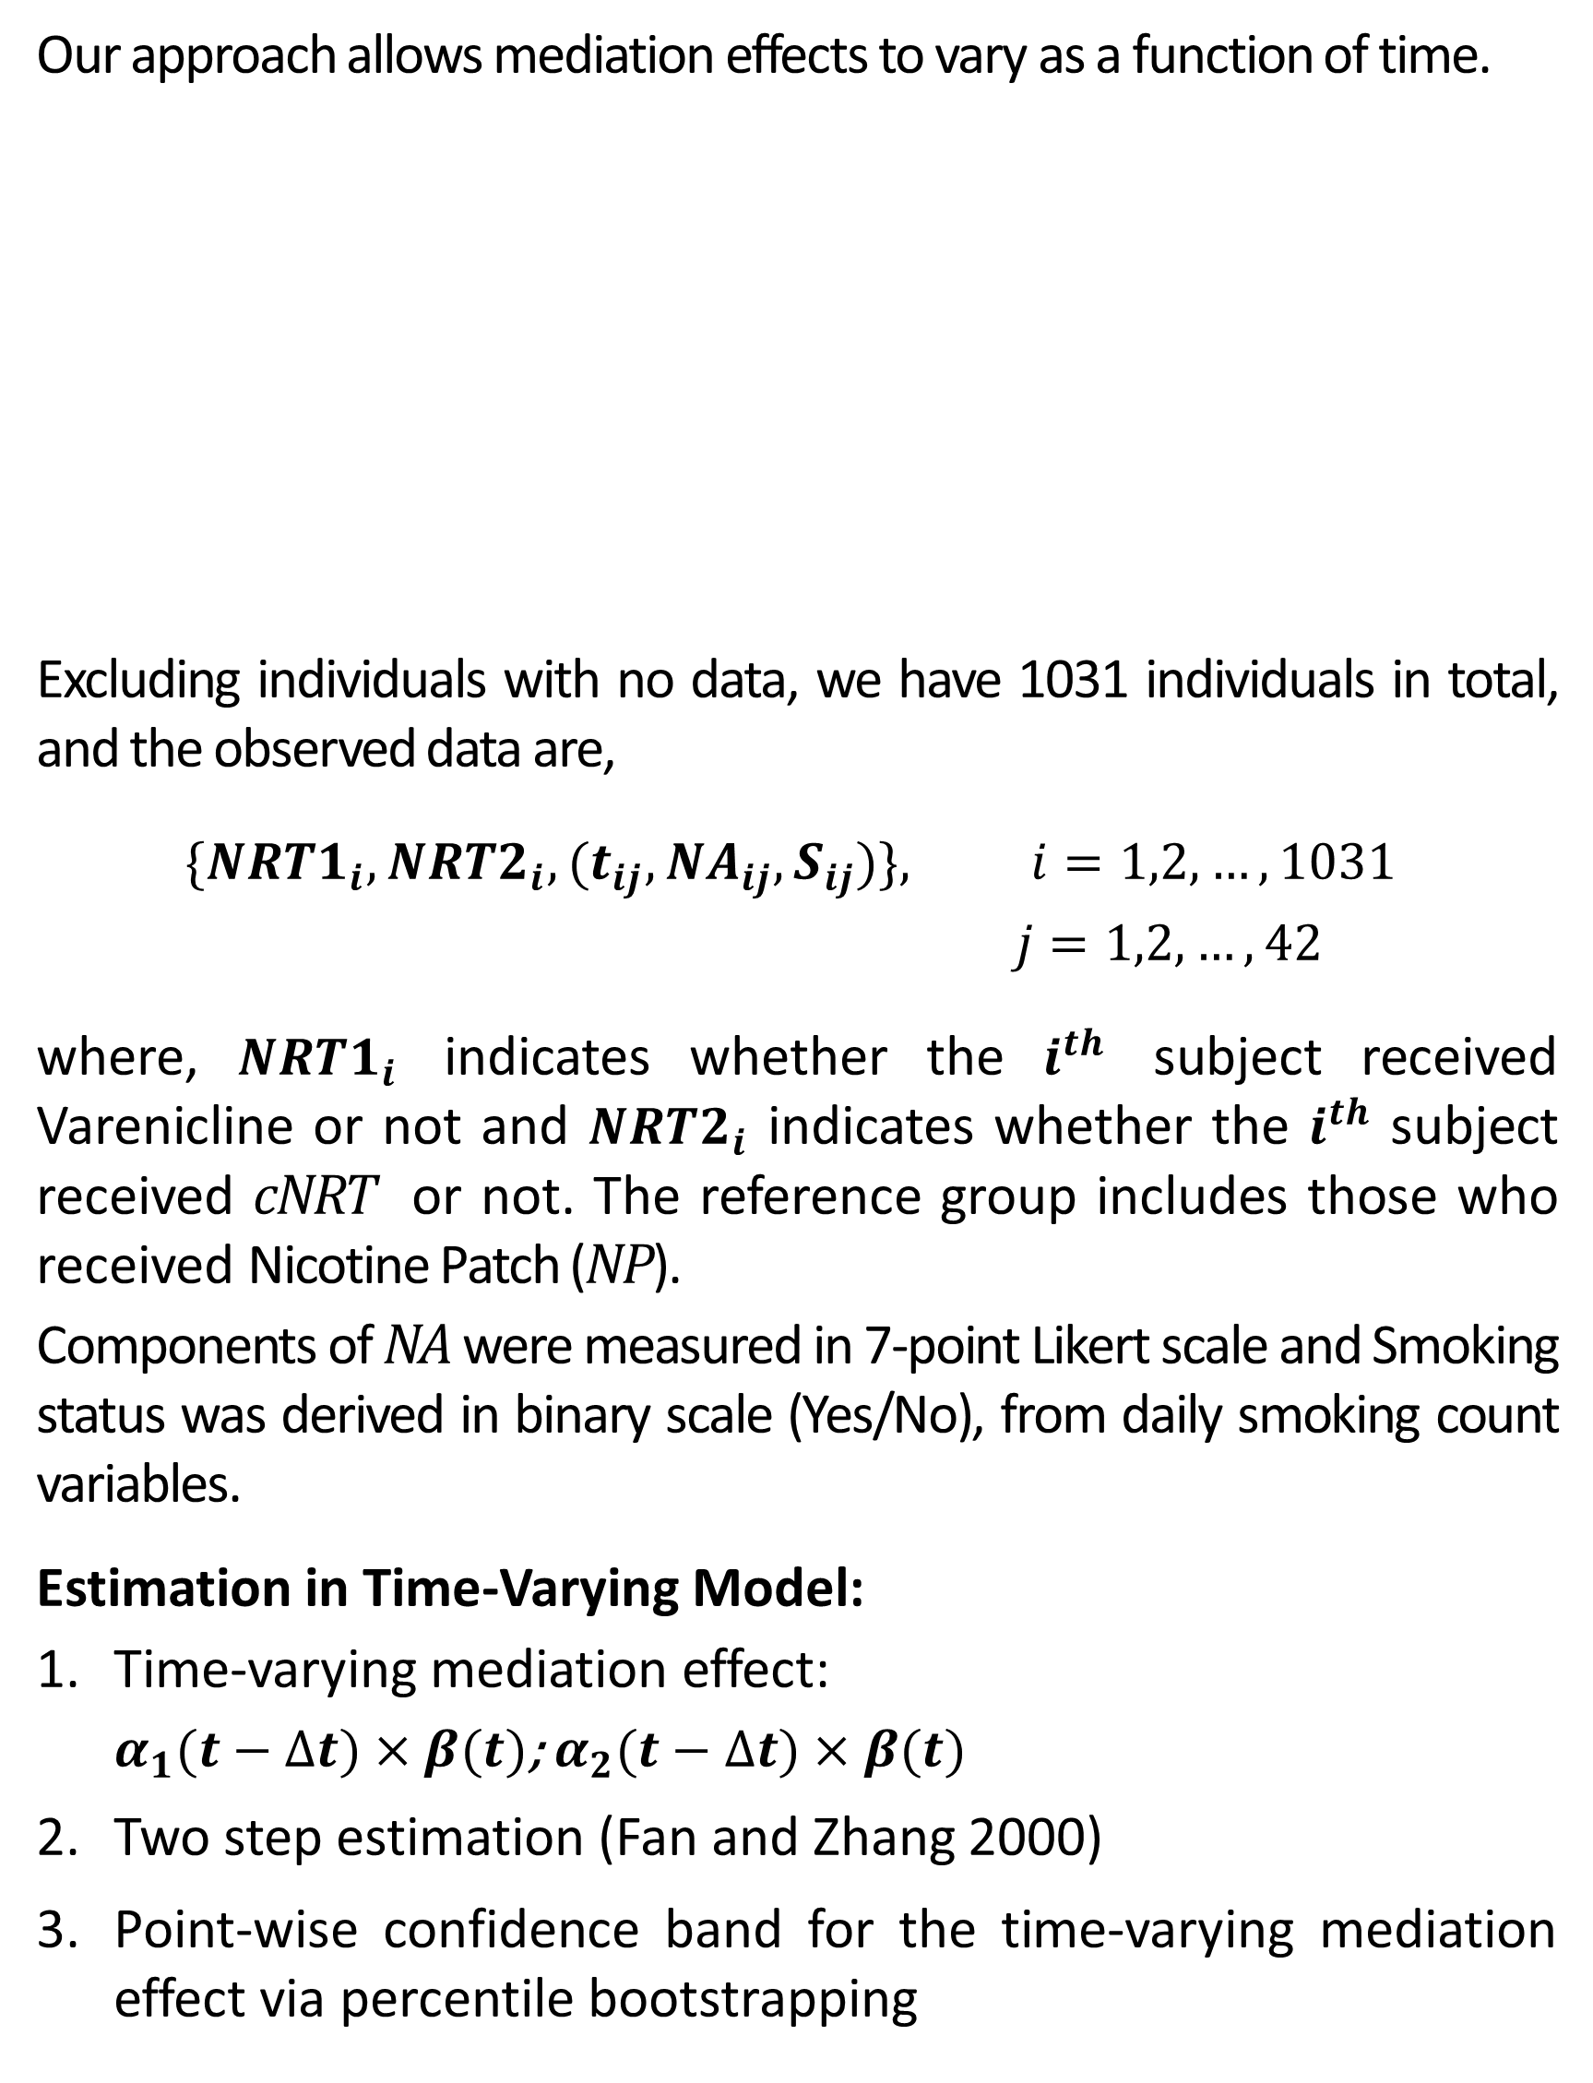
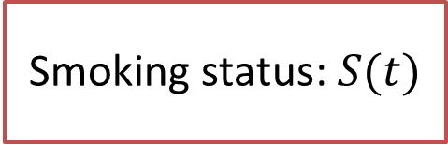

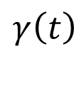

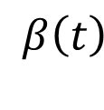
Time-Varying Mediation of Negative Affect on Smoking Status: An Exploratory Analysis
Yajnaseni Chakraborti¹, Donna Coffman, PhD¹
¹ Temple College of Public Health, Department of Epidemiology & Biostatistics
College of Public Health
Background
Methodology
Results
The pharmacokinetic mechanism of action of tobacco makes smoking cessation an extremely challenging process
Chronic exposure of nicotine negatively reinforces smoking
Withdrawal symptoms peak in the first week of quitting, usually resolving over a month
These withdrawal symptoms often act as mediators regulating the pathway between cessation intervention and (un) successful smoking cessation
Our approach allows mediation effects to vary as a function of time.
Excluding individuals with no data, we have 1031 individuals in total, and the observed data are,
$$\{{NRT1}_{i}, {NRT2}_{i}, {(t}_{ij}, {NA}_{ij}, S_{ij})\}, i=1,2,…, 1031$$
$j=1,2,…, 42$
where, ${NRT1}_{i}$ indicates whether the $i^{th}$ subject received Varenicline or not and ${NRT2}_{i}$ indicates whether the $i^{th}$ subject received cNRT or not. The reference group includes those who received Nicotine Patch (NP).
Components of NA were measured in 7-point Likert scale and Smoking status was derived in binary scale (Yes/No), from daily smoking count variables.
Estimation in Time-Varying Model:
Time-varying mediation effect:
$α_{1}(t−∆t)×β(t)$; $α_{2}(t−∆t)×β(t)$
Two step estimation (Fan and Zhang 2000)
Point-wise confidence band for the time-varying mediation effect via percentile bootstrapping
Figure 1: Mediation effect of craving and component indirect effects $\{α\left(t\right), β\left(t\right)\}$ with 95% CI estimated for binary outcome (Smoking Status – Yes/No)
Negative Affect: $NA(t−∆t)$
Craving
Varenicline
cNRT
0.00
0.00
$$α_{1}\left(t−∆t\right),$$
$$α_{2}\left(t−∆t\right)$$
$$β\left(t\right)$$
-0.04
-0.03
Trigger the neuronal reward system
Neuroadaptation
Hedonic Dysregulation
-0.08
-0.06
-0.12
Week 1
Week 2
Week 3-4
Week 1
Week 2
Week 3-4
Intervention: $Int$
$$γ\left(t\right)$$
Smoking status: $S(t)$
-0.25
0.00
$$α(t)$$
-0.50
-0.20
-0.75
-0.40
Week 1
-0.60
-1.00
Week 2
Week 3-4
-0.80
Week 1
Week 2
Week 3-4
0.16
0.20
$$β(t)$$
0.12
0.15
Objective
0.08
0.10
0.04
Week 1
Week 2
Week 3-4
0.05
Week 1
Week 2
Week 3-4
Study the variations in the mediated effect of withdrawal symptoms (primarily ‘Negative Affect’- NA) over time
Identify peaks and/or drops in the mediated effect curve which could be suggestive of specific time-points of including mood-boosting/ coping techniques
Conclusions
Compared to NP, the effect of Varenicline on the smoking status that is mediated by craving declines after quitting (first week), and stabilizes thereafter with an intermediate increase mid-week 2
Compared to NP, craving decreases steeply in the Varenicline group over the first week and stabilizes post mid-week 2 after an increase
The pattern for both $α(t−∆t)×β\left(t\right)$ and $α(t)$ curves observed in the cNRT group is similar to the Varenicline group initially, however post week 1, the effects lose its statistical significance
The effect of craving on the smoking status remains stable after week-1 for both Varenicline and cNRT , with some initial decline
Collectively we can say that in week 1 post TQD individuals were less likely to resort to smoking when they had cravings, and monitoring decline in cravings in the post week 1 period, may be useful in identifying trigger time-points of some mood-boosting techniques
Data
Data on NA includes `negative mood`, `cessation fatigue` and `craving` responses from 1086 smokers during the first 4 weeks post target quit day (TQD) of the Wisconsin Smokers Health Study 2 (WSHS2)
Subjects were randomly assigned to one of the 3 pharmacotherapies (Nicotine Patch, Varenicline, Combination Nicotine Replacement Therapy – cNRT)
The responses were collected via 42 Ecological Momentary Assessment (EMA) prompts
Acknowledgements:
Research was supported by National Institutes of Health grant 1 R01
CA229542-01 from the National Cancer Institute and the NIH Office of Behavioral and Social Science Research
Disclaimer: Content is solely the responsibility of the authors and does not necessarily represent the official views of the funding institutions mentioned above
WSDS 2020 - Women in Statistics and Data Science Virtual Conference, October 1, 2020
Please contact Yajnaseni Chakraborti (ychakraborti@temple.edu) for more details on the topic

