Slide 1
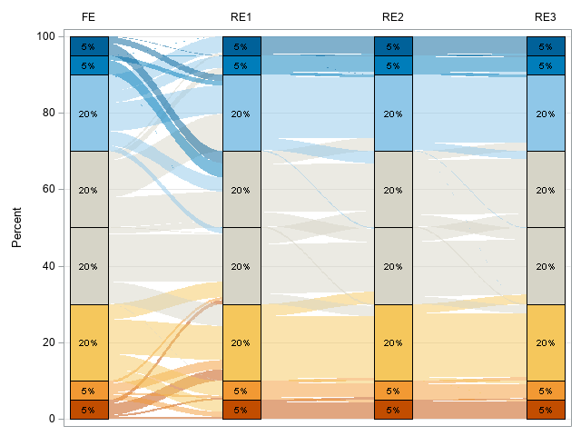

Go with the flow:
Data visualization using Sankey bar charts
Jessica Lavery, MS
Introduction to Sankey Diagrams
Example & Interpretation
Other Applications
Context
Comparing four methods of ranking hospitals for the purposes of provider profiling: Fixed effects, FE; three random effects models adjusted for different sets of covariates, RE1-RE3
With each method, each hospital was ranked into the top 5%, top 6-10%, middle quintile, or bottom 6-10% and 5%
Comparison of fee-for-service Medicare cancer surgical volume and all-payer cancer surgical volume
  Bars represent payer (Medicare, all-payer)
  Flow represents the proportion of providers with relatively low-volume Medicare surgical volume to high-volume all-payer surgical volume, and vice versa
Changes in asthma severity over time
  Bars represent years
  Flow represents changes in the percent of patients with severe and non-severe asthma at different time points
FiveThirtyEight: Who’s changing voters’ minds?
  Bars represent time (before the first debate, after the first debate and after the second debate)
  Flow represents changes in candidate preference over time
Game of Thrones Affiliations
  Bars represent seasons of Game of Thrones
  Flow represents changes in character affiliation by season
What are they? A type of flow diagram
Also known as: Sankey bar charts, alluvial diagrams
Applications: Broadly speaking, Sankey bar charts are useful for visualizing two proportions simultaneously (the proportion in the stacked bar and the proportion that change at the next bar). This can be useful for visualizing:
  Changes over time
  Survey data
  Likert scale data
Figure. Hospital ranking based on fixed and random effects models
Implementation
R
{ggalluvial}
Not officially part of tidyverse but adheres to tidyverse principles
Vignette available
SAS
Set of macros provided by Rho, Inc.
%rawtosankey(): to prep dataset for %sankeybarchart macro
%sankeybarchart(): Produces the Sankey bar chart via PROC SGPLOT
Reference: Rosanbalm, S. (2019). Getting Sankey with bar charts. Chapel Hill, NC: Rho, Inc.; 2015
Reference includes examples using dummy dataset
Conclusion
Interpretation
Each bar corresponds to a different method and indicates the percentage of providers in the top (blue), bottom (orange) and middle (gray) categories. In this case, the percentages are fixed by design to compare how the top 5% of providers by one method are ranked by another method.
Conclude that there is a meaningful difference in ranking between fixed and random effects models; providers in the top decile according to the FE model move to a lower ranking with the RE model, and vice versa. The differences between the random effects models are less pronounced.
Sankey bar charts are a type of flow diagram used to visualize two types of proportions simultaneously: the proportion in each group, as well as the proportion that changed, or flowed, between groups. They may be especially useful for demonstrating changes in survey & Likert scale responses over time, and for comparing different assessments of the same outcome.

