Slide 1

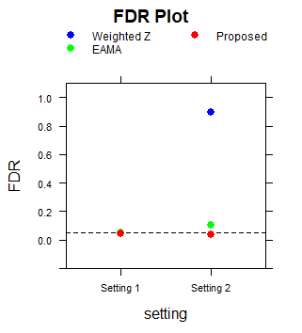
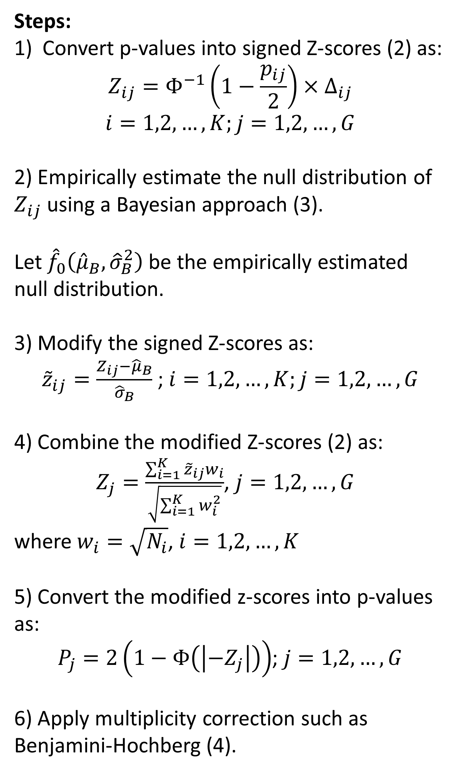
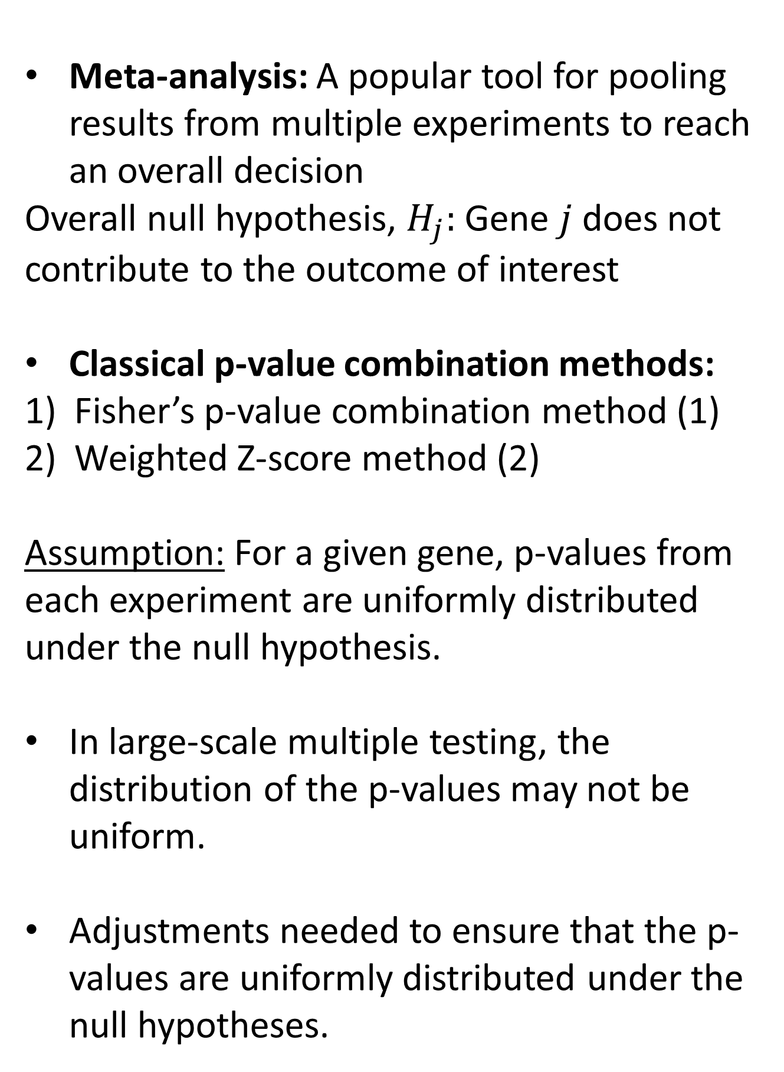
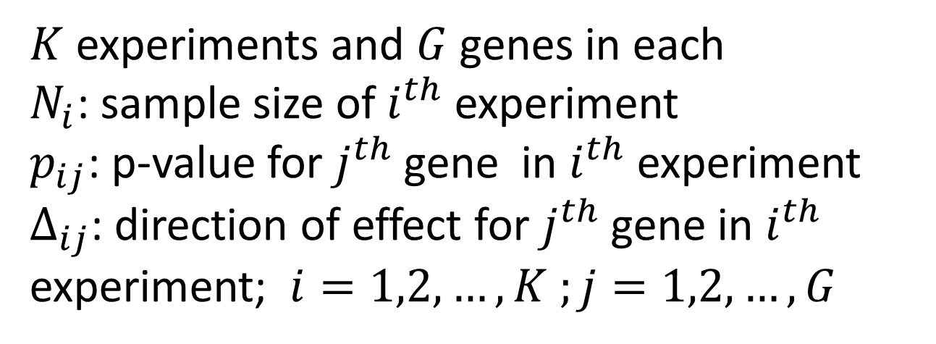
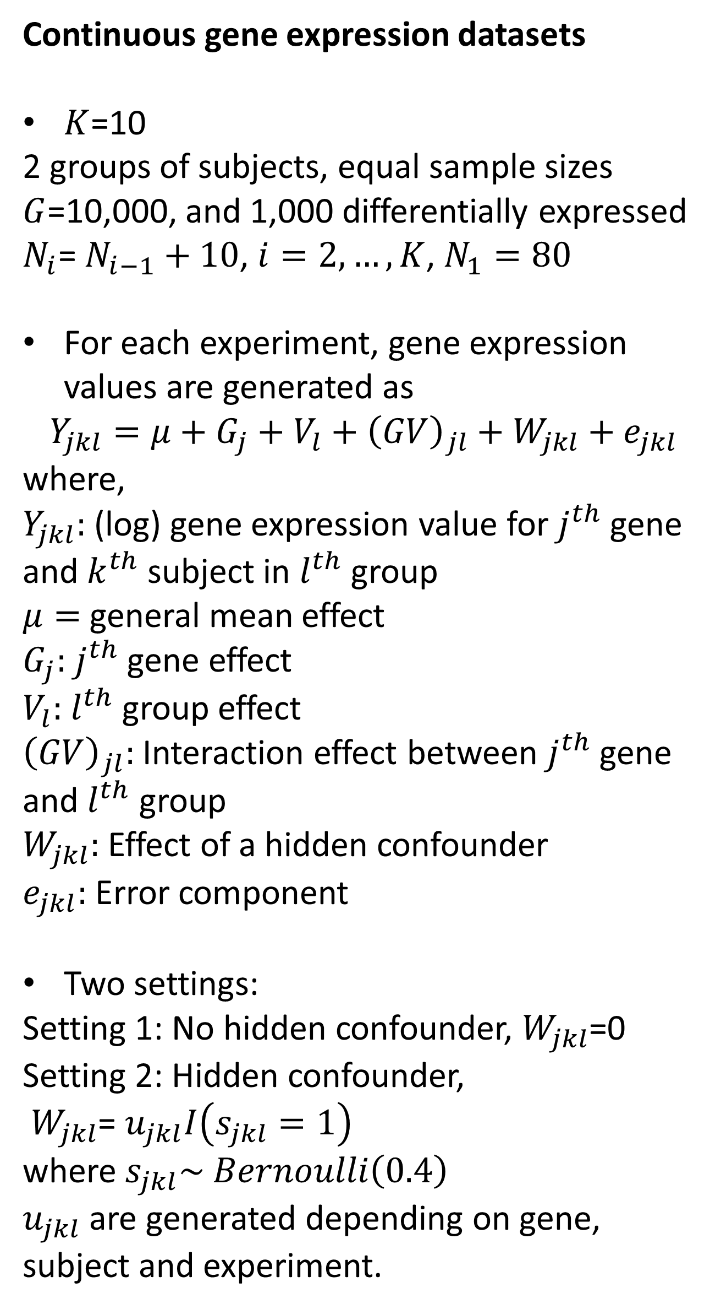
Meta-analysis of Genomic Experiments: An Empirical Approach
SINJINI SIKDAR (ssikdar@odu.edu)
OLD DOMINION UNIVERSITY
BACKGROUND
METHODS
SIMULATIONS
RESULTS
Meta-analysis: A popular tool for pooling results from multiple experiments to reach an overall decision
Overall null hypothesis, $H_{j}:$ Gene $j$ does not contribute to the outcome of interest
Classical p-value combination methods:
Fisher’s p-value combination method (1)
Weighted Z-score method (2)
Assumption: For a given gene, p-values from each experiment are uniformly distributed under the null hypothesis.
In large-scale multiple testing, the distribution of the p-values may not be uniform.
Adjustments needed to ensure that the p-values are uniformly distributed under the null hypotheses.
Steps:
Convert p-values into signed Z-scores (2) as:
$$Z_{ij}=Φ^{−1}\left(1−\frac{p_{ij}}{2}\right)×∆_{ij}$$
$$i=1,2,…,K;j=1,2,…, G$$
2) Empirically estimate the null distribution of $Z_{ij}$ using a Bayesian approach (3).
Let ${\hat{f}}_{0}\left({\hat{μ}}_{B}, {\hat{σ}}_{B}^{2}\right)$ be the empirically estimated null distribution.
3) Modify the signed Z-scores as:
${\tilde{z}}_{ij}=\frac{Z_{ij}−{\hat{μ}}_{B}}{{\hat{σ}}_{B}}$ ; $i=1,2,…,K;j=1,2,…, G$
4) Combine the modified Z-scores (2) as:
$Z_{j}=\frac{\sum_{i=1}^{K}{{\tilde{z}}_{ij}w_{i}}}{\sqrt{\sum_{i=1}^{K}{w_{i}^{2}}}}$, $j=1,2,…, G$
where $w_{i}=\sqrt{N_{i}}$, $i=1,2,…,K$
5) Convert the modified z-scores into p-values as:
$P_{j}=2\left(1−Φ\left(\left|−Z_{j}\right|\right)\right)$; $j=1,2,…, G$
6) Apply multiplicity correction such as Benjamini-Hochberg (4).
Continuous gene expression datasets
$K$=10
2 groups of subjects, equal sample sizes
$G$=10,000, and 1,000 differentially expressed
$N_{i}$= $N_{i−1}+10$, $i=2,…,K$, $N_{1}=80$
For each experiment, gene expression values are generated as
  $$Y_{jkl}=μ+G_{j}+V_{l}+{\left(GV\right)}_{jl}+W_{jkl}+e_{jkl}$$
  where,
  $Y_{jkl}:$ (log) gene expression value for $j^{th}$ gene and $k^{th}$ subject in $l^{th}$ group
  $μ=$ general mean effect
  $G_{j}:$ $j^{th}$ gene effect
  $V_{l}:$ $l^{th}$ group effect
  ${\left(GV\right)}_{jl}:$ Interaction effect between $j^{th}$ gene and $l^{th}$ group
  $W_{jkl}:$ Effect of a hidden confounder
  $e_{jkl}:$ Error component
  Two settings:
  Setting 1: No hidden confounder, $W_{jkl}$=0
  Setting 2: Hidden confounder,
  $W_{jkl}$= $u_{jkl}I\left(s_{jkl}=1\right)$
  where $s_{jkl}\sim Bernoulli\left(0.4\right)$
  $u_{jkl}$ are generated depending on gene, subject and experiment.
Compared with Weighted Z-score method (2) and EAMA (5)
Proposed method has better performance in presence of hidden confounder
REFERENCES
NOTATIONS
1. Fisher RA. London: Oliver and Boyd, 1932.
2. Wllier CJ et al. Bioinformatics, 2010.
3. Van Iterson M et al. Genome Biology, 2017.
4. Benjamini Y et al. JRSSB, 1995.
5. Sikdar S et al. PloS one, 2017.
$K$ experiments and $G$ genes in each
$N_{i}$: sample size of $i^{th}$ experiment
$p_{ij}$: p-value for $j^{th}$ gene in $i^{th}$ experiment
$∆_{ij}$: direction of effect for $j^{th}$ gene in $i^{th}$ experiment; $i=1,2,…,K ;j=1,2,…,G$

