Slide 1

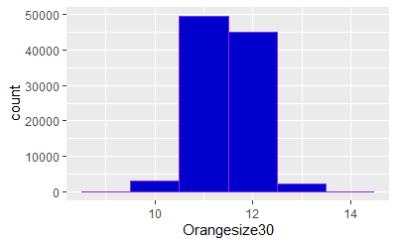
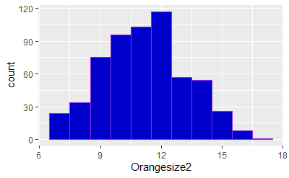
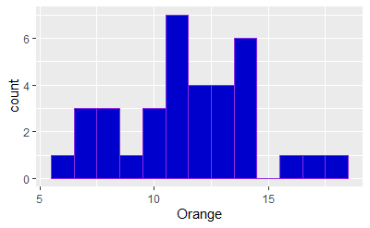
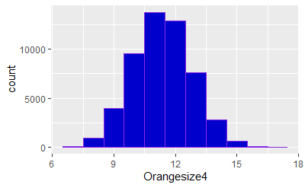
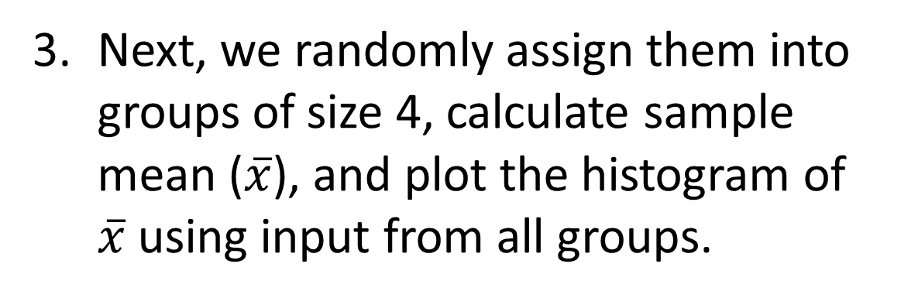
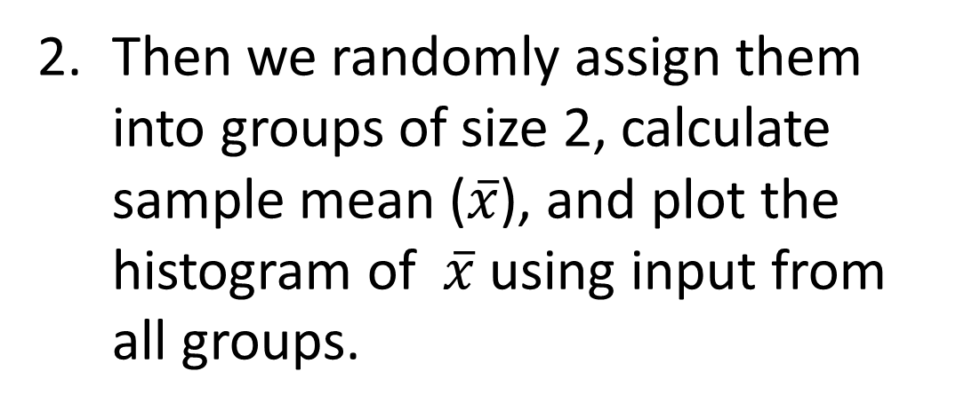
Active Learning in Intro Statistics Classroom: Sampling Variability
BURCU EKE RUBINI (Burcu.EkeRubini@unh.edu)
DEPARTMENT OF DECISION SCIENCES, UNIVERSITY OF NEW HAMPSHIRE
MOTIVATION
OTHER USES
Sampling variability one of the most challenging concepts in an intro class
Common struggles How many possible samples of size 10 there are in a population of 100?
Solution: Let’s count orange M&Ms!!!
Then we randomly assign them into groups of size 2, calculate sample mean ($\overline{x}$), and plot the histogram of $\overline{x}$ using input from all groups.
Continue until entire class is one big sample.
We can refer back tot this data:
While talking about calculating Normal probabilities using the sampling distribution of sample mean.
While talking about one population confidence interval, we can calculate a confidence interval for the mean number of orange M&M’s per bag.
Figure 4: Samples of size 30
STEPS
Figure 2: Samples of Size 2
Everyone gets a fun size M&M bag and records the number of orange candies in their bag. We will pretend that this is the population data and plot the histogram.
Next, we randomly assign them into groups of size 4, calculate sample mean ($\overline{x}$), and plot the histogram of $\overline{x}$ using input from all groups.
ONLINE VERSION
Students can use simulated data.
Students can be pre assigned into samples.
A discussion board can be used on similarities and differences of samples at a fixed sample size and similarities and differences of histograms for different sample sizes.
A more detailed version can be found at https://www.openintro.org/book/os/
Under Chapter 5 resources
Figure 1: Entire Population
Figure 3: Samples of size 4

