Slide 1


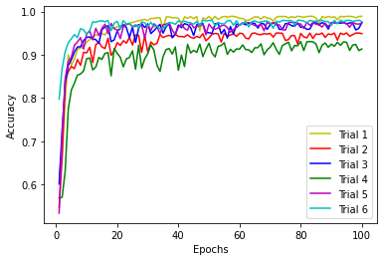
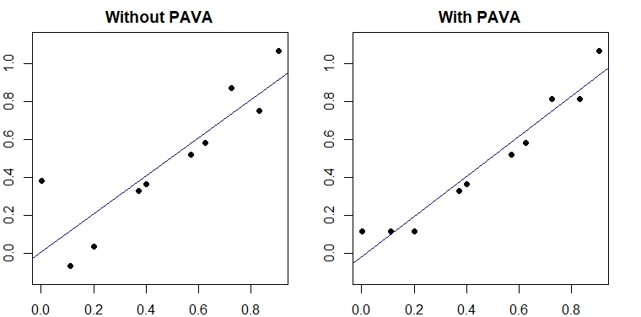
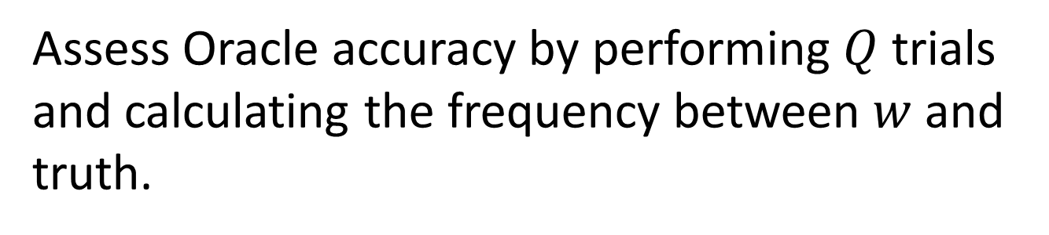
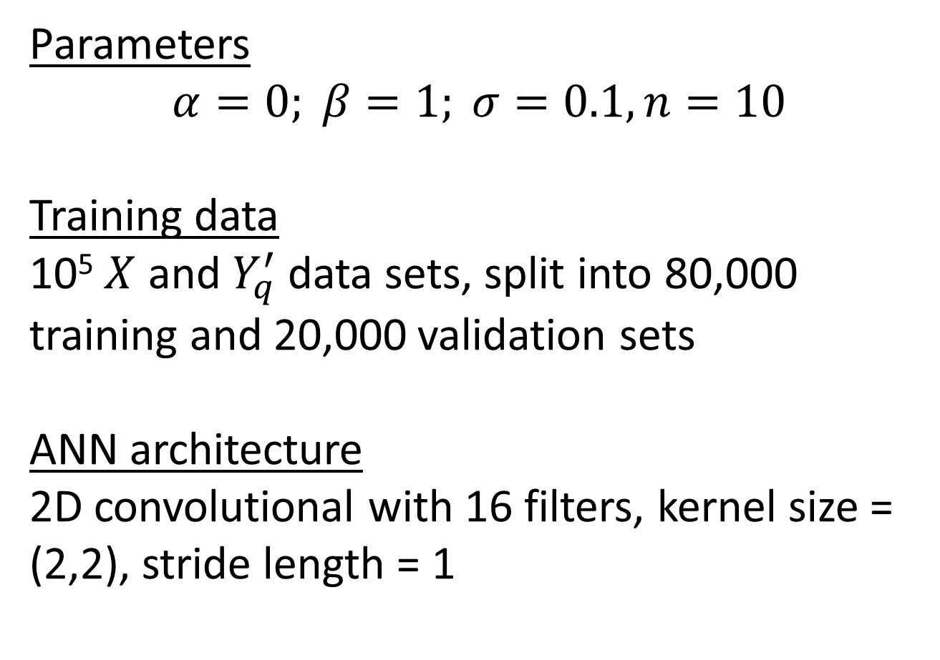
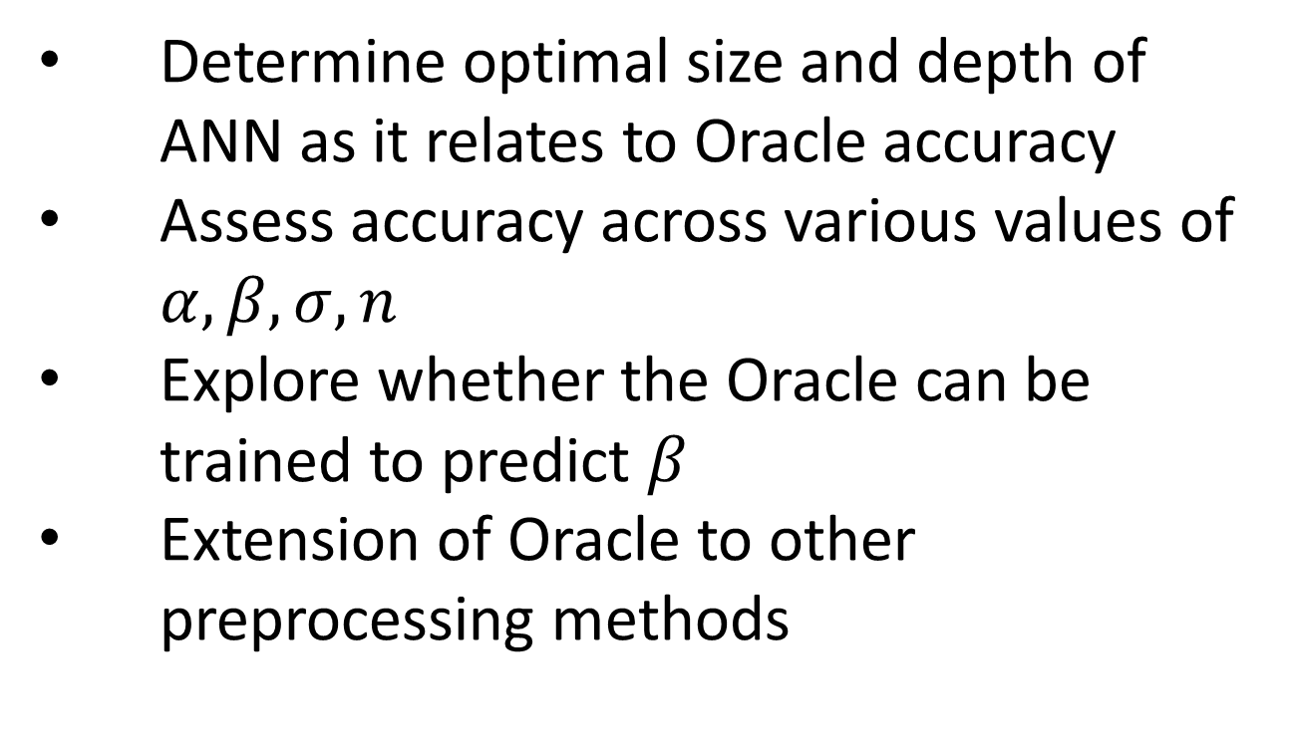
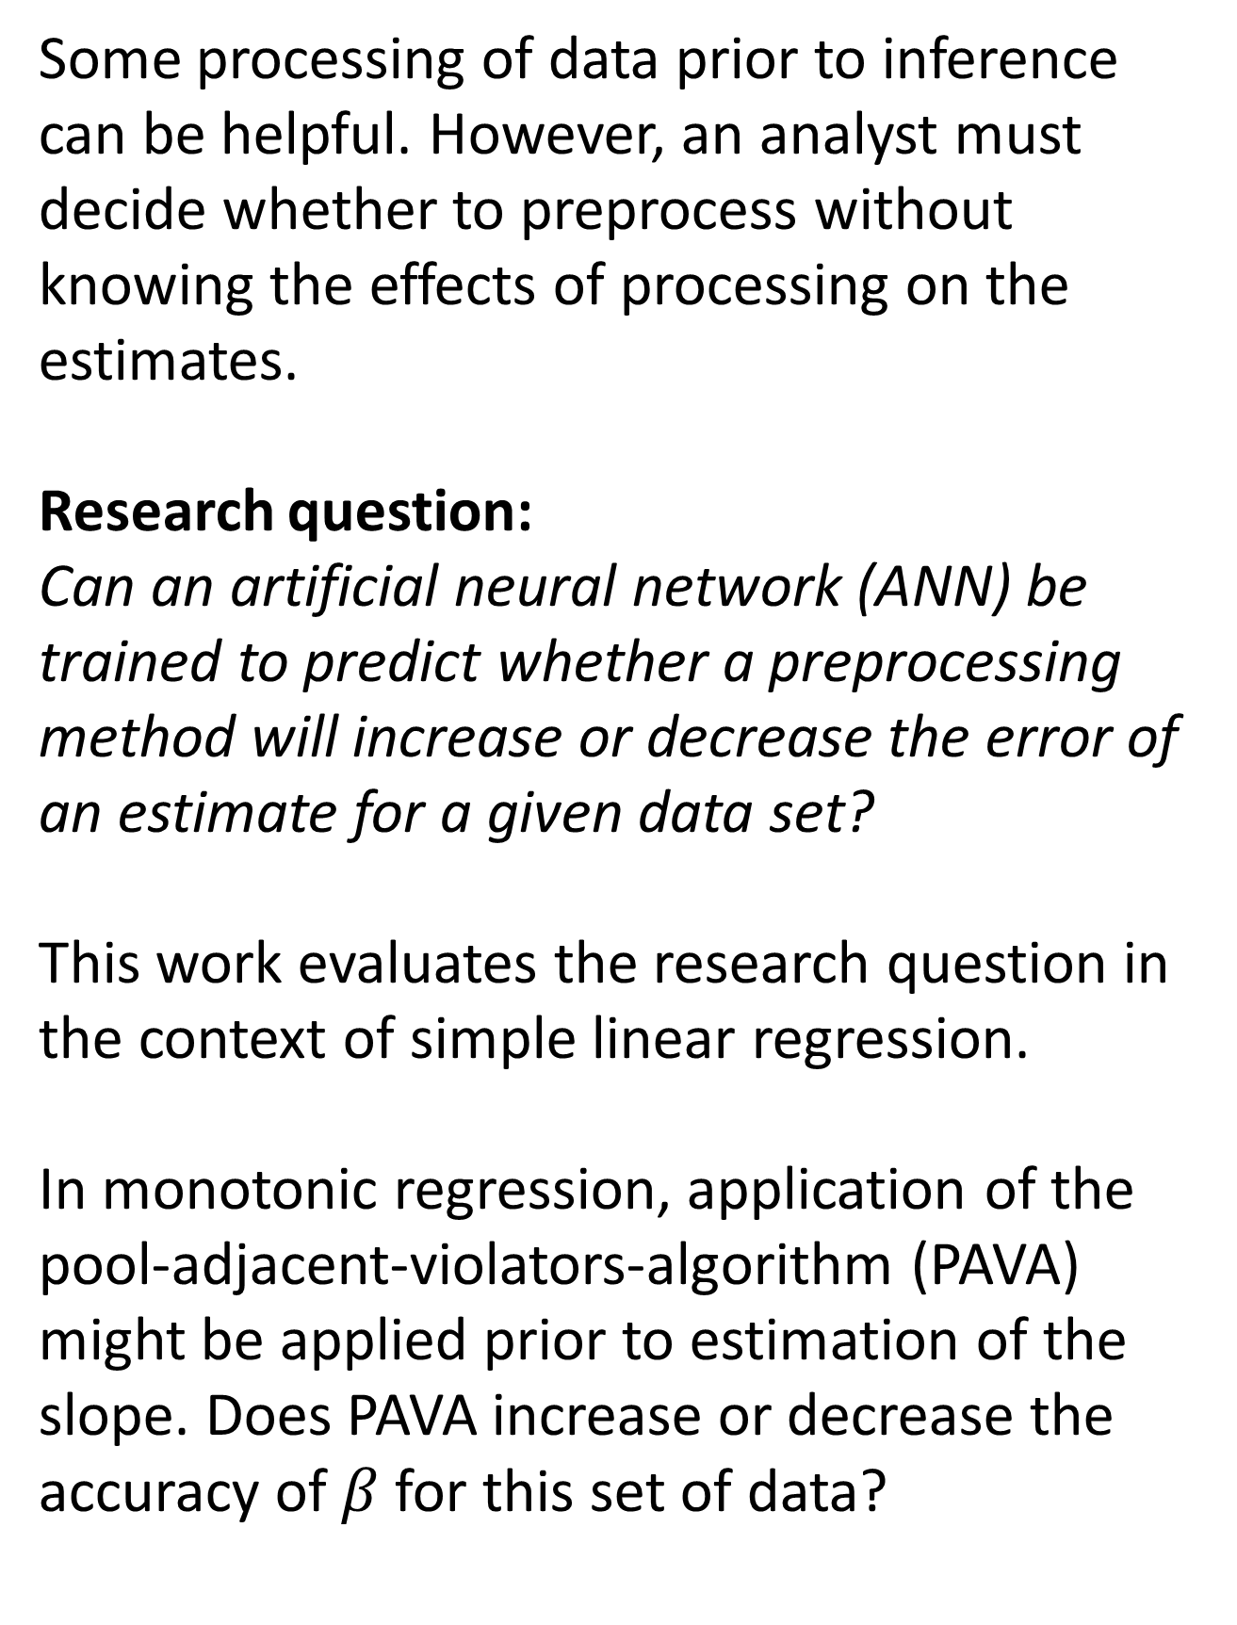
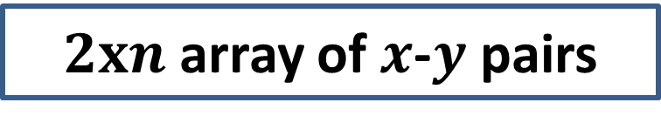
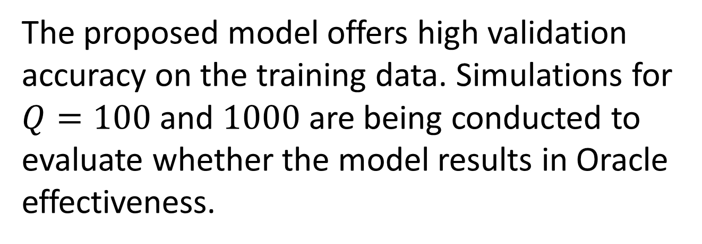
A Tailored Machine Learning Oracle to Guide Statistical Processing
Mary Gregg^{1,2} (mary.gregg@NIST.gov), Lucas Koepke¹, Michael Frey¹
¹National Institute of Standards and Technology, ²University of Colorado Boulder
INTRODUCTION
EXPERIMENT
DESIGN &
ARCHITECTURE
EVALUATION
Some processing of data prior to inference can be helpful. However, an analyst must decide whether to preprocess without knowing the effects of processing on the estimates.
Research question:
Can an artificial neural network (ANN) be trained to predict whether a preprocessing method will increase or decrease the error of an estimate for a given data set?
This work evaluates the research question in the context of simple linear regression.
In monotonic regression, application of the pool-adjacent-violators-algorithm (PAVA) might be applied prior to estimation of the slope. Does PAVA increase or decrease the accuracy of $β$ for this set of data?
Trial design
Generate observed data
Estimate model parameters
Simulate training data
Consists of n outcome values:
$$Y=α+βX+ ε, ε\sim N(0,σ^{2})$$
Consists of n outcome values:
𝑌=𝛼+𝛽𝑋+ 𝜀, 𝜀~𝑁(0,𝜎^2)
From observed data, obtain $\hat{α}, \hat{β}, \hat{σ}$. Estimate slope with PAVA: $\tilde{β}$
From observed data, obtain 𝛼 ̂, 𝛽 ̂, 𝜎 ̂. Estimate slope with PAVA: 𝛽 ̃
Train ANN
Predict for observed data
$Y_{q}^{′}={\hat{α}}^{′}+{\hat{β}}^{′}X+{\hat{ε}}^{′}$, with parameter estimates generated from distributions of $\hat{α}, \hat{β}, \hat{σ}$
𝑌_𝑞^′=𝛼 ̂^′+𝛽 ̂^′ 𝑋+𝜀 ̂^′, with parameter estimates generated from distributions of 𝛼 ̂, 𝛽 ̂, 𝜎 ̂
Estimate ${\hat{β}}^{′}$ without $({\hat{β}}_{q}^{′})$ and with $({\tilde{β}}_{q}^{′})$ PAVA
Estimate 𝛽 ̂^′ without (𝛽 ̂_𝑞^′) and with (𝛽 ̃_𝑞^′) PAVA
For 10⁵ training cases, train ANN on target variable
$$w^{′}=I\left[\left|{\tilde{β}}_{q}^{′}−\hat{β}\right|<\left|{\hat{β}}_{q}^{′}−\hat{β}\right|\right]$$
For 10⁵ training cases, train ANN on target variable
𝑤^′=𝐼[|𝛽 ̃_𝑞^′−𝛽 ̂ |<|𝛽 ̂_𝑞^′−𝛽 ̂ |]
For original $X,Y$, used trained ANN to predict
$$w=I\left[\left|\tilde{β}−β\right|<\left|\hat{β}−β\right|\right]$$
For original 𝑋,𝑌, used trained ANN to predict
𝑤=𝐼[|𝛽 ̃−𝛽|<|𝛽 ̂−𝛽|]
  Parameters
  $$α=0; β=1; σ=0.1, n=10$$
  Training data
  10⁵ $X$ and $Y_{q}^{′}$ data sets, split into 80,000 training and 20,000 validation sets
  ANN architecture
  2D convolutional with 16 filters, kernel size = (2,2), stride length = 1
  The proposed model offers high validation accuracy on the training data. Simulations for $Q=100$ and $1000$ are being conducted to evaluate whether the model results in Oracle effectiveness.
Dense
Relu
Sigmoid
Input
$2xn$ array of $x$-$y$ pairs
2D convolutional layer
FUTURE EXPERIMENTS
32
Determine optimal size and depth of ANN as it relates to Oracle accuracy
Assess accuracy across various values of $α, β, σ, n$
Explore whether the Oracle can be trained to predict $β$
Extension of Oracle to other preprocessing methods
Output
1
  ANN training
  Train model for 100 epochs with batch size of 100, optimize using stochastic gradient descent. Evaluate performance using validation accuracy and loss (binary cross entropy)
Assess Oracle accuracy by performing $Q$ trials and calculating the frequency between $w$ and truth.

