Slide 1

Interactive Data Visualization for International Policy Makers
Presenting author: Sarah Zimmermann, RTI International
Women in Statistics and Data Science
Bellevue, Washington
October 3-5, 2019

Slide 2
Need for Accessible Data
Policy change is data-driven
What happens policy makers lack capacity to understand and interpret data?
Let’s explore this issue in international context of education

Slide 3
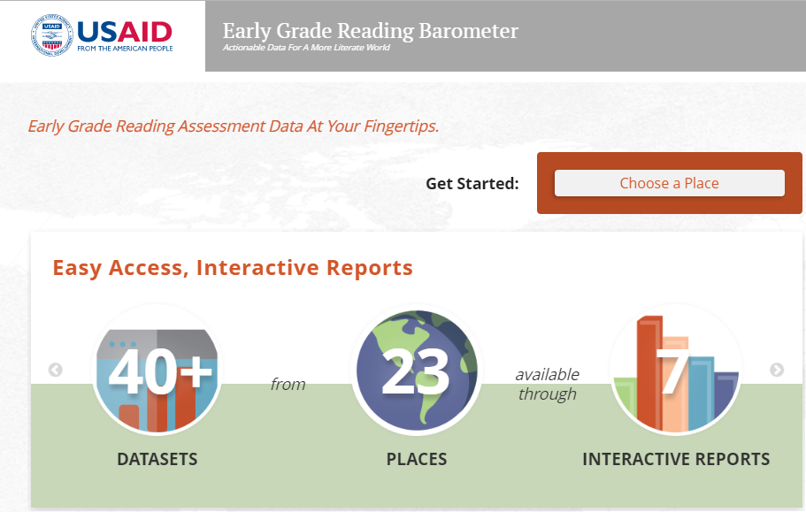
Early Grade Reading Barometer
The Early Grade Reading Barometer- one of only a few web-based applications allowing access and ease of understanding of education data. Sponsored by the United States Agency for International Development, the tool showcases Early Grade Reading Assessment or EGRA Data.
The early grade reading assessment is an individual, oral assessment for early grade reading skill acquisition. On the barometer we showcase these assessment data before an intervention such as new textbooks or more teachers and after, thus giving light to see how effective the intervention was.

Slide 4
Early Grade Reading Barometer Objectives
My research explores transforming data into effective visualizations and the considerations behind their creation. My team has devised solution to the following:
1
Draws attention to study outcomes
2
Highlights the relationships between study outcomes
3
Tracks progress overtime
4
Projects what future improvement looks like
5
And how the barometer considers equity

Slide 5

Visit the Early Grade Reading Barometer to explore our visualizations
www.earlygradereadingbarometer.org

Slide 6
Visualizations Objectives and Solutions
Snapshots
  See an overview of how well students are reading the percentages of struggling readers and how comprehension is associated with reading fluency
Results
  View information about student performance on EGRA subtasks. See how outcomes vary by key student and school characteristics.
Comparisons
  See how Cambodia compares to other places with respect to student outcomes on the EGRA assessments
1
  Draws attention to study outcomes
www.earlygradereadingbarometer.org

Slide 7
Visualizations Objectives and Solutions
2
Relationships report
  Explore how difference EGRA subtasks are related to one another. View graphic displays of these relationships
  Highlights the relationships between study outcomes
www.earlygradereadingbarometer.org

Slide 8
Visualizations Objectives and Solutions
3
Trends report
  Compare how the distribution for selected EGRA subtasks have changed or remained the same over time.
  Tracks progress overtime
www.earlygradereadingbarometer.org

Slide 9
Visualizations Objectives and Solutions
4
Benchmark report
  Chose a target ORF benchmark and see information on how man student are meeting the target benchmark now and how the percentages student meeting the benchmark value could change over time
  Projects what future improvement looks like
www.earlygradereadingbarometer.org

Slide 10
Visualizations Objectives and Solutions
5
Provide gender, residence and sub-national unit as key variable for disaggregating performance on subtasks
  And how the barometer considers equity
www.earlygradereadingbarometer.org

Slide 11
Any questions?
Sarah Zimmermann
Statistician, RTI International
919.485.5587
szimmermann@rti.org
https://www.linkedin.com/in/sarah-zimmermann-7a7167127/

