Slide 1
Transitioning into Leadership
Heather Kopetskie
heather_kopetskie@rhoworld.com

Slide 2
Transitioning into Leadership a new Leadership Role
Heather Kopetskie
heather_kopetskie@rhoworld.com

Slide 3
Then
Lead Statistician on Studies
Wrote protocols and SAPs
Performed analyses
Wrote manuscripts
Functional Lead
Overseeing project work of several statisticians to ensure work was performed, answer questions, general leadership for set of studies
DM Evolution
Helped evolve some routine DM work to increase efficiency
Now
Biometrics Lead
Oversee portfolio of projects
Manage programs/projects
Provide insight on statistics, data management, and programming
Responsible for change management
Lead Statistician
Same as before

Slide 4

A year ago

Slide 5

Afraid of what?

Slide 6

Afraid of what?

Slide 7
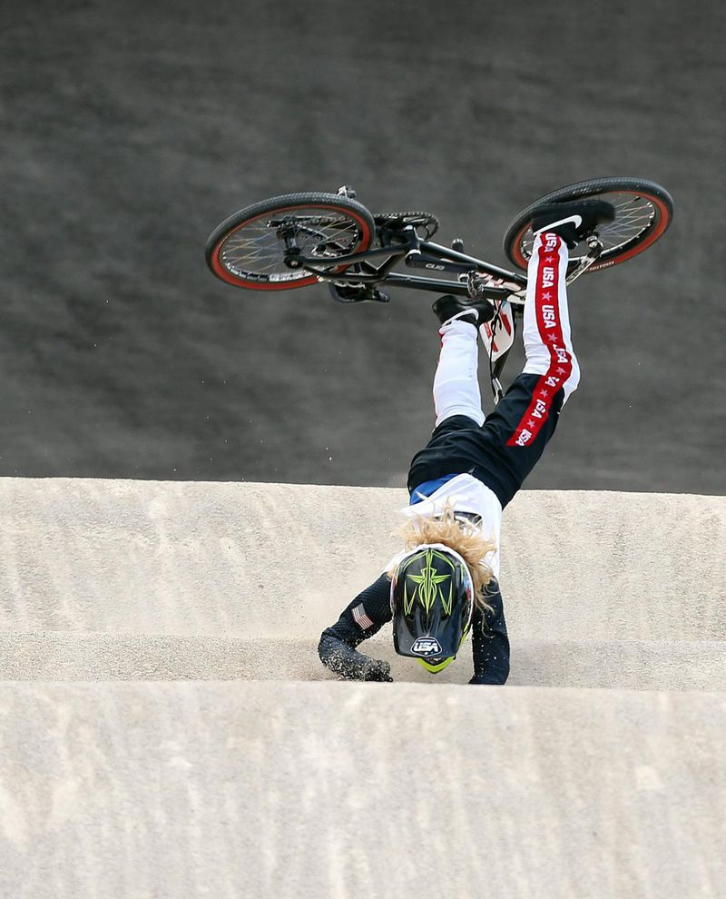
Afraid of what?

Slide 8

Afraid of what?

Slide 9

Alignment of skills

Slide 10
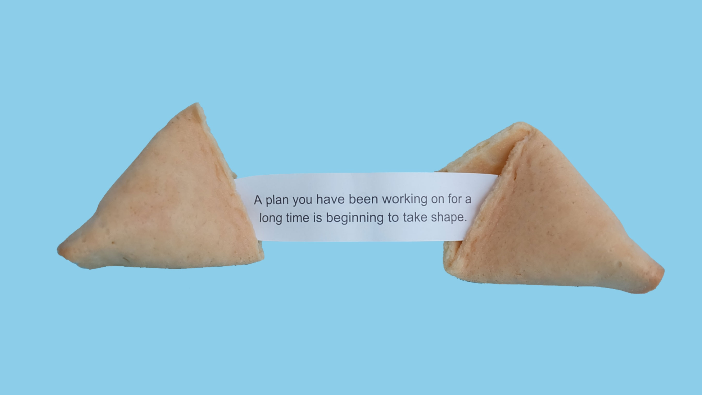
Where are things now?

Slide 11

Going in Circles

Slide 12

Listening and Planning

Slide 13

Not all Good

Slide 14

Still have fears

Slide 15
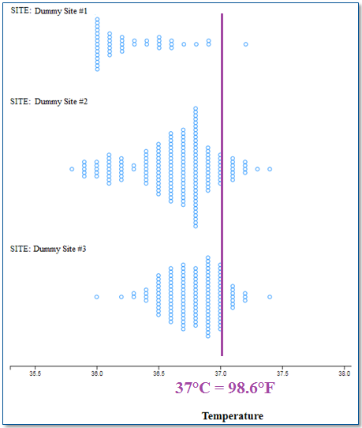
Successes

Slide 16
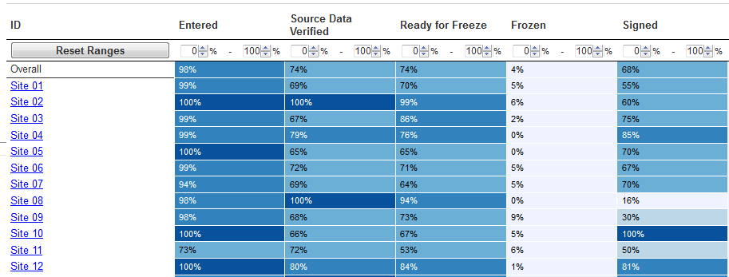
Success

Slide 17

Reflections

Slide 18

Questions

