Slide 1

Accounting for Informative Sampling in Estimation of Associations between STIs and HCs
Anu Mishra
University of Washington
Department of Biostatistics

Slide 2

Outline
Motivating problem from ASPIRE trial
Review of Informative Sampling
Inverse Intensity Rate Weighted Method
Application to ASPIRE data
Discussion

Slide 3
Motivation
We are interested in understanding the association between hormonal contraceptives (HCs) and sexually transmitted infections (STIs)
The APSIRE clinical trial provides a unique opportunity to assess this relationship, but data structure has some challenges

Slide 4
Motivation
Exposure of interest: HC use (time-varying)
  Injectables
  Implants
  Non-hormonal intrauterine devices (IUD)
Outcome: STI diagnosis (recurrent event)
  Chlamydia trachomatis
  Neisseria gonorrhoeae
  Trichomonas vaginalis

Slide 5
Motivation
ASPIRE Trial
ASPIRE is a randomized trial of a biomedical intervention to prevent HIV-1 acquisition
Data on HC use and STI screening were routinely collected for all women
STI & HC
Unscheduled STI & HC
STI & HC
STI & HC
HC
HC
HC
HC
HC
HC
HC
HC
HC
Baseline
Month 6
Month 12

Slide 6
Motivation
ASPIRE Trial
The mix of scheduled and unscheduled screening can be problematic estimating associations
Two conventional approaches could be taken:
  Use all the data to estimate association
  Use only scheduled visits to estimate association
These analyses are subject to informative sampling bias

Slide 7
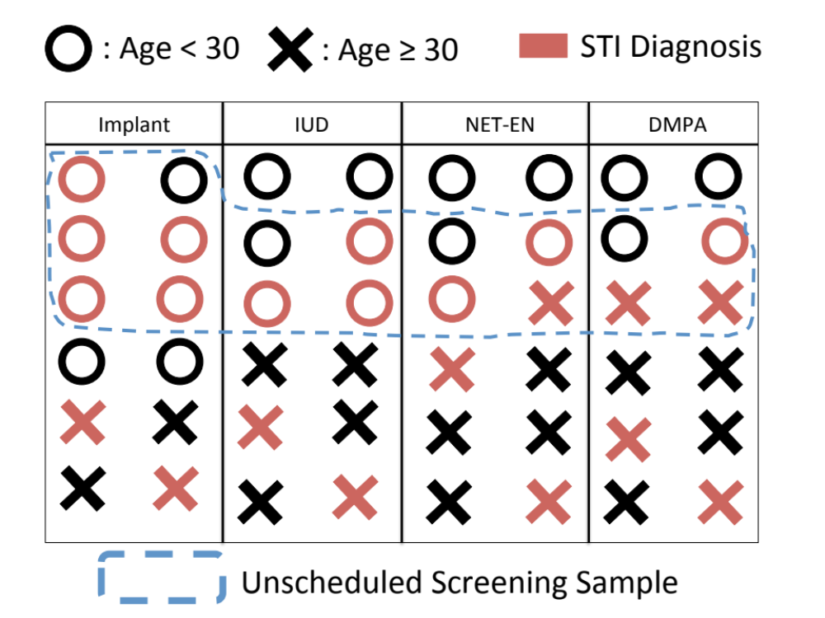
Informative Sampling
A Toy Example

Slide 8
Informative Sampling
A Toy Example
If we use all available data without any adjustment we may be “over-screening” implant users
If we only use data from scheduled visits we may be “under-screening” implant users

Slide 9
Informative Sampling
Existing Methods
Existing methods of handling informative sampling model the two processes of interest jointly
  Process 1: The model for the outcome
  (i.e. STI diagnosis)
  Process 2: The model for the observation process (i.e. STI screening)

Slide 10
Informative Sampling
Existing Methods
Authors | Method | Assumptions
Liang et al. (2009) Huang et al. (2006) Tan et al. (2014) | Frailty, mixture model method | Two processes are correlated through a latent variable
Lin and Ying (2001) Song et al. (2012) | Counting process method | Observation process is explained by the covariates used in the outcome model
Buzkova and Lumley (2009) Buzkova (2010) | Counting process method with inverse intensity rate ratio (IIRR) weights | Observation process explained by any measured covariates

Slide 11
IIRR Weighted Method
Our goal is to use all available data to estimate an unbiased association between HC method and STI acquisition
We extend Buzkova’s work to allow for
  Time-varying exposure of interest
  Stratification covariates

Slide 12
IIRR Weighted Method
Outcome Model
For person i at time t let:
  N_{i}(t) be the cumulative number of STIs diagnosed and dN_{i}(t) be an indicator of STI diagnosis
  X_{i}(t) be a 1 x p vector of contraceptive use
  k be the stratum membership
  β is a the p-length vector of hazard ratios of interest
The model for STI diagnosis is

Slide 13
IIRR Weighted Method
Observation Model
For person i at time t let:
  Ñ_{i}(t) be the cumulative number of STIs screenings and dÑ_{i}(t) be an indicator of STI screening
  Z_{i}(t) be a 1 x q vector of covariates associated with STI screening
  X_{i}(t) be a 1 x p vector of of the exposure of interest
Two models for STI screening are

Slide 14
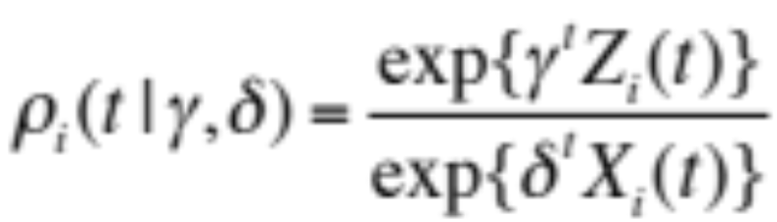
IIRR Weighted Method
Weight Definition
Given these observation models the IIRR weights can be constructed
For person i at time t the IIRR weight is

Slide 15
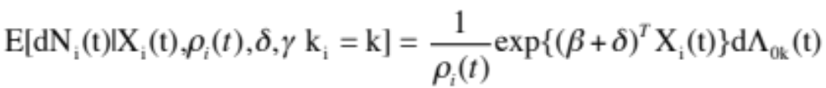
IIRR Weighted Method
Joint Model
Once weights are estimated we augment the outcome model to account for the informative sampling
The IIRR weighted proportional rate model is

Slide 16
Application to ASPIRE
Analysis
We fit 3 separate STI comparing risk of STI among HC users.
  C. trachomatis, N. gonorrhoeae, and T. vaginalis
Estimated HR three ways:
  Site stratified Andersen-Gill model using scheduled STI screenings only
  Site stratified Andersen-Gill model using all STI screenings
  IIRR weighted method using all STI screenings

Slide 17
Application to ASPIRE
Data
Data from 1,131 participants was included in analysis
  Restricted analysis to South African women
  Excluded women not using contraceptive method of interest at baseline
Censored for HIV-1, pregnancy, tubal litigation, and first visit where HC of interest not used
For scheduled visit analysis the sample size was decreased to 1,015
  Some women had censoring event prior to first semi-annual visit

Slide 18
Application to ASPIRE
Baseline Characteristics
Characteristic | All Visits Sample (N = 1131) | Scheduled Visits Sample (N = 1015)
 | N (%) | N (%)
Age (Mean, SD) | 25.43 (5.71) | 25.42 (5.77 )
Married | 75 (6.6) | 71 (7.0)
Sex without condom in past week | 367 (32.5 ) | 330 (32.5)
Baseline STI | 272 (24.1) | 243 (23.9)
Contraceptive Method IUD DMPA NET-EN Implants | 75 (6.6) 661 (58.4) 375 (33.2) 20 (1.8) | 70 (6.9) 608 (59.9) 322 (31.7) 15 (1.5)

Slide 19
Application to ASPIRE
IIRR Weight Construction
To select weight covariates, Z_{i}(t), we fit unadjusted logistic GEE models examining for association between covariate and STI screening
Covariates with p-value > 0.10 were included in weight model
  Baseline: demographics, sexual behavior, pelvic exam findings
  Time-varying: sexual behavior, pelvic exam findings, past STI diagnoses

Slide 20
Application to ASPIRE
Results: C. trachomatis
Method | IIRR Weighted | All Visits Unweighted | Scheduled Visits Unweighted
 | HR¹ (95% CI)² | HR¹ (95% CI) | HR¹ (95% CI)
IUD (Ref.) | 1 (-) | 1 (-) | 1 (-)
DMPA | 1.42 (1.00, 2.01) | 1.27 (0.88, 1.84) | 1.22 (0.83, 1.81)
NET-EN | 1.33 (0.91, 2.06) | 1.32 (0.86, 2.01) | 1.15 (0.76, 1.75)
Implants | 0.68 (0.37, 1.21) | 0.55 (0.30, 1.00) | 0.57 (0.30, 1.05)
¹ Adjusted for baseline: age, study arm, condom use, > 1 partner, STI diagnosis, and stratified by site.
² Bootstrap CIs obtained from 500 replications

Slide 21
Application to ASPIRE
Results: N. gonorrhoeae
Method | IIRR Weighted | All Visits Unweighted | Scheduled Visits Unweighted
 | HR¹ (95% CI)² | HR¹ (95% CI) | HR¹ (95% CI)
IUD (Ref.) | 1 (-) | 1 (-) | 1 (-)
DMPA | 0.94 (0.56, 1.77 ) | 0.82 (0.49, 1.38) | 1.03 (0.57, 1.86 )
NET-EN | 0.98 (0.63, 1.77 ) | 0.84 (0.49, 1.43) | 1.06 (0.57, 1.95 )
Implants | 0.69 (0.27, 1.70) | 0.68 (0.30, 1.55) | 0.90 (0.36, 2.26 )
¹ Adjusted for baseline: age, study arm, condom use, > 1 partner, STI diagnosis, and stratified by site.
² Bootstrap CIs obtained from 500 replications

Slide 22
Application to ASPIRE
Results: T. vaginalis
Method | IIRR Weighted | All Visits Unweighted | Scheduled Visits Unweighted
 | HR¹ (95% CI)² | HR¹ (95% CI) | HR¹ (95% CI)
IUD (Ref.) | 1 (-) | 1 (-) | 1 (-)
DMPA | 0.44 (0.25, 0.83) | 0.41 (0.23, 0.73) | 0.37 (0.20, 0.75 )
NET-EN | 0.51 (0.25, 1.05) | 0.50 (0.26, 0.94) | 0.65 (0.33, 1.30 )
Implants | 0.59 (0.17, 1.39) | 0.54 (0.203, 1.42) | 0.54 (0.19, 1.56 )
¹ Adjusted for baseline: age, study arm, condom use, > 1 partner, STI diagnosis, and stratified by site.
² Bootstrap CIs obtained from 500 replications

Slide 23
Discussion
Extended Buzkova’s method for estimation of bias corrected HRs to allow for time-varying covariates
Proposed method makes use of all available data to estimate associations and reduce bias from informative sampling
Application to ASPIRE data shows that adjustment for informative sampling bias can lead to meaningfully different estimates and CIs

Slide 24
Discussion
We assumes the observation process can be explained by measured covariates. This assumption should be carefully considered.
Currently, we do not have a way to estimate incidence rates that are subject to informative sampling. This is an area of future work.

Slide 25
Acknowledgements
Dr. Elizabeth R. Brown (UW Biostat, FHCRC)
Dr. Jennifer E. Balkus (UW Epi, FHCRC)
Dr. Petra Buzkova (UW Biostat)

Slide 26
Acknowledgements
We thank the study participants for their dedication to the ASPIRE trial. We acknowledge the study staff and investigators from the MTN sites
We thank IPM, the developer and provider of the study product.
The Microbicide Trials Network is funded by the National Institute of Allergy and Infectious Diseases, with co-funding from the Eunice Kennedy Shriver National Institute of Child Health and Human Development and the National Institute of Mental Health, all components of the U.S. National Institutes of Health.

Slide 27
Thank you!
Selected References:
Buzkova, P. (2010): “Panel count data regression with informative observation times,” The International Journal of Biostatistics, 6.
Buzkova, P. and T. Lumley (2009): “Semiparametric modeling of repeated mea-surements under outcome-dependent follow-up,” Statistics in medicine, 28, 987–1003
Huang, C.-Y., M.-C. Wang, and Y. Zhang (2006): “Analysing panel count data with informative observation times,” Biometrika, 93, 763–775.
Liang, Y., W. Lu, and Z. Ying (2009): “Joint modeling and analysis of longitudinal data with informative observation times,” Biometrics, 65, 377–384.
Lin, D. and Z. Ying (2001): “Semiparametric and nonparametric regression analysis of longitudinal data,” Journal of the American Statistical Association, 96, 103– 126.
Matovu, F., E. Brown, A. Mishra, G. Nair, T. Palanee-Phillips, N. Mgodi, C. Nakabiito, N. Chakhtoura, S. Hillier, and J. Baeten (2017): “Acquisition of sexually transmitted infections among women using a variety of contraceptive options: a prospective study among high-risk African women,” in Journal of the International AIDS Society, volume 20, Int. AIDS Society Avenue de France 23, Geneva, 1202, Switzerland, volume 20, 94–95.
Song, X., X. Mu, and L. Sun (2012): “Regression analysis of longitudinal data with time-dependent covariates and informative observation times,” Scandinavian Journal of Statistics, 39, 248–258.
Tan, K. S., B. French, and A. B. Troxel (2014): “Regression modeling of longitudinal data with outcome-dependent observation times: extensions and comparative evaluation,” Statistics in medicine, 33, 4770–4789.

Slide 28
Appendix Slides:
IIRR Model Assumptions
Assumptions of this model:
Non-informative censoring
Within an individual, events are independent given the covariates included in the model.
Dependency of observation times on Z_{i}(t), X_{i}(t), N_{i}(t), and the censoring mechanism is only through Z_{i}(t).

Slide 29
Appendix Slides
Incidence Rates
Method | C. trachomatis | N. gonorrhoeae | T. vaginalis
 | IR¹ (95% CI) | IR¹ (95% CI) | IR¹ (95% CI)
IUD | 16.8 (12.6, 22.5) | 8.2 (5.5, 12.5) | 11.2 (7.9, 16.0)
DMPA | 17.5 (15.1, 20.4) | 6.3 (4.9, 8.1) | 4.9 (3.7, 6.5)
NET-EN | 19.8 (16.2, 24.2) | 7.4 (5.3, 10.2) | 6.1 (4.3, 8.8)
Implants | 11.2 (6.9, 18.2) | 6.3 (3.4, 12.0) | 6.3 (3.4, 12.0)
¹ IR calculated using all visit data, reported per 100 woman-years

