Slide 1
Modeling visitation to public lands
Sama Winder*, Emmi Lia, and Spencer Wood
Outdoor Recreation & Data Lab
University of Washington
10/3/19 - Women in Statistics & Data Science Conference

Slide 2
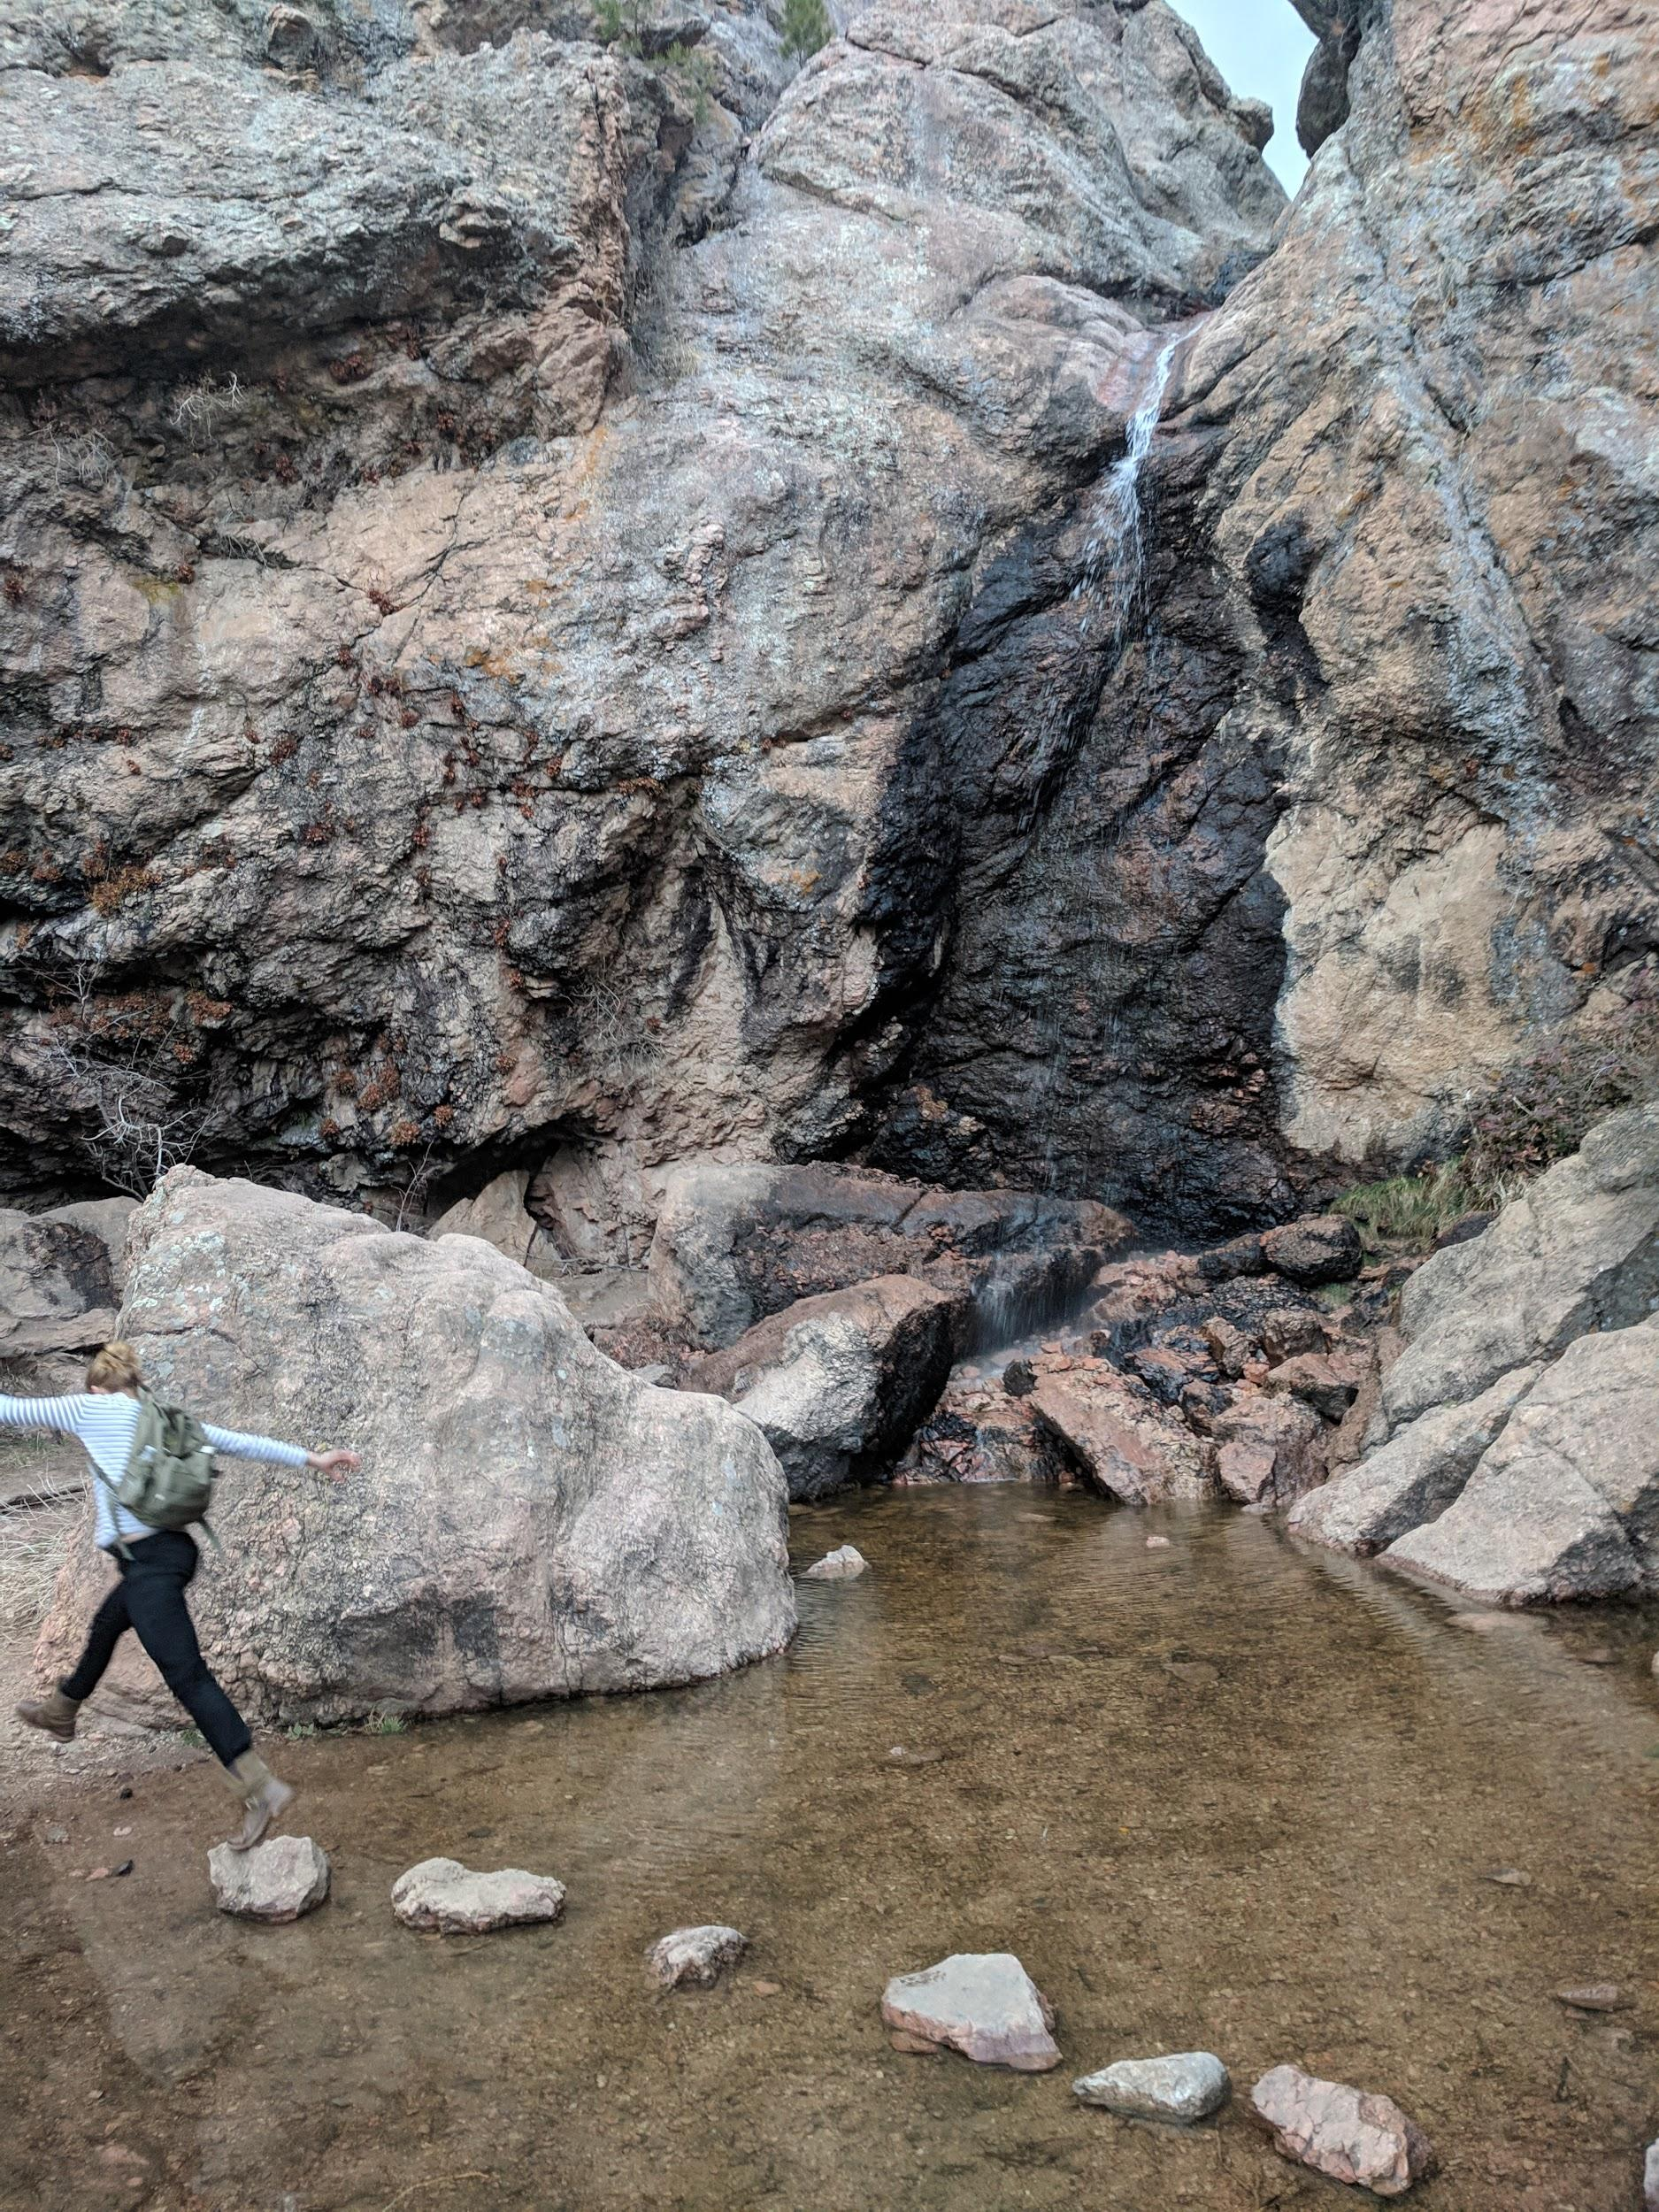
Outdoor recreation matters
Nearly 40% of land in the US is public
$887 billion annual spending on outdoor recreation (Outdoor Industry Association)
Spending time outside improves physical and mental health and happiness
Notes:
Recreation is important & good for you

Slide 3
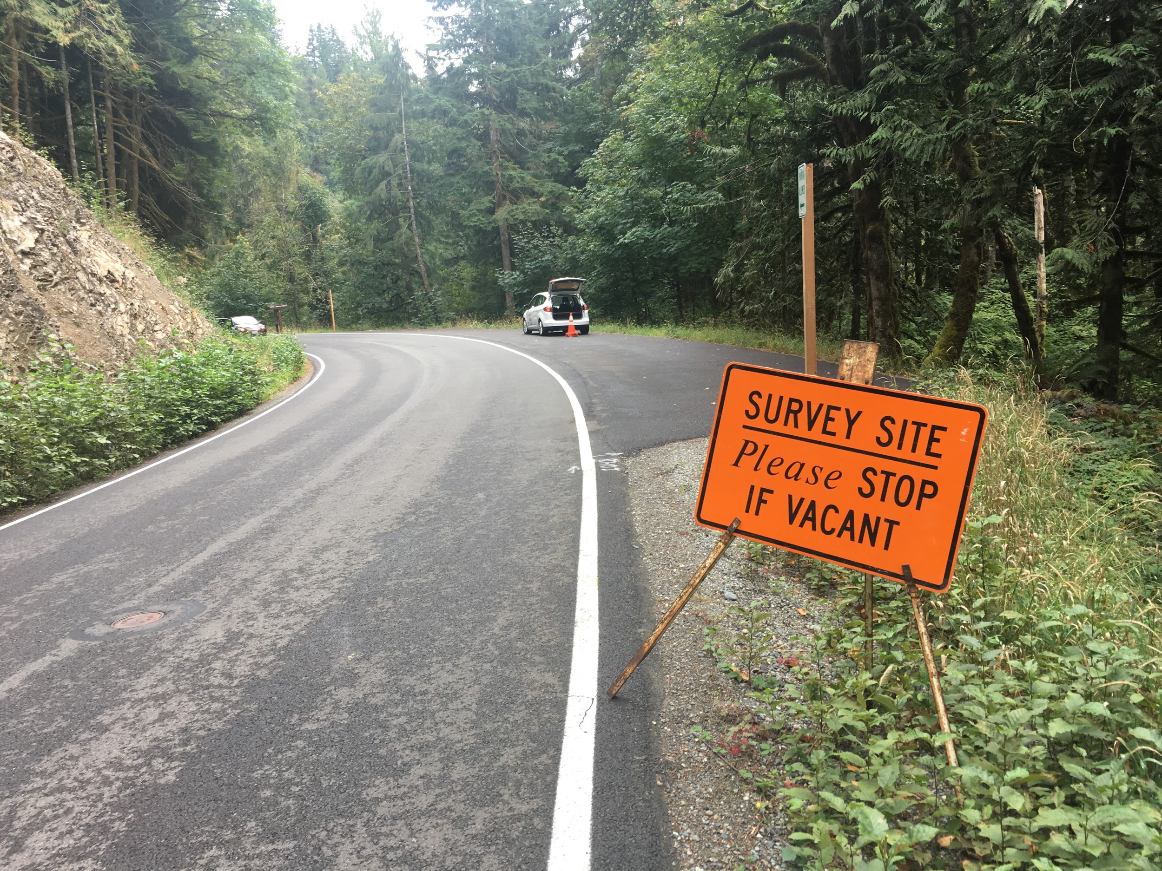
Effective management requires data
How many people are visiting?
Who are they?
Where are they from?
What are they doing?
Are they having a good time?
… but getting data on visitor numbers is hard
Surveys
Trail counters
Game cameras
All expensive and time intensive to deploy and maintain
Notes:
Effectively managing rec areas leads to better and more equitable recreation opportunities, but requires knowledge about quantity and character of recreational use
Traditional methods of collecting these data are expensive and time-intensive
Effectively managing these lands requires knowledge on the number and character of visitors
More than 148 million annual visits to national forests

Slide 4
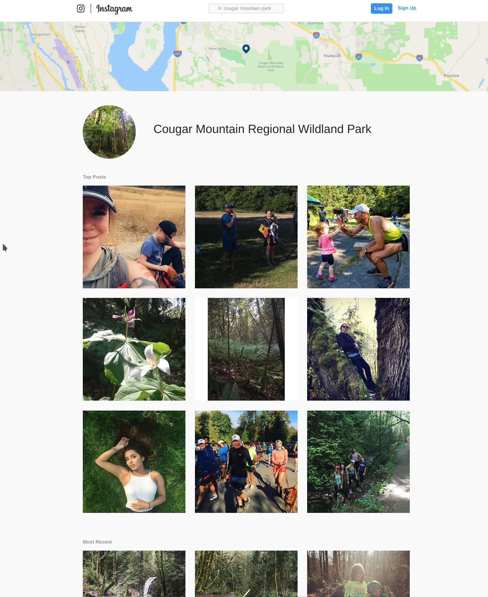
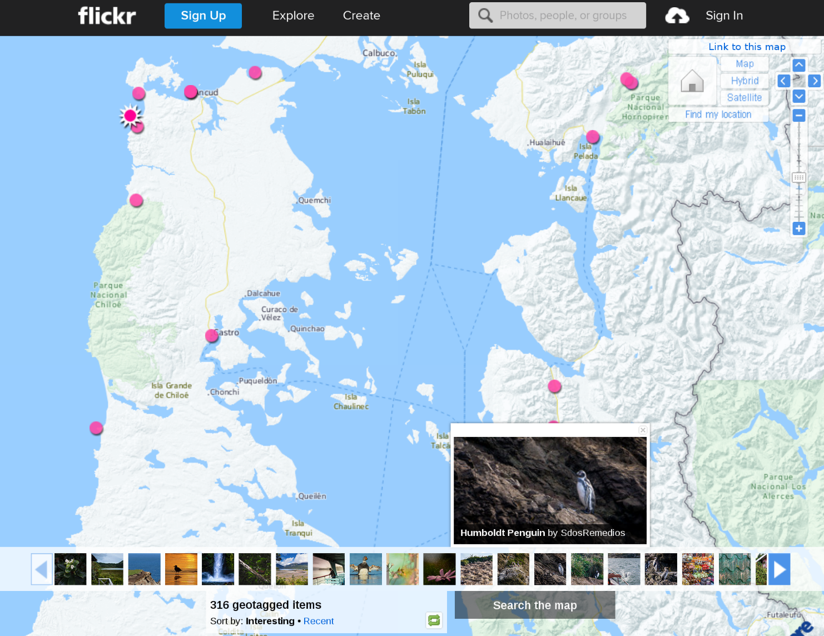
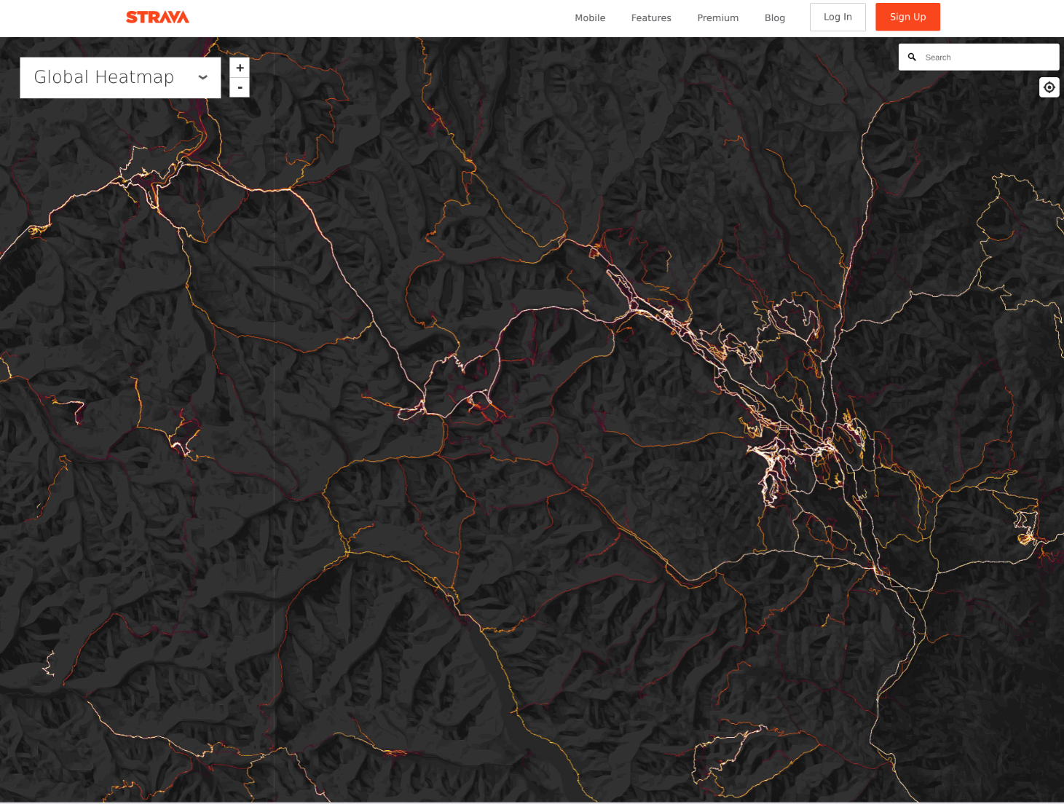
Geolocated social media
Notes:
people have suggested that social media can fill our data gaps and inform visitor use
because there’s lots of it, it’s geolocated and time-stamped, obviously related to visitor behavior, etc

Slide 5
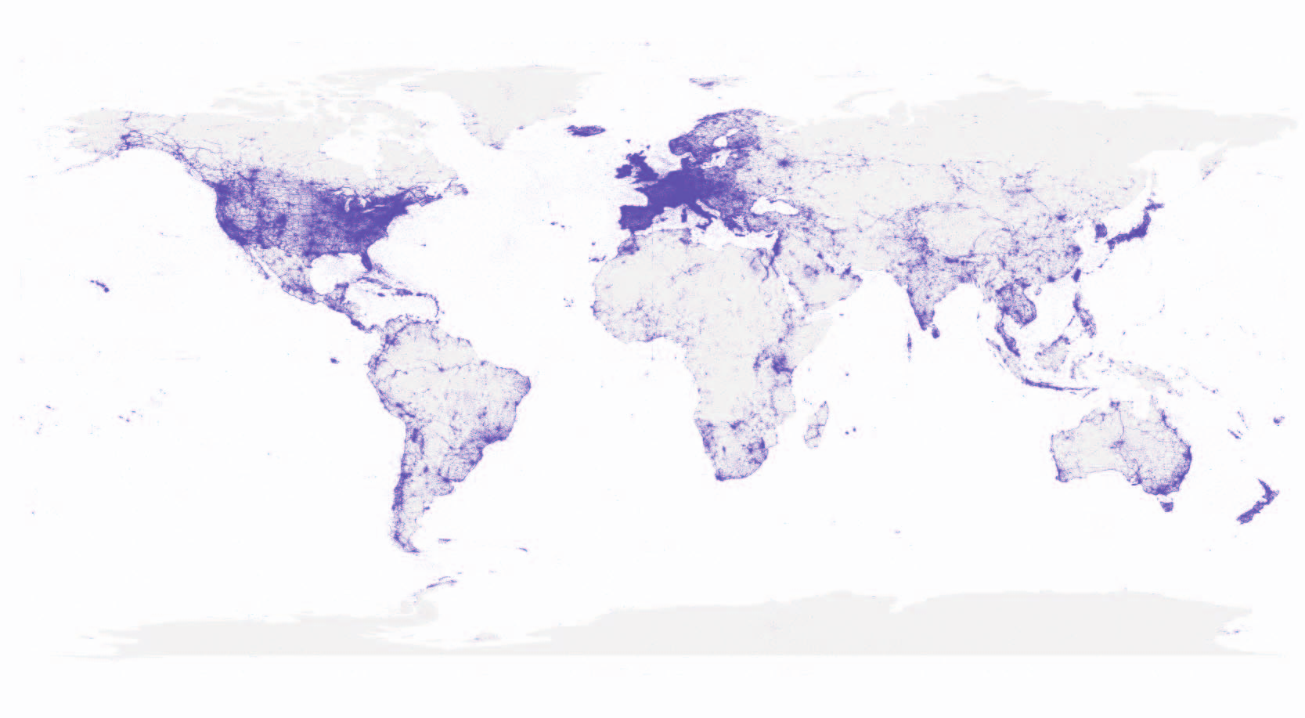
flickr
Notes:
Initial attempts to answer the question of whether social media can inform visitor estimates looked at flickr photo sharing platform (now out of fashion)
Data generation process
Users take images, stamped with location and datetime, go home and share. Doesn’t require internet/data connection

Slide 6
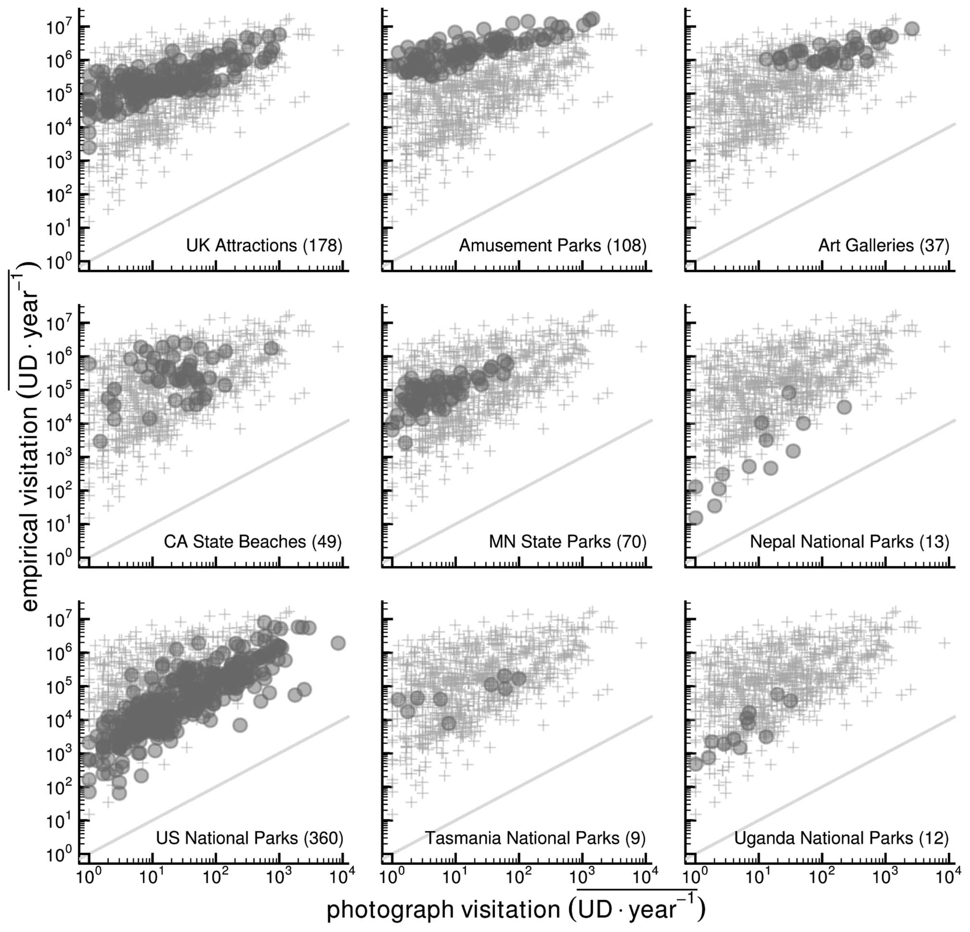
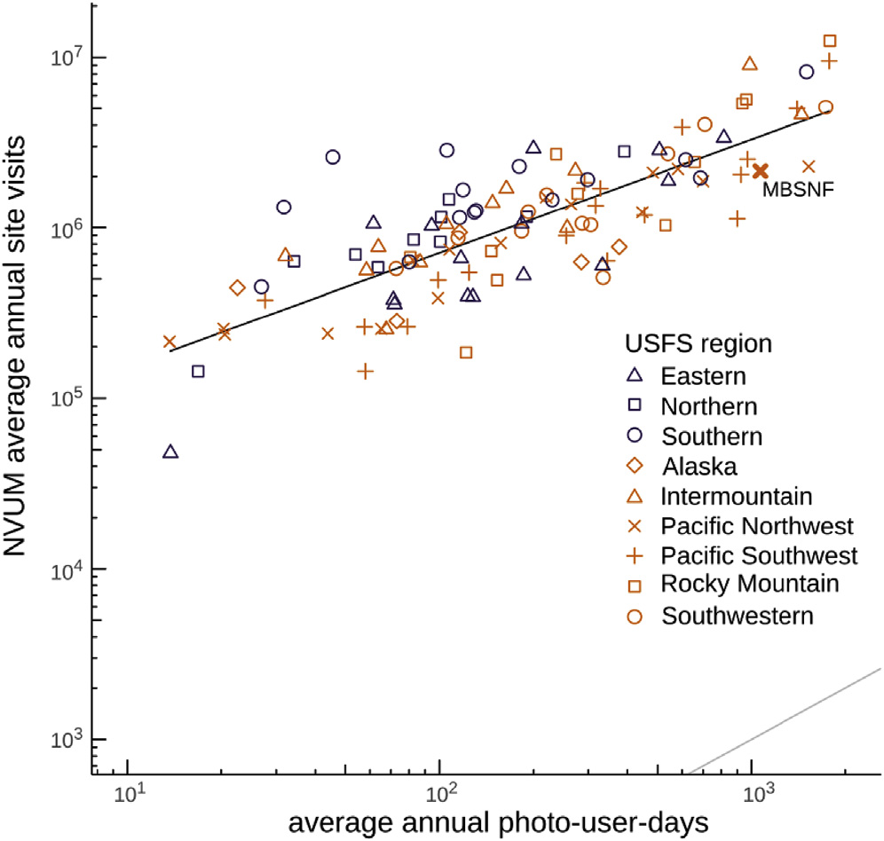
Geolocated social media - Spatial trends
( Wood et al 2013 Sci Rep; Fisher et al 2018 J Env Man)
Notes:
Analyses considered sites in space spanning a range of visitation rates
Correlate the best estimate of the number of visitors per site with the number of users who share geolocated content from the same site and time on social media
Plot shows on-site counts that were collected using a variety of methods vs the number of flickr photo-user-days
This was some of the early evidence that the volume of content that’s shared online is related to the number of visitors at rec sites
It’s far from perfect: there’s lots of noise. But it indicated that there’s useful information to be learned and research should continue

Slide 7
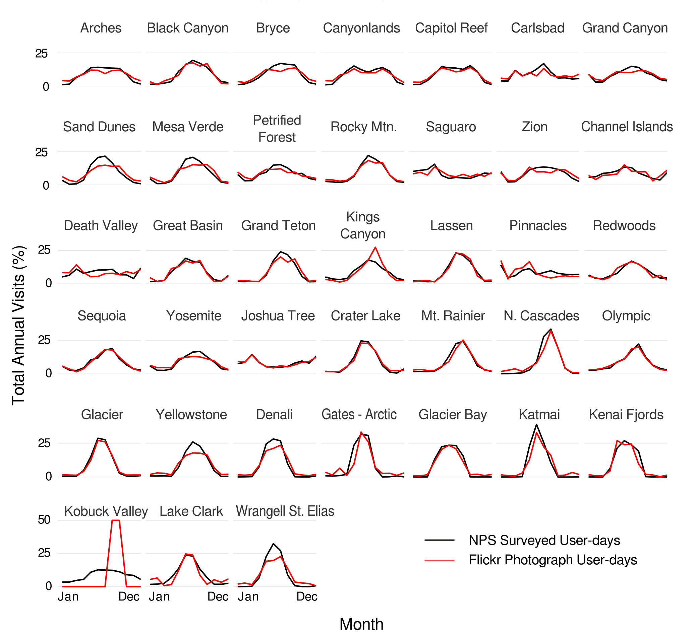
Geolocated social media - Seasonal trends
( Sessions et al 2016 )
Notes:
Research has continued.
Other studies have compared seasonal/temporal trends in visitation with temporal trends in online activity
At US National parks, relative number of visitors per month matches changes in relative number of images that people share from visits to the same parks
Again, this was a good sign that there’s a signal in the noise

Slide 8
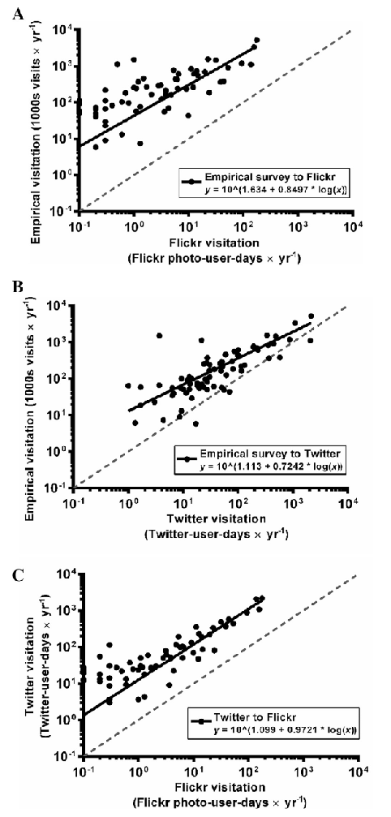
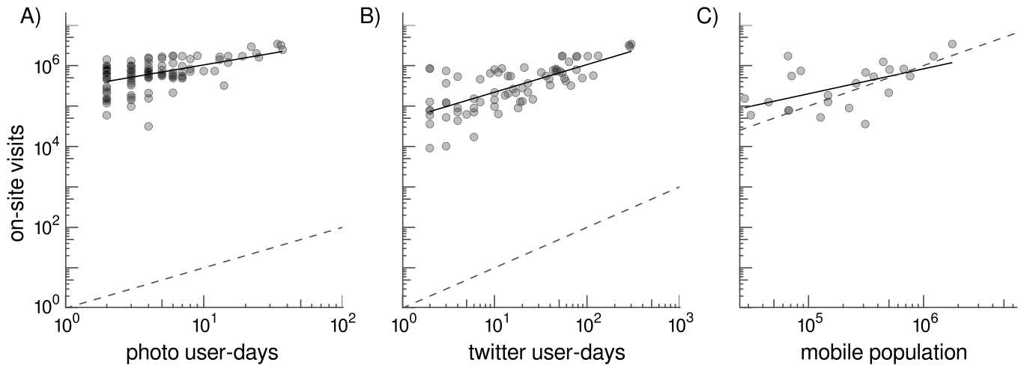
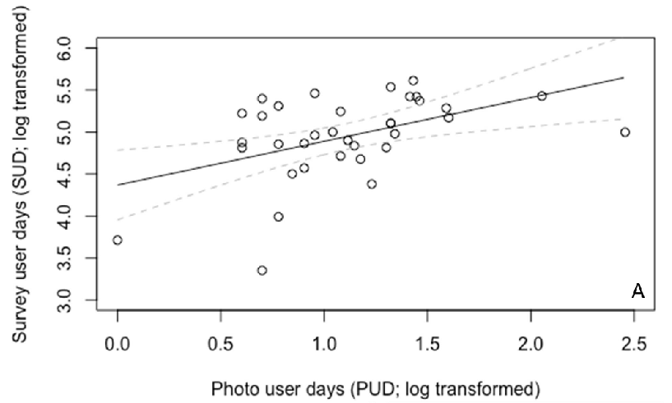
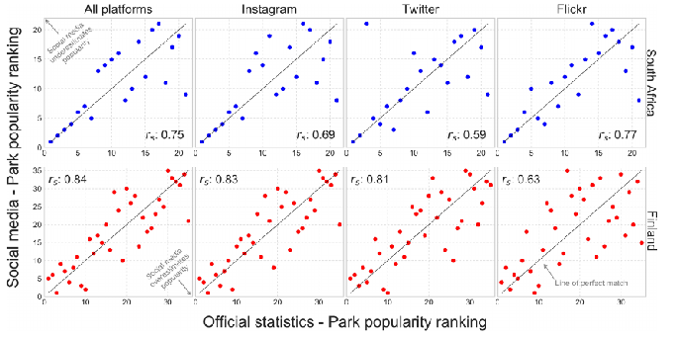
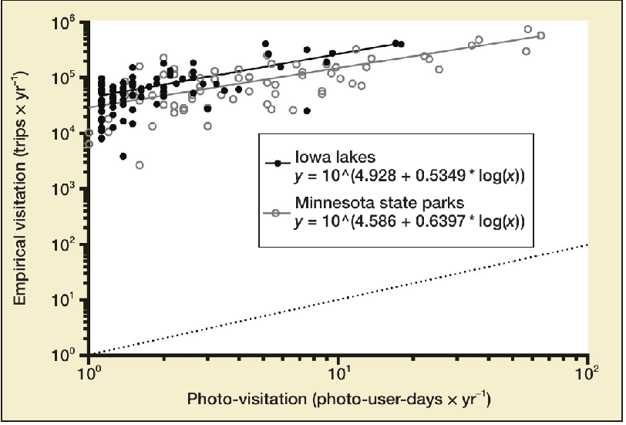
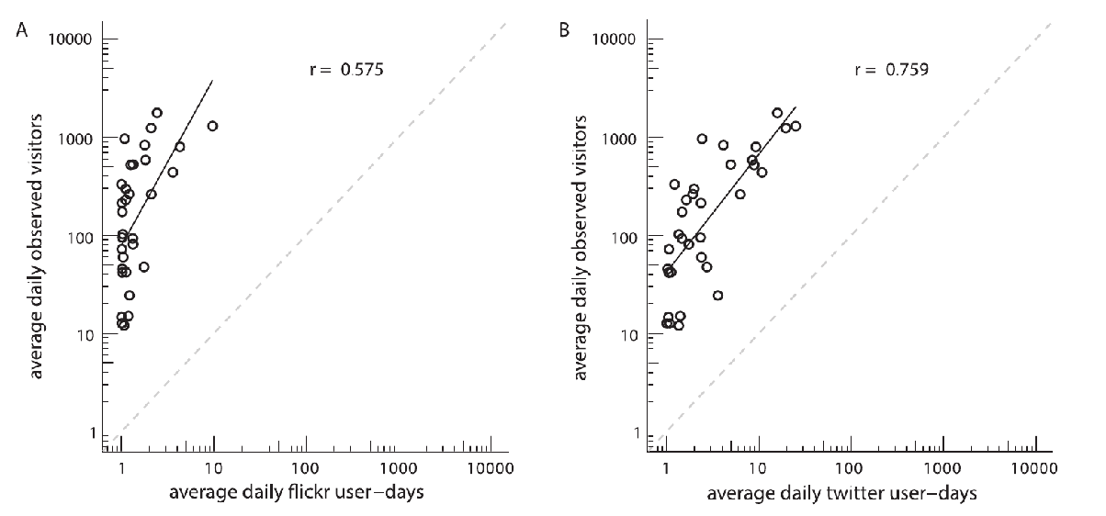
Geolocated social media
( Keeler et al 2016, Sonter et al 2016, Tenkanen et al 2017, Donahue et al 2018, Hamstead et al 2018, Fisher et al 2019 )
Notes:
‹#›
‹#›
In intervening years, a bevy of studies have examined the correlation between actual visits and popularity of rec sites on social media
Across several platforms:
Mention twitter, instagram, mobile call/text records
Generally supporting the initial finding of 60-90% correlation of online popularity with actual popularity

Slide 9
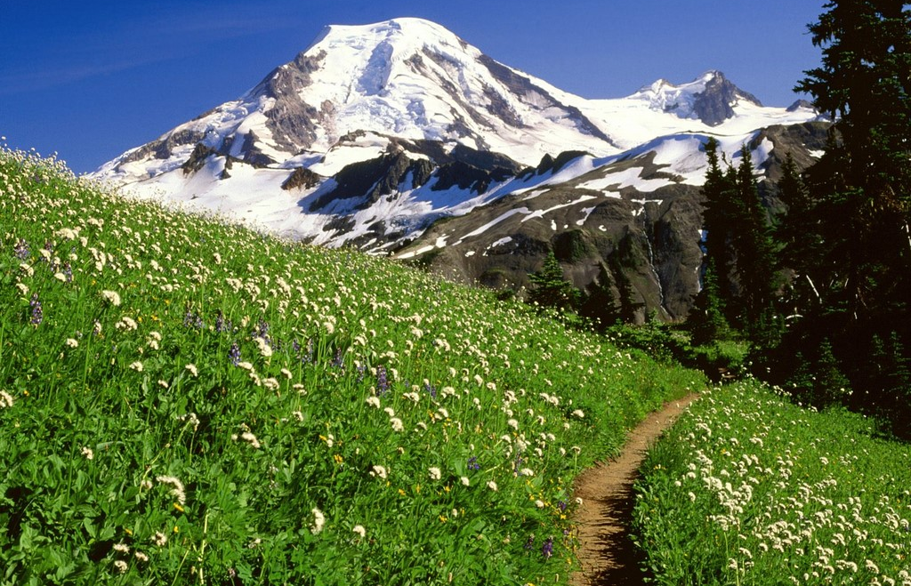
Can we model weekly visitation by trail?
Using only widely available data
Combining multiple social media platforms
Notes:
But we think we can do better by combining multiple platforms that each capture a slightly different user group
Question: Can we build a generalizable model of visitation?
Using broadly available data, can we parameterize a model in one part of the country and apply it elsewhere?

Slide 10
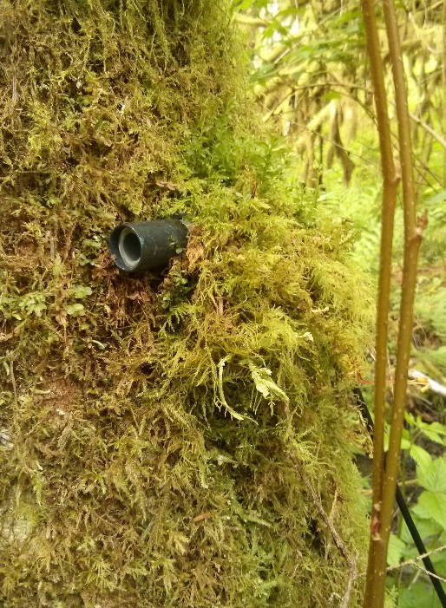
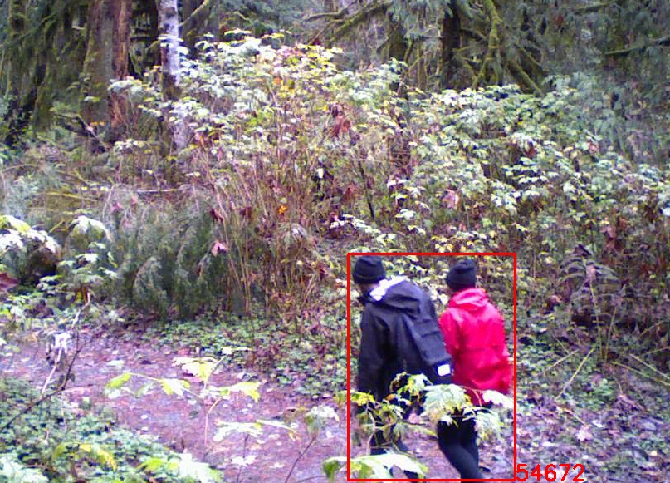
Visitor estimation in Western Washington
On-site Data (16+ trails)
Hiker counts
  Infrared (IR) counters & trail cams
Three seasons (2016-2018)
with Dave Fisher, Emmi Lia, & Spencer Wood (UW)
Sarah Lange, Dave Redman, Alex Weinberg, Eric White, Dale Blanha & Monika Derrien (USFS)

Slide 11
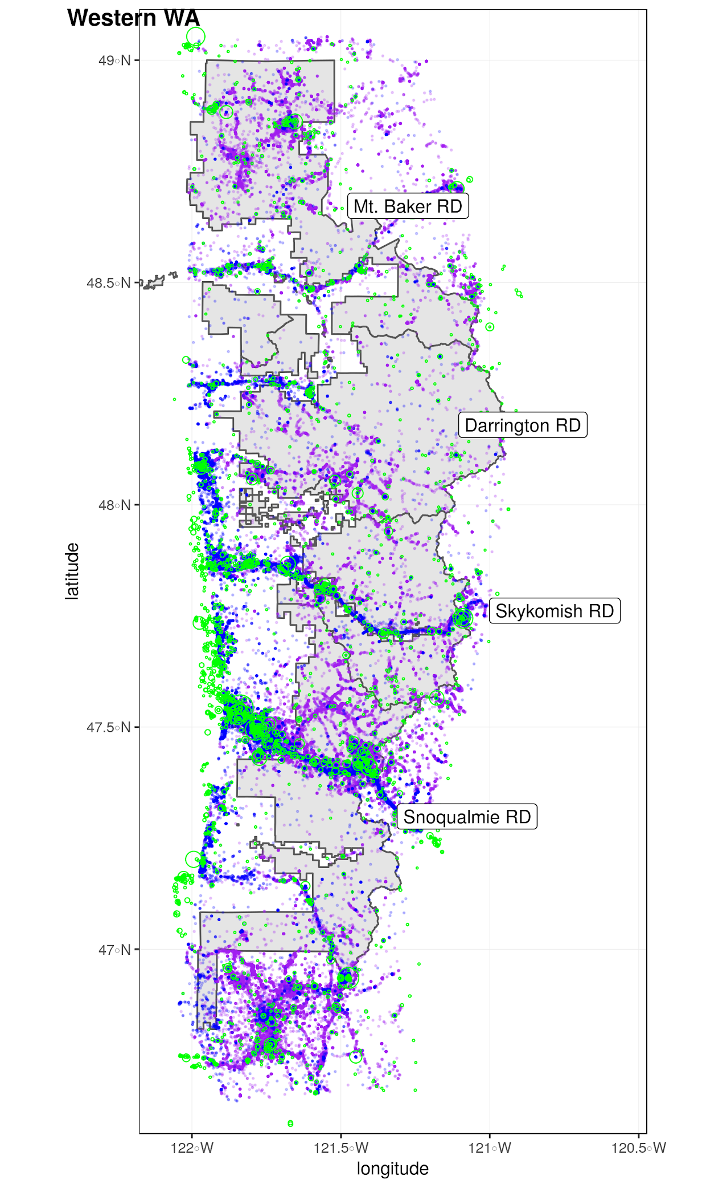
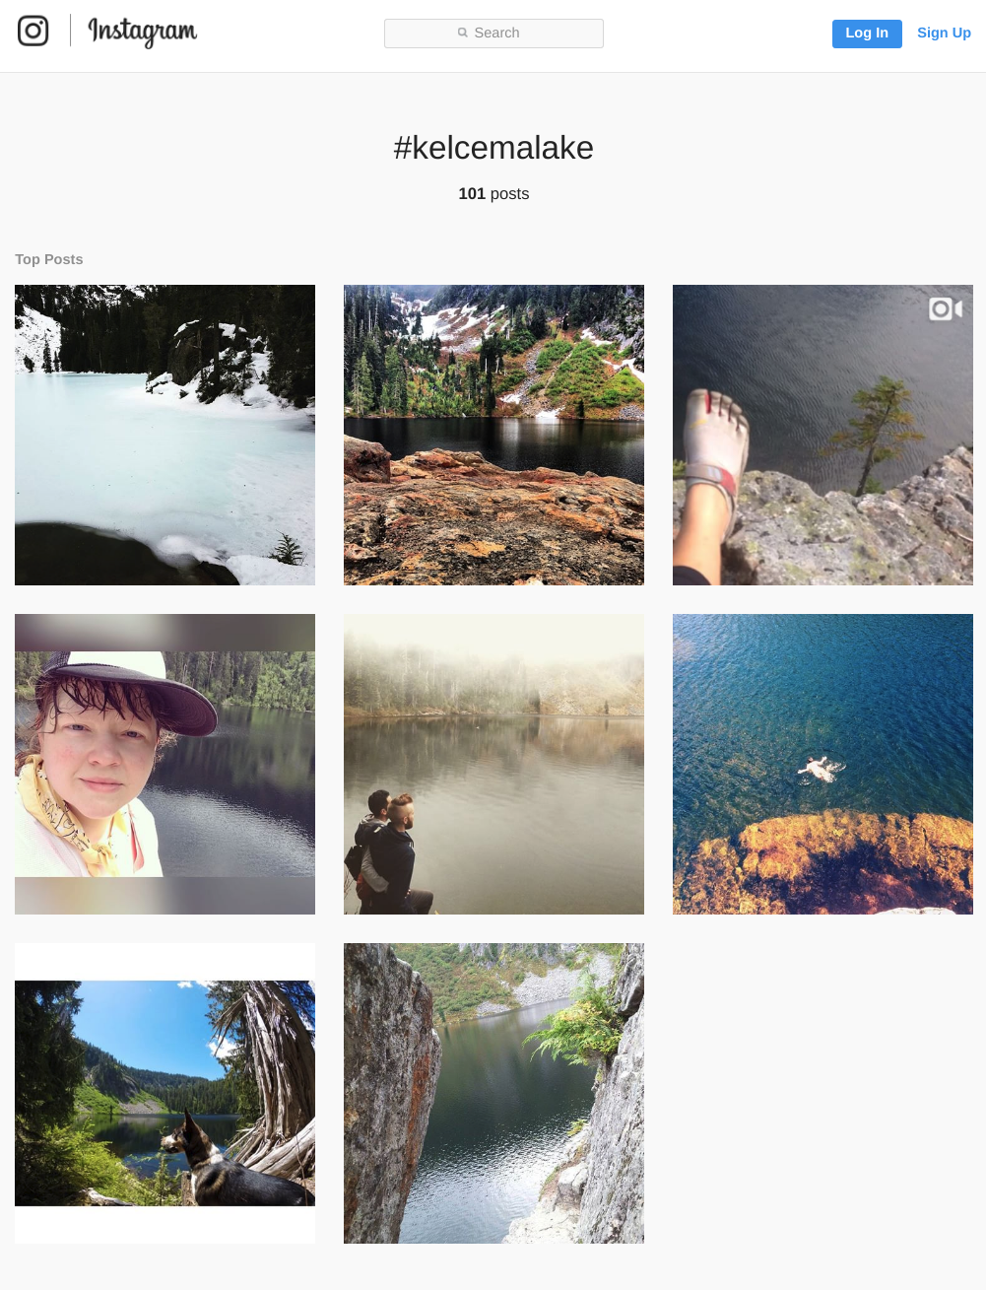
Visitor estimation in Western Washington
On-site Data (16+ trails)
Hiker counts
  Infrared (IR) counters & trail cams
Three seasons (2016-2018)
Social Media Data
Flickr photos (14 yrs)
Twitter posts (6 yrs)
Instagram photos (8 yrs)

Slide 12
Visitor estimation in Western Washington
On-site Data (16+ trails)
Hiker counts
  Infrared (IR) counters & trail cams
Three seasons (2016-2018)
Social Media Data
Flickr photos (14 yrs)
Twitter posts (6 yrs)
Instagram photos (8 yrs)
Baseline Data
Holidays
Weather (precipitation, smoke, temperature)
Week of year

Slide 13
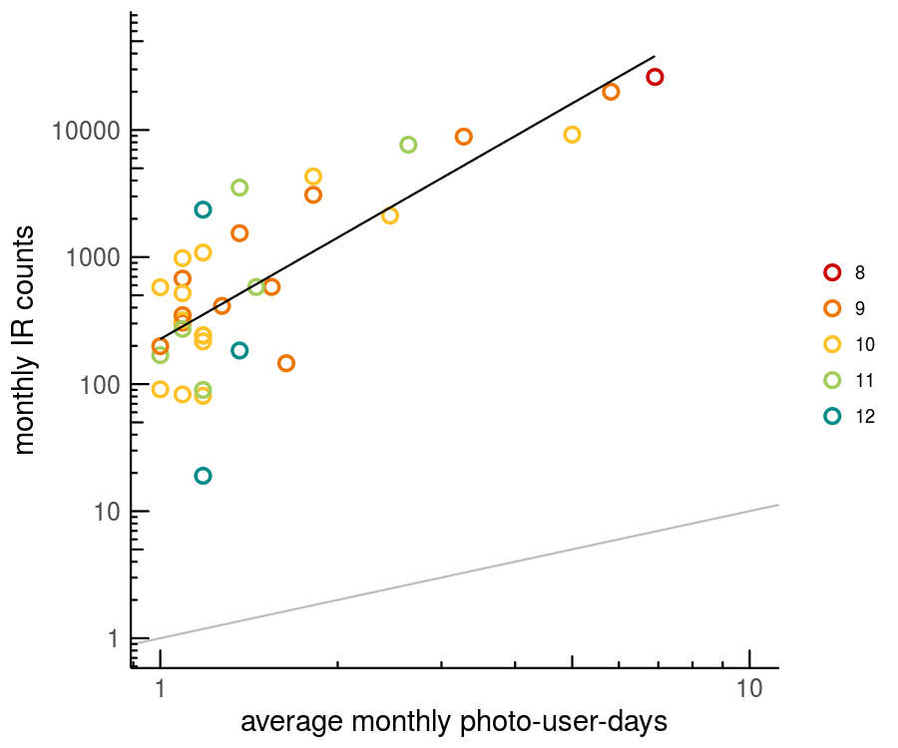
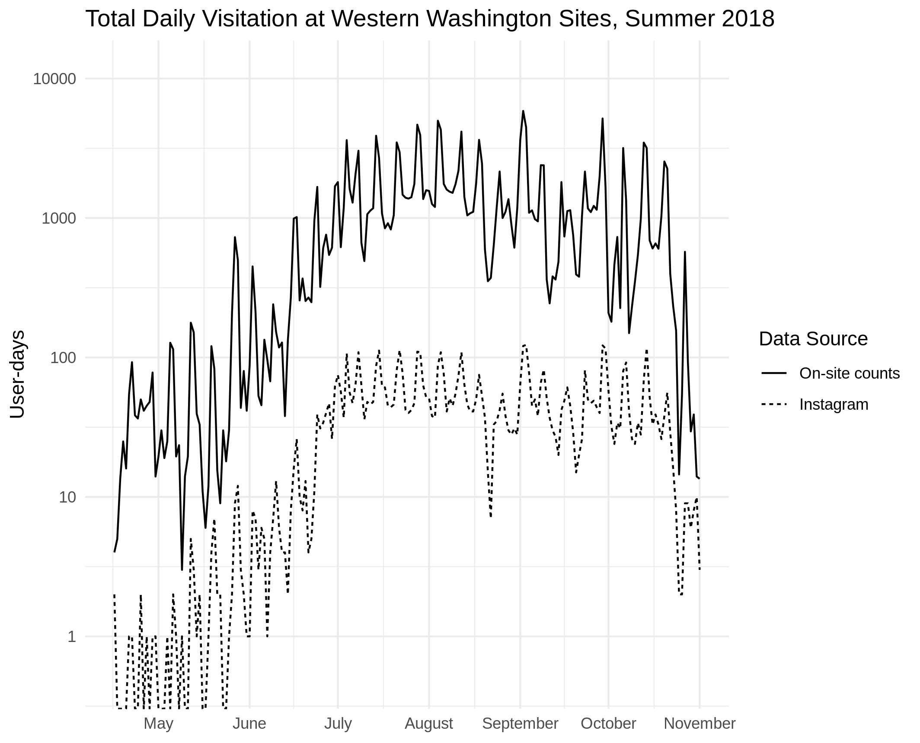
Visitor estimation in Western Washington
On-site Data (16+ trails)
Hiker counts
  Infrared (IR) counters & trail cams
Three seasons (2016-2018)
Social Media Data
Flickr photos (14 yrs)
Twitter posts (6 yrs)
Instagram photos (8 yrs)
Baseline Data
Holidays
Weather (precipitation, smoke, temperature)
Week of year
r = 0.84
Fisher et al. 2018

Slide 14
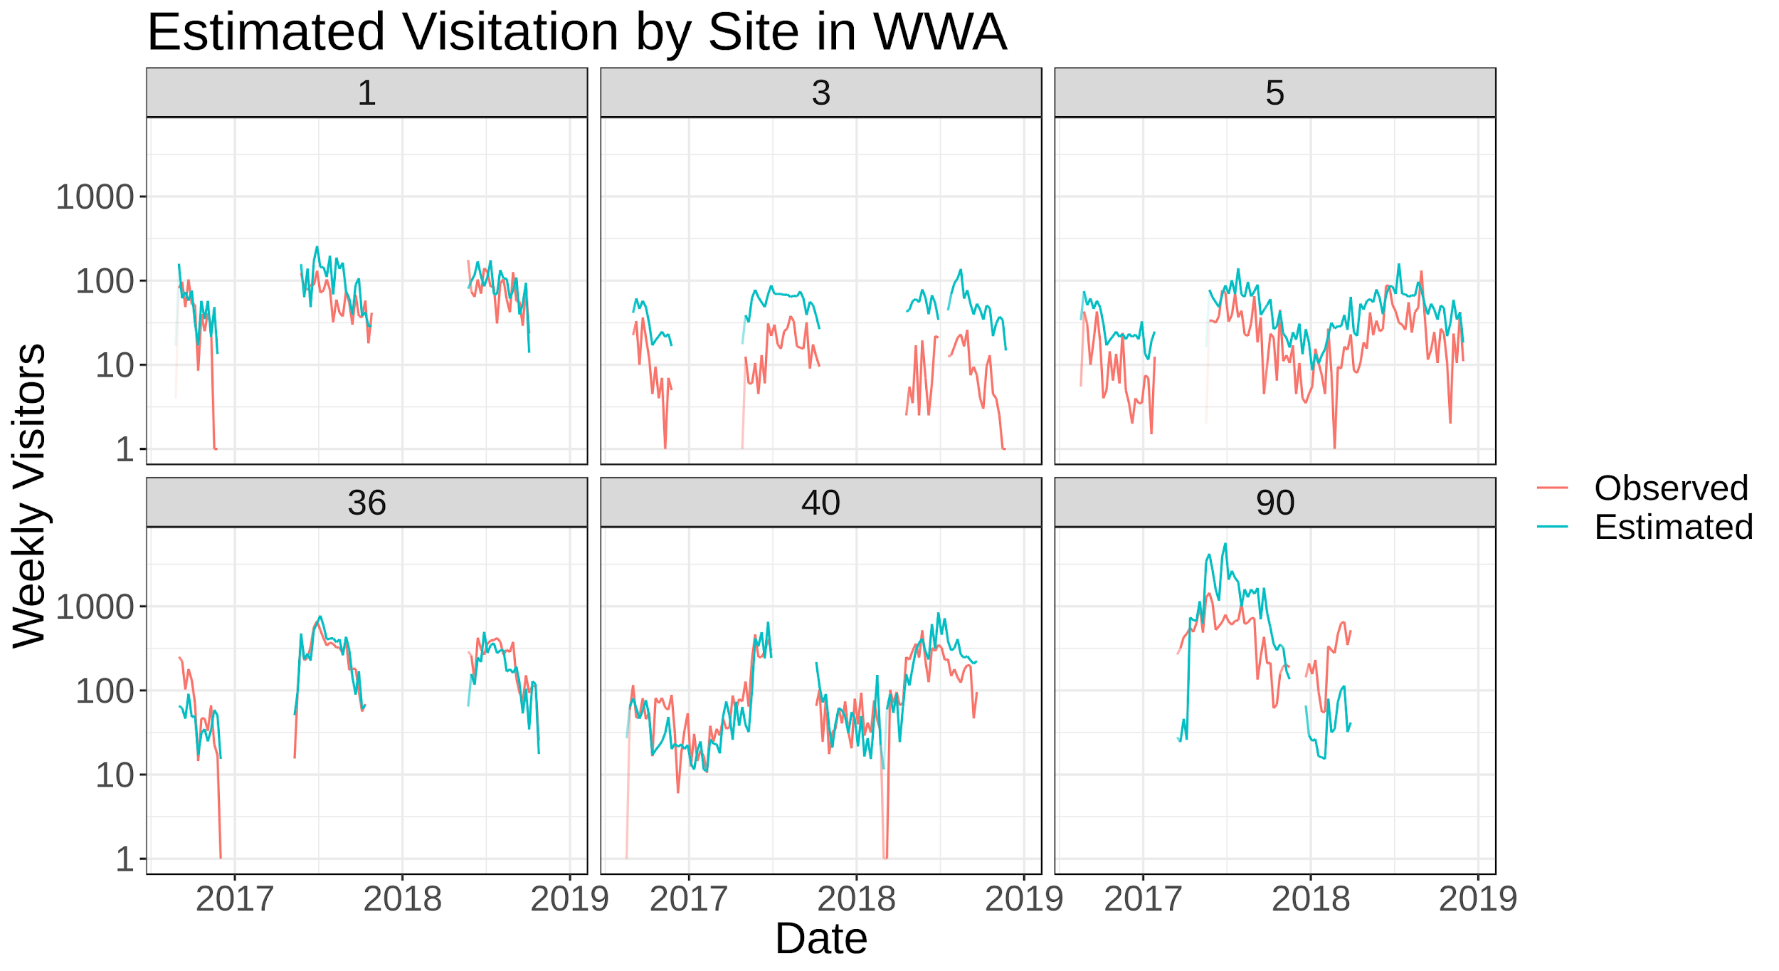
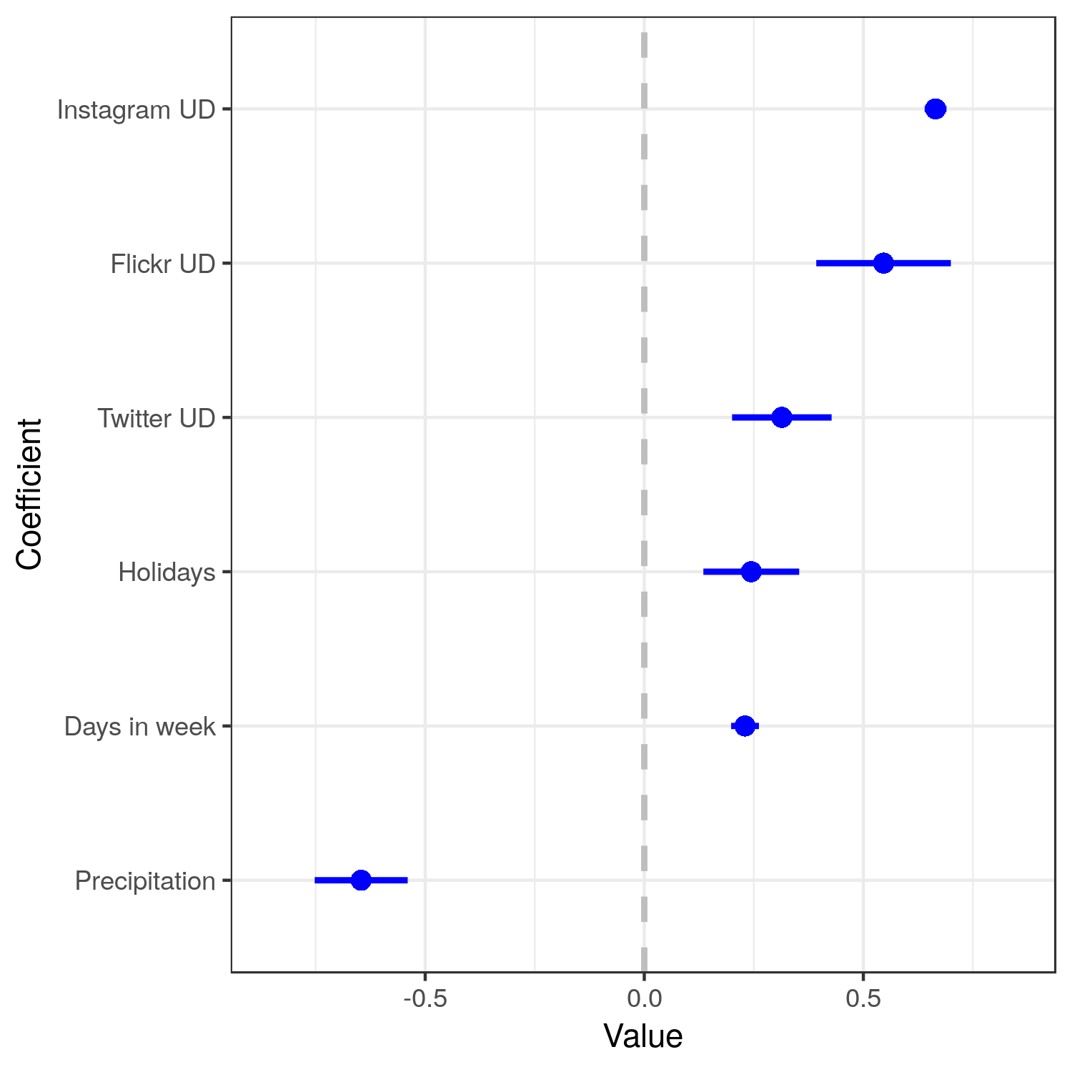
Western Washington Visitation Model
Linear model (Normal errors)
Log(weekly visitors) =
Photo User-Days (Flickr) +
Instagram User-Days +
Twitter User-Days +
Precipitation +
Week of year +
(Week of year)^2 +
Holidays +
Days in week (control)
Adj R² = .58
Neiderprum
Meadow Creek
Dorothy Lake
Snoqualmie Lake

Slide 15
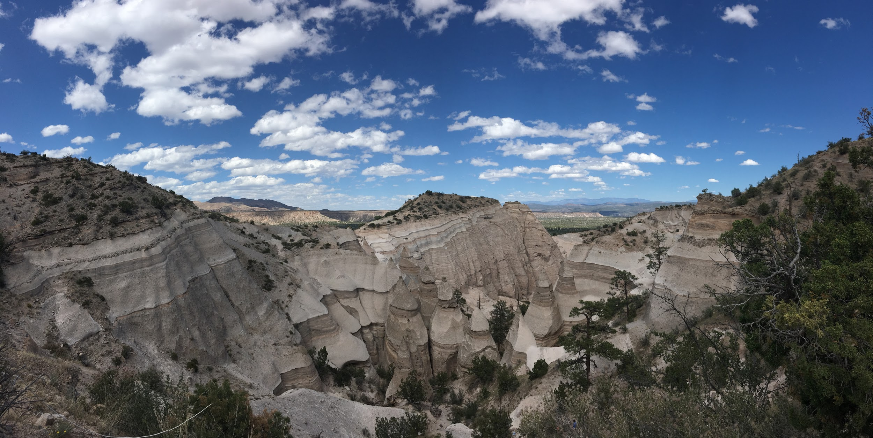
Are the relationships between social media and outdoor visitation the same in an entirely different place?
Notes:
Collected on-site data at 13 sites in Northern New Mexico (summer, 2018)
Used our Washington model to predict weekly visitation at those sites
Compared our estimates to what we observed

Slide 16
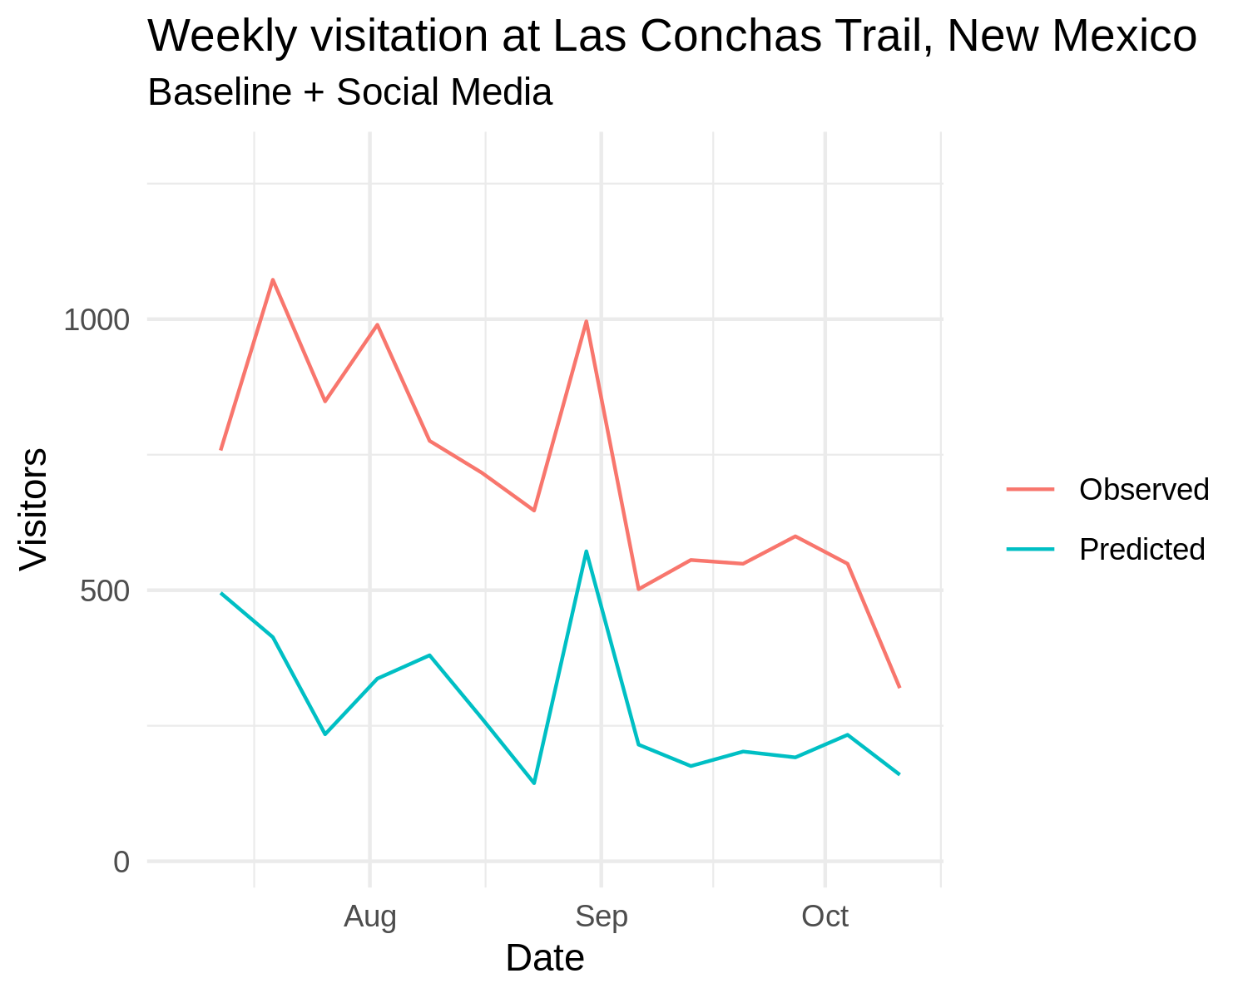
Estimating visitation in Northern New Mexico
Without any on-the-ground data collection in NNM, our model captured 41% of the variability in visitation!
r = .62 (Correlation between out-of-sample predicted visitation and observed visitation = .62)
Notes:
Our model did well, resulting in a 60% correlation between observed and predicted weekly visitation! As you can see, the relationship was stronger at higher visitation sites, likely because there were more social media posts to these areas. However, the model defaulted to average visitation, overestimating the number of visitors to many low visitation sites, and underestimating the number of visitors to higher visitation sites.

Slide 17
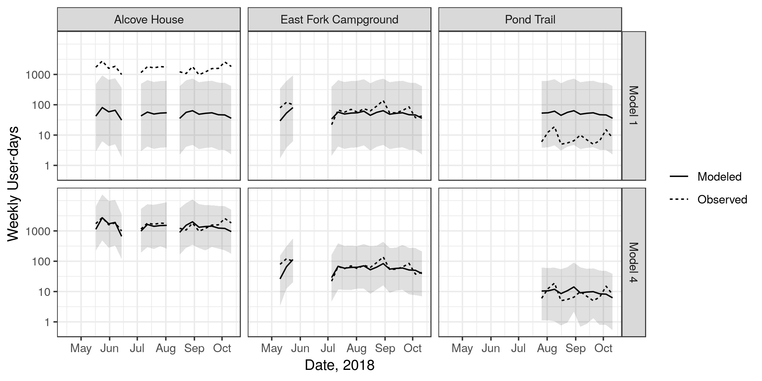
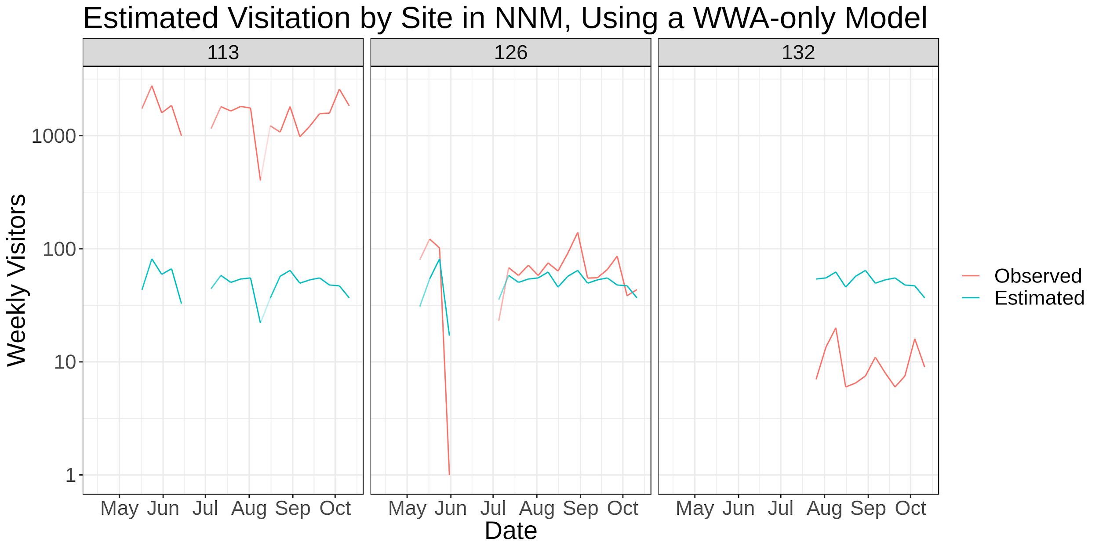
Visitation at 3 sites in New Mexico
Model estimates from a model based on Washington data only
Weekly User-days
Notes:
Replace with only 3 sites (high, med, low viz)
Site 113 = Alcove House (very high), 126 = East Fork Campground (medium), 132 = Pond Trail (Very high)

Slide 18
What if we have some Northern NM on-site counts?
Reparameterized the model
Using 80 weeks of on-site counts across NNM sites, in addition to the WWA data
Added a “region” factor
Added a site-level random effect - Now a Linear Mixed Model
Estimated visitation for 160 out-of-sample weeks across NNM sites
Calculated correlation between observed and estimated visitation
Notes:
Script random effects bullet a little more
Be sure to talk about ramifications of the random effect addition
Allows magnitude of visitation to vary by site
Repeated 200 times

Slide 19
(Manuscript in preparation)

Slide 20
Implications for Visitor Estimation
Encouragement
Visitation is predictably related to baseline conditions and social media
Relationships are broadly similar in two very different regions
Multiple data sources are most powerful
Complementing traditional approaches
Precautions
Issues of representation
Ethics, privacy, and access to data
Within-region diffs in social media use
Notes:
When and where to use social media in visitation estimation?
If you have no on-site count data for a site or location.
At a site with particularly high visitation or shifting popularity trends (on social media platforms)
Social media data can be incorporated into visitation model with informative value
It provides information about visitation from a slightly different view point
However, there is great value in using this method with with other traditional visitor count methods

Slide 21
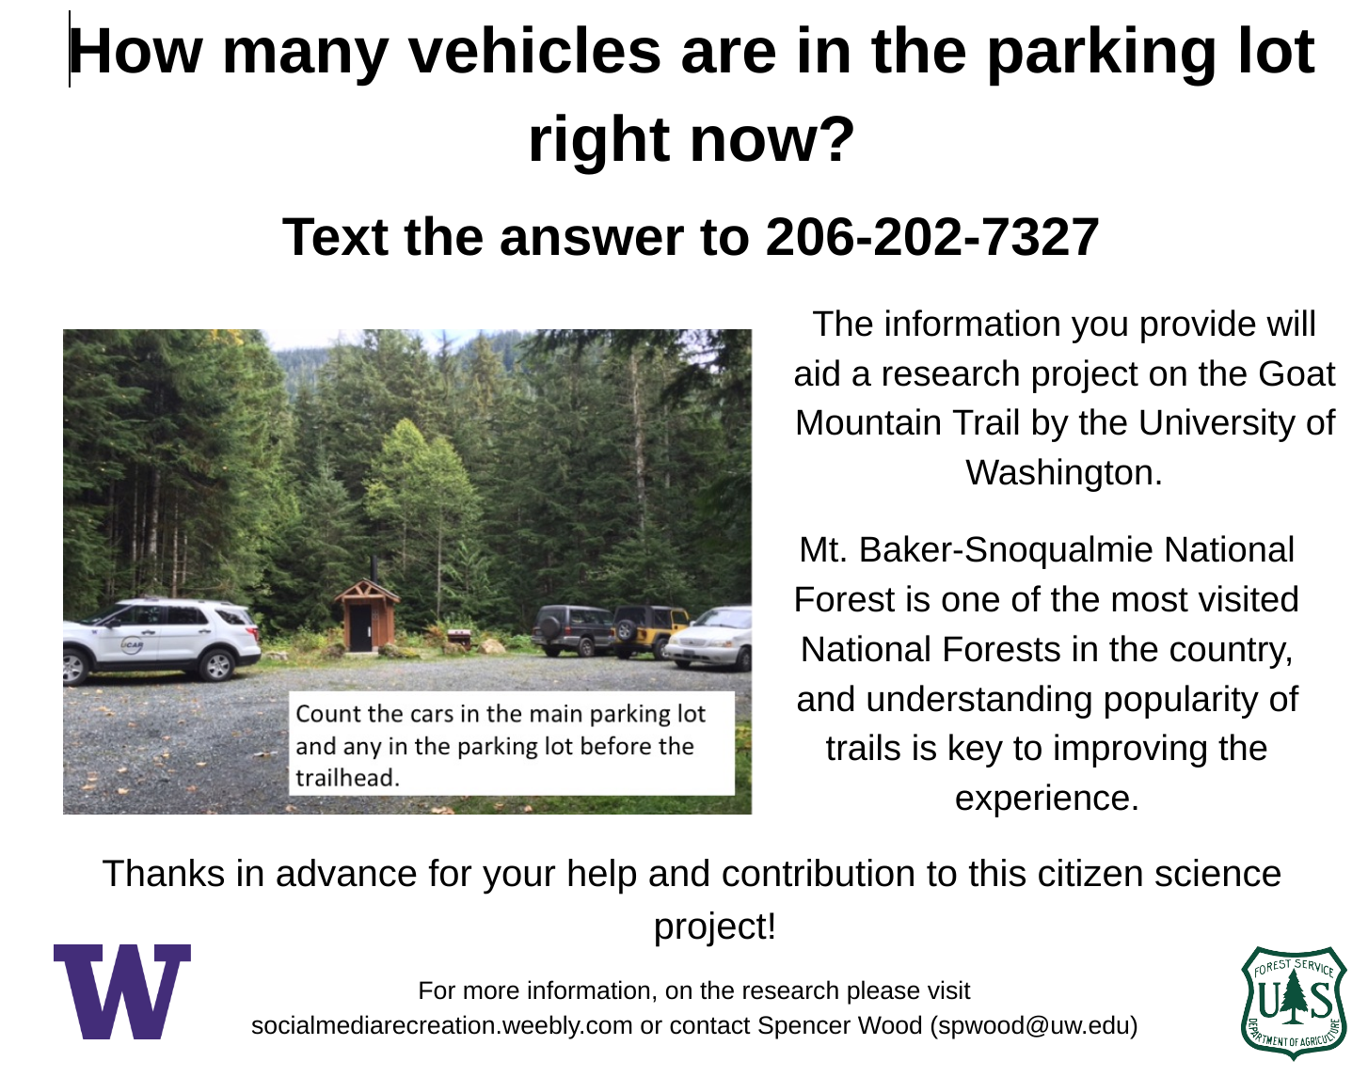
Current Work - On-site data
Crowd-sourced parking lot counts
Deploying SMS-based chatbot at trailheads
Adds on-site data from new trails!
We use information about length of stays across the forest to estimate daily visitors from instantaneous parking lot counts
Use this information for days or sites where we don’t have on-site IR counts
Allows us to fit random intercepts at more sites
Notes:
Parking lot counts (crowdsourced via SMS messages)
Much easier/cheaper to collect
Using average trip length data for entire forest, we can go from instantaneous parking lot counts to an estimate of daily visitors
Daily Visitation = On-site counts OR Estimates from parking lot counts
Allows us to fit random intercepts at more sites

Slide 22
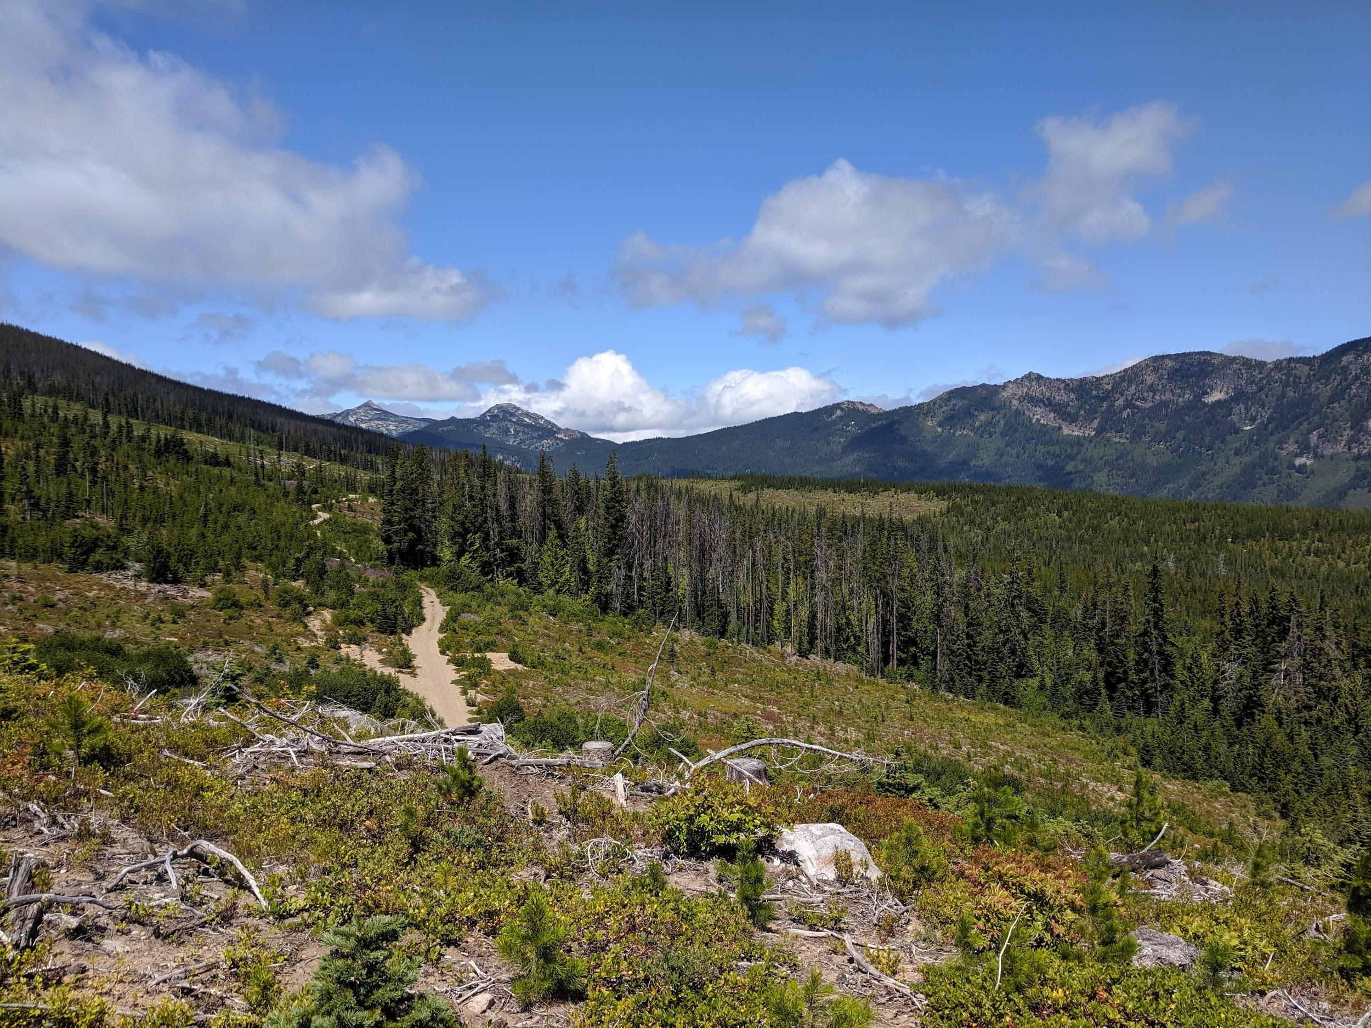
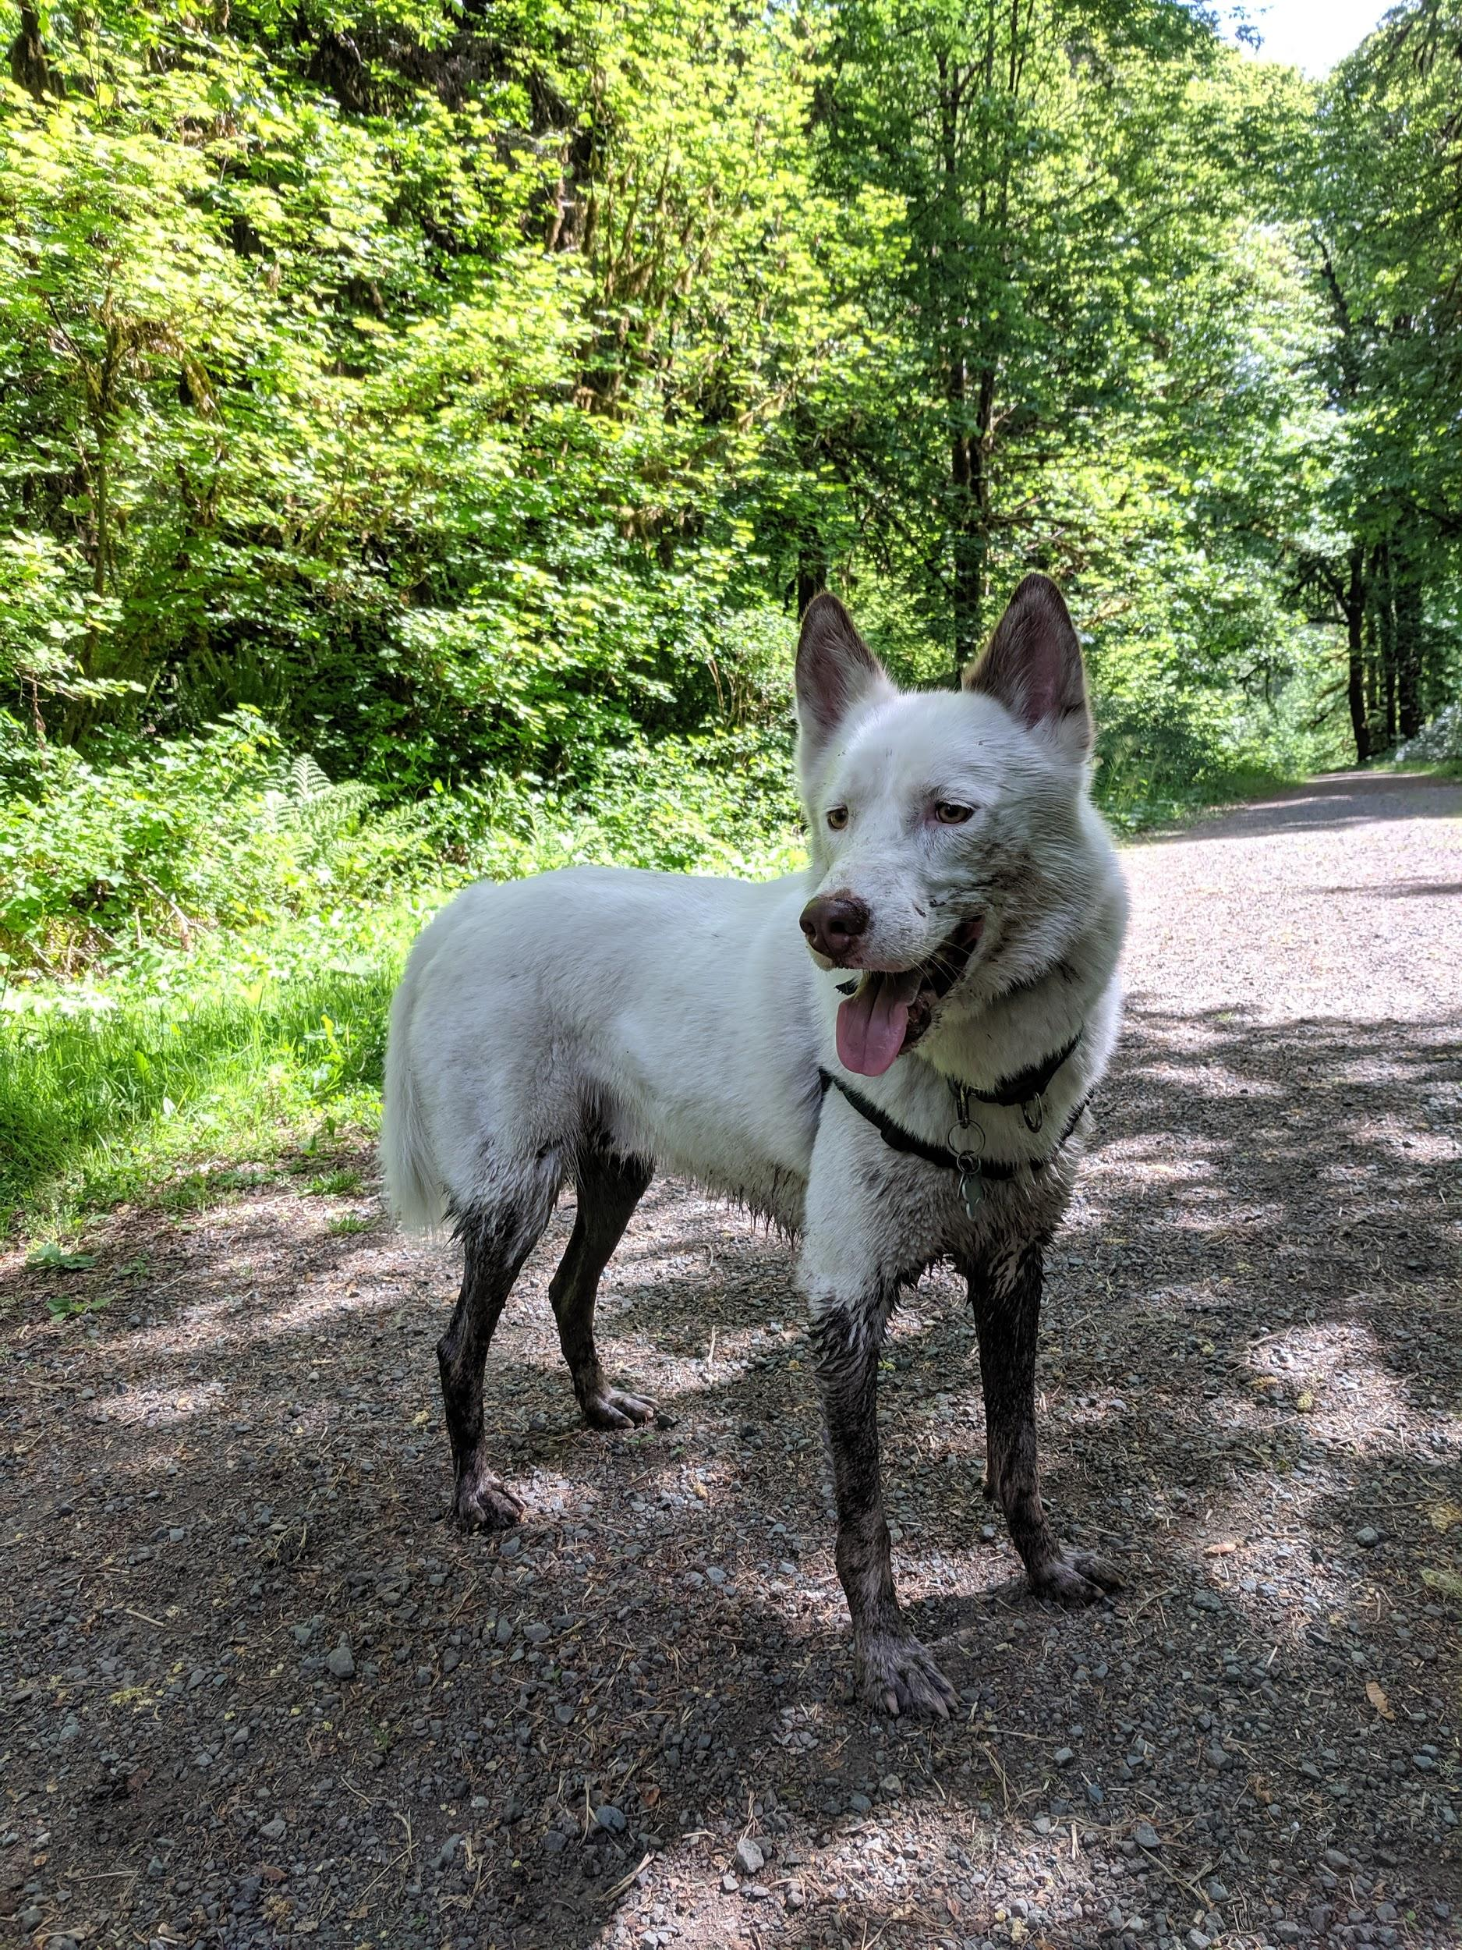
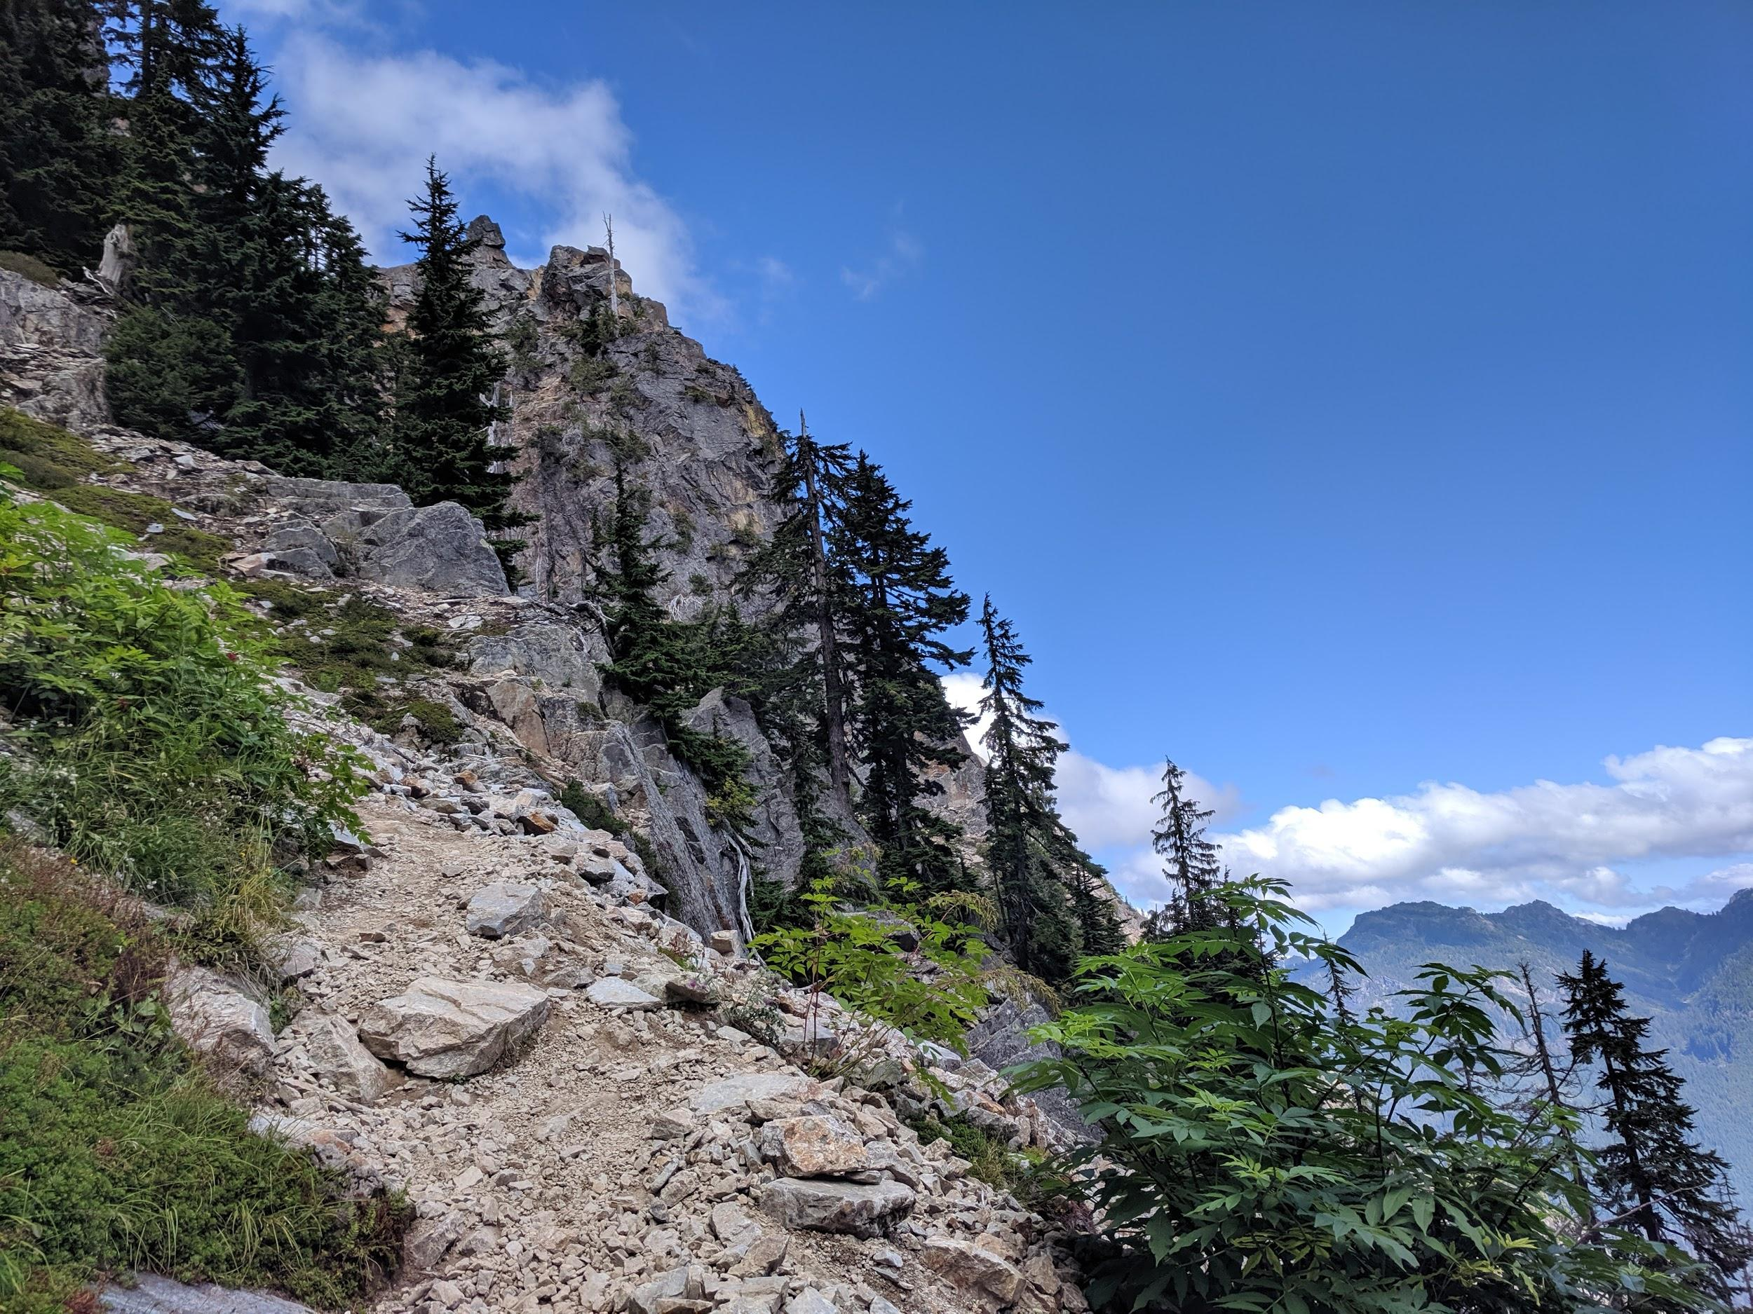
Current Work - Predictors
Adding WTA trip reports
Adding Site-level Characteristics
Estimated use level (expert knowledge)
Length of trail
Elevation gained
Scenic views
Dog friendly
etc.
Notes:
In an attempt to depend less on the random effects

Slide 23
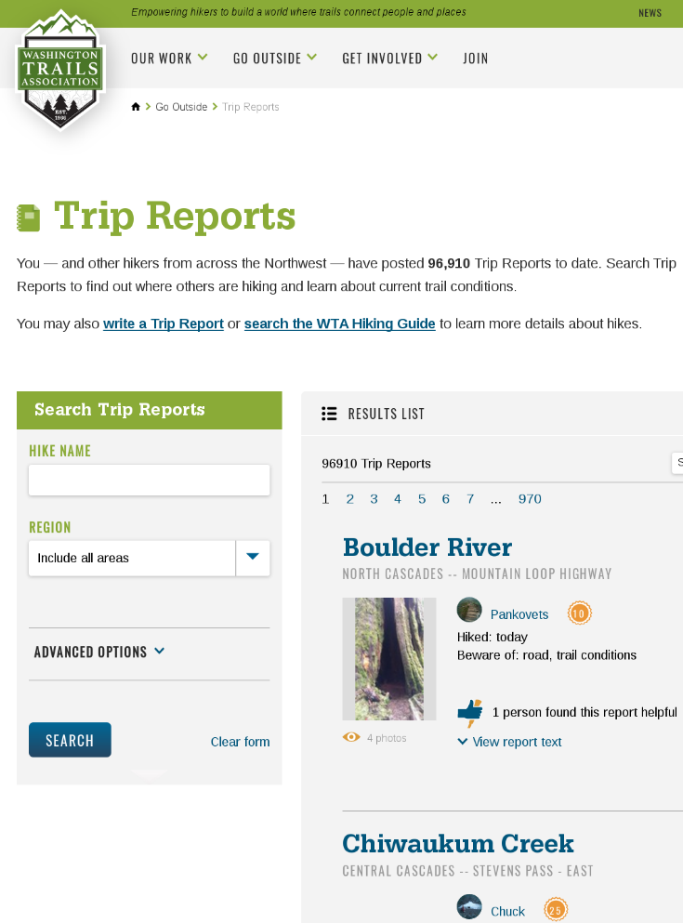
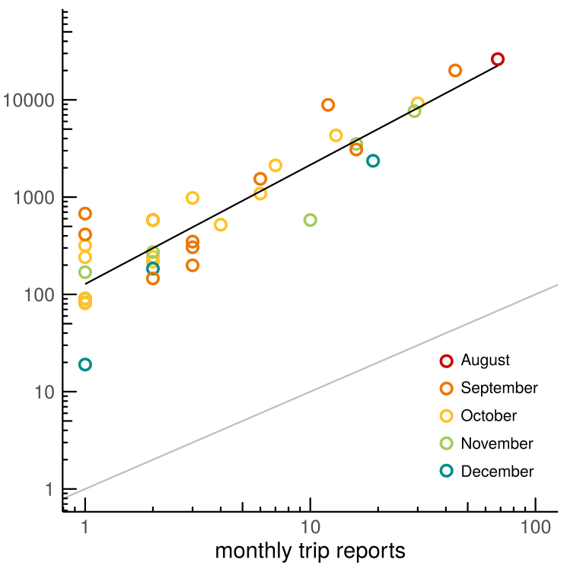
Current work - New Model
Log(weekly visitors) =
Photo User-Days (Flickr) +
Instagram User-Days +
Twitter User-Days +
WTA User-Days +
Precipitation +
Week of year +
(Week of year ) ^2 +
Holidays +
Use level +
(1 | siteid)
( Fisher et al 2018 J Env Man )
Notes:
Washington Trails Association (WTA) - Trip Reports
Site-level characteristics (estimated use-level for now)

Slide 24
Preliminary Results - Predictive power at new sites
Randomly dropped 5 of 45 sites to fit model
Predicted weekly visitation at those 5 out-of-sample sites
Calculated correlation between the predicted and observed weekly visitation
Repeated 400 times
 | Old model (no WTA or use-level) | New model (with WTA & use-levels)
Mean correlation (r) | 0.66 | 0.75
Coef of determination (r²) | 0.44 | 0.57

Slide 25
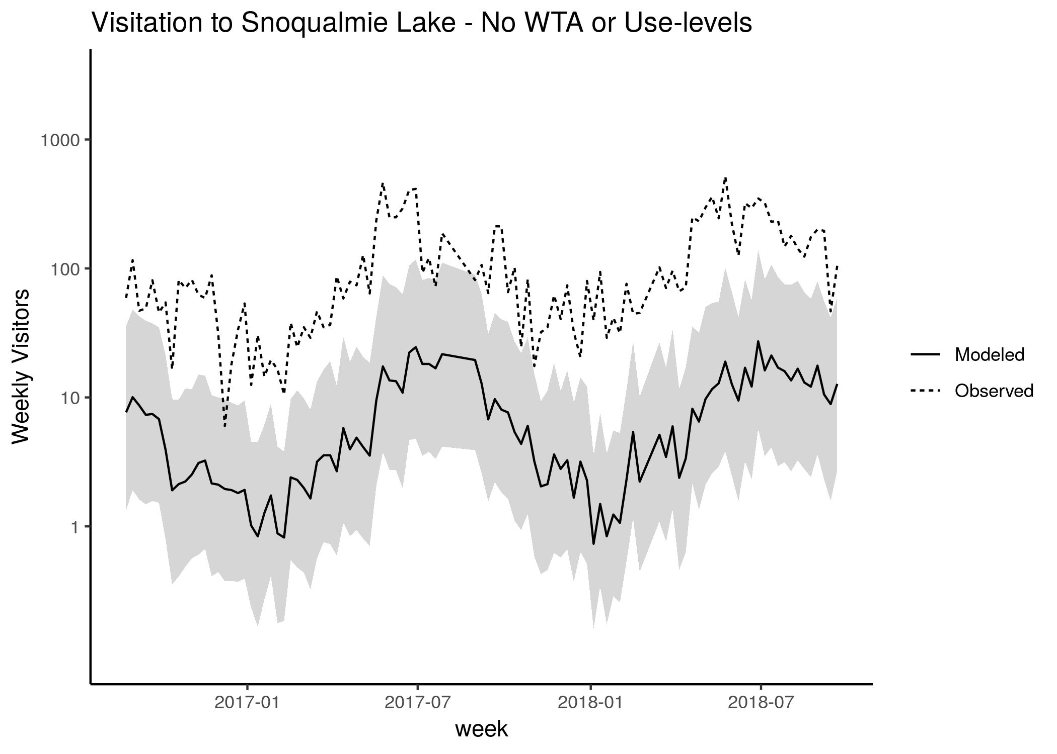
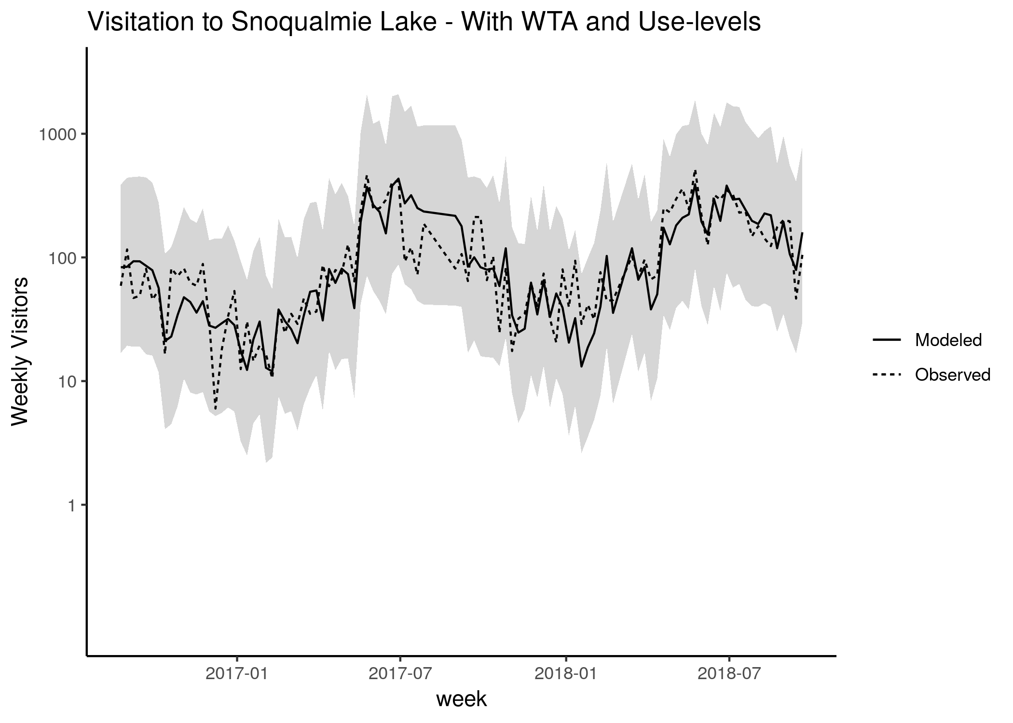
Estimated visitation at an out-of-sample site

Slide 26
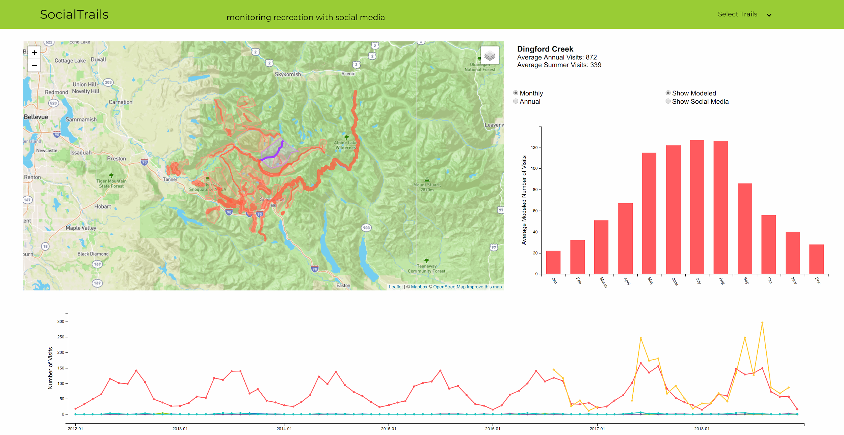
Current work - Data Visualization

Slide 27
Conclusions
Visitation patterns (at fine spatial and temporal scales) can be explained by social media posts & baseline conditions
Broadly similar across regions
High site-to-site variability
Adding additional site-level attributes (which visitors may have various preferences towards) will likely continue to improve the models
These models complement traditional methods of data collection

Slide 28
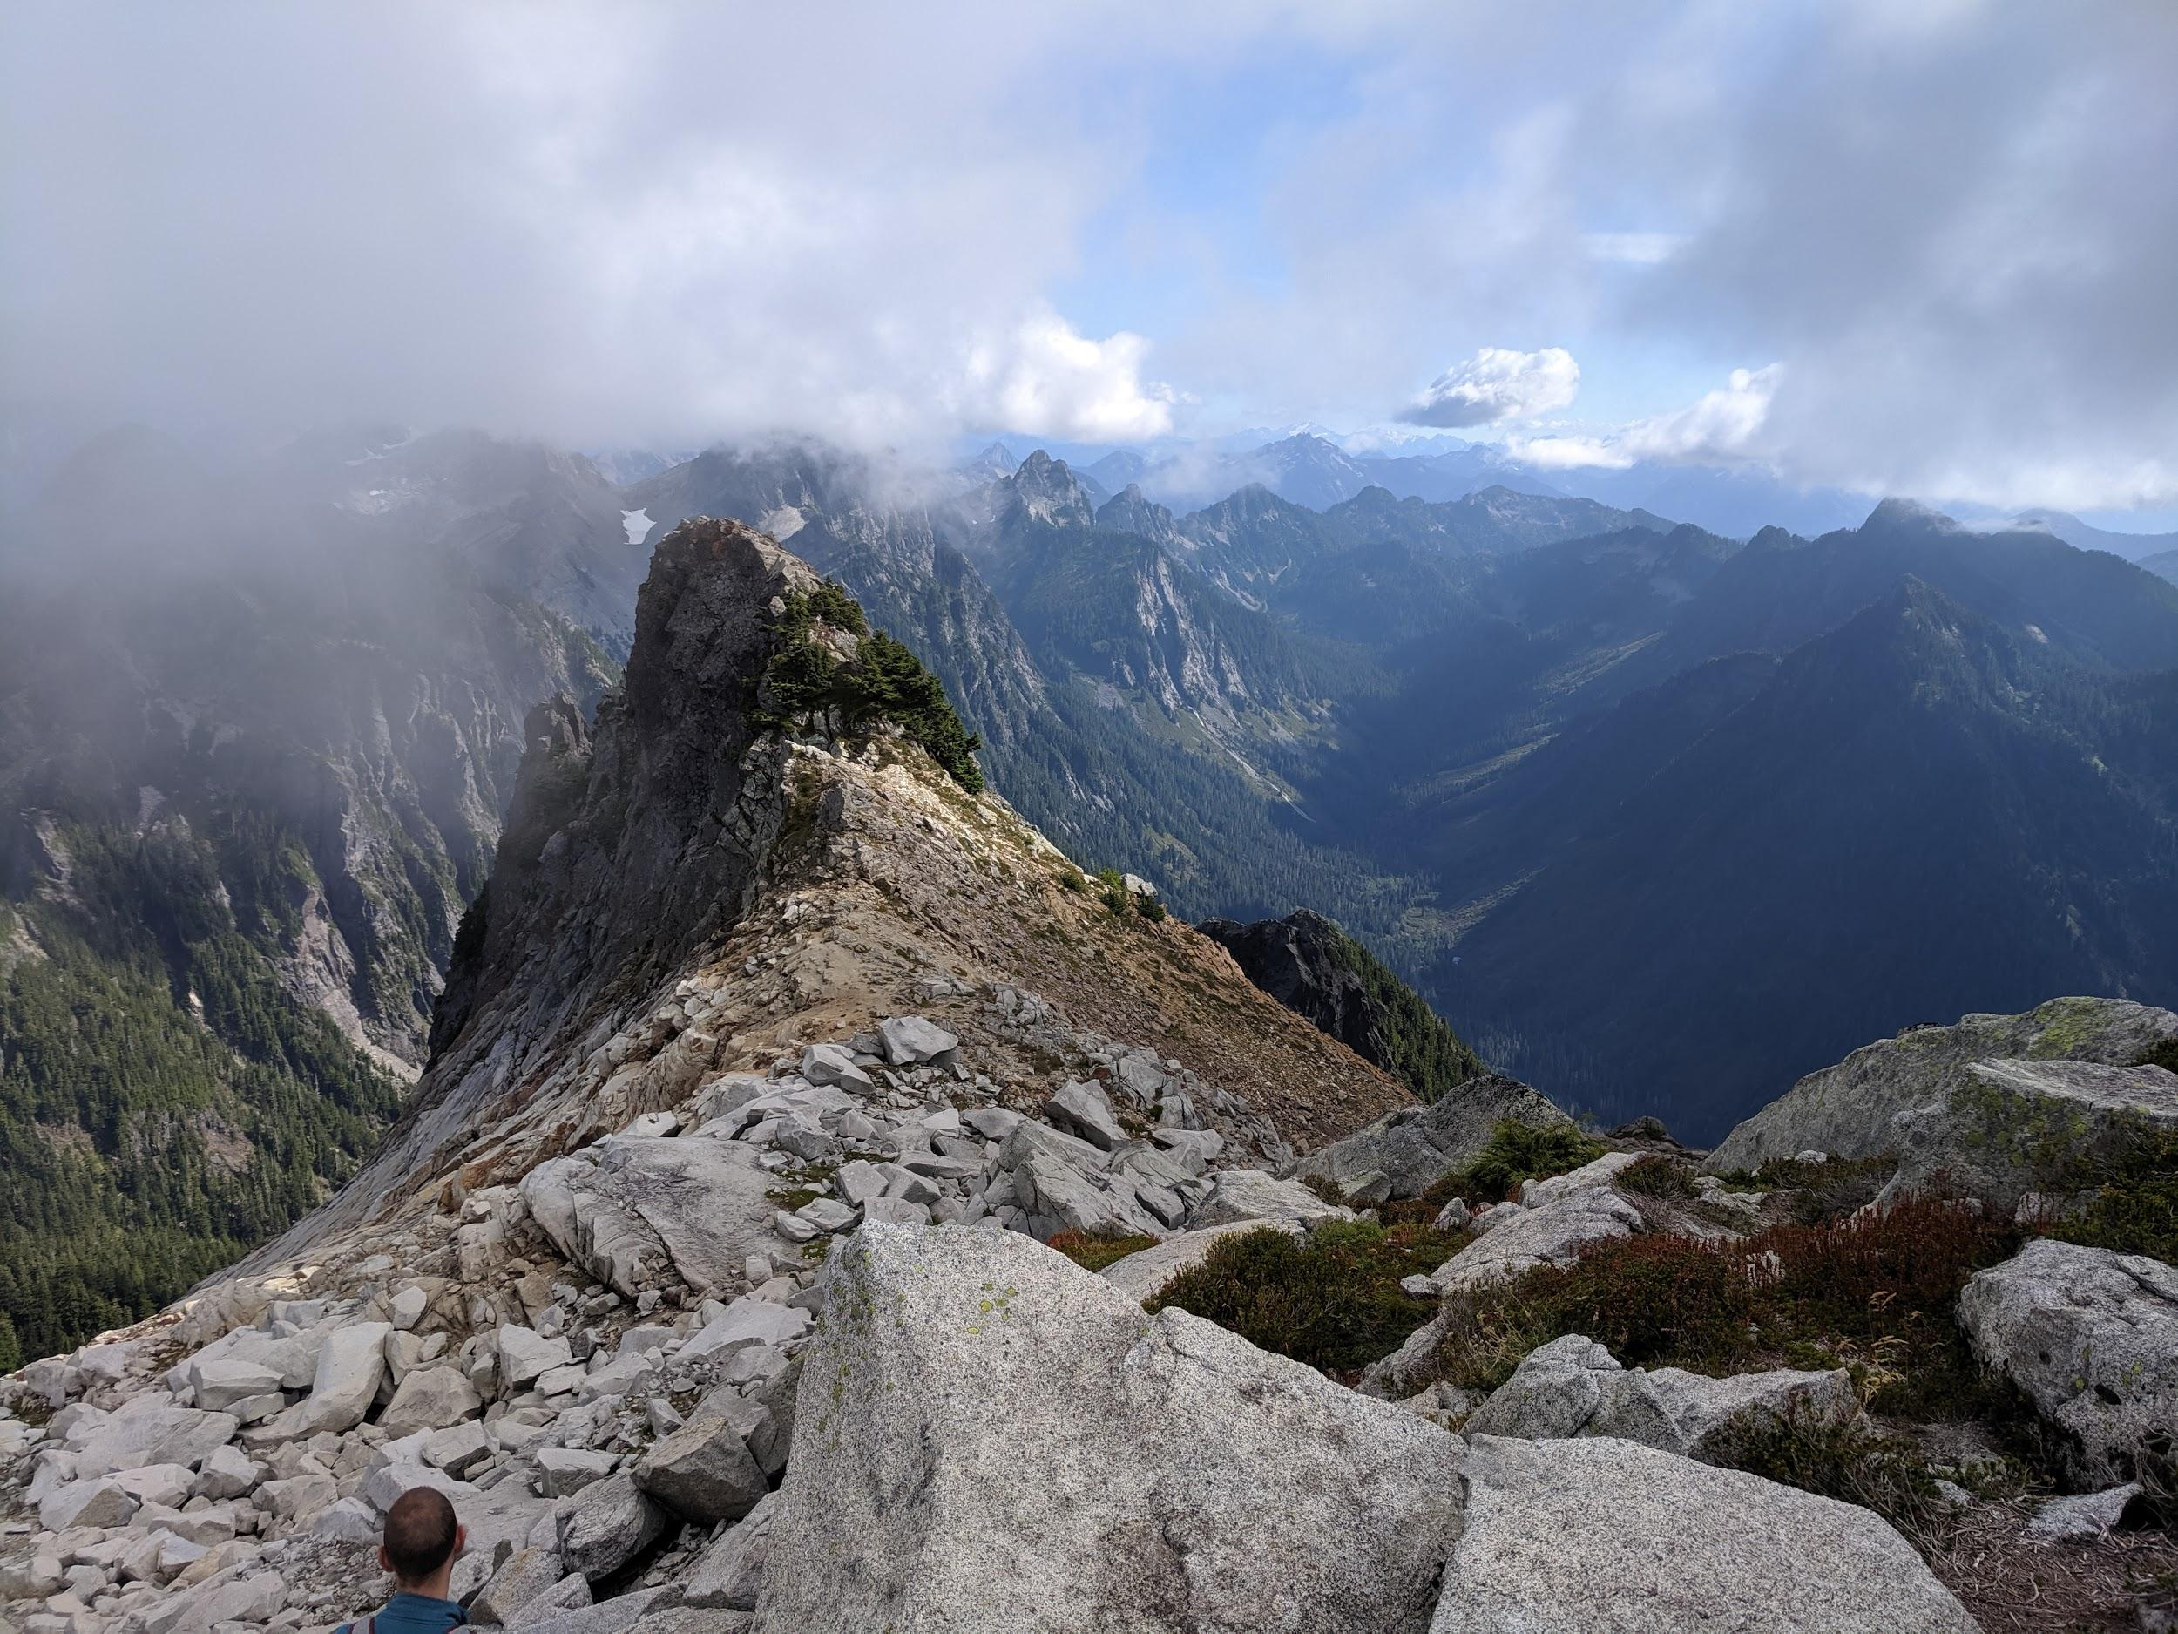
Thank you!
Sama Winder
Outdoor Recreation & Data Lab
University of Washington
sgwinder@uw.edu

Slide 29
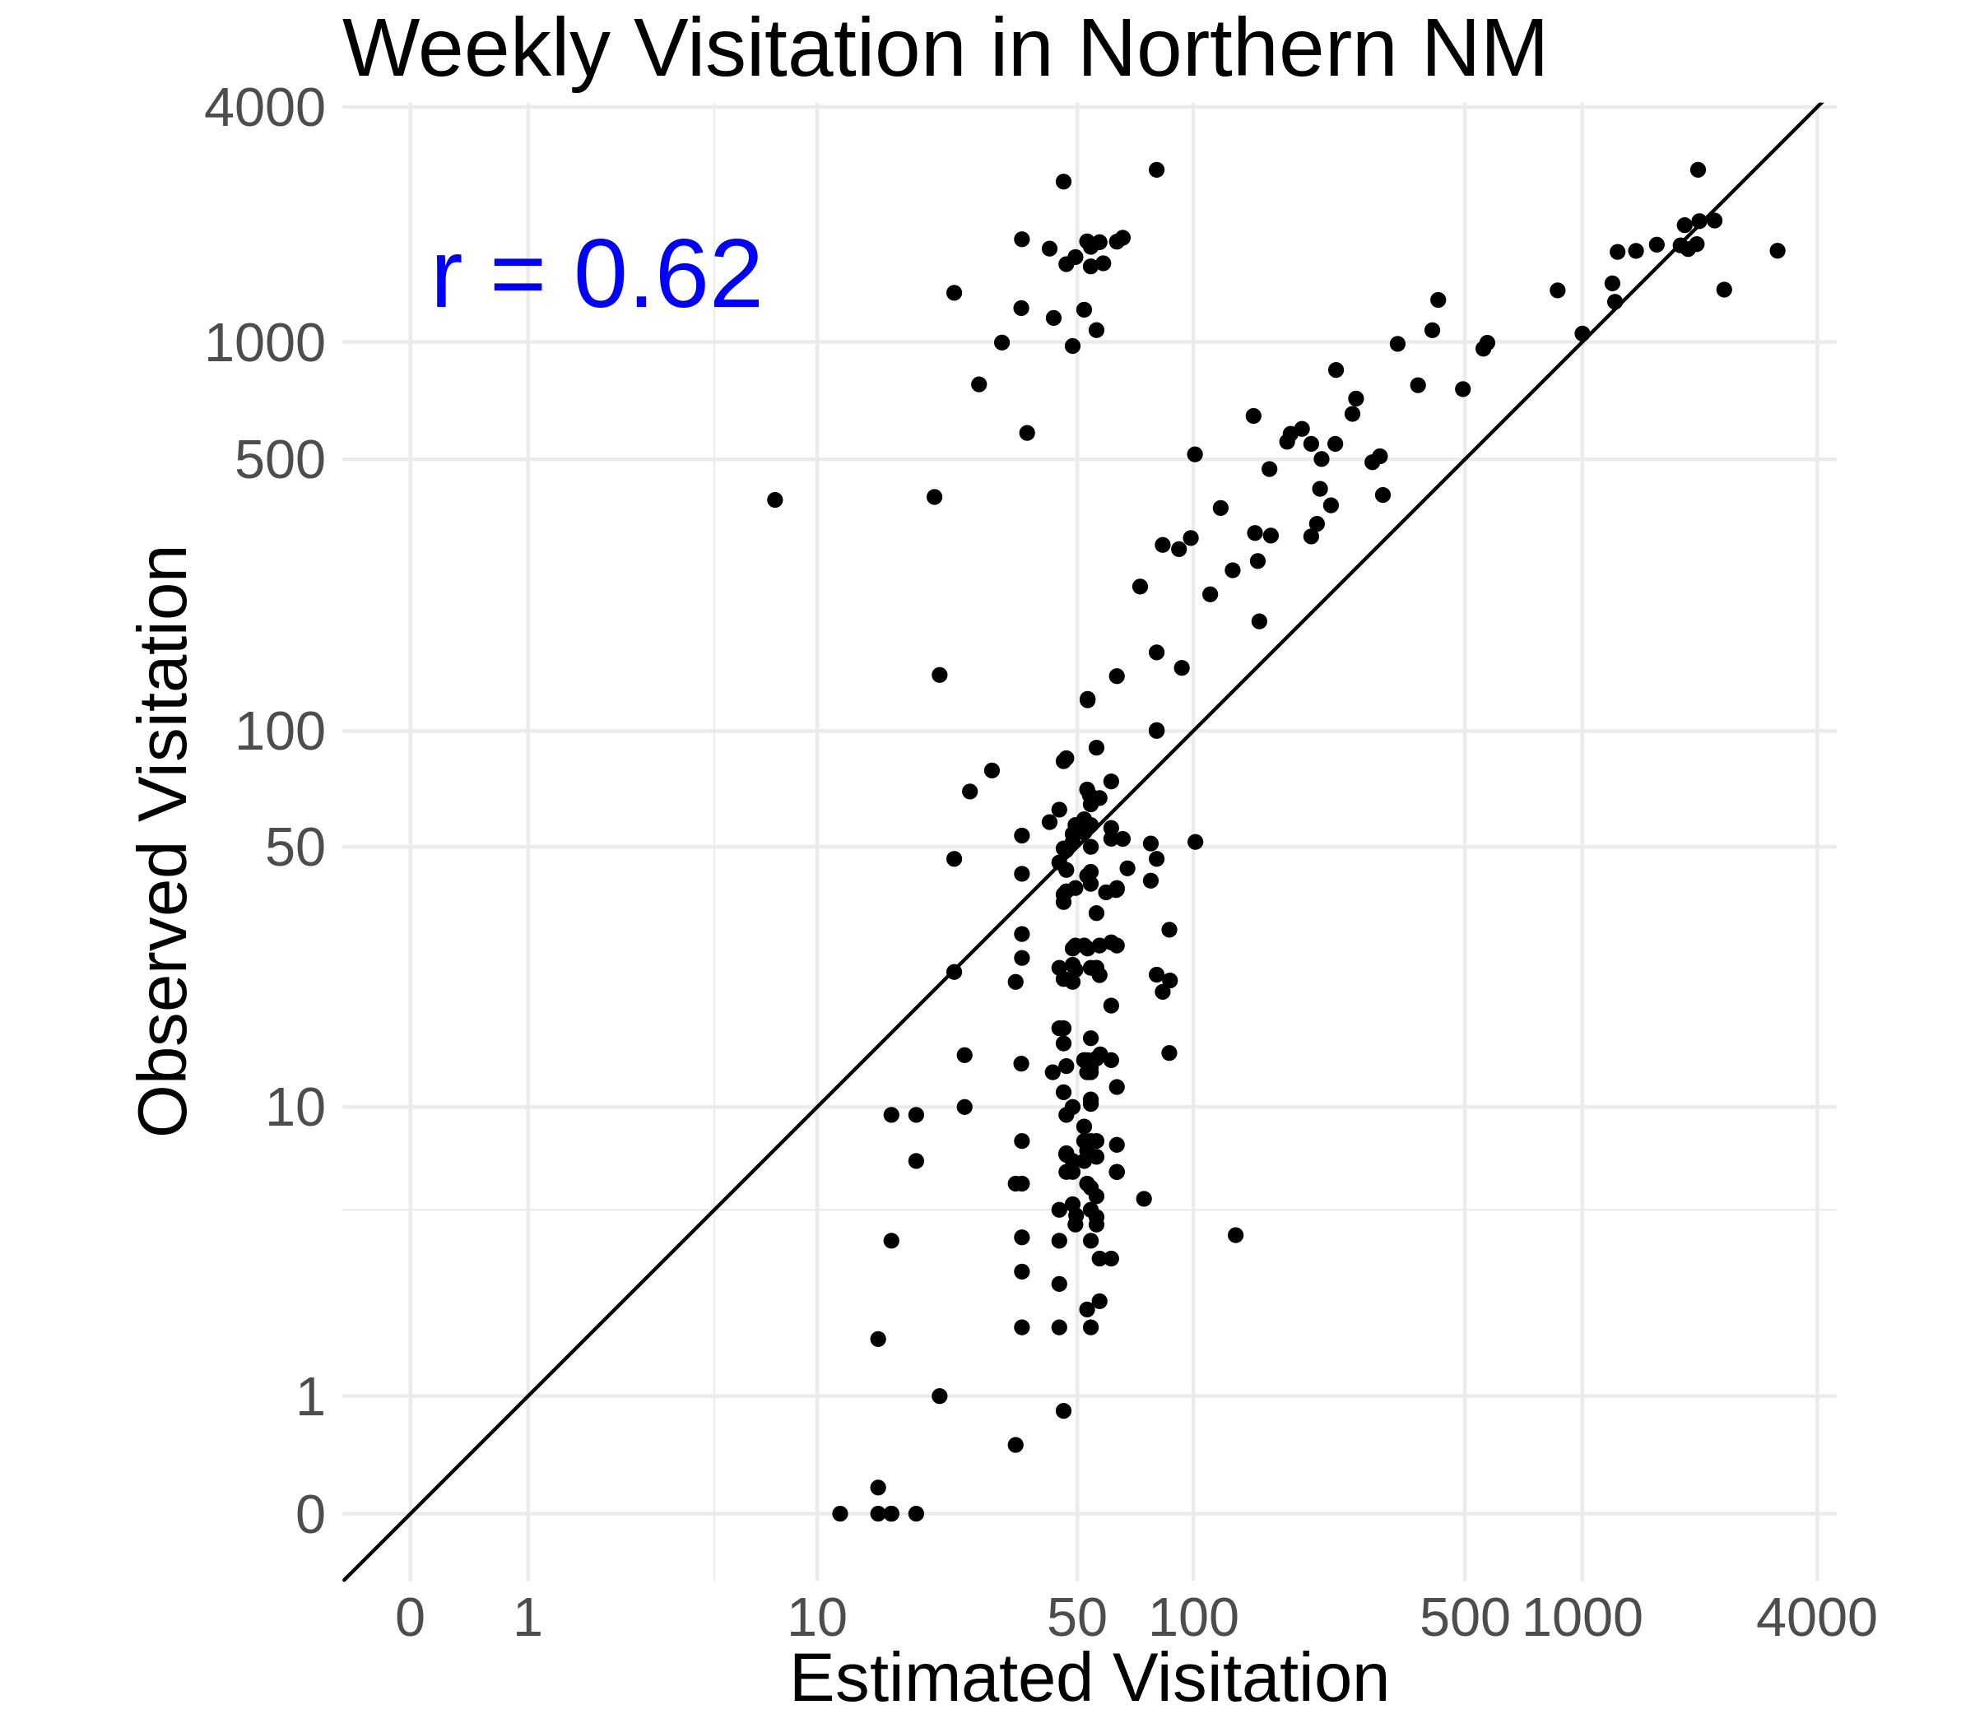
But issues remain...

Slide 30
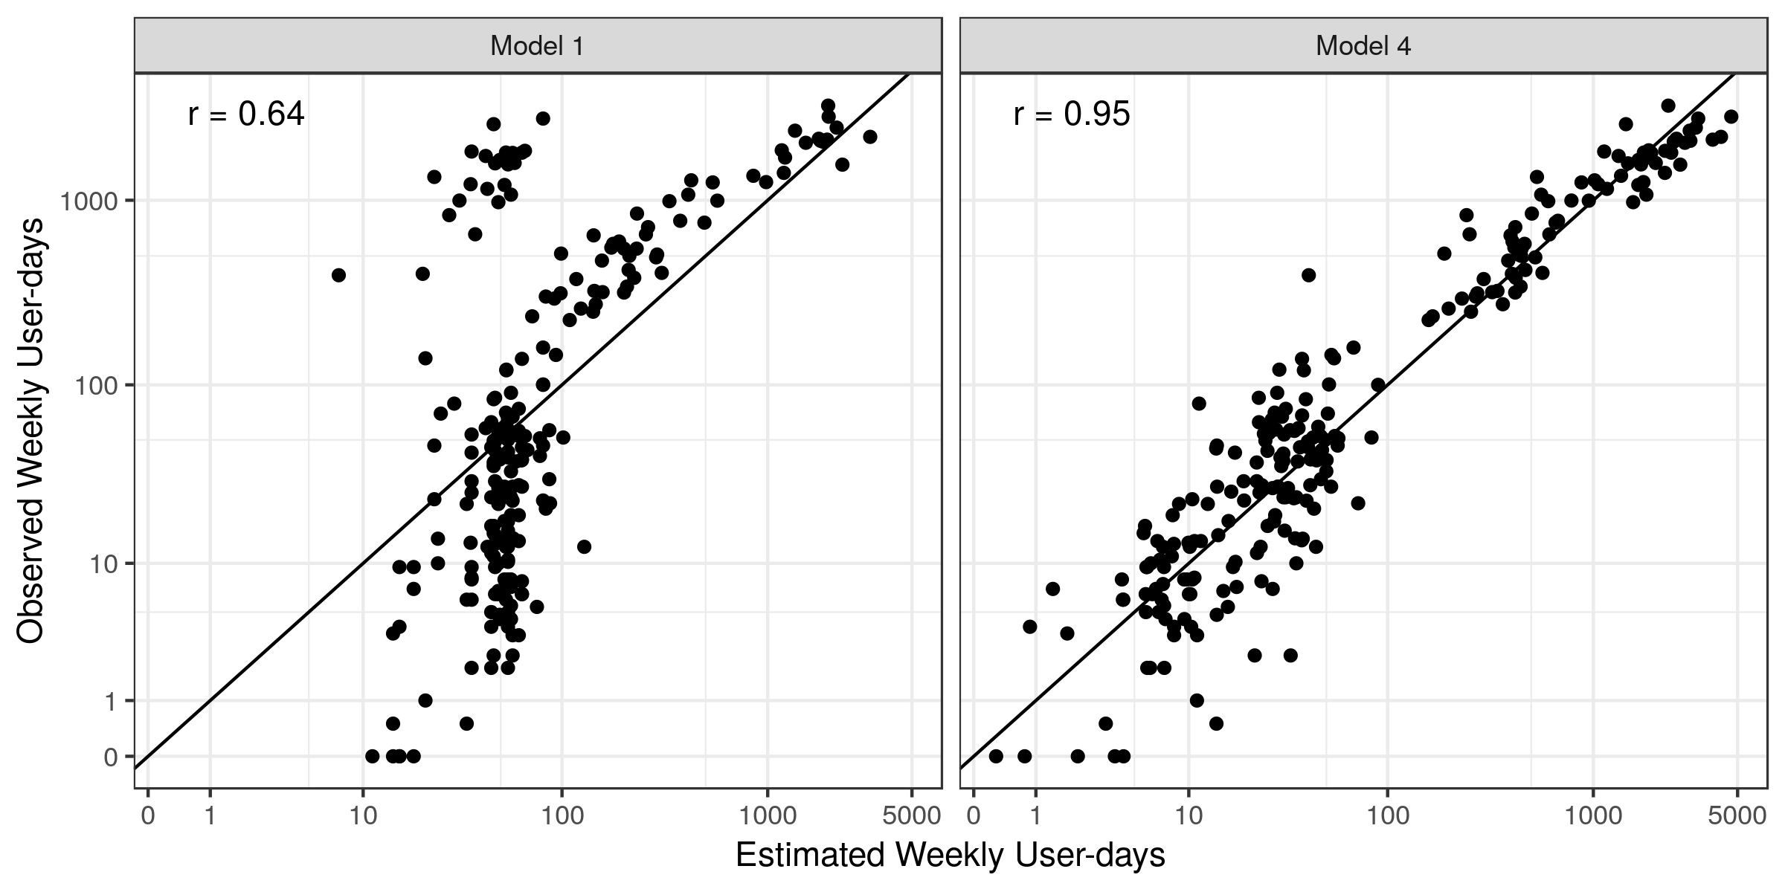
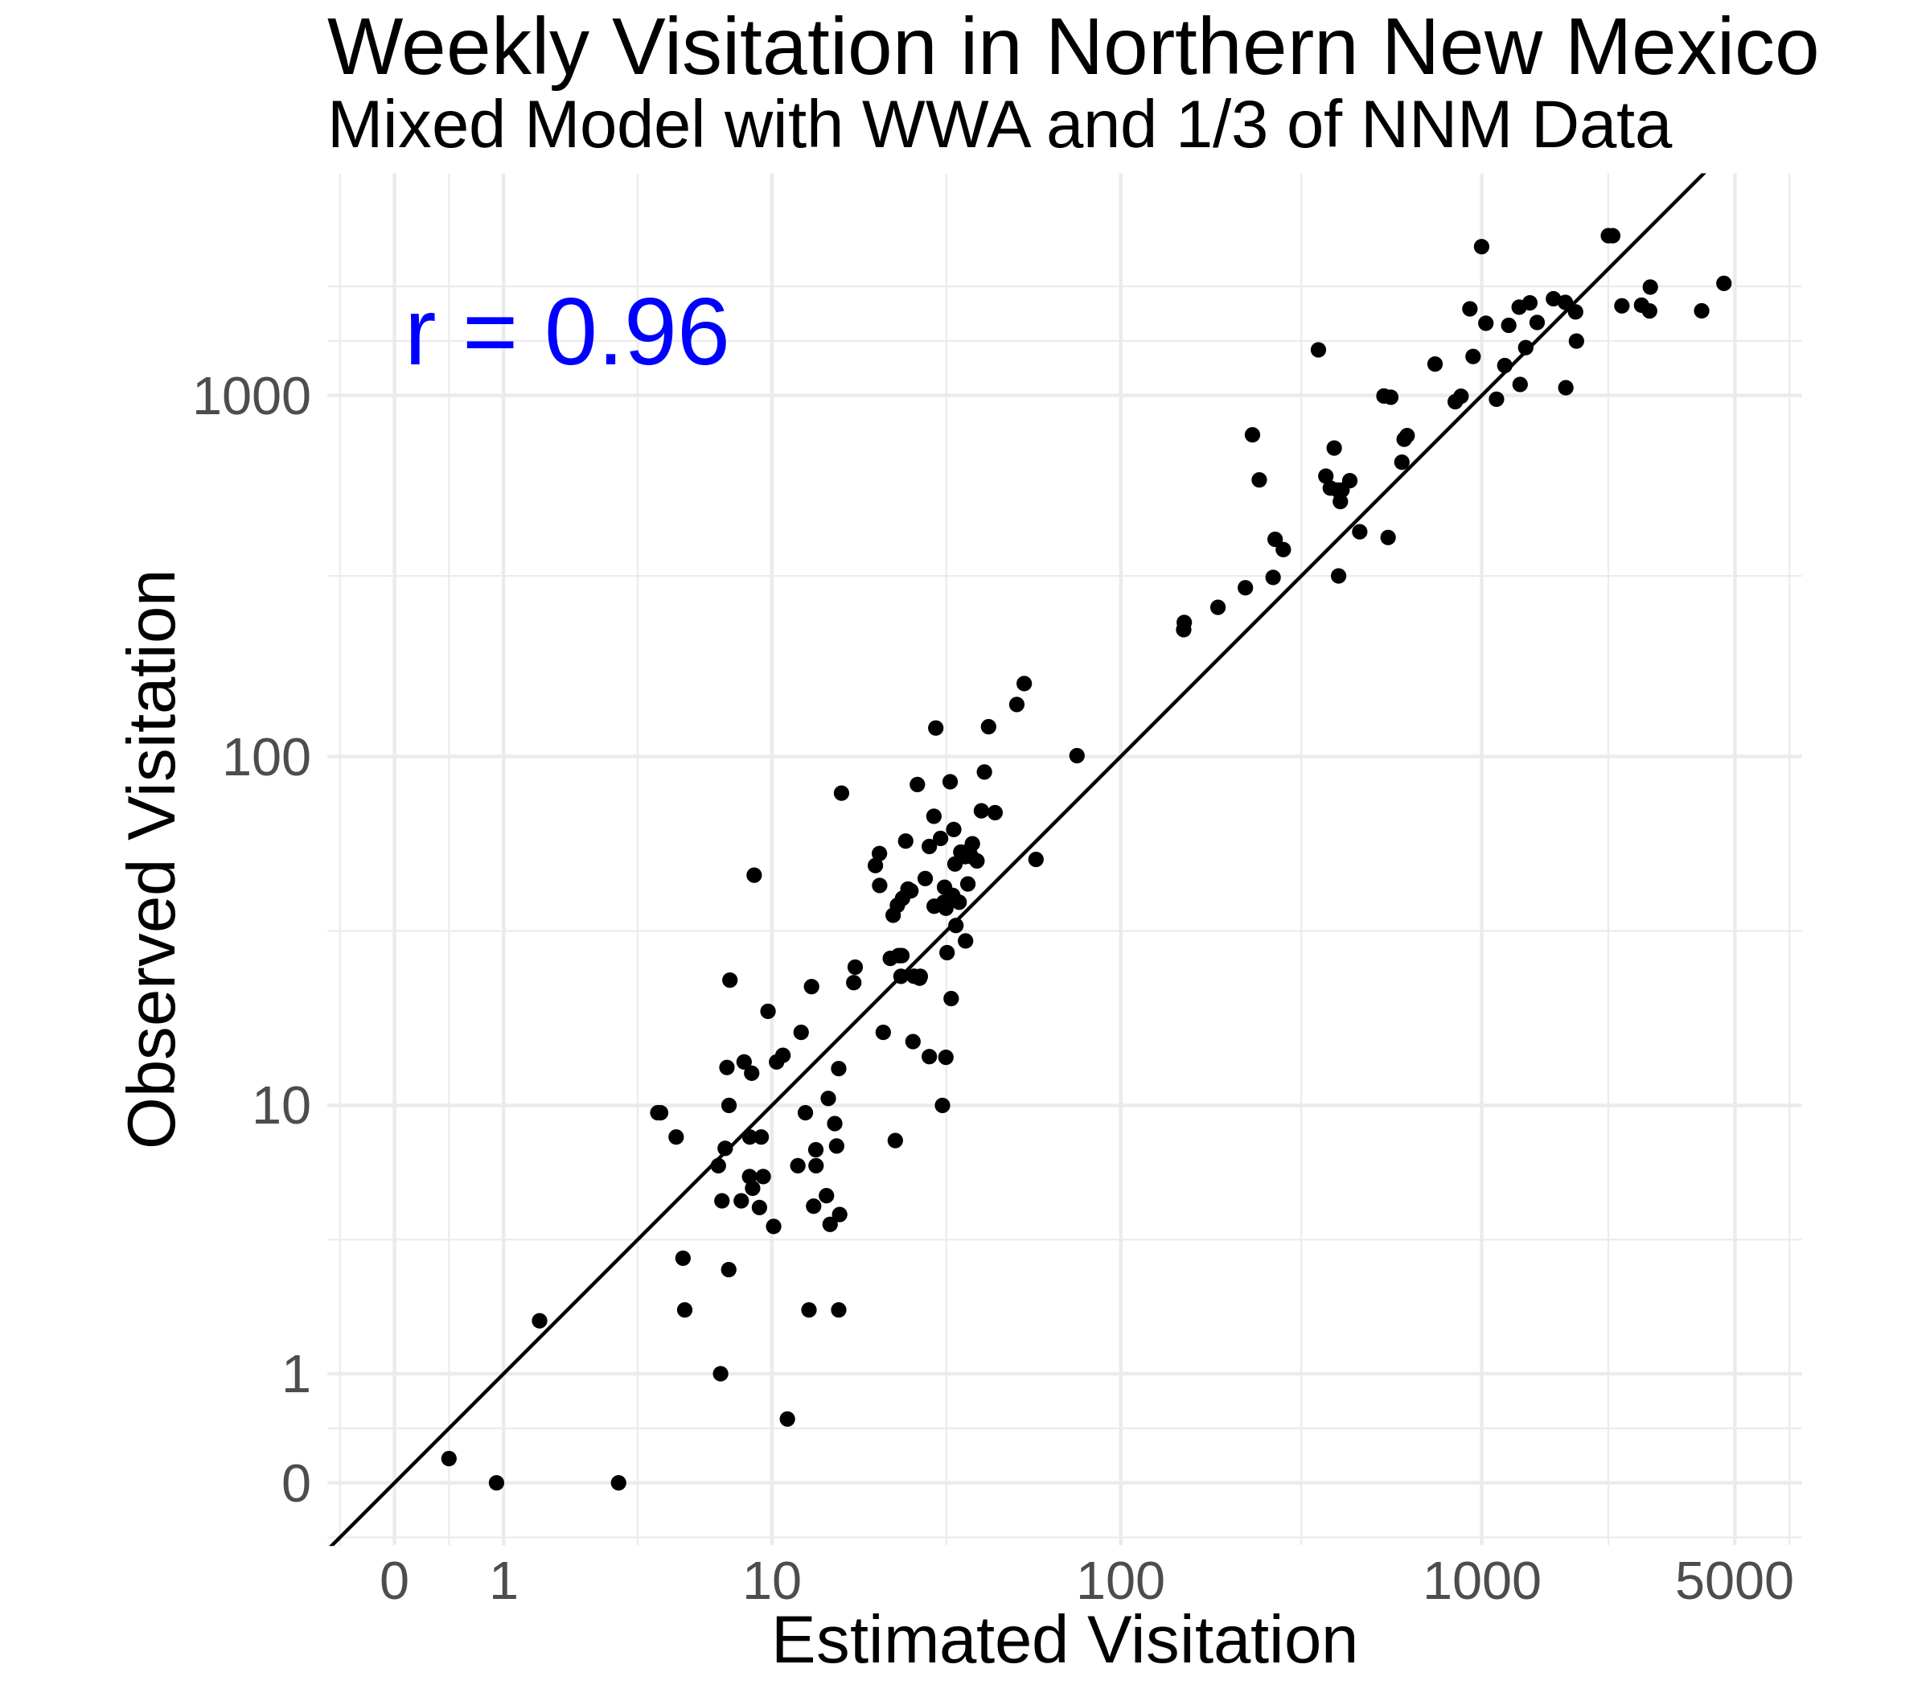
Estimating visitation in New Mexico with some on-site counts
Before (no NNM on-site counts)
After (with 80 weeks of NNM data across sites)
r² = 0.41
r² = 0.90
(Manuscript in preparation)
Notes:
Add corr from slide 17 to compare
Much cleaner relationship between predicted and observed visitation, without that line of predictions at average values of visitation

Slide 31
Approach
Use daily visitation estimates from parking lot counts for days when we don’t have IR counts
But, we still have missing day/site combos (counter failed, just have a couple parking lot counts from a week, etc).
So, effectively imputing missing values and aggregating by week
Using the proportion of visitors who come on each day of the week
Weekly visitation = sum(counts) / proportion(counts)

Slide 32
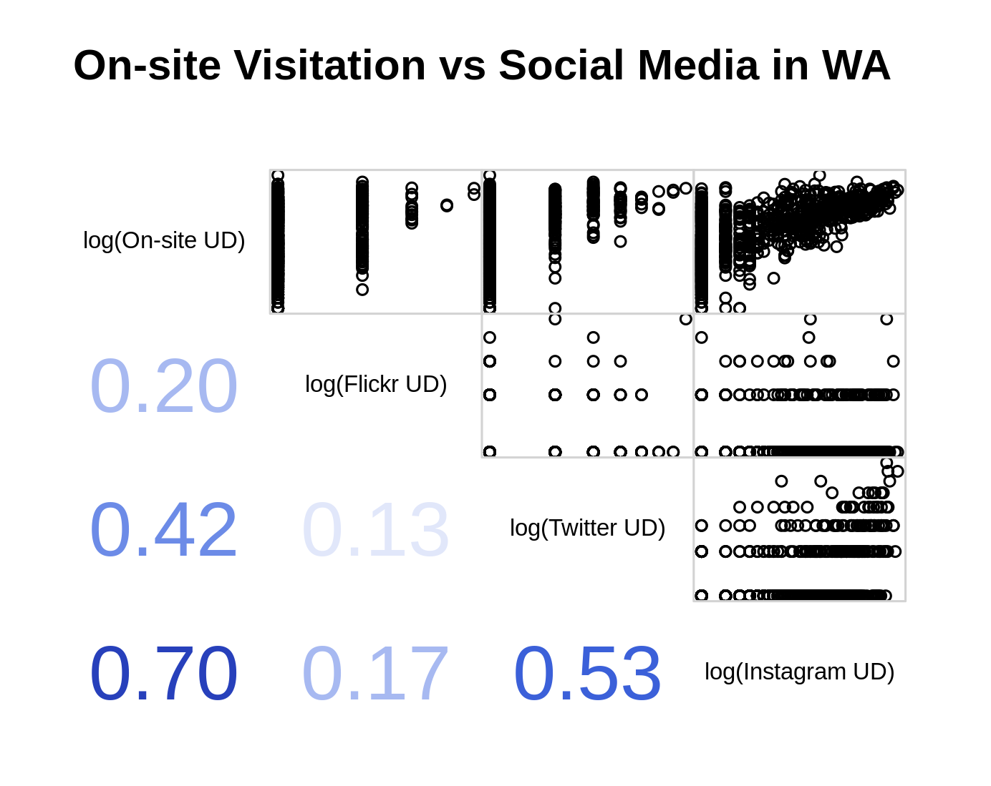
Notes:
Or add a slide for NNM

Slide 33
Social media use in two very different regions
Percent of Visitors Posting to Social Media, Summer 2018
Region | Instagram | Flickr | Twitter
Western WA | 3.44% | 0.02% | 0.04%
Northern NM | 3.21% | 0.01% | 0.01%
Number of Visitors Posting to Social Media, Summer 2018
Region | Instagram | Flickr | Twitter | Total Observed Visitors
Western WA | 6,753 | 39 | 80 | 196,220
Northern NM | 2,724 | 8 | 9 | 84,773
Notes:
Percent of people posting to different social media platforms is very similar. Especially considering the differences between the regions outlined earlier (no large metro population near NNM, more dispersed rec, etc.). This is somewhat surprising, and very encouraging for the idea of a generalizable visitation model which incorporates social media.
However, the raw number of people posting in NNM was much lower than people posting in WWA. Due to differences in number of people visiting these areas, but more particularly differences in the number of sites at which we counted visitors over summer 2018.

Slide 34
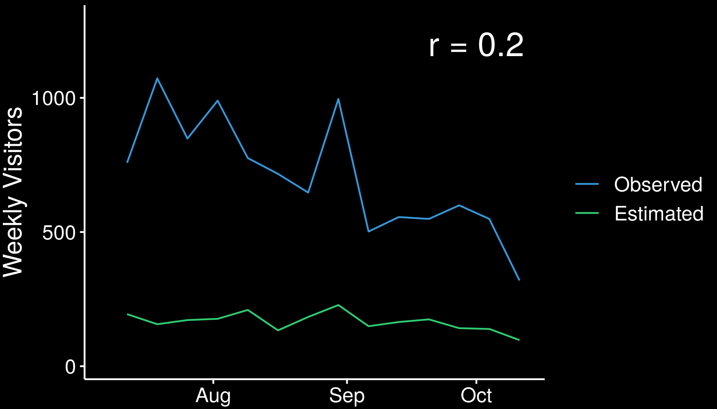
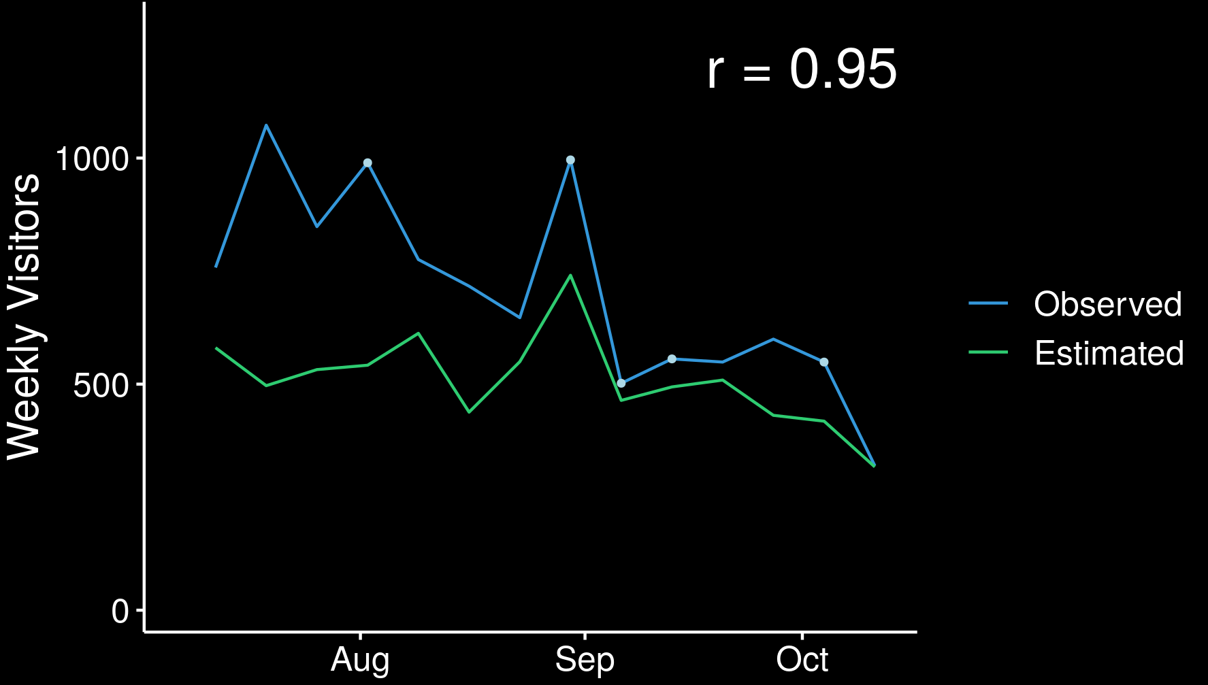
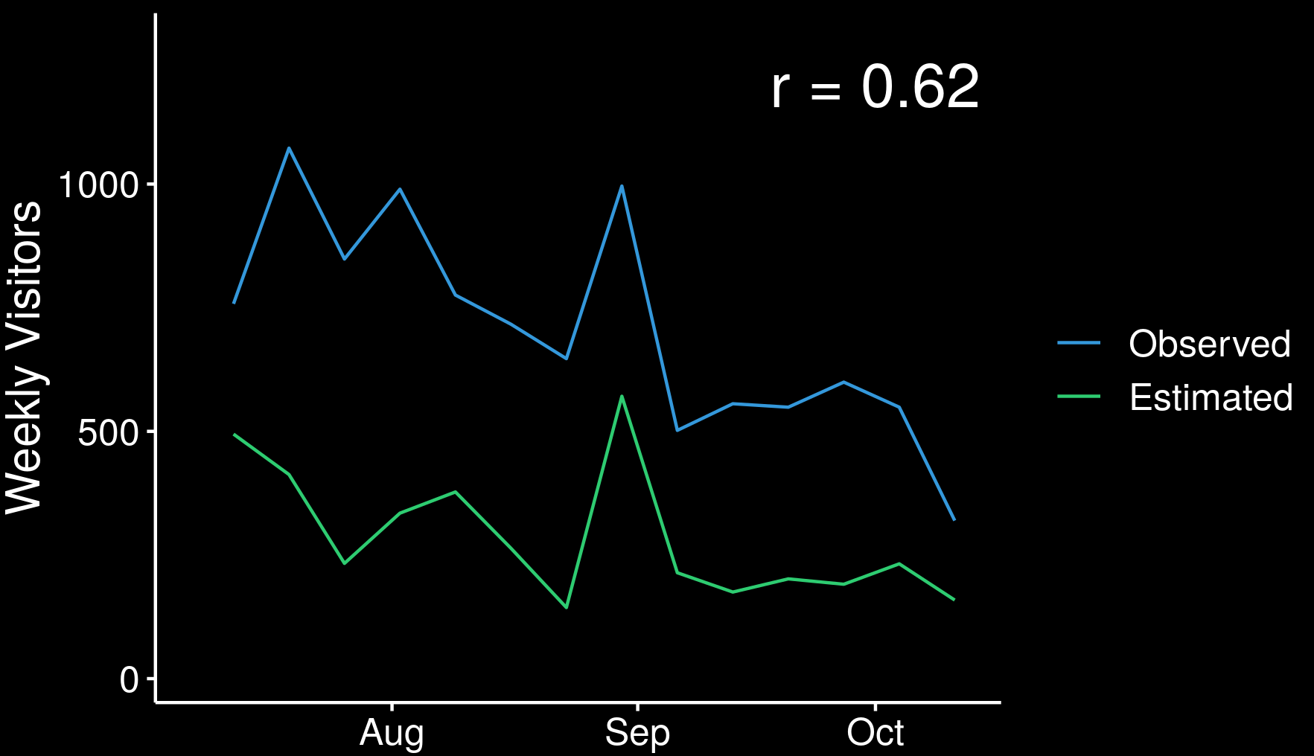
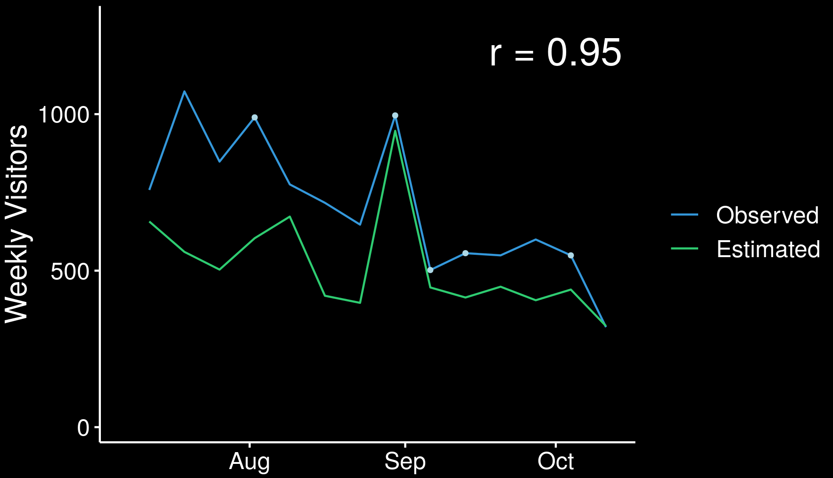
visitor estimation in northern NM
No site-specific data
Site-specific data
Baseline knowledge (eg season, weather) Baseline effects in WA | Baseline knowledge (eg season, weather) Baseline effects in WA & NM
Baseline knowledge (eg season, weather) Baseline effects in WA Crowd-sourced effects in WA | Baseline knowledge (eg season, weather) Baseline effects in WA & NM Crowd-sourced effects in WA & NM
No Crowd-sourced
Crowd-sourced
( Wood et al In prep )
Notes:
Here, in the scenario with some on-site data from NNM, we found that the differences between the baseline conditions model and social media data model was much more nuanced. [We found that in the scenario of a model using some on-site data form our study sites in NNM, the role of social media was much more nuanced.]
The baseline-only model performed extremely well when we added some on-site counts and a site-level random effect, creating estimates of visitation which were 95% correlated with observed visitation.
This is the same correlation value we found for the model which included social media data between the visitation estimates observed on-site counts.
We suspect that the similarity in correlations is because we now have empirical data on the relative popularity of study sites, via on-site counts, so social media no longer plays that role.
However, the trend lines, at this particular site still appear to tell slightly different stories.
The model estimates created using social media appears to be doing a better job at accurately estimating the peak in visitation, seen here around Labor Day, and perhaps at catching some temporal popularity trends.
This is a question which we are actively working to understand, and hope to be able to elucidate in which contexts social media has the greatest addition value to onsite data.
With that, I’ll hand it over to Monica who will discuss some of the implications for using these data types in visitor moitoring

Slide 35
Neiderprum
Meadow Creek
Dingford Creek
Dorothy Lake
Snoqualmie Lake
Mailbox Peak

