Slide 1
Navigating Relationships in Multicenter Collaborations
Jessica Flynn
WSDS 2019

Slide 2
Outline
Project Description
  What is VOLPACT?
  Who is involved?
My Role
Research
  Data Structure
  Our Goal
  Progress
4) Challenges
  How is this different than the typical clinical collaboration?
5) Tips on Navigating Multicenter Collaborations

Slide 3
Project Description

Slide 4
Background
Phase II: Does the treatment work?
Phase III: Is the treatment better than what is already available?
Formed to address the high failure rate of Phase III trials in showing significant treatment benefit
Hypothesis: Phase II trial endpoints are inadequate
Notes:
Volumetric – we have 3D CT data which has promise over 1D and 2D imaging techniques.
Millions of dollars and thousands of patients are invested in the development and testing of new therapies for solid tumor cancers, yet a large proportion of Phase III trials fail to show significant treatment benefit
-Possible explanation: Phase II trial outcomes are inadequate
Volumetric – have 3D data that might be superior

Slide 5
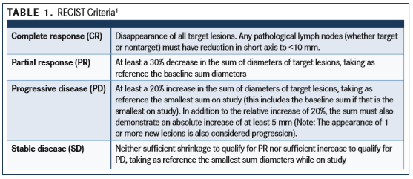
Background
Current endpoint: RECIST
Notes:
This is the endpoint typically used. We want to expand upon this and improve it. Want to create something more flexible.

Slide 6
VOLPACT
“Volumetric CT for Precision Analysis of Clinical Trials”
  Reporting of CT scans are typically unidimensional
  Volumetric scans may be a favorable technique
Multi-center collaborative project
First to use imaging from multiple pharmacy sponsored Phase II/III clinical trials

Slide 7

Who involved?
Pharmaceutical Companies
Research Teams
Notes:
Wrote grant to FNIH, they approved idea and help facilitate with pharm companies
Weekly calls – research team and FNIH, bi monthly calls with pharma companies to update on progess
Also, annual face to face meeting at ASCO conference

Slide 8



Who is involved?
Notes:
Weekly calls
Clinicians
Oncologists
Radiologists
Statisticians
Project Coordinators

Slide 9





Who is involved?
Notes:
Provided phase 2b/3 trails
Bi-monthly calls

Slide 10
My Role

Slide 11
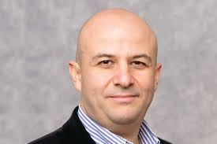
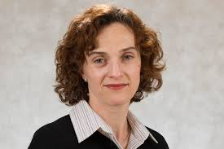
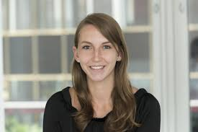
MSK Team
Mithat Gonen, PhD (PI)
Chaya Moskowitz, PhD

Slide 12
My Role
Management of data for the 10 trials
  Data cleaning and quality checking
  Handle distribution of the training and validation sets
Conduct analysis on the data with the MSK statistical team
  Coding and implementation of the methods
Prepare results to present on the weekly calls

Slide 13
Data Curation
Data from 10 trials and a variety of sponsors
  Not all in the same format or have the same variables
  Each trial came with several files
    Imaging measurements all from Columbia, but many files for clinical variables
Some trials on a clinical trial data transparency portal
  Difficult to unify databases when in different locations
HUGE undertaking
  Took several years to produce a usable, clean, working database

Slide 14
Research

Slide 15
Our Goal
To develop a new efficacy metric to use as an early phase clinical trial endpoint
Notes:
Different research teams working on different questions to address with the data, but this is what the MSK team is doing

Slide 16
Data Structure
Trial | Disease Site | Number of Patients | % Training | % Validation
Velour | Colorectal | 1,057 | 50% | 50%
VEG105192 | Renal Cell | 324 | 0% | 100%
Comparz | Renal Cell | 930 | 50% | 50%
Amgen PRIME | Colorectal
Mutant |  | 370 | 0% | 100%
Wildtype |  | 573 | 66% | 33%
Amgen 20020408 | Colorectal | 288 | 0% | 100%
Lux Lung 1 | Lung* | 479 | 66% | 33%
Lux Lung 3 | Lung* | 300 | 100% | 0%
Lux Lung 6 | Lung* | 363 | 0% | 100%
Keynote 2 | Melanoma | 331 | 0% | 100%
Keynote 6 | Melanoma | 467 | 66% | 33%
* All lung trials are NSCLC
Notes:
Split to try and equally represent diseases in the training and validation cohorts.
Training and validation previously assigned and this is the formal breakdown moving forward. No one will be touching the validation data
N patients= have both training and treatment information

Slide 17
Building a Trial Endpoint From A Regression Model
Existing metrics: Slope (time burden) , Slope (lesion profile), Slope (log time burden), Slope (log lesion profile), Ratio of log change (time burden), Ratio of log change (lesion profile), RECIST (continuous), RECIST (binary)
    Pre-defined
    Do not use all data
    Lack of flexibility
Proposed metric: Use tumor measurement data up to a specified time point to predict overall survival at a time point of interest
  Flexible
  Incorporates the longitudinal aspect of tumor measurements without assumptions about entire tumor trajectory
  Versatile for different endpoints

Slide 18
Proposed Metric
Probability of surviving beyond a time point of interest based on the data available at the time

Slide 19
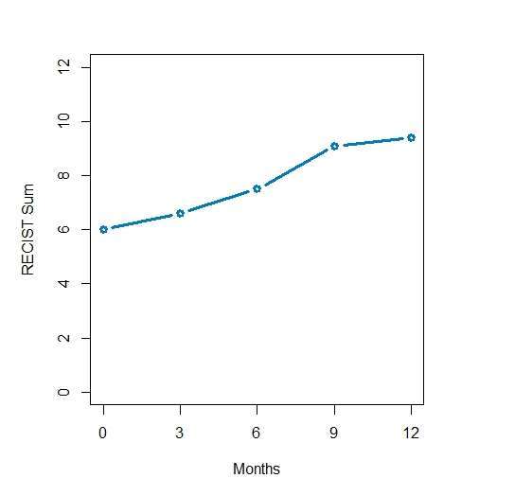
Example of Partly Conditional Modeling
Zheng, Y. and Heagerty, P. J. (2005),

Slide 20
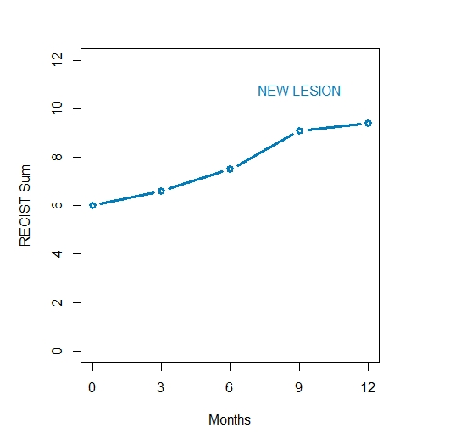
Example of Partly Conditional Modeling

Slide 21
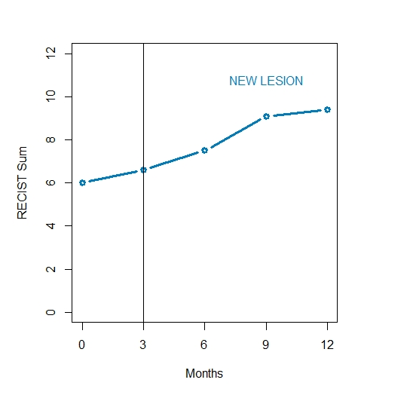
Example of Partly Conditional Modeling

Slide 22
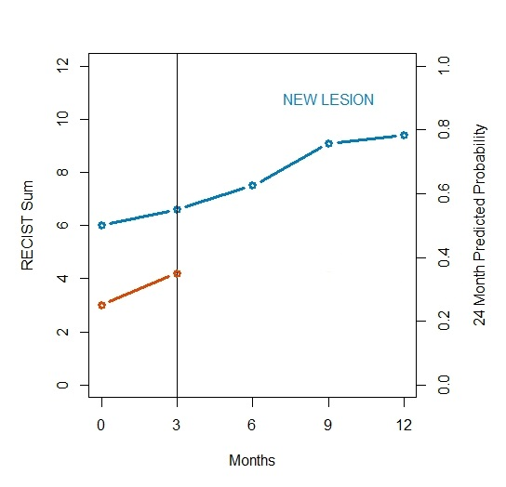
Example of Partly Conditional Modeling

Slide 23
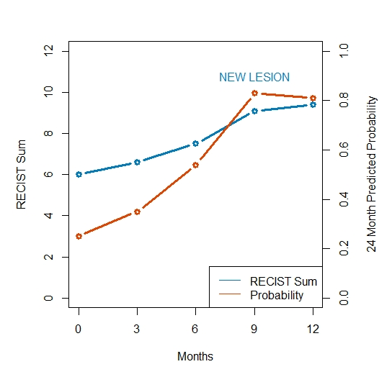
Example of Partly Conditional Modeling

Slide 24
Current Work
Working to refine the models
  Exploring other potential clinical covariates
Exploring a variety of time points for prediction
Simulating phase II trials to evaluate performance
Notes:
Potential covariates: disease site, trial, non-target progression

Slide 25
Challenges & Tips on Navigating

Slide 26
Typical Collaboration
Working closely with 1-2 physicians at MSK
Focused research question to answer
Data from our institution
  Usually one file sent to us for analysis
2-3 week turnaround of analysis results
Aim is often abstract submission and/or manuscript writing

Slide 27

1.) Weekly Calls
Constant expectation for new results
Feel pressure to produce something new
Difficult to put together presentation worthy results each week
Anything new from MSK this week?
Notes:
FNIH on the call each week (weekly meeting minutes circulated after)
Also, bi-monthly calls where we need to update on our project to our sponsors to continue to receive funding

Slide 28

Always produce more results than what you share with the team
If you do not have anything new results, use time to discuss issues with other team members
Be upfront and honest
Notes:
Start a discussion to gain clinical input

Slide 29

2.) Convincing a Large Group
Typically in collaborations, we can explain why something may not be statistically sound
Constant feedback can be difficult to manage
“Why not?”, “Can we look?”

Slide 30
Take the time to show, not just tell
Be patient as this may be a setback in moving forward with your own goals
Know when to draw the line
  Balance the clinical input to the best of your abilities

Slide 31

3.) Evolving Goals
Shifts in research questions and goals for the project
Sub-goals branch out from the major goals
Challenging to manage all of the arising questions

Slide 32
Divide and conquer
Take the lead and help other team members devise an analysis plan
Don’t spread yourself too thin

Slide 33

4.) Staying Knowledgeable
Comprehending complex research questions and analyses
Unfamiliar methods compared to typical collaborations
Managing large data efficiently

Slide 34
Ask questions!
Don’t execute analysis without knowing why you are doing it
Set in place standard data cleaning and QC processes
Take advantage of the opportunity to learn from those with more experience

Slide 35

5.) Asserting yourself
Easy to feel like you are getting lost in the shuffle
Challenging to speak up in front of a large group of more senior researchers
Handling feelings of inferiority and doubt

Slide 36
Be an expert in your own sphere
  Confidence is key!
Don’t be shy to chime in when you see fit or know the answer
Do not feel inferior because of your experience level/age/education level
  You are an essential asset!
Take advantage of all opportunities offered

Slide 37

Thank you!
Questions? Comments?
flynnj@mskcc.org

Slide 38
References
Dercle L. , Connors D.E. , Tang Y., et al (2018), Vol-PACT: A Foundating for the NIH Public-Private Partnership That Supports Sharing of Clinical Trial Data for the Development of Improved Imaging Biomarkers in Oncology. JCO Clinical Cancer Informatics. doi: 10.1200/CCI.17.00137.
Zheng, Y. and Heagerty, P. J. (2005), Partly Conditional Survival Models for Longitudinal Data. Biometrics, 61: 379-391. doi:10.1111/j.1541-0420.2005.00323.x
Maziarz, M. , Heagerty, P. , Cai, T. and Zheng, Y. (2017), On longitudinal prediction with time‐to‐event outcome: Comparison of modeling options. Biom, 73: 83-93. doi:10.1111/biom.12562
R package:
mdbrown/partlyconditional
Graphics: FlatIcon

