Slide 1


Maximizing Your Potential, with the
Erin Wiley
Westat
American Statistical Association (ASA)
Committee on Membership Retention and Recruitment (CMRR)

Slide 2
Outline
The ASA and CMRR
Storytelling
Overview of ASA Membership Benefits (on paper)
Making your membership POP with…
  Potential
  Opportunity
  Participation
Final Thoughts

Slide 3

The American Statistical Association
Over 19,000 members from academia, government, research, and business.
Improve human welfare
Vision
A world that relies on data and statistical thinking to drive discovery and inform decisions.
Advancing research
Promoting sound statistical practice
More than 90 countries
70+ Chapters
6 yearly conferences
17 journals
30+ Sections and special interest groups
Inform public policy
Notes:
Who we are: Members, countries, chapters, and sections/groups
What we do: Conferences, journals, advancing research
Why: Sound practice, inform public policy, improve welfare
All to support the Vision

Slide 4
Committee on Membership Retention and Recruitment (CMRR)
ONE SIMPLE AND IMPORTANT CHARGE
To promote and preserve membership in the American Statistical Association.
To Promote
  Find ways to highlight the ASA to prospective members
  Outreach to the statistical community and beyond
To Preserve
  Strengthen member engagement in ASA activities and initiatives
  Support the building of connections between members, chapters, committees, etc.

Slide 5
Your Story
PROSPECTIVE MEMBERS
Purpose: To give a glimpse of the multitude of benefits that come with joining the ASA.
NEW MEMBERS
Purpose: To offer ideas about how to get more out of your membership.
EXISTING MEMBERS
Purpose: To suggest ways to get more involved and to make an impact.
Something for everyone!!
Notes:
If you don’t fit into one of these groups, you get to come talk to me afterwards and tell me how I could have better served you with this presentation. See? Something for everyone!

Slide 6
My Story
At Westat for 12 years without ever joining ASA, despite the membership fees being covered by the company.
Colleague planted a seed in my mind about presenting at CSP 2016. (ASA membership now seemed like a good idea!)
Found a mentor!
Presented also at WSDS 2016 and wrote an article for the WSDS edition of CHANCE (April 2017).
Joined ASA CMRR (January 2018).

Slide 7

ASA Membership Benefits
Connections
  ASA Chapters, Sections, Committees,
  Interest Groups, and Outreach Groups
  Student Chapters
  ASA Community
Access
  Online journals
  ASA published magazines
  Proceedings from the Joint Statistical Meetings
  (JSM) and other conferences
  Education Publications (including teaching
  resources for K-12 or undergraduate classrooms)

Slide 8

ASA Membership Benefits (cont.)
Career Opportunities
  ASA JobWeb
  JSM Career Service
  Awards and Recognition
Learning Opportunities
  Meetings and Conferences
  Professional Development
Discounts and Offers
  Conference fees
  Publishers and more

Slide 9

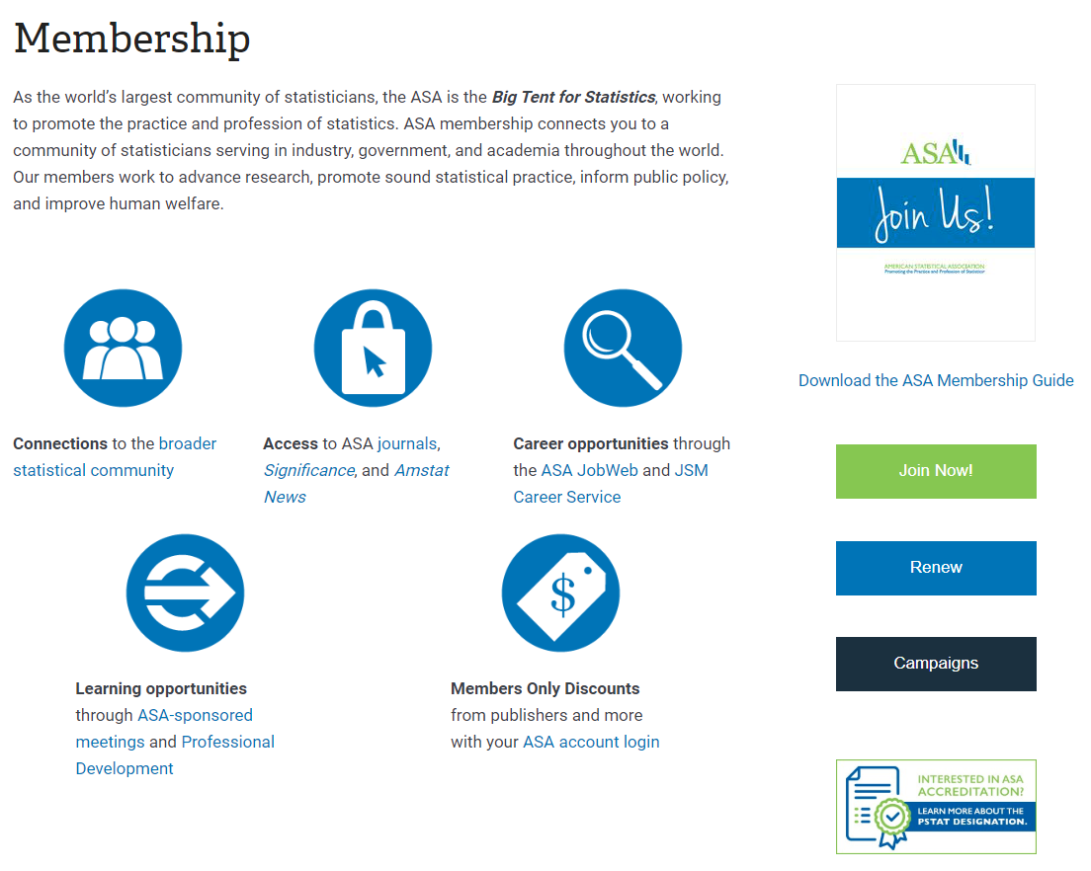
ASA Membership Benefits (cont.)
www.amstat.org
0

Slide 10
This is where YOU come in…

Slide 11

Making your ASA Membership POP!
The membership journey can pass through multiple stages and take many forms, depending on the individual.
We will consider three common “stages” of membership:
  Potential: Take a look around; Examine your surroundings.
  Opportunity: Choose your own adventure!
  Participation: To be continued…
An individual member could experience any or all of these stages at some point during the membership journey.

Slide 12

Your Membership
POTENTIAL

Slide 13
The secret of getting ahead is getting started.
- Mark Twain

Slide 14
ASA
Membership
Types
POTENTIAL
  Regular
  Student
  Senior/Retired
  Early Career (the first 5 years after degree completion)
  K-12 Teacher
  Community College educator
  Economically Developing Country Resident
  Family
  Life

Slide 15

ASA Chapters
POTENTIAL
  ASA Chapters promote statistics and provide benefits to chapter members, which are typically located in a particular geographic area.
  Chapters engage in many local activities
    Meetings and networking events
    Continuing education offerings
    Outreach to local schools to promote statistics as a career
    Courses and webinars about the application and practice of statistics

Slide 16
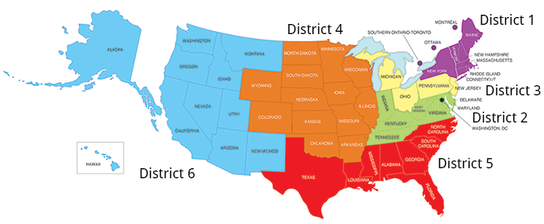
ASA Chapters (cont.)
POTENTIAL
There are currently 73 ASA Chapters operating around the country and in Canada.

Slide 17
ASA Chapters (cont.)
POTENTIAL
When registering, members choose which Chapter(s) they would like to join.
Multiple Chapters can be located within a state, for example:
Eastern Tennessee
Mid-Tennessee
Western Tennessee
Full list, including links to individual Chapter websites, can be found on the ASA website www.amstat.org

Slide 18

ASA Sections and
Interest Groups
POTENTIAL
  Due to the diverse nature of our profession, members work in a wide range of fields requiring the use of different methodologies, applications, etc.
  Sections (29) and Interest Groups (9) are focused on a particular subject-area or industry.
  Benefits can be more specialized and specific to the topics of interest for the members.

Slide 19

ASA Sections and Interest Groups (cont.)
POTENTIAL
  Sections include:
    Biometrics Section (est. 1938)
    Statistical Consulting
    Section on Statistical Learning and Data Science
    Section on Statistical Computing, etc.
  Interest Groups include:
    Transportation Statistics
    Quantum Computing in Statistics and Machine Learning
    Text Analysis (est. 2019)
    Astrostatistics
    History of Statistics, etc.
Notes:
Powerpoint slides on ASA website on the Sections and Interest Groups that has a slide and brief description of each one individually, except maybe the 2 most recent ones.

Slide 20

ASA Conferences and Meetings
POTENTIAL
  ASA hosts and sponsors multiple meetings and conferences, covering a variety of topics and interest areas.
  Conferences typically include short courses, poster sessions, invited and contributed sessions, keynote addresses, career services, and more.
  Many networking opportunities in the form of mixers, discussion groups, informal lunch gatherings, and other possible formats.

Slide 21


Annual Conferences and Meetings
POTENTIAL
Joint Statistical Meetings is one of the largest gatherings of statisticians and data scientists in the world.
Conference on Statistical Practice brings together statistical practitioners, including data analysts, researchers, scientists and others engaged in the daily application of statistics.

Slide 22


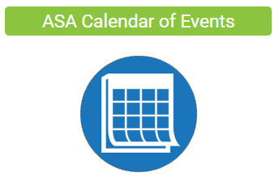
Annual Conferences and Meetings (cont.)
POTENTIAL
Women in Statistics & Data Science Conference is geared towards women in the fields of statistics and data science at all career levels, in academia, business, industry, and government.
Symposium on Data Science & Statistics is for data scientists, computer scientists, and statisticians analyzing and visualizing complex data.
And More…
www.amstat.org

Slide 23

Making Connections
POTENTIAL
  Group connections
    Participate in Section or Chapter meetings, activities and events
    Network at conferences
    Engage in discussions or join groups
    on
  Personal connections
    Find a mentor in your organization/institution
    Find a mentor within the wider ASA community, or within Chapter or Section
    Participate in a mentoring program

Slide 24

Mentoring options
POTENTIAL
Several ASA Sections and Chapters have their own
internal mentoring programs.
Sections
  Statistics and Data Science Education Section
  Biopharmaceutical Section
  And more…
Chapters
  North Carolina Chapter (NC ASA)
  Washington Statistical Society (DC Metro area)
  Southern Ontario-Toronto Chapter
  And still more…
Notes:
NC – Presentations, workshops, speed mentoring, peer mentoring
Southern Ontario-Toronto members engage in mentoring activities with other associations, through a program organized by the Statistical Society of Canada

Slide 25

Mentoring (cont.)
POTENTIAL
Conference-based mentoring programs
  Diversity Mentoring Program at JSM
  (Committee on Minorities in Statistics)
  CSP Mentoring Program
Speed or One-Time Mentoring Events
  NC ASA (North Carolina Chapter) recently held
  their first speed mentoring event
  Mentoring Roundtable Sessions at JSM (Section
  on Statistics and the Environment, Government
  Statistics Section, etc.)
Mentoring relationships can often extend beyond the initial meeting.
Notes:
DWP – Multi-day program consisting of small group discussions, one-on-one meetings, and other events throughout JSM

Slide 26

Your Membership
OPPORTUNITY

Slide 27
Your big opportunity may be right where you are now.
- Napoleon Hill (Author, “Think and Grow Rich”)

Slide 28
Picture this…
Stat A has been employed at an organization for 3 years. The company pays professional dues for its employees, so Stat A signed up for an ASA membership, since there was no personal cost.
Data Scientist B works closely with many individuals from the local ASA Chapter and has even attended Chapter events. Data Scientist B reasons that an ASA membership would provide greater opportunities to network and decides to join.
Stat C has paid for an ASA membership for 15 years and keeps up with current issues in the profession by reading the various print and online publications.
Data Scientist D eagerly joined the ASA as a graduate student and uses ASA JobWeb and ASA Community to explore potential career opportunities.

Slide 29

Your Membership Opportunity
Any ASA member can go through periods of increased or decreased activity, availability, and interest.
IF the desire for change arises, there is always an OPPORTUNITY to:
  Try something new Join a new section; Volunteer at a conference or in the local community
  Meet new people Find a mentor; Join a discussion group on ASA Community; Attend a Chapter event
  Step outside the comfort zone Present a paper or poster at a conference; Run for a Section office

Slide 30
Consider this…
OPPORTUNITY
The statistical community can engage in a wide variety of volunteer activities.
  Chair a session at a conference
  Help K-12 statistics teachers in a nearby school district
  Participate in a career night hosted by a local school or Chapter
ASA Connect currently has over 450 communities and over 7,500 discussions.
  Chapters, Sections, Committees, and Special Interest Groups have their own discussion spaces
  Conference-specific discussion groups
  Other discussion groups include Young Professionals, ASA Volunteers, Preparing to Teach Statistics and Data Science, and more!

Slide 31
ASA Committees
There are 71 ASA Committees, organized under the following four committee councils
OPPORTUNITY
Awards Council: Responsible for the ASA’s various awards, including the creation of new awards and elimination of existing awards
Education Council: Focuses on issues, initiatives, and policies regarding statistics education
Membership Council: Concerned with building and retaining membership and meeting the needs of underserved and minority groups within the ASA
Professional Issues and Visibility Council: Increases visibility and support for the statistics profession and promotes the use of statistics in other fields

Slide 32

ASA Committees (cont.)
OPPORTUNITY
Most ASA Committees are made up of volunteers who are appointed for 2-3 years, plus liaisons from the ASA and the Leadership Support Council.
Use the volunteer form on the ASA Committees page
  Express interest in committees that you would be interested in serving on.
  Recommend colleagues and other members to serve on committees that would suit their skills and interests.
Submitting this form serves two very important purposes
  Demonstrates your personal interest and willingness to become more involved.
  Provides useful information to support the nomination process, leading up to the Committee appointment decisions, which are made by the ASA President-Elect.

Slide 33

OPPORTUNITY
Shameless plug…
CLICK HERE!!!
...with a purpose!
Notes:
This is a final encouragement to consider learning more about committee involvement. But also a way to show you how to find the form, which is sneakily hidden in plain sight on the Committees page!

Slide 34

Your
Membership
PARTICIPATION

Slide 35
One wants to find a career where the work is so enjoyable you never want to stop, where being involved in your work is one of the most rewarding things you do.
- Janet Myhre (ASA Member for more than 50 years)

Slide 36






Being involved in your work can mean…
PARTICIPATION
Representing the profession
Taking action
Benefiting from increased participation

Slide 37
Representing the Profession
PARTICIPATION
Professional conferences and meetings provide opportunities to present research, chair sessions, network, and more!
Submit articles on topics of interest to the Amstat News, the monthly membership magazine of the ASA. Write a blog post or start a discussion on ASA Connect.
ASA Speaker’s Bureau engaging and interesting speakers that are available for speaking events, by request.
  Expected to officially launch in 2020.
  Would you like to recommend a speaker you’ve heard for the Speaker’s Bureau? Send an email to Jack Joyce jack@amstat.org

Slide 38



Taking Action!
PARTICIPATION
Write to elected officials about matters that are important to the statistics and data science profession, especially regarding statistical and science policy.
Join or start an outreach group.
Students - Start an ASA student chapter at your college or university.

Slide 39
Benefits of
Increased Participation
PARTICIPATION
Gain influence and exposure by representing
the statistical profession both within and
beyond the statistical community.
Build and expand your network by interacting
with others when volunteering.
Grow in experience and perspective.
Demonstrate the theme of JSM 2019:
Make an Impact!

Slide 40
Once upon a time…

Slide 41

Your Story
continued…
All journeys are different and valuable.
Strive for peace, contentment, and satisfaction at every phase of your journey.
Self-examine often and decide for yourself if you want to make changes.

Slide 42
I would say a career in statistics can open itself to the most exciting and unexpected avenues of fulfillment. Keep your sights high. Expect the unexpected!
- Calvin Zippin (ASA Member since 1947)

Slide 43


Final Thought
Looking for a change
OR
Content where you are
The ASA Supports You!!
Photo by Javier Allegue Barros on Unsplash

Slide 44

Contact:
Erin Wiley
ErinWiley@westat.com
www.amstat.org

