Slide 1

Transition from Education to Profession:
Experiences of Statisticians
Layla Guyot
Texas State University

Slide 2
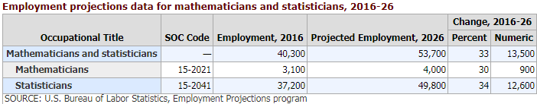
Importance of statistics and statisticians
Wide range of applications for statistics (from Actuarial science to Zoology) and the era of Big Data
Employment for statisticians expected to grow by 34% between 2016 and 2026 compared to a 7% growth rate for all occupations:
http://statistician.intelligentedge.com/
1/20

Slide 3
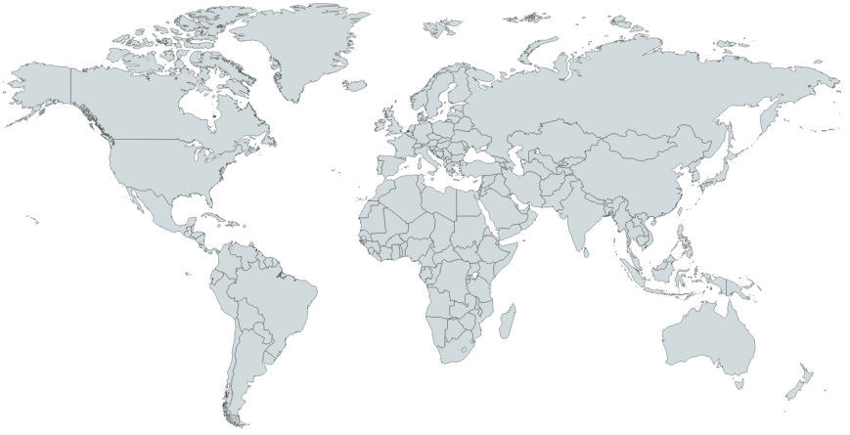
A need for statisticians
http://statistician.intelligentedge.com/
2/20

Slide 4
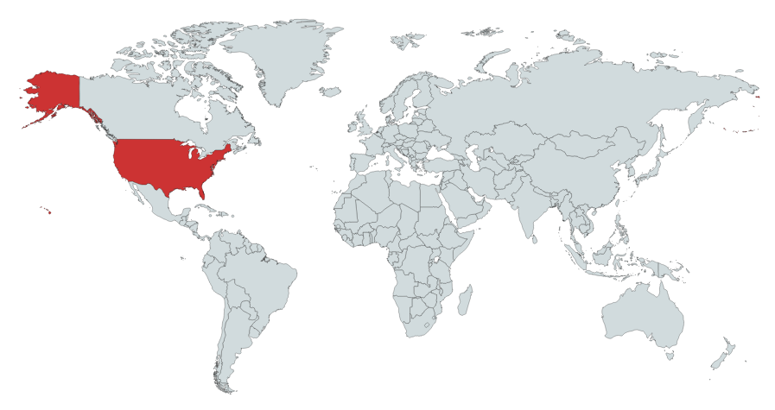
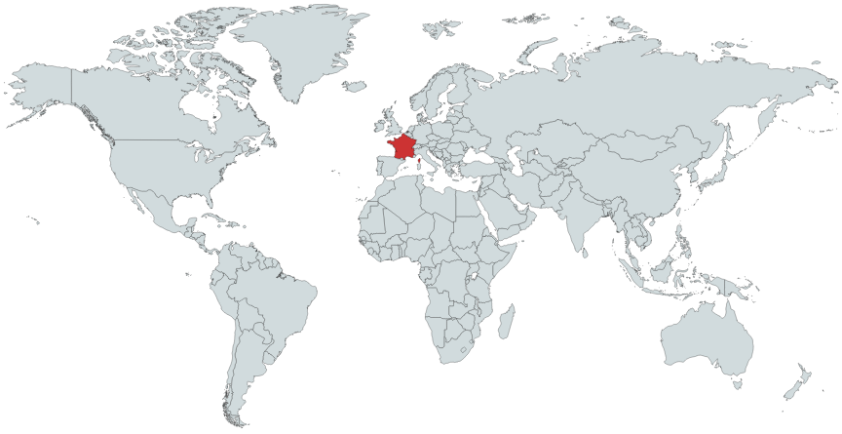
A need for statisticians
“Statisticien, un bac+5 très courtisé”
(Le Parisien Etudiant, 2013)
http://statistician.intelligentedge.com/
2/20

Slide 5
A need for statisticians
“More Students Earning Statistics Degrees, But Not Enough To Meet Surging Demand for Statisticians”
(American Statistical Association, 2015)
http://statistician.intelligentedge.com/
2/20

Slide 6
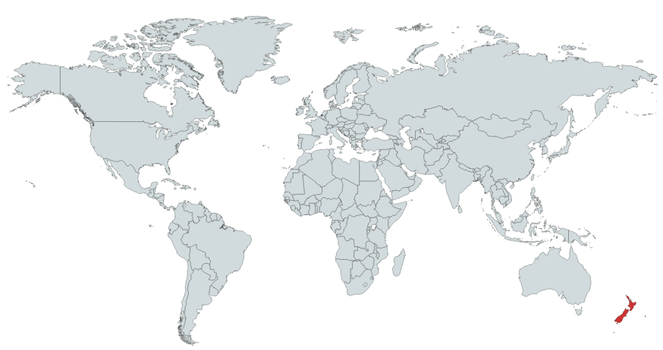
A need for statisticians
“Most employers are looking for experienced statisticians when they are hiring”
(Occupation Outlook, 2018)
http://statistician.intelligentedge.com/
2/20

Slide 7
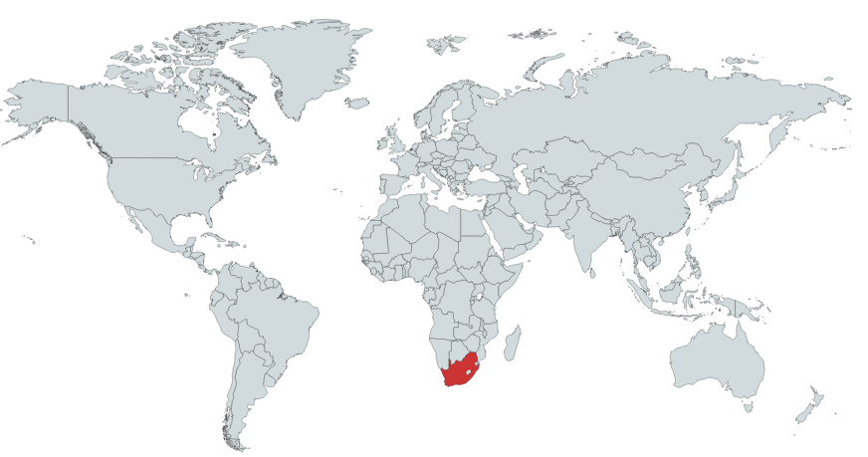
A need for statisticians
“Needed: statisticians – not nerds – with workplace knowledge”
(Mail & Guardian, 2017)
http://statistician.intelligentedge.com/
2/20

Slide 8



Motivations
Education
Master’s Degree in Applied Probability and Statistics
Courses taught by professionals in many disciplines
Professionals from various disciplines and sectors
Workplaces: Central Bank, Hospital
http://statistician.intelligentedge.com/
3/20

Slide 9


Identifying a challenge
Education
Profession
Students focus on statistical theory and concepts
(Kenett & Thyregod, 2006)
Statisticians perform statistics
in a specific context
(Pfannkuch & Wild, 2000)
http://statistician.intelligentedge.com/
4/20

Slide 10
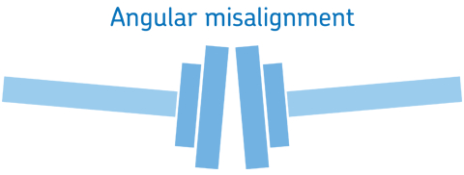

Identifying a challenge
Education
Profession
Students focus on statistical theory and concepts
(Kenett & Thyregod, 2006)
There is a misalignment for statistical practices
(Van der Berg, 2017)
Statisticians perform statistics
in a specific context
(Pfannkuch & Wild, 2000)
http://statistician.intelligentedge.com/
4/20

Slide 11
Identifying a challenge
Van der Berg (2017) surveyed 95 intern statisticians:
71% agreed that they did acquire the appropriate statistical knowledge needed at the workplace
72% indicated that they did not acquire the appropriate statistical skills needed at the workplace
http://statistician.intelligentedge.com/
5/20

Slide 12
Identifying a challenge
Respondents could list skills required at the workplace and indicate if it was taught or not:
21 out of a total of 28 skills were mentioned as not being taught
Most cited skills were: data collection, questionnaire design, communication, writing skills, and using statistical software.
http://statistician.intelligentedge.com/
5/20

Slide 13
Purpose of the study
  Identify important practices performed by statisticians
  Understand how important practices are developed by statisticians, and how mentors support learning
  Offer how to include these practices in education
http://statistician.intelligentedge.com/
6/20

Slide 14
Design of the study
Meeting statisticians, students and educators of statistics at conferences
Engaging in a task to explore perspectives on the profession of statistician
Reflecting on experiences through a survey
Discussing personal experience in an interview
http://statistician.intelligentedge.com/
7/20

Slide 15
Participation to the study
You can participate in this study and share your perspective on the practices performed by statisticians:
http://statistician.intelligentedge.com/
By answering the questions you are giving permission to use the results for research purposes. You can also complete a survey to share your experience or share your contact information to participate in an interview.
This study has been approved by the Internal Review Board (Approved IRB #6144).
http://statistician.intelligentedge.com/
8/20

Slide 16

Discussion
Out of the 24 practices listed:
    - pick 3 practices that you consider as most important
    - pick 3 practices that you consider as less important
Can you think of any practice you would like to add?
Compare your ranking and additional practices with the persons sitting next to you
http://statistician.intelligentedge.com/
9/20

Slide 17
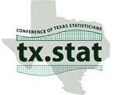
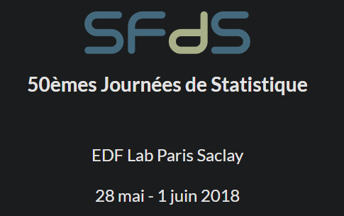



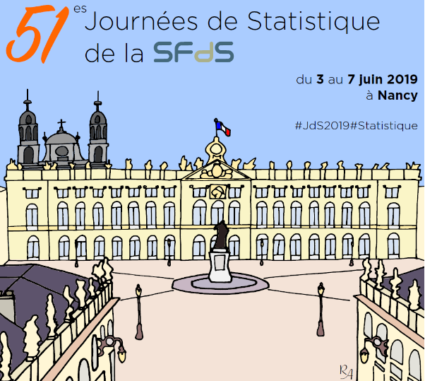

Preliminary results: Participants
154 participants were recruited across 7 conferences that focused on statistical practice and on statistical education
http://statistician.intelligentedge.com/
10/20

Slide 18
Preliminary results: Participants
Participants self-identified as:
Statistician | 49 (33%)
Statistician - Professor | 15 (10%)
Professor | 46 (31%)
Graduate student | 26 (17%)
Undergraduate student | 14 (9%)
Total | 150 (100%)
+ 4 missing
http://statistician.intelligentedge.com/
10/20

Slide 19
Preliminary results: Participants
A diversity of degrees (highest degree obtained or currently pursued)
in a variety of fields:
 | Bachelor | Masters | PhD | Total
Statistics – Data Science | 0 | 24 | 24 | 48 (44%)
Biostatistics | 0 | 13 | 7 | 20 (18%)
Mathematics | 8 | 0 | 4 | 12 (11%)
Others: Accounting, Computer Science, Energy, Engineering, Management, Psychology | 2 | 5 | 5 | 12 (11%)
Missing description | 6 | 2 | 10 | 18 (16%)
Total | 16 (15%) | 44 (40%) | 50 (45%) | 110 (100%)
http://statistician.intelligentedge.com/
10/20

Slide 20
Preliminary results: Participants
A diversity of fields of applications for Statisticians and Statisticians - Professors:
Health / Pharmaceutical | 26 (41%)
Education | 14 (22%)
Government / Policy | 6 (9%)
Economics / Finance / Commerce | 6 (9%)
Engineering | 5 (8%)
Mathematics + Statistics | 3 (5%)
Consulting | 2 (3%)
Missing | 2 (3%)
Total | 64 (100%)
http://statistician.intelligentedge.com/
10/20

Slide 21
Preliminary results: Task
Collected 120 sorting tasks
Analysis of sorting task (Q-methodology)
  using data reduction to identify patterns of thought
  applying PCA on tasks (participants are correlated)
  identifying 3 groups of participants = 3 perspectives
1 | 2 | 3 | 4 | 5 | 6 | 7 | 8 | 9
http://statistician.intelligentedge.com/
11/20

Slide 22
Task: Categories of practices
Process of data analysis |  |  | Traits
Design | Data | Techniques | Interpersonal skills | Personal skills
- Using knowledge of the context - Translating a real problem into a statistical form - Designing studies - Preparing sampling frames | - Collecting data - Creating / Maintaining databases - Cleaning data - Using statistical software - Producing visual representations - Interpreting data | - Researching appropriate statistical methods - Developing new statistical methods - Applying statistical methods - Using advanced mathematics | - Participating in teams / Collaborating - Communicating in writing - Communicating orally - Consulting with a client - Communicating interpretations of statistics to non-statisticians | - Working independently - Being curious / willing to learn - Being skeptical / critical - Meeting deadlines - Considering ethical issues
http://statistician.intelligentedge.com/
12/20

Slide 23
Task: Perspective 1
 |  |  |  |  | Meeting deadlines
 |  | Working independently |  |  | Being curious / willing to learn | Participating in teams / Collaborating
 |  | Preparing sampling frames / Drawing samples |  | Considering ethical issues | Communicating orally / Making presentations | Translating a real problem into a statistical form
 | Creating / Maintaining databases | Collecting / Gathering data | Being skeptical / critical | Using knowledge of the context | Producing visual representations of data | Interpreting data (Limitations of methods / Bias) | Communicating in writing
Using advanced mathematics | Developing new statistical methods and techniques | Researching appropriate statistical methods | Cleaning data / Managing missing data | Designing studies / Aligning design with research goals | Using statistical software package / Writing computer programs | Applying statistical methods and techniques | Consulting / Working with a client to solve a problem | Communicating interpretations of statistics to non-statistical audiences
1 | 2 | 3 | 4 | 5 | 6 | 7 | 8 | 9
http://statistician.intelligentedge.com/
13/20

Slide 24
Task: Perspective 2
 |  |  | Considering ethical issues
 |  | Meeting deadlines | Communicating in writing / Writing reports |  | Participating in teams / Collaborating | Being skeptical / critical
 |  | Working independently | Cleaning data / Managing missing data |  | Communicating orally / Making presentations | Being curious / willing to learn
 | Preparing sampling frames / Drawing samples | Consulting / Working with a client to solve a problem | Developing new statistical methods and techniques |  | Communicating interpretations of statistics to non-statistical audiences | Using statistical software package / Writing computer programs | Translating a real problem into a statistical form
Creating / Maintaining databases | Collecting / Gathering data | Using knowledge of the context | Using advanced mathematics | Producing visual representations of data | Designing studies / Aligning design with research goals | Researching appropriate statistical methods and techniques | Applying statistical methods and techniques | Interpreting data (Limitations of methods / Bias)
1 | 2 | 3 | 4 | 5 | 6 | 7 | 8 | 9
http://statistician.intelligentedge.com/
13/20

Slide 25
Task: Perspective 3
 |  |  |  |  | Communicating interpretations of statistics to non-statistical audiences
 |  | Working independently |  |  | Communicating in writing / Writing reports | Designing studies / Aligning design with research goals
 |  | Communicating orally / Making presentations | Meeting deadlines |  | Consulting / Working with a client to solve a problem | Producing visual representations of data
 | Being skeptical / critical | Using knowledge of the context | Preparing sampling frames / Drawing samples | Participating in teams / Collaborating | Creating / Maintaining databases | Cleaning data / Managing missing data | Translating a real problem into a statistical form
Considering ethical issues | Being curious / willing to learn | Using advanced mathematics | Collecting / Gathering data | Developing new statistical methods and techniques | Researching appropriate statistical methods and techniques | Interpreting data (Limitations of methods / Bias) | Applying statistical methods and techniques | Using statistical software package / Writing computer programs
1 | 2 | 3 | 4 | 5 | 6 | 7 | 8 | 9
http://statistician.intelligentedge.com/
13/20

Slide 26
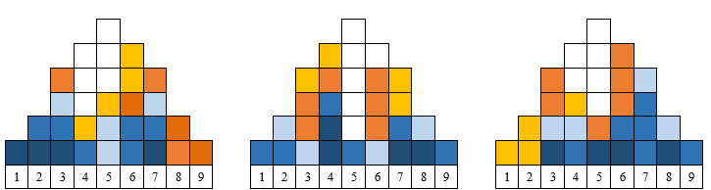
Task: Perspectives
 | Perspective 1 |  | Perspective 2 |  | Perspective 3
% explained variance | 23.47 |  | 13.16 |  | 8.19
Number of loading sorts | 55 |  | 29 |  | 11
 | + | - | + | - | + | -
 | 54 | 1 | 28 | 1 | 9 | 2
http://statistician.intelligentedge.com/
14/20

Slide 27
Task: Additional Practices
Practices | Occurrences
Training constantly / Learning / Reading | 10
Mentoring / Teaching / Providing feedback | 10
Managing projects / budget / people | 9
Developing computer skills | 3
Communicating with employers / other departments | 3
Complying with Data Security / Privacy regulations / Ethics | 2
http://statistician.intelligentedge.com/
15/20

Slide 28
Preliminary results: Survey
- Collected 81 questionnaires
  - open-ended questions
  - educational background, professional experience, and experience of the transition to the profession
- Analysis of survey
  - qualitative analysis
  - create categories / themes
http://statistician.intelligentedge.com/
16/20

Slide 29
Survey: Top 5 practices developed in education
Practices | Occurrences
General statistical methods | 29
Programming | 18
Designing studies | 11
Presentation | 8
Work habits (interpersonal skills) | 7
http://statistician.intelligentedge.com/
17/20

Slide 30
Survey: Top 5 practices developed for the profession
Practices | Occurrences
General statistical methods | 29
Programming | 18
Designing studies | 11
Presentation | 8
Work habits (interpersonal skills) | 7
Practices | Occurrences
Communication | 19
Specific statistical methods | 17
Programming | 11
Data management | 8
Designing studies | 6
http://statistician.intelligentedge.com/
17/20

Slide 31
Survey: Top 5 recommendations for education
Practices | Occurrences
Data management / Real data | 12
Projects / Consulting courses | 11
Programming | 10
Use real scenario, case studies, applications | 10
Theory tied to practice | 7
http://statistician.intelligentedge.com/
17/20

Slide 32
Interviews
Interviews are conducted with participants willing to share:
their experience of the transition to the profession
how they learned to develop statistical practices at the workplace
or help young statisticians learn to develop these practices.
http://statistician.intelligentedge.com/
18/20

Slide 33
Two takeaways
Communicating with
employers / other departments
Sorting Task:
Additional Practice
Survey:
Practice developed
at the workplace
http://statistician.intelligentedge.com/
19/20

Slide 34
Two takeaways
Communicating with
employers / other departments
Sorting Task:
Additional Practice
Interview:
“The first thing the mentor did was pull both me and my boss and, say ‘let's have a meeting’. And she sat us down and asked three questions and they were, um, what does a first year statistician do? What does a first year college graduate do and what are you actually doing? And sitting down and identifying those three things and they're startling lack of overlap in terms of what I was actually doing was, was pretty big.”
Survey:
Practice developed
at the workplace
http://statistician.intelligentedge.com/
19/20

Slide 35
Two takeaways
Communicating with
employers / other departments
Sorting Task:
Additional Practice
Interview:
“The first thing the mentor did was pull both me and my boss and, say ‘let's have a meeting’. And she sat us down and asked three questions and they were, um, what does a first year statistician do? What does a first year college graduate do and what are you actually doing? And sitting down and identifying those three things and they're startling lack of overlap in terms of what I was actually doing was, was pretty big.”
Survey:
Practice developed
at the workplace
Role of the mentor – Finding a mentor
http://statistician.intelligentedge.com/
19/20

Slide 36
Two takeaways
Programming
Sorting Task:
Additional Practice
Survey:
Practice developed both
in education and
at the workplace
http://statistician.intelligentedge.com/
19/20

Slide 37
Two takeaways
Programming
Sorting Task:
Additional Practice
Interview:
“People [at work] were not documenting their code so they had me come in and said "okay, here's our git page, just read all the code.”
“Good documentation is not a skill that's taught in school and it's like so important for every single person who's practicing as a statistician that is maybe, I think the single most important thing is keeping good documentation.”
Survey:
Practice developed both
in education and
at the workplace
http://statistician.intelligentedge.com/
19/20

Slide 38
Two takeaways
Programming
Sorting Task:
Additional Practice
Interview:
“People [at work] were not documenting their code so they had me come in and said "okay, here's our git page, just read all the code.”
“Good documentation is not a skill that's taught in school and it's like so important for every single person who's practicing as a statistician that is maybe, I think the single most important thing is keeping good documentation.”
Survey:
Practice developed both
in education and
at the workplace
Code documentation – Communicating
http://statistician.intelligentedge.com/
19/20

Slide 39
Discussion
How does your ranking of top 3 practices compare with these preliminary results?
If a statistician, how have you developed your top 3 practices?
If a teacher of statistics: how do you promote your top 3 practices in your courses?
If a student of statistics: how do you expect to develop your top 3 practices?
http://statistician.intelligentedge.com/
20/20

Slide 40
References
American Statistical Association. (2015, October 1). More Students Earning Statistics Degrees, But Not Enough To Meet Surging Demand for Statisticians.
Brown, S. R. (1980). Political subjectivity: Applications of Q methodology in political science. New Haven, CT: Yale University Press.
Bureau of Labor Statistics, U.S. Department of Labor (2018). Occupational Outlook Handbook.
Kenett, R., & Thyregod, P. (2006). Aspects of statistical consulting not taught by academia. Statistica Neerlandica, 60(3), 396-411.
Ministry of Business, Innovation and Employment in New Zealand (2017). Occupational Outlook.
Pfannkuch, M., & Wild, C. J. (2000). Statistical thinking and statistical practice: themes gleaned from professional statisticians. Statistical Science, 15(2), 132-152.
Van der Berg, G., H. (2017). A framework to integrate the formal learning with the informal workplace learning of statisticians in a developmental state (Doctoral Dissertation).

Slide 41
Thank you for your participation!
Questions?
If you are interested in taking part in this study or spreading the word about this research please contact Layla Guyot at l_g244@txstate.edu http://statistician.intelligentedge.com/

