Slide 1


Slide 3

Monitoring Demographics of Enrolling Participants in COVID-19 Phase 3 Vaccine Studies Using Tableau (Abstract ID:#309778)
To measure and monitor enrollment, focusing on recruiting priority populations in CoVPN (COVID-19 Prevention Network) sites and ramping up community engagement and recruitment response

Slide 4
Introduction of report analytics team members
Rohit Banerjee - BI Analyst, SCHARP, FredHutch
Richa Chaturvedi - Lead Report Analyst, SCHARP, FredHutch
Pallabi Deb - Program Manager, SCHARP, FredHutch
Jasmine Hwang - Report Analyst, SCHARP, FredHutch
Notes:
Linkedin link of every member?

Slide 5
Agenda
  Background
  Scope creation
  Data preparation
  Dashboard
  Sharing with stakeholders
  Impact
  Challenges
  Learning
  Current status
© Fred Hutchinson Cancer Research Center
4

Slide 6
Background
SCHARP (Statistical Center for HIV/AIDS Research and Prevention)
  Full-service statistical and data management center
    Study design, Data collection system development and management, Site training, Clinical and lab data management and quality control, Clinical coding, Data and safety monitoring, Statistical analysis and reporting, Data dissemination and archiving
  Report Analytics Team provides reporting and dashboarding at study request through Tableau
COVID-19 Prevention Network (CoVPN) was established by the National Institute of Allergy and Infectious Diseases as the functional unit of Operation Warp Speed.
  To conduct efficacy trials for COVID-19 vaccines and monoclonal antibodies
  Focusing on recruiting priority populations in CoVPN sites and ramping up community engagement
Notes:
Lookup the CoVPN websites to get some background on CoVPN.
Should we tell about SCHARP? Include CoVPN details.

Slide 7
  Scope creation
Stakeholders
  Study Principal Investigator, Staff Scientists
Scope
  Stakeholders’ Requirement
  Data providers
  Data types
  Deliverables
Timeline
  Project started in fall 2020
  Refreshed dashboard weekly till enrollment completion
Stakeholders’ Requirement
Need easier monitoring of study demographic enrollment
Need a way to cross study comparisons
Need a combined Enrollment Detail Report
Data Information
Types
SAS, CSV Files
Providers
Data Management centers of the sponsors
Deliverables:
Study Specific Dashboard
Cross Protocol Dashboard
Enrollment Listing Report
Notes:
Timeline – need to mention project start date?

Slide 8
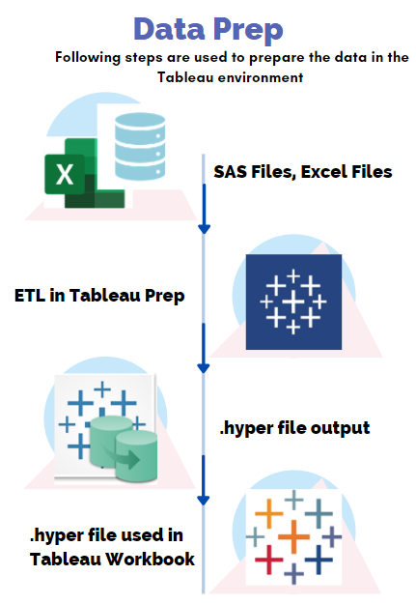
  Data preparation
Data source files
  SAS; Excel; CSV
Tableau Prep Builder
  ETL process
  Data cleaning
Output
  .hyper file format
Tableau desktop application
  Study specific
  Cross-study
  Enrollment listing
Notes:
Data cleaning: removing variables, standardization of race and ethnicity variables, joining
Describe cross protocol and study specific
Mention mapping file how it helped in create cross study dashboard creation

Slide 9
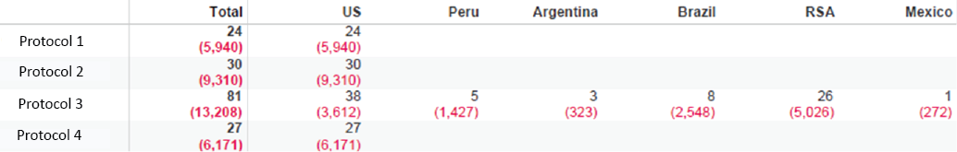
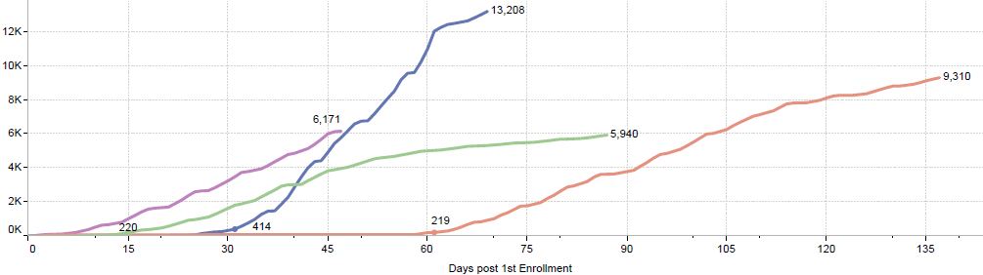
  Dashboard: example 1
Figure 1:
  Stakeholder can monitor cumulative enrollment of participants across countries
  The number of active sites and the number of participants enrolled
Figure 1: World-wide Cumulative Enrollment Numbers
Figure 2:
  Trend showing the enrollment rate across studies from Day 0
  Stakeholders can compare the rate of enrollment over number of days
Figure 2: Cumulative Enrollment Trend

Slide 10

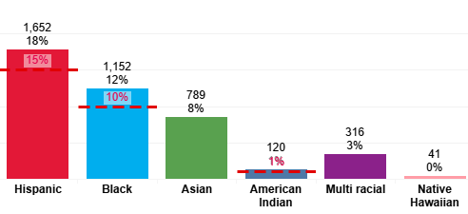
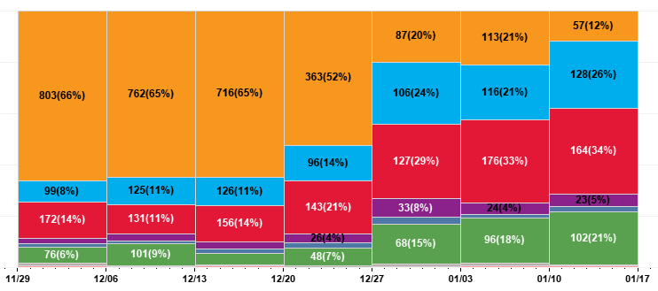
Dashboard: example 2
Color legends
Figure 3: Study Specific Priority Demographic Distribution in CoVPN Sites
Figure 4: Study Specific Weekly Race Distribution by Study in CoVPN Sites
Figure 3:
  KPI markups are defined by the stakeholders
  The demographic distribution helps in understanding the enrollment target and gaps in enrollment
  The stakeholders can monitor total enrollment of priority demography
Figure 4:
  Weekly enrollment by race and ethnicity
  The stakeholders can visualize weekly progress in enrolling priority population
  Ramp up community engagement in the sites if needed

Slide 11
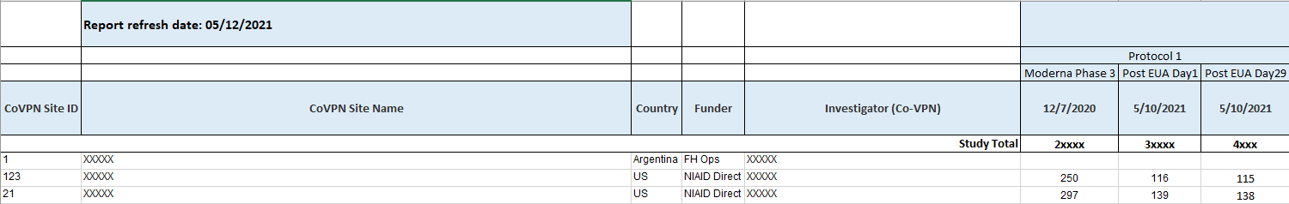
Dashboard: example 3
Figure 5a: Cross protocol enrollment report_site level
Figure 5b: Cross protocol enrollment report_participant details
Figure 5:
  Complete site level information and number of enrollment data to be used for fiscal decision
  Excel listing with one row per participant per visit
  The stakeholders used the listing for operational monitoring of the sites
Notes:
Work on the snapshot

Slide 12
  Sharing with stakeholders
CoVPN protocol dashboard
  Static report in PDF format for data security
  Refresh schedule
Enrollment listing
  Report exported in Excel format

Slide 13
  Impact
Enrollment Numbers, Race Distribution, and Gender Monitoring provided key insights in enrolling a diverse population
Defining ethnicity and race distributions was integral to the project as standardization of definitions helped in comparison of data from one study to another
Simplified visuals assisted in study operations
Efficient fiscal decision across all COVID studies
“I think the dashboard may have gone all the way up to Tony Fauci who was very pleased with of the success with enrolling a diverse population. The studies probably tell the story of how the companies realized how important this was, and every company did a bit better than the previous one.”​
- CoVPN Staff Physician​
Notes:
Need to elaborate the points; mention Dr. Fauci

Slide 14
  Challenges
  Evolving nature of scope and requirements
    Short turnaround time due to the urgency of the situation
  Frequent delay in source data set delivery
    The reporting team had dependency on CROs and other entities for data
  Different data definitions and structures across protocols
    The race and ethnicity variable representation was different in different studies; e.g., both binary and string representation of race variables in data
  Inconsistent variable names in source datasets
    The ETL process gets hindered if the variable names are irregular and different

Slide 15
  Learning
Be agile in processes and documentation
  The reporting team documented each change requests along the scope creation
Continuous communication with stakeholders
Resolution and display of data definition
  Due to varying nature of the source data, dashboards displayed clear definitions of values shown
Importance of simple visualization for diverse stakeholders

Slide 16
  Current status
The protocol specific demography enrollment is completed
The Enrollment listing is still supported by the Report analytics team
A new study launched in March 2021
  A randomized controlled study to assess SARS CoV-2 infection, viral shedding, and subsequent potential transmission in university students immunized with Moderna COVID-19 vaccine
  The Tableau analytics team is creating several dashboards to monitor study operation
Notes:
Use Tableau analytics team instead of reporting team.

Slide 17
Happy to answer further queries
contact:
Rohit Banerjee, rbanerje@scharp.org
Notes:
Which email id to share?

