Slide 1
Strong Orthogonal Arrays and Orthogonal Array-Based Latin Hypercube Designs for Planning Experiments
A Method for Improving Study Design in Biomedical Research

Slide 2
BACKGROUND OF THE STUDY
Orthogonal Array-based Latin Hypercube Designs (OALHDs) have become popular in practice among techniques used in the development of computer experiments and they are also useful whenever interest is on planning experiments in biological and medical research.
Design construction for experiments in biomedical research has become a novel area especially in Nigeria and Africa at large since it is more about experimental planning rather than modelling aspect in which some progress has been documented
The new family of experimental design called a space-filling design that is commonly used in designing computer experiments is a focus of this study.

Slide 3
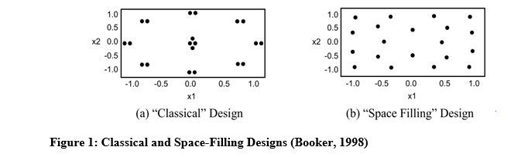
Space-filling designs are designs that spread design points evenly throughout the experimental region. Space-filling designs prevent replicate points by spreading the design points out to the maximum distance possible between any two points and distribute the points uniformly. The classical and space-filling designs are presented in Figure 1.

Slide 4
METHODOLOGY
The Bush Construction Type II method was used in this study to construct a strong Orthogonal Array (OA) of strength three, using Galois Fields (GF) of order s which gave rise to the constructed Orthogonal Array-Based Latin Hypercube Designs (OALHD) for planning experiments.
The study also employed the maximin criterion in the k-Nearest Neighbour with Euclidean distance for constructing strong orthogonal arrays along with the Orthogonal Array-Based Latin Hypercube Designs (OALHDs).
MATLAB 2016 computer package was used to implement the construction of OALHDs.

Slide 5
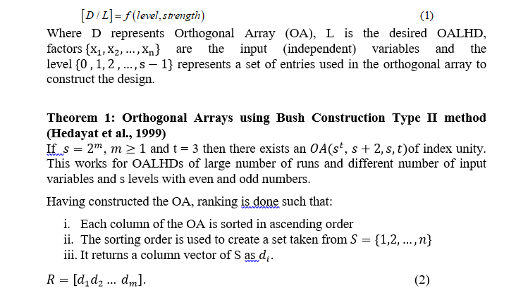
METHODOLOGY CONT’D

Slide 6
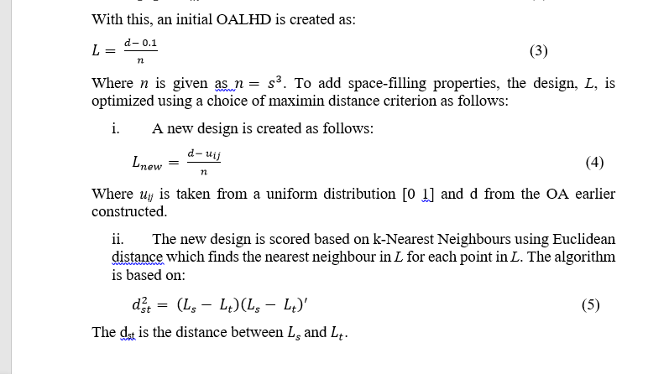

Slide 7
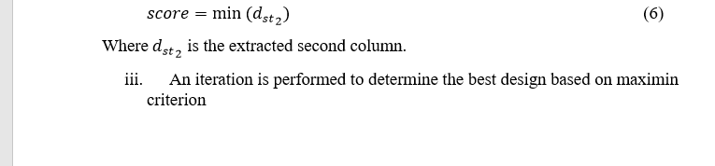
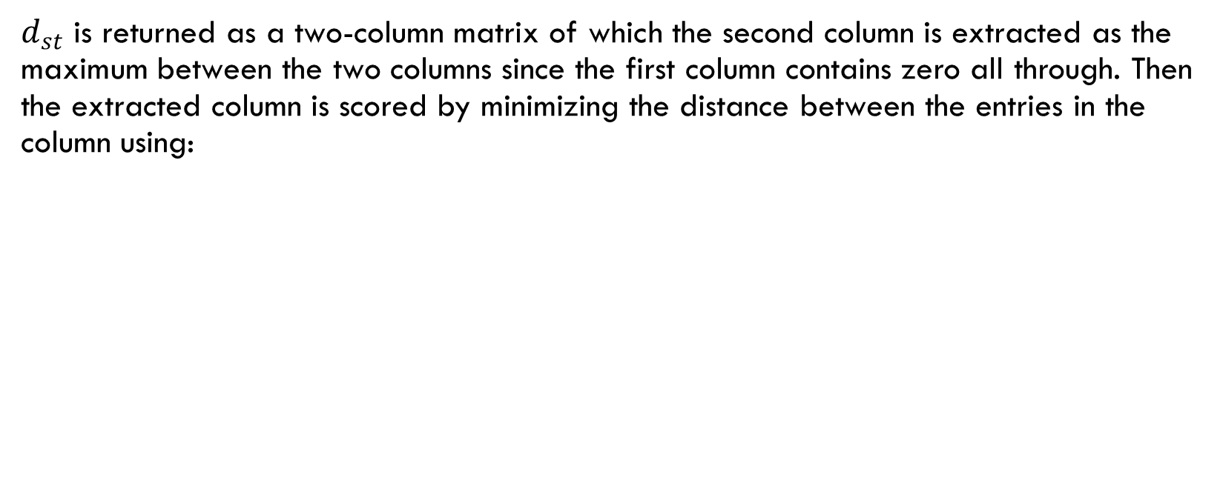
METHODOLOGY CONT’D
$d_{st}$ is returned as a two-column matrix of which the second column is extracted as the maximum between the two columns since the first column contains zero all through. Then the extracted column is scored by minimizing the distance between the entries in the column using:

Slide 8
Results: OALHDS CONSTRUCTED
OA (216, 8, 6,3) OA (216, 8) LHD
OA (343, 9, 7, 3) OA (343, 9) LHD
Both OALHDs possessed better space-filling properties and they achieve uniformity in each dimension of the designed variables.

Slide 9
CONCLUSION
This study concludes that the constructed OALHDs can be used whenever interest is focused on planning experiments to improve the study design in biomedical research.

Slide 10
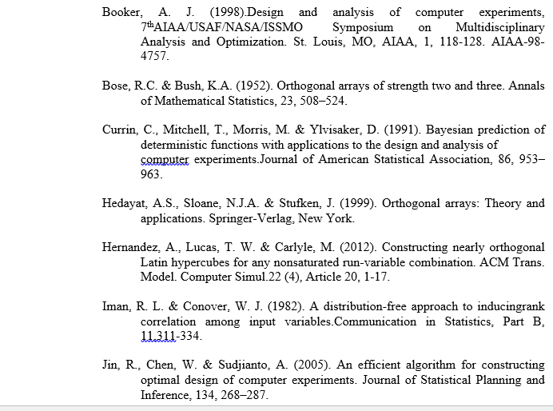
REFERENCES

Slide 11
APPRECIATION
THANK YOU

