Slide 1



Veridical Data Science
Raaz Dwivedi
PhD Student, EECS, UC Berkeley
Symposium on Data Science and Statistics
June 5, 2020
Notes:
Invite you to challenge and critique and make suggestions and reactions (positive and negative feedback is all encouraged)

Slide 2
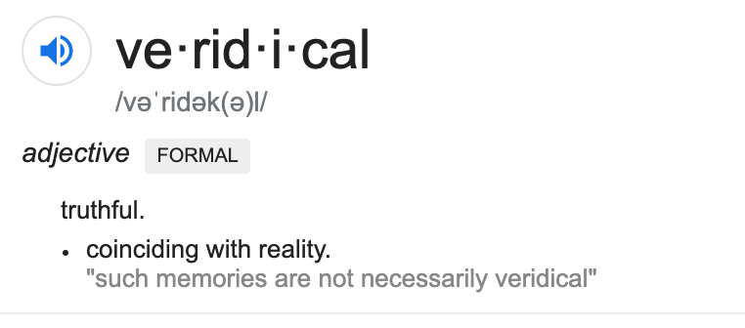
Notes:
"veridicality" in the psychology literature on perception. (see this paper for an example of such discussions)
"Veridicality is a term used in cognitive science; it is the degree to which your internal representation of the world accurately reflects the external world."

Slide 3
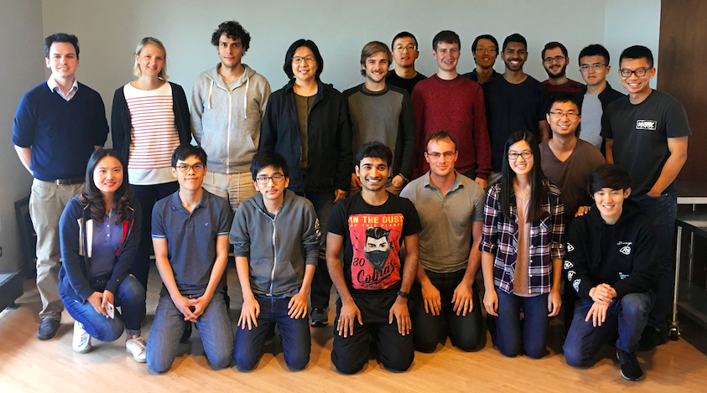
Today’s talk
Majority part of the talk based on slides used by Prof Bin Yu in her talks on Veridical Data Science and PCS Framework, developed by her and the group over the last decade

Slide 4




2020 AI taking over the world: Hope?

Slide 5


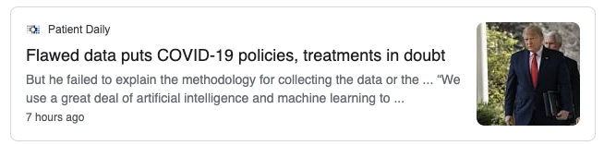
2020 AI taking over the world: Hype?

Slide 6
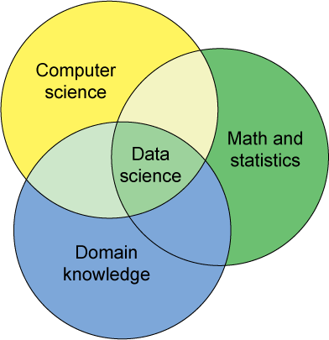
Data science is a key element of AI
Conway’s Venn Diagram
Goal:
combine data with domain knowledge to make decisions and generate new knowledge
Machine
learning
Notes:
It uses machine learning for scientific research to extract, from data, discoveries, theory, and knowledge
It builds scientific principles in machine learning algorithms
It iterates between the above two steps
It subjects itself to scientific standards

Slide 7
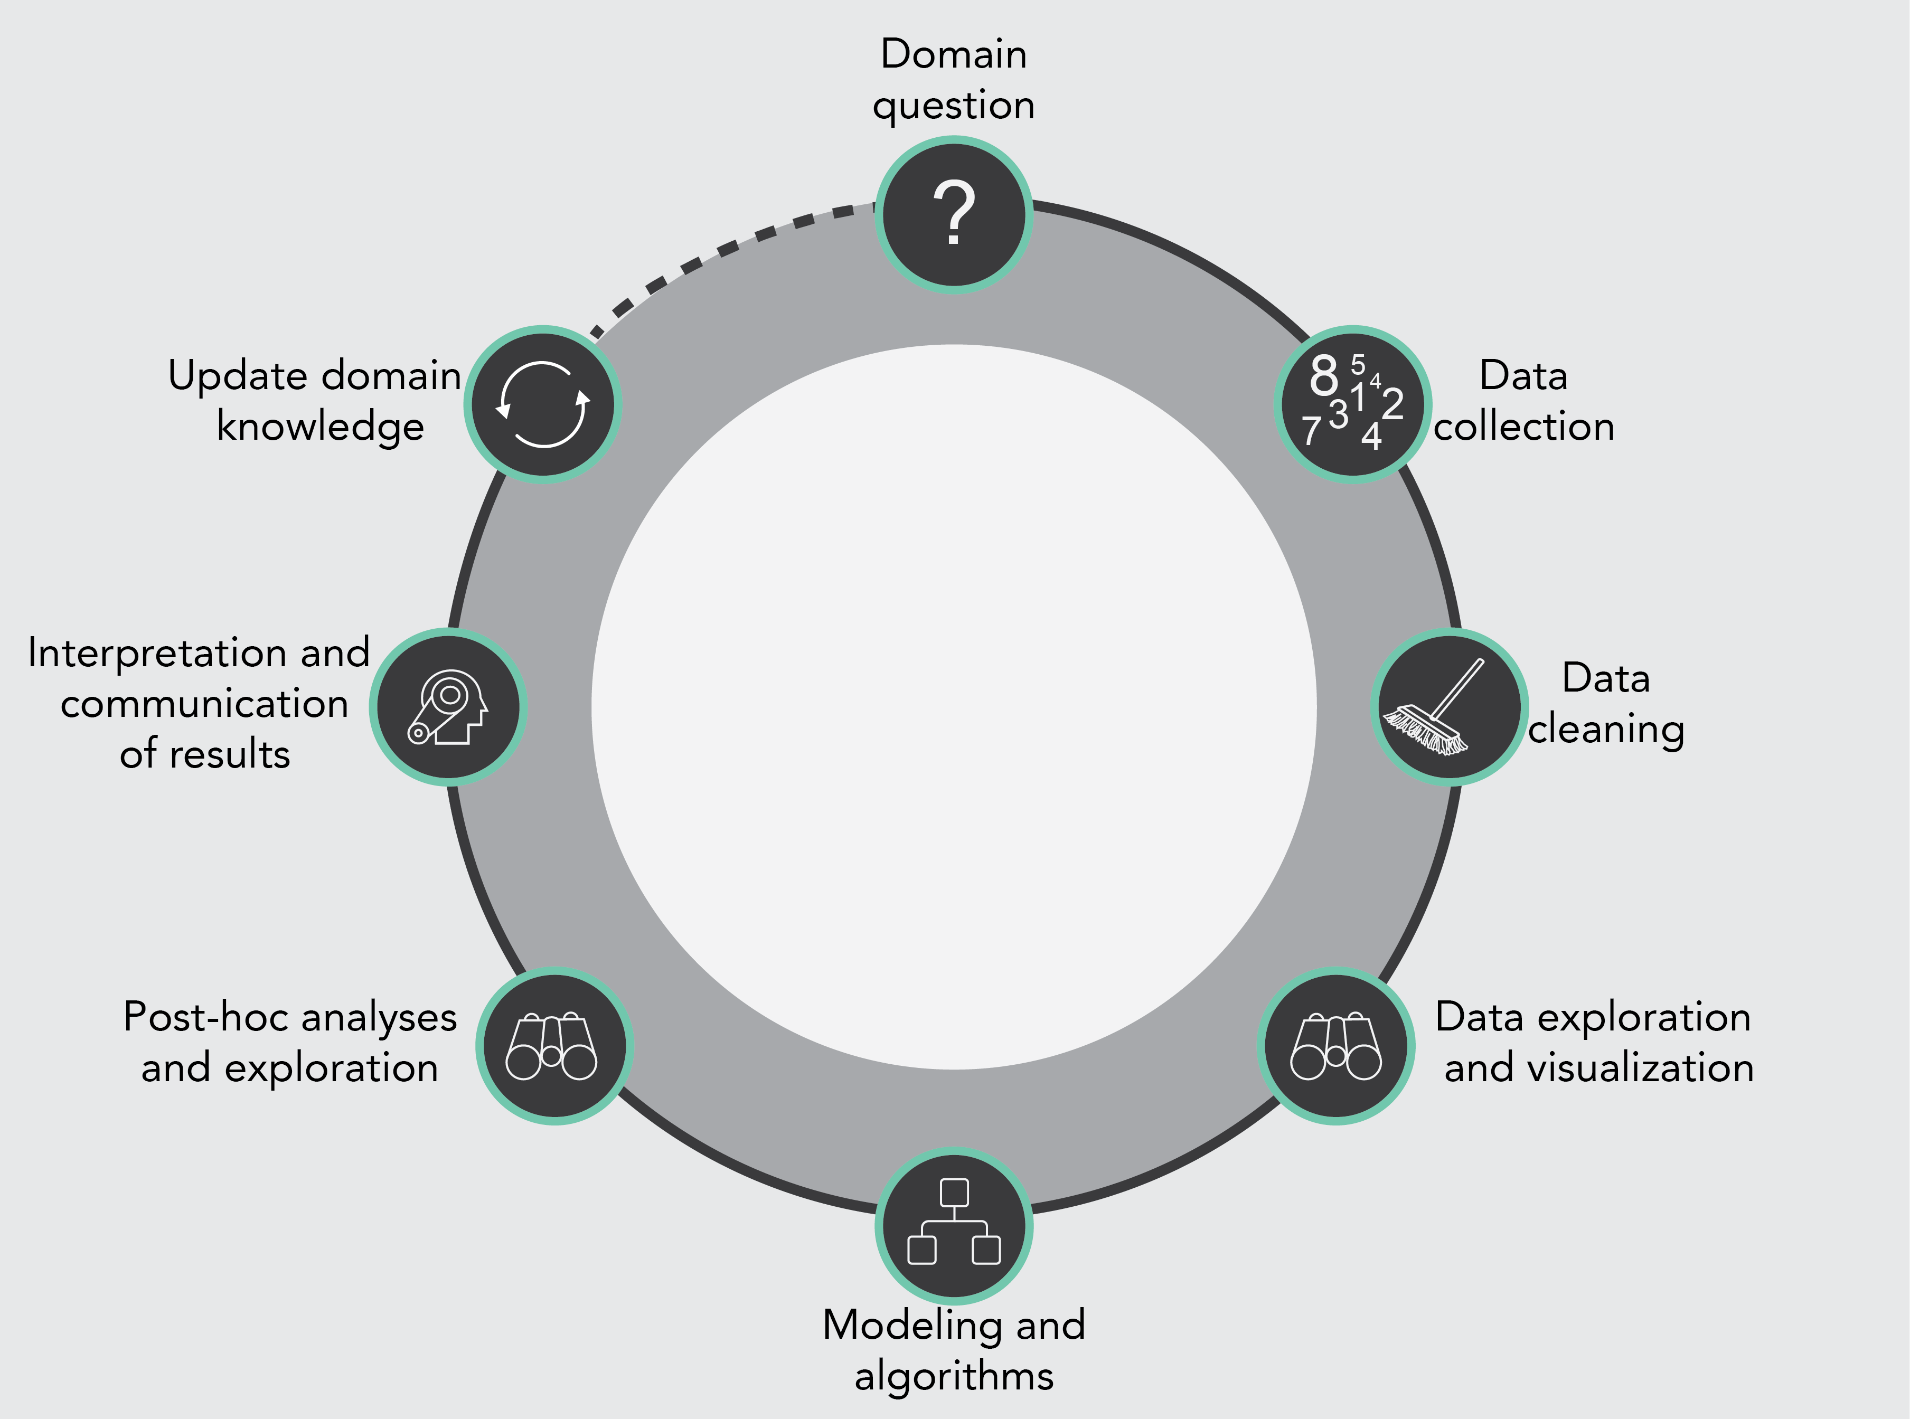
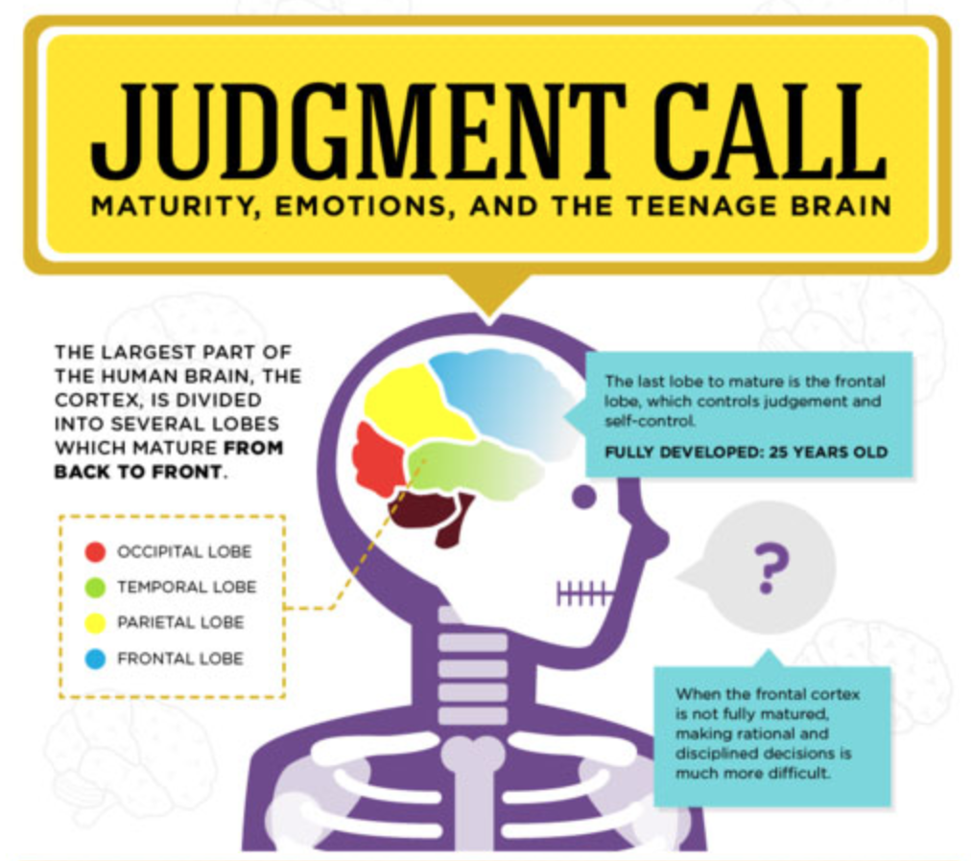
DS Life Cycle (DSLC): A system
Missing: quality control and standardization of the process
Image credits: R. Barter and toronto4kids.com
Notes:
Stability starts with “domain problem” -- linguistic stability
Data Cleaning: takes a whole lot of time, usually underemphasized
Computability starts at “data collection” –
Language stability means codes run on different compilers/platforms
…
Stability important at every stage…
Judgement calls: Underemphasized

Slide 8
Veridical Data Science
Extracts reliable and reproducible information from data,
with an enriched technical language to communicate
and evaluate empirical evidence in the context of
human decisions and domain knowledge
Notes:
Minimum requirement for trustworthy AI
Communication to non-technical audience is also important

Slide 9
Today’s agenda
PCS framework for veridical data science
Iterative random forests
PCS principles in causal inference
Notes:
PCS: connecting machine learning and statistics
iRF: Make it more stable, and make it interpretable for genomic problems and beyond
Interpretability a key behind models

Slide 10
PCS framework for
veridical data science

Slide 11

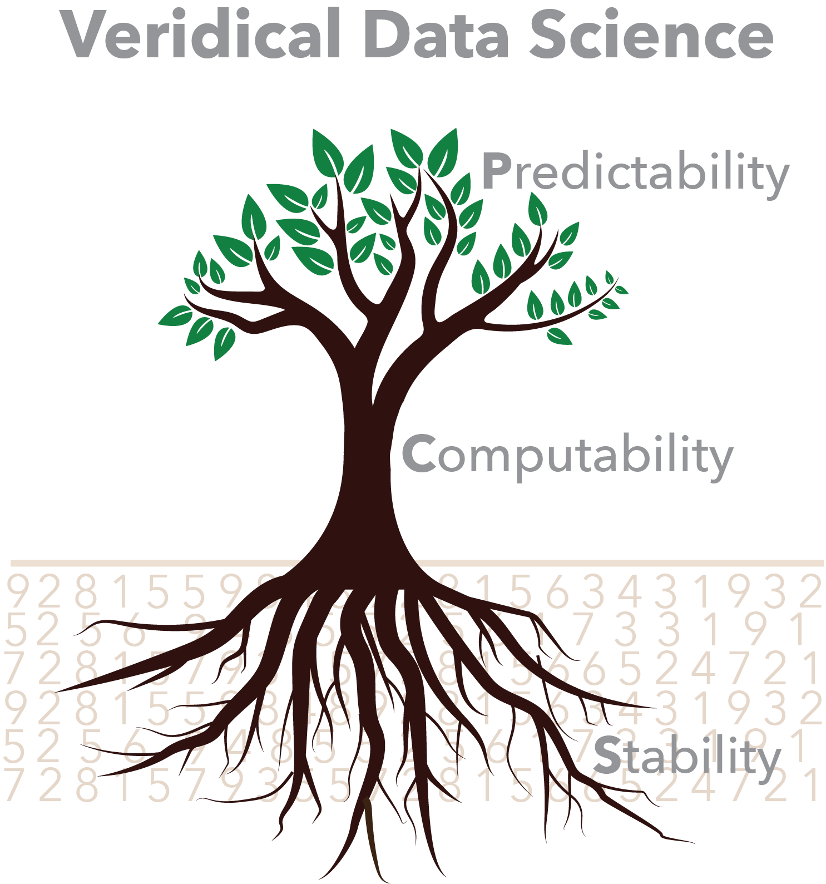
PCS framework
Three principles of data science : PCS
Predictability (P) (from ML)
Computability (C) (from ML)
Stability (S) (from statistics)
PCS bridges the two cultures:
Statistics and machine learning
Yu and Kumbier (2019)
Image credit: R. Barter
Notes:
PCS unifies myriad of works in the literature and builds a platform for further developments

Slide 12
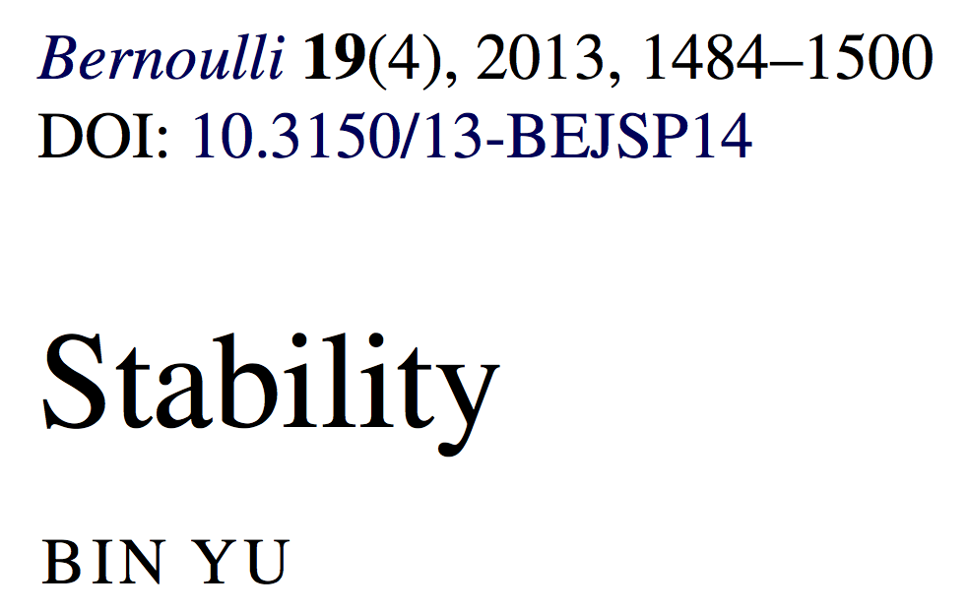
Stability is robustness for all parts of DSLC
It unifies and extends a myriad of works on “perturbation” analysis.
It is a minimum requirement for interpretability, reproducibility, and
scientific hypothesis generation or intervention design.
Image credit: designnews.com
Notes:
Prediction alone is not enough, CV is not enough.
Use stability principle to prevent “model-hacking” or overfitting
It builds on stability of knowledge, tracable to Plato, and connects with uncertainty measures.
It unifies a myriad of concepts in the literature

Slide 13
Predictability for reality check
Stability tests DSLC by “shaking” every part
DSLC
Shakes come from
human decisions
Image credits: R. Barter and toronto4kids.com
Notes:
All judgement calls need to be brought to forefront
—need to document and make it transparent; to make things reproducible

Slide 14
Human judgment calls ubiquitous in DSLC
Which problem to work on
Which data sets to use
How to clean
What plots
What data perturbations
What algorithm perturbations
What post-hoc plots/results
What interpretations
What conclusions
Image credits: toronto4kids.com

Slide 15
PCS workflow
Workflow incorporates P, C, S into each step of the DSLC
In particular, basic PCS inference applies PCS through data and model perturbations at the modeling stage (with P as a first screening step before perturbation intervals are made)
Image credits: R. Barter and toronto4kids.com
Notes:
PCS inference can be extended to other steps too.
P is about the future; problem formulation should keep the future in mind

Slide 16
Data perturbations (existing)
Cross-validation
Bootstrap
Subsampling
Adding small noise to data
Bootstrapping residuals
Block-bootstrap

Slide 17
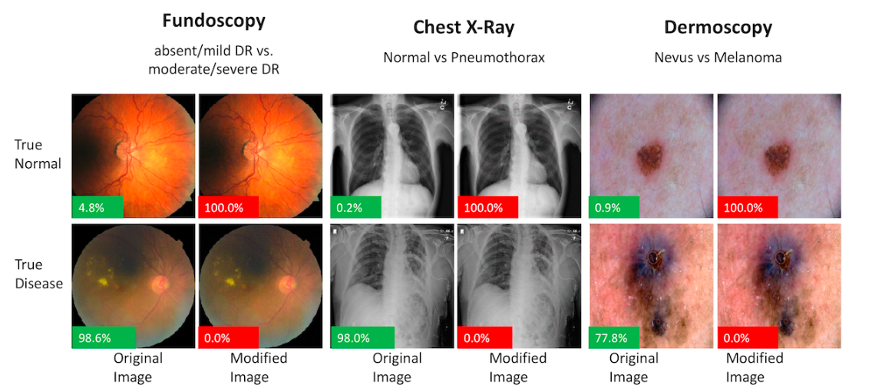
Data perturbations (recent)
Data modality choices
Synthetic data (mechanistic PDE models )
Data under different environments (invariance)
Differential Privacy (DP) (2020 US census)
Adversarial attacks to deep learning algorithms
Image credits:groundai.com

Slide 18
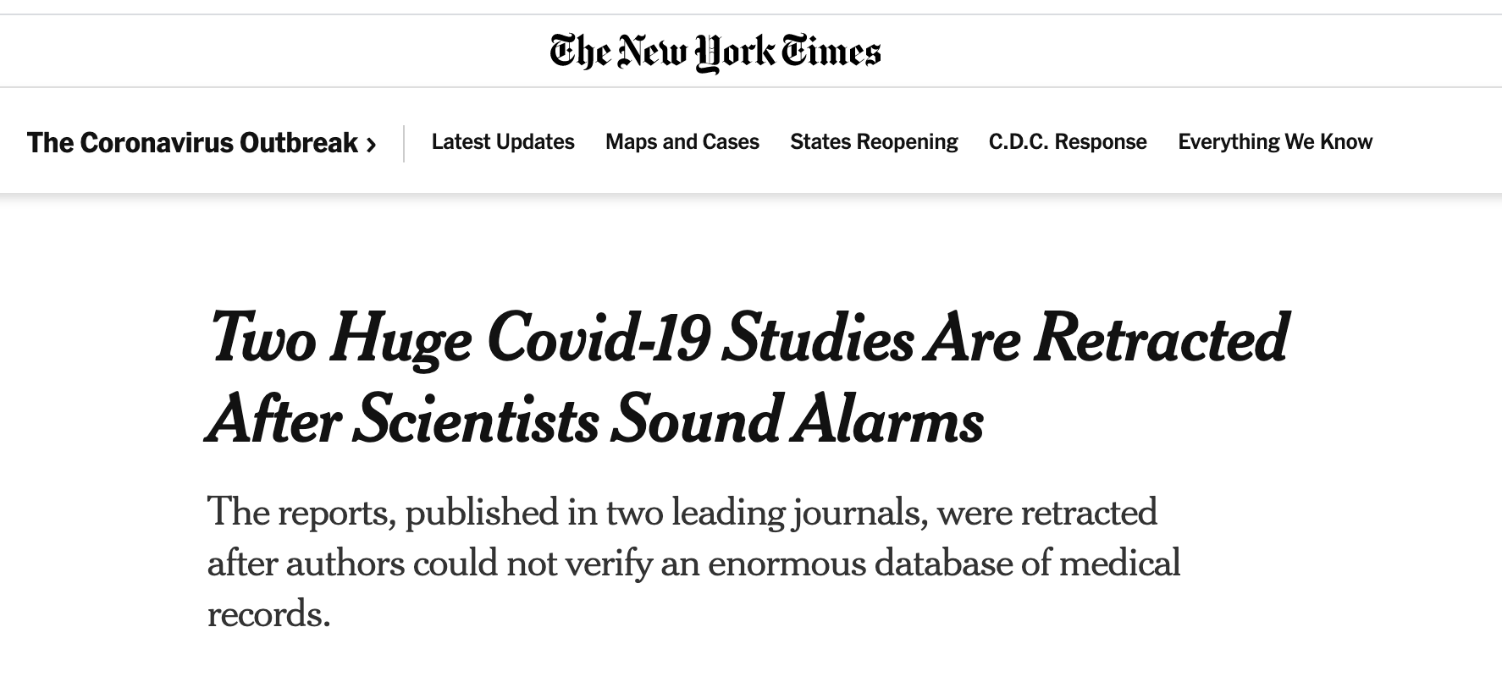
Data perturbations (new)
Data pre-processing (cleaning) matters
Notes:
In American economic review
RR website lists 76 high-profile features.
Only evidence cited in Paul Ryan’s report in 2010
Does High Public Debt Consistently Stifle Economic Growth? A Critique of Reinhart and Rogof
After correction by Herndon et al (2014), average growth rate for countries with over 90% debt/GDP changes from - 0.1 % to 2.2 %.
According to Reinhart’s and Rogoff’s website,1 the findings reported in the two 2010 papers formed the basis for testimony before the Senate Budget Committee (Reinhart, February 9, 2010) and a Financial Times opinion piece “Why We Should Expect Low Growth amid Debt”
2019, US ratio 106%, 2008, 68% why we always need growth? Isn’t life about balance with limited resources? Economics is part of life.
In one of life’s little ironies, last Friday’s disappointing G.D.P. figures, which reflected a sharp fall in government spending, appeared on the same day that the economists Carmen Reinhart and Kenneth Rogoff published an Op-Ed in the Times defending their famous (now infamous) research that conservative politicians around the world had seized upon to justify penny-pinching policies. Addressing a new paper by three lesser lights of their profession from the University of Massachusetts, Amherst, which uncovered data omissions, questionable methods of weighting, and elementary coding errors in Reinhart and Rogoff’s original work, and which went around the world like a viral video
Really? Even somebody living in a bubble stretching over Harvard Yard would have difficulty believing that. For all of the illuminating work Reinhart and Rogoff have done on the history of financial crises and their aftermaths, including their popular 2011 book “This Time Is Different: Eight Centuries of Financial Folly,” their most influential claim was that rising levels of government debt are associated with much weaker rates of economic growth, indeed negative ones. In undermining this claim, the attack from Amherst has done enormous damage to Reinhart and Rogoff’s credibility, and to the intellectual underpinnings of the austerity policies with which they are associated. In addition, it has created another huge embarrassment for an economics profession that was still suffering from the fallout of the financial crisis and the laissez-faire policies that preceded it. After this new fiasco,
how seriously should we take any economist’s policy prescriptions, especially ones that are seized upon by politicians with agendas of their own?
The Marketing of Austerity Policies

Slide 19
Model/algorithm perturbations (existing)
Robust statistics
Semi-parametric
Lasso and Ridge
Modes of a non-convex empirical minimization
Kernel machines
Sensitivity analysis in Bayesian modeling

Slide 20
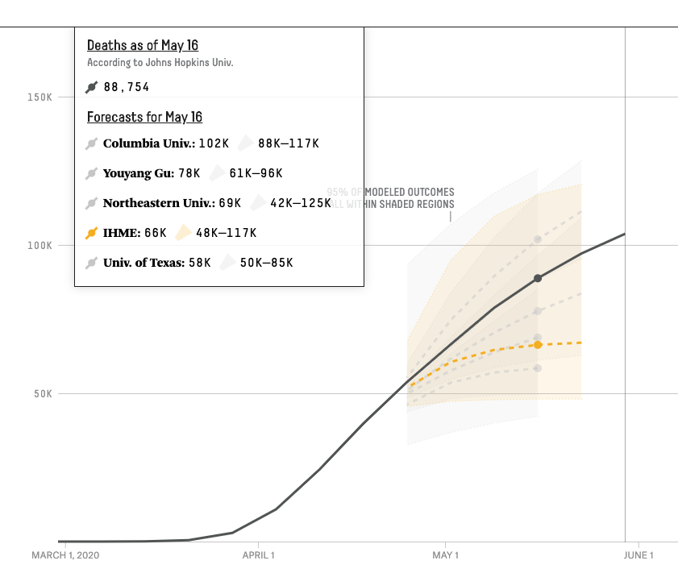
Model/algorithm perturbations (new)
Team to team
perturbation
https://projects.fivethirtyeight.com/covid-forecasts/
Notes:
Program Chair
Hugo Larochelle, Google Brain
Program Co-chairs
Alina Beygelzimer, Yahoo! Research
Florence d'Alché-Buc, Télécom ParisTech
Emily Fox, University of Washington & Apple

Slide 21
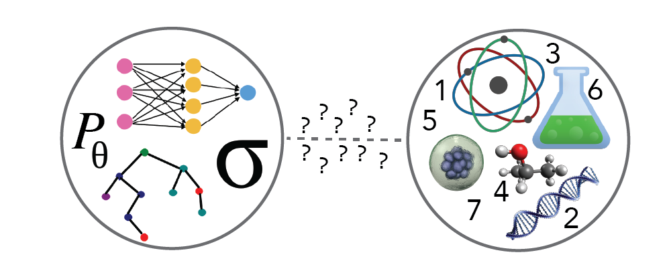

“It is not p-value’s fault”
“The p-value is a very valuable tool, but when possible it should be complemented – not replaced - by confidence
Intervals and effect size estimates” – Yoav Benjamini
For one thing, normal approximation can’t back up small p-values like , and there are other problems before normal approx. is used.
Notes:
Confidence intervals are much less likely to mislead than tiny
p-values, which are often automatically interpreted by humans
as precise hence strong evidence while it is hard to imagine we
can back up precisions like since normal approximation
often does NOT work at such a small probability value

Slide 22
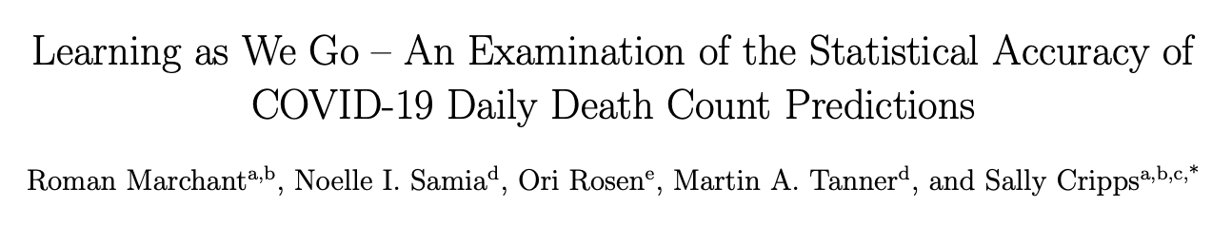
“It is not p-value’s fault”
“…the true number of next day deaths fell outside the IHME prediction intervals as much as 76% of the time, in comparison to the expected value of 5%...”

Slide 23


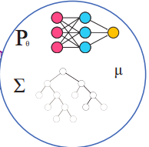
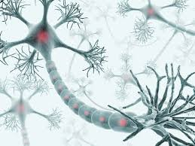
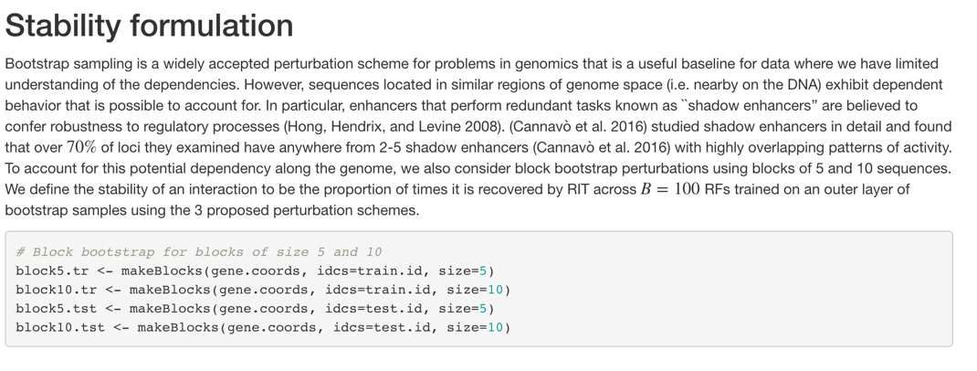
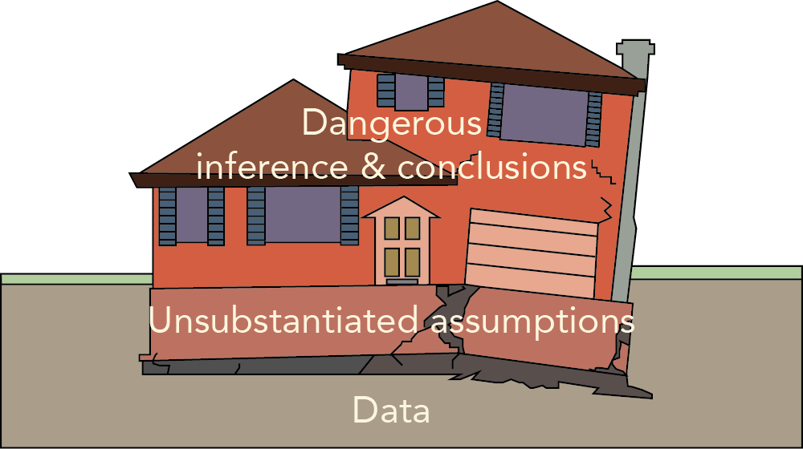
PCS doc. bridges reality and models on Github
Reality
Models
quantitative and
qualitative narratives
Image credit: Rebecca Barter
Notes:
Points to make:

Slide 24
How to choose perturbations in PCS?
One can never consider all possible perturbations
A pledge to the stability principle in PCS would lead to null results if too many perturbations were considered
PCS requires documentation on the appropriateness of all the perturbations
To avoid null results, PCS encourages careful and well-founded choices of the perturbations through PCS documentation

Slide 25
Proposed PCS inference (basic)
Problem formulation: Translate the domain question to be answered by a model/algorithm (or multiple of them and seek stability). Specify a target of interest.
Prediction screening for reality check: Filter models/algorithms based on prediction accuracy on held out test data – a sample split approach (it helps assess model bias)
Target value perturbation distribution: Evaluate the target of interest across “appropriate” data and model perturbations
Perturbation interval reporting: Summarize the target value perturbation distribution.

Slide 26
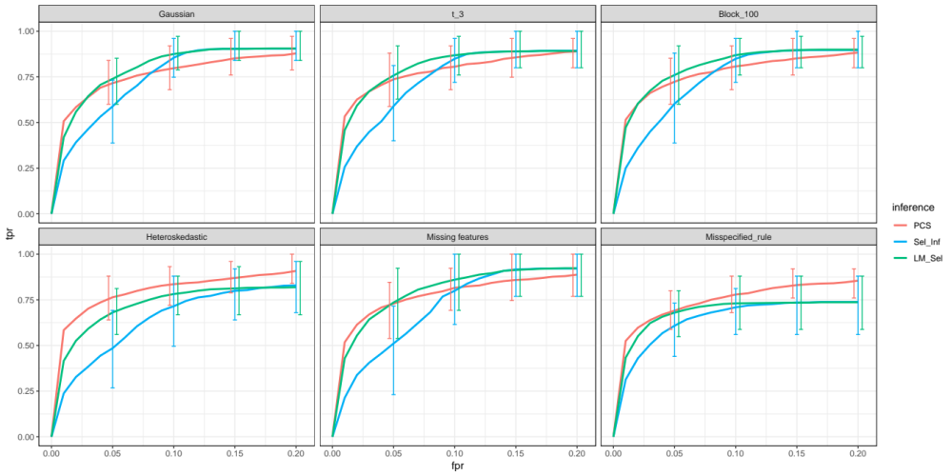
Feature importance study: PCS performs well simulation results for lasso feature selection in linear model n=1000, p=630
Adding another method: Lasso (CV)+ asymptotic normal approx.

Slide 27
Making Random Forests interpretable
by adding (more) stability

Slide 28



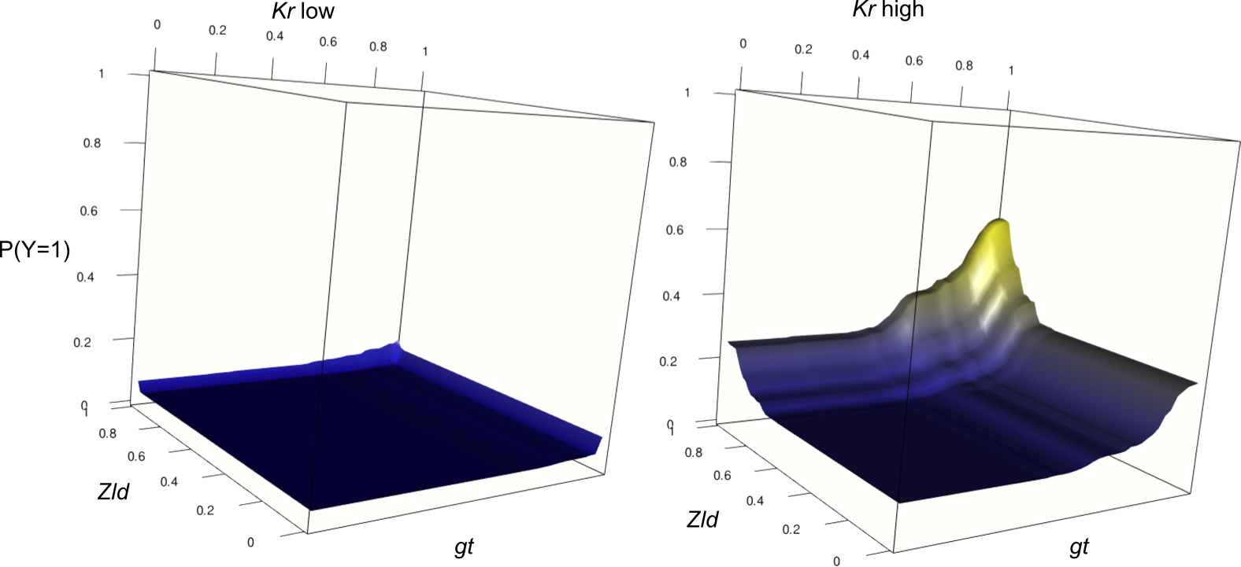
Co-authors
S. Basu K. Kumbier B. Brown
Culmination of 3+ years of work

Slide 29



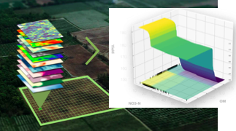
Pattern Recognition vs. Pattern Discovery

Slide 30
iterative Random Forests (iRFs)
Basu, Kumbier, Brown and Yu (2018)
Core ideas
Soft dim reduction using importance index
Random interaction trees to find intersections of paths
Outer-loop bagging assesses stability
Similar computational and memory costs as RF
Notes:
The first phase of weighted RF fitting has the same memory cost compared to RF. The second part, i.e., the RIT and stability calculation, needs to store extra information that requires more memory. The newly required memory is mainly for storing the set of features each path used, so the memory cost overhead is
number of paths in RF * avergae number of features used along each path
I am not sure how much is that compared to the memory cost of the original RF but should not be too much. Also, this memory cost can be avoided if RIT directly sample paths from trees in RF. Compared with the time complexity, the increase of memory complexity of iRF is not very large, I think.

Slide 31
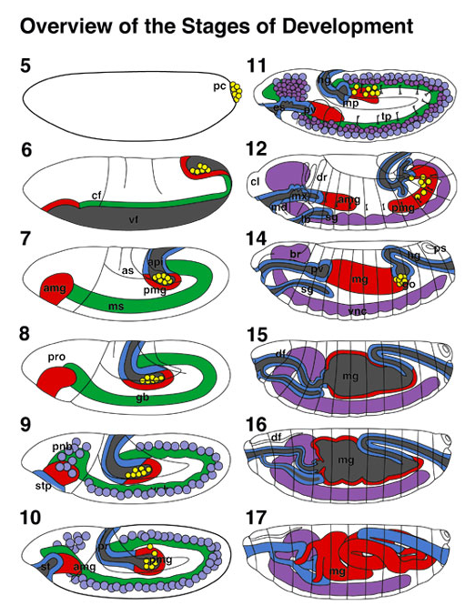
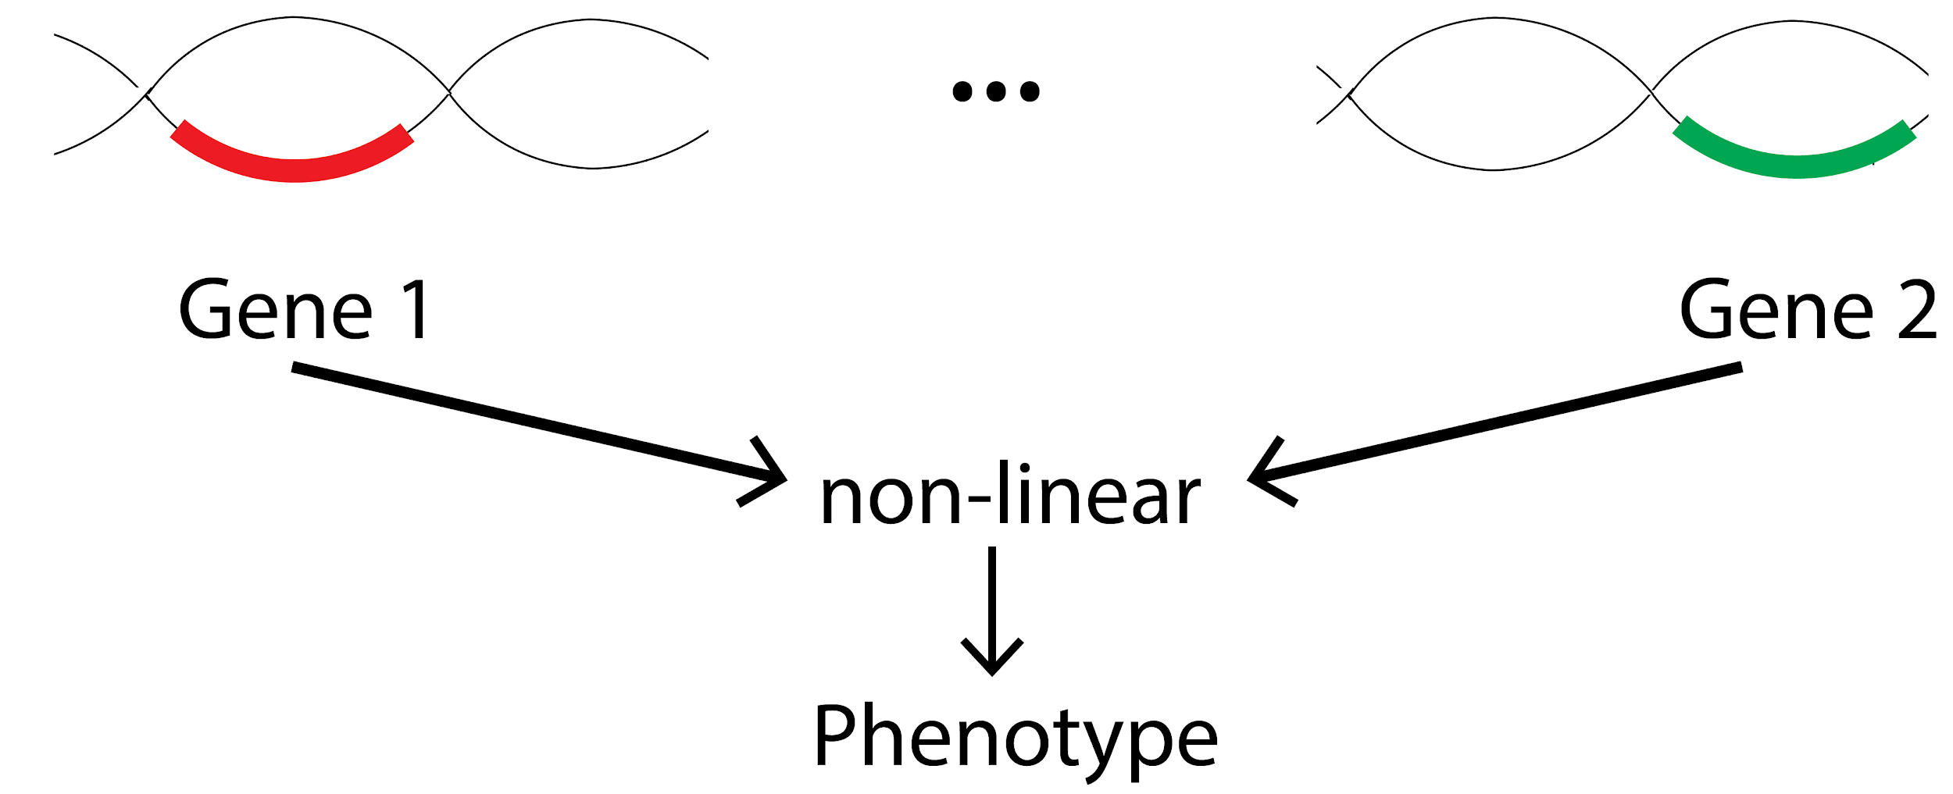
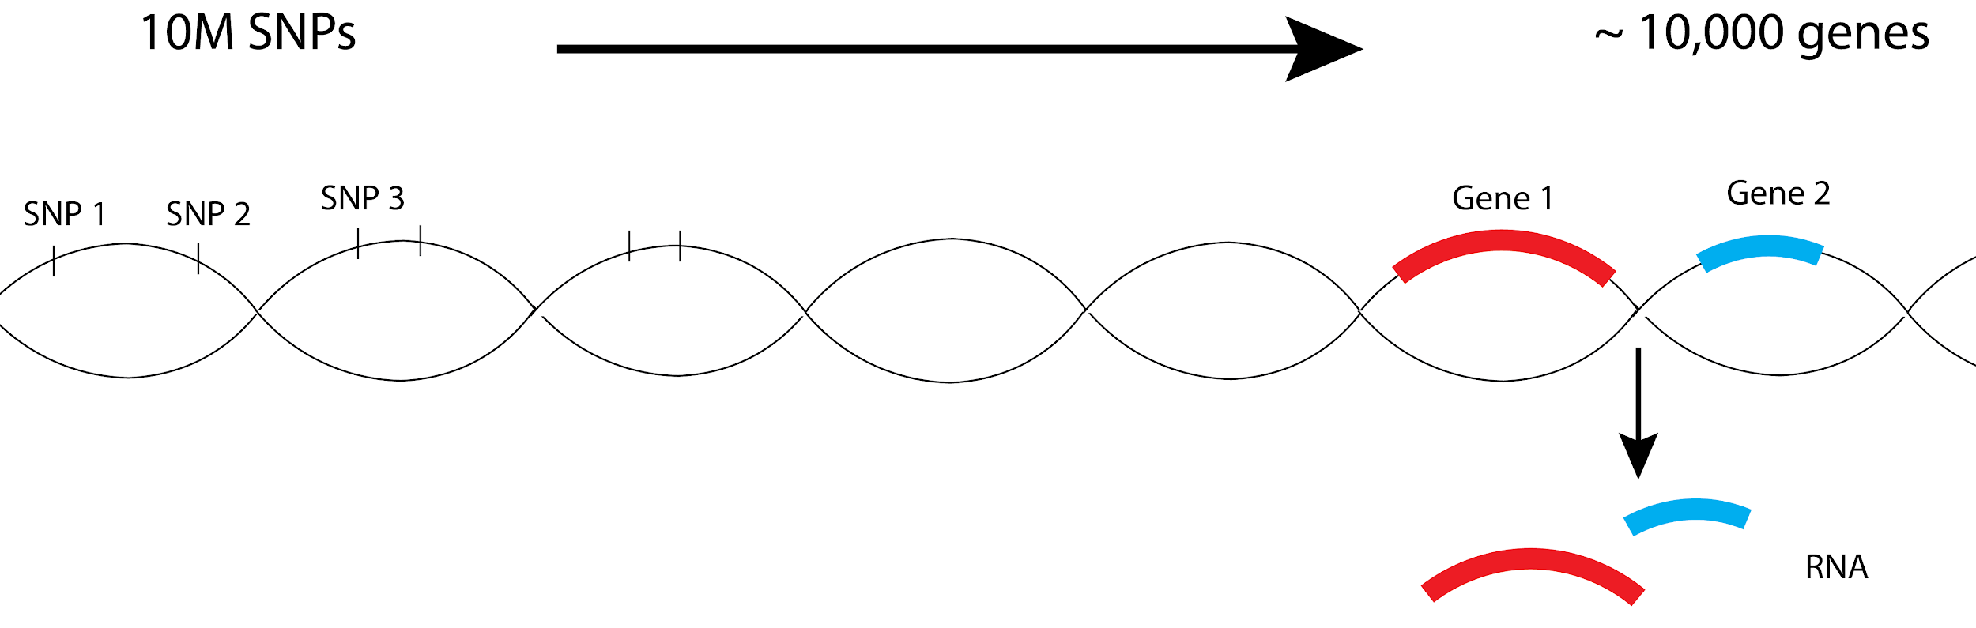
Enhancer activity in Drosophila
Detecting epistasis with iRF screening

Slide 32
iRF in Action!
iRF rediscovers several non-linear interactions known in the literature and that too without overfitting to an exhaustive search of the literature
Interpreting iRF results generates biological hypotheses and also provides new recommendations for future experiments

Slide 33


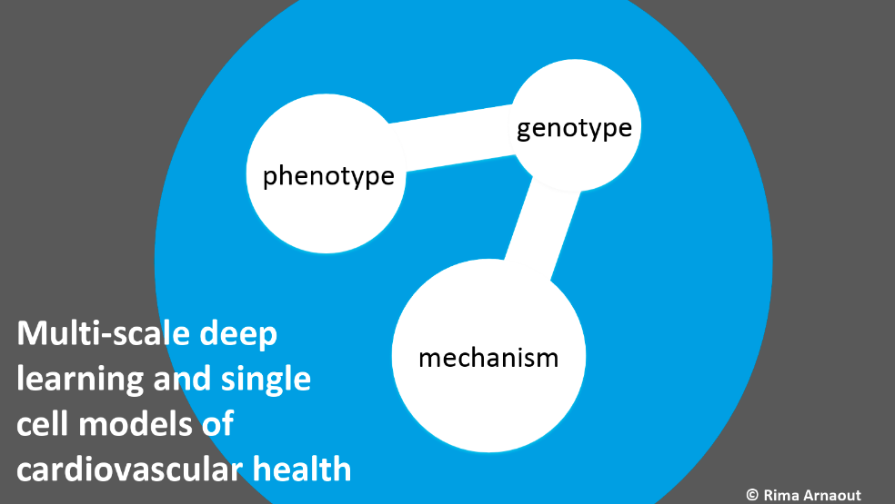
2018: Chan Zuckerberg Biohub Intercampus Award
iRF is a cornerstone
One of the 6 awards
Project leaders:
Rima Arnout and Atul Butte (UCSF)
James Priest and Euan Ashyley (Stanford)
Ben Brown and Bin Yu (UC Berkeley)
Collaborators:
Chris Re (Stanford), Deepak Srivastava (UCSF)
Image credits: Rima Arnout.

Slide 34

PCS Framework for Causal Inference:
Subgroup discovery in Randomized Clinical Trials
Work in progress, with Briton Park, Yan Shuo Tan, Mian Wei, Bin Yu and David Madigan

Slide 35
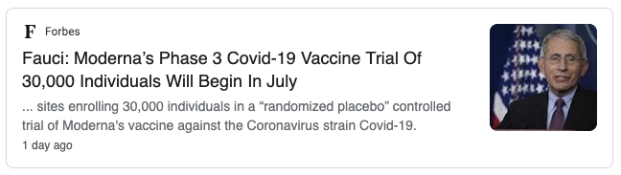


Clinical Trials: Sounds familiar…

Slide 36


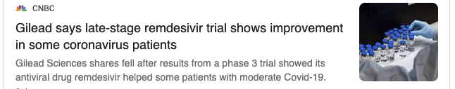
Clinical Trial: Does the drug work?

Slide 37
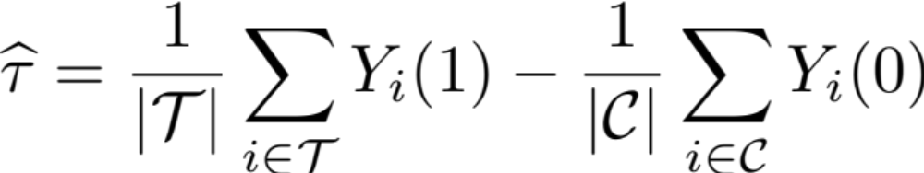



Treatment Effect is not homogeneous
Average treatment effect an easy task in a well-randomized clinical trial (randomization may not be kosher)
Treatment effect likely to vary with Age, Sex, Comorbidity, medical history

Slide 38

Our dataset: RCT with Vioxx

Slide 39
Our dataset: RCT with Vioxx
RCT with painkillers for arthritis:
Vioxx (treatment) vs. Naproxen (control)
Outcome: Gastrointestinal (GI) event, a side effect
Study population: 8076 patients with rheumatoid arthritis
177 patients (2%) experienced a GI event
Huge number of covariates; domain experts reduced the search space to 16 covariates

Slide 40
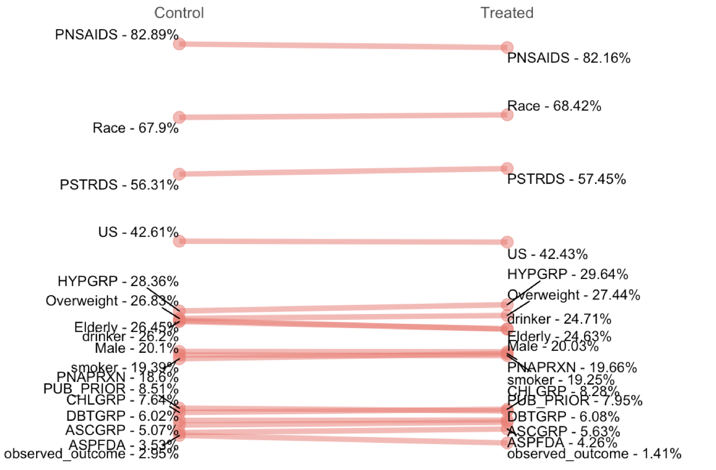
Vioxx reduces the chances of GI event: ATE = -1.6%

Slide 41
Closer look at the treatment effect
Which group was most benefited? Which group was worst affected?

Slide 42
Which subgroups are affected the most?
Direct search for all possible subgroups?
  Exponentially large search space; overfitting
Use an outcome model?
Use CATE model? (heterogeneous treatment effect model)

Slide 43
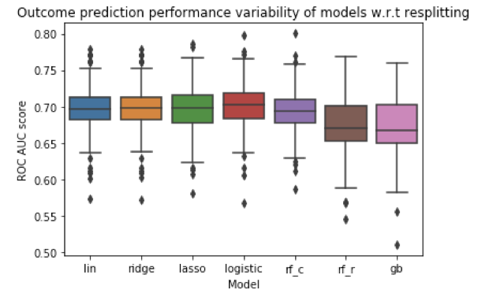

Use an outcome model?
Rare event: Low AUC Scores, not stable
to bootstrap samples ($0.7±0.1)$

Slide 44
Use a CATE model: Your CATE model or mine?

Slide 45
Use a CATE model: Your CATE model or mine?
Which model to pick? Lasso, Random Forest, Boosting…
How to validate the estimated treatment effect?
Missing data: The fundamental problem in causal inference.
Validating CATE for each individual: An impossible task.
CATE models in general not validated enough

Slide 46
PCS Principles To Rescue
First do a data split: Train/Validation/Test
Fit several CATE models (C check) on training set
Group patients based on predicted outcomes (percentiles), and validate Neyman estimate for CATE for these groups (P Check)

Slide 47
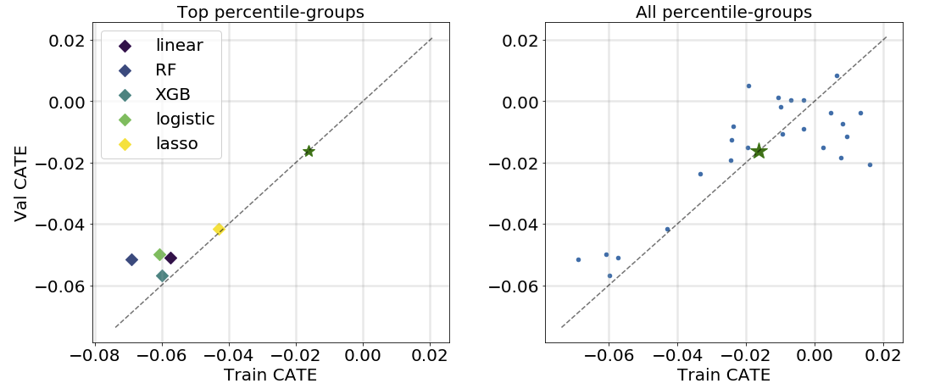
Top percentiles generalize well…!

Slide 48
PCS Principles To Rescue
Screen the models based on P check, can be combined (averaging) for stability or simplicity
Find the most affected group (top percentile) for the ensemble
  Percentile easy to define, hard to explain in terms of features
Form an interpretable cover using a few features for this group (iRF comes to rescue)
Finally test the findings on the holdout test data

Slide 49
PCS Principles To Rescue
Perform stability checks throughout the pipeline for various hyperparameters, document the judgement calls

Slide 50
Preliminary Results
PCS based search yields interpretable subgroups that generalize well.
Vioxx reduces GI side effect much more significantly than average for patients with
-- History of perforations, ulcers, bleeding
-- History of Steroids with old age
-- History of Steroids and hypertension
But other effects (hypertension, cardiac rates) may go up in some of these subgroups!
Validation with domain experts in progress…

Slide 51
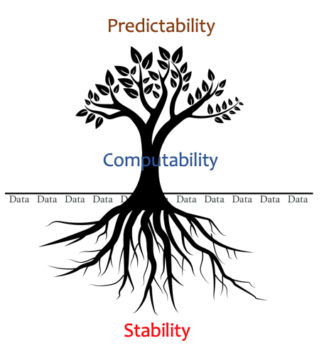
Summary
Veridical data science (trustworthy AI) through
PCS framework (workflow and documentation on github) advocating best practices for a responsible, reliable, reproducible and transparent DSLC to reach trustworthy data conclusions
PCS inference incorporating data and model (researcher) perturbations
Case studies: iRF (siRF), Subgroup discovery in RCT
Domain knowledge is important and PCS generates testable hypotheses towards causality
Hope PCS is useful for your project!
Notes:
Integrating the two cultures and developing further,

Slide 52



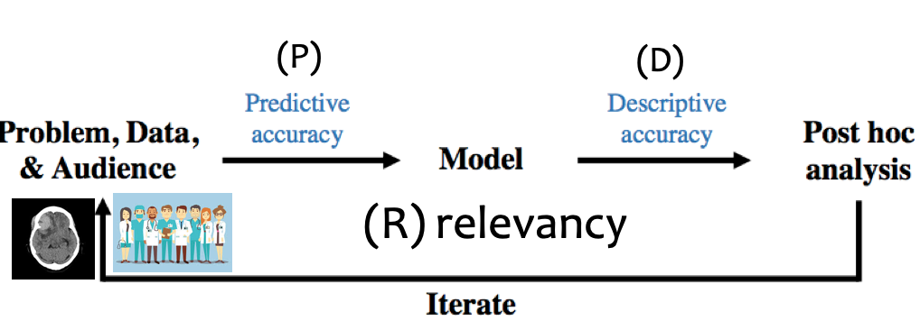
References
1. Veridical data science
(B. Yu and K. Kumbier, 2020, PNAS)
https://arxiv.org/abs/1901.08152
2. Definitions, methods and applications in interpretable machine learning
J. Murdoch, C. Singh, K. Kumber, R. Abbasi-Asl, and
B. Yu
(2019) , PNAS
Notes:
DS – three components, CS, math/stats and domain knowledge.
Prediction and computation (especially through various first-order method and CV) are driving forces behind success of ML in recent years.
EU 2016 General Data Protection Regulation dictates human intepretabiilty of ML/Stat algorithms.
As the drawing shows, prediction and computation are grounded thruogh stability for intepretation and as we argue, also
for intervention design in causal inference including digital experimentation.
“We define interpretability, in the context of statistical
machine learning, as the extraction of relevant
knowledge about domain relationships contained in data.”

Slide 53
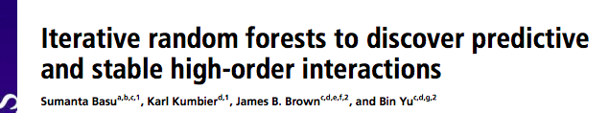
iRF and siRF papers and software
iRF paper in PNAS (2019)
Open source R implementation: https://cran.r-project.org/web/packages/iRF/
Refining interaction search through signed iterative Random Forests (s-iRF) by Kumbier, Basu, Brown, Celniker and Yu (2019)
https://arxiv.org/pdf/1810.07287.pdf
Software: https://github.com/sumbose/iRF
containing both iRF and s-iRF

Slide 54

Upcoming book on data science
Coming (2021?)

