Slide 1
Data Management with Data Verbs
Todd Iverson, Winona State University (Speaker)
Chris Malone, Winona State University
Slides: https://bit.ly/2MsP10Q

Slide 2
How do you learn to solve a Rubik's cube?

Slide 3
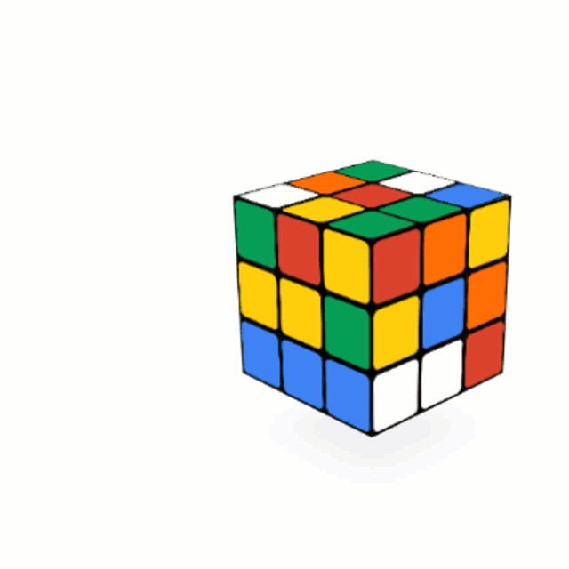
Understand the moves
Source : https://bit.ly/2z2RyM7

Slide 4
Learn combinations of moves
Image removed
before posting to GitHub
Source: https://bit.ly/36XNKs5

Slide 5
Solve the cube!
Image removed
before posting to GitHub
Source: https://bit.ly/3ePOcuW

Slide 6
Rubik's cube?
I thought this was about data management?

Slide 7
Focus on structured data first
Structured
Data that can be stored easily in a table
Unstructured
All other data

Slide 8
Understand the moves
dplyr
Spark SQL
select
filter
select
filter
mutate
withColumn
gather
spread
gather
spread
group_by
summarise
group_by
agg
union
left_join
union
join
intersect
full_join
intersect
setdiff
inner_join

Slide 9
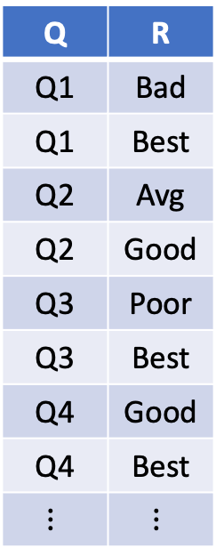
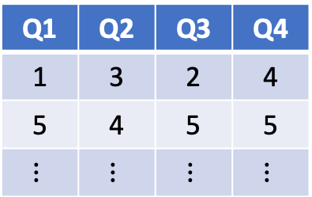
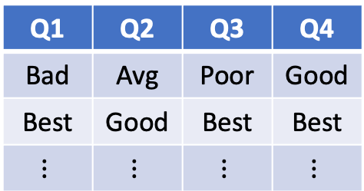
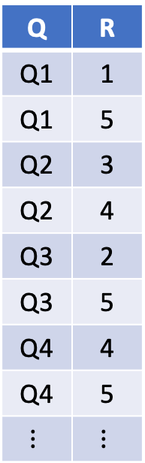
Learn combinations of moves
Q | R
Q1 | Bad
Q1 | Best
Q2 | Avg
Q2 | Good
Q3 | Poor
Q3 | Best
Q4 | Good
Q4 | Best
$$⋮$$ | $$⋮$$
Q | R
Q1 | 1
Q1 | 5
Q2 | 3
Q2 | 4
Q3 | 2
Q3 | 5
Q4 | 4
Q4 | 5
$$⋮$$ | $$⋮$$
Q1 | Q2 | Q3 | Q4
Bad | Avg | Poor | Good
Best | Good | Best | Best
$$⋮$$ | $$⋮$$ | $$⋮$$ | $$⋮$$
Q1 | Q2 | Q3 | Q4
1 | 3 | 2 | 4
5 | 4 | 5 | 5
$$⋮$$ | $$⋮$$ | $$⋮$$ | $$⋮$$
recode
stack
unstack
Wickham--Stack Overflow https://bit.ly/3gQTWqj

Slide 10
Solve the table
T1
T1
G | X
a | 5
a | 2
b | 3
b | 1
G | X
a | 5
a | 2
b | 3
b | 1
T1
group by(G)
agg(sum(X))
G | X
a | 7
b | 4
ijoin(T1.G,T2.G)
G1 | X | G2 | Y
a | 7 | a | 5
b | 4 | b | 6
select(G1, X, Y)
G1 | X | Y
a | 7 | 5
b | 4 | 6
T2
T2
G | Y
a | 3
a | 2
b | 4
b | 1
b | 1
G | Y
a | 3
a | 2
b | 4
b | 1
b | 1
T2
group_by(G)
agg(sum(Y))
G | Y
a | 5
b | 6

Slide 11
Managing data with dplyr feels like solving the cube

Slide 12
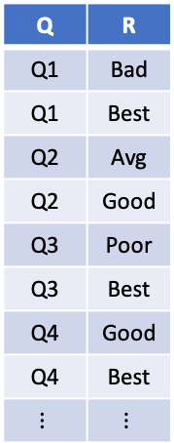
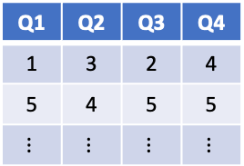
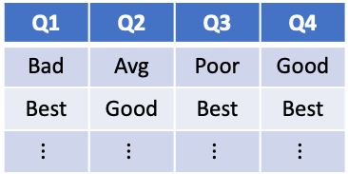
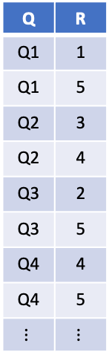
The algebra of data management
Q | R
Q1 | 1
Q1 | 5
Q2 | 3
Q2 | 4
Q3 | 2
Q3 | 5
Q4 | 4
Q4 | 5
$$⋮$$ | $$⋮$$
Q | R
Q1 | Bad
Q1 | Best
Q2 | Avg
Q2 | Good
Q3 | Poor
Q3 | Best
Q4 | Good
Q4 | Best
$$⋮$$ | $$⋮$$
Image removed
before posting to GitHub
mutate
(recode)
Q1 | Q2 | Q3 | Q4
Bad | Avg | Poor | Good
Best | Good | Best | Best
$$⋮$$ | $$⋮$$ | $$⋮$$ | $$⋮$$
Q1 | Q2 | Q3 | Q4
1 | 3 | 2 | 4
5 | 4 | 5 | 5
$$⋮$$ | $$⋮$$ | $$⋮$$ | $$⋮$$
gather
spread
Source: https://bit.ly/36XNKs5

Slide 13
WSU curriculum uses these data verbs end-to-end
DSCI 210
DSCI 325
DSCI 430

Slide 14
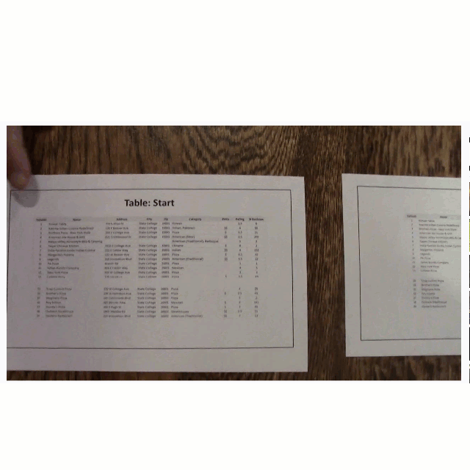
Hands-on, technology agnostic introduction

Slide 15
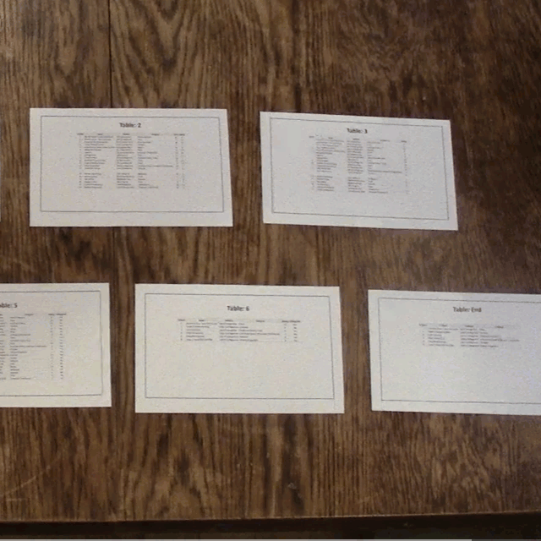
Hands-on, technology agnostic introduction

Slide 16
Common language applied to every platform
JMP
dplyr
SQL
pandas
PySpark

Slide 17
and prepares students for the next platform
JMP
dplyr
SQL
pandas
PySpark
??

Slide 18
What about unstructured data?
Structured
Data that can be stored easily in a table
Unstructured
All other data

Slide 19
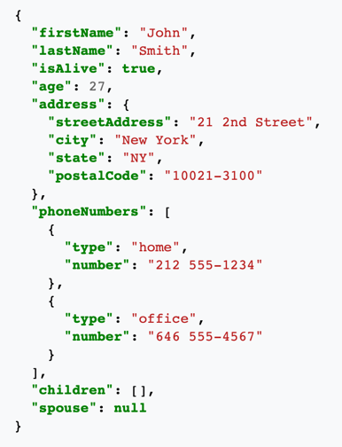

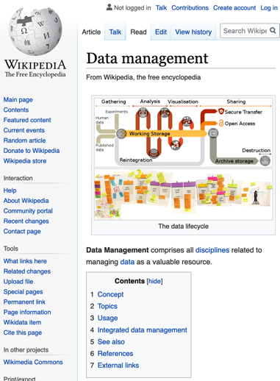
JSON
Images
Websites
Text
You do not like them.
So you say.
Try them!
Try them!
And YOU
May!
Source: Green Eggs and Ham, Dr. Seuss
Source: https://en.wikipedia.org/wiki/JSON
Source: https://en.wikipedia.org/wiki/Data_management

Slide 20
Unstructured data still has structure …
You do not like them.
So you say.
Try them!
Try them!
And YOU
May!
text
paragraphs
sentences
words
characters

Slide 21

and some unstructured data is recursive
JSON
JSON
JSON
JSON
JSON
JSON
Source: https://en.wikipedia.org/wiki/JSON

Slide 22
Is there a universal vocabulary for unstructured data?

Slide 23
I think the answer starts with data origami
Origami Programming
“… folds and unfolds are the natural patterns of computation … unfolds generate data structures and folds consume them.”
Origami Programming, Jeremy Gibbons

Slide 24
Origami Example
Adding commas to a long string of digits
1232115
1232
115
1
232
115
1
232,115
1,232,115

Slide 25
Understand the moves
Unfold
Split a value into nested data structures
Unfold
Split a value into nested data structures
Transform
Transform the atoms of a nested data structures
Transform
Transform the atoms of a nested data structures
Fold
Reduce a Data structure to a single value

Slide 26
Learn combinations of moves
Unfold
Fold
1232115
1
232
115
1,232,115

Slide 27
Solve!
Data Origami Workflow
Unfold into atomic elements
  Preserve groupings
Transform atoms
Fold/Combine elements

Slide 28
Example – Strategies to solve
Summary statistics on text
You may like them.
You will see.
You may like them in a tree!
???
4.33
Problem: Find the average number of words per sentence

Slide 29
Unfold based on the levels of abstraction
You do not like them.
So you say.
Try them!
Try them!
And YOU
May!
text
paragraphs
sentences
words
characters

Slide 30
The Laws of Data Origami
Unfold into atomic elements
  Preserve groupings
Transform atoms
Fold/Combine elements
You may like them.
You may like them.
You will see.
You may like them in a tree!
You will see.
You may like them in a tree!

Slide 31
You
may
The Laws of Data Origami
Unfold into atomic elements
  Preserve groupings
Transform atoms
Fold/Combine elements
You may like them.
like
them.
You may like them.
You will see.
You may like them in a tree!
You
will
You will see.
see.
You
may
like
them
You may like them in a tree!
a
in
tree!

Slide 32
You
may
1
1
The Laws of Data Origami
Unfold into atomic elements
  Preserve groupings
Transform atoms
Fold/Combine elements
You may like them.
like
1
them.
1
You may like them.
You will see.
You may like them in a tree!
You
will
1
1
You will see.
see.
1
You
may
1
1
like
them
1
1
You may like them in a tree!
a
in
1
1
tree!
1

Slide 33
The Laws of Data Origami
Unfold into atomic elements
  Preserve groupings
Transform atoms
Fold/Combine elements
You
may
1
1
You may like them.
like
1
4
them.
1
You may like them.
You will see.
You may like them in a tree!
You
will
1
1
You will see.
3
see.
1
You
may
1
1
like
them
1
1
You may like them in a tree!
7
a
in
1
1
tree!
1

Slide 34
Don’t Forget. Averaging requires two folds
Total all elements
Count all elements
You
may
1
1
You may like them.
like
1
4
them.
1
You may like them.
You will see.
You may like them in a tree!
You
will
1
1
You will see.
3
(14, 3)
4.67
see.
1
You
may
1
1
like
them
1
1
You may like them in a tree!
7
a
in
1
1
tree!
1

Slide 35
Unfold
Transform
Fold
You
may
1
1
You may like them.
like
1
4
them.
1
You may like them.
You will see.
You may like them in a tree!
You
will
1
1
You will see.
3
see.
1
(14, 3)
4.67
You
may
1
1
like
them
1
1
You may like them in a tree!
7
a
in
1
1
tree!
1

Slide 36
Final Thoughts

Slide 37
Employ technology-agnostic concepts across the curriculum

Slide 38
Data verbs provide a universal language for data management

Slide 39
Spend time of both structured and unstructured data

Slide 40
Resources
Slides
  https://github.com/WSU-DataScience/SDSS20_data_verbs
Data verb poster & activities:
  https://github.com/WSU-DataScience/SDSS19_data_verb_poster
DSCI 330 – The Management of Unstructured Data
  https://github.com/yardsale8/DSCI330
DSCI 430 – Data Science at Scale
  https://github.com/yardsale8/DSCI430
→ https://bit.ly/2MsP10Q

Slide 41
Sources
Zaharia, M., Chowdhury, M., Franklin, M. J., Shenker, S., & Stoica, I. (2010). Spark: Cluster computing with working sets. HotCloud, 10(10-10), 95.
Armbrust, M., Xin, R. S., Lian, C., Huai, Y., Liu, D., Bradley, J. K., ... & Zaharia, M. (2015, May). Spark sql: Relational data processing in spark. In Proceedings of the 2015 ACM SIGMOD international conference on management of data (pp. 1383-1394).
Wickham, H., Francois, R., Henry, L., & Müller, K. (2015). dplyr: A grammar of data manipulation. R package version 0.4, 3.
Gibbons, J. (2003). Origami programming.

Slide 42
Appendix
Using verbs and map to describe/combine arrows

Slide 43
There are other well-established verbs
Other functional vocabulary
I
False
I
1
map(has_a)
filter(has_a)
reduce(add)
am
True
am
am
2
6
Sam.
True
Sam.
Sam.
3
Notes:
Doug recalls this assignment requires unit tests. What was it that Iverson said in class about unit test?

Slide 44
Step 1 – Assign verbs to each arrow
Split
(Word)
You
may
1
1
Add
You may like them.
like
1
4
Map
(one)
them.
1
You may like them.
You will see.
You may like them in a tree!
You
will
1
1
Divide
You will see.
Split
(Word)
Add
3
(43, 3)
4.67
see.
Map
(one)
1
(Add,
Count)
Split
(Sentence)
You
may
1
1
Split
(Word)
like
them
1
1
You may like them in a tree!
Add
Map
(one)
7
a
in
1
1
tree!
1
tree!
one
1

Slide 45
Step 2 – Combine arrows with map
Split
(Word)
You
may
1
1
Add
You may like them.
like
1
4
Map
(one)
them.
1
You may like them.
You will see.
You may like them in a tree!
You
will
1
1
Divide
You will see.
Split
(Word)
Add
3
(43, 3)
4.67
see.
Map
(one)
1
(Add,
Count)
Split
(Sentence)
You
may
1
1
Split
(Word)
like
them
1
1
You may like them in a tree!
Add
Map
(one)
7
a
in
1
1
tree!
1

Slide 46
Step 2 – Combine arrows with map
You
may
1
1
Add
You may like them.
like
1
4
Map
(one)
them.
1
Map
Split
(Word)
You
will
1
1
Divide
You may like them.
You will see.
You may like them in a tree!
Add
3
(14, 3)
4.67
You will see.
see.
Map
(one)
1
(Add,
Count)
Split
(Sentence)
You
may
1
1
like
them
1
1
Add
You may like them in a tree!
7
a
in
Map
(1)
1
1
tree!
1

Slide 47
Step 2 – Combine arrows with map
You
may
1
1
Add
You may like them.
like
1
4
them.
1
Map
Split
(Word)
You may like them.
You will see.
You may like them in a tree!
You
will
1
1
Divide
You will see.
Add
3
(14, 3)
4.67
see.
1
(Add,
Count)
Map
Map
(one)
Split
(Sentence)
You
may
1
1
like
them
1
1
Add
You may like them in a tree!
7
a
in
1
1
tree!
1

Slide 48
Step 2 – Combine arrows with map
You
may
1
1
Add
You may like them.
like
1
4
them.
1
Map
Split
(Word)
You may like them.
You will see.
You may like them in a tree!
You
will
1
1
Divide
You will see.
Add
3
(14, 3)
4.67
see.
1
(Add,
Count)
Map
Map
(one)
Split
(Sentence)
You
may
1
1
like
them
1
1
Add
You may like them in a tree!
7
a
in
1
1
tree!
1

Slide 49
Step 2 – Combine arrows with map
You
may
1
1
You may like them.
like
1
4
them.
1
Map
Split
(Word)
You
will
1
1
Map
Add
Divide
You may like them.
You will see.
You may like them in a tree!
You will see.
3
(14, 3)
4.67
see.
1
(Add,
Count)
Map
Map
(one)
Split
(Sentence)
You
may
1
1
like
them
1
1
You may like them in a tree!
7
a
in
1
1
tree!
1

Slide 50
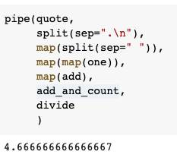
Step 3 – Translate to Python
You
may
1
1
You may like them.
like
1
4
them.
1
Map
Split
(Word)
You
will
1
1
Map
Add
Divide
You may like them.
You will see.
You may like them in a tree!
You will see.
3
(14, 3)
4.67
see.
1
(Add,
Count)
Map
Map
(one)
Split
(Sentence)
You
may
1
1
like
them
1
1
You may like them in a tree!
7
a
in
1
1
tree!
1

