Slide 1
Wednesday, June 3, 2020
Data Viz for High-Dimensional Data Validation: Case Studies on Evaluating Synthetic Data Generation
Aaron R. Williams

Slide 2
Acknowledgments
INTRO
Arnold Ventures
The team
  Claire McKay Bowen
  Victoria Bryant
  Leonard Burman
  Surachai Khitatrakun
  Robert McClelland
  Phillip Stallworth
  Kyle Ueyama
  Graham MacDonald

Slide 3
Outline
Case Study
Dimensionality
Data Viz Techniques
Data that Are Suitably Paired
Data that Are Not Suitably Paired
Iteration

Slide 4
Outline
Case Study
Dimensionality
Data Viz Techniques
Data that Are Suitably Paired
Data that Are Not Suitably Paired
Iteration

Slide 5
Case Study

Slide 6
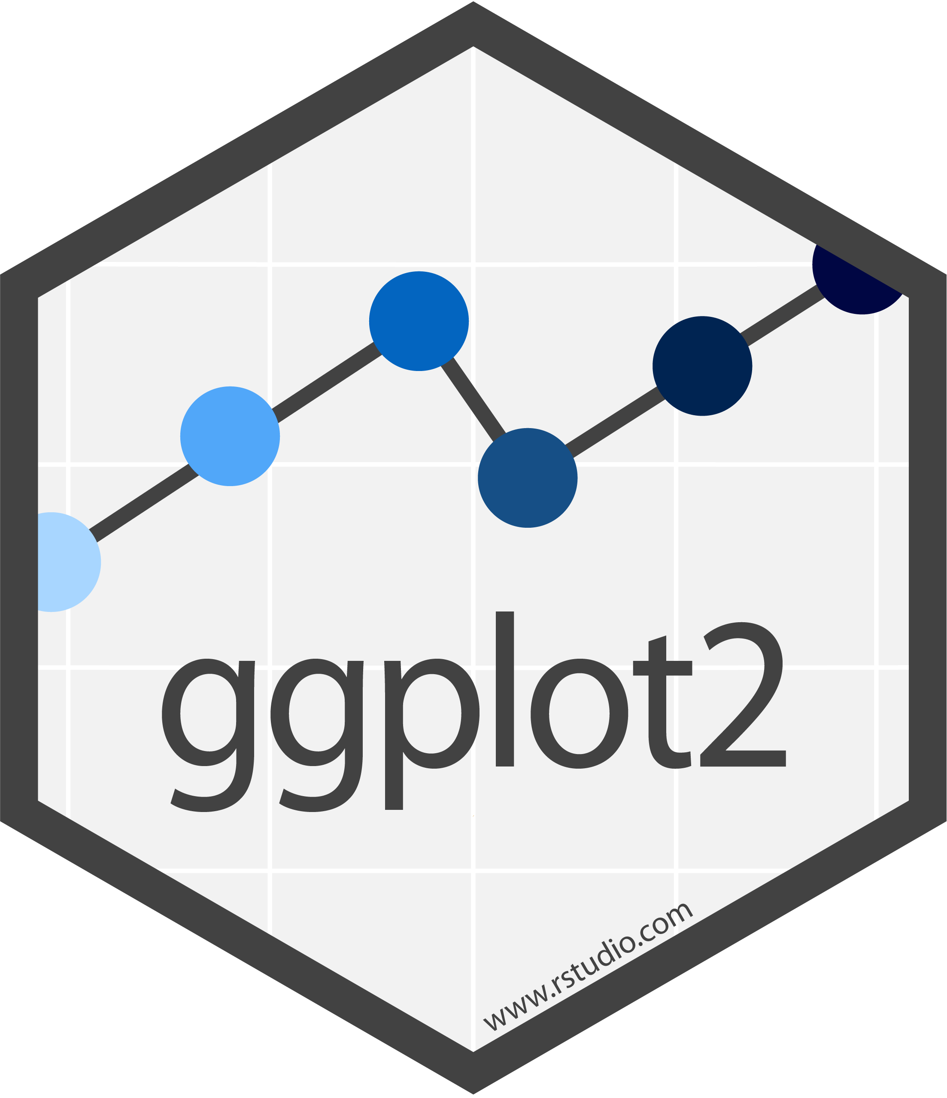

Implementation
DATA VIZ

Slide 7
Project
CASE STUDY
Synthetic Data Generation
  Urban-Brookings Tax Policy Center synthesis of IRS tax records

Slide 8
Goals
CASE STUDY
Produce fully synthetic data file with the same record layout as IRS Administrative Data that:
  Protects the confidentiality of tax return information
  May be used for statistically valid analysis for certain research purposes
  May be used as a “training dataset” to develop programs to run on confidential data
Notes:
microsimulation, summary statistics. Not regression.
Validation server

Slide 9
Synthetic Data
CASE STUDY
Partially-Synthetic Data
  Selected observations/variables are synthesized
  Little (1993)
Fully-Synthetic Data
  All observations/variables are synthesized
  Rubin (1993)

Slide 10
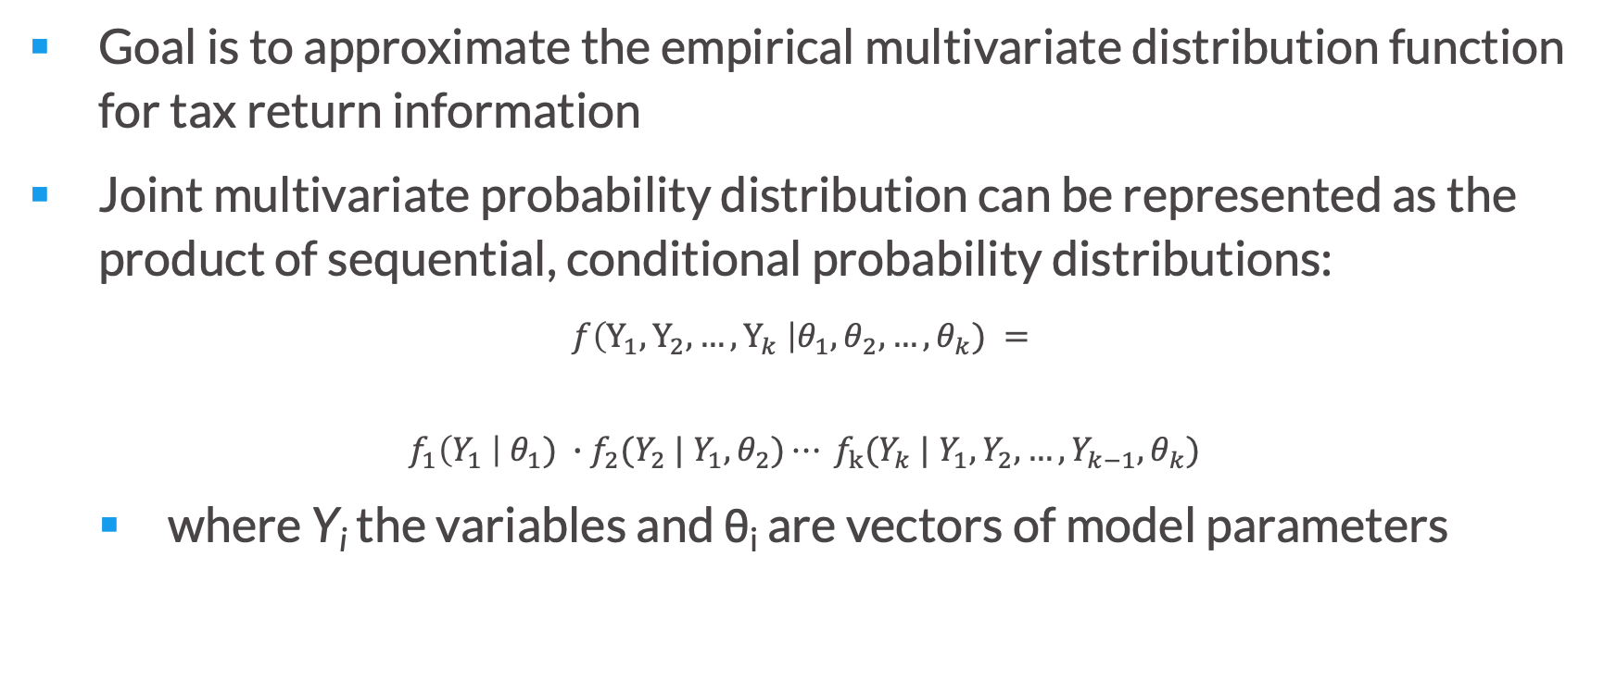
Estimating the multivariate distribution of tax variables
CASE STUDY
Goal is to approximate the empirical multivariate distribution function for tax return information
Joint multivariate probability distribution can be represented as the product of sequential, conditional probability distributions:
$$f\left(Y_{1},Y_{2}, …, Y_{k} \right|θ_{1}, θ_{2}, …, θ_{k}) =$$
$$f_{1}\left(Y_{1} \right|{ θ}_{1}) ∙f_{2}(Y_{2} | Y_{1}, θ_{2})⋯ f_{k}(Y_{k} | Y_{1}, Y_{2}, …, Y_{k−1}, θ_{k})$$
  where Y_{i} the variables and θ_{i} are vectors of model parameters

Slide 11
Sequential CART Process
CASE STUDY
Unconditionally sample sex from the confidential data with replacement
Synthesize age based on sampled sex
Synthesize wages based on synthetic sex and age
Sequentially synthesize remaining variables with all previously synthesized variables as predictors

Slide 12
Methods
CASE STUDY
Multinomial synthesizer for categorical variables
Non-parametric methods for continuous variables
  CART, RF
  Kernel density estimates for additional smoothing

Slide 13
Dimensionality

Slide 14
N large
DIMENSIONALITY
150,000-300,000 observations
Problem: overplotting
Notes:
Small for biologists

Slide 15
Many complicated relationships
DIMENSIONALITY
20-150 variables
Problem: m(m - 1)/2 relationships
Problem: tax variable relationships are complicated
  phase-ins, phase-outs
  discontinuities
  bunching at kink points

Slide 16
Iteration (save for later)
DIMENSIONALITY
  Hundreds of specifications
  Each specification is run up to 100 times

Slide 17
Data Visualization Techniques

Slide 18
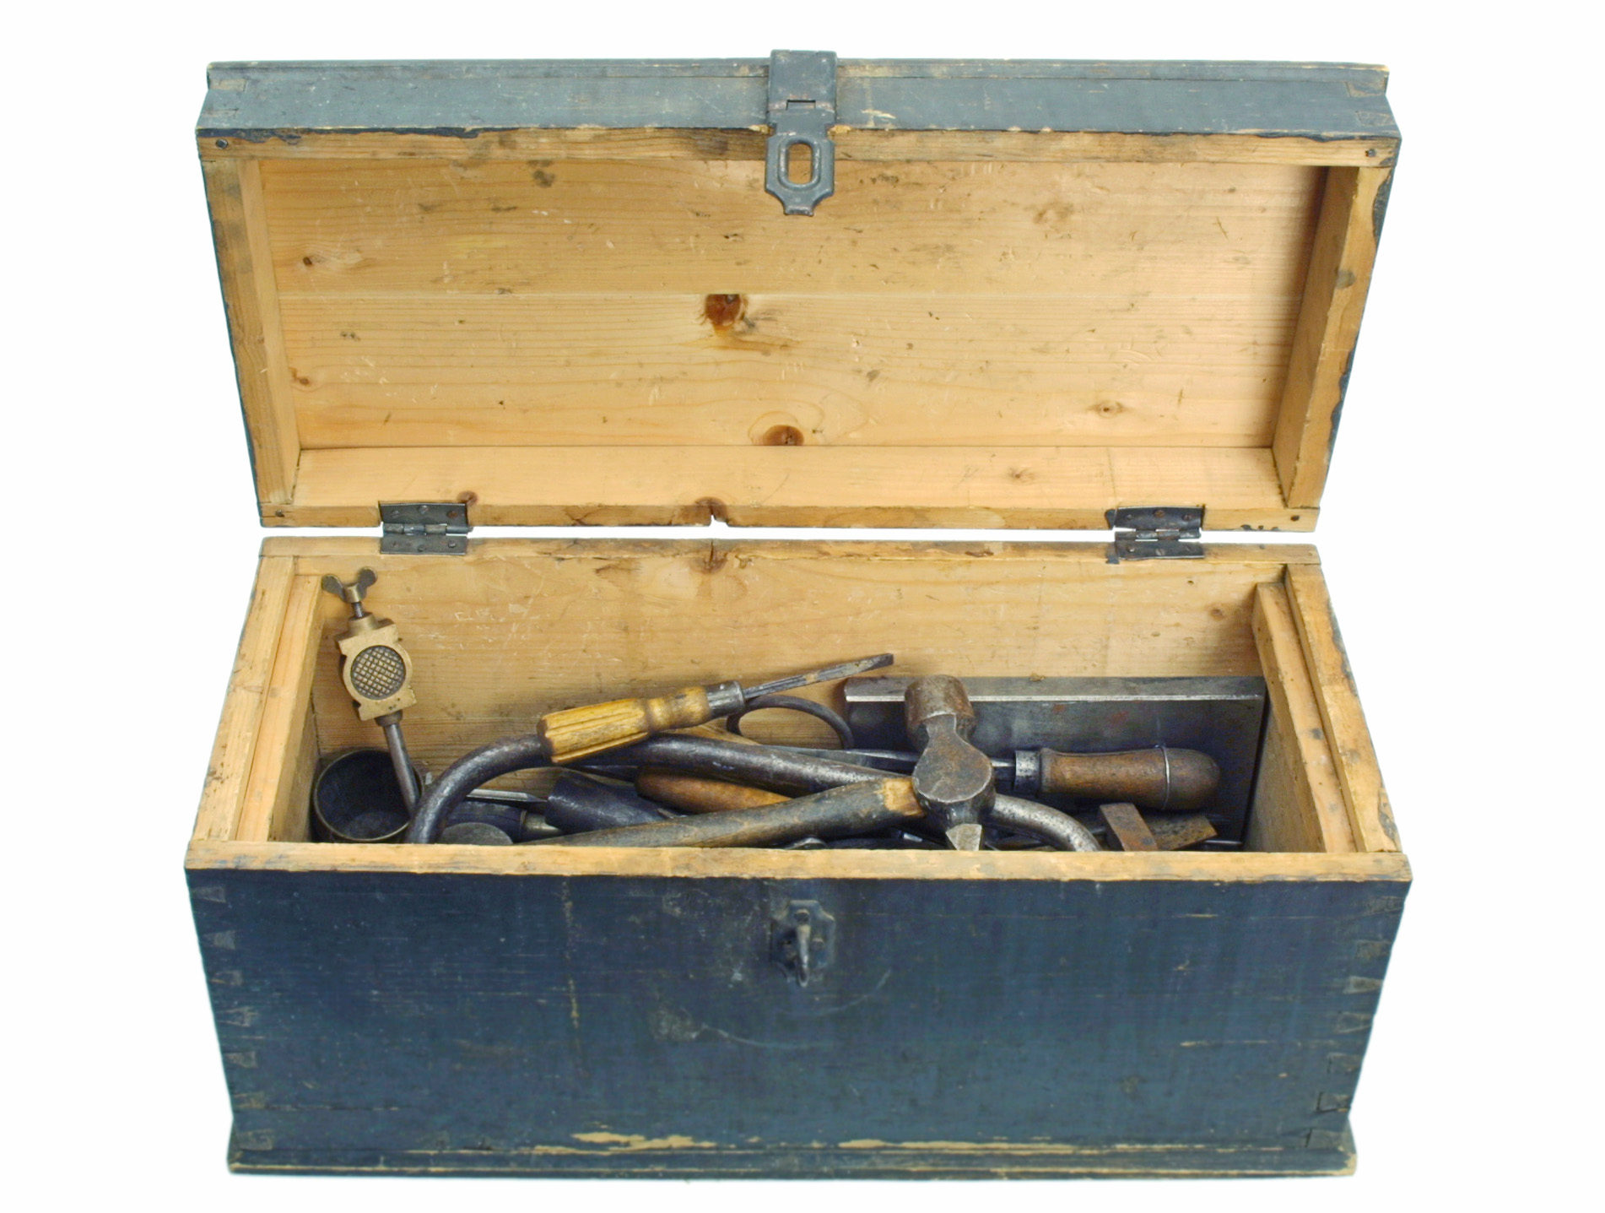

Photo by Reetta Tervakangas, Vapriikki Photo Archives

Slide 19
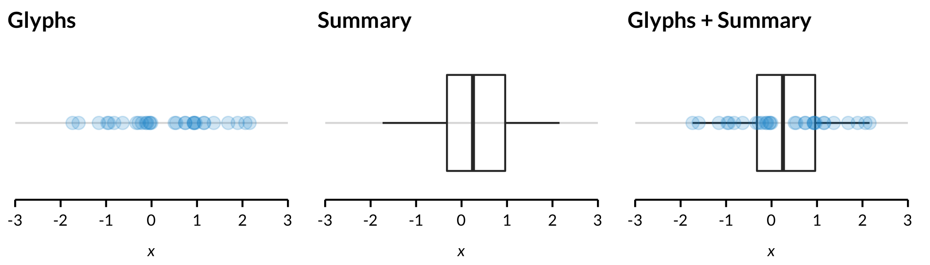
Two types of data visualization
DATA VIZ
  Direct visualization with glyphs
  Visualization of statistical summaries

Slide 20
Remedial measures for overplotting
DATA VIZ
  Smaller glyphs and hollow glyphs
  Jittering
  α-blending
  Conditional plots/trellis displays
  Histograms and binning
  Kernel smoothing
  Models: linear, LOESS, penalized cubic regression splines
  Sampling

Slide 21
Remedial measures for many variables
DATA VIZ
  Parallel coordinate plots (Inselberg, 1985)
  Scatterplot matrices (Carr, 1985)
  PCA/factor analysis
  t-SNE (Maaten and Hinton, 2008)
  UMAP (Mcinnes et al., 2018)
  Grand tours (Asimov, 1985)
  Rotating plots (Cook and Miller, 2006)

Slide 22
Data that are Suitably Paired

Slide 23
Data that are suitably paired
SUITABLY PAIRED
Partially-synthetic data
age | gender | income
45 | M | $11,000
58 | F | $438,000
19 | M | $2,000
23 | M | $38,000
… | … | …
45 | F | $126,000

Slide 24
Data that are suitably paired
SUITABLY PAIRED
Partially-synthetic data
age | gender | income | synthetic_income
45 | M | $11,000 | $9,500
58 | F | $438,000 | $496,000
19 | M | $2,000 | $1,500
23 | M | $38,000 | $38,200
… | … | …
45 | F | $126,000 | $125,000
There is a one-to-one match between the row in the generated data and the row in the reference data!

Slide 25
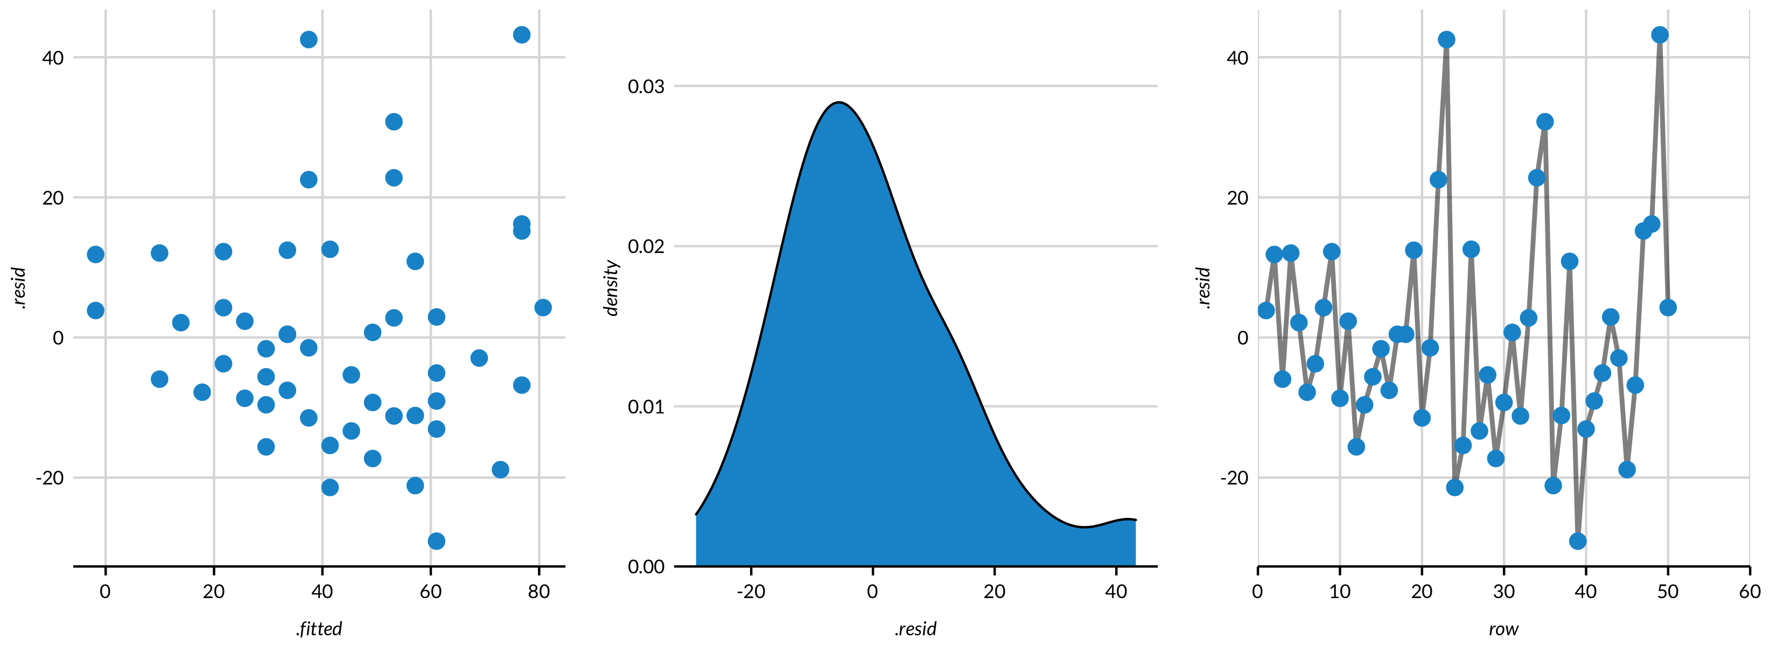
Residual plots/analysis
SUITABLY PAIRED

Slide 26
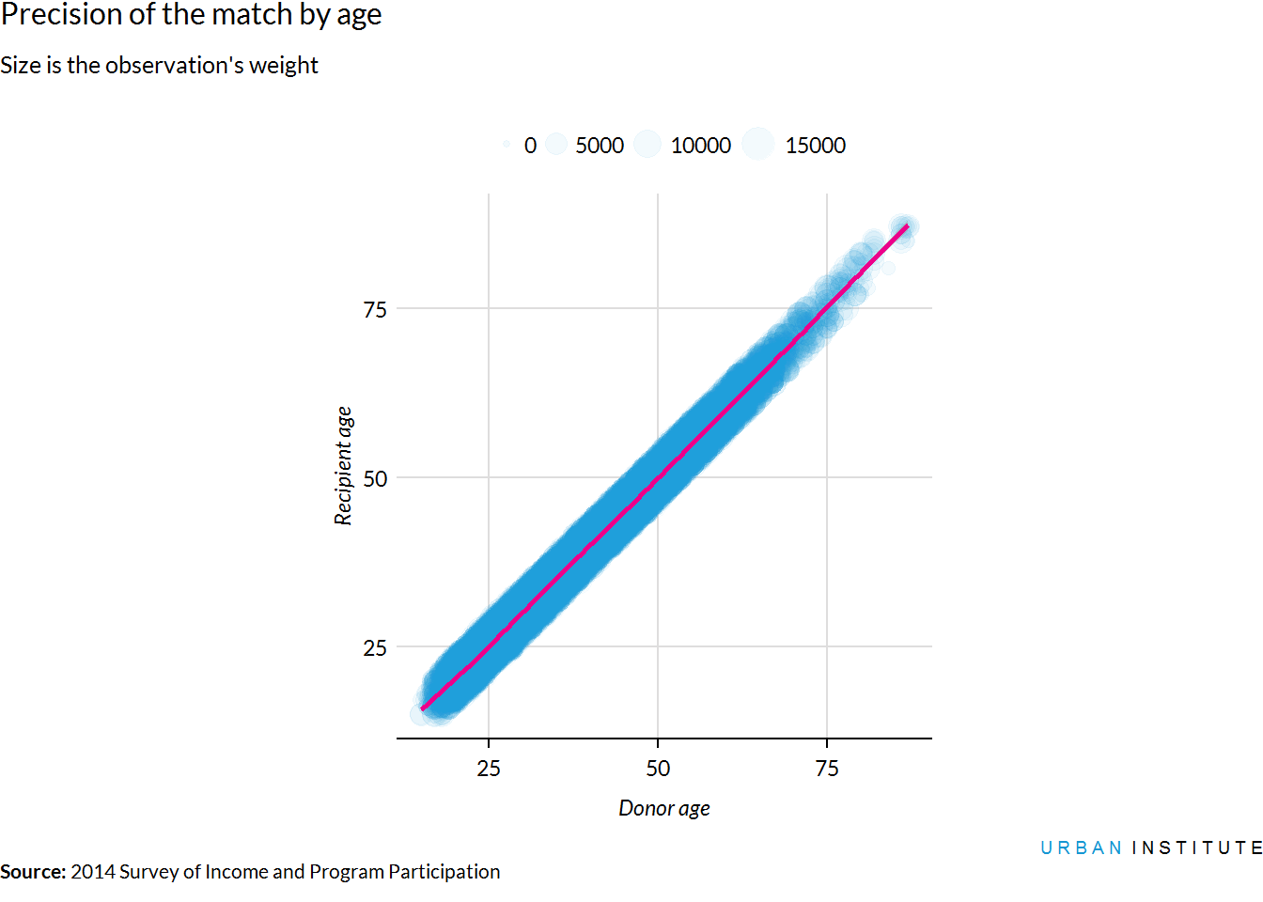
Comparison plot
SUITABLY PAIRED

Slide 27
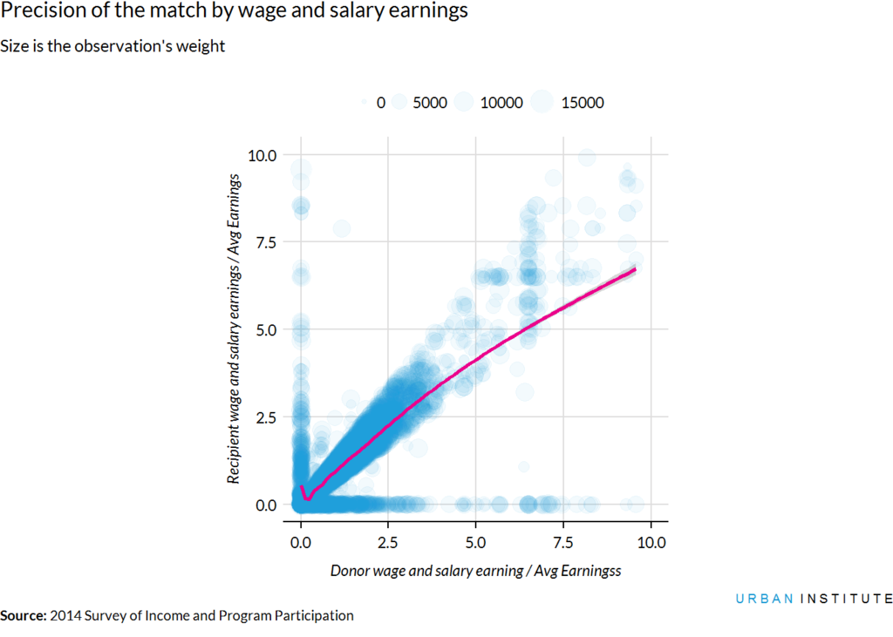
Comparison plot
SUITABLY PAIRED

Slide 28
Data that are not Suitably Paired

Slide 29
Data that are suitably paired
NOT SUITABLY PAIRED
Fully-synthetic data
Reference data (confidential)
Generated data
age | gender | income
45 | M | $11,000
58 | F | $438,000
19 | M | $2,000
23 | M | $38,000
… | … | …
45 | F | $126,000
synth_age | synth_gender | synth_income
38 | F | $42,000
25 | M | $11,000
66 | F | $0
37 | M | $420,000
… | … | …
22 | F | $88,000
The rows between the generated data and reference data no longer
have a one-to-one match!

Slide 30
Objective
NOT SUITABLY PAIRED
Come up summaries that create one-to-one matches between the reference data and the generated data

Slide 31
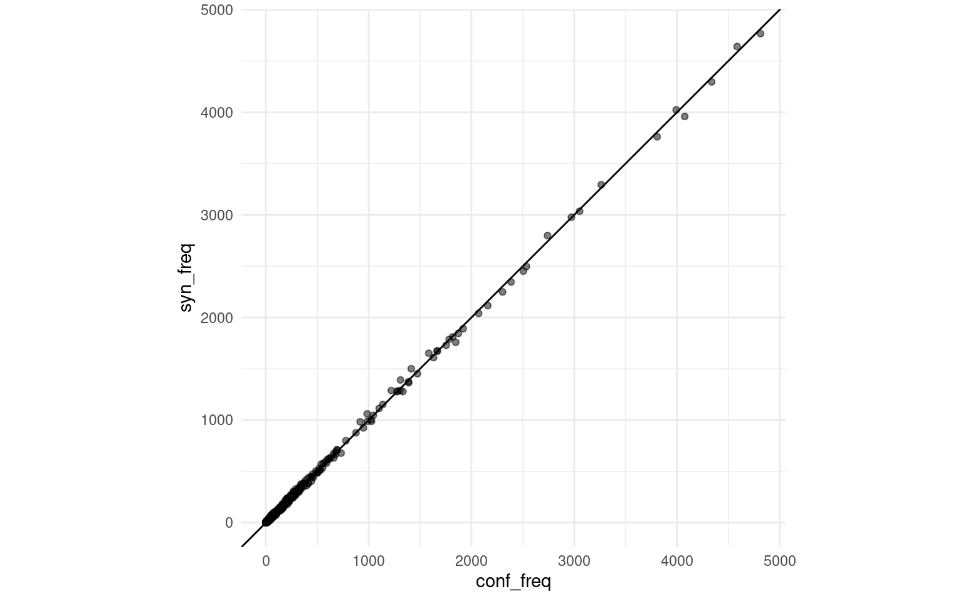
Joint Multivariate Frequency
NOT SUITABLY PAIRED
Reference
age | gender
18 | M
19 | F
19 | F
20 | M
age | gender | reference | generated
18 | M | 1 | 1
19 | F | 2 | 2
20 | F | 0 | 1
20 | M | 1 | 0
Generated
age | gender
18 | M
19 | F
19 | F
20 | F

Slide 32
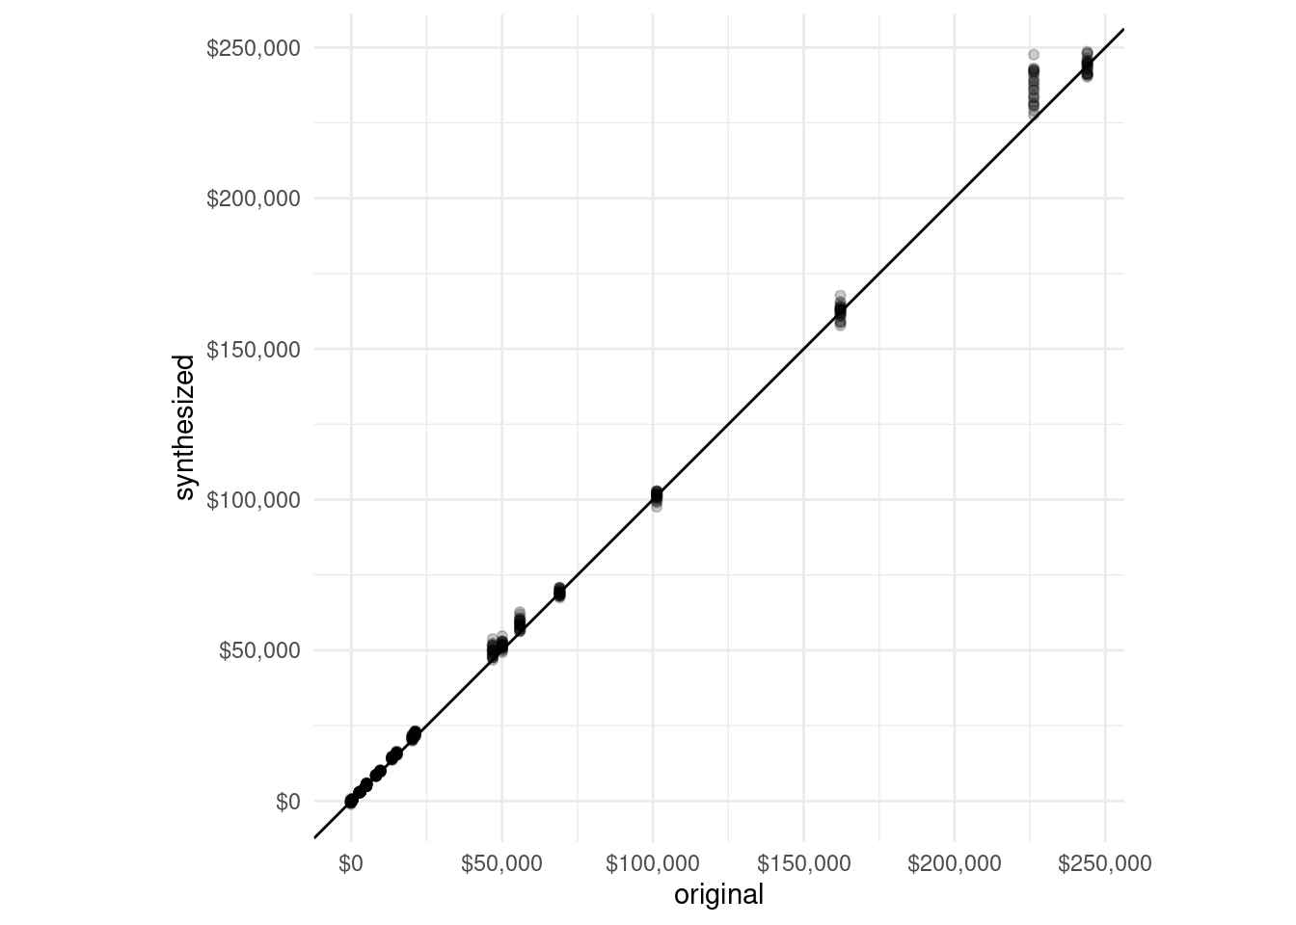
Moments
NOT SUITABLY PAIRED
Comparison of means
Means
Standard Deviations
Skewness
Kurtosis
Vertical variation because of “repetitions”

Slide 33
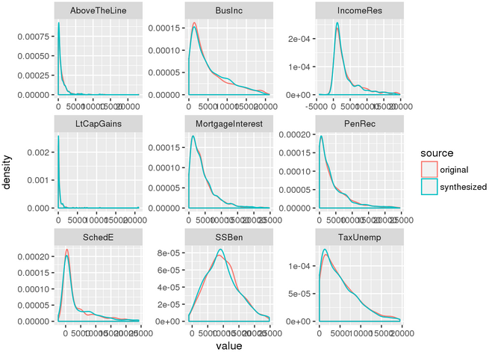
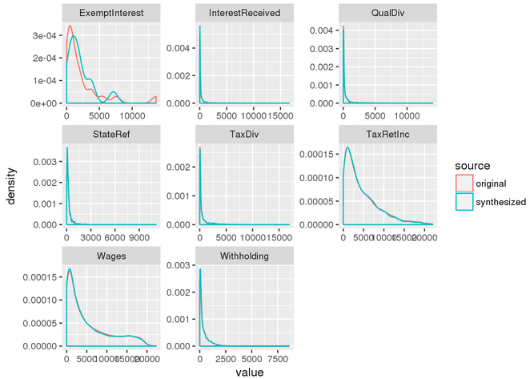
Density Plots
NOT SUITABLY PAIRED
Results
Among nonzero values < $25,000

Slide 34
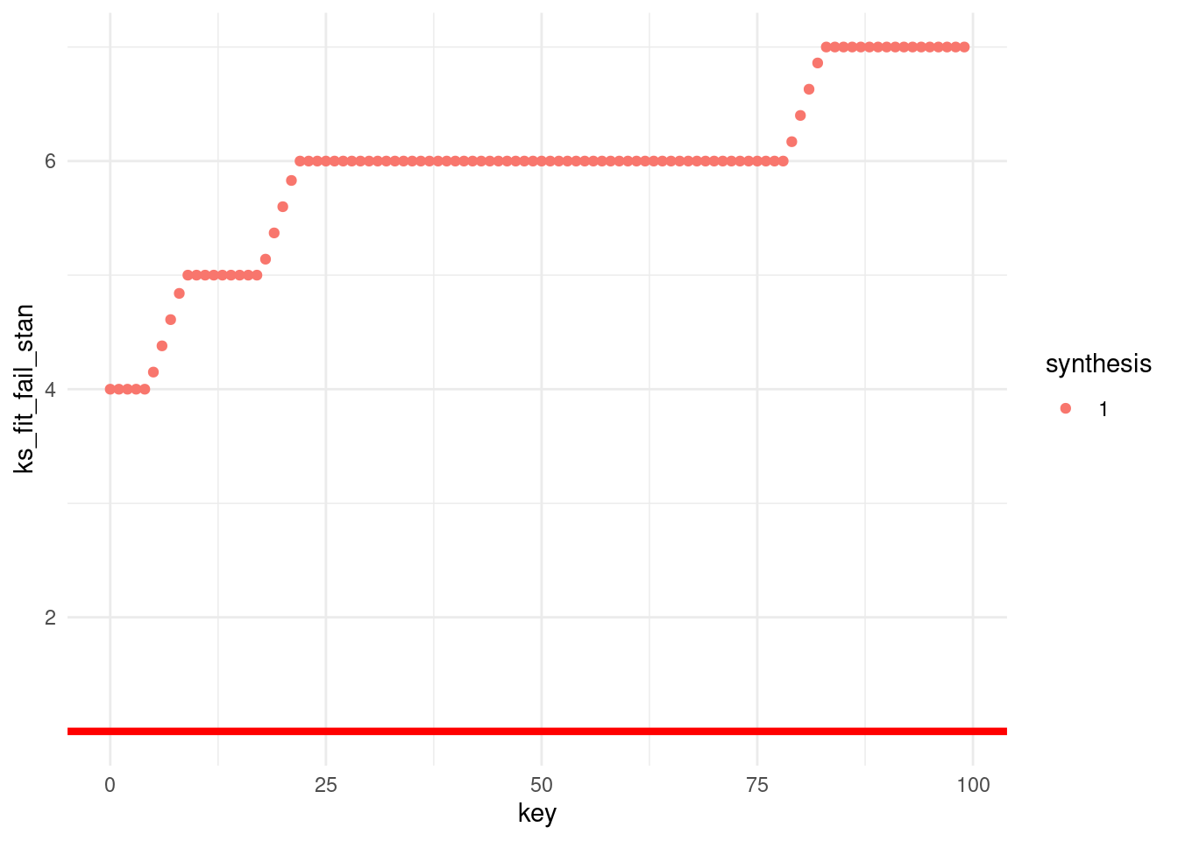
Kolmogorov-Smirnov Tests
NOT SUITABLY PAIRED
Number of KS test failures

Slide 35
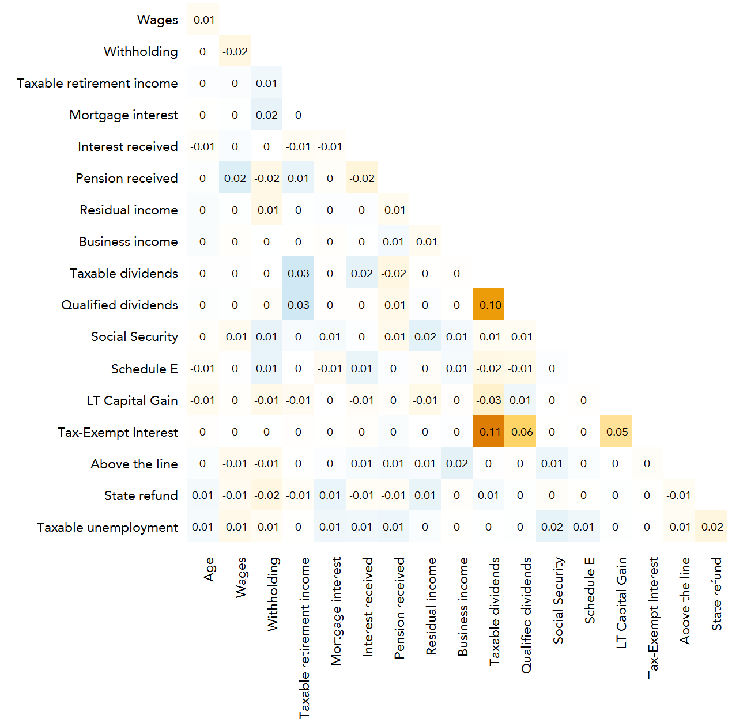
Correlation Fit
NOT SUITABLY PAIRED
Difference between lower triangle of Pearson’s linear correlation matrices from generated and reference data
Average of Euclidean distances between matrices is an overall summary measure

Slide 36
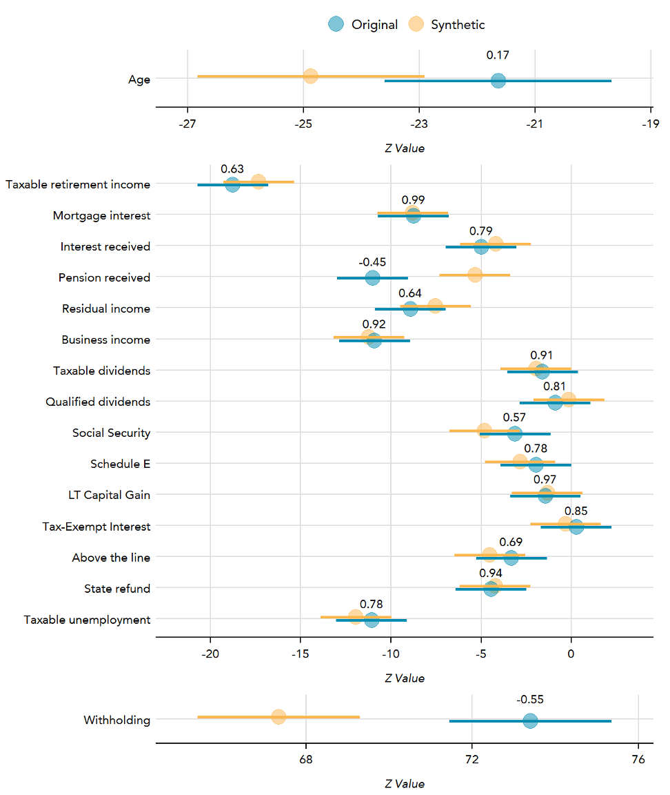
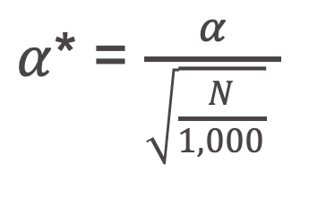
Regression Confidence Interval Overlap (Karr et al., 2006)
NOT SUITABLY PAIRED
Interval Overlap
Specifications come from literature and experts
Perfect overlap = 1
No overlap, adjacent = 0
Separation < 0
Standardize alpha (Good, 1982)
$α$* = $\frac{α}{\sqrt{\frac{N}{1,000}} }$

Slide 37
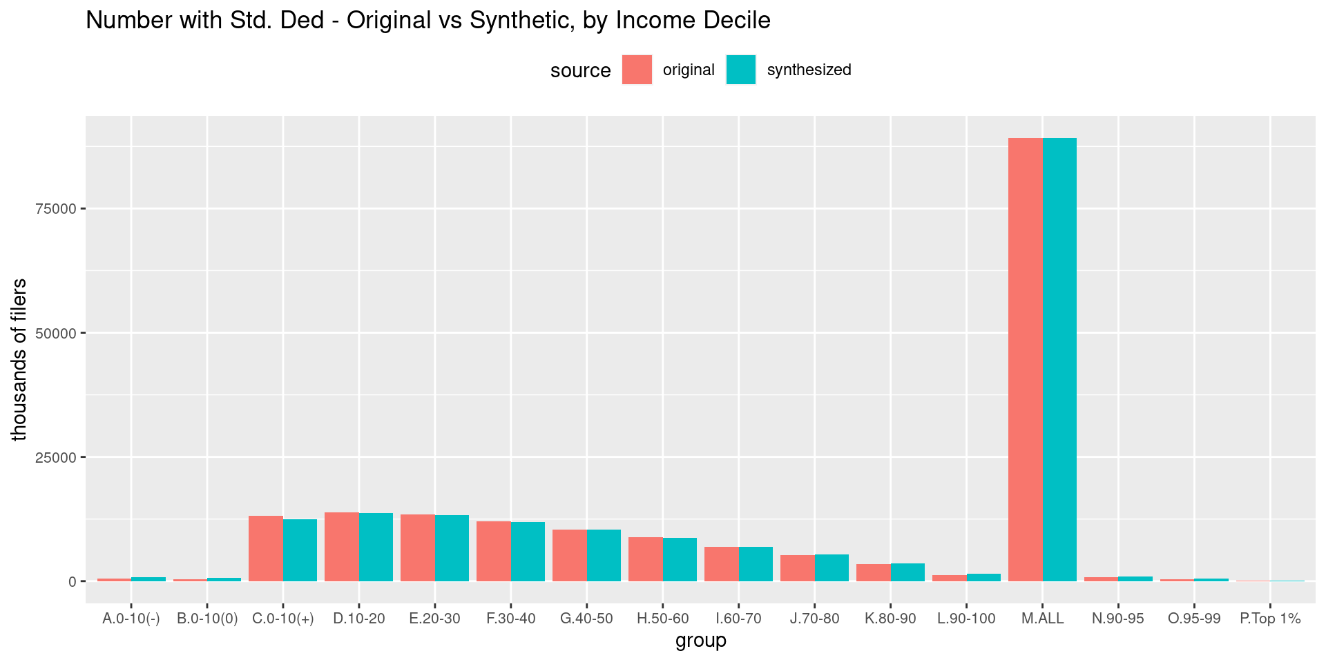
Tax Microsimulation
NOT SUITABLY PAIRED
Baseline estimation
Counterfactual estimation
Distributional estimates for AGI, standard deductions, itemized deductions, taxable income, tax cred- its, tax

Slide 38
Iteration

Slide 39
Challenges
ITERATIONS
As many as 300,000 observations and 150 variables for a synthesis
Hundreds of synthesis specifications
As many as 100 syntheses for each specification
Multiple locations: local computers, cloud computers, IRS servers
Large project team

Slide 40




Tools
ITERATIONS
R Markdown
Blogdown
GitHub
Amazon Web Services S3
Continuous Integration/Deployment with Codeship

Slide 41
Workflow
ITERATIONS
synth00091
(local)
Individual Report
Blogdown blog
Bootstrap Report
synth00092
(AWS)
Individual Report
Blogdown blog
Bootstrap Report
GitHub
CI/CD
AWS S3
synth00093
(IRS server)
Individual Report*
Blogdown blog
Bootstrap Report*
Summary of Summaries
Sortable Tables
*Disclosure Review

Slide 42
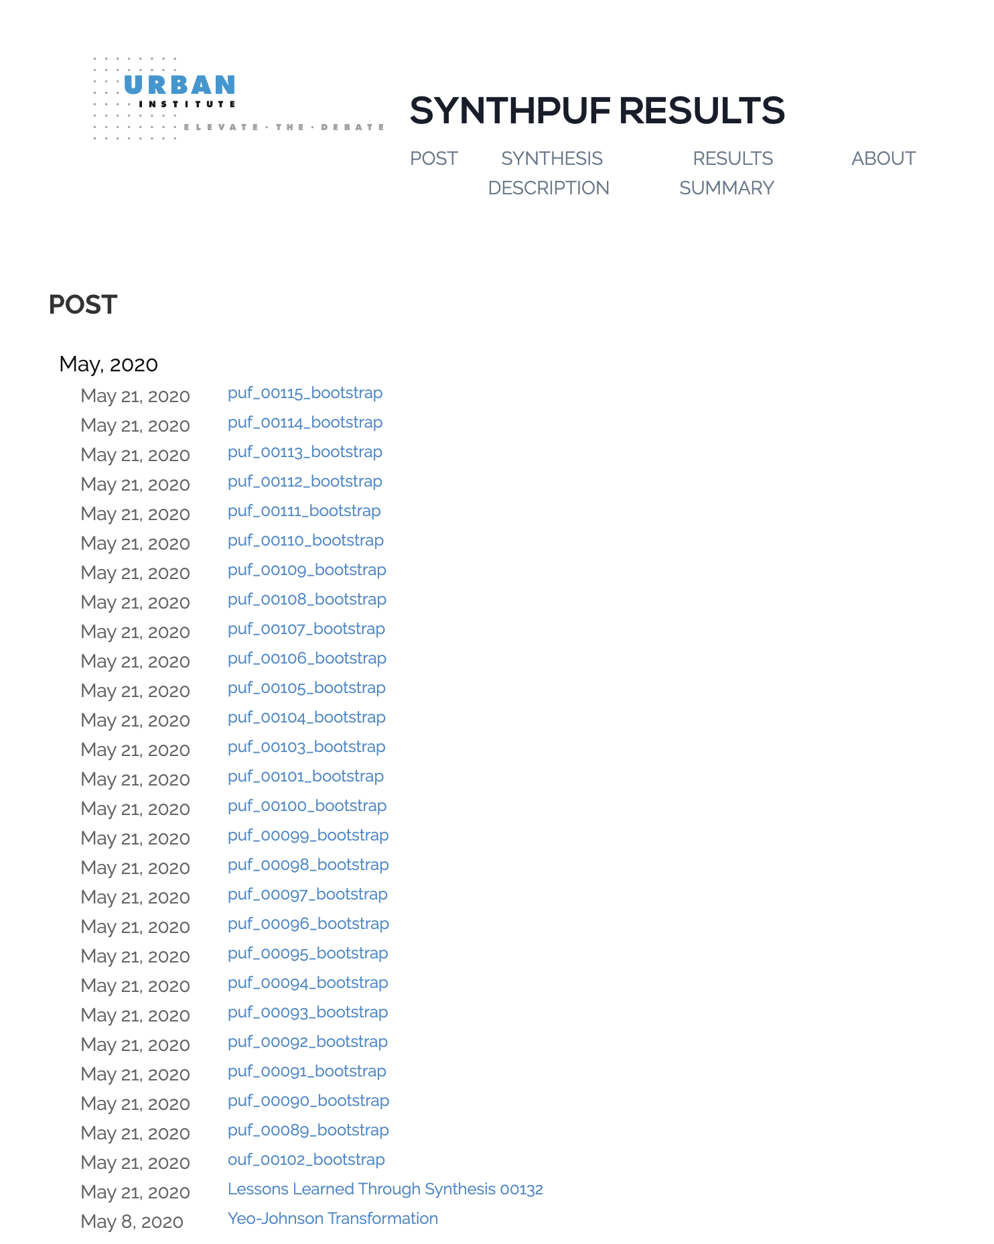
Output
ITERATIONS

Slide 43
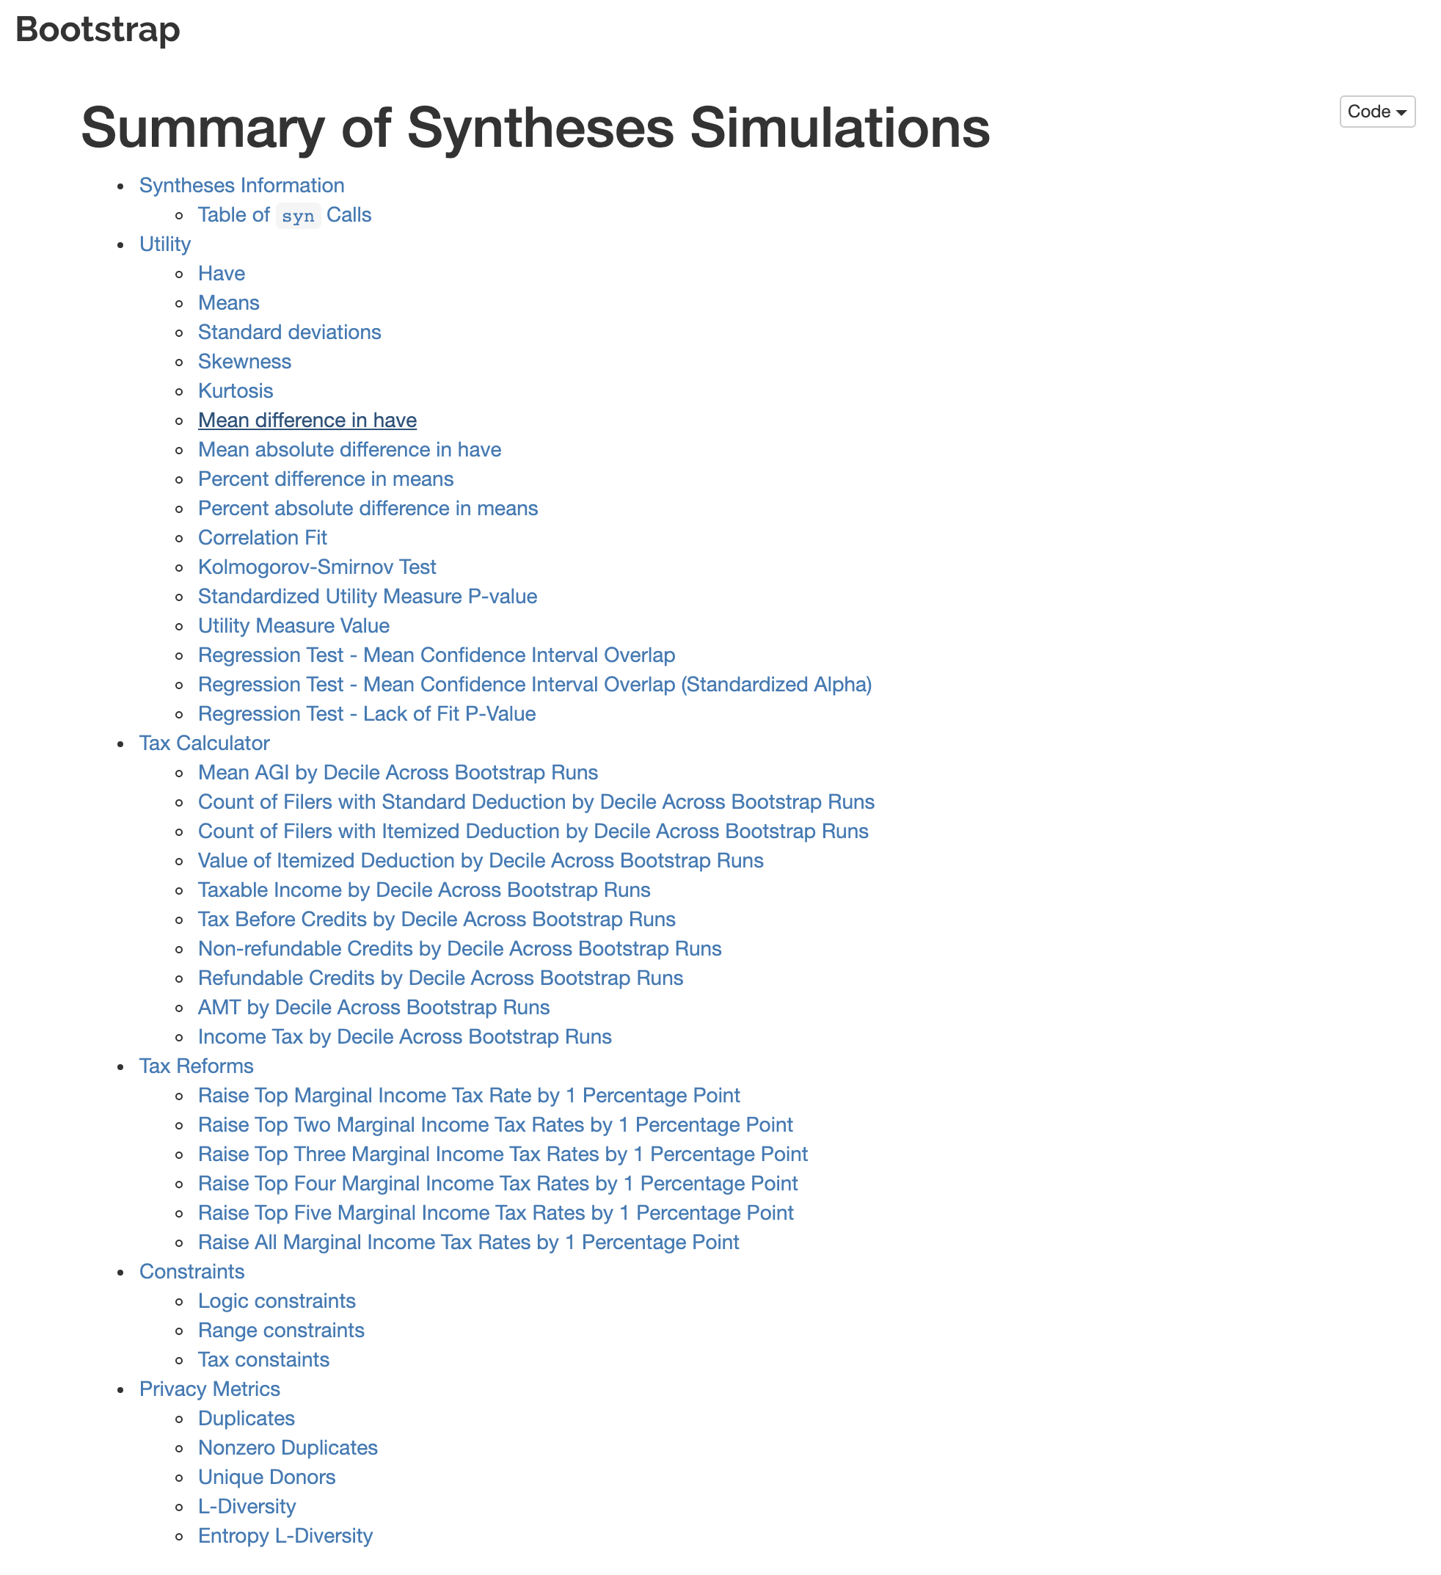
Output
ITERATIONS

Slide 44
Next Steps

Slide 45
Next Steps
OVERVIEW
Synthesis work is ongoing
  Finish and release at least two data sets
  Validation server
Find/develop better theory for validation of data that are not suitably paired
  Pair tests with visual validation a la Unwin (2015)
More metrics for synthetic data

Slide 46
Discussion and Questions

Slide 47
References
REFERENCES
Daniel Asimov. 1985. The grand tour: A tool for view- ing multidimensional data. SIAM Journal on Scien- tific and Statistical Computing, 6:128–143.
D.B. Carr. 1985. Evaluation of graphical techniques for data in dimensions 3 to 5: Scatterplot, glyph, and stereo examples. ASA Proceedings of the Section on Statistical Computing, pages 229–235.
Dianne Cook and Leslie Miller, 2006. Graphics of Large Datasets, chapter Rotating Plots.
I.J. Good. 1982. Standardized tail-area probabilities. Journal of Statistical Computing, 16:65–66.
Alfred Inselberg. 1985. The plane with parallel coordi- nates. The Visual Computer, 1:69–91.
A.F. Karr, C.N. Kohnen, A. Oganian, J.P. Reiter, and A.P. Sanil. 2006. A framework for evaluating the utility of data altered to protect confidentiality. The American Statistician, 60:224–232.
Roderick Little. 1993. Statistical analysis of masked data. Journal of Official Statistics, 9:407–426.
L. Van Der Maaten and G. Hinton. 2008. Visualizing data using t-sne. Journal of Machine Learning Re- search, 9:2579–2625.
Leland Mcinnes, John Healy, Nathaniel Saul, and Lukas Großberger. 2018. Umap: Uniform manifold approxi- mation and projection. Journal of Open Source Soft- ware, 3:861.
Donald Rubin. 1993. Discussion: Statistical disclosure limitation. Journal of Official Statistics, 9:462–468.
Antony Unwin. 2015. Graphical data analysis with R. Chapman Hall/CRC the R series.

