Slide 1
Beyond NYC flights in intro to data science:
Curtis Flowers and the role of race in jury selection
SDSS 2020: Virtual Conference
Paul Roback
St. Olaf College

Slide 2

Intro to Data Science (no prerequisite)
Data visualization (ggplot2, shiny)
Data transformation (dplyr)
Data import and scraping (tibble, readr, httr, rvest)
Relational data (joins)
Strings and text mining (stringr, tidytext)
Computing – factors, vectors, functions, iteration, style
Version control

Slide 3
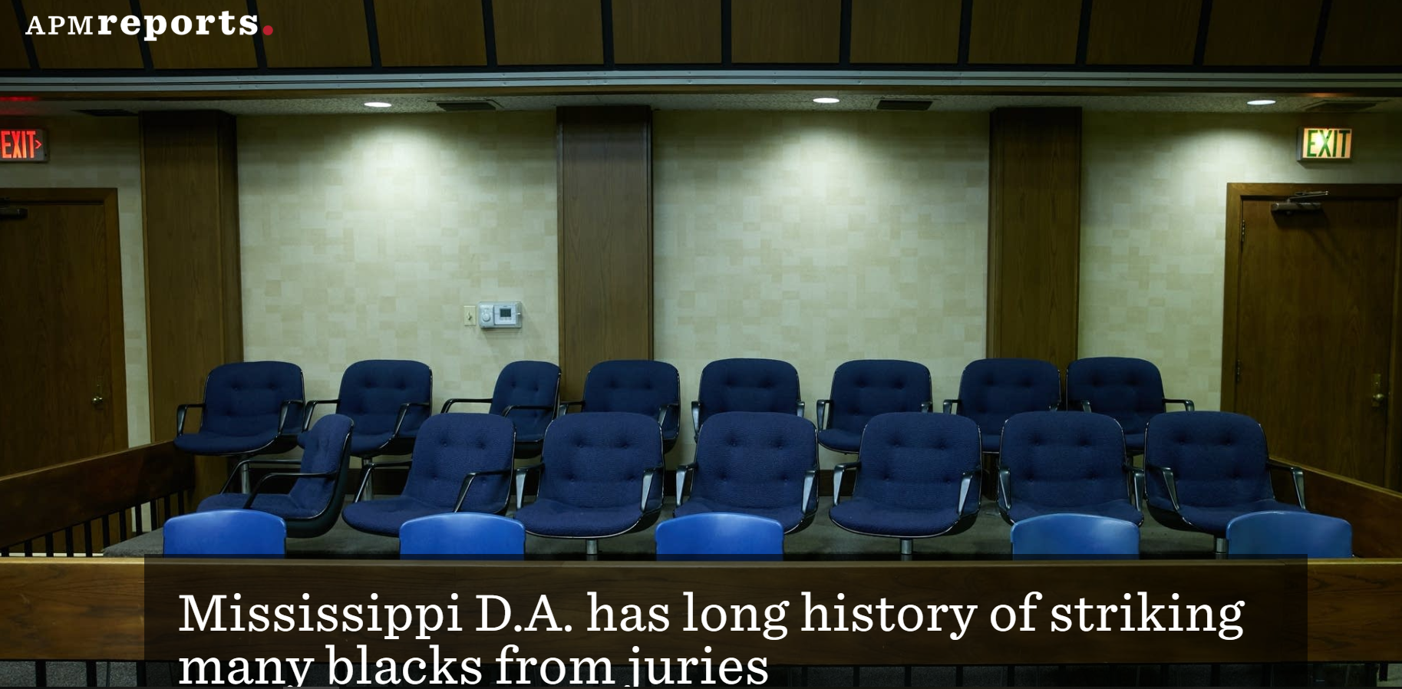
https://features.apmreports.org/in-the-dark/mississippi-district-attorney-striking-blacks-from-juries/ (6/12/18)

Slide 4

Mississippi Juries case study: Overview
Curtis Flowers was originally convicted in 1997 for the murders of 4 people at Tardy Furniture in Winona, Mississippi
He remained on death row for 22 years despite winning 6 appeals
US Supreme Court reversed his conviction on June 21, 2019
Justices ruled that DA Doug Evans violated Flowers’ constitutional rights by intentionally removing black jurors

Slide 5
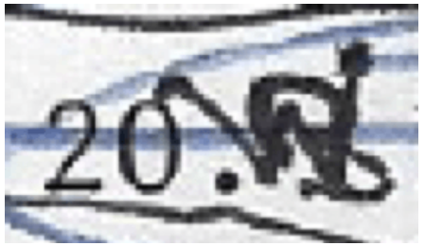
Mississippi Juries case study: Data
APM Reports team led by Will Craft
Scoured courthouse documents across 7 counties in central Mississippi for over a year
Every case Doug Evans prosecuted from 1992-2017
Every potential juror and every question during voir dire
Data made available publicly in 2018
2018 white paper, podcast, and website provided momentum for case to reach Supreme Court

Slide 6
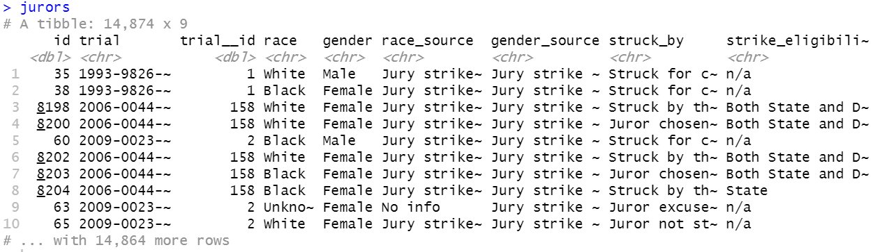
jurors.csv (14,874 x 9)

Slide 7
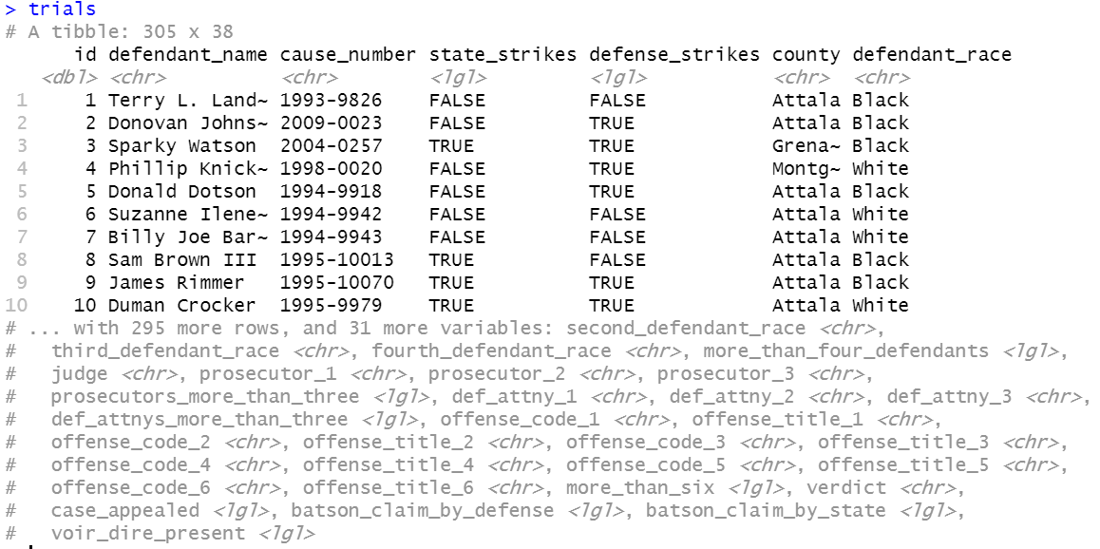
trials.csv (305 x 38)

Slide 8
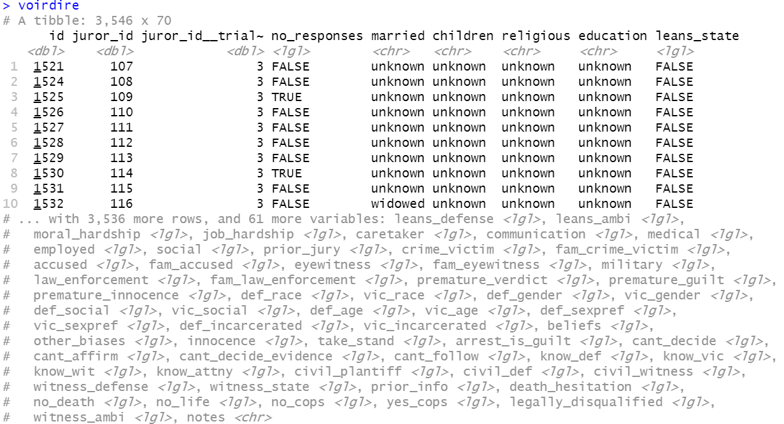
voirdire.csv (3546 x 70)

Slide 9
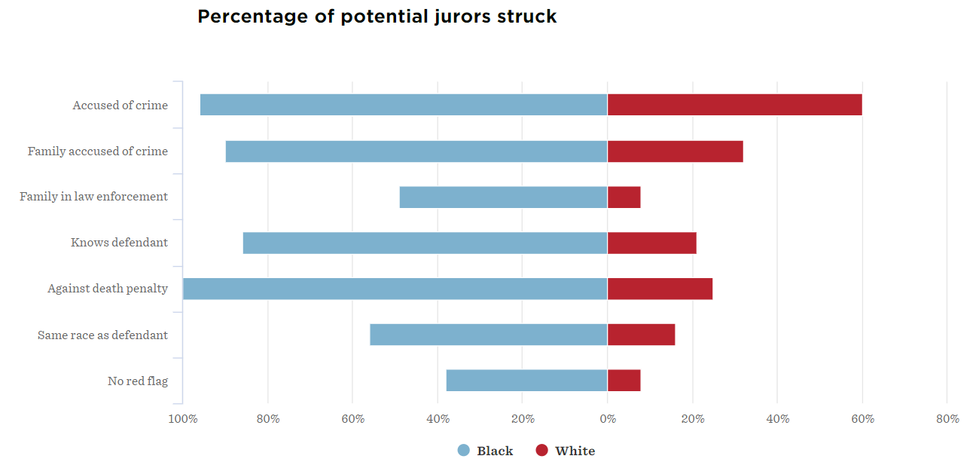
Mississippi Juries case study: Key Features
Relational data sets
Data transformations
Creative visualizations
Predictive modeling
Text analysis
Benchmarks in white paper
Compelling story

Slide 10
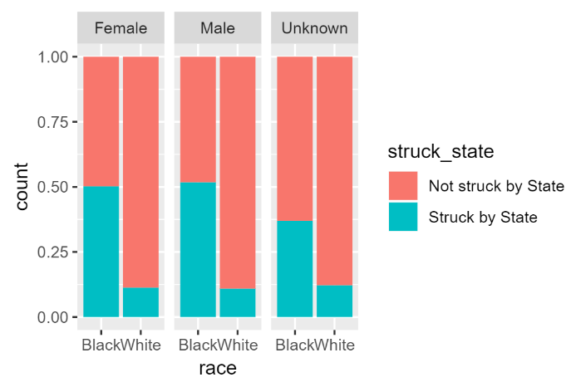
Mississippi Juries case study: my GitHub repo
Take-home exam and key
StatChat_013019 (Rmd, pdf) – explore data and produce key results and plots from white paper
Intermediate data sets
Links to original data and report

Slide 11
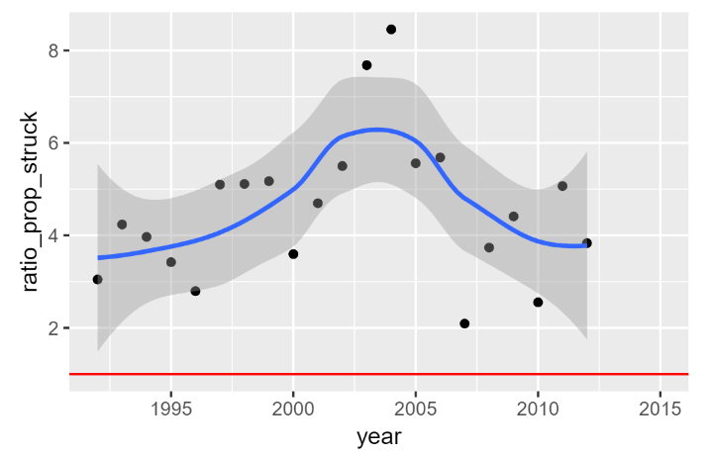
Mississippi Juries case study: Conclusions
“A critical task in the education of future data scientists is to instill data acumen. This requires exposure to key concepts in data science, real-world data and problems that can reinforce the limitations of tools, and ethical considerations that permeate many applications.” – from the 2018 National Academies’ report on ‘Data Science for Undergraduates’

Slide 12
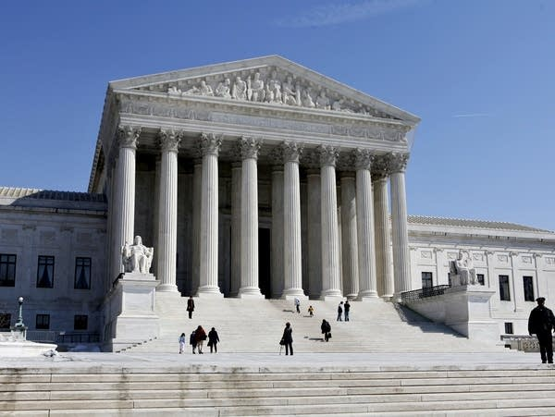
Thanks! I’d love questions and feedback!
For more information:
https://github.com/proback/MississippiJuries
roback@stolaf.edu
References:
Craft, W (2018a, June 12). Mississippi D.A. has long history of striking many blacks from juries. APM Reports. Retrieved January 17, 2020, from https://features.apmreports.org/in-the-dark/mississippi-district-attorney-striking-blacks-from-juries/
Craft, W (2018b). Peremptory strikes in Mississippi’s Fifth Circuit Court District [White paper]. Retrieved January 17, 2020, from https://www.apmreports.org/files/peremptory_strike_methodology.pdf
Craft, W (2018c). The role of race in jury selection [GitHub repository]. Retrieved January 17, 2020, from https://github.com/APM-Reports/jury-data
Freemark, S (Sr Producer) (2020). In the Dark. [Audio podcast]. Retrieved January 17, 2020, from https://www.apmreports.org/in-the-dark
Wickham, H and Grolemund, G (2017). R for Data Science. Sebastopol, CA: O’Reilly Media
https://img.apmcdn.org/06db8cd108fd1a88fd315ea691ac251952ecc122/normal/fc5ba5-20190318-the-supreme-court.jpg

