Slide 1


Team-Based Learning in a Statistical Consulting Course
John Gabrosek,
Grand Valley State University,
Department of Statistics

Slide 2
What is Team-Based Learning (TBL)?

Slide 3
(TBL is) a special form of small group learning using a specific sequence of individual work, group work, and immediate feedback to create a motivational framework in which students increasingly hold each other accountable for coming to class prepared and contributing to discussion.
- Michael Sweet (2010)

Slide 4
TBL isn’t a method that you sprinkle over your existing lecture course. It requires a complete rethinking of your overall course goals, a focused redevelopment of your course materials, and a commitment to take that adventuresome plunge into learning-centered teaching.
- Jim Sibley et. al (2014)

Slide 5
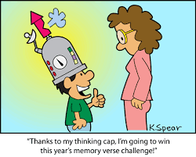
What do I want my students to know?

Slide 6

What do I want my students to be able to do?

Slide 7

List Learning Objectives

Slide 8

Organize Learning Objectives into Learning Modules

Slide 9

We Wish It Was

Slide 10

We Wish It Was
LM 1 Consultant Skills

Slide 11
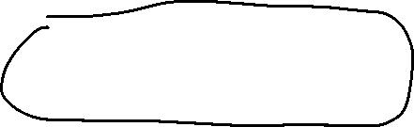
We Wish It Was
LM 1 Consultant Skills
LM 2 Technical Writing

Slide 12

We Wish It Was
LM 1 Consultant Skills
LM 2 Technical Writing
LM 3 Data Analysis

Slide 13
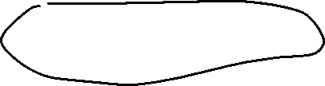
We Wish It Was
LM 1 Consultant Skills
LM 2 Technical Writing
LM 3 Data Analysis
LM 4 Client Reports

Slide 14
Reality Is More Like
LM 1 Consultant Skills
LM 2 Technical Writing
LM 4 Client Report
LM 3 Data Analysis

Slide 15
Team Structure in TBL
Students are split into teams of 4-5
Teams are instructor chosen
Teams are persistent throughout the semester
Teams are not required to meet outside of class
Teams are required to sit and work together in class EVERYDAY

Slide 16
The Learning Module Process

Slide 17
The Learning Module Process
Readiness Assurance Process

Slide 18
The Learning Module Process
Readiness Assurance Process
Team Application Process

Slide 19
The Learning Module Process
Readiness Assurance Process
Team Application Process
Culminating Experience

Slide 20
The Learning Module Process
Readiness Assurance Process
Team Application Process
Culminating Experience
Reflection

Slide 21

The Learning Module Process
Readiness Assurance Process
Team Application Process
Culminating Experience
Reflection

Slide 22
LM 1 Consultant Skills

Slide 23
LM 1 Consultant Skills
Readiness Assurance Process

Slide 24
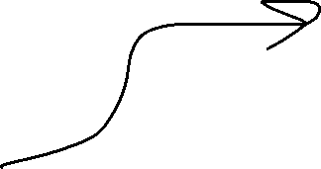
LM 1 Consultant Skills
Determine what readings, videos, etc. students can do ahead of time
Readiness Assurance Process

Slide 25
LM 1 Consultant Skills
JSM 2014 (Boston): Communicating Statistical Findings to Consulting Clients Operating in a Decision-Making Climate: Best and Worst Practices
Panelists: Michael Greene, Deloitte Consulting; John H. Schuenemeyer, Southwest Statistical
Consulting: Ralph M. Turner, HealthCore; MaryJo O. Smith, Ypsilon Associates
Organizer/Chair: Isabella R. Ghement

Slide 26
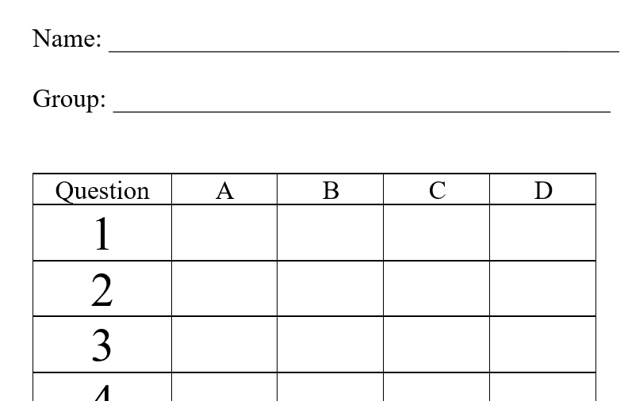
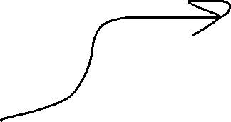
LM 1 Consultant Skills
Determine what readings, videos, etc. students can do ahead of time
Individual Readiness Assurance Test (I-RAT)
Readiness Assurance Process

Slide 27
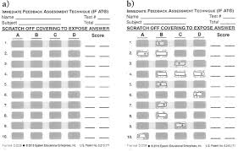
LM 1 Consultant Skills
Determine what readings, videos, etc. students can do ahead of time
Individual Readiness Assurance Test (I-RAT)
Team Readiness Assurance Test (T-RAT)
Readiness Assurance Process

Slide 28
LM 1 Consultant Skills
Team Application Process

Slide 29
LM 1 Consultant Skills
Determine team activities to spend class time on
Team Application Process

Slide 30
LM 1 Consultant Skills
Activity 1.1 Ideal Traits of a Statistical Consultant
Activity 1.2 Developing Good Listening Skills
Activity 1.3 Developing Good Questioning Skills
Activity 1.4 A Successful Consulting Session Video
Activity 1.5 A Consulting Session Goes Off The Rails

Slide 31
Activity 1.3 Developing Good Questioning Skills
Read an excerpt from the paper, “The Effect of Moonlight on Activity Patterns of Adult and Juvenile Prairie Rattlesnakes (Crotalus viridis viridis)” by Jennifer A. Clarke et al.

Slide 32
Activity 1.3 Developing Good Questioning Skills
After reading this short excerpt you should be able to:
Identify the individuals under study,
Explain the research hypothesis, and
Explain the idea of snakes spending time near “cover” in this experiment.

Slide 33


Activity 1.3 Developing Good Questioning Skills
Who/What are the individuals under study?
Snakes
Adult mongooses
habu (Trimeresurus flavoviridis)
Adult and juvenile prairie rattlesnakes

Slide 34

Activity 1.3 Developing Good Questioning Skills
In the paper reporting results of the study, it mentions that predation threat and reproductive condition were controlled. Write a sentence or two explaining what this means and why this was done.

Slide 35
Activity 1.3 Developing Good Questioning Skills
You now have some basic knowledge of the research design and what the client wants to know. I want your team to brainstorm a series of questions to ask the client. Here is the process I want you to use. It is a part of a process known as Design Thinking.

Slide 36
Activity 1.3 Developing Good Questioning Skills
Each team has been given several pads of post-its. Working individually and without speaking, write out a question that you want to know on a post-it. Keep writing questions as fast as you can – one question per post-it note. Don’t worry about the “quality” of the question. I just want you to get your thoughts down quickly. After you write a question, place the post-it to the side on the desk. You have 3 minutes for this.

Slide 37
Activity 1.3 Developing Good Questioning Skills
Now as a team, do the following: You have 10 minutes for this.
On your team whiteboard write the numbers 1, 2, 3 at the top.
Go through each question one at a time. The person who wrote the question reads it EXACTLY as written.
After the writer of the question has read it aloud, team members can ask for clarification. Keep this short. You are not re-writing the question.
After clarification, as a team decide on a rating of the question where 1 = must know, 2 = nice to know, but not essential, or 3 = do not need to know.
When you are done rating the question move the post-it to the appropriate place on the team whiteboard.

Slide 38
Activity 1.3 Developing Good Questioning Skills
As a team, place the questions within each Rating into the order you would want to ask them. This may put the most important question first, but it may not. You may move questions to a different rating if you want to. You have 5 minutes for this.

Slide 39
Activity 1.3 Developing Good Questioning Skills
Finally, on this handout write your top five Rating 1 questions. Now is the time to polish up the questions. Remember that it is nice if you have a mix of closed-ended questions and open-ended questions that invite an explanation. Have your Writer come up to the classroom whiteboard and write the 5 questions. You have 10 minutes for this.

Slide 40
The Learning Module Process
Readiness Assurance Process
Team Application Process
Culminating Experience
Reflection

Slide 41
Examples of LM Assessments
Journal Entries
In class we spoke about the desirable traits of a statistical consultant. Complete the following in your journal entry:
Item 1 – Identify two traits for which you feel you need the least improvement. For each identified trait, explain why you feel that you need very little improvement on the trait.
Item 2 – Identify two traits for which you feel you need the most improvement. For each identified trait, explain why you feel that you need improvement on the trait.

Slide 42
Examples of LM Assessments
Statistical Consulting Center Observation and Paper
The Statistical Consulting Center (SCC) provides statistical assistance to all GVSU faculty, staff, and students. Each student in STA 419 is required to attend and write about a consulting session in the SCC.
Area 1: Follow Instructions and Meet Deadlines – 10 points
Area 2: Report Form up to Non-Verbal Aspects – 20 points
Area 3: Non-Verbal Aspects – 35 points
Area 4: Questioning and Listening Skills – 35 points

Slide 43
Examples of LM Assessments
Data Analysis Paper
In Activity 3.2 you chose a data set and did some brainstorming on how to analyze the data set. You will turn in two products.
Product 1 – Program Code
Product 2 – Data Analysis Write-up
You are permitted two pages (that’s all!) to answer your goals.

Slide 44
Examples of LM Assessments
Client Report
Your final client report will have four major sections: “Introduction”, “Methods”, “Results”, and “Conclusions/Discussion”.
You will turn in the following:
An electronic version of the final client report.
All data files.
All SAS or R programs.
One color, hard copy of the final client report for me to grade.

Slide 45
Benefits of TBL in a Consulting Class
Students quickly began to discuss issues in teams
Responding to instructor questions is “lower stakes” since students are relaying a group answer
Students realize the “smartest” student in other classes is not necessarily the best student in this class
Students with exemplary writing skills are able to bring those talents to the group

Slide 46
Questions, please
John Gabrosek,
gabrosej@gvsu.edu
Grand Valley State University,
Department of Statistics

