Slide 1
Using Enrollment Records to Guide Categorization of
Health Insurance Coverage Type Post-ACA
Joanne Pascale, US Census Bureau
Kathleen Call, State Health Access Data Assistance Center
Angela Fertig, Medica Research Institute
Symposium on Data Science & Statistics
May 19, 2018
Any views expressed are those of the authors and not necessarily those of the U.S. Census Bureau

Slide 2
Pre-ACA Typical Health Insurance Coverage Type Classifications from Surveys
1. Private
  Employer-sponsored insurance (ESI)
  Non-group purchased on the individual market
2. Public
  a. Medicaid (for low income)
  b. Medicare (for 65+)
  c. Military

Slide 3
ACA Marketplace Coverage
Private non-group coverage
Multiple pathways to obtaining coverage
  Marketplace/portal, aka healthcare.gov
  Brokers
  Community-based organizations
Some qualify for subsidies

Slide 4
Post-ACA with Marketplace Coverage in the Mix
1. Private
  Employer-sponsored insurance (ESI)
  Non-group purchased on the individual market
    Outside the marketplace
    On the marketplace/portal
2. Public
  a. Medicaid
  b. Medicare
  c. Military

Slide 5
Post-ACA with Marketplace Coverage in the Mix
1. Private
  Employer-sponsored insurance (ESI)
  Non-group purchased on the individual market
    Outside the marketplace
    On the marketplace/portal
2. Public
  a. Medicaid
  b. Medicare
  c. Military

Slide 6
Ambiguity Between Marketplace and Medicaid/Public Coverage
The term ‘marketplace’ has a dual meaning:
  Portal for shopping for the coverage (e.g.: healthcare.gov)
  The coverage itself
Both marketplace and public coverage are available on the portal
  broad spectrum from fully-subsidized public to fully-unsubsidized private
Private/public blurry line:
  Some marketplace coverage has $0 premium
  Some Medicaid requires enrollees to pay part of premium

Slide 7
Post-ACA Landscape Saddled Questions with Ambiguity
What is the coverage called?
  “Marketplace” could mean Medicaid (if they got the coverage on healthcare.gov) or marketplace
Did you get coverage on the marketplace?
  “Yes” could mean Medicaid or marketplace
  “No” does not mean they don’t have marketplace coverage; they could have got it from a broker
Is there a monthly premium?
Is the premium subsidized?
  “Yes” to either could mean marketplace or Medicaid

Slide 8
Upshot
Due to this ambiguity, in many cases:
no one question identifies coverage type
some patterns of response across several questions could define multiple types of coverage
➔ Need an algorithm for harnessing survey data to classify coverage type

Slide 9
Supervised Machine Learning
Start with enrollment records from a private health plan that offers range of private and public coverage
Use records as sample in a telephone survey that includes a health insurance module
Identify survey items useful as “features” (variables) in a classification scheme to categorize coverage type
Create an algorithm to classify coverage type
Calculate reporting accuracy metrics

Slide 10
Reverse Record Check Study (“CHIME”) Data Collection Methods
Sample: phone numbers of enrollees from private health insurance company records; random sample drawn from multiple strata:
  Employer-sponsored insurance (ESI)
  Non-group (direct purchase/outside marketplace)
  Marketplace (unsubsidized and subsidized)
  Public
15-minute phone survey conducted in Spring, 2015
Content: abbreviated Current Population Survey (CPS ASEC)
Data collected on all household members
Response rate = 22%
Health plan enrollment file sent post-data collection
Records matched to survey at person-level
Final person-level matched file n=1,989
Weighted data to health plan population totals

Slide 11
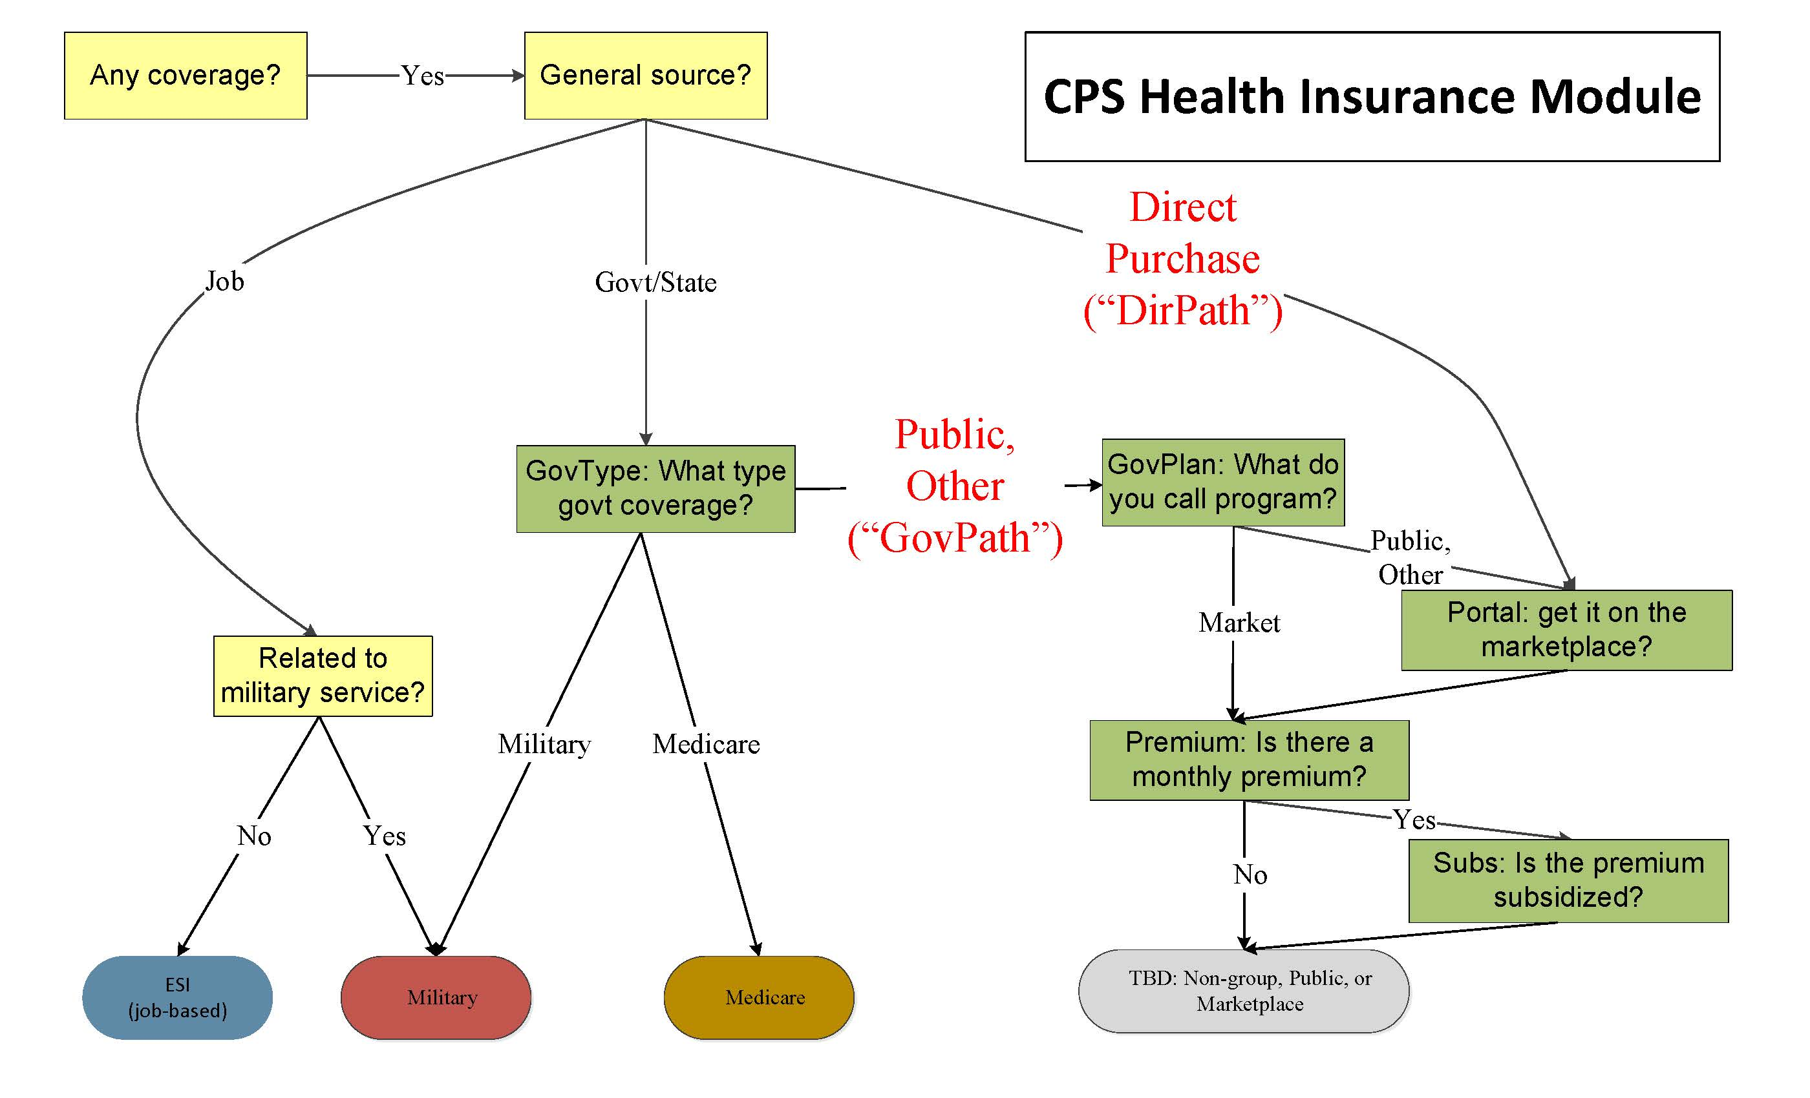

Slide 14
Feature Refinement for
GovPath and DirPath
Create all possible permutations from the 5 key questions on coverage (n=150+ permutations):
  GovType
  GovPlan
  Portal
  Premium
  Subsidy
Examine distribution of enrollment records within each permutation
Collapse permutations where:
  Substantive answers are similar (e.g.: don’t know/refused) and
  Enrollment record distribution is similar across permutations

Slide 15
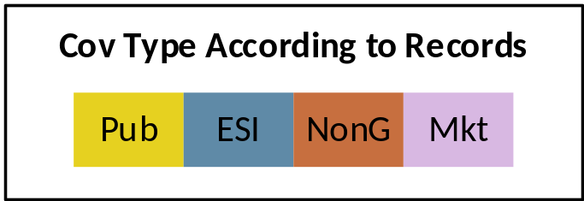
Data Reduction Example
Perm | Freq | GovType | GovPlan | Portal | Prem | Subs
A | 70 | Public | Medicaid | Yes | No | n/a
B | 22 | Public | Medicaid | No | No | n/a
C | 13 | Public | Medicaid | D/R | No | n/a
Perm | Freq | GovType | GovPlan | Portal | Prem | Subs
ABC | 103 | Public | Medicaid | Y,N,D/R | No | n/a

Slide 16
Feature Selection for
Algorithm Development
Data reduced to 5 features/variables; 4 with only two collapsed response categories:
  GovType: Public, Other/D/R
  GovPlan: Public, Market, Other/D/R
  Marketplace: Yes, No/D/R
  Premium: Yes, No/D/R
  Subsidy: Yes/D/R, No
➔ 11 total permutations

Slide 17
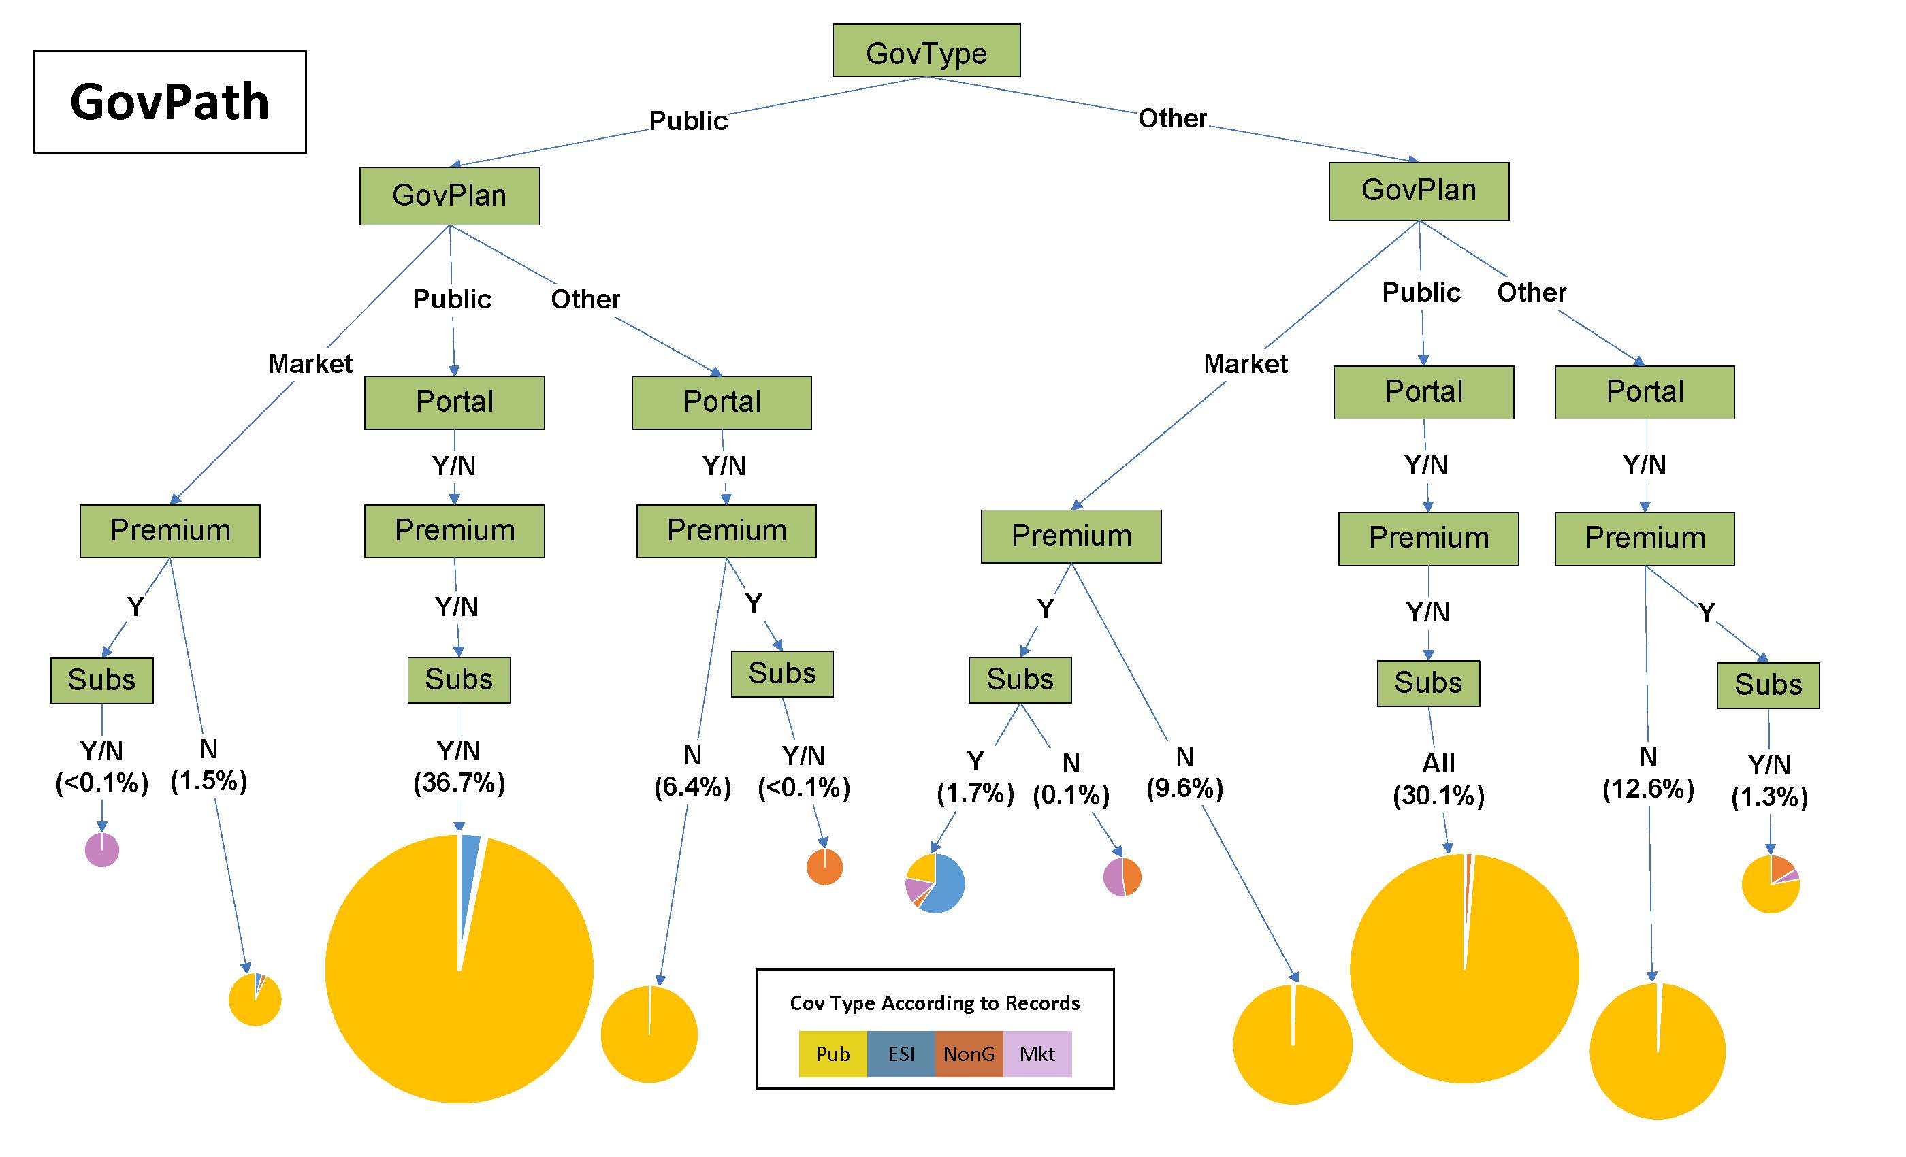

Slide 19
Unambiguous Cases
Six paths can be collapsed further:
  IF:
    GovPlan=Public OR
    GovPlan=(Market or Other) and Premium=No
  THEN: 97% or more are public enrollees, according to records
Those six paths add up to 96.9% in GovPath

Slide 21
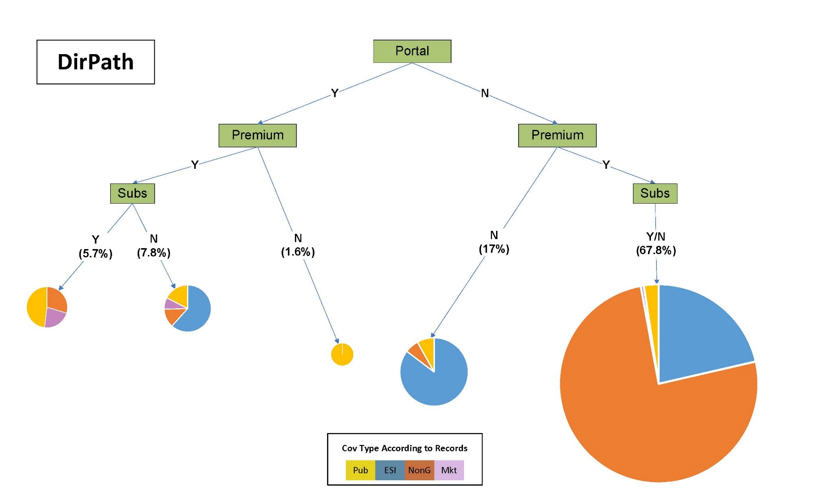

Slide 22
Ambiguous Cases
Cell sizes in some paths are vanishingly small (<5)
Enrollment data are mixed
ESI heavily weighted due to prevalence in population
Priority is to correctly categorize private versus public; then correctly categorize type of private
Marketplace:
  Marketplace coverage most difficult to define on paper
  Few actual marketplace cases (n=147)
  Marketplace enrollees highly diverse in reporting patterns

Slide 23
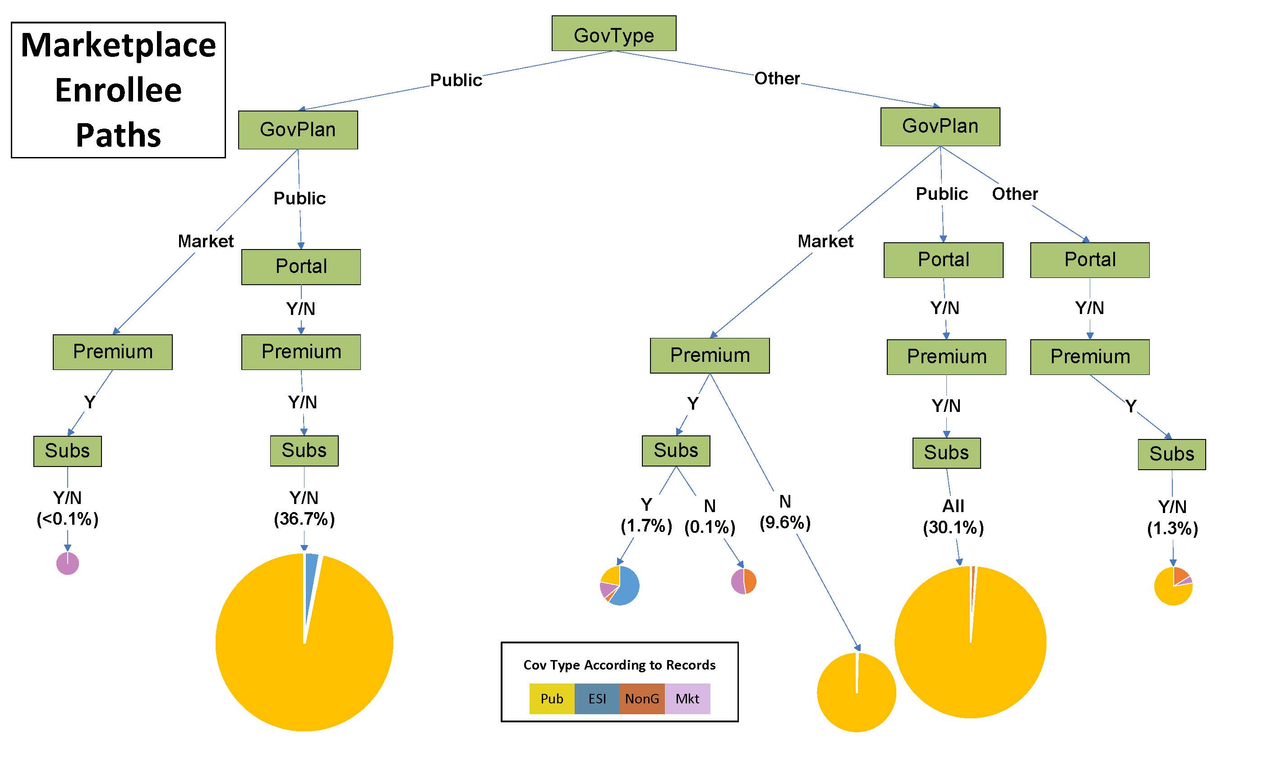

Slide 25
Three Alternative Algorithms
Given small cell sizes, mixed enrollment data, ambiguity of survey answers, range of reporting patterns among marketplace enrollees:
  No clear coverage type assignment for some paths
Developed three alternatives for ambiguous paths:
  “PubSkew”
  “MktSkew”
  “Hybrid”
Calculated reporting accuracy metrics, which account for relative prevalence of coverage types in the population
Analysts can see trade-offs across:
  Reporting accuracy metrics
  Individual and aggregated coverage types
➔ Allows analyst to decide which algorithm is best suited for purpose

Slide 26
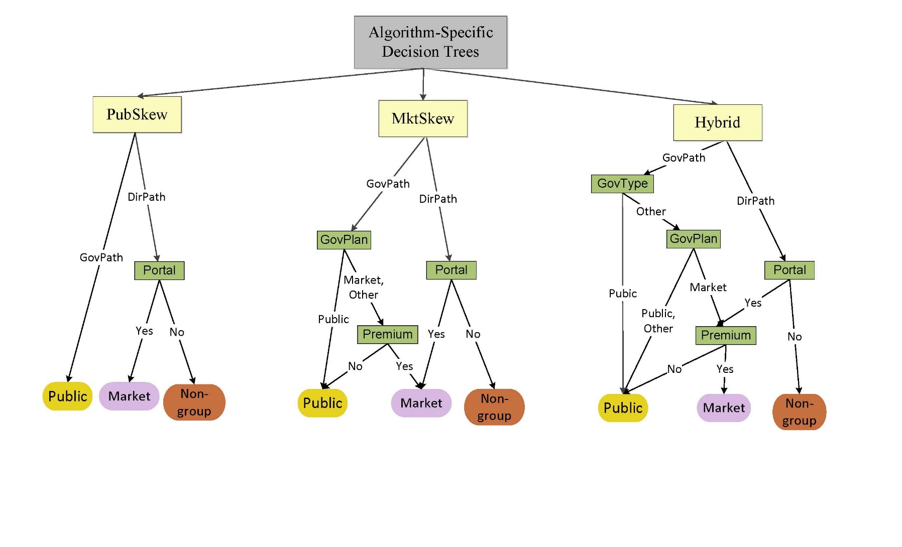

Slide 27
Results

Slide 28
Reporting Accuracy Metrics
Under-reporting
  among those enrolled in Cov Type X, how many reported Cov Type X?
Over-reporting
  among those reporting Cov Type X, how many were enrolled in Cov Type X according to records?
Prevalence
  how does point estimate of Cov Type X from survey compare to population estimate from records?

Slide 29
Under-Reporting Trade-Offs

Slide 30
Effect of Algorithm Choice has Little Effect on Public Coverage

Slide 31
…but Marketplace Under-reporting is High Under PubSkew

Slide 32
Over-Reporting Trade-Offs

Slide 33
PubSkew and MktSkew get Higher Over-reporting of their Skew

Slide 34
Point Estimate versus Population Prevalence

Slide 35
Point Estimate versus Population Prevalence

Slide 36
Thank you!
Contact Information:
Joanne Pascale
Joanne.Pascale@census.gov

Slide 37
General Source of Coverage Reported by Strata
General Source Reported in Survey | Coverage Type According to Enrollment Records
 | Non-group | Market | Market/Unsub | Market/Subs | Medicaid
ESI | 17% | 10% | 22% | 5% | 5%
Direct purchase | 78% | 40% | 45% | 39% | 2%
Govt/State | 6% | 42% | 27% | 48% | 83%
Other | 4% | 8% | 8% | 9% | 12%
Medicare | 2% | 3% | 0% | 5% | 3%
Military | 0% | 0% | 0% | 0% | 1%
Uninsured | 1% | 1% | 0% | 2% | 5%
Notes:
Table 8

Slide 38
Marketplace, Premium and Subsidy Reporting by Strata
Data Reported in Survey |  | Coverage Type According to Enrollment Records
 |  | Non-group | Market/ Unsub | Market/ Subs | Medicaid
Marketplace | Yes | 9% | 89% | 87% | 64%
 | No | 89% | 11% | 9% | 22%
 | D/R | 2% | 0% | 4% | 14%
Premium | Yes | 97% | 95% | 95% | 12%
 | No | 2% | 5% | 6% | 87%
 | D/R | 2% | 0% | 0% | 0%
Subsidy | Yes | 5% | 9% | 90% | 87%
 | No | 91% | 86% | 9% | 14%
 | D/R | 4% | 6% | 1% | 0%
Notes:
Table 10. Among those Where General Source of Coverage was Reported as Direct or Government/State

Slide 39
Premium and Subsidy
Verbatim Questions
Is there a monthly premium for this plan?
READ IF NECESSARY: A monthly premium is a fixed amount of money people pay each month to have health coverage. It does not include copays or other expenses such as prescription costs.
Yes
Is the cost of the premium subsidized based on family income?
READ IF NECESSARY: A monthly premium is a fixed amount of money people pay each month to have health coverage. It does not include copays or other expenses such as prescription costs.
READ IF NECESSARY: Subsidized health coverage is insurance with a reduced premium. Low and middle income families are eligible to receive tax credits that allow them to pay lower premiums for insurance bought through healthcare exchanges or marketplaces.

