Slide 1

Practical Guidelines for Translating and Testing a Cross-National Instrument for Developing Countries: A Workshop
Elizabeth Dean and Clark Letterman
QDET2, November 11, 2016
Miami, Florida

Slide 2
Opportunities in International Social Research
Low and lower-middle income countries are a growing international market for survey research services
New social research markets offer exciting opportunities:
Demographic, social and economic data on countries under-represented in international statistics
Improved metrics through decentering of scales and measures and expanded validation across global populations
Intercultural partnership on shared economic and research objectives

Slide 3

Multinational Study of Internet Adoption
Cross-national household survey about Internet and technology adoption funded by a confidential commercial client.
50,000
interviews
Partnership between confidential commercial client, RTI and various local and regional data collection contractors
Asia (Indonesia, Thailand, India, Bangladesh), Africa (Kenya, Ghana, Nigeria, Uganda, Rwanda), and Latin America (Brazil, Colombia, Guatemala).

Slide 4
Challenges for Questionnaire Design, Development, Evaluation and Testing
US-trained and practicing survey designers and managers
Instrument measured basic socioeconomic concepts that are variable by culture
  Access to technology
  Identification with sociocultural, ethnic and religious groups
  Availability of economic resources
  Marriage and family relationships and decision-making
Instrumentation was conceptualized and written in English and tested and fielded in over 25 languages
Translation process required frequent iterations of testing and review to clarify meaning in target languages
Translation decisions were dependent on geographic sampling
Mobile devices used to deploy surveys offered technical challenges

Slide 5
Today’s Workshop
3 Topics for Discussion
Each case study will be presented followed by a discussion session
We want to hear from you!
  Questions
  Experiences
  Suggestions
Case Study 1: Translation Procedures: Standardized yet Customized
Case Study 2: Selecting Languages for Translation
  Nigeria
  India
Case Study 3: Survey Technology and its Impact on Translation
Notes:
Before we get into the details of our case studies, we’d like to get a feel for where folks in this session coming from.
Is anyone here a survey researcher from a developing or low income country?
Experience with multinational surveys
Experience with multinational surveys in low income countries
Ask questions about group experience –
-international surveys
-surveys in developing countries
-surveys with nonLatin alphabets

Slide 6
Customizing the Translation, Standardizing the Process

Slide 7

14 Countries, 27 Languages
Bangladesh - Bangla
Brazil - Brazilian Portuguese
Colombia - Spanish
Ghana - Akan, Dagbani, English, Ewe, Ga, Hausa
Guatemala - Spanish
India - Hindi, Gujarati, Telugu
Indonesia - Bahasa Indonesian
Kenya – English, Luo, Kamba, Kikuyu, Kiswahili
Nigeria - English, Hausa, Igbo, Yoruba, Pidgin English
Rwanda - English, French, Kinyarwanda
Thailand - Thai
Uganda - English, Luganda, Lunyankole, Luo, Rutoro

Slide 8
Survey Content
Survey of technology adoption in countries with
developing tech infrastructure
Internet access
Technology use and access
Survey questions were culturally or geographically nuanced
Cultural affinity and values
Relationships and social support
Economic and demographic indicators
Survey content was sometimes sensitive
Income
Relationship status
Religious beliefs

Slide 9

Developing The Instrument
Instrument development and translation was an iterative process involving RTI and client designers,
in-country translators and
field staff
Translators
Core
Instrument
Designers
Field Staff
Notes:
Keep in mind that we had a core instrument that was developed in advance. Each time we went into a country the instrument went under an iterative review, customization, and translation process. This process was the result of a combined effort of RTI and client designers, and translators, management, and field staff from our in country partners. Having a close working relationship with the in-country partners enabled us to do these frequent iterations to customize and translate the questionnaire.

Slide 10

Adapting and Translating the Core Instrument
1
Revise core instrument with country-specific tailoring
5
Field interviewer training
2
Prepare excel files for translation
6
Field test
3
Translation and review of instrument
Round 1 Cognitive Interviews
Round 2 Cognitive interviews
7
Dress rehearsal
4
Quality Control and Testing
Review database of translations
  Consistent implementation of translations
  Missing translations
Review programmed instrument with imported translations
  Proper display of characters

Slide 11
Country Specification – Some Examples
Describe intent of terms for “professional” and “acquaintance” to partners and seek appropriate terminology.
Identify local process for adding cell phone minutes/data
Identify key brands in internet provider market
Identify appropriate livestock for economic measures (no pigs in Muslim countries, no cows in India)
Determine whether polygamous unions are allowed.
Identify common local languages and religious groups.
Obtain input on whether questions are insensitive
Questions about children out of wedlock were removed for Bangladesh
Notes:
Country specification was a sort of decentering the instrument.
-spent time before translating adapting the content of the instrument

Slide 12

Recommendations
Use in country partners’ guidance and insight to refine core instrument prior to translation. Use cognitive interviews as a translation improvement tool Encourage iterative review and revision of instruments

Slide 13
Selecting Languages for Translation

Slide 14
Language Selection Process
Initial assumption, include languages spoken by
10% or more of the population at the national level
Receive input from local partners.
Are there some language groups where most members are also fluent in a 2nd more common language. This is often a judgment call based on experience because official statistics regarding language usage are often old or conflicting.
What to do with primarily spoken languages or dialects?
Draw sample and make adjustments based on geographic coverage.

Slide 15
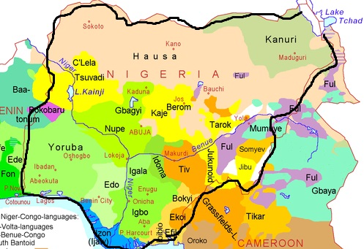
Language Selection in Nigeria
Nigeria
36
states
170+
population (millions)
English
Official Language
Hausa Yoruba Igbo
Major Regional Languages
Multiple smaller languages
Pidgin (non-formal) English
often spoken
How you dey?
Hi, How are you doing?

Slide 16
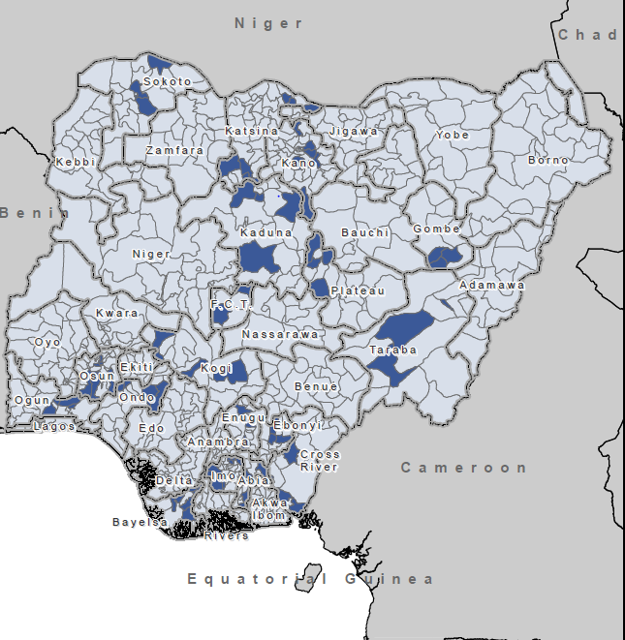
Sampled Local Government Areas
Hausa
Yoruba
Igbo

Slide 17
Using Pidgin
Local partner advised that the instrument should be available in English, Hausa, Yoruba, and Igbo but NOT Pidgin English
  Not their standard practice
  Usually not written or read
  Hard to standardize. speakers of different native languages speak slightly different versions of pidgin
Translation testing- inconclusive
(both positive and negative feedback)
RTI and client decided we should translate into Pidgin anyway
Respondents might not understand formal English
Desire to standardize questionnaire administration as
much as possible
Was it a good idea?

Slide 18
The Test
Percent Completed Interviews in Each Language
53.2%
Hausa
20.2%
English
11.9%
Yoruba
8.5%
Igbo
6.3%
Pidgin English
Interviewer Feedback
Pidgin translation hard to read. Seems un-natural.
Better to use standard English instrument and throw in some pidgin words as long as the intent of the question not altered.
Decision
Don’t translate into Pidgin English for follow-up surveys
  Quality maintained and perhaps enhanced by taking away confusing translation
  Cost saved by not trying to improve pidgin translation

Slide 19
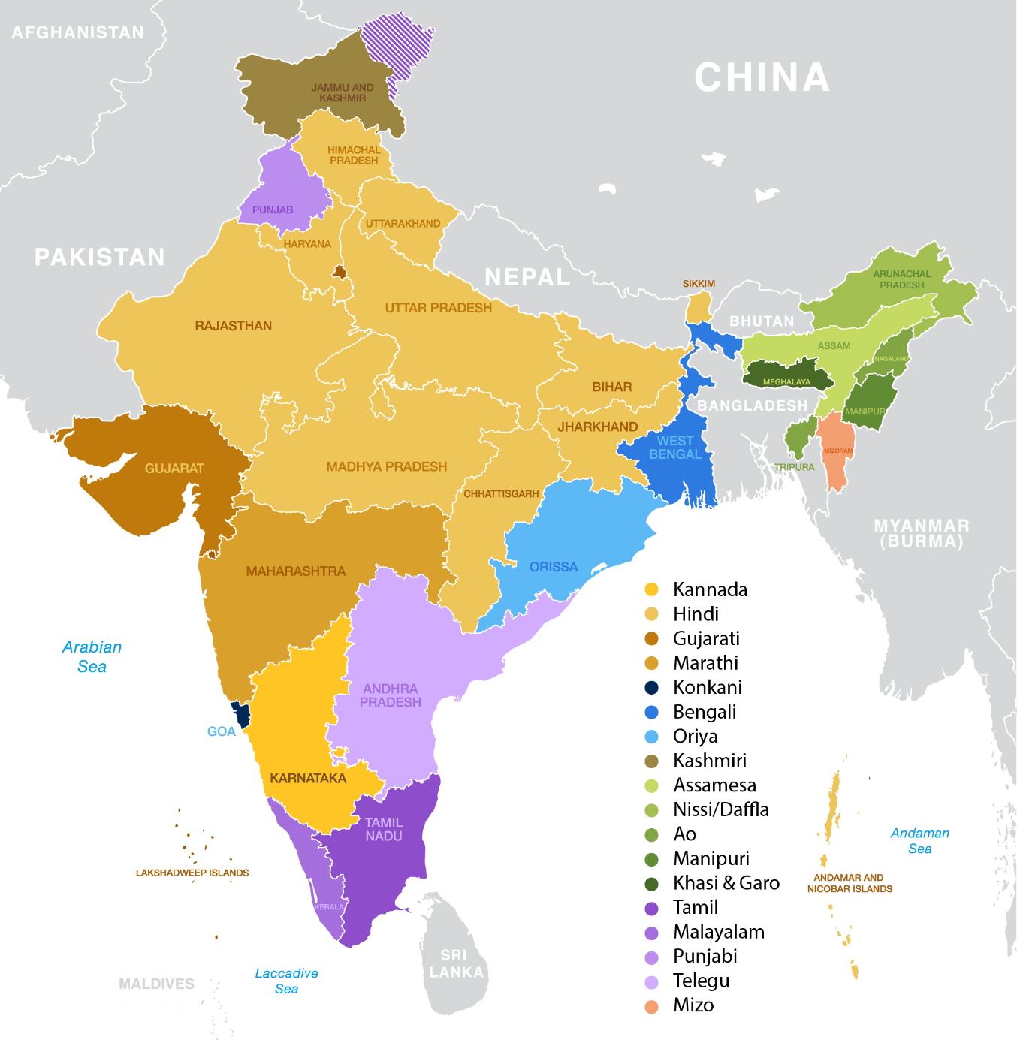
Language Diversity in India
India
Hindi
English
The main languages of government
22
languages
officially recognized languages and hundreds more
Many languages are very distinct from each other and have different scripts while some are very similar.
Most states have a dominant language spoken by at least 75% of the population

Slide 20
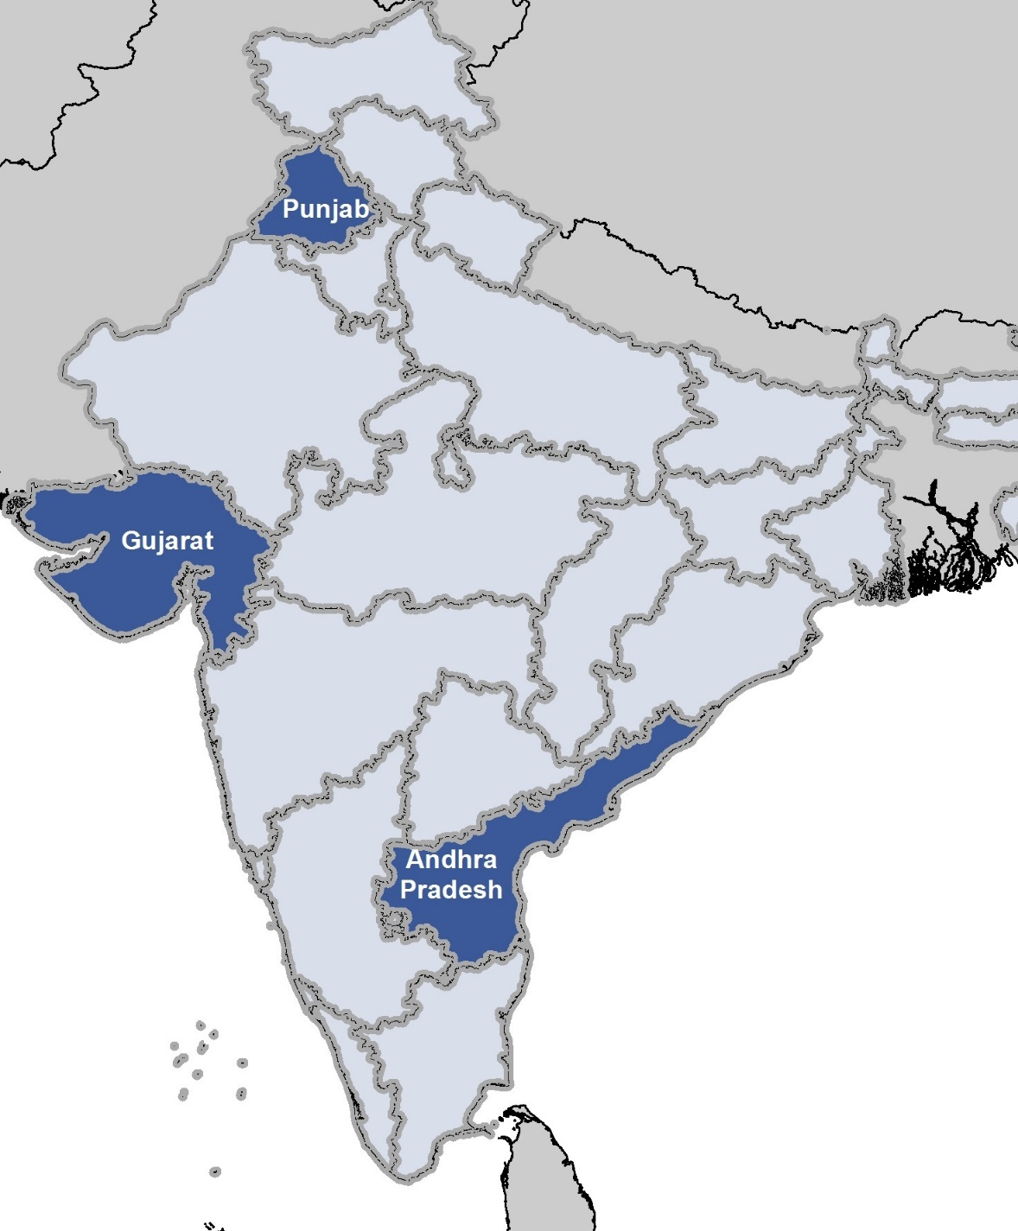
State Level Surveys in Three States- 1 language per state
Andhra Pradesh:
Telugu
Gujarat:
Gujarati
Punjab:
Punjabi or Hindi??
Considerations
Survey vendor standard practice (Hindi)
Similarity of the languages
Interviewer comfort reading Punjabi- most were from other states

Slide 21
Compromise Solution
Translate and program CAPI instrument in Hindi- Separate Punjabi translation of words or concepts that were found to be problematic in the pretest and pilot test.
Survey was about internet and mobile technology so we were afraid there might be key tech concepts that needed to be translated into Punjabi
Words/phrases that caused issues from a 30 minute questionnaire:
“Recharged/topped up” (mobile phone airtime)
“Which of the following”
“current events”
“Specify”
“Sunday”

Slide 22

Conclusions/Recommendations
Listen to local partners, but understand their rationale for certain recommendations.
Be flexible
Understand the language environment you are getting into and budget for sufficient resources for multiple iterations of translations.

Slide 23
Survey Technology and Translation

Slide 24
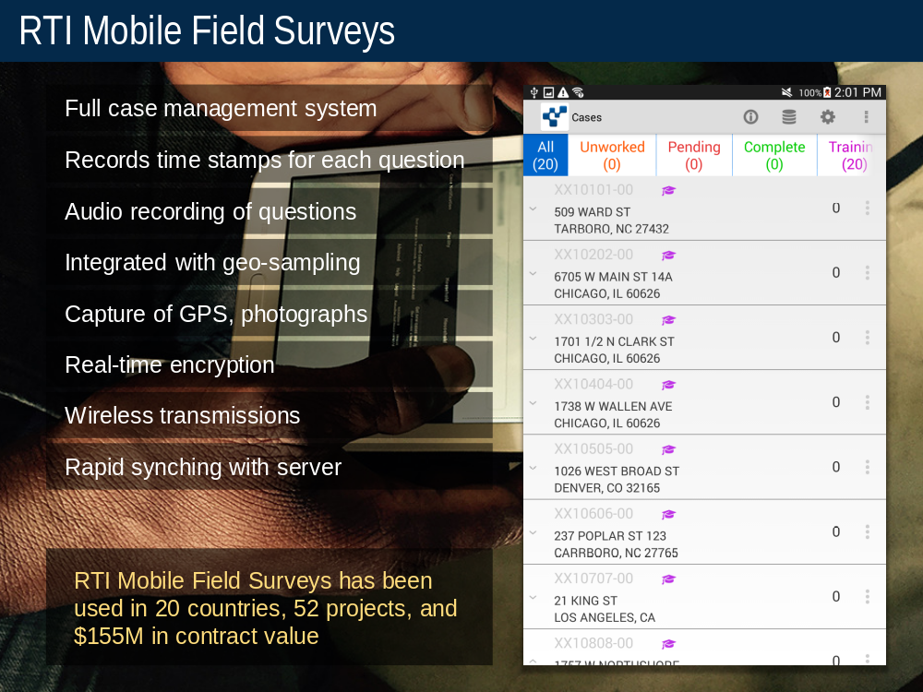
RTI Mobile Field Surveys

Slide 25
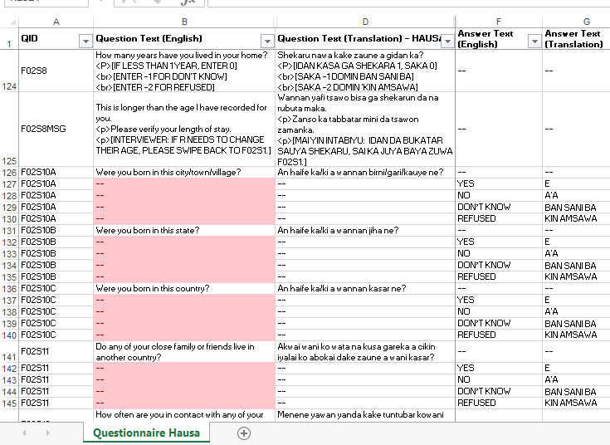
Translation Imported from Excel
Notes:
Line-by-line text for English and translation positioned side-by-side for copying and pasting.

Slide 26
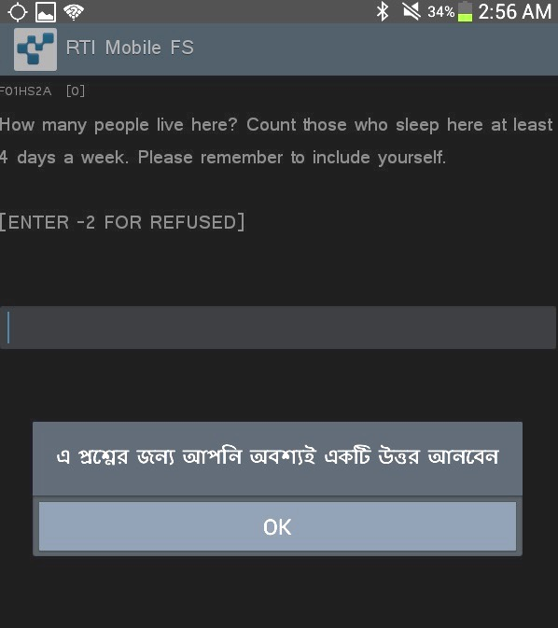
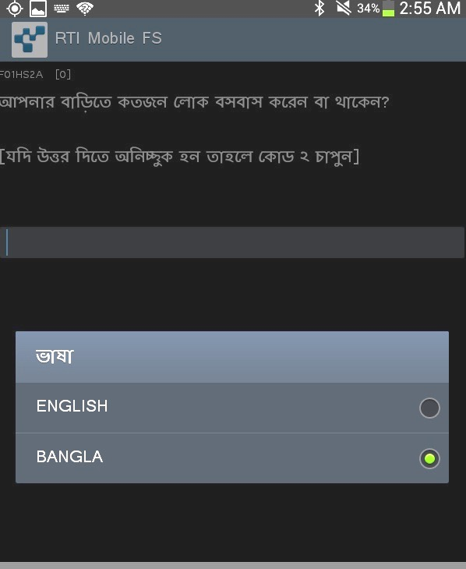
Example of Translation in Mobile FS
English
Bangla
Notes:
Default messages set to Bangla
Language toggle for questionnaire text

Slide 27
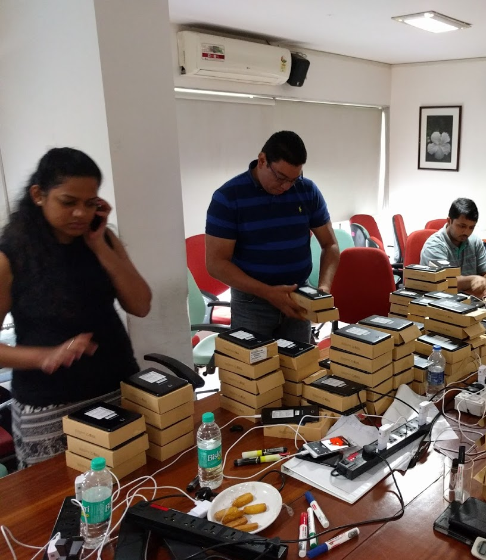
Initial Translation Testing
Follows compatibility test of device using English language base instrument
Samsung (tablet and smartphone)
Lenovo
Huawei
Need in-country staff proficient in the local language to check translations early in the process.
Not always a priority for partners (other projects, short-timelines, easy to say we checked and it’s fine)
Theoretically: This should be the end of translation task.
Reality: The iterations can seem never ending
Theoretically: This should be the end of translation task.
Reality: The iterations can seem never ending

Slide 28
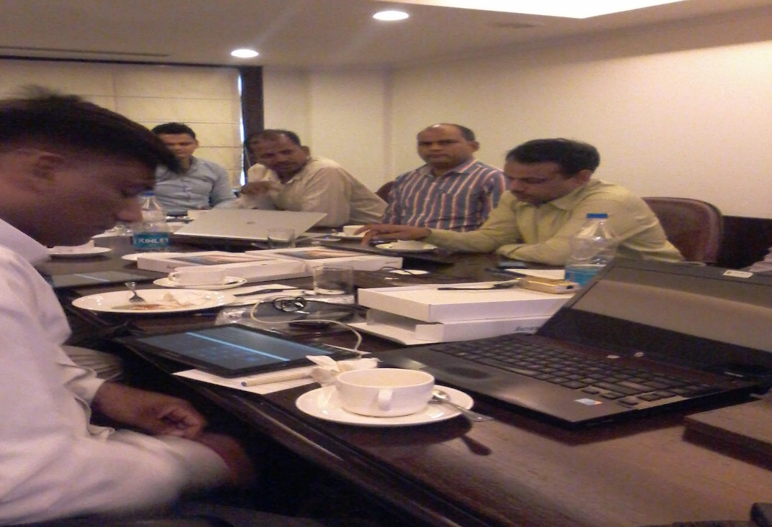
Translation Testing Steps
Initial import of translations (questionnaire and menu items)
Office testing and revision
Field Testing
Training and Dress Rehearsal
Final updates before fieldwork
Updates in field if needed

Slide 29
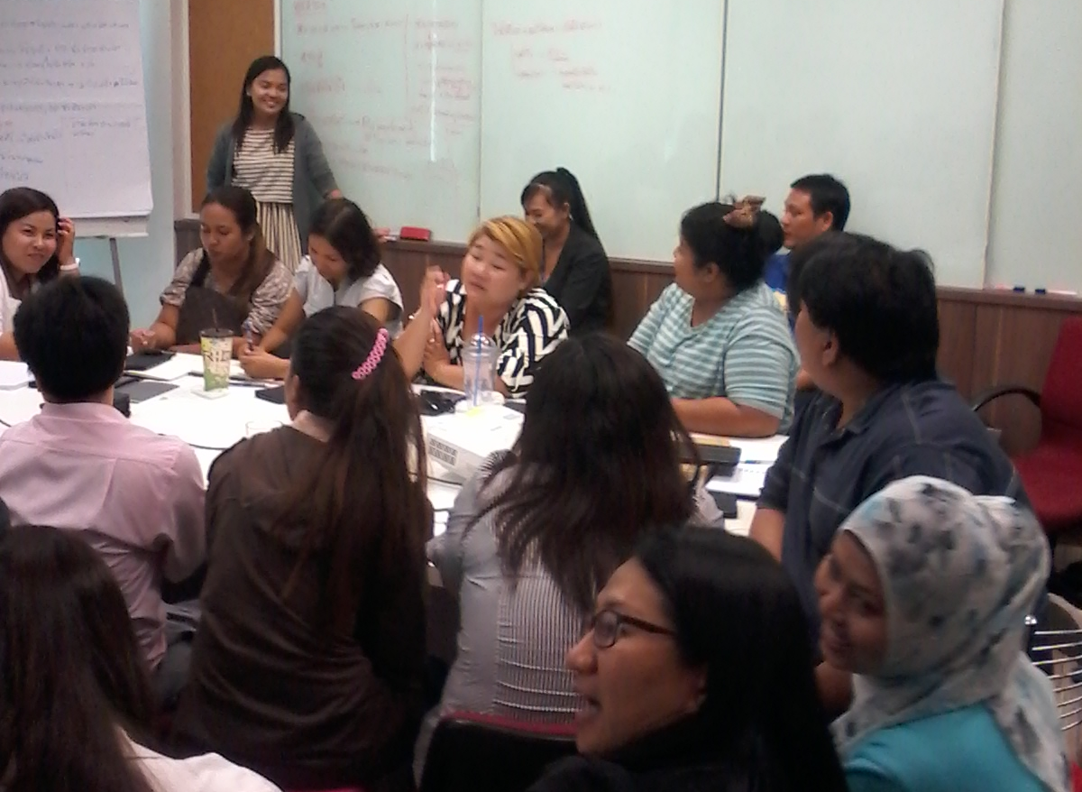


Why So Much Testing?
English Language Testers
Programmer
Programmer
Feedback collators
Local Language Testers
Testers
Respondents
Supervisors
Maximize eyes on the QUEX to avoid a single point of failure
Interviewers
Notes:
Objectives
Make sure questionnaire is NOT based primarily on one translators understanding and perspective
Guard against errors introduced into the questionnaire during scripting
The scripter is usually copying and pasting text that they can’t read, so some errors will occur.
Make sure questionnaire is usable for those in the field.

Slide 30
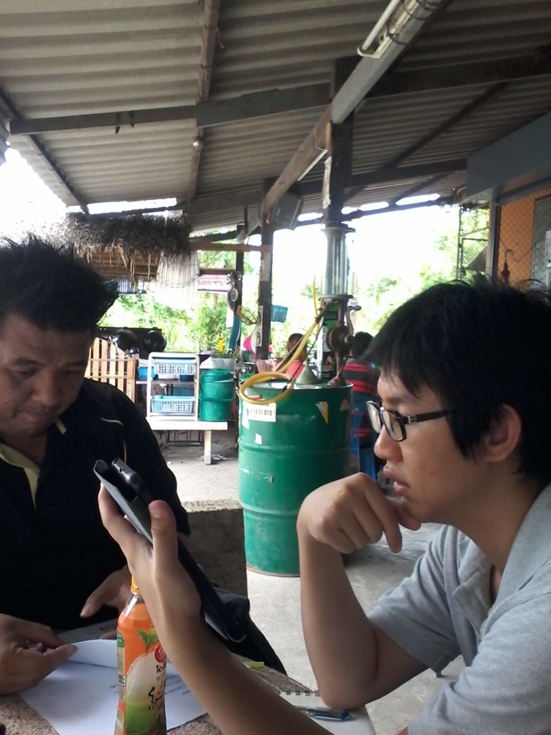
When Should You Stop Testing?
1
When the $$ is gone.
2
When the time is gone.
3
When you feel you have hit the point of diminishing returns.
The point of diminishing returns is project specific and knowing when you have hit it is based on experience and judgement about the ability of your team and your local research partner.

Slide 31
More Information
Elizabeth Dean
edean@rti.org
Clark Letterman
letterman@rti.org

