Slide 1
Questionnaire length and response rates: A nationwide experiment across three modes of administration
René Bautista, Michael Stern, Alyson Prater
NORC at the University of Chicago
International Conference on Questionnaire Design, Development, Evaluation, and Testing (QDET2)
November, 2016
Miami, FL
Notes:
Thank you all for coming
COLLEAGUES

Slide 2
Research Objective
  Assess the impact of questionnaire length across three modes of data collection:
    Mail
    Web
    Phone

Slide 3
Context
Two major surveys combined into a single survey
National Survey of Children’s Health (NSCH) | National Survey of Children with Special Health Care Needs (NS-CSHCN)
Key metrics: Physical health Mental health Access to quality health care Information on the child’s family Neighborhood and social context | Key metrics: Physical health Emotional health Behavioral health Chronic conditions Access to medical services Coordination of services
Notes:
The National Survey of Children’s Health (NSCH)
Sponsored and directed by the Health Resources and Services Administration’s Maternal and Child Health Bureau (MCHB)
NSCH collects information on a range of health factors and asks about medical conditions ranging from asthma to autism spectrum disorders to migraines

Slide 4
Background of Study
Study sponsored and directed by the Maternal and Child Health Bureau (MCHB) in the Health Resources and Services Administration (HRSA) an agency of the U.S. Department of Health and Human Services (HHS)
NSCH previously fielded by NORC as part of the State and Local Area Integrated Telephone Survey (SLAITS)
Major re-design:
From: |  | To:
Phone (aural mode) |  | Mail and web (visual mode)

Slide 5
Survey Design
Screener
  Prior to topical re-designed questionnaire
3 Topical Questionnaires
  3 age groups: 0-5 years, 6-11 years, 12-17 years
Two versions: English & Spanish
Nationally representative sample: ABS sampling
  Included address and phone number
  Included exact age flag indicating presence of child <18 years old
  Sample randomly divided across modes:
    Phone (N=9,066)
    Mail (N=6,012)
    Web (N=18,606)
  Data collection: January 7, 2015 - (Data as of April 14, 2015)

Slide 6
Survey Design
CATI
  Initial letter mailing
  $10 incentive for those who qualify
Web
  Initial letter mailing ($1 incentive included)
  Reminder postcard
Mail
  Screener packet 1 ($1 incentive included)
  Reminder postcard
  Screener packet 2
  Topical packet 1 ($2 incentive included)
  Reminder postcard
  Topical packet 2
Notes:
Tasked with:
combining NSCH with National Survey of Children with Special Health Care Needs
Transitioning from RDD sampling to ABS sampling
and redesigning a phone survey to be administered via mail and web

Slide 7
Questionnaire Length
Because the goal of the NSCH Re-design was to create the best possible instrument through maximizing quality and completeness of data collected, evaluations of questionnaire length were included
All NSCH Re-design questionnaires were divided into two lengths:
  Long
  Short
Questions eliminated for the short survey were not necessary to derive key indicators and were not essential to the survey

Slide 8
Questionnaire Length
Questions were removed from the following sections of the NSCH Re-design to create the short surveys:
  Your Child’s General Health
    Ex: How well does each of these items describe your child?
  Health Care Services
    Ex: Are you concerned about your child’s weight?
  Experience with Your Child’s Health Care Providers
    Ex: During the past 12 months, were any decisions needed about your child’s health care services or treatment, such as whether to start or stop a prescription or therapy services, get a referral to a specialist, or have a medical procedure?

Slide 9
Questionnaire Length
  Providing for your Child’s Health
    Ex: In an average week, how many hours do you or other family members spend providing health care at home for your child? Care might include changing bandages, or giving medication and therapies when needed.
  Your Child’s Schooling and Activities
    Ex: During the past 12 months, how often did you attend events or activities that your child participated in?
  About Your Child
    Ex: During the past 12 months, was there someone that you could turn to for day-to-day emotional support with parenting or raising children?
  About Your Family and Household
    Ex: When your family faces problems, how often are you likely to do each of the following?

Slide 10
Experimental Design
2 experimental versions of topical re-designed questionnaires:
  Long vs. Short (~30% shorter)
 | 0-5 yrs | 6-11 yrs | 12-17 yrs
 | # of Questions in Questionnaire
Long | 318 | 304 | 318
Short | 235 | 215 | 230
Mode by Type of Questionnaire
Mode | Experimental Condition
Phone | Short | Long
Mail | Short | Long
Web | Short | Long

Slide 11
Experimental Design
3 x 2 experiment (Mode by Type of Questionnaire)
  Participants were given the same time estimate to complete long and short instrument in Web and Phone (30 mins)
Actual number of completes (as of 4/14/2015)
Mode | Type of Questionnaire
 | Short | Long
Phone | 223 | 217
Mail | 179 | 114
Web | 538 | 494
Total | 940 | 825
Notes:
Tasked with:
combining NSCH with National Survey of Children with Special Health Care Needs
Transitioning from RDD sampling to ABS sampling
and redesigning a phone survey to be administered via mail and web

Slide 12
Metrics (Production Rates):
Interview Completion Rate total
  Proportion of identified eligible households that completed the interview.
Council of American Survey Research Organizations (CASRO) response rate
  Product of the resolution rate, screener completion rate, and interview completion rate.
    Resolution rate is the proportion of sample units that could be determined to be either a household or a non-household.
    Screener completion rate is the proportion of determined households that were screened for household eligibility.
    Interview completion rate is the proportion of identified eligible households that completed the interview.

Slide 13
Results
Overall comparison of Short vs. Long
  Results from a two sample t-test
    Using p-value<.10 as marginally significant
    Also, using conventional statistical levels (p <.001; p <.01; p <.05)
Overall | Short | Long | Diff. | Sig. | p-value
CASRO response rate | 11% | 10% | 1% | Marginally significant | <.10
Interview completion rate | 59% | 56% | 3% | Significant | <.001

Slide 14
Results
Overall comparison of Short vs. Long by Mode
CASRO Response Rate | Short | Long | Diff. | Sig. | p-value
Phone | 16% | 15% | 1% | Not significant | >.10
Mail | 12% | 12% | 0% | Not significant | >.10
Web | 9% | 8% | 1% | Not significant | >.10
Overall | 11% | 10% | 1% | Marginally significant | <.10

Slide 15
Results
Overall comparison of Short vs. Long by Mode
Interview completion rate | Short | Long | Diff. | Sig. | p-value
Mail | 45% | 42% | 3% | Significant | <.001
Phone | 56% | 51% | 5% | Marginally significant | <.10
Web | 69% | 67% | 2% | Not significant | >.10
Overall | 59% | 56% | 3% | Significant | <.001

Slide 16
Discussion
Questionnaire length
  Likely to have an impact on completion rates, but not likely to have an effect on response rates
In terms of completion rate:
  Likely to have a marginally significant effect in phone (~5%)
  Likely to have a statistically significant effect in mail (~3%)
Completion
Phone
(Marginally significant effect)
Web
(No effect)
Mail
(Significant effect)

Slide 17
Bautista-Rene@norc.org

Slide 18
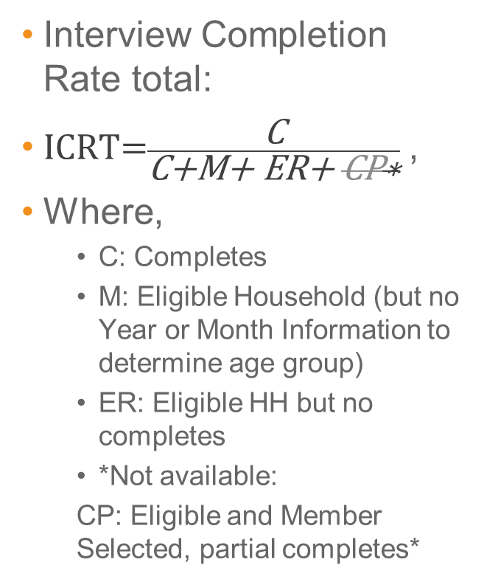
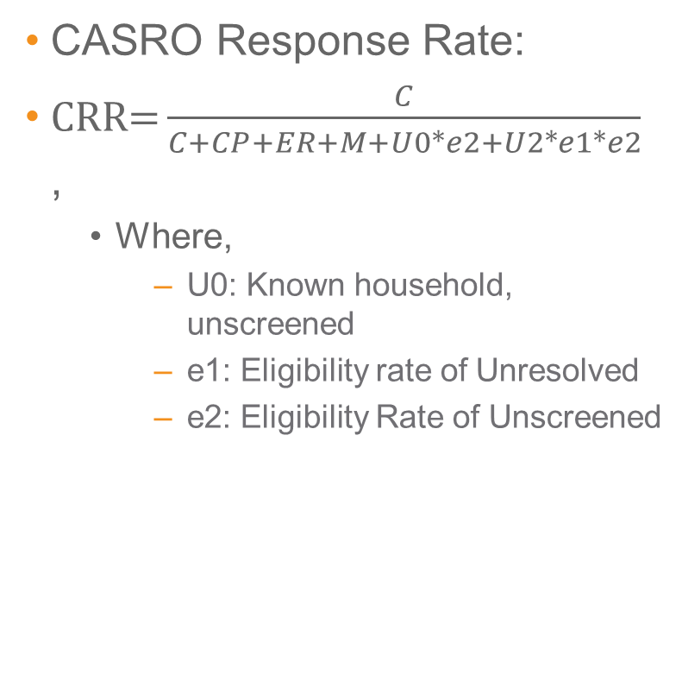
Metrics (Production Rates):
Interview Completion Rate total:
$\text{ICRT}\text{=}\frac{\text{C}}{\text{C}\text{+}\text{M}\text{+ }\text{ER}\text{+ }\text{CP}\text{∗}}$,
Where,
  C: Completes
  M: Eligible Household (but no Year or Month Information to determine age group)
  ER: Eligible HH but no completes
  *Not available:
  CP: Eligible and Member Selected, partial completes*
CASRO Response Rate:
$\text{CRR}\text{=}\frac{C}{C+CP+ER+M+U0∗e2+U2∗e1∗e2}$,
  Where,
    U0: Known household, unscreened
    e1: Eligibility rate of Unresolved
    e2: Eligibility Rate of Unscreened

