Slide 1
The need for biomarkers in surveys,
the case of immunization
Bernardo Hernández Prado, D.Sc.
Associate Professor, Global Health
November 12, 2016

Slide 2
Introduction
Vaccination coverage as a key element to prevent infectious diseases preventable through immunization
2 types of coverage:
  Crude coverage
    Coverage of a health intervention in terms of the proportion of the target population who receives it
    Example: proportion of the target population receiving a vaccine
      Measured through mother/caregiver report or immunization cards
  Effective coverage:
    Impact of health of a given intervention: proportion of population who has a gain in terms of health
    Example: proportion of the target population who is immune (has antibodies) against a given disease because of receiving the vaccine
      Measured through seroconversion in the target population

Slide 3
The problem…
Estimating vaccination coverage is challenging in resource-poor settings where accurate records are sparse.
Little is known about how coverage estimates based on maternal recall differ from those based on health cards for the same children.
Even less is known about how these measures compare with actual rates of seroconversion (effective coverage).

Slide 4
Objective
To compare the accuracy of maternal recall, immunization card documentation, and antibody presence in vaccination coverage estimates in the poorest 20% of the population in the state of Chiapas, Mexico.

Slide 5
Methods
Data collected as part of the Salud Mesoamérica Initiative
Sample of 4,700 households with children under-5 and women of reproductive age
Pre-survey census within segments which had been randomly selected with probability proportional to size.
Evaluation includes:
  Census
  Household survey
    Information on immunization from mother´s report and immunization cards
  Anthropometry, anemia tests, and dried blood spot samples
  Health facility surveys: interview, observation, and medical record review

Slide 6
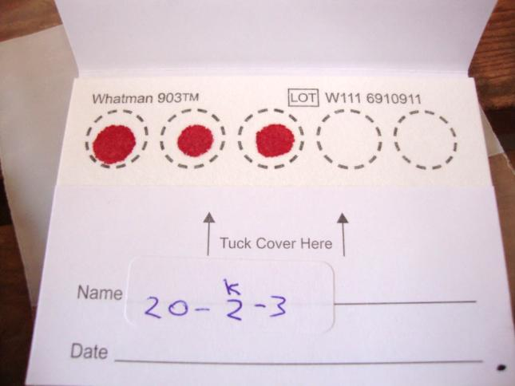
Coverage and effective coverage of measles immunization
Coverage: immunization history from health card and caregiver recall for all children under five
Effective coverage: dried blood spot (DBS) samples from children 436 aged 12-23 months in Chiapas, Mexico
ELISA test of DBS samples for presence of measles antibodies
Comparison of survey-based and biomarker-based estimates of measles immunization coverage
Notes:
~500 DBS samples pending in Nicaragua

Slide 7
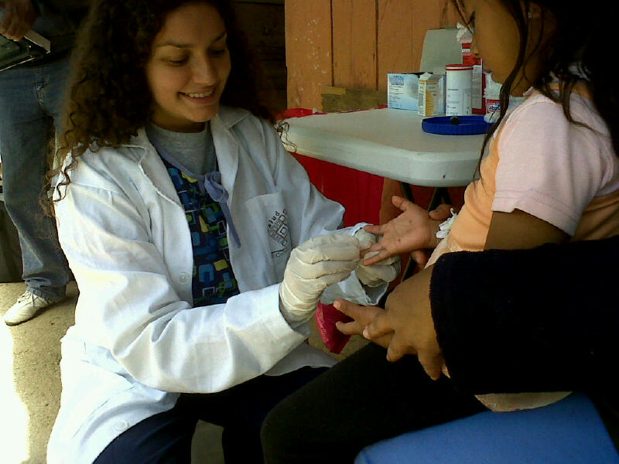
Challenges associated with DBS
Samples must be collected, transported and stored properly
Measurement of serostatus typically done using whole blood or serum samples
Methods for eluting and analyzing DBS are still being developed and standardized
ELISA tests of DBS must be validated, calibrated and checked for consistency against known standards

Slide 8
Validation of DBS data
Collected blood samples from 25 vaccinated and 25 unvaccinated children
ELISA tests for each child from both serum and DBS
Treated serum results as gold standard; measured adjustment and amount of error in DBS results
Calibrated DBS results for the whole sample using this transformation
Notes:
Linear relation between standardized OD values representing anti-measles IgG titers of matched DBS and serum samples

Slide 9
Clear division of protected and unprotected children
* Indeterminate results falling between the cutoffs were re-run
Notes:
Distribution of 0 – 2.0 DBS serum-equivalent values across microtiter plates

Slide 10
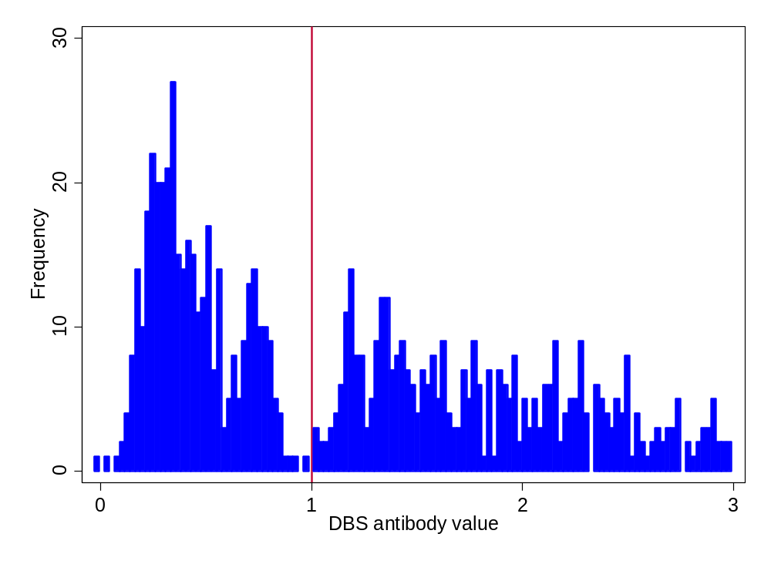
Clear division of protected and unprotected children

Slide 11
Results: measles immunization coverage, Chiapas, Mexico
Notes:
Restricted to 608 children aged 12-23 months with all 3 sources of data
If we restrict just to those kids that have card and DBS, we have 1000 kids and the coverage is 76.6% according to card and 67.0% according to DBS
92.5% (weighted) of children in this subsample have health cards
In our whole sample of children 12-59 months (because measles is given at 12 months)
Recall & card: 77.9% (CI: 76.0 – 79.9%)
Recall: 70.2% (CI: 67.5 – 72.9%)
Card: 72.8% (CI: 70.6 – 75.1%)
(Keep in mind that the previous bar graphs showing all vaccines included children 0-59 months, not 12-59 months, and some vaccines aren’t administered until 2, 4, 6, 12, 18 months, etc)
MMR vaccination coverage of children 1-2 years old according to the most recent national survey (ENSANUT 2012) found 75.7% coverage in Chiapas

Slide 12
Health Card
Measles immunization coverage
19% of survey-positive children do not have antibodies
DBS
Yes
No
59.8% | 14.2%
9.3% | 16.7%
Yes
No
Notes:
- Now lets drill down on the difference between the two metrics
This is a cross tabulation of positive and negative status from survey and serology
Box 3: According to a world health organization report, there have been 790 suspected measles cases in 2013, but none have been confirmed.
There were no confirmed cases in last year either, but there were a handful in 2011.
[In rural regions of Chiapas, its possible that measles cases go unreported if the child is not taken to a health facility]
14 respondents reported the child had had measles. 13 of these reported yes to survey, and 1 reported no to survey. 11 of the 14 had antibodies.
24% of children vaccinated according to the survey did not have antibodies.

Slide 13
Geographic distribution of coverage
* Numbers are the total of observations in each municipality

Slide 14
Where are the gaps?
* Numbers are the total of observations in each municipality
Proportion of card-positive children lacking antibodies, by grouped health jurisdictions

Slide 15
Factors predicting that a card-positive child will lack antibodies
Characteristic | Odds Ratio* | 95% CI lower | 95% CI upper
Basic facility | 0.35 | 0.07 | 1.77
Complete facility | 1.16 | 0.09 | 15.09
Facility has doctor | 0.78 | 0.06 | 9.98
Electricity at all hours | 2.72 | 0.28 | 26.91
Internet access | 0.23 | 0.04 | 1.37
Routine staff meetings on medical topics | 1.22 | 0.12 | 12.81
Any fridges with out-of-range temperature on day of survey | 10.79** | 1.55 | 74.99
N = 101
*adjusted for all variables in the table
** p <0.05

Slide 16
Why the gap?
Errors in caregiver recall of immunization
Errors in health card documentation, possibly motivated by conditions for cash transfer programs
Dried blood spot ELISA test sensitivity
Interruptions in cold chain
Incorrect administration of the vaccine
Limitations of vaccine efficacy, even under ideal conditions

Slide 17
Conclusions
Maternal recall, child health cards, and antibody tests generate differing estimates of immunization coverage.
  Effective coverage is significantly lower that immunization coverage as measured by household surveys
  Use of biomarkers generates strong evidence about effective coverage
Differences highlight possible weaknesses in mother´s report, card accuracy, card coverage, and vaccine administration.
Current national estimates of immunization coverage based on the combination of maternal recall and children’s health cards may be over-estimating actual protection
Geographic patterns and health facility characteristics suggest cold chain problems

Slide 18
Thank You
For more information:
bhp3@uw.edu
www.healthmetricsandevaluation.org

