Slide 1






A Comparison of Quantitative and Qualitative
Methods to Measure Wildlife Value Orientations Among Diverse Audiences: : A Case Study of Latinos in the American Southwest
Loren Chase, PhD
LorenChase
@InjoyTheSilence
HDofWildlife
623.236.7518
Lchase@azgfd.gov
Notes:
Opinions are my own and mention of products or services do not constitute endorsement of any kind.
In no way should they be construed to represent any governmental organization, boards, commissions, or technical advisory committees that I participate in or chair.

Slide 2
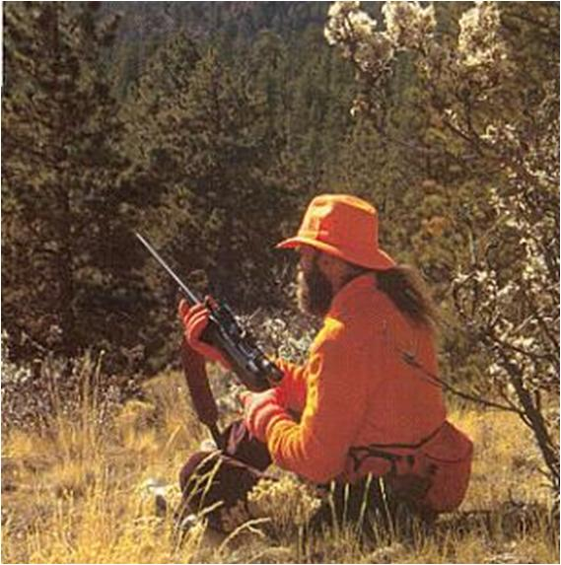
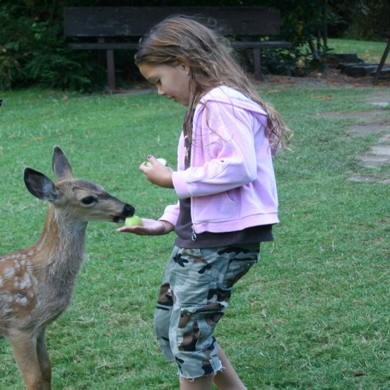
Different cultures may perceive and interpret wildlife differently
Wildlife Value Orientations
Domination
Mutualism
Introduction
Methods
Results
Hunting is acceptable
Animals are for the use of humans
Humans have priority
Animal have rights
Emotional bonds
Companionship
Discussion
Notes:
value-attitude-behavior model (Homer and Kahle 1988)
Excellent at predicting acceptability of management actions, and recreation behaviors

Slide 3
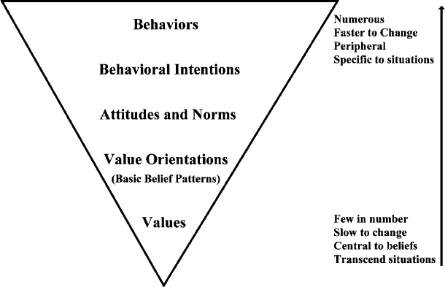
Introduction
Methods
Results
Discussion
Notes:
WVO have been defined as ‘networks of basic beliefs that organize around values and provide contextual meaning to those values in relation to a particular domain such as wildlife’ (Teel and Manfredo 2009, p. 129)
Right to life example

Slide 4
Factor Structure for the two WVOs
Abundant hunting
Co-living w/ out fear
Introduction
Hunt is cruel*
Hunting
Extended family
Social Affiliation
Hunt disrespectful*
Analogous rights
Methods
Hunting rights
Domination
Mutualism
Familial affiliation
Results
Human use
Care for animals
Appropriate
Use
Caring
Human priority
Emotional connection
Discussion
Human benefit
Companionship
*Reverse coded

Slide 5
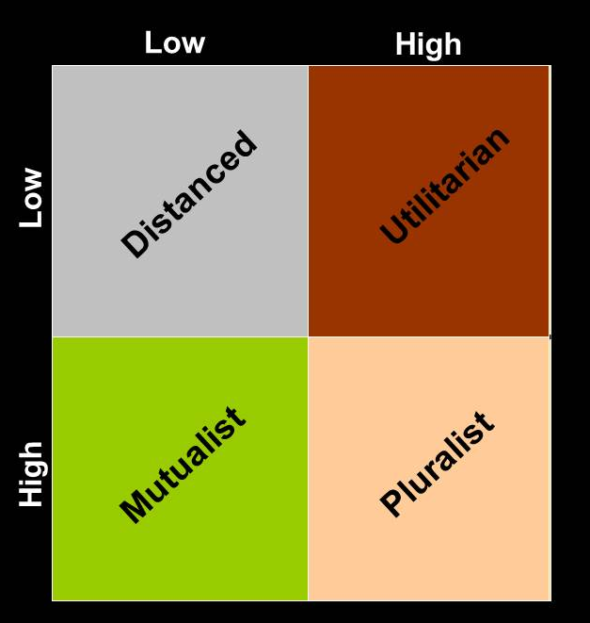

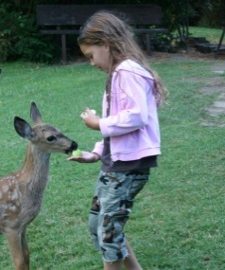
Introduction
Methods
Results
Discussion
Notes:
Tetlock’s value pluralism
They paid the cost of dichotomization in exchange for simplicity
Both are continuous variables from a scale of 1-7. and then dichotomized using a median split.

Slide 6
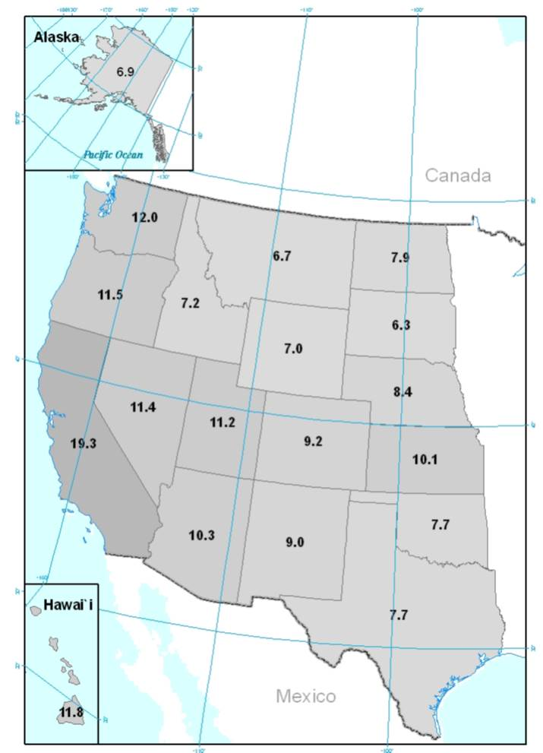
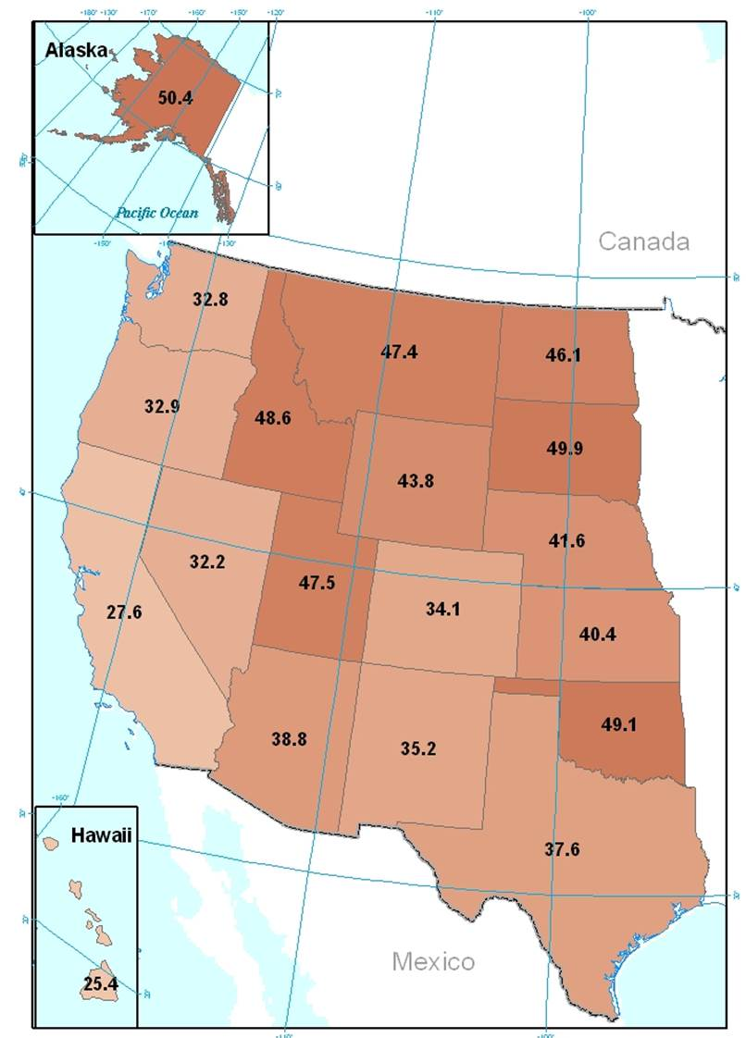
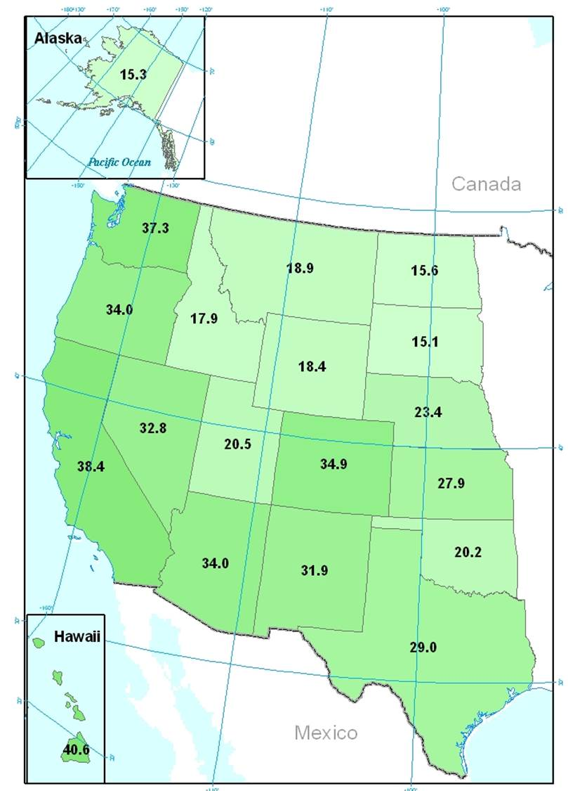
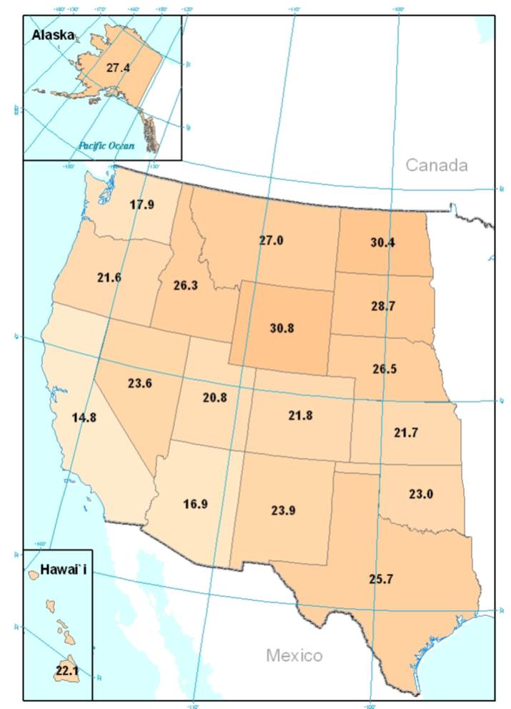
Introduction
Utilitarian
Distanced
Methods
Results
Pluralists
Mutualists
Discussion
Notes:
Teel et al (2005)

Slide 7
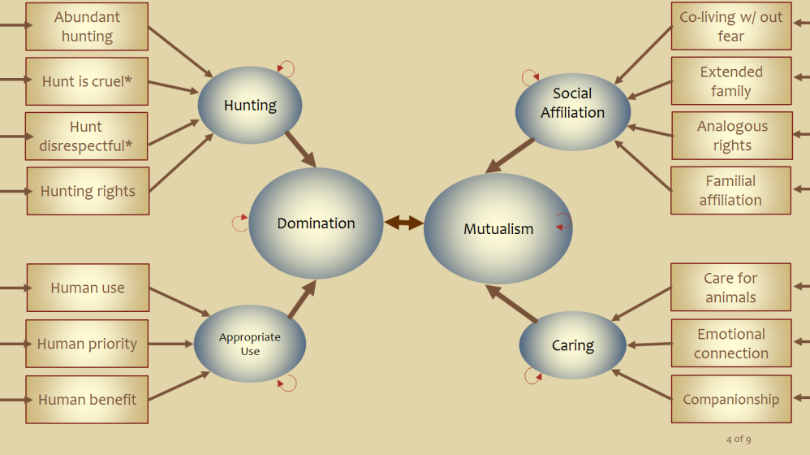

Problem:
WVO scale may not measure ethnicities the same
Introduction
Non-Hispanic
White
Hispanic
Methods
Results
α =.73
α =.83
α =.61
α =.81
Discussion

Slide 8
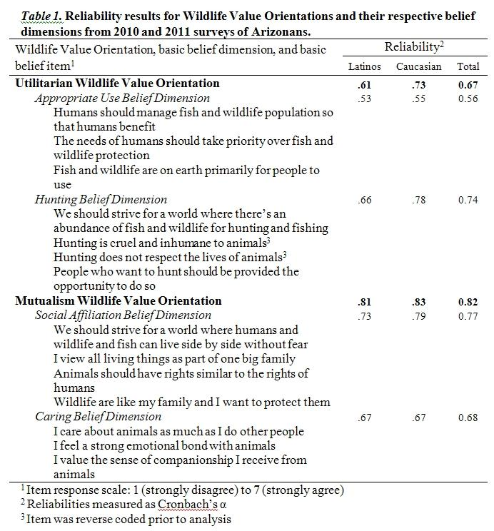
14 Item Battery
Introduction
Methods
Results
Discussion

Slide 9
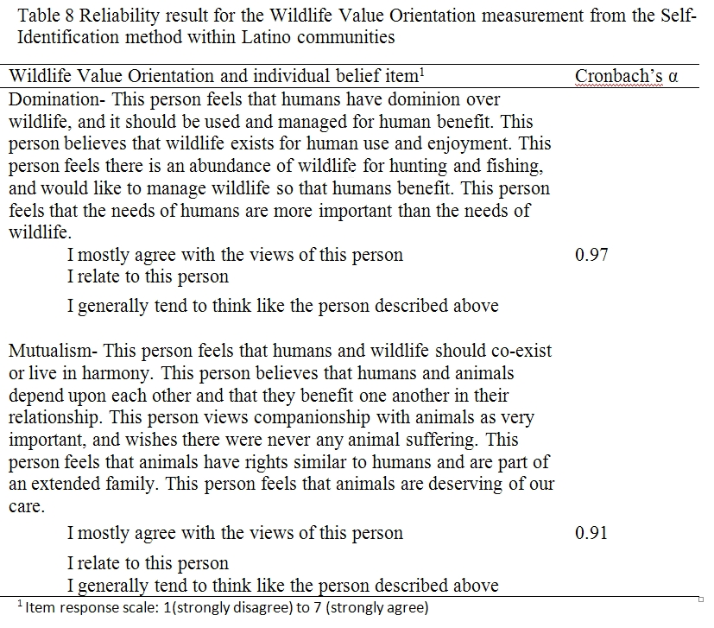
Self Identification
Introduction
Domination
Archetype
Methods
Results
Mutualist
Archetype
Discussion

Slide 10
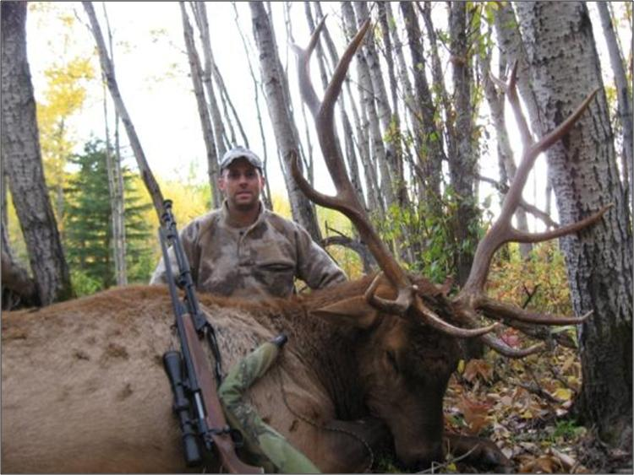
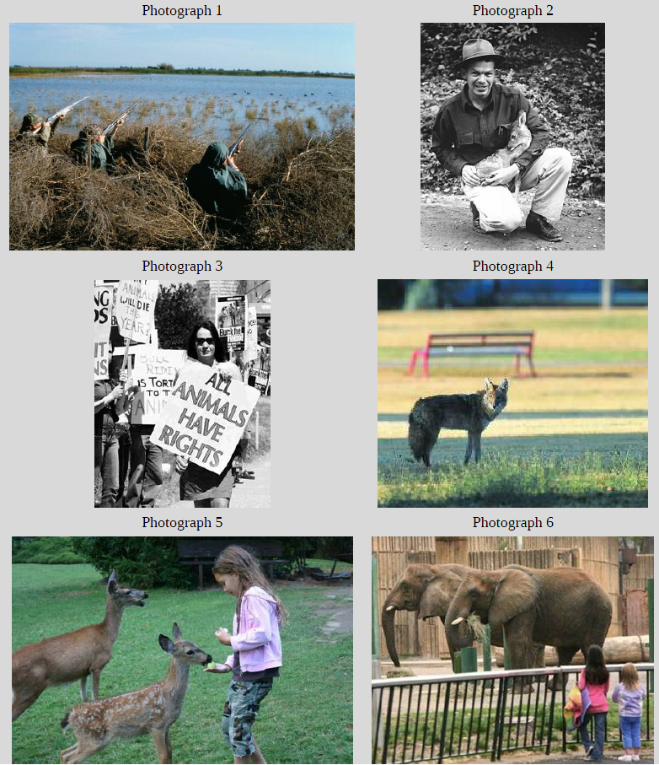
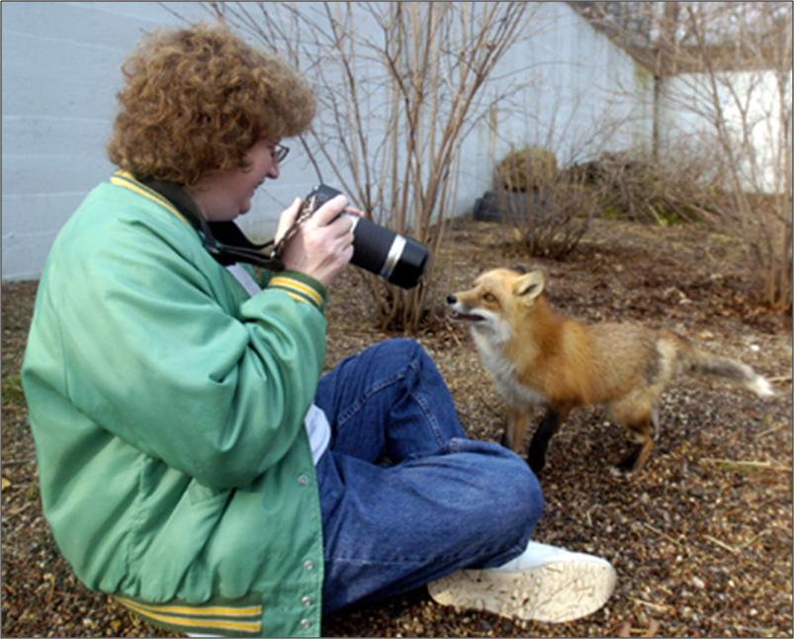
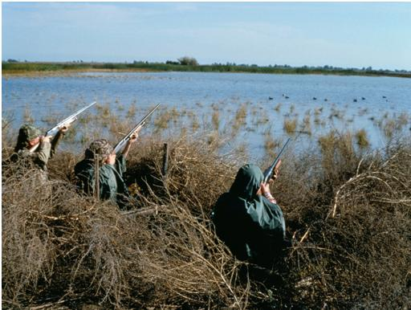

Photos
Introduction
Methods
Results
Discussion
Notes:
how the photo made participants feel
if participants related to the photo,
under what circumstances the scenes depicted might be more or less acceptable.
Coded onto a scale of 1-7

Slide 11

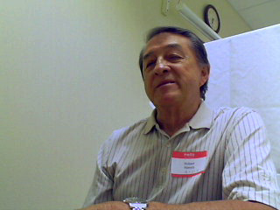
Stories
Introduction
Methods
Results
Discussion
Notes:
Please share with me experiences with wildlife that make you happy [repeated using other emotions of sad, angry, and afraid
Tanaka and Osgood 1965
Also coded onto a scale of 1-7

Slide 12
 |  | Pearson’s |  |  |  | Tetrachoric
 |  | Reliability | Survey | Self ID | Photos | Reliability | Survey | Self ID | Photos
Domination | Survey | .80 |  |  |  | .80
 | Self ID | .97 | .44 |  |  | .97 | .64
 | Photo | .90 | .71 | .21 |  | .97 | .73 | .15
 | Stories | .93 | .58 | .41 | .72 | .93 | .58 | .33 | .84
Mutualism | Survey | .86 |  |  |  | .96
 | Self ID | .91 | .55 |  |  | .91 | .65
 | Photo | .84 | .25 | .35 |  | .96 | .10 | .59
 | Stories | .67 | .22 | .19 | .42 | .80 | .47 | .45 | .40
Introduction
Methods
Results
Discussion

Slide 13
Introduction
Methods
Results
Discussion

Slide 14
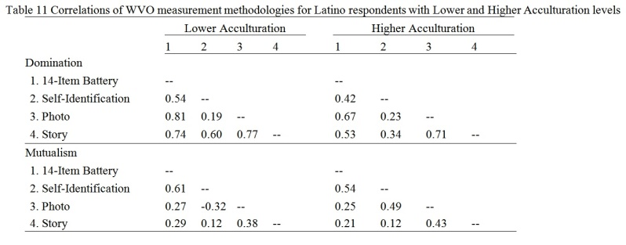
Future Research- Acculturation had an impact
Introduction
Methods
Results
Discussion

Slide 15
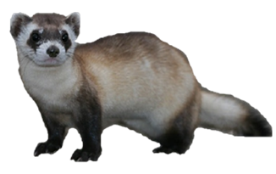
Take Homes
Introduction
WVOs may be applied to Hispanic populations… cuidosamente
Hispanics cannot be treated as monolithic
Photos & experiences will be useful because they use emotions, which transcend cultures
91% of AZ Hispanics
claim Mexican heritage
Methods
There is more variance within ethnicities than between
Results
Tanaka & Osgood, 1965
Discussion
Notes:
Questions associate with constructs in the same configuration
Questions load onto construct similarly
Questions are similar difficultly and leniency

Slide 16
Introduction
Methods
Thank you
Results
Chase, Teel, Thornton-Chase & Manfredo, 2016
Discussion
Notes:
Questions associate with constructs in the same configuration
Questions load onto construct similarly
Questions are similar difficultly and leniency

