Slide 1






Measurement of Wildlife Value Orientations among diverse audiences: A multi-group confirmatory factor analysis among Hispanic and Non-Hispanic White communities
Loren Chase, PhD
LorenChase
@InjoyTheSilence
HDofWildlife
623.236.7518
Lchase@azgfd.gov

Slide 2
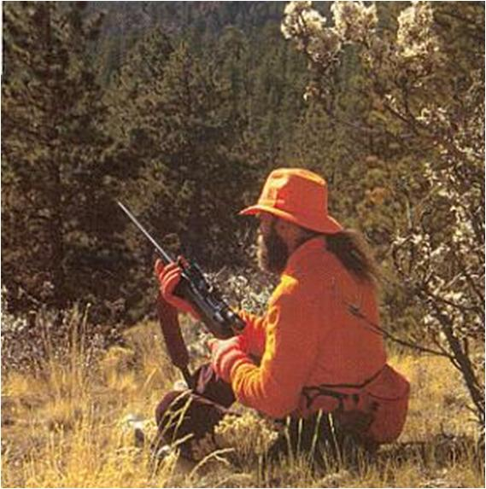
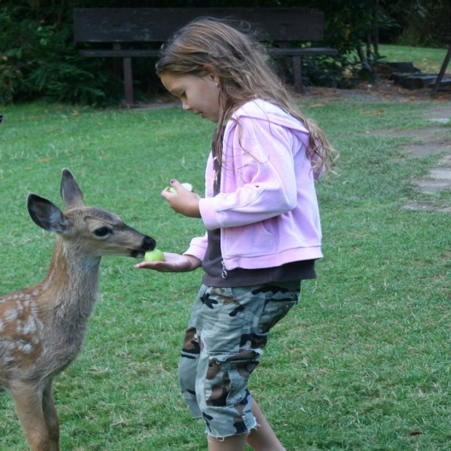
Different cultures may perceive and interpret wildlife differently
Wildlife Value Orientations
Domination
Mutualism
Hunting is acceptable
Animals are for the use of humans
Humans have priority
Animal have rights
Emotional bonds
Companionship

Slide 3
Factor Structure for the two WVOs
Abundant hunting
Co-living w/ out fear
Hunt is cruel*
Hunting
Extended family
Social Affiliation
Hunt disrespectful*
Analogous rights
Hunting rights
Domination
Mutualism
Familial affiliation
Human use
Care for animals
Appropriate
Use
Caring
Human priority
Emotional connection
Human benefit
Companionship
*Reverse coded

Slide 4
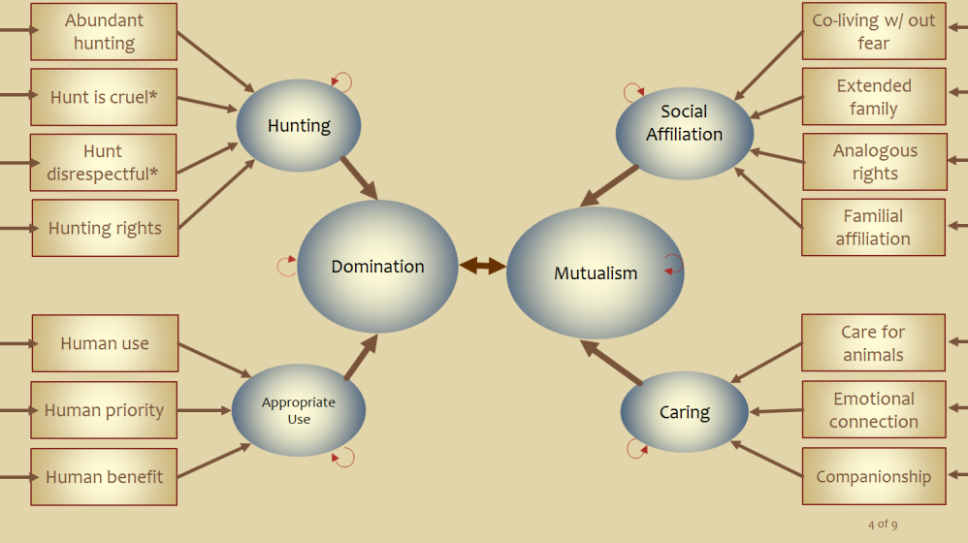

Problem:
WVO scale may not measure ethnicities the same
Non-Hispanic
White
Hispanic
α =..73
α =.83
α =.61
α =.81

Slide 5

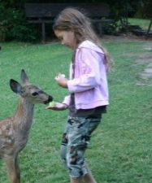
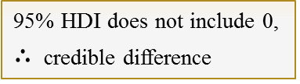
Finding:
Hispanics are more Mutualistic and less Domination oriented
Hispanic | Non-Hispanic White | NHST | BEST (Bayesian Estimation Supersedes the T test)
M = 4.74 | M = 5.11 | t₍₂₁₅₁₎ = 7.06 p < .001 r_{pb} = .17 | M∆= -.38; 95% HDI (-.48 , -.28) Effect: δ= .32; 95% HDI (.23,.41)
M = 5.67 | M = 5.09 | t ₍₂₂₅₈₎ = 10.56 p < .001 r_{pb} = .19 | M∆= .60; 95% HDI (.49, .71) Effect: δ= .50; 95% HDI (.40,.59)
* 1-7 point Likert scale
95% HDI does not include 0,
$∴$ credible difference
But is it real OR an artifact of measurement?

Slide 6
Invariance Type
Constraint
Configural
Form
Both groups construe the constructs similarly
Metric
factor loadings
Items load onto constructs similarly
Scalar
intercepts
Items intercepts are similar
Strict
group means
Item residuals are similar
Notes:
Questions associate with constructs in the same configuration
Questions load onto construct similarly
Questions are similar difficultly and leniency

Slide 7
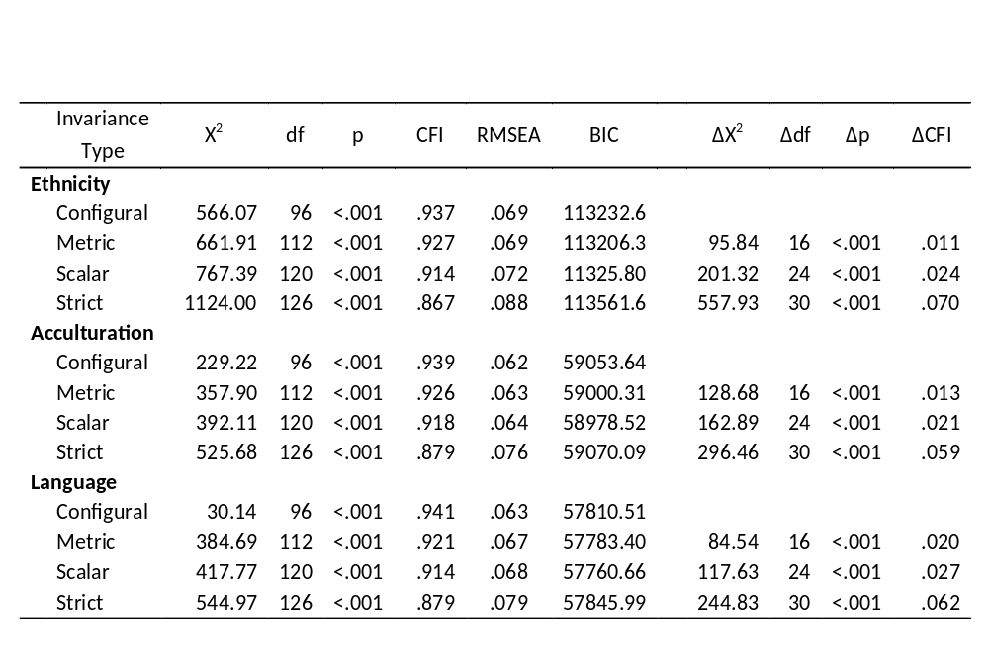
Findings:

Slide 8
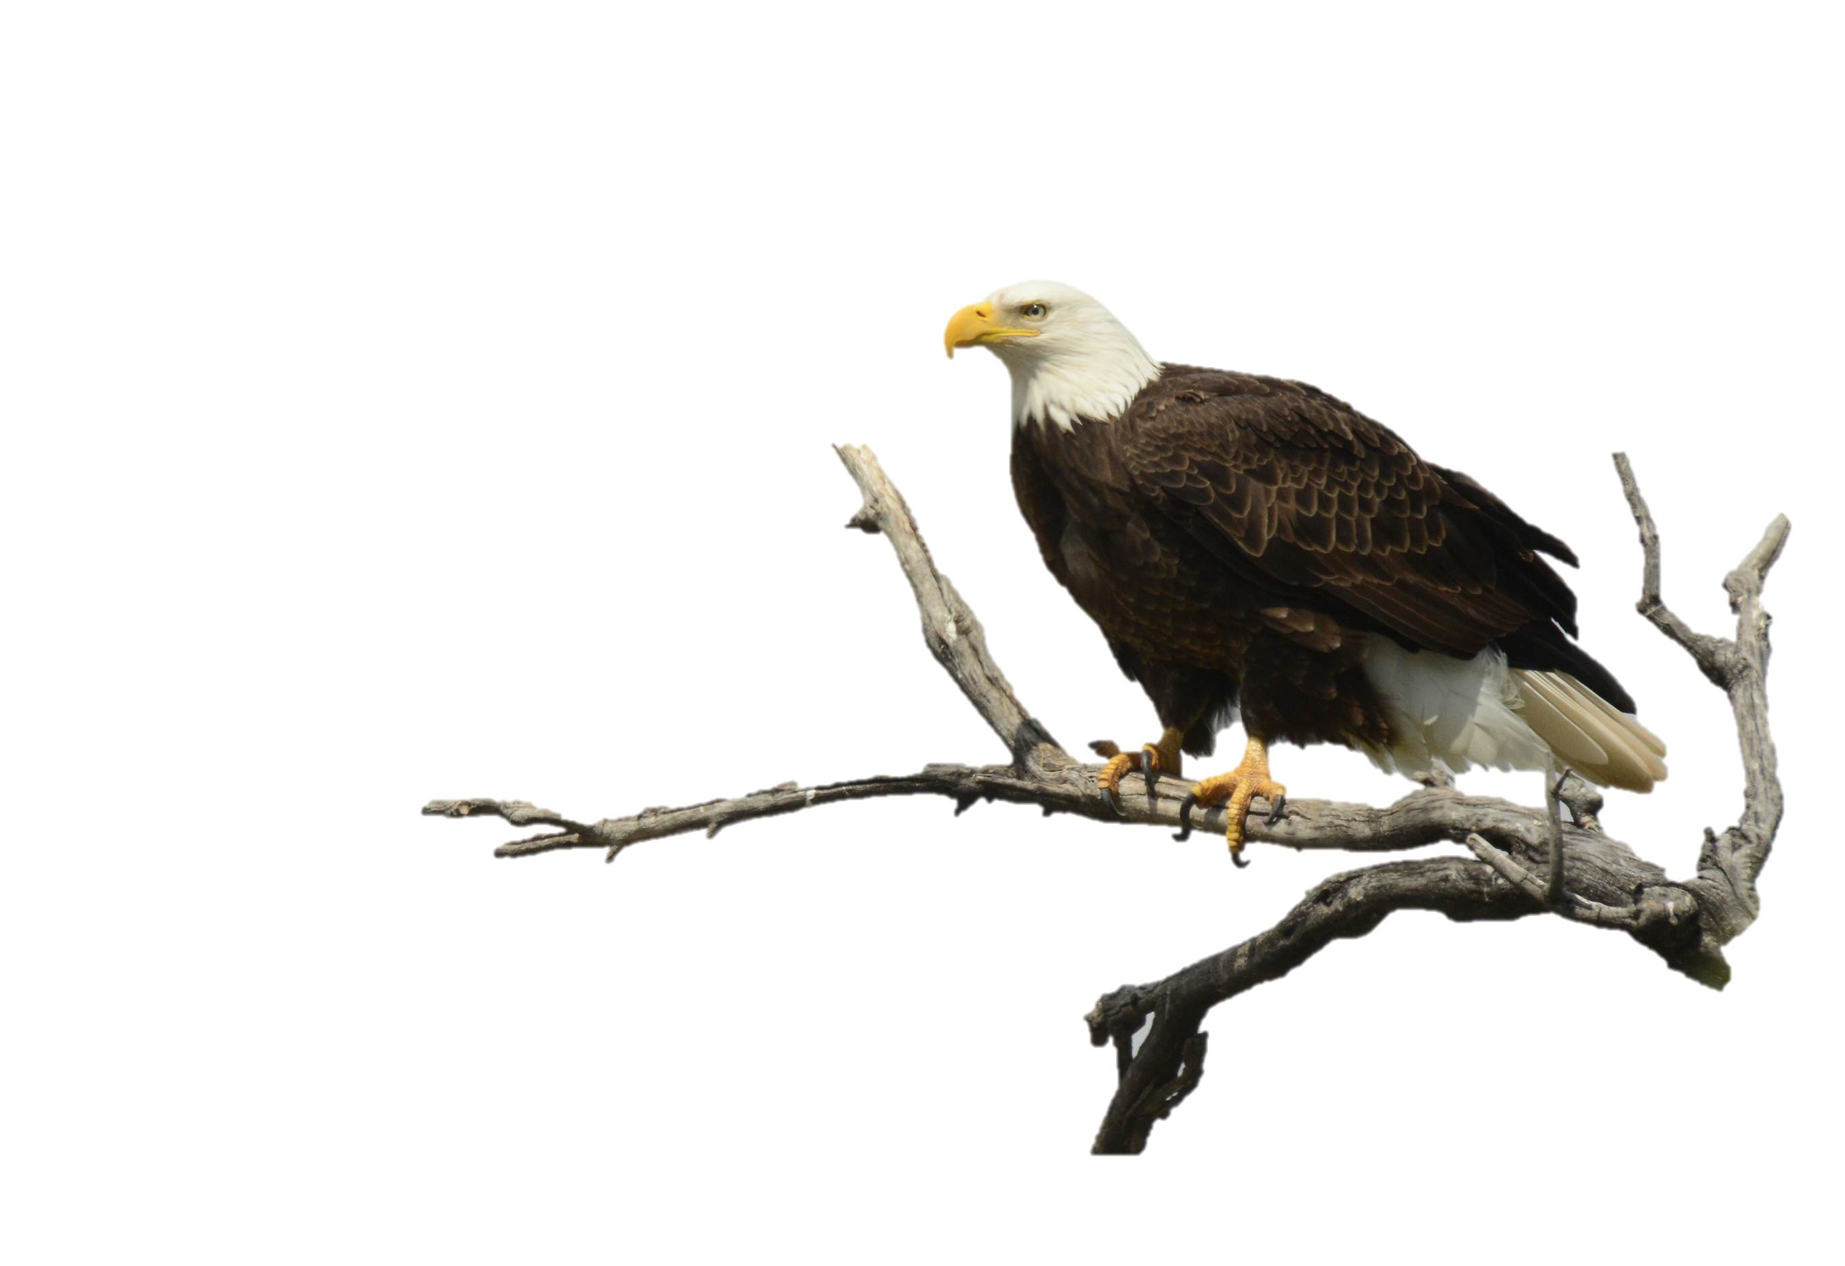
Comparison
Finding
Ethnicity
The instrument may tentatively be used with Hispanics and Non-Hispanic Whites
Acculturation
The instrument may tentatively be used with high acculturated Hispanics and low acculturated Hispanics
Language
The instrument may tentatively be used with Spanish-speaking Hispanics and English-speaking Hispanics
Notes:
Questions associate with constructs in the same configuration
Questions load onto construct similarly
Questions are similar difficultly and leniency

Slide 9
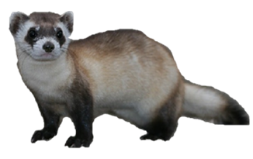
Take Homes
WVOs may cautiously be applied to Hispanic* populations
Hispanics are not monolithic
conducting a MGCFA is a necessary precondition when comparing WVOs across cultures
91% of AZ Hispanics
claim Mexican heritage
There is more variance within ethnicities than between
We need to show them how
Notes:
Questions associate with constructs in the same configuration
Questions load onto construct similarly
Questions are similar difficultly and leniency

