Slide 1




A CUB Model Strategy to Select Anchoring Vignettes
Omar Paccagnella¹ and Maria Iannario²
¹ Department of Statistical Sciences – University of Padua
² Department of Political Sciences – University of Naples Federico II

Slide 2

Introduction
In socio-economic surveys, collecting subjective evaluations of individuals’ health, living conditions or thoughts on certain aspects of their own life is quite common
Questions on individual’s attitudes, opinions or perceptions (i.e. job or customer satisfaction, life quality, health status, etc.) try to measure an underlying continuous latent variable, but for practical reasons the answer is usually expressed through an ordered set of categories
QDET2 2016
Miami – November 12, 2016

Slide 3
Introduction
There is a large literature on ordinal data modelling, particularly on the analysis AFTER data collection.
What about the selection of questions to be included in a questionnaire, that is BEFORE data collection ?
This work aims at introducing a mixture model strategy (i.e. a parametric model solution) to select questions requiring ordinal answers
→ Pretesting ?
→ Selection questions from a large set of questions?
QDET2 2016
Miami – November 12, 2016

Slide 4
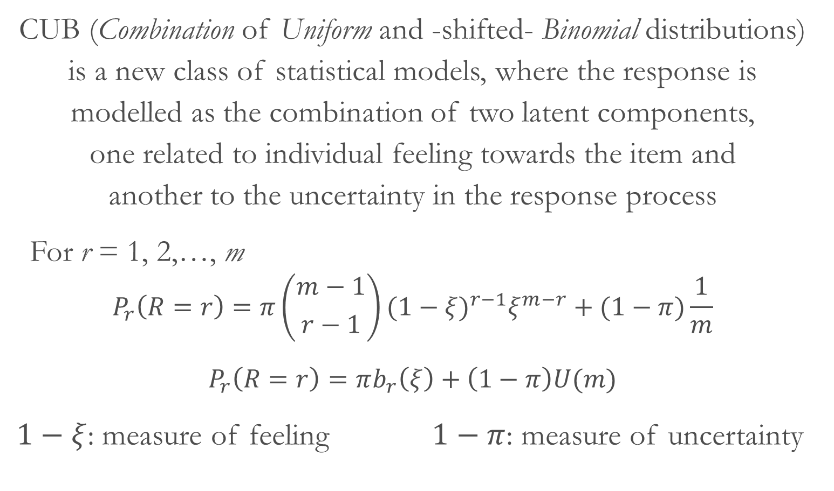
CUB models
CUB (Combination of Uniform and -shifted- Binomial distributions) is a new class of statistical models, where the response is modelled as the combination of two latent components, one related to individual feeling towards the item and another to the uncertainty in the response process
For r = 1, 2,…, m
$$P_{r}\left(R=r\right)=π\left({m−1 \atop r−1}\right){(1−ξ)}^{r−1}ξ^{m−r}+(1−π)\frac{1}{m}$$
$$P_{r}\left(R=r\right)=πb_{r}\left(ξ\right)+\left(1−π\right)U(m)$$
$1−ξ$: measure of feeling $1−π$: measure of uncertainty
QDET2 2016
Miami – November 12, 2016

Slide 5
Uncertainty
In CUB uncertainty is the result of some related factors:
Amount of time devoted to the response
Tiredness or fatigue
Nature of the chosen scale
Willingness to joke and fake
Knowledge/ignorance
Partial understanding of the item
…
QDET2 2016
Miami – November 12, 2016

Slide 6
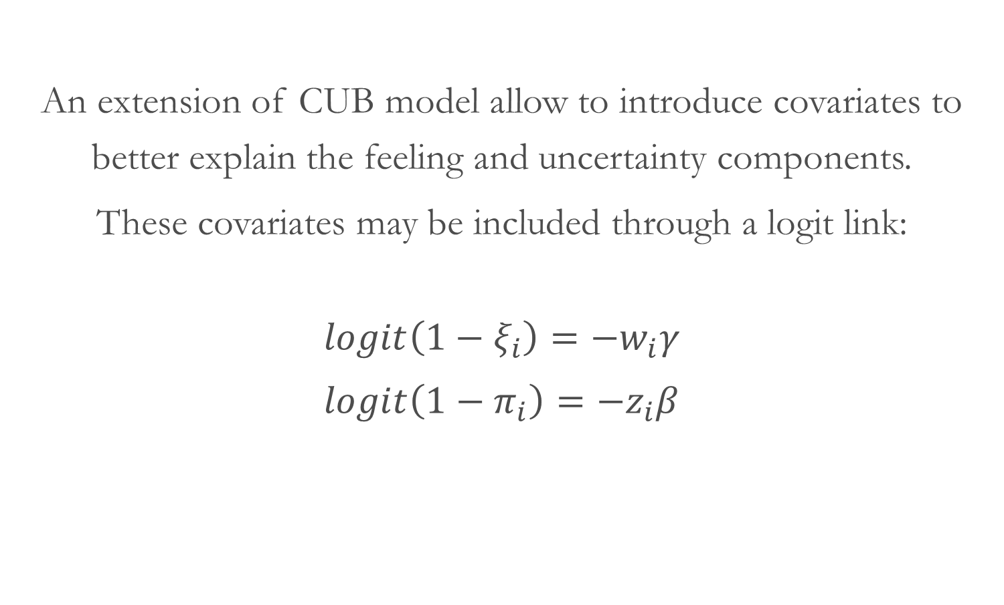
CUB models
An extension of CUB model allow to introduce covariates to better explain the feeling and uncertainty components.
These covariates may be included through a logit link:
$${logit\left(1−ξ_{i}\right)=−w}_{i}γ$$
$${logit\left(1−π_{i}\right)=−z}_{i}β$$
QDET2 2016
Miami – November 12, 2016

Slide 7
Vignettes
Vignettes have a long history to investigate social phenomena
“…short descriptions of a person or a social situation which contain precise references to what are thought to be the most important factors in the decision-making or judgement-making process of respondents” (Alexander & Becker, 1978)
Statistical solutions exploiting the vignettes as an additional tool to identify and correct for the systematic differences in the use of response scales within countries or socio-economic groups were introduced by King et al. (2004)
QDET2 2016
Miami – November 12, 2016

Slide 8
Vignettes
The presence of individual heterogeneity leads respondents to interpret, understand, use the response categories for the same questions differently: DIF – Differential Item Functioning
Anchoring vignettes aim at making comparable, across respondents, self-evaluations affected by individual unobserved heterogeneity
Since the ratings of the vignette persons provide an anchor (a gold standard) for adjusting self-ratings, these instruments were called anchoring vignettes
Two assumptions: response consistency & vignette equivalence
QDET2 2016
Miami – November 12, 2016

Slide 9
The application
The proposed strategy is applied to a vignette dataset on work disability, collected in the SHARE (Survey of Health, Ageing and Retirement in Europe) project
The self-reported question asks:
Do you have any impairment or health problem that limits the amount or kind of work you can do?
(1=None; 2=Mild; 3=Moderate; 4=Severe; 5=Extreme)
In wave 1 (2004) 9 vignettes were proposed, while in wave 2 (2006) only 3 of them were collected !
QDET2 2016
Miami – November 12, 2016

Slide 10
The application
The final dataset is composed by 4007 observations
(individuals who answered to all questions)
coming from 8 countries:
Sweden, Belgium, the Netherlands, Germany,
France, Italy, Spain and Greece
QDET2 2016
Miami – November 12, 2016

Slide 11
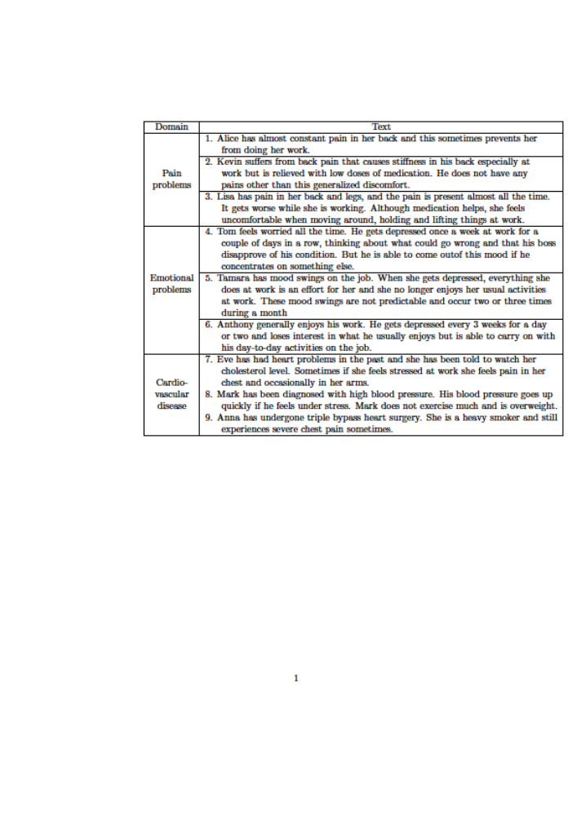
The application
QDET2 2016
Miami – November 12, 2016

Slide 12
The application
Some analyses of reliability and construct validity show:
Reliability:
According to coefficient alpha (0.82 – even if criticised…), Guttman lower bounds, split-half tests, inter-item correlations no vignette shows particular problems
Validity:
According to EFA, 3 factors appears – one for each domain! However, vignette 2 shows a large value of uniqueness (0.52), the lowest factor loading (0.47) in its factor (“pain problems”) and a loading of 0.34 for factor “emotional problems”
QDET2 2016
Miami – November 12, 2016

Slide 13
The application
Vignette 2:
Kevin suffers from back pain that causes stiffness
in his back especially at work but is relieved with
low doses of medication. He does not have any pains
other than this generalized discomfort
QDET2 2016
Miami – November 12, 2016

Slide 14
The application
Wave 2 vignettes were chosen in order to provide the most accurate estimates of cross-country differences, according to wave1 results. The different domains were also taking into account.
The wave 2 selection was: vignette 2 – 6 – 7
Which is the result using a CUB model framework without taking into account the domains’ information ?
QDET2 2016
Miami – November 12, 2016

Slide 15
The application
A CUB model where self-rating is the dependent variable and ratings of the 9 vignettes are the explanatory variables is estimated.
The statistically significant coefficients are associated to:
Feeling component:
vignette 1 – 3 – 4 – 9
Uncertainty component:
vignette 2
QDET2 2016
Miami – November 12, 2016

Slide 16
The application
A further analysis that checks the best model fit for each of the statistically significant vignettes in the feeling component leads to propose the following selection:
vignette 1 – 4 – 9
(The wave 2 selection was: vignette 2 – 6 – 7)
QDET2 2016
Miami – November 12, 2016

Slide 17
Main results
This approach is able to identify – in the uncertainty component – the vignette with potential problems of understanding.
Without imposing any constraints, a vignette for each domain has been selected
QDET2 2016
Miami – November 12, 2016

Slide 18
Main results
Is our result the best set of vignettes?
We do not, because we cannot have the “right” answer !
We could try to check which vignettes satisfy the assumptions (however, no formal testing are available in the literature so far…)
We could compare the two sets of selected vignettes (i.e. number of countries having an answer category with a frequency smaller than 1%) or ...
QDET2 2016
Miami – November 12, 2016

Slide 19
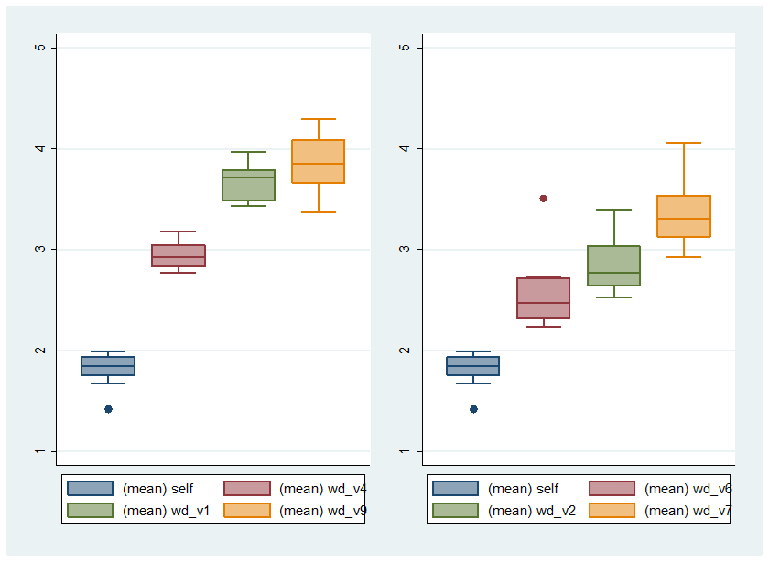
Main results
QDET2 2016
Miami – November 12, 2016

Slide 20
Concluding remarks
CUB models may be an promising tool for selecting subsamples of questions asking for a rating
It is based on a mixture model strategy
Future research:
Experimental vignettes
Selecting the components of an overall satisfaction
QDET2 2016
Miami – November 12, 2016

Slide 21
THANK YOU !
QDET2 2016
Miami – November 12, 2016

