Slide 1
The Effects of Prelisted Items in Business Survey Questionnaire Tables
Rachel Sloan, Kathy Ott, and Heather Ridolfo
National Agricultural Statistics Service
QDET, Miami, FL
November 2016

Slide 2
Background
The National Agricultural Statistics Service conducts surveys on a variety of agricultural topics
Commonly conducted via self administered paper forms
Can be long and complex, asking many questions about various types of commodities

Slide 3
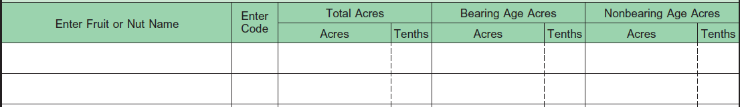
Apples
1101
22
5
12
5
10
Pears
1122
10
10
Notes:
This is a common example of how respondents may be asked to report commodities. Explain what respondents do for each column. The code column asks for the number that goes with each commodity. These are provided to respondents, and in a moment, I will explain how. These are important for data entry and analysis. Each code represents a valid response and it can be easily read.

Slide 4
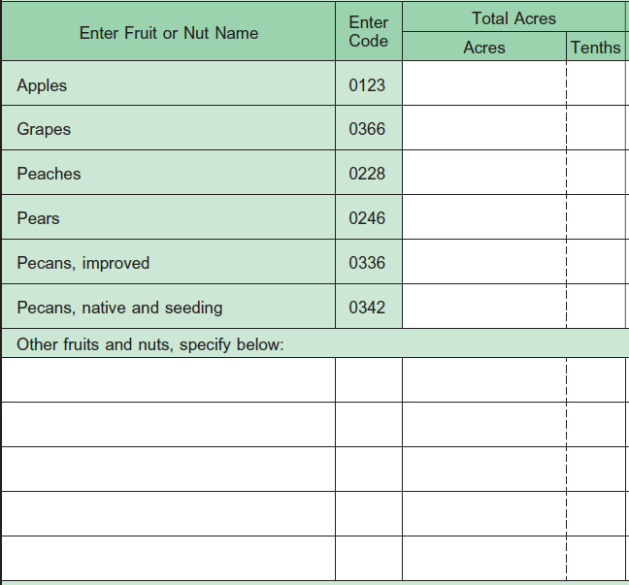
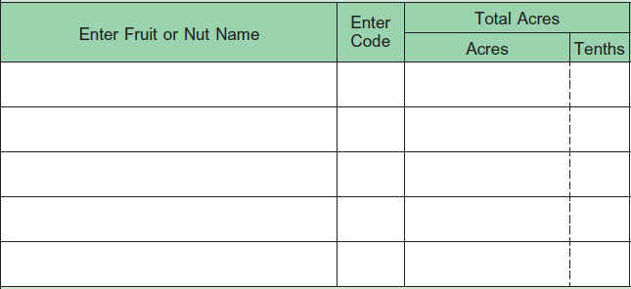
Options for Questionnaire Formatting-Prelisted Items in Response Tables
Prelisted Items in Response Tables
No Prelisted Items in Response Tables
Notes:
The option on the left shows commonly grown fruit and nuts with the commodity names and codes already listed in the table. Respondents who have these commodities will not need to write them in, as they would with the option on the right, which has no prelisted items. Theoretically, this saves time and effort for respondents who have these items. The option on the left has blank lines for respondents to report other commodities that are not prelisted.

Slide 5
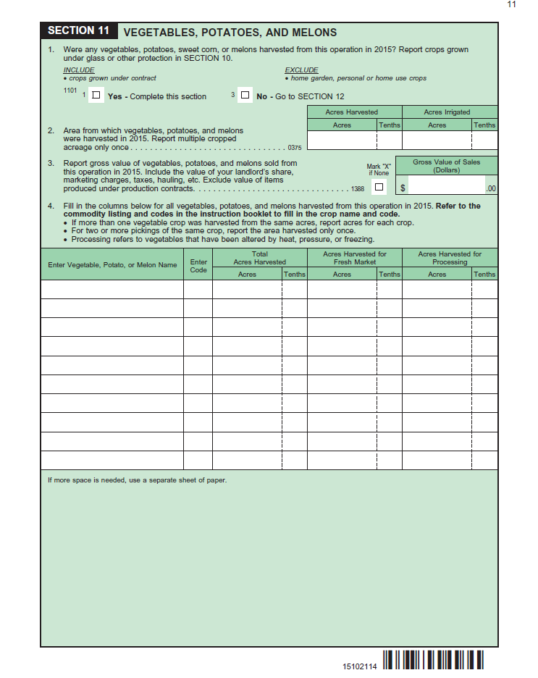
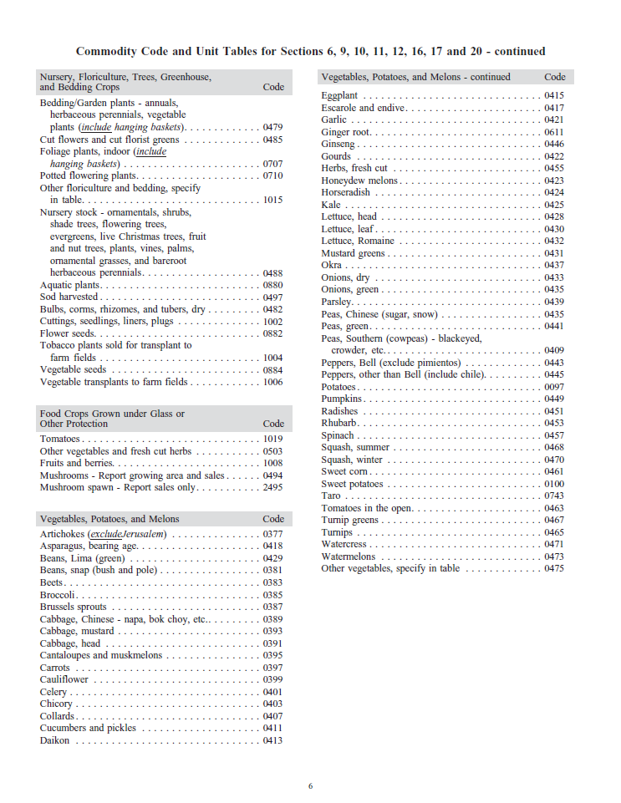
Options for Questionnaire Formatting-Location of Commodity Listings
Notes:
These are two ways of listing commodities for respondents to choose from. This option shows part of the instruction booklet that is mailed along with the questionnaire. In this format, there are no commodities listed on the questionnaire, and respondents must use the instruction booklet to find commodity names and codes.

Slide 6
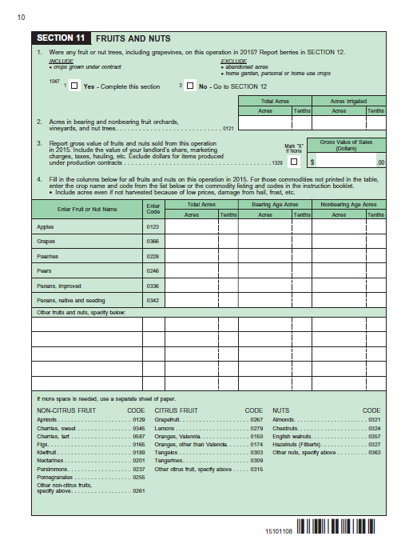
Options for Questionnaire Formatting-Location of Commodity Listings
Notes:
The option on the shows some commodities that were listed on the bottom of the page of the questionnaire. Any commodities that did not fit on the questionnaire page were placed in the instruction booklet. This can help respondents by having all information in one place, but also takes up a lot of space.

Slide 7
Research Questions
Do prelisted items in response tables decrease respondent burden while still maintaining data quality?
Can we move commodity listings to a separate booklet to save space on the questionnaire without significantly impacting data quality?

Slide 8
Benefits of Prelisted Items in Response Tables
Lower respondent burden for respondents with commodities that were chosen to be prelisted
  Increase unit response
  Aid in recall
Help with analysis
  Reduce errors during data entry
Notes:
Existing literature does not conclude either way whether or not prelisting items in response tables is beneficial or not. Here are some possible benefits of prelisting items in response tables.

Slide 9
Issues with Prelisted Items In Response Tables
Item nonresponse
  Observed in cognitive testing for 2014 and 2015 Organic Surveys
Primacy effect
Satisficing
Anchoring and adjustment heuristic
Notes:
A possible issue is item nonresponse due to confusion from respondents. This was observed in two rounds of cognitive testing for our Organic Survey, in which respondents who did not have prelisted items did not understand that they were supposed to write in their items, and did not report them.
Prelisting items in the response tables may also encourage incorrect responses due to the primacy effect from seeing these items listed first. Respondents may also satisfice and only report for prelisted items because they are listed in a prominent location and may be more salient in the respondent’s mind.
Also, according to the anchoring and adjustment heuristic, prelisted items could remind respondents of similar items, while dissimilar items are forgotten.
*Should be five mins through presentation*

Slide 10
Testing Conducted
Testing conducted with various versions of the Census of Agriculture
  Multiple rounds of cognitive interviews
  A large scale field test
Testing included several versions of the questionnaire
  Placement of prelisted items in response tables
  Placement of commodity listings on the questionnaire below the response tables or in a separate booklet
Notes:
This study used versions of the Census of Agriculture Questionnaire. Testing for the census included multiple rounds of cognitive interviews, which I will describe in more detail in this presentation, as well as a large scale field test. Different versions of the census questionnaire were tested. The differences between these versions included some prelisting certain commodities in the response tables, with some not prelisting any items in the response tables. Some versions of the questionnaire included a list of commodities and their codes on the questionnaire, below the response table, while other versions had the commodities and codes in separate instruction booklets.

Slide 11
Round 1 of Cognitive Testing for Census of Agriculture
Round 1
  Conducted in January 2016
    31 cognitive interviews were completed

Slide 12
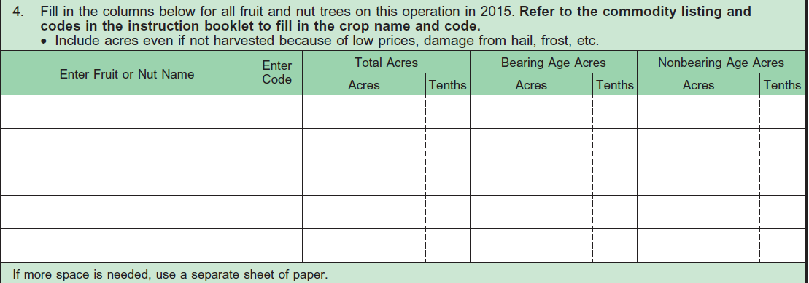
Notes:
This is part of the questionnaire used for Round 1 of cognitive testing. It has no prelisted items in the response tables, and no commodities listed on the questionnaire below the response table. All commodities are listed in the instruction booklet, which the respondents are instructed to refer to.

Slide 13
Results from Round 1 of Cognitive Testing
Respondents tended to not use the instruction booklet correctly without prompting
No listed examples to help respondents understand which items belong in each section
Notes:
Respondents were often not aware that the instruction booklet contained any lists of commodities, despite the instructions on the questionnaire. Respondents often reported commodities incorrectly and did not use codes.
Several respondents reported crops in the wrong section because there were no commodities on the questionnaire to act as examples for them to understand what kind of crops should be reported.

Slide 14
Round 2 of Cognitive Testing for Census of Agriculture
Round 2
  Conducted in February 2016
    40 cognitive interviews were completed

Slide 15
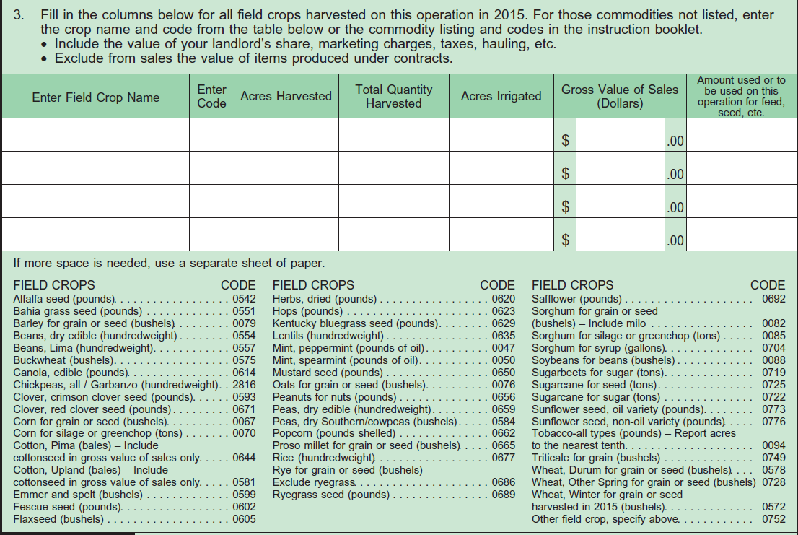
Round 2
Notes:
This version has no prelisted items in the response table, but has commodities below the response table, listed on the bottom of the page.

Slide 16
Results from Round 2 of Cognitive Testing
Respondents were much more successful with reporting commodities and codes correctly

Slide 17
Round 3 of Cognitive Testing for Census of Agriculture
20 interviews were conducted in March, April, and May 2016
Commodities and code numbers were listed in three areas:
    In the response tables
    Below the response tables
    Instruction booklet

Slide 18
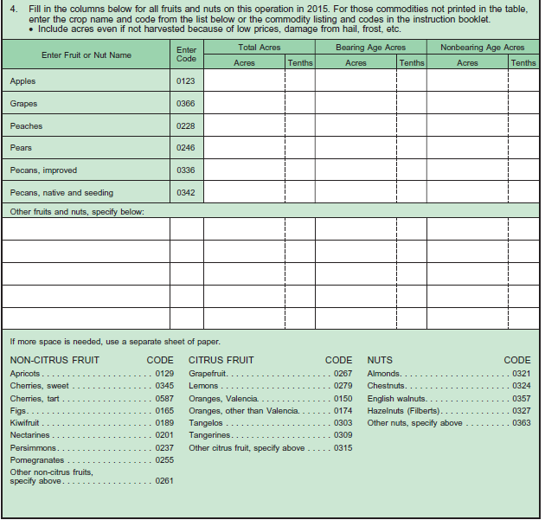
Round 3
Notes:
Here is the questionnaire that was used. You can see the commodities were listed in two places on the actual questionnaire, in the table, and at the bottom of the page. There are some that did not fit and are in the instruction booklet, which respondents are instructed to use. Respondents are also instructed to use a separate sheet of paper to record any commodities that do not fit in the table.
*should be halfway done with presentation*

Slide 19
Round 3 of Cognitive Testing for Census of Agriculture
Scripted probes were written specifically to test the effects of prelisting items in the response tables
Compared results to the previous two rounds of cognitive testing
Compared results to analysis of commodities reported in large scale field test
Notes:
Unlike previous rounds of testing, this round focused specifically on the effects of items being prelisted in the response tables
Respondents were asked to explain what they believed they should do to report their commodities.
They were also asked why they believed certain commodities were prelisted in the tables.

Slide 20
Results from Round 3 of Cognitive Testing
Respondents had difficulty reporting commodities listed solely in the instruction booklet
Respondents tended to write these commodities in blank lines in the table along with the numeric code for “other” or with no numeric code at all
Notes:
*should be ten minutes through presentation*
It was not clear to them that any commodities would be listed in the booklet. If they did write in a code number, they used the code meant for “other crops” that had not been assigned a code of their own, instead of the code actually assigned to their commodity. This could lead to mistakes in data entry and analysis.

Slide 21
Results from Round 3 of Cognitive Testing
  Many respondents did not have enough lines in the table to report all of their commodities
    None of the respondents used a separate sheet of paper to report the rest of the commodities
    Either did not report these commodities, or reported them incorrectly
Notes:
Some respondents tried to save space by crossing off the items that were prelisted in the response tables and writing in their own. Some wrote lists of crops all together on one line. This was disorganized and difficult to interpret. Some reported several crops under one name such as “onions” or “cole crops”

Slide 22
Results from Round 3 of Cognitive Testing
  Respondent confusion
    Some did not understand why some items were prelisted in the response tables
      Assumed to be the most common commodities in the state
      Assumed to be the most important commodities to NASS

Slide 23
Results from Cognitive Interviews
Cognitive Testing Round | Prelisted Items in Response Tables | Commodity Listings on Bottom of Questionnaire Pages
Round 1 | X | X
Round 2 | X | ✓
Round 3 | ✓ | ✓
Notes:
To reiterate, these three tests used different versions of the questionnaire, all with different ways of listing commodities for respondents to report. We found that prelisting items in the response tables often caused confusion for respondents. On the other hand, having a list of commodities below the response table at the bottom of the questionnaire was very helpful for respondents.

Slide 24
Results from Field Test
In general, respondents tended to report more commodities in treatment groups that did not have commodities prelisted in the response tables
Respondents were also more likely to report commodities that were uncommon enough not to be assigned their own code, and are classed under “other crops”

Slide 25
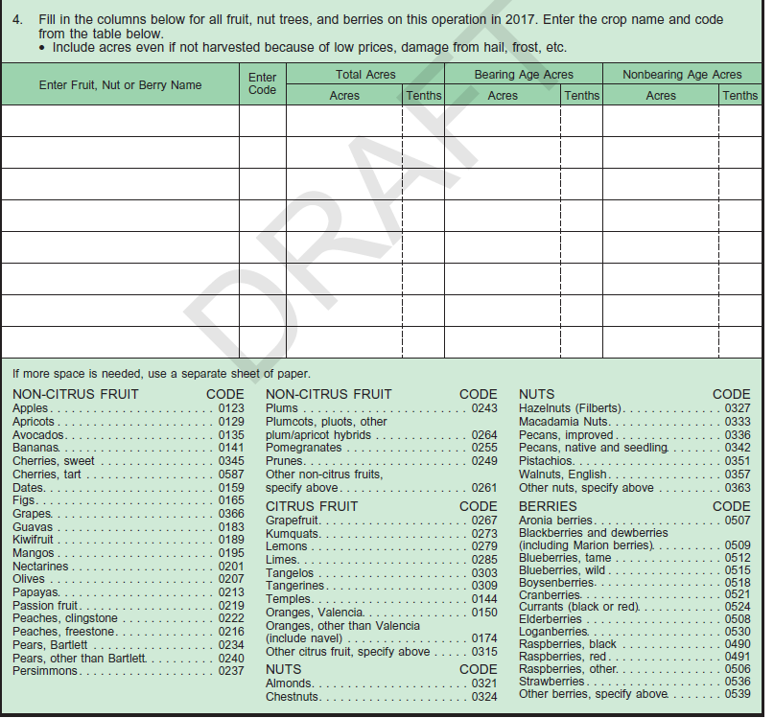
Recommendations for 2017 Census of Agriculture
Use empty response tables with no prelisted commodities
Include all commodities on the questionnaire

Slide 26
Conclusions
From a respondent’s perspective, it is not necessary to prelist items in tables
Items prelisted in tables can confuse respondents when they do not match the respondents’ expectations
  Prelisting items in tables may also imply that other items are less important
Prelisting items in tables takes up space
Notes:
Items prelisted in tables can confuse respondents when they do not match the respondents’ expectations of what should be listed there.
Prelisting items in tables takes up space that may be used to report other items.

Slide 27
Conclusions
It is important to have all information needed to complete the survey on the questionnaire
Commodity listings on the questionnaire were shown to be very useful
  Helps respondents understand what kind of commodities belong in each section

