Slide 1

The Implications of Questionnaire Redesign on Trend Estimates in the 2011 Police-Public Contact Survey
Glynis Ewing
Every time an established periodic survey introduces a newly redesigned field instrument, there is a risk of introducing between-year measurement error rooted in the questionnaire design. Improvements to questionnaire structure and items that more accurately measure constructs of interest can also introduce instability to the associated trend estimates between survey years. In 2011, the Police-Public Contact Survey (PPCS) questionnaire was redesigned to better capture the U.S. population’s experiences with and perceptions of police during contacts in the previous 12 months. Changes to the instrument included expanded definitions of contact with police, use of behaviorally-specific items to measure contact and use or threat of force during the contact, and a restructuring of questionnaire order to increase respondent recall and decrease burden. This poster will outline some features of a redesigned questionnaire and describe how the estimates are impacted, describe methods for evaluating questionnaire item comparability between survey years, and provide a solution for adjustment to correct for between-year measurement error, illustrated by select examples from the PPCS.
RTI International is a registered trademark and trade name of Research Triangle Institute.
www.rti.org

Slide 2
Background
Survey instruments in periodic surveys are often changed over time, to improve current measures and/or include emerging measurement objects of interest, but trend estimates should still be able to be produced even after changes are made
In the PPCS, certain types of contact were not considered in previous instruments
  Voluntary contacts like block watch participation and non-face-to-face contact
Previous instruments did not collect any detail on other contacts the respondent might have had besides the most recent.
Redesigning a field instrument can introduce instability to the validity of outcome measures when discussing estimates in terms of trend over time, regardless of improvement.
The 2011 redesigned PPCS introduced:
  An inclusive and expanded ‘type of contact’ screener module to include voluntary contacts, non-face-to-face contacts, and street stops
  Specific questionnaire modules geared toward contact characteristics
Potential sources of measurement error in the PPCS questionnaire design:
  Salience of attitude object, e.g. police contacts
  Backwards telescoping, memory error
  Error of commission or omission
  Context effect, order effect
How does one know if an observed change in trend is valid and not due to measurement error related to the changes in the instrument?

Slide 3
Goals
Research question:
Is there a way to correct previous estimates for measurement error in previous PPCS instruments?
Objective #1:
Establish which outcomes of interest are comparably measured between the original and the revised instrument.
How was comparison conducted?
  Measurement within questionnaire, considering:
    Underlying construct
    Questionnaire text and placement
    Respondent domain, referring to the group of respondents presented with the opportunity to answer the given questionnaire item(s) of interest
Objective #2:
Quantitatively assess items for comparability and adjust for measurement error accordingly.
Assess quantitative difference with split-sample design to control for time
Adjust estimates for the quantitative difference found in split-sample estimate
Apply adjustment to past survey years to correct for measurement error

Slide 4
Quantitative methods to identify measurement error
Measurement
The revised instrument asked some questions similarly of the same respondent domain making the estimates comparably measured
Though qualitatively similar enough to compare, measurement error may exist due to a variety of potential changes
  E.g. measuring face-to-face contact with the police in the past year
Original instrument asked respondents about face-to-face contact before determining types of contact.
  “During the last 12 months… did you have any face-to-face contact with a police officer?”
    Yes or No response choices, singular item
    Respondents selecting ‘no’ are immediately routed out of instrument
Revised instrument assessed contact using screener module of questions.
  Instrument assumes certain types contacts occur face-to-face, e.g. traffic stops
  Vector of dichotomous items
    More effective method to improve recall
    Increased number of respondents reporting contact
The same domain of respondents receive the questions.
  Though very different questionnaire design, qualitatively comparable measurement eligible for adjustment.

Slide 5
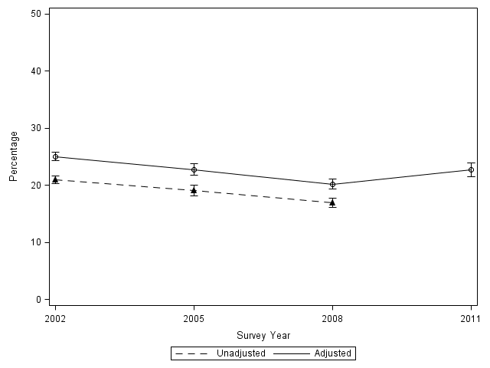
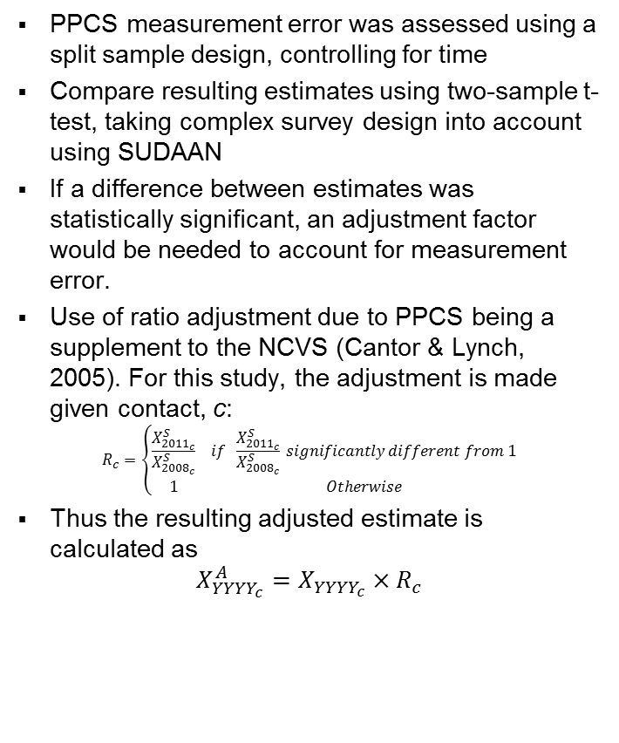
Qualitative Difference, Adjustment & Results
PPCS measurement error was assessed using a split sample design, controlling for time
Compare resulting estimates using two-sample t-test, taking complex survey design into account using SUDAAN
If a difference between estimates was statistically significant, an adjustment factor would be needed to account for measurement error.
Use of ratio adjustment due to PPCS being a supplement to the NCVS (Cantor & Lynch, 2005). For this study, the adjustment is made given contact, c:
$$R_{c}=\left\{\begin{matrix}\frac{X_{{2011}_{c}}^{S}}{X_{{2008}_{c}}^{S}} & if \frac{X_{{2011}_{c}}^{S}}{X_{{2008}_{c}}^{S}} significantly different from 1 \\ 1 & Otherwise\end{matrix}\right.$$
Thus the resulting adjusted estimate is calculated as
$$X_{{YYYY}_{c}}^{A}=X_{{YYYY}_{c}}×R_{c}$$
Exhibit 1. PPCS Weighted Split-Sample Estimate for Face-to-face contact with the police in the past year, 2008 and 2011 instruments, and ratio adjustment
Estimate Type | 2008 Estimate | 2011 Estimate | Ratio Adjustment (2011/2008)
Face to face contact | 19.1% | 22.8%*** | (22.8/19.1) = 1.19
*** Overall estimates significantly different from 1 at the 0.001 level
Exhibit 2. Adjusted and Unadjusted Trend for Face-to-face contact with police in the past year, 2002-2008 PPCS

Slide 6
Acknowledgements, Selected References & Contact Information
Cantor, D., & Lynch, J. P. (2005). Exploring the effects of changes in design on the analytical uses of the NCVS data. Journal of Quantitative Criminology, 21(3), 293-319.
Clark, C. Z. F., Tinari, R., Singh, R., Tupek, A., Hogan, H., Killion, R. A., & Wright, T. (2003, July 25). Census Bureau Standard: Pretesting Questionnaires and Related Materials for Surveys and Censuses. Retrieved from https://www.census.gov/srd/pretest-standards.html
Duncan, G. and Kalton, G. (1987). Issues of design and analysis of surveys across time. International Statistical Review, 55(1): 97-117.
Firebaugh, G. (1997). Analyzing Repeated Surveys. Sage University Paper Series on Quantitative Applications in the Social Sciences, no. 07-115. Thousand Oaks, CA: Sage.
The authors would like to thank Bureau of Justice Statistics for sponsoring this research and comments provided by Mike Plantey and Lynn Langton. However, we would like to note that the views expressed in this paper are those of the authors only and do not reflect the views or position of BJS or the Department of Justice.
Glynis Ewing
Statistician
919-541-6046
gewing@rti.org
Marcus Berzofsky, DrPh
Sr. Research Statistician
919-316-3752
berzofsky@rti.org

