Slide 1

Intelligent Validation in Online Questionnaires
- including Establishment-Specific Prefill of Known Information for Cross Validation
Pia Thomsen & Lise Stahl Jacobsen, Statistics Denmark
Presented at: QDET2: Miami, November 2016

Slide 2
Outline
Data Editing in Statistics Denmark
Why online validation?
Types of online validations
Analysis: Effect of online validation
Challenges and perspectives

Slide 3
Standardized and Modernized
Data Editing (SMOF) 2016-2020
Design division:
Implement online validation in all (70) online questionnaires
Methods division:
Review of data editing for all statistical outputs
Recommendation with regard to
  Prioritized data editing
  Online validation
IT division:
Develop Data Archive for data Editing

Slide 4

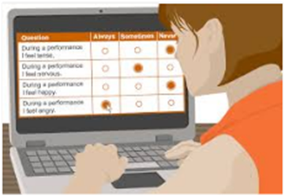
Why online validation?
DURING
the response process
Instant feedback
AFTER
submission
  Data quality improved
  Fewer re-contacts
  Respondent can
  review
  edit
  confirm
  explain
  Cost-effective production

Slide 5
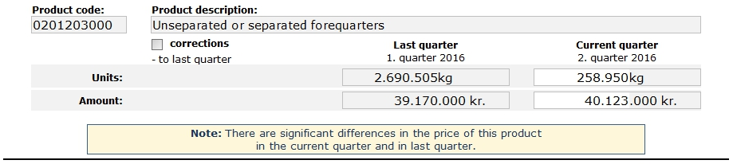
Types of validation: ‘Soft’
  Respondent may review or ignore:
Price:
14,56 kr./kg
Price:
154,94 kr./kg

Slide 6
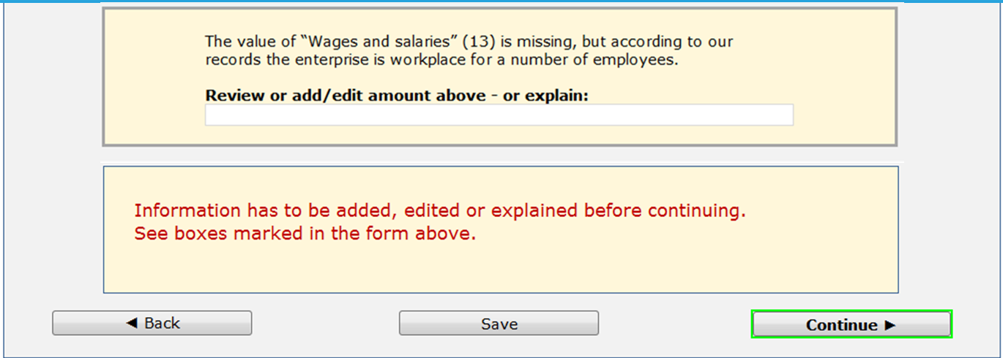
Types of validation: ‘Semi-hard’
Correct, explain, or confirm:

Slide 7
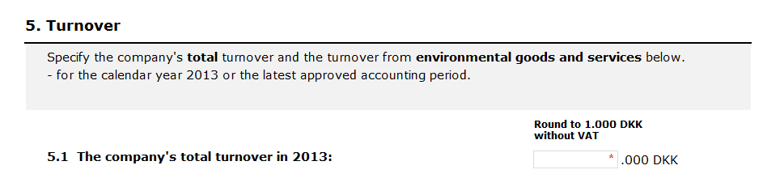

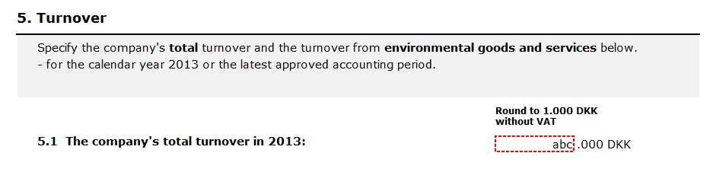


Types of validation: ‘Hard’
  Must enter/correct data

Slide 8

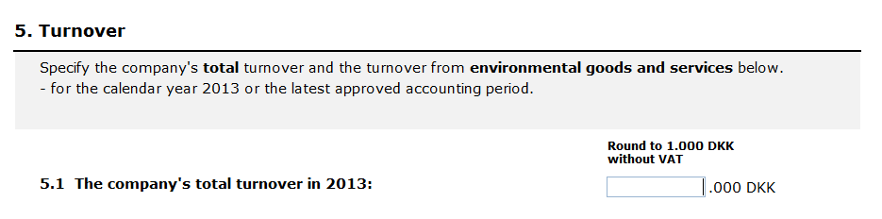
Analysis: Issues (2013)
Many respondents enter …
“0” as total turnover
Factor errors (too few or too many digits)
  Possible cause: Round to nearest 1.000 DKK

Slide 9
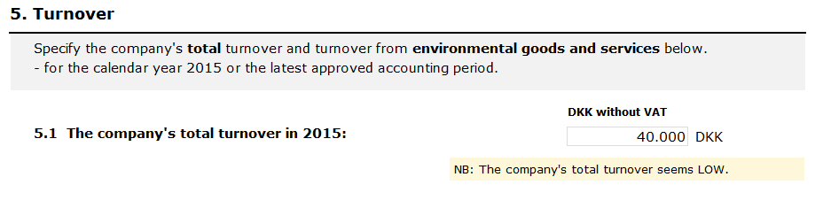
Analysis: Solution (2015) :
1. Total turnover in DKK instead of 1.000 DKK
2. Soft cross validation with hidden prefill

Slide 10

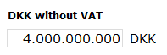
Analysis: Effect
Decrease in data edits and re-contact to enterprises
Fewer respondents submitted …
  “0” as total turnover
    4,5 % data edits in 2013
    0,8 % data edits in 2015
  factor errors (too few or too many digits)
    10 % data edits in 2013
    3 % data edits in 2015

Slide 11
Challenges and perspectives
Online validation is mainly guided by technical capability & presumption
The “soft” validation can be perceived as “hard” resulting
in new errors
Respondents expect online validation
  Need to balance interruption and assistance
Optimized validation require follow up analysis
  Need to document errors and effect on data quality

Slide 12
Pia Thomsen, pit@dst.dk
Lise Stahl Jacobsen, ljc@dst.dk
Thank you

