Slide 1


QDET 2016: Challenges in Measurement
Measures of Sleep: Methodologies, Potential Measurement Error, and New Measurement Techniques
Heidi Guyer, MPH, PhD candidate
Ana Baylin, MD, DrPH
University of Michigan

Slide 2
Overview
Background and importance
Sleep Measurement
Measurement methodologies
Measurement error by methodology
New measurement techniques
Summary and Recommendations

Slide 3
Background
Sleep is a basic biologic need. Decreased and increased sleep duration as well as poor quality sleep have been linked to poor health, poor quality of life and employment outcomes.
Sleep disturbances are a life course issue. The type and degree of disturbance vary by age (newborns, infants/toddlers, adolescents, young, middle age and older adults).
Approximately 30% of the U.S. work force is estimated to have sleep problems. Rates of sleep disturbances are higher among women.

Slide 4
Background
The CDC estimates that 9 million Americans use prescription sleep aides. This rate tripled among 18 to 24 year olds between 1998 and 2004.
Medical conditions (sleep apnea, restless leg syndrome, depression), medication use (diuretics), obesity, tobacco and alcohol use all associated with sleep problems.
HealthyPeople 2020: Sleep Quality Goal
Multiple methods are available to determine sleep quality and duration in a survey context.

Slide 5
Sleep Measures
Sleep duration
  Total hours of sleep (daytime, nighttime, naps)
  Decreased sleep is defined as <6 hrs per night
  Increased sleep is defined as >9/10 hrs per night
Sleep Quality:
    Difficulty falling asleep
    Difficulty staying asleep
    Waking too early
    Feel well rested
Sleep Efficiency
  Proportion of time sleeping of time spent in bed

Slide 6
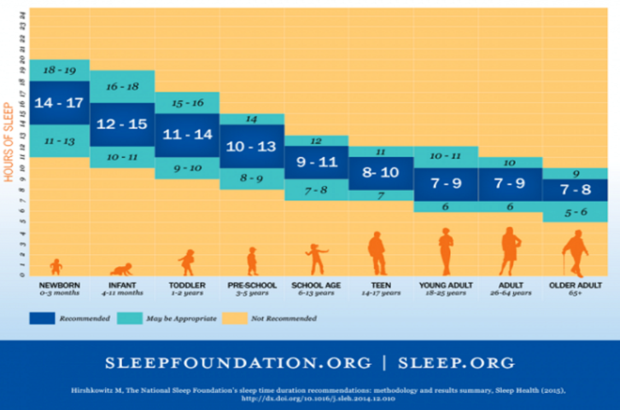
Recommended Sleep Duration by Age

Slide 7
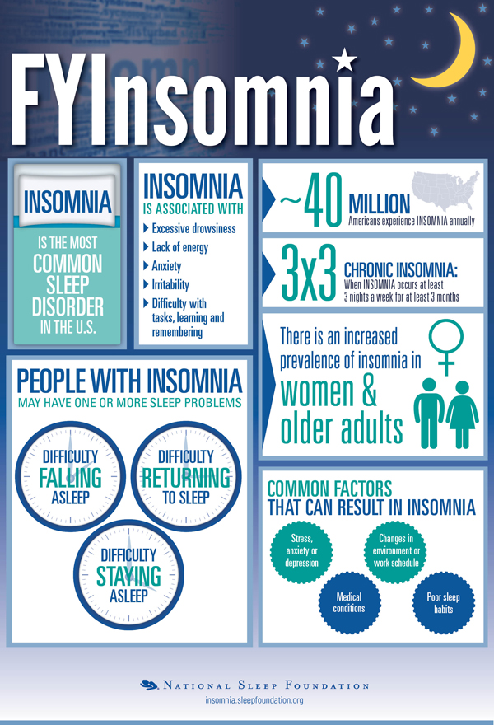
Sleep Concepts: Where does insomnia fit in?
What is insomnia?
Insomnia is difficulty falling asleep or staying asleep, even when a person has a chance to do so. People with insomnia can feel dissatisfied with their sleep and usually experience one of the following symptoms: fatigue, low energy, difficulty concentrating, mood disturbances, and decreased performance in work or at school.
DSMV:
http://www.theravive.com/therapedia/Insomnia-Disorder-DSM--5-780.52-(G47.00)
Notes:
Sleepfoundation.org/insomnia
DOI: 092316

Slide 8
Sleep Measures
Questionnaires:
  Sleep/Wake time
  Time frame: On average (last week, 2 weeks, year), yesterday
  Trouble falling asleep
  Trouble staying asleep
  Waking up too early
Sleep Diaries
  Record wake, sleep, nap times for multiple days; any other information related to sleep quality
Wearable Devices
  Participant driven: Fitbit
  Researcher driven: Actigraphy

Slide 9
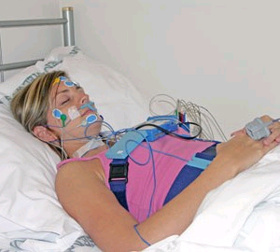

Gold Standard: Polysomnography
Polysomnography continues to be the gold measure of sleep duration due to the ability to monitor brain waves as well as heart rate.
New measures of sleep duration and sleep quality can be validated with polysomnography.
This method is costly and burdensome for survey research participants.
Notes:
Need to finish this slide…

Slide 10
Global Sleep Assessment: Questionnaires
Pittsburgh Sleep Quality Index
20 questions
Self-administered or interviewer administered; Paper, web, phone
Validated in clinical and population-based settings to detect insomnia and sleep quality
Summary score comprised of 7 areas:
        1. Subjective sleep quality
        2. Sleep latency
        3. Sleep duration
        4. Habitual sleep latency (ie sleep efficiency: hours of sleep/hours in bed)
        5. Sleep disturbances
        6. Use of sleep medications
        7. Daytime dysfunction

Slide 11
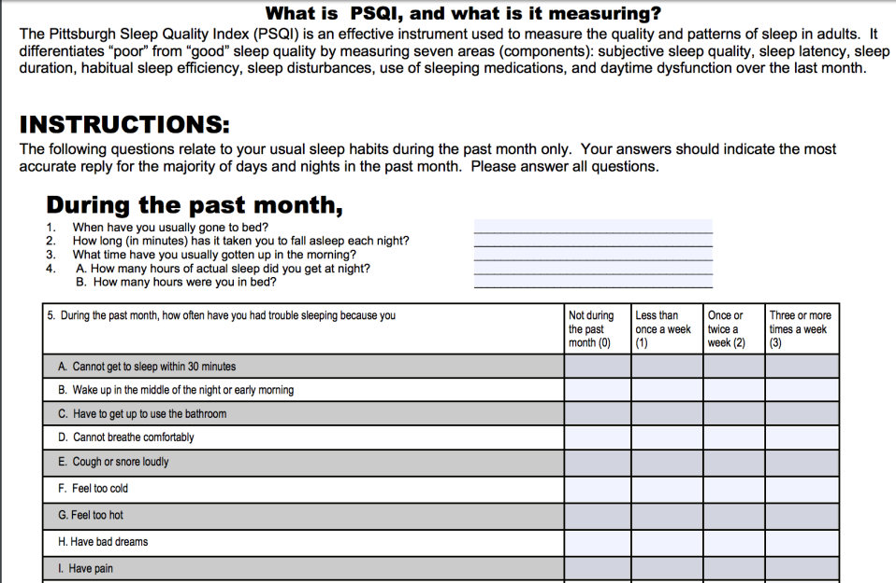

Slide 12
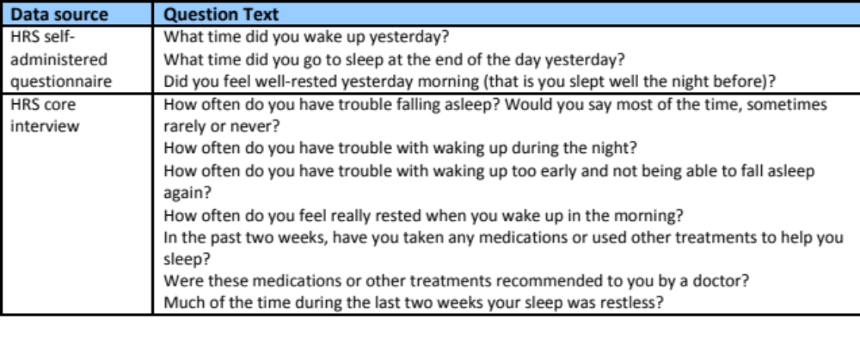
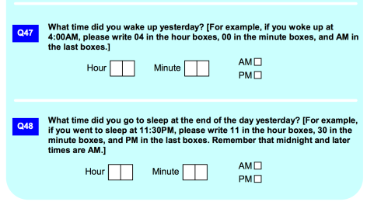
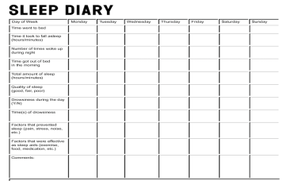
Measuring Sleep: Survey Questions
Health and Retirement Study
Panel Study of Income Dynamics

Slide 13
Sleep Questionnaires: Benefits
Allows for evaluation of sleep duration, quality and efficiency by self-report.
Adaptable to various modes of administration (phone, in-person, web).
With additional questions, can take into account variation by day as well as sleeping patterns (naps, shifts, caring for others, etc).
Low respondent burden; low cost.
Low rates of missing data and improbable values.

Slide 14
Sleep Questionnaires: Potential Sources of Measurement Error
Reporting error: may choose to report habits differentially.
Reference period:
  may need multiple weeks or days to detect usual pattern.
  response may vary by reference period is “on average”, “last night”, “in the last 2 weeks”
Recall bias: may report best/worst scenario, social desirability.
Respondent burden: time-consuming to record habits over time.
Recording/data entry errors.
Individual variation not taken into account.
May not take into account naps, shift work, broken sleep patterns.
Potential for interviewer bias.

Slide 15

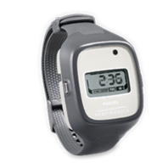

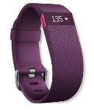
Measuring Sleep: Wearable Devices
Potential Benefits:
Can evaluate sleep duration and efficiency.
Relatively low respondent burden.
User feedback options: none, on device, on phone or other device.
Provides user feedback via messages and colorful dashboard graphics.
Allows for respondent input if desired (monitor + log).
Potential Sources of Measurement Error:
Based on movement detected by accelerometer and sensors: can over/underestimate actual sleep based on movement
Requires user to wear the device, ensure it is charged and sync the data throughout the course of the study.
Potential for differential missing data.
May be more expensive than other methods.

Slide 16
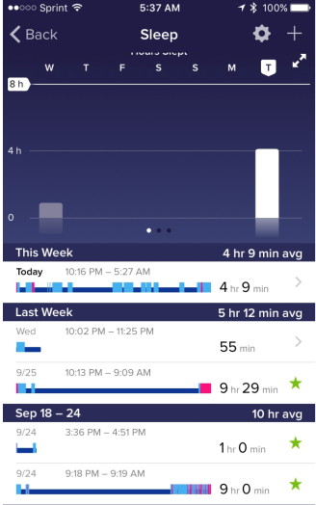
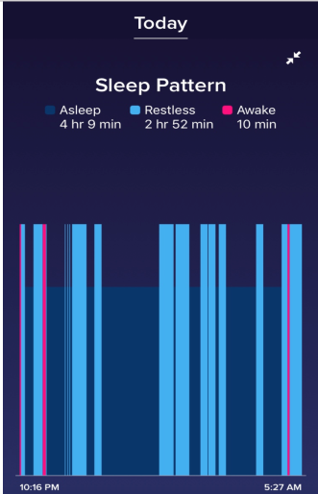
Wearables: measurement error/feedback
1
2
3

Slide 17
Summary: Sleep Measures
Consider population of interest, measure of interest (duration, quality, etc), time available, data collection, mode, cost to obtain measure in your population.
Validated sleep questionnaires exist.
Sleep diaries provide more precise information but require additional coding and analysis steps.
Important to collect data on potential covariates/confounders (employment status, age, medications, health conditions, etc).

Slide 18
Summary: Considerations with Wearables
Wearables allow for more precise measurement but participant interpretation/input is still necessary and useful.
Sleep questionnaires, diaries or cognitive interview, along with wearable, is still necessary
Operational questions to consider:
  How will you receive the data?
  Is the participant using their own device and giving you access to the data?
  Are you providing the respondent with the device and asking them to return it to you? (consider number of days of data storage without syncing and battery life; delivery and return mechanism: by mail, in person)
  Are you providing the respondent with the device and asking them to sync with a certain frequency, and grant you access to the data?
  Do you want the participant to see their results?

Slide 19
New Areas of Sleep Research
Adolescents: Screen Time & Use
  Biological disturbance of circadian rhythms due to light exposure
  Sleep interruption
    Where are devices placed at night?
    Are you woken up at night with alerts (text notification, snapchat, instagram, facebook)?
    Do you wake up while sleeping to text, chat, etc
    Is the lack of sleep and “always being connected” linked to increased levels of depression and anxiety in youth?
Wearable devices
“Big Data”: linking to other data sources that capture sleep data such as Fitbit, etc.

Slide 20
Thank You!
Contact info: hguyer@umich.edu

