Slide 1
Designing Event-History Calendars for Web Surveys: Evidence from Two UK Longitudinal Studies
Matt Brown, Centre for Longitudinal Studies

Slide 2
Background
  ‘Event histories’ are a key component of longitudinal studies – e.g. CLS cohort studies have collected relationship, housing and economic activity histories in all adult sweeps.
  Event History Calendars (EHC) can increase quality of reporting past events – particularly with long reference periods (Belli,1998)
  Information typically captured in timelines over a fixed reference period – timelines relate to different domains
  EHCs tap into the structure of autobiographical memory
  Paralell cueing – recollection of events in one domain helps to trigger recollection of events in other domains
  Used in most recent sweeps of BCS70 (F2F), NCDS (Web and Tel) and Next Steps (Web, Tel and F2F)
Notes:
Collecting event histories is a key part of most longitudinal studies – very common to wish to ask for details about changes in circumstances since time of last interview.
In CLS cohort studies – we have collected relationship histories, housing histories and economic activity histories throughout adult life.
Previous research has shown that using an EHC can increase the quality of reporting of past events – especially when reference periods are long.
EHCs generally capture information in a form of timeline – which displays events relating to different domains of life.
They work by tapping into the structure of autobiographical memory and encouraging paralell cueing – i.e. where recalling an event in one domain of life helps trigger recollection of events from other domains.
At CLS we have used EHCs in 3 of our studies – firstly used in a face to face survey – and subsequently in two mixed mode surveys where web has been the first mode of completion.

Slide 3
Calendar aims
  Increase accuracy of data collected
  Reduce missing data
  Reduce seam effects – (whereby a disproportionate proportion of transitions are reported at the beginning of the reference period)
  Increase consistency of information collected about transitions across domains – many changes will be related (e.g. Moving home for a new job)
  Prevent illogical dates – e.g. Starting job n+1 before ending job n.
Notes:
Main aim is of course to increase the accuracy of data collected.
Reduce missing data – e.g. dates
Reduce seam effects – when collecting information about past events you often find a big spike of changes being reported at the beginning of the reference period – calendar could potentially reduce this.
Changes in one domain of life are often related to a change in another - e.g. moving home for a new job or new relationship – so a calendar could help increase consistency between domains.
Prevent illogical dates.

Slide 4
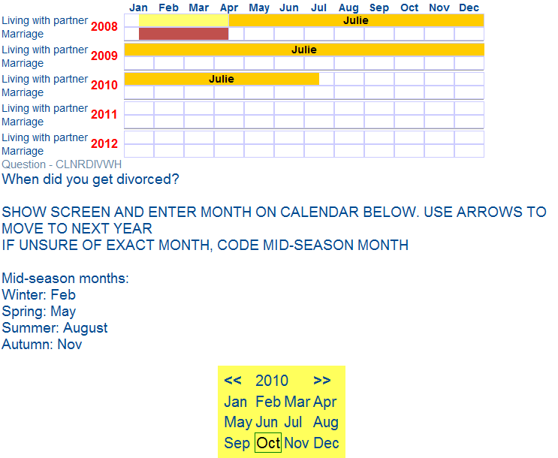
BCS70 EHC – Face to Face
Notes:
This is an image of our first calendar – used in a face to face survey in 2012.
The interviewer sat with respondent and asked them questions – and dates were selected using the date picker at the bottom of the screen.
When a date was entered the event was displayed on the screen. Relationships were dealt with first, and the calendar gradually built up as questions about housing and economic activity were asked.

Slide 5
Successful?
  Cannot yet evaluate impact on accuracy of dates – hope to do this via comparison with admin data
  Evaluation of data suggests data quality equivalent with data previously collected via standard question based approaches
  Anecdotal feedback from respondents and interviewers was positive – reported as having helped with recall of dates
  Next surveys both to be conducted via web – NCDS at age 55, Next Steps at age 25
  EHCs could enhance user experience – assist respondents with navigation of complex histories (as no interviewer present)
  But for use on the web - design would be vital
Notes:
Not been possible YET to evalute impact on accuracy of dates – hope to do this by comparing with admin data soon.
BUT
Other aspects of data quality found to be comparable with previous sweeps where histories collected via standard question based approaches
AND
Positive feedback from participants and interviewers – anecdotal feedback that helped with recall of dates
Our next two surveys were to be coducted via web (in the first place).
We were keen to use an EHC as we felt it would assist respondents navigate their way through the history sections of the questionnaire in the absence of an interviewer.
But for use on the web design would be even more crucial.
x

Slide 6
Testing
NCDS | Next Steps
User testing (Two rounds) | User testing (One round)
1 – Accompanied (and recorded) | Remote observation – ‘think aloud’
2 – Remote observation ‘Watch and Learn’ | Eye-tracking
 | Gaze replay – retrospective probing
Full pilot study | Full pilot study
Notes:
Testing was absolutely vital
Extensive user-testing carried out during development of both calendars.
Two rounds in NCDS – in which people were invited into a research lab to complete a cut-down version of the questionnaire.
In the first round a researcher sat with the participant – so that questions could be answered and advice could be given in the event that participants ran into difficulty.
In the second round participants were observed remotely using software which showed researchers the participant’s screen, a video of their face and any sound – so essentially replicating the unaided situation in which respondents would complete the questionnaire at home.
Next Steps used a similar approach – but all participants first completed the questionnaire on their own – whilst linked up to eye-tracking software. Cognitive interviews followed which included ‘gaze-replay’.

Slide 7
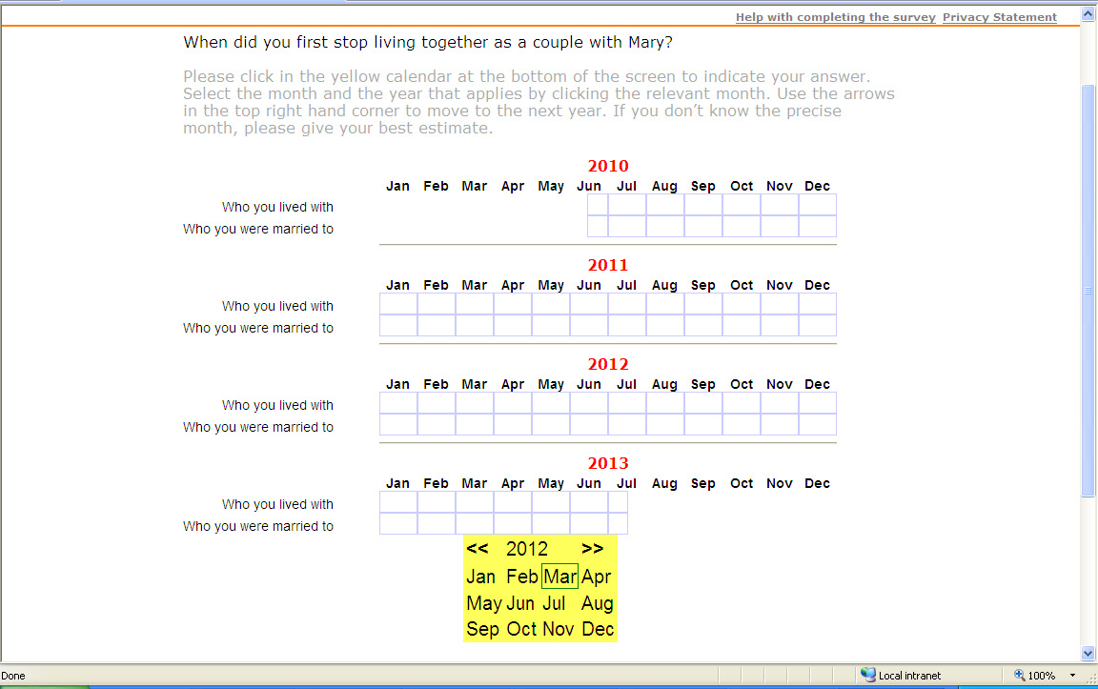
NCDS – Version 1
Notes:
First round of testing – 2 versions trialled.
Version 1 had this date-picker – replicating the approach used in our previous F2F survey…….

Slide 8
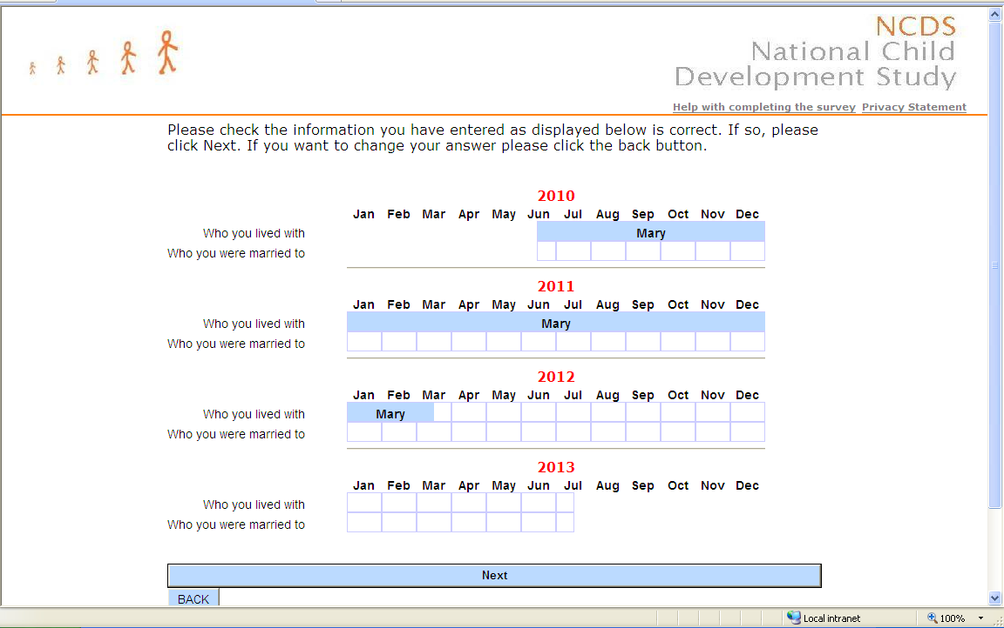
NCDS – Version 1
Notes:
After entering the date the calendar would be populated……

Slide 9
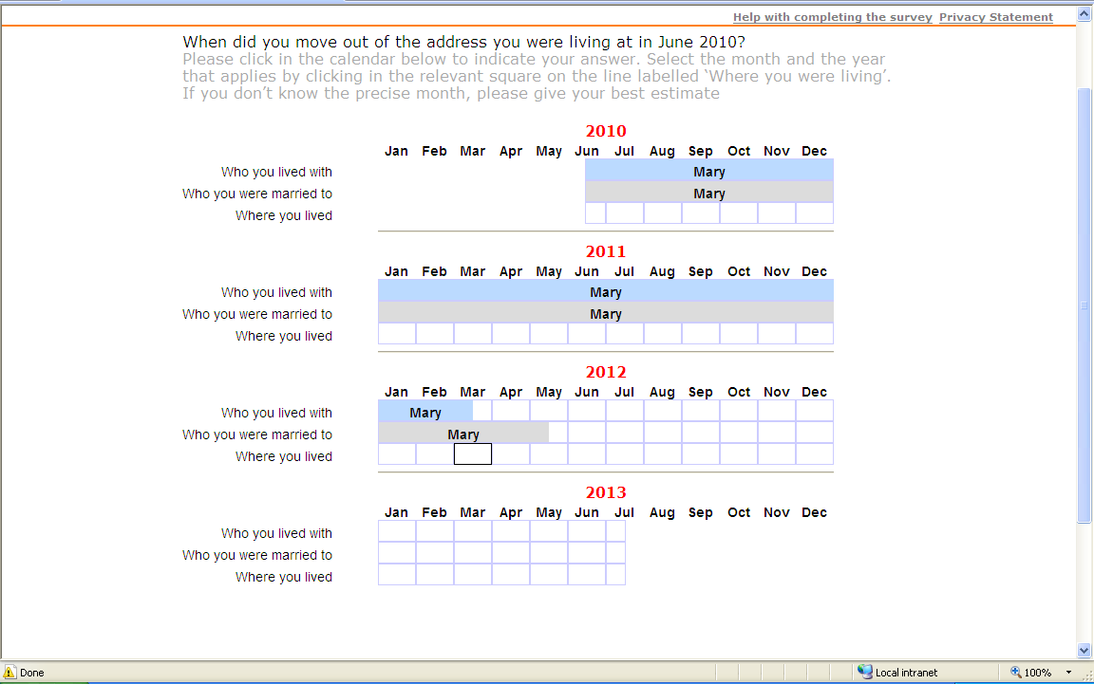
NCDS - Version 2
Notes:
The second approach trialled was more interactive – and dates were entered by clicking into the calendar itself.
This approach was found to be much more intuitive – participants using the date picker were trying to use the calendar in this way anyway.
Still somewhat confusing – was not sufficiently clear that a date had been selected.

Slide 10
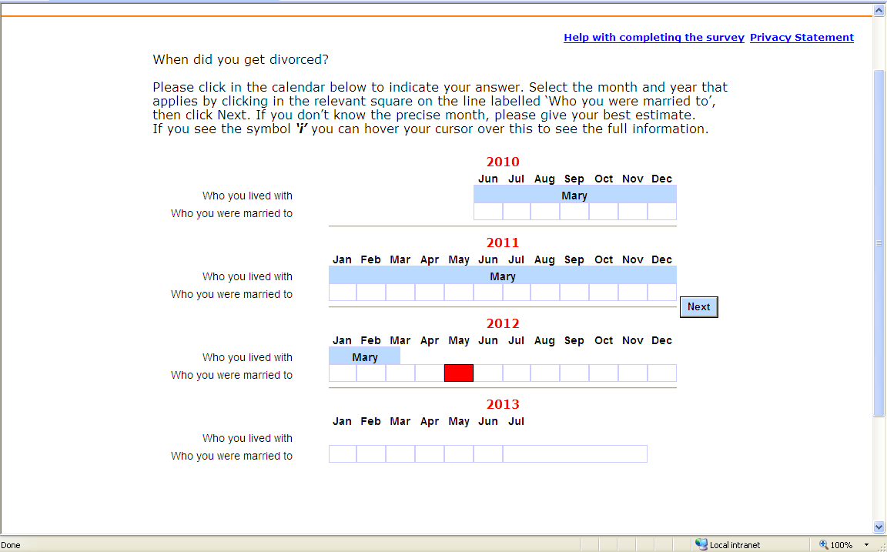
NCDS – Version 3
Notes:
So in the second round of testing the date-picker approach was dropped.
The Next button was moved to the side of the calendar because of instances where participants had not scrolled down to find it too.
The red indication that a date had been selected worked well – other minor adjustments to layout and instructions made a big difference too……
But not all changes were successful……
The moving of the next button caused more problems than it solved.
Introduction of an ‘i’ icon – used when the label for a bar was too long to display – label would be replaced with this icon which could be hovered over to display the full text. Caused confusion.
Further clarifications to instructions – were also required.

Slide 11
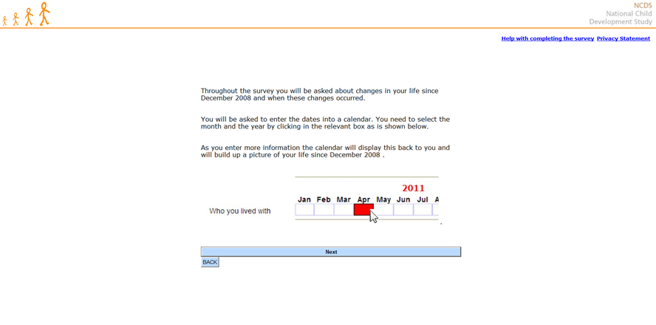
NCDS – Final version
Notes:
And instructions very important. Unlike in the F2F survey, where interviewers were briefed in how to use the calendar – training of respondents had to happen online and so had to be very concise and very clear.
The placement of the instructions was found to be very important too.
In the first tested version - instructions regarding the use of the calendar were at the beginning of the interview alongside more general instructions. Found that instructions had been forgotten by the time the calendar first appeared. Appearance of the calendar was a big surprise. Better to place immediately before the first time that the calendar will be used.

Slide 12
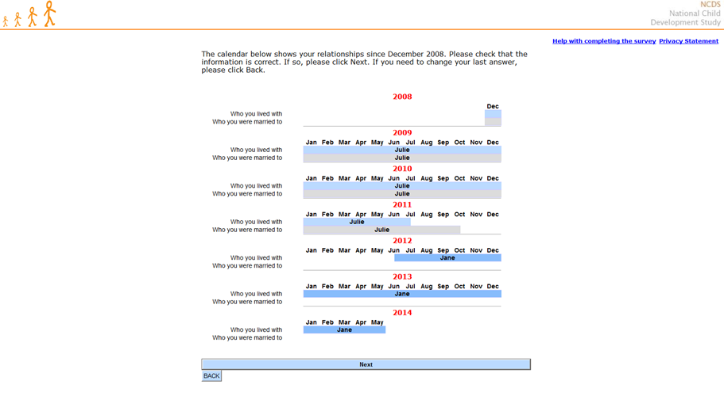
NCDS – Final version
Notes:
Once dates entered the bars are populated – and they gradually build up – cohabiting relationships, marriages, then housing and economic activity

Slide 13
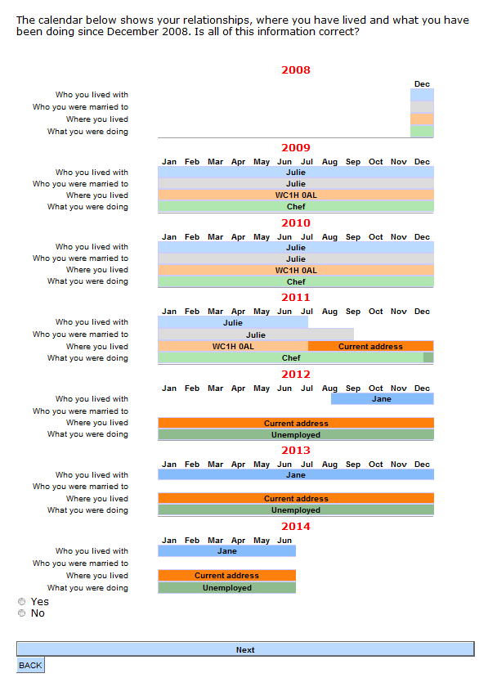
NCDS – Final version
Notes:
Fully completed calendar – final design – final review screen…..
One issue was that it did not prove possible to add any capability to edit the data at this stage. So that the best solution was to ask a Yes/No question about whether everything correct – and then to route those saying No to an Open question in which corrections had to be described.
The final version of the calendar was well received by participants…..

Slide 14
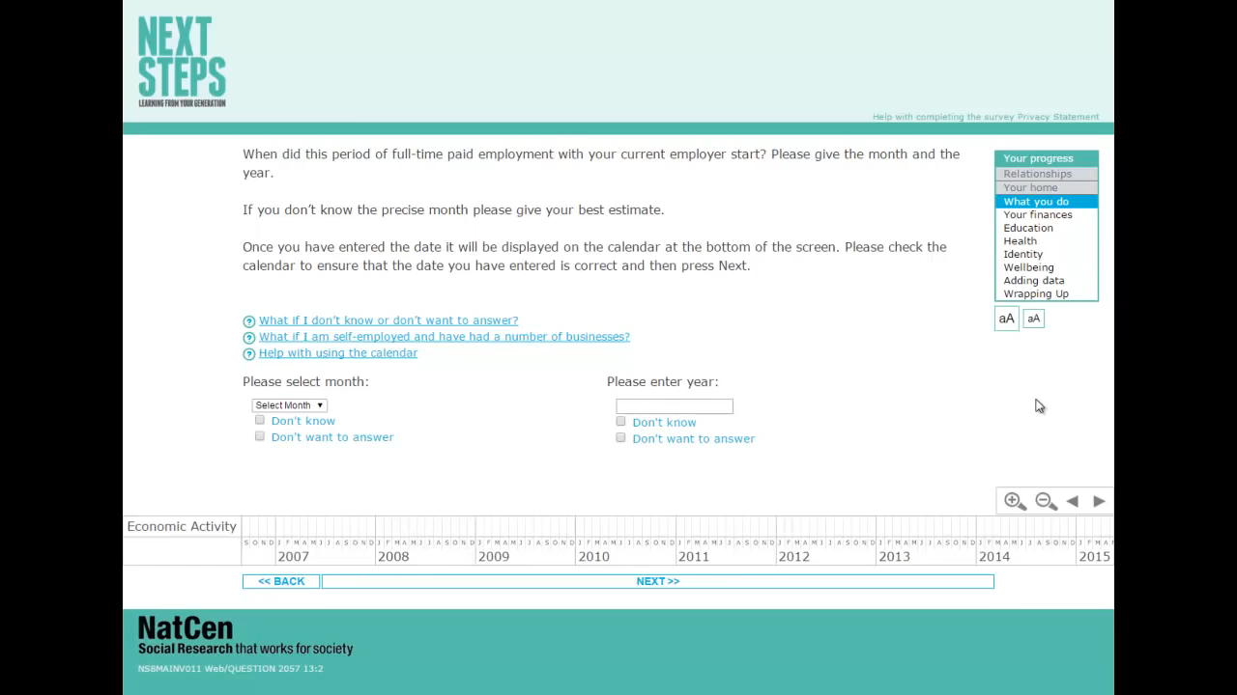
Next Steps
Notes:
Training of respondents accomplished via a video – in response to user-testing finding that text based instructions were very often not read.
Focus of instructions shifted in tone to explaining why the calendar should be used – and not just how.

Slide 15
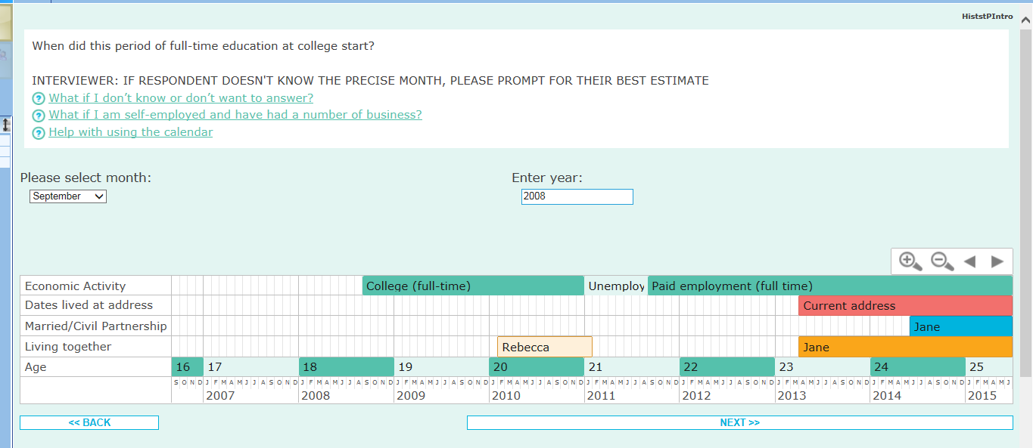
Next Steps
Date entry fields
Zoom buttons
Navigation buttons
Events
Notes:
So dates entered into entry fields above the calendar.
Events displayed below.
Some additional features relative to NCDS – zoom buttons and navigation buttons. Zoom set up as default to see entire reference period.
Worked backwards from present day.
Dates could be edited – by dragging bars – on all questions and on final review screen.
User testing however found that these advanced features did not tend to be used – and the calendar was often completely ignored / not noticed.
Instructions improved – encouragement to review calendar before moving on - but we are unsure of the extent to which improvements will have affected usage – as only one round of testing.

Slide 16
Conclusions and reflections
  User testing of vital importance – and multiple stages beneficial
  Minor amendments can have major impact
  NCDS – calendar was simple in design, used by participants, and broadly found to work well
  Next Steps – more advanced features, but only acted as a display, evidence from user testing suggests frequently ignored/not noticed
  Significant programming work required – some question about whether this paid off in terms of participant experience / data quality

