Slide 1

Developing self-completion instruments for children and young people: experience from the UK Millennium Cohort Study
Kate Smith
Centre for Longitudinal Studies, UCL Institute of Education, London, UK
QDET2 - 11th November 2016

Slide 2
Background
Designing questionnaires for children and young people requires different considerations than designing for adults
Survey literature suggests children answer questions differently from adults & can handle different types of qs at different ages (Scott 2008)
Small errors in question design, e.g. ambiguity, can lead to greater errors by children, especially satisficing (McGee & d’Ardenne 2009)
When surveying children and YP particularly important to pre-test and pilot robustly for: understanding, relevance and sensitivity
Presentation describes our experiences designing questionnaires at ages 11 and 14 or the UK Millennium Cohort Study

Slide 3
The UK Millennium Cohort Study
Longitudinal birth cohort study following over 19,000 children born in the UK in 2000/2001
Six sweeps to date at ages: 9 months, age 3, age 5, age 7, age 11, age 14. Age 17 survey planned to start 2018
Funded by UK Economic and Social Research Council (ESRC) and UK government departments
Over sampled places in Scotland, Wales and Northern Ireland, areas with high child poverty and in England areas with higher minority ethnic populations
Known in the field as ‘Child of the New Century’
One of four British Birth Cohort Studies

Slide 4








Overview of MCS content
 | 9m | 3 | 5 | 7 | 11 | 14 | 17
Interview and questionnaire self-completion (resident parents) | x | x | x | x | x | x | (x)
Questionnaire self-completion |  |  |  | x | x | x | x
Physical measurements |  | x | x | x | x | x | x
Cognitive assessments |  | x | x | x | x | x | x
Activity monitor |  |  |  | x |  | x
Time use diary |  |  |  |  |  | x
Saliva for DNA extraction |  |  |  |  |  | X
C
Both resident Parents
Cohort member
Also: consent to link to administrative health records (to age 14); education records (to age 16); parents’ economic records
Notes:
MCS involves different family members & a multitude of instruments including interviews, self completion questionnaires, cognitive assessments, physical measurements and one off survey specific elements such as acclerometry & saliva sampling

Slide 5


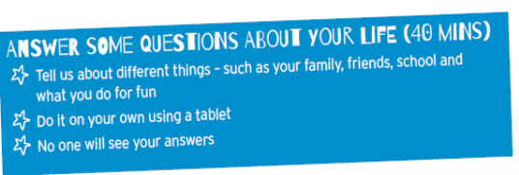
MCS self completion questionnaires at 11 & 14
 | Age 11 | Age 14
Mode | Paper (in home) | CASI tablet (in home)
Length | 30 minutes | 45 minutes
Content | Age appropriate Multi disciplinary: variety of qs about life incl. some sensitive Non complex | Age appropriate Multi disciplinary: incl. more sensitive areas More complex q types: more routing, grids & filtering
Visual Design | Designed to appeal to age | Revised study design to appeal to age
Conduct | Given by interviewer Parents not allowed to see completed version Completed on own Text to encourage honest answers Placed in envelope & given back to interviewer | Encouraged to do in private Interviewer could not explain any terms Design features to encourage honesty & reassure about confidentiality

Slide 6
Age 11: considerations for design
mode: paper - challenges for routing
question wording & phrasing
response categories: grids, frequency descriptions, variation, don’t knows
instructions
floating text: section intros & definitions

Slide 7

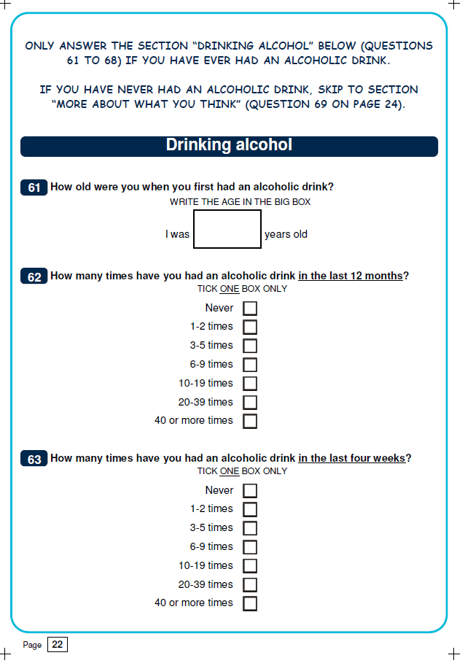
Age 11: resolving design issues
Routing:
pilots showed children could not follow routing
result~
dropped routing where possible.
one place could not avoid, printed page in different colour & instructions in bold
Response categories:
grids ~
where possible removed to avoid ‘satisficing’
variation & number ~
harmonised frequency categories for the same types of questions
tried to limit to 4-5 categories where possible

Slide 8
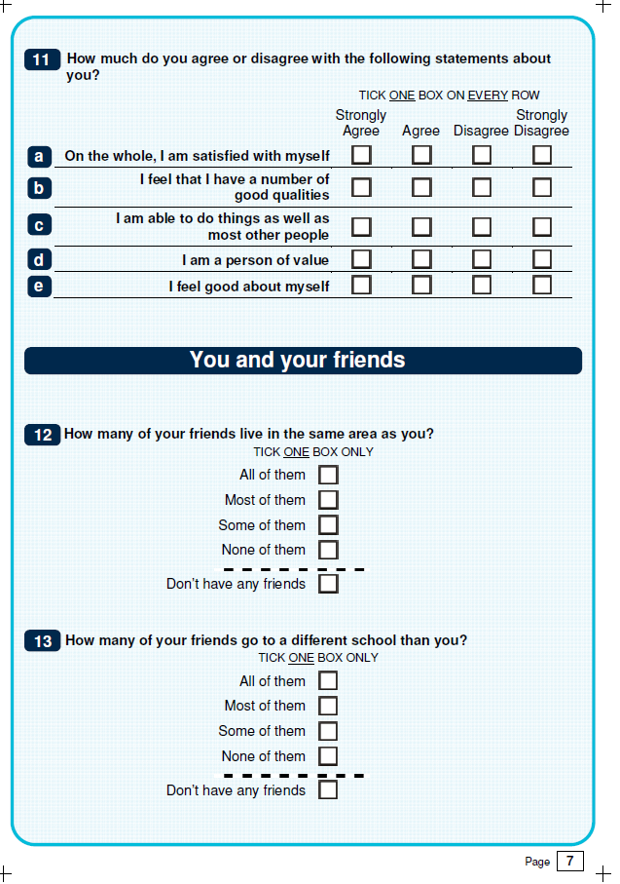
Age 11: resolving design issues
don’t knows:
removed ‘don’t know’ & ‘not applicable’ where able
exceptions = separated by dotted line
question wording & formats:
reviewed all qs to check we were asking a question rather than giving a statement
kept qs short & wording simple
underlined certain words for emphasis

Slide 9
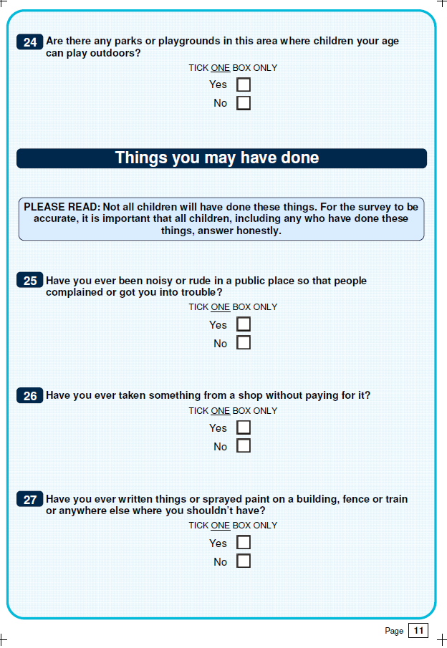
Age 11: resolving design issues
Instructions & floating text:
pilot work showed children were not reading them
result ~
section intros dropped, replaced with descriptive section headings
question instructions kept to a minimum, placed in boxes & in bold with ‘PLEASE READ’ added
honesty text to encourage true answers

Slide 10
Age 14: considerations for design
Mode: CASI - tablet
More complex question types
Giving control to: skip questions, give ‘DK’ answers,
How to indicate where they were in the questionnaire
How to collect information about sensitive & risky activities and get accurate and honest answers
Reassuring confidentiality

Slide 11
Age 14: electronic questionnaire design
Allowed for more complex question design: particularly routing
Allowed routing from minor to bigger risks
Gave as much control as possible over completion
CMs positively encouraged to complete away from others

Slide 12
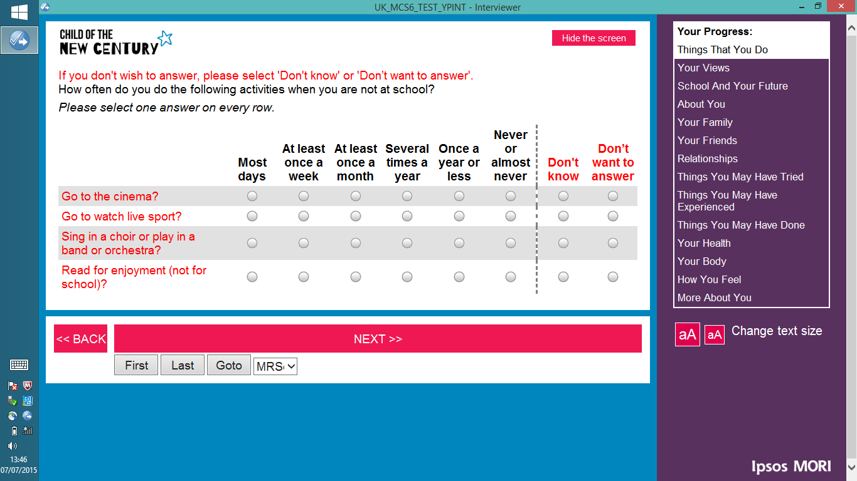
Age 14: resolving design issues
don’t knows
skipping a question
progress bar
Notes:
SKIP Qs: The YP were able to skip qs that they do not want to answer or offer a DK
PROGRESS BAR: The qaire included a progress bar down the side which gave the YP visual feedback on where they are in the qaire in terms of which section they were on - to help with motivation

Slide 13
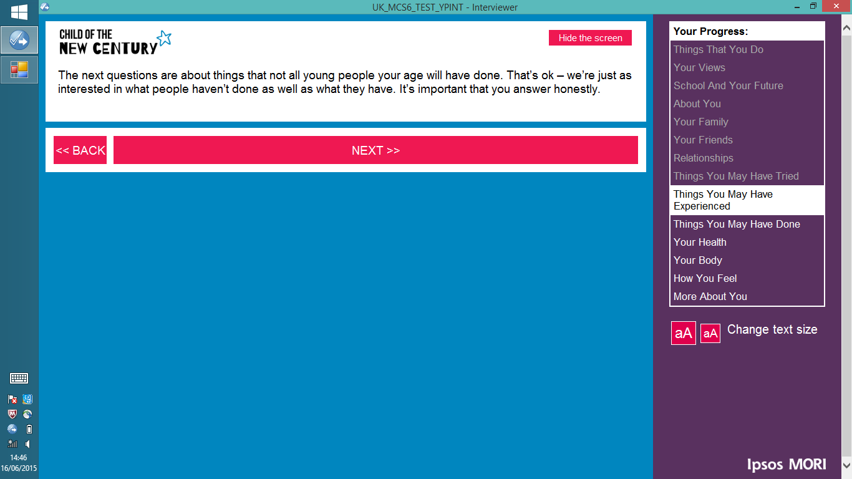


Age 14: resolving design issues
privacy: hiding the screen
Notes:
HIDE BUTTON: The YP could hide the screen at any time if someone came into the room or they need to take a break

Slide 14
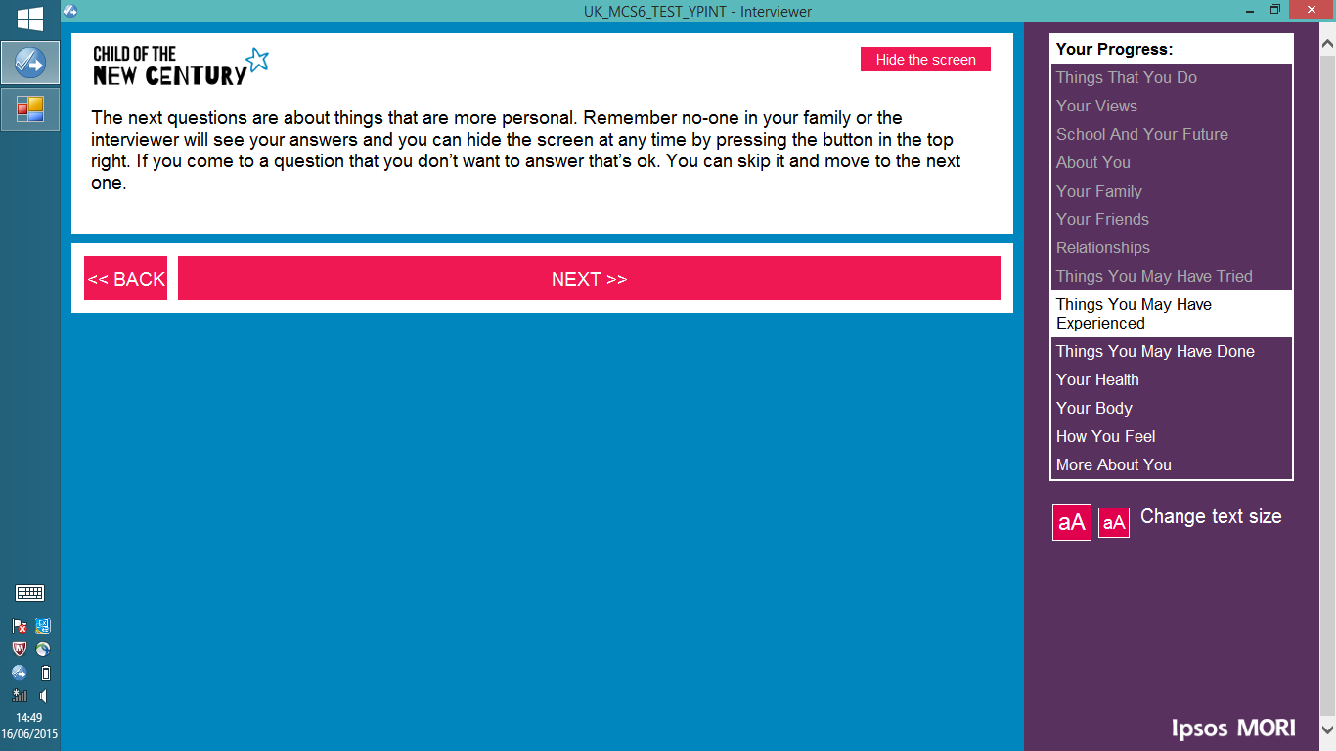
Age 14: resolving design issues
sensitivity text

Slide 15
Age 14: resolving design issues
honesty text

Slide 16
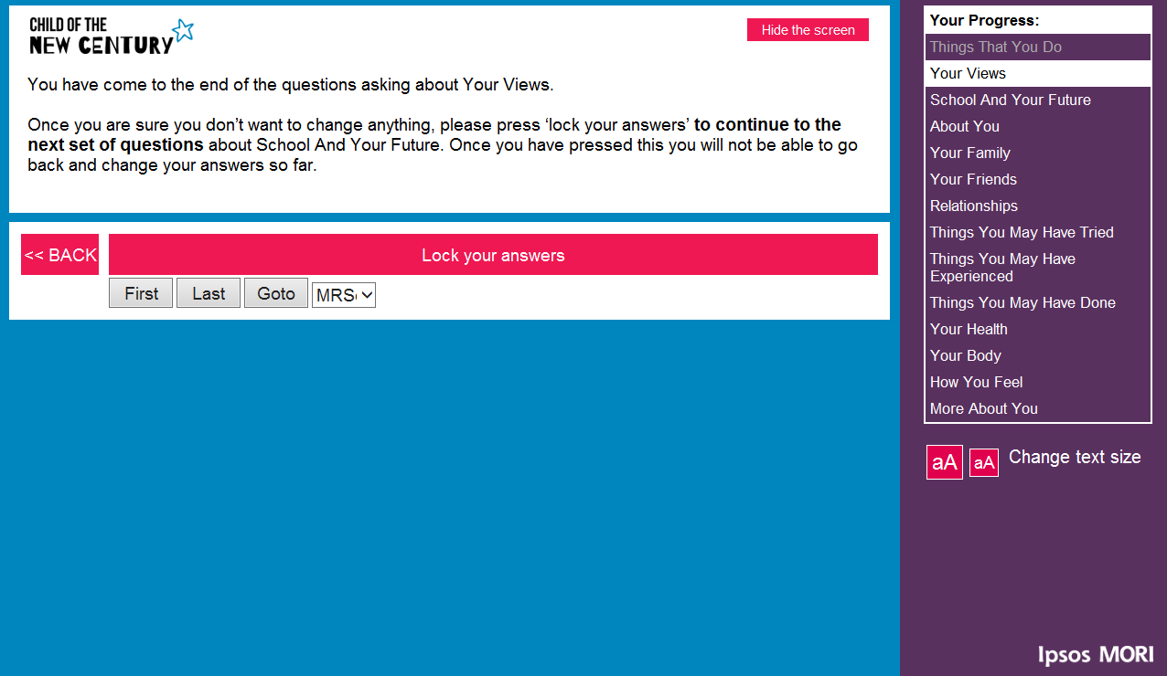
Age 14: resolving design issues
locking answers –
at end of each section

Slide 17
Conclusions
Careful consideration given to the design of the age 11 & 14 MCS young person questionnaires
Well tested to check for length, acceptability, sensitivity, relevance & understanding
Design age appropriate: less complex at age 11 – removed almost all routing, hanging instructions etc.
Designed to get honest and accurate answers to sensitive questions and protect privacy of answers
Indicator of success – high completion rates (Age 11: 98%) (Age 14: 97%). Very low break off rates and low item missing data

Slide 18
Thank you.
k.c.smith@ucl.ac.uk

