Slide 1

Advances in Survey and Instrument Design for Youth
Ann Arthur, M.S.
Michelle Howell Smith, Ph.D.
Leslie R. Hawley, Ph.D.
Andrew White
Natalie Koziol, Ph.D.

Slide 2
Background
Children and youth are being surveyed more often
  National Assessment of Educational Progress (NAEP)
  Program for International Student Assessment (PISA)
  Trends in International Mathematics and Science Study (TIMSS)
We know very little about the survey response process in youth
Respondents’ ability and willingness to complete the task is a function of
  Respondent ability
  Respondent motivation
  Question difficulty (Krosnick, 1991)
that generate data grant. However, we need evaluation data; we’ve taken heat from campus, so we need to ramp up our evaluation efforts.”
Notes:
Add each line one by one and at the end bold/color important key words

Slide 3
The Survey Response Process
Four stages (Tourangeau, Rips, & Rasinki, 2000)
  Comprehension
  Retrieval
  Judgment
  Reporting
The quality of youths’ responses depends on their development in 3 domains
  Cognitive ability
  Language (and reading) ability
  Social and moral ability
Notes:
Add each line one by one and at the end bold/color important key words

Slide 4
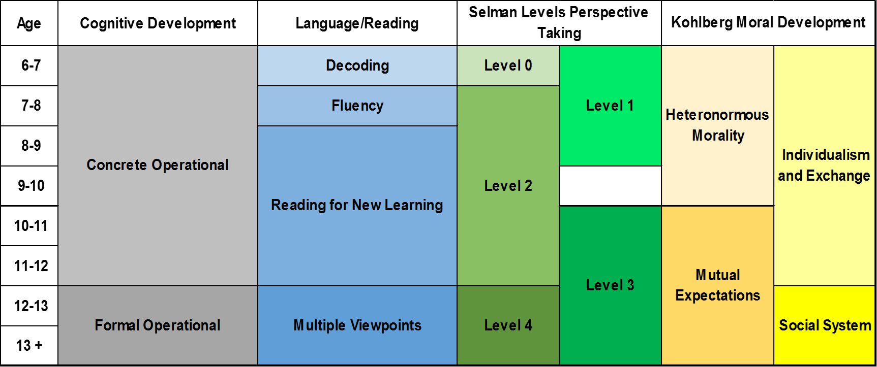
Developmental Skills: Cognition
Classification
Ordering
Understanding of the world in “black and white”
Working memory capacity
Processing speed
Logical reasoning
Notes:
Add each line one by one and at the end bold/color important key words

Slide 5
Developmental Skills: Language/Reading
Limited reading comprehension
Can focus on meaning rather than decoding
Limited vocabulary
Can understand multiple layers of meaning from multiple viewpoints
Extensive vocabulary
Notes:
Add each line one by one and at the end bold/color important key words

Slide 6
Developmental Skills: Social/Moral
Rule-based morality
See others’ perspectives
“Tit for tat” morality
Sees multiple perspectives simultaneously but unable to apply to broader contexts
Apply perspectives to broader social/legal contexts
Notes:
Add each line one by one and at the end bold/color important key words

Slide 7
Developmental Skills
Notes:
Add each line one by one and at the end bold/color important key words

Slide 8
Recommendations for Developmentally-Appropriate Instrument Design
For youth ages 9 – 18 (grades 4 – 12)
  Wide variability in this range
Build on existing guidelines for youth and adults
Attempt to match youths’ abilities to complete the question-answer process
Notes:
Add each line one by one and at the end bold/color important key words

Slide 9
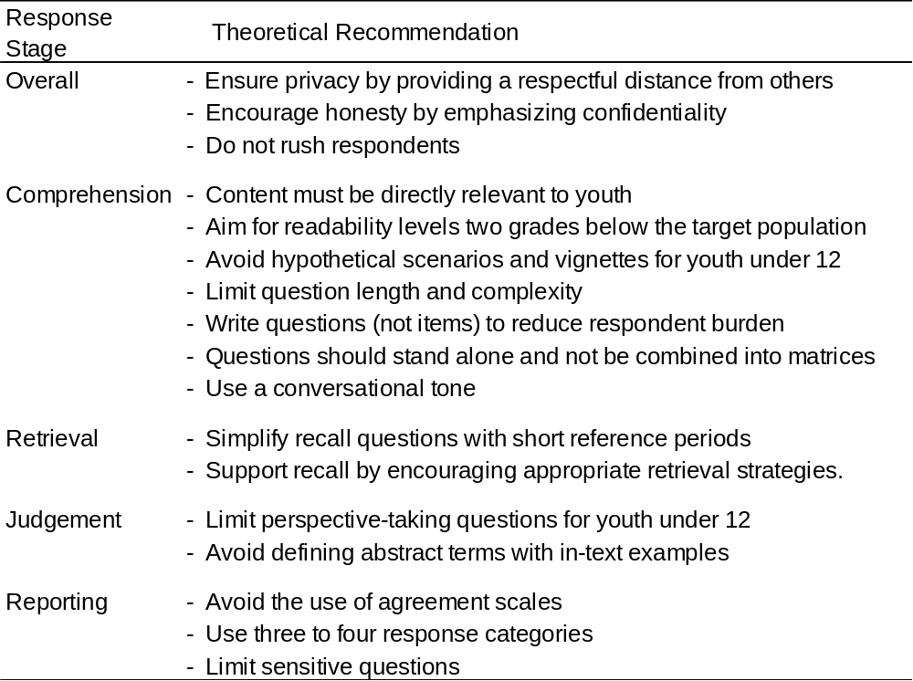
Notes:
Add each line one by one and at the end bold/color important key words

Slide 10

Testing the Recommendations

Slide 11
Testing the Recommendations
Instruments for a youth development organization
Participants
  180 youth between the ages of 9 and 18 (Grades 4 and 12)
    Diverse sample
    Some known disabilities (e.g., autism, hearing disability)
  6 states (Pacific Northwest, Midwest, South, Northeast)
Procedures
  Teacher reviews
  6 rounds of pretesting
    Cognitive interviews
    Focus groups
    Retrospective interviews

Slide 12
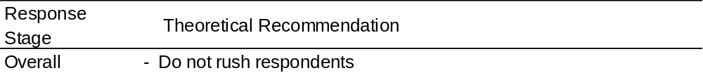
Recommendation 3
Supported?
  Yes.
    Youth in grades 4 – 6 took 1 ½ to 2 times longer to complete an instrument than youth in grades 7+.

Slide 13
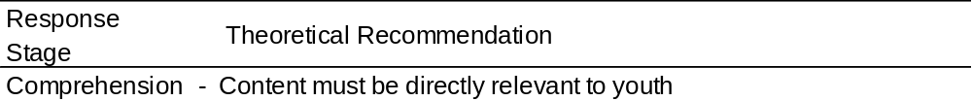
Recommendation 4
Supported?
  Yes
    Youth became dismissive if content was not directly relevant
    Once you “lose” a respondent, it was difficult to get them back

Slide 14
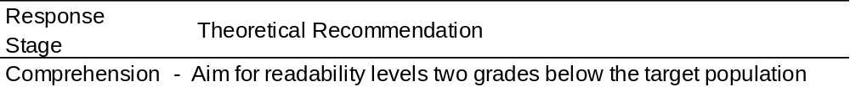
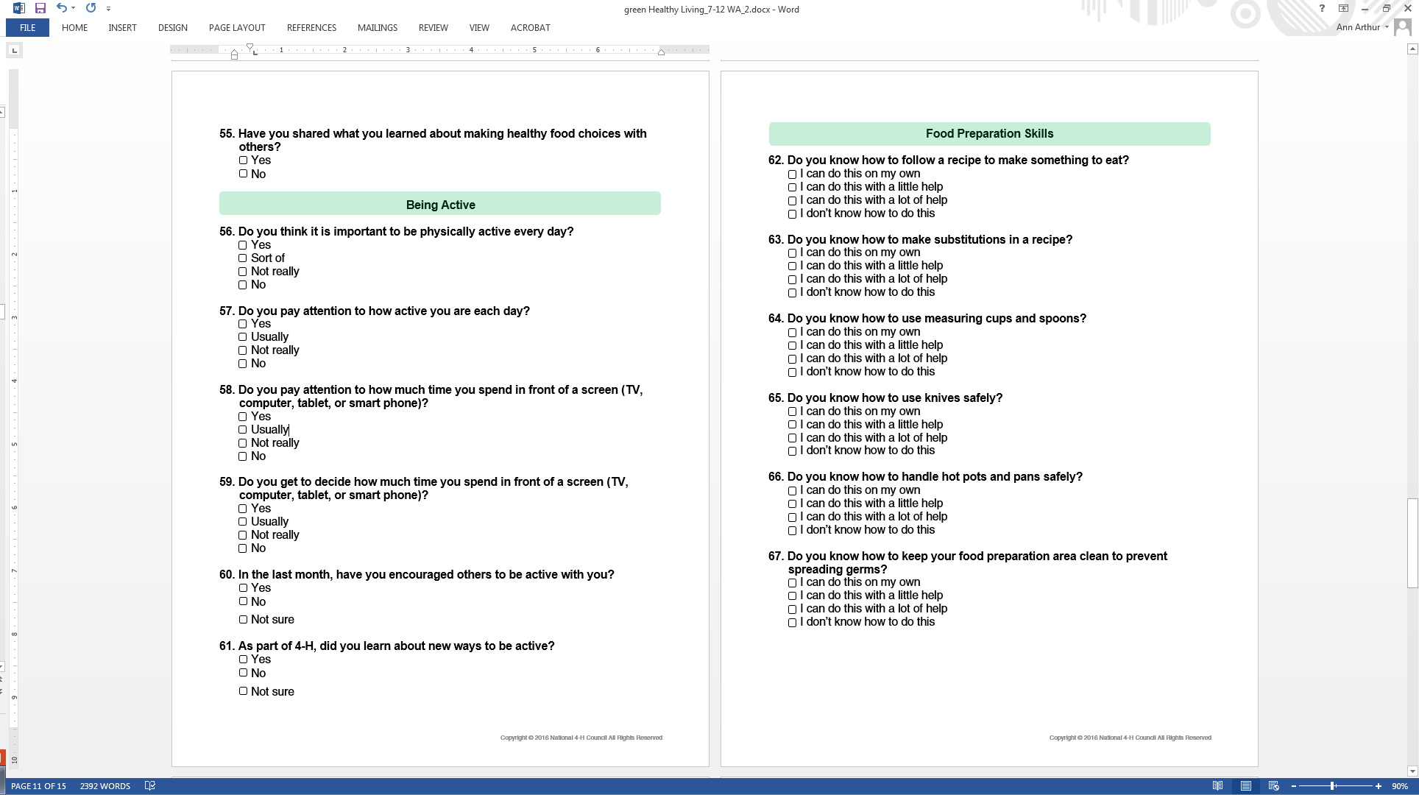
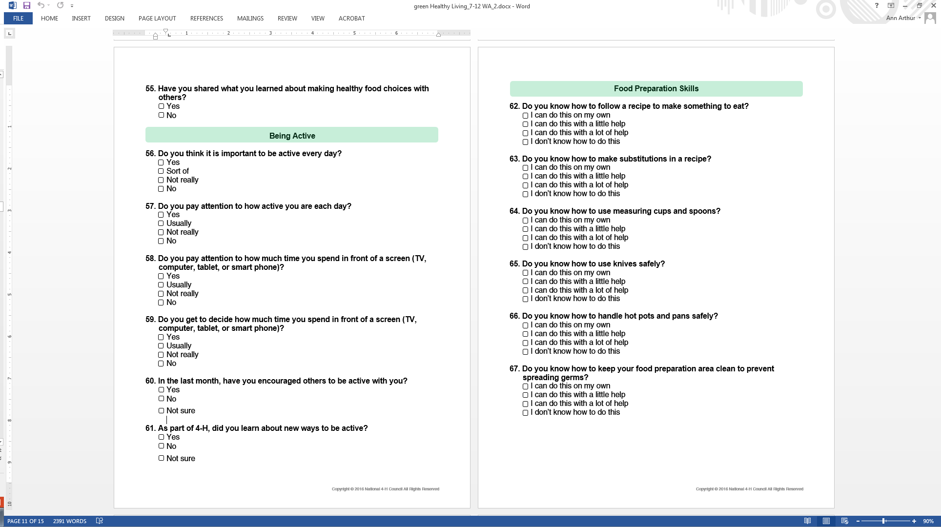
Recommendation 5
Supported?
  Yes. Do not overestimate youths’ vocabulary.
Original wording
Revised wording
    Source: De Leeuw (2011)

Slide 15
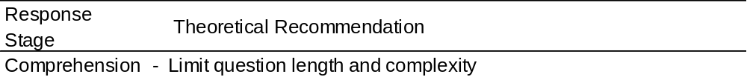
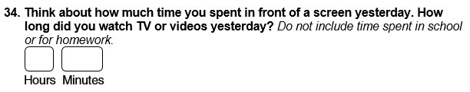
Recommendation 7
Supported?
  Yes. Overly long questions were burdensome for respondents to read.
Example

Slide 16
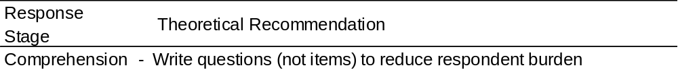
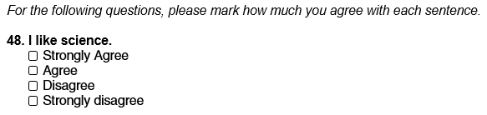
Recommendation 8
Supported?
  Yes. Younger youth did not know how to answer these items.
Example

Slide 17
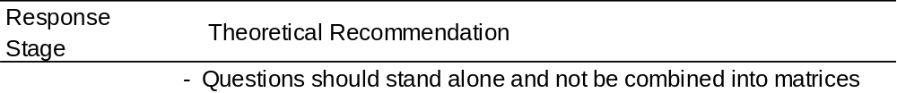
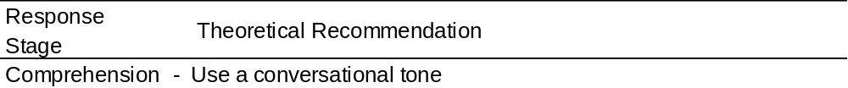
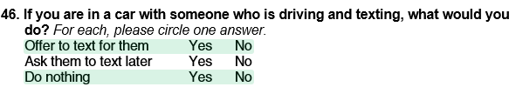
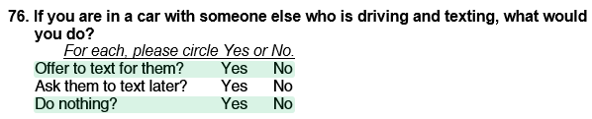
Recommendation 9
Supported?
  No. Nonresponse is a challenge, but better instructions helped.
Original instructions
Revised instructions
    Source: Levine, Huberman, & Buckner (2002)

Slide 18
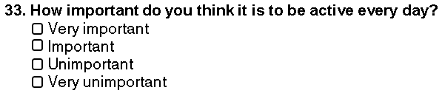
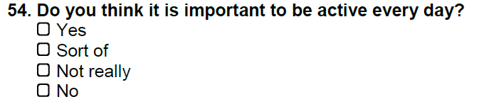
Recommendation 10
Supported?
  Yes. Youth preferred more natural, authentic wording.
Original wording
Revised wording

Slide 19
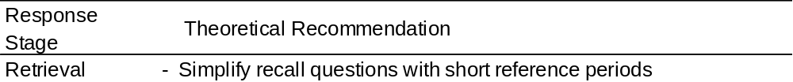
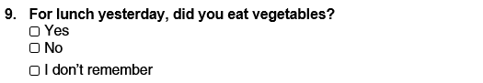
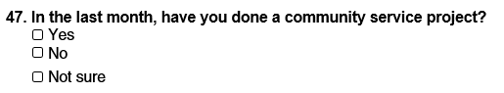
Recommendation 11
Supported?
  Yes. The reference period depends on frequency and regularity.
Examples

Slide 20
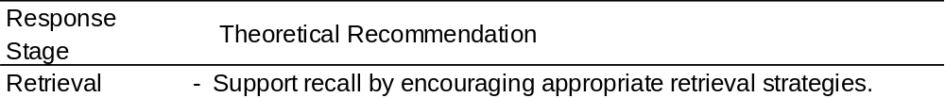
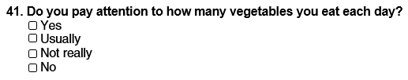
Recommendation 12
Supported?
  No. In most cases, youth tended to use an estimation strategy.
Original wording
Revised wording

Slide 21
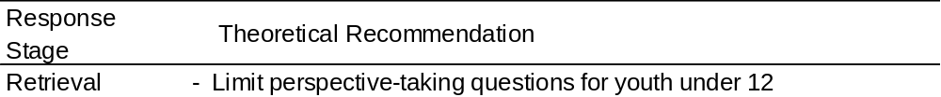
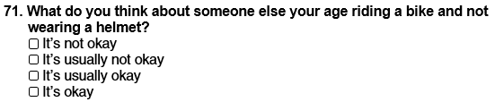
Recommendation 13
Supported?
  Yes. Youth could complete these questions but at different levels.
Example

Slide 22
Conclusions

Slide 23
Conclusions
The three developmental domains all have implications for instrument design
  Ages listed are leading age at which these levels are reached
Age 12/Grade 7 seems to be a threshold
  At this age, abilities support survey research designed for adults
    Working memory capacity is equivalent to adult levels
    Vocabulary is at a 5th grade reading level or higher
  Content must be appropriate and relevant for 12-year-olds
Not all of the recommendations were supported
  Older youth are able to do more than younger youth
  Further research is needed

Slide 24
Selected References
Beebe, T. J., Harrison, P. A., Mcrae, J. A., Anderson, R. E., & Fulkerson, J. A. (1998). An evaluation of computer-assisted self-interviews in a school setting. The Public Opinion Quarterly, 62(4), 623-632.
Chall, J. S. (1983). Stages of reading development. New York, NY: McGraw-Hill Book Company.
De Leeuw, E. D. (2011, May). Improving data quality when surveying children and adolescents: Cognitive and social development and its role in questionnaire construction and pretesting. Report presented at the Annual Meeting of the Academy of Finland: Research Programs Public Health Challenges and Health and Welfare of Children and Young People, Naantali, Finland. Retrieved from http://www2.aka.fi/Tiedostot/Tiedostot/LAPSET/Presentations%20of%20the%20annual%20seminar%2010-12%20May%202011/Surveying%20Children%20and%20adolescents_de%20Leeuw.pdf
Kohlberg, L. (1976). Moral stages and moralization: the cognitive-developmental approach. In T. Lickona (Ed.), Moral development and behavior. New York: Holt, Rinehart & Winston.
Krosnick, J. A. (1991). Response strategies for coping with the cognitive demands of attitude measures in surveys. Applied cognitive psychology, 5(3), 213-236.
Levine, R., Huberman, M., & Buckner, K. (2002). The Measurement of Instructional Background Indicators: Cognitive Laboratory Investigations of the Responses of Fourth and Eighth Grade Students and Teachers to Questionnaire Items. Working Paper Series.
Selman, R. L. (1980). The growth of interpersonal understanding. New York: Academic Press.
Tourangeau, R., Rips, L. J., & Rasinski, K. (2000). The psychology of survey response. New York, NY: Cambridge University Press.

Slide 25
Thank you!
Ann.Arthur@huskers.unl.edu

