Slide 1
LFS Transformation in UK

Slide 2
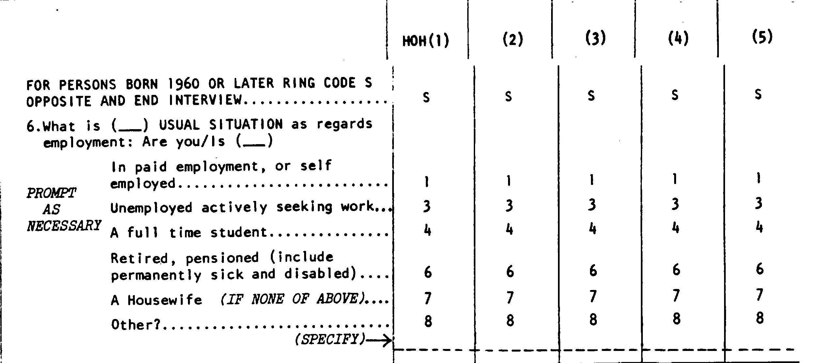
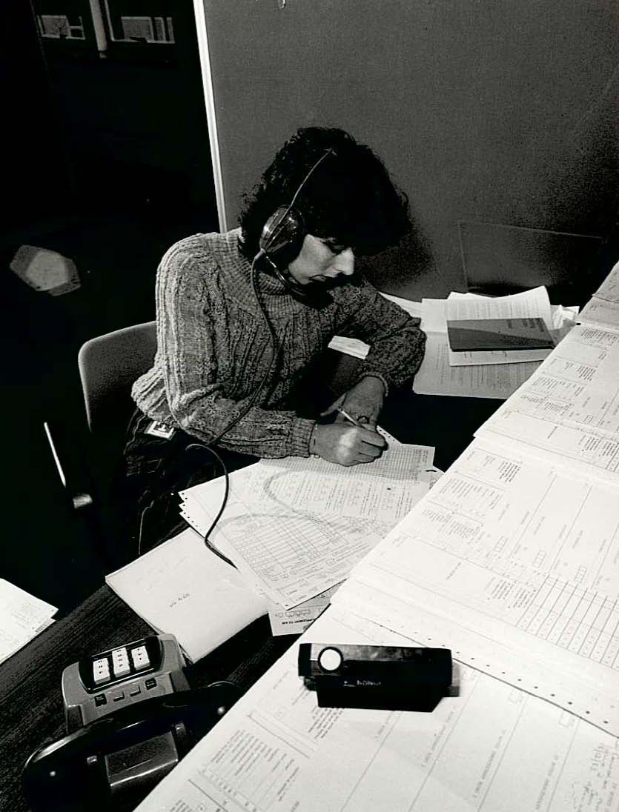
Labour Force Survey: background
More than 200,000 people a year take part, making the LFS the UK’s largest regular survey
Started in 1973 Telephone in 1984
Data used by the Bank of England
1984 introduction of a boost survey (~60,000 HH), and a quarterly survey – wave structure still used today
Was almost exclusively about work and looking for work…
Today, it covers health, qualifications, social-mobility, national well-being, benefit entitlement, and earnings
It is long! ~ 600 variables & household enumeration
First cognitive interviews in 2005

Slide 3

How the LFS has been put together…

Slide 4
Moving online
‘Digital by default’
  Timely
  Cost saving
Early design work
Electronic data collection programme 2012-2014
  Take the survey and put it online unchanged
  Respondents had a lot of trouble self-completing
  Essnet recommendations to optimize for mode

Slide 5
Now: Transformation, not translation!
Radical redesign: strip back to the output requirements
and design the online mode first!
What?
Changes to survey content (cut down, rationalise)
Changes to questionnaire flow (more relevant)
Changes to questions (simplify)
How?
Design principles
  Question design mobile focussed
  Questionnaire design respondent focussed
Focus group with interviewers
Designing from data
Agile and iterative development
Non-survey data
Notes:
Cutting content – What are the actual requirements – today, not when first started collecting – and what’s critical? Then, as there are already questions we know don’t work we can cut those next.
It also gives stakeholders a chance – when considering what their actual output requirements are – to get new questions/concepts that actually measure what they’re really after better.

Slide 6
Design principles

Slide 7
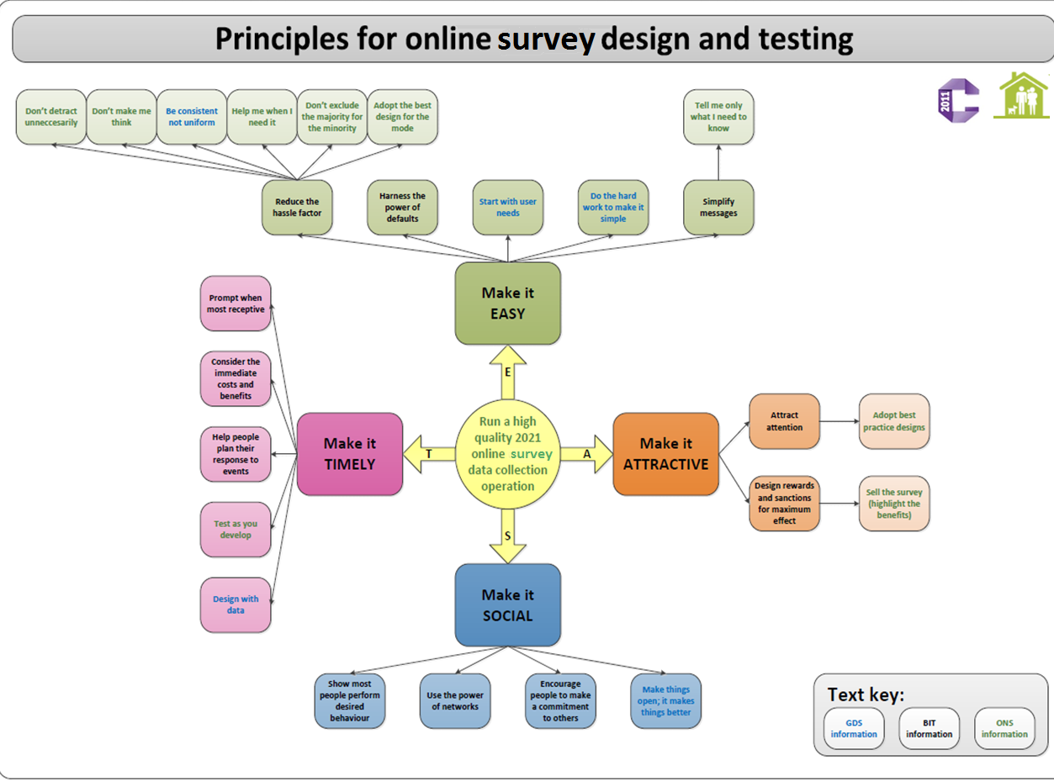
Notes:
The work of the Behavioural Insight Team (BIT; Cabinet Office department) identified some higher-order principles for encouraging behavioural change (which is essentially what we’re trying to achieve), under which we’ve nested slightly more specific design approaches
Further principles from Government digital services were also used to help formulate these principles – they focus and lead user-centric service design for online government services.
When you think about the survey design standards with which you’re familiar, (like putting definitions in the question text, avoiding the use of grids, breaking up complex questions, considering context effects) they can probably be thought of as achieving these higher order principles

Slide 8
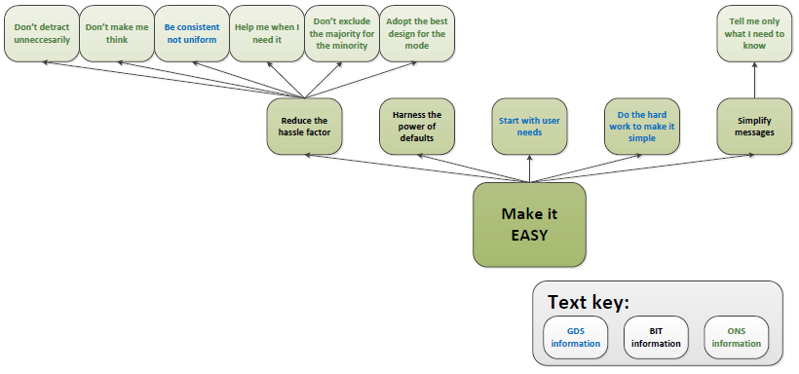
Easy
Notes:
Using simple language
Use routing to only provide relevant information and questions
Reduce ‘friction costs’ associated with every stage (from signing in to answering specific questions)
A friction cost can be thought of as anything that gets in the way of performing the behaviour – every seemingly inconsequential action can be a potential barrier to completion
Make online the default mode – if you send out paper questionnaires too easily, online response rates will be low and the cost savings won’t be realised

Slide 9
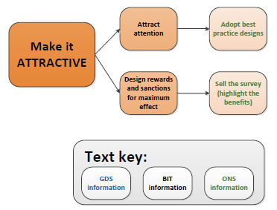
Attractive
Notes:
Make the online version look more compelling than the paper version so that the cost savings can be realised (not just visual appeal, but potentially time saving)
‘Give back’ to the respondent – what is the information for? How does it help me?

Slide 10
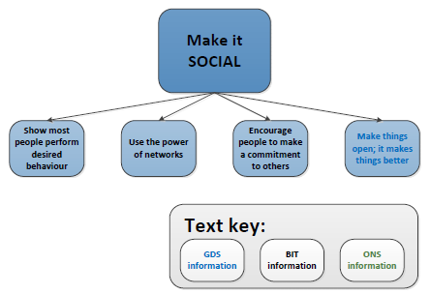
Social
Notes:
Using the power of networks – can we generate a ‘buzz’ around completing the Census online so that people share their experience on social media and in the real world, encouraging more people to try
When trying to encourage online response emphasise it as normative – everyone is doing it

Slide 11
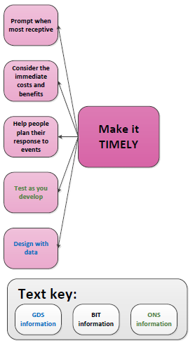
Timely
Notes:
Consider when people are most receptive to communications and reminders
Help them plan when they can participate?
Consider also the timing (context effects) of questions when designing the questionnaire flow

Slide 12
Step 1 - RATIONALISING the lfs

Slide 13
Future model wave 1 core
Contract types; Shift work; Employment history;
Other LM-Priority
Full time / part time;
Phase 1
Socio-demographics, jobs, second jobs
Usual and actual hours
Redundancy; duration of unemployment; current education
Work absences;
Number of employees; Managerial duties;
Eurostat Adhoc modules
Scope to be agreed
Future LFS
Key labour market statistics
Economic activity

Slide 14
Step 2 - Changes – data, flow, wording

Slide 15
No
72,800
Were you on one of these schemes?
Yes, on schm 6, 7 or other
200
44,900
Govt. Schm
72,600
Working Ref?
Yes (any other positive choice)
Yes
Any, not studying
27,900
No
Govt funded?
Yes
Activity while on scheme
Yes
Is that because you’re away from job?
Waiting to start new job
No
Govt. Schm
Voluntary/ environmental work; or other employment training
Activity while on scheme
Employment status
Yes
As well as scheme, working?
Receiving SE help
Working for/ away from employer; practical training
SE
EMP
Before or after setting up own business?
Before
EMP
No
Govt. Schm
After
200
SE
UFW
Yes
Unpaid work for own business?
27,700
No
Yes
No
Looking for work?
Looking for govt schm?
Waiting to start new job?
Would like work?
Unpaid work for rele business?
No
No
No
Yes
Yes
24,800
Able to start?
Yes
Able to start?
No
Why can’t start?
No
0
Yes
No
Yes
Yes
Main reason not looking
Main reason not looking
Not active 6-11
unemployed
400
2,500
Not active 12-22
Not active 23-33
27,300
24,800
Notes:
This is the current LFS. This is one derived variable, economic activity. Outcomes are 1. employee 2. self-employed 3. unpaid family worker (UFW) 4. on a Government training scheme 5. Unemployed (looking and available for work) 6. economically inactive (27 outcome codes the for various circumstances, i.e., retired; student)

Slide 16
Did you do any paid work in Ref?
Yes
No
Self employed or as employee?
No
But have a job? (…as a…)
Looking for work?
SE
EMP
SE
EMP
No
Yes
Yes
Able to start?
No
Waiting to start new job
unemployed
Why not?
ANY
Not active
Any unpaid work?
Any training in ref?
Govt funded?
Yes family work
UFW
Govt. Schm

Slide 17
72,800
Did you do any paid work in Ref?
44,700
Yes
No
28,100
Self employed or as employee?
No
But have a job? (…as a…)
Looking for work?
SE
EMP
SE
EMP
No
Yes
Yes
Able to start?
Disqualified – no job to go back to; work is casual
Ineligible if:
long term away no pay;
work is casual;
not started job / business
Why not working Ref?
This work was part of a training scheme = true
No
Waiting to start new job
unemployed
Why not?
Govt. Schm
ANY
27,700
Not active
300
Before setting up own business = true
Job not actually started
100
Any unpaid work?
Any training in ref?
Govt funded?
28,000
Yes family work
Govt. Schm
UFW
300
Govt. Schm
unemployed
0

Slide 18
Did you do any paid work?
No
Yes
No
Because away from a job?
Self employed or as employee?
If more than 1 job, status of main job?
How many?
Looking for work?
Status of each
SE
EMP
No
Yes
Yes
Able to start?
SE
EMP
This work was part of a training scheme = true
No
Waiting to start new job
Disqualified – no job to go back to; work is casual
unemployed
Why not?
Ineligible if:
long term away no pay;
work is casual;
not started job / business
Why not working Ref?
Govt. Schm
ANY
Not active
Before setting up own business = true
Any unpaid work?
Any training in ref?
Govt funded?
Job not actually started
Yes family work
Govt. Schm
UFW
Govt. Schm
unemployed

Slide 19
Step 3 - Qualitative work

Slide 20
Question wording
Simplify
  Easier, modern language
  More relevant response options
  Driven by limited screen space
Focus Groups with Interviewers
  Able to shed a lot of light on the problems with the questions; frustrations of the respondent
  Including complaints of the order and repetitiveness

Slide 21
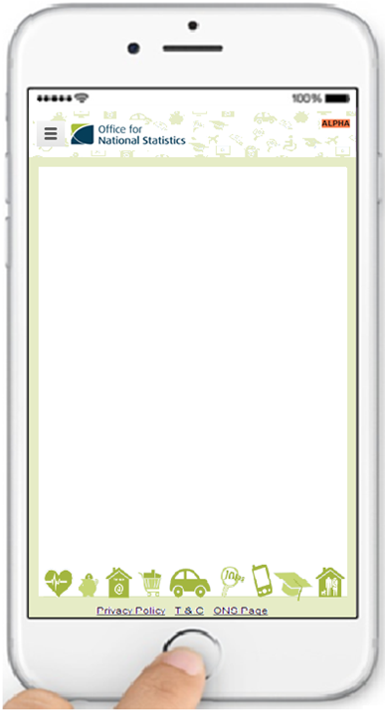
Current LFS
Last Transformation iteration
In the seven days ending Sunday the [date] were you on any of the following schemes/programmes…
Work or Enterprise Club
New Enterprise Allowance
Work Experience
Work Trials
Work Programme
Any other Government Scheme
None of these
What was the main reason that you did fewer hours than usual/were away from work in the week ending Sunday the …?
Number of hours worked/overtime varies
Bank holiday
Maternity or paternity leave
Parental leave
Other leave/holiday
Sick or injured
Attending a training course away from own workplace
Started new job/ changed jobs
Ended job and did not start new one that week
Did you do any work for payment or profit (including in self-employment) in the week ending Sunday the [date], even for as little as one hour?
Yes
No
Were you working as an employee or were you self-employed?
Employee
Self-employed
Government Scheme
Unpaid family worker
What was the main reason you were not working in the week ending Sunday the [date]?
On leave (paid or unpaid)
Short term sick or injured
Long term sick or disabled
Maternity or paternity leave
Waiting to start a new job
My hours vary
Temporary interruption to work
Job is casual
Other
Did you do any paid work in the 7 days ending Sunday the [date], either as an employee or as self-employed?
Yes
No
Even though you were not doing paid work, did you have a job or business that you were away from in the week ending Sunday the [date] (and that you expect to return to)?
Yes
No
Waiting to take up new job
Did you have a paid job or business that you were away from in that week?
Yes
No
Are you…
An employee
Self-employed
Do you have more than one paid job or business?
Yes
No

Slide 22
Cog testing
How?
Built questionnaire in Axure RP to work online
Who?
13 respondents
On their own devices, in their homes
Techniques
Think aloud
Retrospective probing
Usability testing

Slide 23
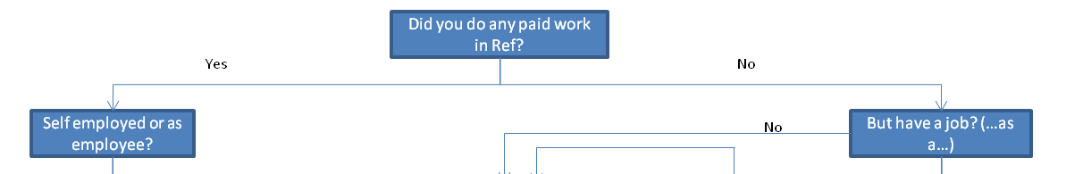
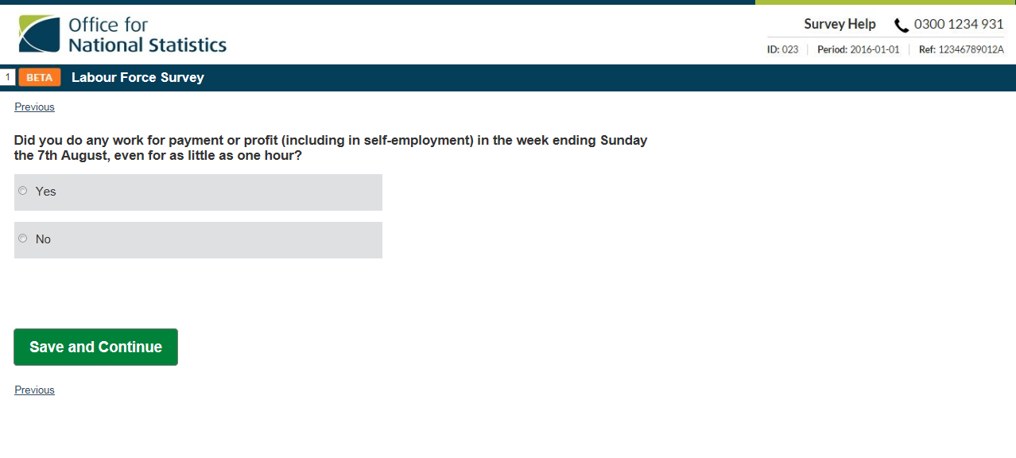
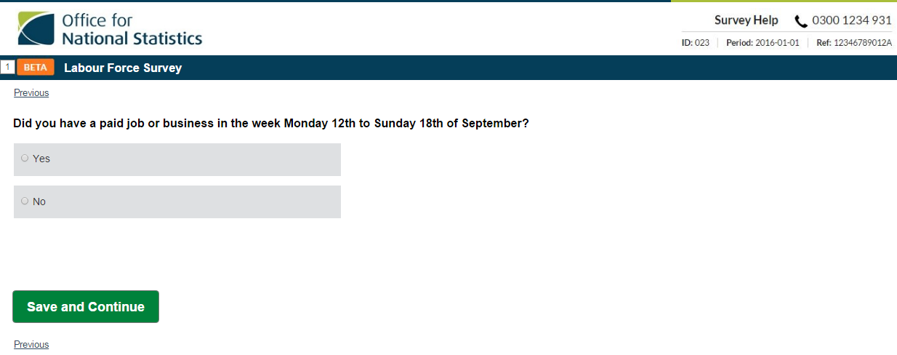
Testing…
Did you do any paid work in Ref?
‘Payment’ can focus on whether paid/earning – and not about working
‘Profit’ more problematic for S-emp as they consider whether made money, not whether worked

Slide 24
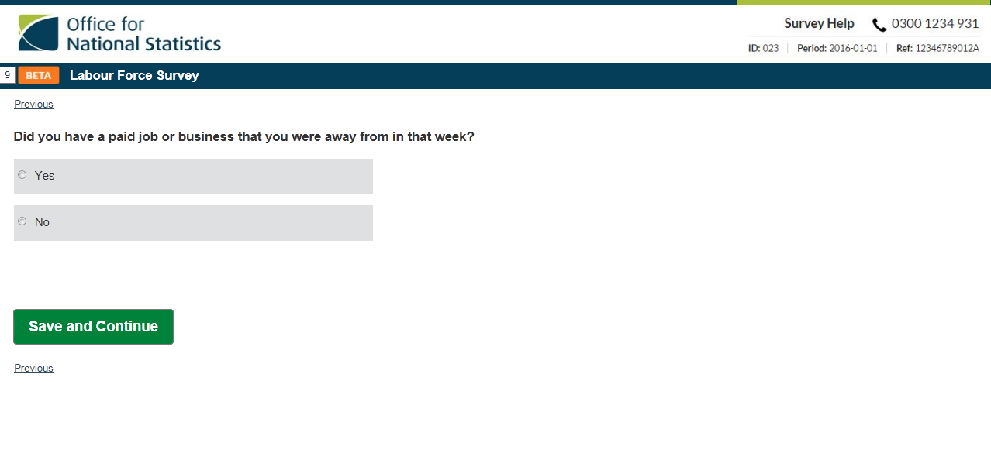
Testing…
Did you do any paid work in Ref?
But have a job? (…as a…)
“…I have a paid job the whole year… so I wasn’t away from a paid job, even though I’m paid through the holidays”

Slide 25
Did you have a job?
Yes
No
More than 1 job?
Did you do ANY paid work, even an hour?
Self employed or as employee?
Main job Employee / self-employed
Looking for work?
No
SE
EMP
SE
EMP
Yes
unemployed
Full time/ part time?
Able to start?
Yes
Second job Employee / self-employed
No
Why not?
Full time/ part time?
SE
EMP
ANY
Full time/ part time?
Not active
Which days did you work?
Any unpaid work?
Do you do overtime?
What are you usual hours?
UFW
What are your actual hours?
Why fewer hours than usual?

Slide 26
Q1.Were you working? Payment & profit
Observations
‘Payment’ can focus on whether paid/earning – and not about working
Findings
User selecting ‘Yes’ (I was working) when on leave because leave was paid
As with paid leave for employees; self-employed people also focus on the profit aspect of the question, and not what it should be asking: whether they did work that week
Quotes
“I would have said yes because they still gets holiday pay”
“Well I was on holiday so I was paid”
‘Profit’ more problematic for Semp as they consider whether made money, not whether worked
Loss-leading exercises (that don’t expect an immediate return on investment; or just cover expenses) are not counted.
“free with the raffle, so that’s a non-profit job” (and would therefore say ‘no’ if the only work in week).
“It wouldn’t be a return in that week”
“[profit is]money derived from activity… minus expenses”
Actions
Question needs to focus on days worked in Ref, and paid job could be dealt with elsewhere
Need to emphasise it’s a question about whether working, not whether earning for that week.
Intention to make profit, not actually making profit
The most sensible way may be to split this question into the components that Rs confuse: Ask first do you have a job/business that pays you?
If Yes, which days did you work in ref (if any)?

Slide 27
Summary
Start with the concepts, not the questions
(NB: we are not re-working existing questions)
Consider the respondent experience…
…and the online mode…
…first!
Be Agile – fail fast
Be radical!

Slide 28
What next
Continue with our development of small chunks in an iterative way – guided by data, principles, advantages of the online mode
Scope the rest of the content by agreeing the concepts to be measured, seeing what’s available from non-survey data
Run a quant test in 2017

