Slide 1
Development of an Abbreviated and Statistically Robust Instrument Using Exploratory Factor Analysis: Example from Neurology Research.
Jay Mandrekar, PhD
Professor of Biostatistics and Neurology
Consultant, Division of Biomedical Statistics and Informatics
Consultant, Department of Neurology
QDET2 2016
November 12, 2016

Slide 2
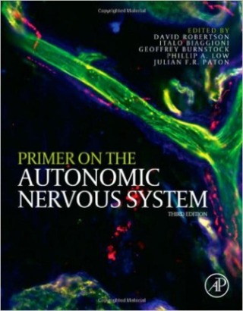
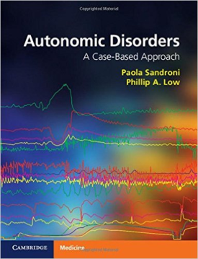
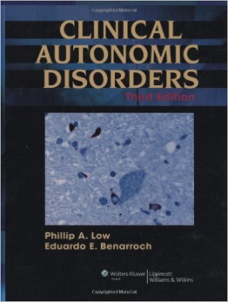
What is Autonomic Nervous System?
A part of nervous system that influences the function of internal organs such as blood vessels, stomach, intestine, liver, kidneys, bladder, genitals, lungs, pupils, heart, and sweat, salivary, and digestive glands.
System responsible for the involuntary functions of the human body; works automatically (autonomously), without a person’s conscious effort.
The autonomic nervous system is a control system that acts largely unconsciously and regulates bodily functions such as the heart rate, digestion, respiratory rate, pupillary response, urination, and sexual arousal.

Slide 3
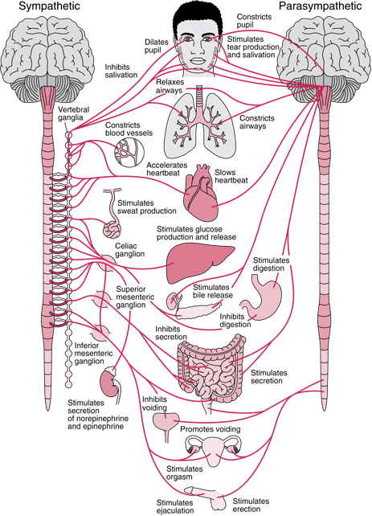
sympathetic nervous system (SNS) controls the body's responses to a perceived threat.
Responsible for the "fight or flight" response.
parasympathetic nervous system (PNS) controls homeostasis and the body at rest.
Responsible for the body's "rest and digest" function.
http://www.merckmanuals.com/professional/neurologic-disorders/autonomic-nervous-system/overview-of-the-autonomic-nervous-system

Slide 4
Autonomic System Disorder: Impact / Type
>1 million Americans are impacted by a primary autonomic system disorder.
Common forms of these conditions include:
  Orthostatic hypotension (OH)
  Orthostatic intolerance (OI)
  Postural orthostatic tachycardia syndrome, also known as postural tachycardia syndrome (POTS)
  Syncope
  Neurogenic bowel (gastroparesis, intestinal dysmotility, constipation)
  Erectile dysfunction and neurogenic bladder

Slide 5
Data collection issue: using lengthy surveys
Completed either by patients or care givers.
Time consuming, burdensome for sicker patients and also problematic if scoring algorithm is complex.
Longer surveys increase likelihood of missing or less reliable information if responses are not captured adequately.

Slide 6
Autonomic Symptom Profile (ASP)
1st described by Suarez et al in 1999 (Mayo Clinic)
Routinely used at Mayo Clinic and many other institutions around the world for a comprehensive assessment of autonomic symptoms and functions
Well established questionnaire designed to evaluate the severity, distribution of symptoms and the autonomic functional capacity of patients with autonomic disorders.
It comprises 169 questions and assesses 11 domains of autonomic function.

Slide 7
Composite Autonomic Symptom Score (COMPASS)
Limited set of 84 clinically selected questions from ASP.
Questions grouped into 11 autonomic domains with 72 questions
  orthostatic intolerance, 9 items; secretomotor, 8 items; male sexual dysfunction, 8 items; urinary, 3 items; gastroparesis, 5 items; constipation, 4 items; diarrhea, 4 items; pupillomotor, 7 items; vasomotor, 11 items; reflex syncope, 5 items; and sleep, 8 items)
Additional 12 items were not scored.
Validated and used extensively by our group and selected others.

Slide 8
What are the problems ?
Concerns about supporting this tool for use by other institutions in spite of broad national an international interest:
The scoring algorithm is highly complicated and ambiguous. Thus extraction process has resulted in even experienced users obtaining inconsistent scores.
Completion of the ASP, even if limited to the questions relevant for COMPASS, is time consuming.
The questions within the domains assessed using COMPASS have not been evaluated for internal consistency.
Several questions included in the original COMPASS instrument have over time been identified to be less meaningful or redundant for scoring autonomic function and symptom severity.

Slide 9
What is needed?
A redesign of the instrument to;
  a simplified
  more time-efficient
  statistically robust, but still comprehensive tool
  to assess and grade symptoms relevant to autonomic function that can find broad application in research and clinical practice .

Slide 10
Specific Aims
to develop a simplified and more user friendly
scoring scheme for questions that comprise COMPASS / ASP
to critically assess current questions and domains and develop an updated, concise, and statistically robust standalone tool with clinical input
Tool should provide a clinically relevant general score of autonomic symptom severity with meaningful sub scores for individual autonomic domains.

Slide 11
Steps involved
Start with COMPASS (72/84 scored questions)
Eliminate redundant / less important questions
Revisit ASP and see what additional questions may be useful based on research over past decade
Develop a standardized scoring scheme to eliminate ambiguity
Compare internal consistency of Old versus New scoring (for COMPASS and COMPASS with extra questions)

Slide 12
Steps involved….
Using New instrument select smaller subset of questions as suggested by Factor analysis
Clinical expert’s revisions to eliminate redundant content and/or to retain clinically important questions
Final assessment of new instrument for internal consistency
Assigning weights to domains to make range 0 - 100

Slide 13
Statistical Analyses
Factor Analysis
  Eigenvalue rule (retaining factors with Eigenvalues > 1) was used to extract factors.
  Scree plot, as a visual representation.
  Items with factor loadings ≥ 0.4 were retained
  ambiguous items (i.e., items loading on > 1 factor) were eliminated.
Chronbach’s alpha was calculated to assess internal consistency of items within their respective domains.
  As this study involved the evaluation of a new scoring assessment of a tool, Chronbach’s alpha ≥ 0.7 was considered acceptable.
Notes:
Internal consistency is usually measured with Cronbach's alpha, a statistic calculated from the pairwise correlations between items. Internal consistency ranges between negative infinity and one. Coefficient alpha will be negative whenever there is greater within-subject variability than between-subject variability

Slide 14
Patients:
405 subjects recruited and seen in the Mayo Clinic Autonomic Disorders Center between March 1, 1995, and March 31, 2010.

Slide 15
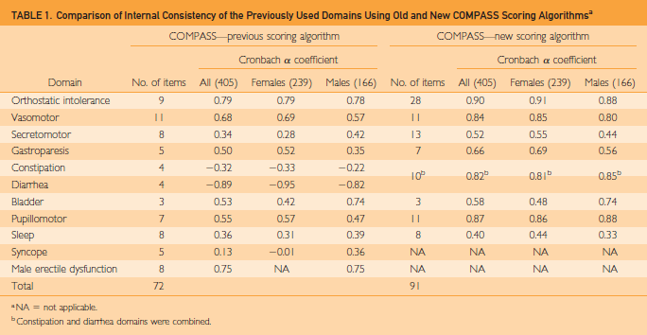

Slide 16
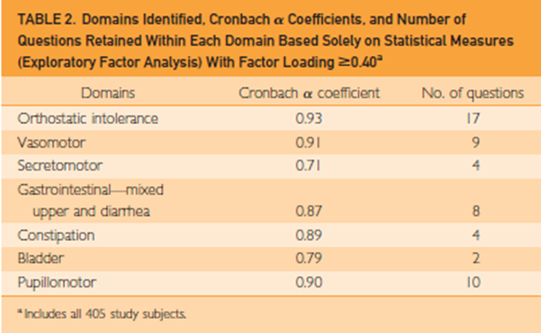

Slide 17
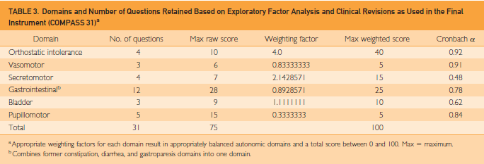

Slide 18
Results
New simplified scoring algorithm alone resulted in higher Cronbach values in all domains.
Factor analysis revealed 7 domains with a total of 54 questions retained.
Expert revisions resulted in further reduction of questions and domains with a remaining total of 31 questions in 6 domains (COMPASS 31).
Measures of internal consistency were much improved compared to those for COMPASS.
Using appropriate weighs, this instrument provided an autonomic symptom score from 0 to 100.

Slide 19
Conclusion
COMPASS 31 is;
  refined, internally consistent, and markedly abbreviated quantitative measure of autonomic symptoms.
  based on the original ASP and COMPASS
  applied a much simplified scoring algorithm
  suitable for widespread use in autonomic research and practice.

Slide 20
Questions & Discussion

