Slide 1
Asking about sexual identity on the 2021 Census in England and Wales
Peter Betts
Office for National Statistics

Slide 2
Introduction
2021 Census Topic Consultation: clear need for information on sexual orientation
Sexual identity question on ONS social surveys since 2009 (interviewer administered)
Need for estimates at small area level and for multivariate analysis
Census Sexual Identity research and testing plan

Slide 3
Research and testing plan
Preparation for 2017 Test:
  Focus groups and Cognitive/in-depth interviews
    Develop/test proposed question for large scale Test
    Explore views around Census acceptability and design
  Survey on public acceptability
2017 Test and Evaluation
  Sample 100k; split sample – with/without SexID
  Effect on overall response rate
  Quality of response to SexID
  Reasons for non-response

Slide 4
Qualitative research methodology
Focus groups (six held, total 36 participants)
Cognitive/in-depth interviews (26 participants)
Purposive sampling criteria
  Primary:
    Sexual identity: heterosexual/straight, gay/lesbian, bisexual, other* (asexual, queer, pansexual) and
    Sex/gender: men, women, non-binary identity*
  Secondary:
    Age, household types (living alone; with spouse/partner, with related adults and with unrelated adults e.g. flatmates), ethnic group*, religious affiliation*, educational attainment
  (* = particularly targeted in interviews)

Slide 5
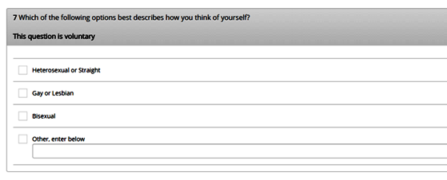
Online question tested in interviews
Based on question developed for surveys
Adapted for Census and online/paper
Added write-in for ‘Other’, after focus groups
Included among other questions for context

Slide 6
Measurement concept, question wording and response categories
Overall, question comprehension and basis for answers was as intended
Wording/language acceptable
No change to wording or response categories for 2017 Test
Need to provide definition of some terms
‘Other’ & write-in space: well received, catch-all
‘Asexual’ category: needs consideration

Slide 7
Acceptability for inclusion on Census
Overall, considered acceptable for Census
Important recognition of LGBO community
Some objection & equivocation
  “Damn cheek’’ ,‘’none of your business’’ , ‘’why does it matter in 2016?’’
  Might or might not answer the question but would not impact on responding to Census overall
General agreement that appropriate to ask age 16>

Slide 8
Purpose, trust, voluntary status
Varied understanding of purpose; LGBO tended to have more insight
No major concerns over uses/users
Varied understanding and trust regarding data security, confidentiality
Voluntary status: positive and negative views

Slide 9
Census administration
Household section and individual sections for each person in single online or paper q’re
Varied ways of completion – one person for all/some, jointly/together, individually
Others seeing/knowing answer: potential for social desirability effect
Proxy response: mixed views across all groups

Slide 10
Maintaining privacy and reducing social desirability
‘Prefer not to say’ or similar category?
Private response (individual internet access code/paper form) on request
Both would arouse suspicion, not prevent social desirability

Slide 11
Conclusions and next steps
‘Newton’s 3rd Law’: for every action there is an equal and opposite reaction
Normalising vs recognising different nature
Public Acceptability survey & 2017 Test
Assessment of all evidence
Consultation, managing expectations
Decision on inclusion, legislative process
More design decisions and potential further research

Slide 12
Links
Census topic consultation - sexual identity report:
https://www.ons.gov.uk/file?uri=/census/censustransformationprogramme/consultations/the2021censusinitialviewoncontentforenglandandwales/topicreport02sexualidentitypostreleaseversion.pdf
Sexual identity research and testing plan:
https://www.ons.gov.uk/file?uri=/census/censustransformationprogramme/consultations/the2021censusinitialviewoncontentforenglandandwales/topicreport19sexualidentityresearchplan.pdf
UK Government Statistical Service Harmonised question on sexual identity:
https://gss.civilservice.gov.uk/wp-content/uploads/2016/03/S13-Sexual-Identity-June-16.pdf
Sexual identity project (2006-09)
http://webarchive.nationalarchives.gov.uk/20160105160709/http://www.ons.gov.uk/ons/guide-method/measuring-equality/equality/sexual-identity-project/index.html

