Slide 1
From First-Generation Web Business Survey Questionnaires to User-Centered Development
Petri Godenhjelm
Qdet2 9.-13.11.2016

Slide 2
Presentation Overview
How the business survey questionnaire design process and methods have evolved in the Statistics Finland both from the perspective of questionnaire designers and software developers
Case example – Questionnaire Redevelopment of Survey on Production of Manufactured Goods
Reflective thoughts on the current state of agile questionnaire design and future challenges

Slide 3
First Generation Web Surveys
In the late 1990s
  StatFin introduced its first electronic business survey questionnaire
From the end of 2006
  All major and permanent business surveys covered
Massive effort
  The whole data collection system had to be set up from the scratch without previous experience
  Not just a simple step of “putting the questionnaires to web”
Focus on technical and process needs
  the perspective of the respondent was not much taken into consideration in the beginning

Slide 4
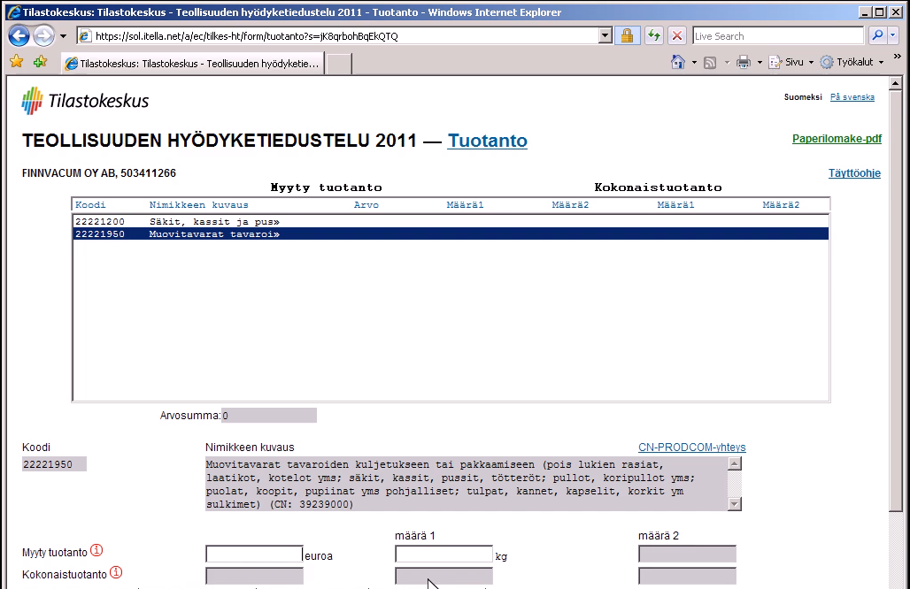
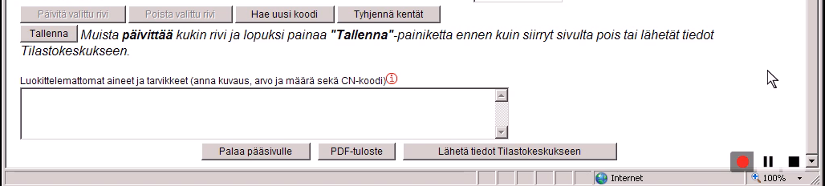
Since 2004
Instructions hidden behind the randomly positioned links
Relatively simple response task is made complex with unnecessary steps, obscure button texts and distracting functions

Slide 5
First Steps on User Centered Development
A round of usability testing 2009 and 2010 with the web questionnaires was one input to think the design process differently
  tests challenged the thinking of subject matter specialists on data quality by revealing the problems to the respondents
Another milestone was a release of the new version of in-house built data collection management software XCola (XML based collection application) in 2012
The developers had to adopt a new methods in software developments as the migration was implemented swiftly and the resources were limited

Slide 6

XCola as Lego
Previously each questionnaire more or less uniquely constructed
  Customization provided flexibility (+)
  Requirement gathering challenging (-)
    The owner (subject area) cannot specify what it needs and the developer is unable to communicate what solution to supply
  Fragmentation (-)
    difficult to maintain questionnaires and different tunings
Now more uniform questionnaire layout and features are utilized
XCola and lego both offer it`s own ready made bricks and possibilities to build own user interface elements

Slide 7
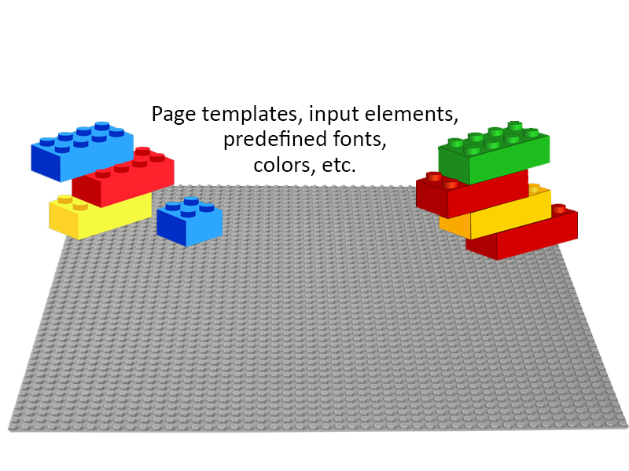
XCola – The Finished Bricks

Slide 8
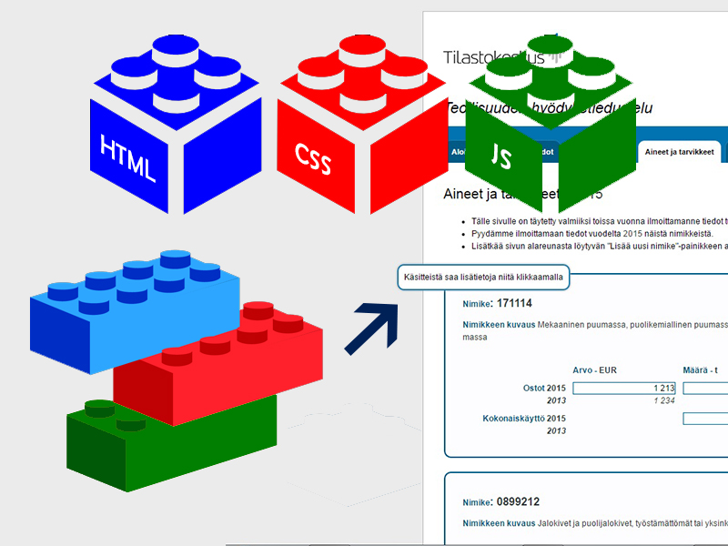
XCola - Possibility to Build Own User Interface Elements

Slide 9
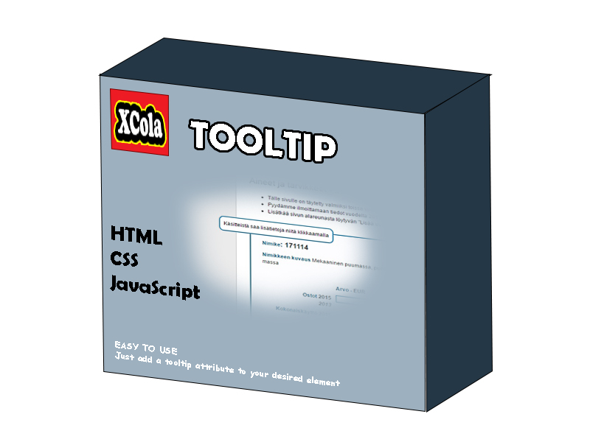
XCola – good user interface elements could also be used in other questionnaires – turn into a product

Slide 10
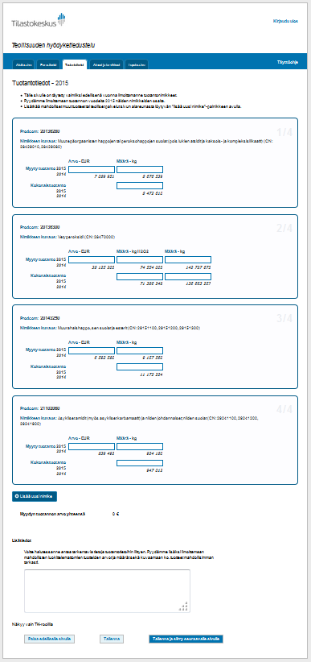
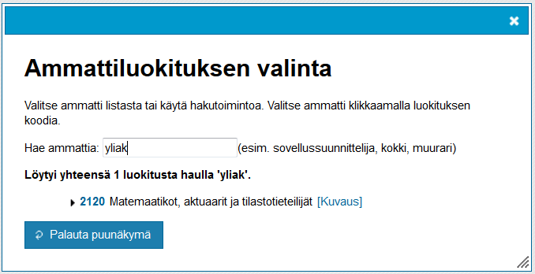


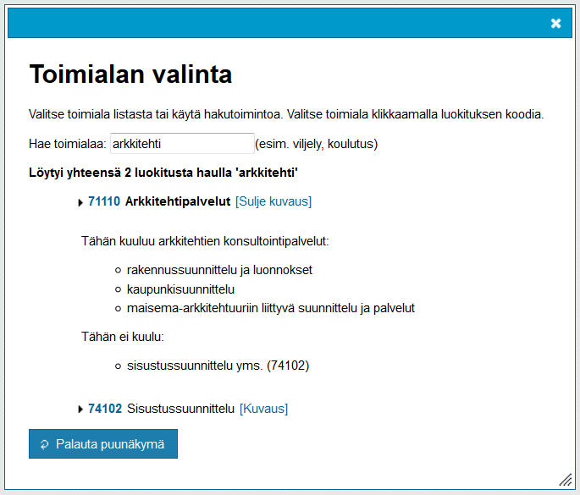

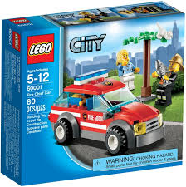
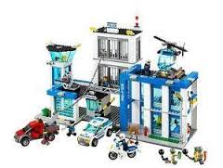
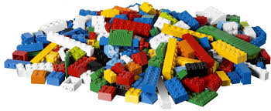
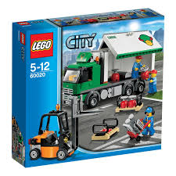

Slide 11
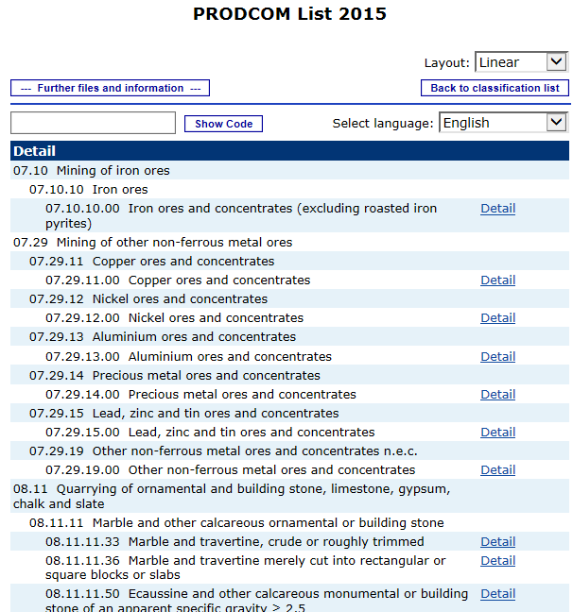
Case example – Questionnaire Redevelopment of Survey on Production of Manufactured Goods
Response task:
  the business has to find and pick from a specified list of products (Prodcom) which of them do they produce
  And provide the value and quantity of production

Slide 12
Case example – Questionnaire Redevelopment of Survey on Production of Manufactured Goods
Problem:
  Prodcom is a list not a classification -->
    No separate title for the each item just only a eight-digit code and a description
      The length of the descriptions varies from one word to more than 500 characters

Slide 13

Case example – Questionnaire Redevelopment of Survey on Production of Manufactured Goods
Problem:
  The respondent are not familiar with the Prodcom list
    Do not know which code means which product
  Less structured, larger (some 4000 items), and more complex than the common statistical classification (industry, occupation, e.g.)
→ Not compatible with a drop-down list or step-wise decision tree

Slide 14
Case example – Questionnaire Redevelopment of Survey on Production of Manufactured Goods
Solution:
  To apply the built-in XCola search tool (already built ”lego” set)
  No changes to source code or any other reprogramming
  Extend the search index to also contain Combined Nomenclature classification (CN)
    Most PRODCOM items correspond to one or more CN-codes, which are designed to meet needs of the common customs tariffs and therefore more familiar to the respondents.

Slide 15
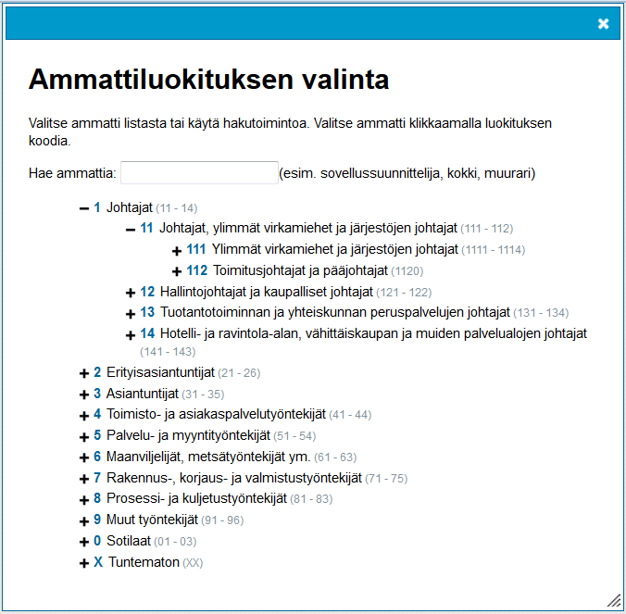
Case example – Questionnaire Redevelopment of Survey on Production of Manufactured Goods
We did a couple of rounds of prototyping and decided
  Not to include a hierarchical tree structure which is a default
  Include more instructions what search queries can be used
  Also display corresponding CN-codes on search results
Occupation search tool

Slide 16
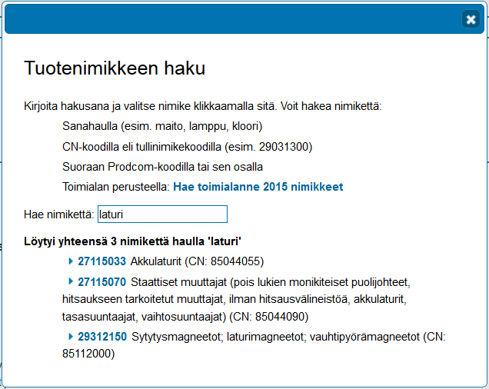
Case example – Questionnaire Redevelopment of Survey on Production of Manufactured Goods
Pretesting showed that the respondent had no problem of using the search tool
    UI convention, search tool was similar to document search (PDF, Word)
All objectives from the requirement gathering implemented
Not overburdened resources and developers

Slide 17
Key points in our approach (1)
It is essential to have already in requirement gathering phase a person who understand user interface design and the technical possibilities of the software platform used
  The questionnaire construction requires technical skills (XML, HTML, CSS and JavaScript)
During requirements gathering, members of the design team obtain ideas from various sources and turn them into requirements
We underscore the importance of mutual communication and iterative development that heavily involves prototyping and testing
  First to check what already exists that can be utilized
  Prototype and test
  Only then to evaluate what new features have to be developed

Slide 18
Key points in our approach (2)
User centered design as a starting point
  ”The approch focuses on how business survey respondent want to use the survey instrument, rather than attempting to get respondents to learn idiosyncratic features of the instruments and alert their behaviour to use them” (Willimack 2013)
Task analysis to test requirements is done as a part of cognitive testing at the business location
  Helps ensure that an instrument meets respondents’ expectations for how an electronic survey should operate
Requirement gathering is like to design good commands, such as questionnaire design is like to design good questions
  ”an succesfull requirement gathering is prerequisite to good questionnaires”

Slide 19

Acknowledgements
Many thanks belongs to my co-authors and colleagues
  Jussi Rouhunkoski
  Taneli Tuomola
  Marko Ylitalo

