Slide 1
Data Collection Transformation
Respondent centric design; an overview of research at ONS to motivate and engage our survey respondents
Laura Wilson - Research and Design Lead
Social Survey Division, ONS

Slide 2
Overview
2. Design Principles
1. Data Collection Transformation Programme
5. Next steps…
4. Questionnaire testing
3. Envelope testing

Slide 3
1. Data Collection Transformation Programme
A brief overview…

Slide 4
Five goals of DCTP:
5. Moving data collection online
1. Survey data and admin data integration
2. Moving to integrated systems
3. Business and Social Survey rationalisation
4. Field Force modernisation
Aim:
Modernise the business!

Slide 5
What does this mean for Social Surveys?
Radical re-design approach
Respondent centric
Agile delivery
Statistical re-design
Questionnaire
Resp. materials

Slide 6
2. Design Principles
Our mantra…

Slide 7
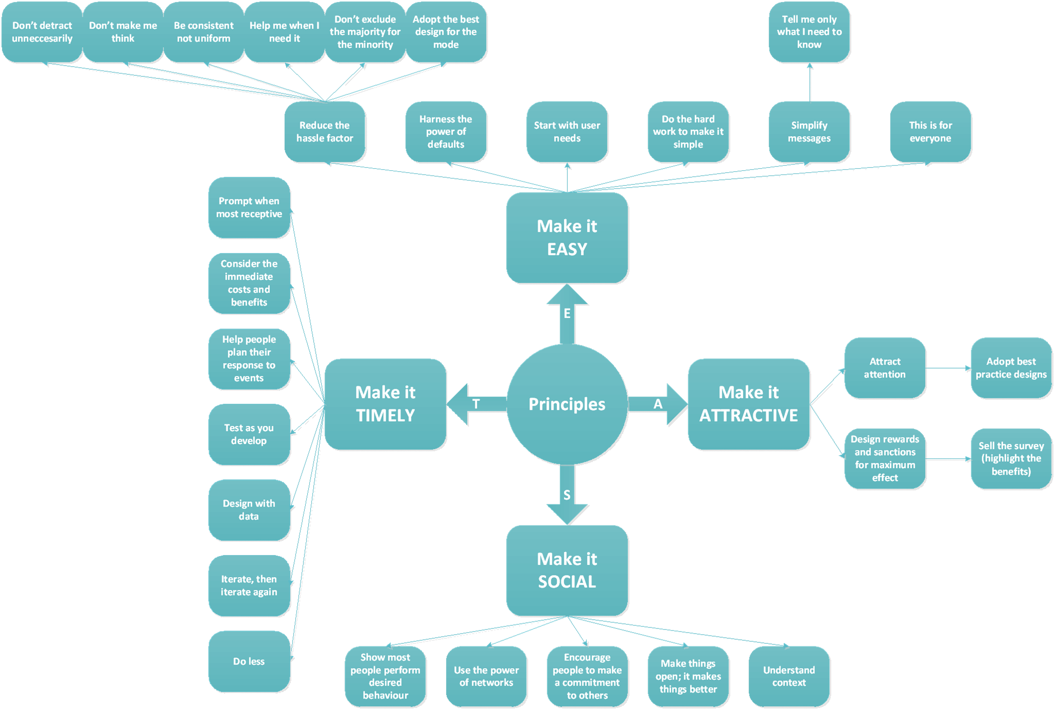
E.A.S.T.
Sources:
- Govt. Digital Service
- ONS
- Behavioural Insights Team
(EAST)

Slide 8
3. Envelope pop-up testing
Innovative methods

Slide 9
Start at the beginning…
Why research the envelope?

Slide 10
Online respondent journey…

Slide 11
Online respondent journey…
But!
Census (mandatory)
versus
Social (voluntary)

Slide 12
Two exercises:
Census pop-up
Social Survey
pop-up

Slide 13

What is pop-up testing? (a.k.a. Guerrilla testing)
What is it?
Stand in a cafe, library, train station, shopping centre etc, essentially anywhere where there is significant footfall
Approach the public to talk to them
Why do it?
Validate the effectiveness of the design before more in-depth testing
Quick feedback and cheap!
What’s the output?
Typically qualitative so insight is often rich and detailed!
https://www.gov.uk/service-manual/user-centred-design/user-research/guerrilla-testing.html

Slide 14
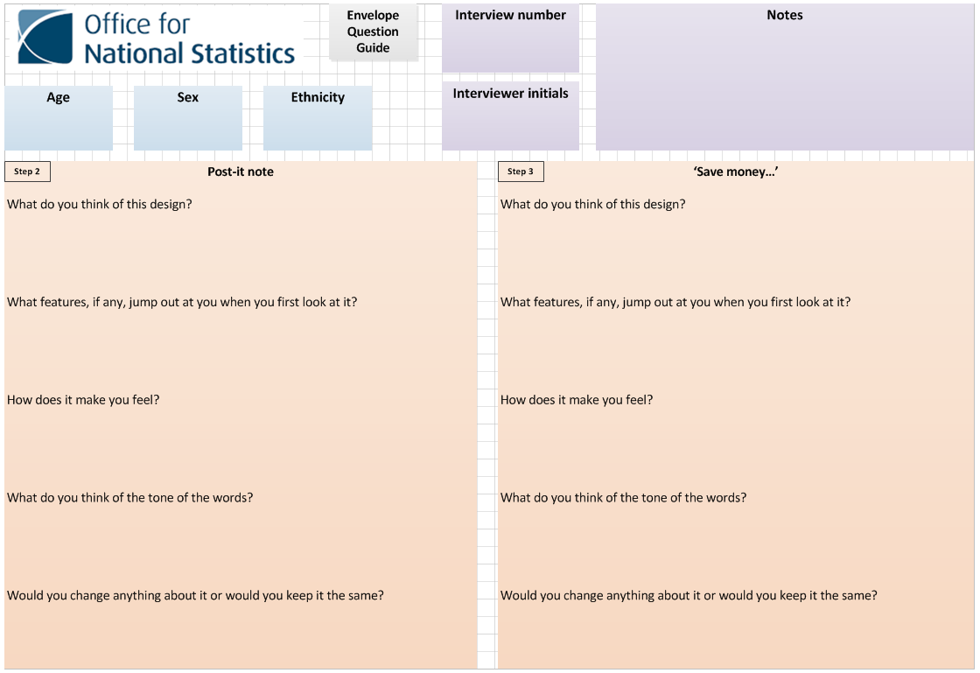
Example Topic Guide (A4 page)

Slide 15
3a. Census pop-up testing
Envelopes (mandatory)

Slide 16
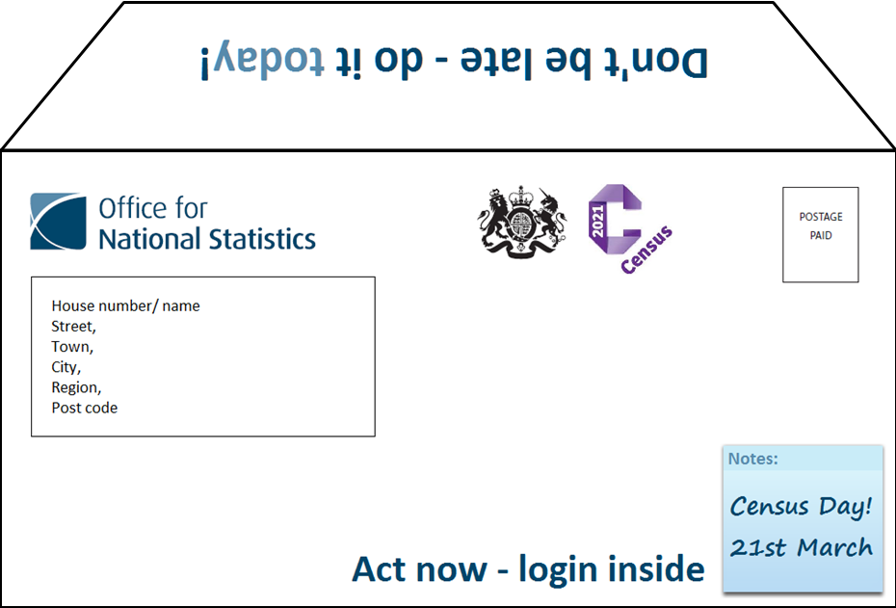
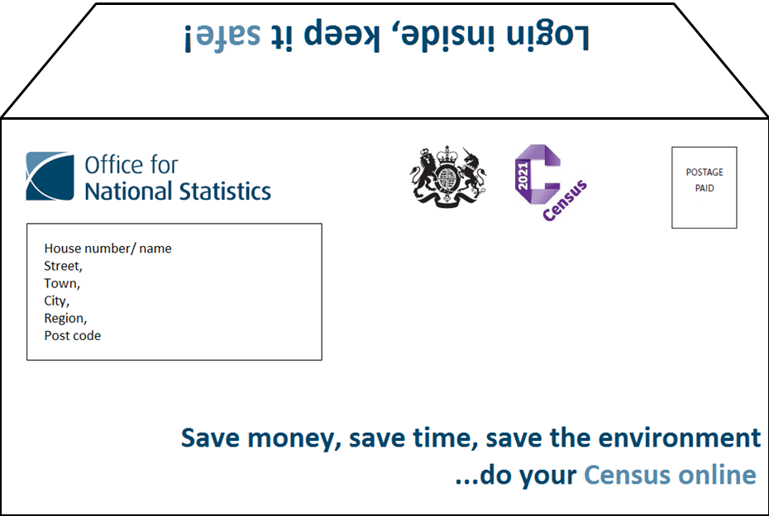
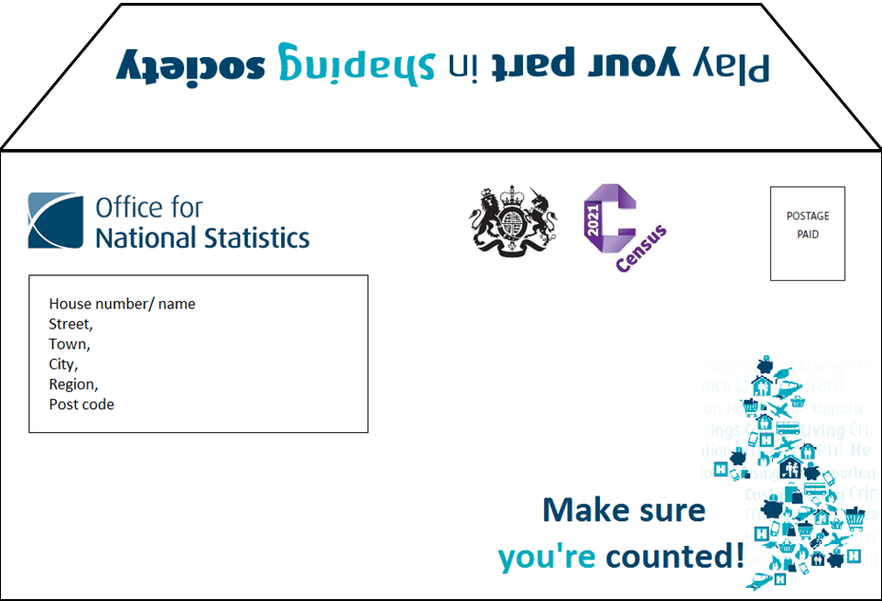
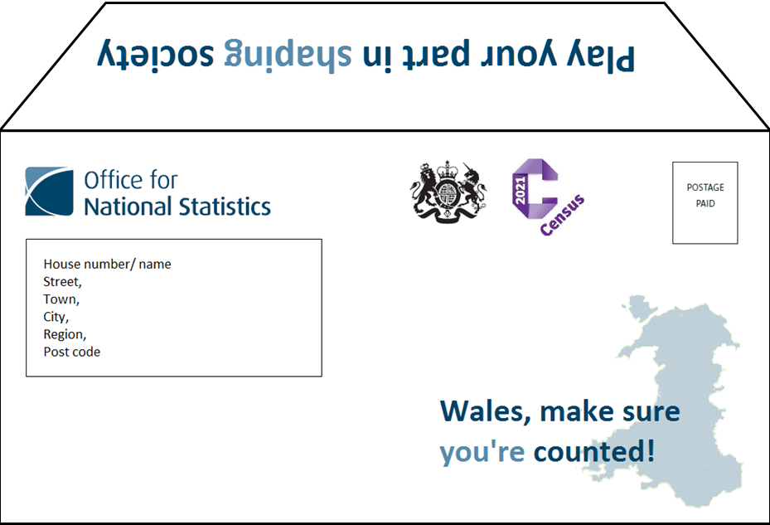
Census pop-up testing

Slide 17
…but why the map of Wales?

Slide 18
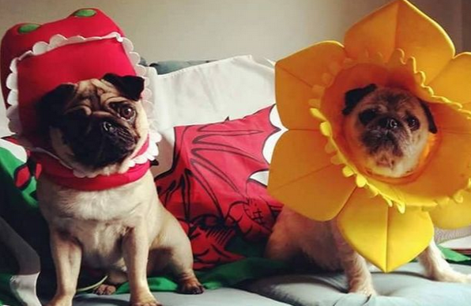

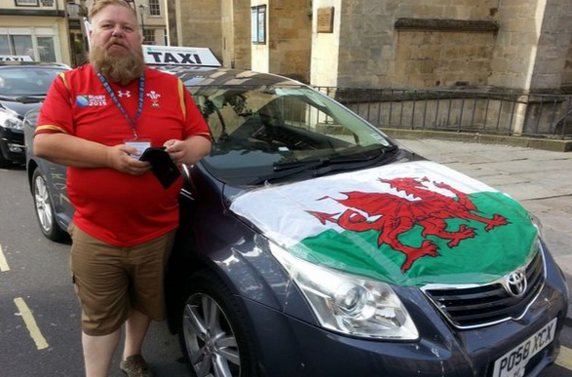

Welsh patriotism!
“WALES is among the most patriotic countries in
Europe
Only the Scottish and Dutch are more proud of their nation than people from Wales, according to the major European survey, conducted by This England magazine.
The survey showed that, on average, Welsh people rated their patriotism at 7.06 out of 10, while the Scots ranked national pride at 7.1 and the Dutch at 7.18.
England, on the other hand, was bottom of the nine nations questioned, with the average Englishman or woman only giving their patriotism a ranking of 5.8.”
Sources:
http://www.walesonline.co.uk/news/wales-news/pride-wales-shines-through-patriotic-1924814
Google image - pictures

Slide 19
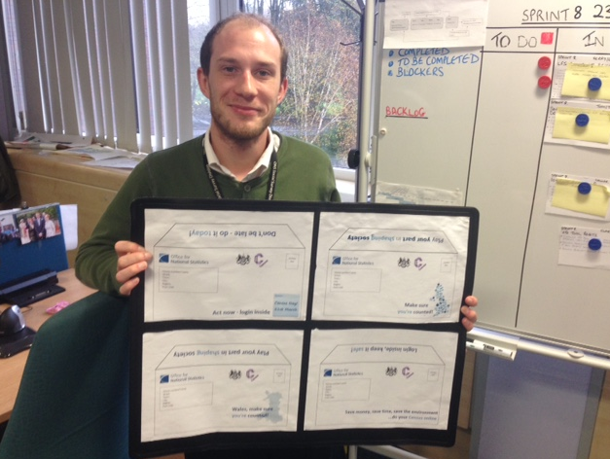
Testing approach
Location: Shopping centre in a town in Wales.
Step 1:
Which, if any, jump out at you?
Step 2:
In-depth probing on individual envelopes

Slide 20
So…which envelope stole the show?

Slide 21
Findings:
Wales map
Wales - because he is welsh and it says 'Wales’
“Both map envelopes but Wales is favourite”
“Wales - because we are in Wales and I am welsh”
Closely followed by…UK map
“UK map - liked the cartoons”
Post-it note and ‘Save…’ message
Indifferent, not as impactful or provocative
Conc: Envelopes with images received the most positive responses!

Slide 22
Map of Wales
Think of this design?
  “Prefer the little pictures on the UK map”, “Like the design and the map is patriotic”, “Like the outline of the map”, “Like the map but prefer the little images on the UK map”, “This is my preferred design”, Preferred UK map because of little pictures, “Like it, very patriotic”
Features jump out
  Map, liked the Wales map – “it's more relevant, Wales is more important”
  Like that it refers to Wales, “The word Wales - proud to be Welsh!”
  Logo’s
How made them feel
  “It would make me feel like I want to open it”
  “I’d like to be counted”, “Make you feel that you are making a difference by being counted”, “Like that it mentions Wales and that I am counted”, “Like the ‘you're counted’ wording, makes it more personal, like you matter”, likes the being counted message - "it's saying be accounted for really"
  “Patriotic”, “Proud to be counted as Welsh”
Tone of words
  Inclusive
  Not too forceful
  Suitable
  Included
Change or the same?
  “Change the map by adding the pictures”
  “Keep the wording for Wales”
  “Change the purple doesn't match the blue”
  “Keep the crown, makes it look important and the Wales map”

Slide 23
UK map
Think of this design?
  “Thought that it drawed you in by the design of the map and being counted”, “Think the design of map is attractive”, “Like the shape of the UK map, it's interesting and pretty”, liked the wording of this, Liked this one "it's pretty”, likes the wording of this design too it "shows the whole of the UK, it's national statistics so it doesn't make sense just to show Wales" Likes the wording too - "it tells you everything you need to know”, likes because it shows “all of the UK”, likes the wording on this too!
Features jump out
  Map
  Make sure you’re counted
How made them feel
  Like the 'be counted' reference
  “Included”, “The worded counted makes me feel included”
Tone of words
  making sure you're counted
  making sure you get your vote
  makes it more personal
Change or the same?
  “Liked to be counted but prefer it to mention Wales”, “like design would prefer it to mention Wales”, “Prefer Wales envelope”

Slide 24
‘Save…”
Think of this design?
  Dominant responses - “Didn't like this - too long winded”, “Basic not that appealing”, “The wording is too long, too much to read - it needs to be snappier”, “Plain, prefer map”, “Too long wouldn't really read this”
  “Do not care as much about saving money, environment, more interested in being counted”
  “Likes the wording here, particularly about saving the environment”, Likes the emphasis of completing online and the savings involved, likes that it saves paper
Features jump out
  Crown
  Census logo (colour)
How made them feel
  “Not interested in the save money, save time”, “It's not really my money that its saving its govt money but perhaps it could say save your communities”, “Makes me feel why should I bother? At my age? Not my responsibility to do this - it is the next generations responsibility”
Tone of words
  Concerned that it would take longer to complete online as you have to get the code then login – “can’t just go ahead and do it”
  “Too detailed might be interested in save money part but not in environment much prefer to be counted”
  “Doesn't appeal to me”, “wouldn't necessarily draw me in”
Change or the same?
  “Make logo bigger and make it about saving personal money more obvious”
  “Shorten sentence and include UK map”
  “Add an image for example a map”
  “Change wording and add map”, “Keep crown, add Wales wording”

Slide 25
Post-it envelope
Think of this design?
  Indifferent about the post-it or thought it wasn’t official looking
  Some liked the date
Features jump out
  Post-it
  Date
  Census logo – “only cos of the colour”, “purple is my favourite colour” – not because of recognising the C!
  “Act now!”
How made them feel
  Sounds formal – “Sounds serious with act now”, “Act now sounds serious”
  “It makes me feel like I should open it as it looks important”
  Doesn’t necessarily look official though... “looks cheap”
Tone of words
  Mixed bag – Thought the wording here was "too bossy", she would ignore this one. “Do not like act now- too forceful”
  Mixed bag – “OK - nothing too strong there”, “Friendly tone and not demanding”
  “Act now not as appealing as being counted”
Change or the same?
  “Don’t' like it”, “Prefer to have a map”, “Change the wording”, “Remove the post-it note - not official”, “Not my favourite

Slide 26
Took forward
Images – explore regional
“Make sure you’re counted” messaging
Crest and logo
Use of the flap

Slide 27
3b. Social Survey pop-up testing
Envelopes (voluntary)

Slide 28
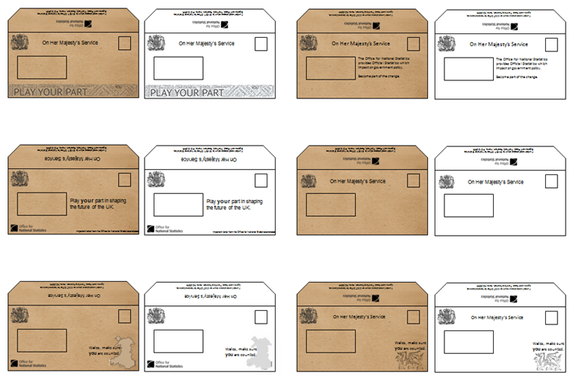
…continuation and expanded

Slide 29
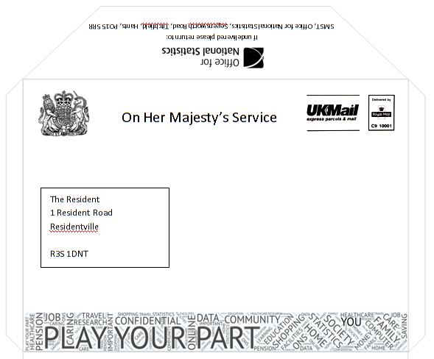
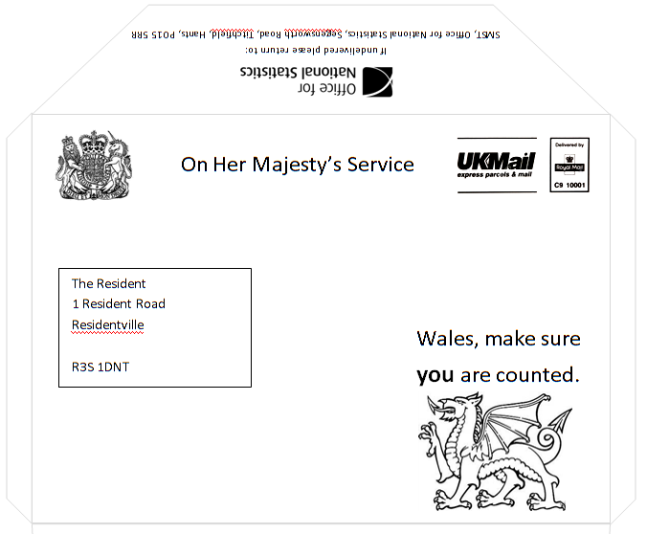
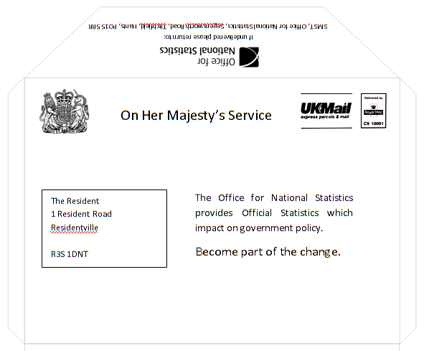
Take a closer look:
Notes:
Aware
Relationship with brand

Slide 30
Findings:
Brown = official, cheaper, environmental
Off-set ‘official’ brown with info about who from
White = less official
Want engagement but not clutter
Regional tested well, again
Envelope
size
Balance – know content/ expectations vs. off-putting
Imagery tested well, again
Inclusion statements: ‘you’, ‘your’, ‘Wales’

Slide 31
4. Questionnaire testing
Engaging designs

Slide 32
4a. Error messages
Engaging messages:
- give us what we want
- respondent confidence

Slide 33
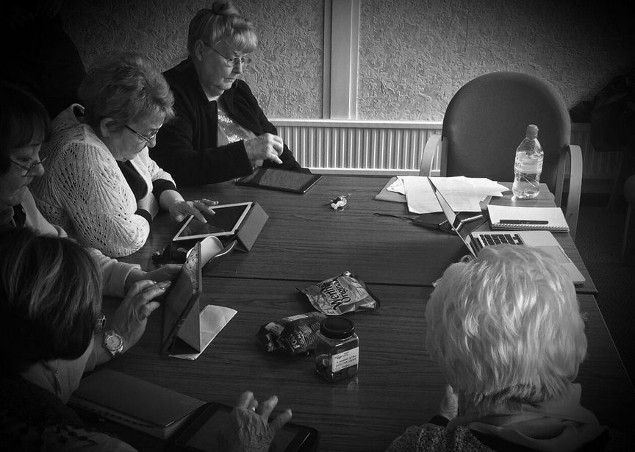
Low skills user testing

Slide 34
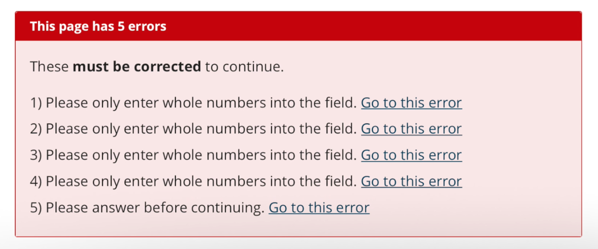
Original approach…

Slide 35
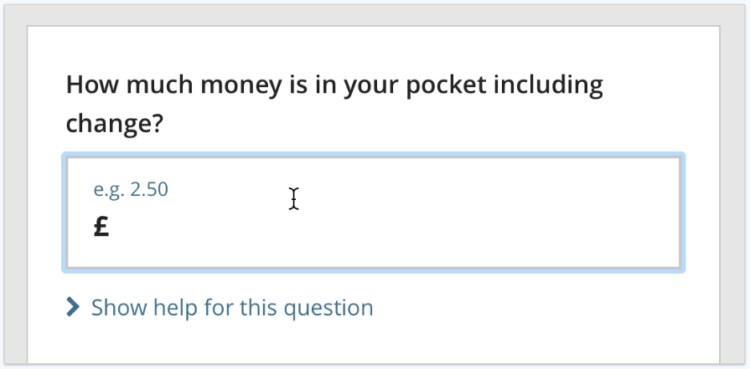
…new error approach
Step 1.

Slide 36
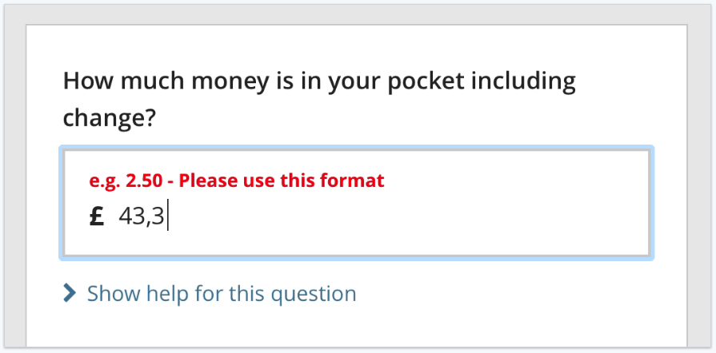
…new error approach
Step 2.

Slide 37
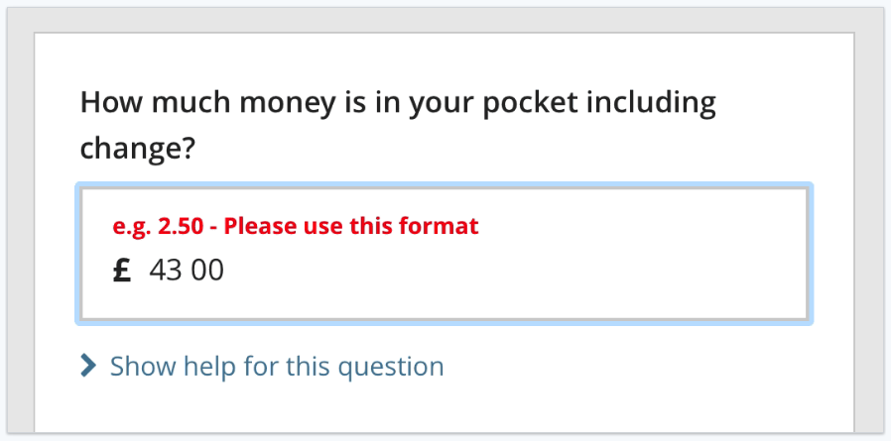
…new error approach
Step 3.

Slide 38
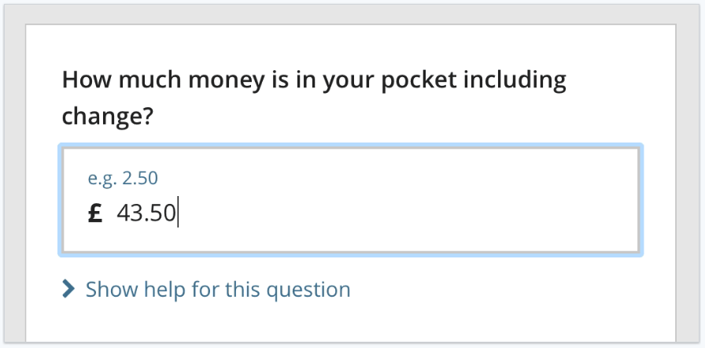
…new error approach
Step 4.

Slide 39
4b. Question design (e.g. ethnicity)
Engaging design:
- give us what we want
- respondent confidence

Slide 40
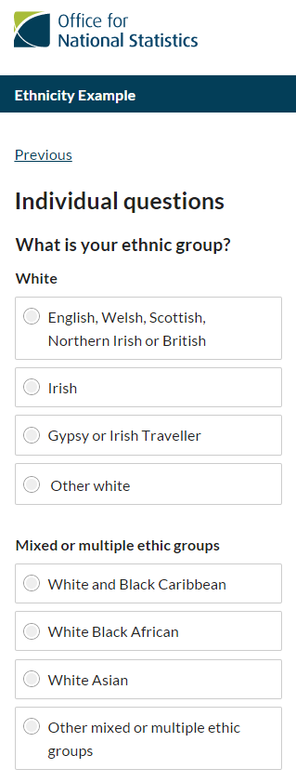
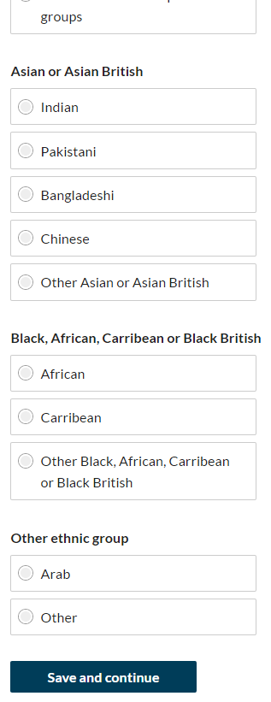
Original
Scrolling design

Slide 41
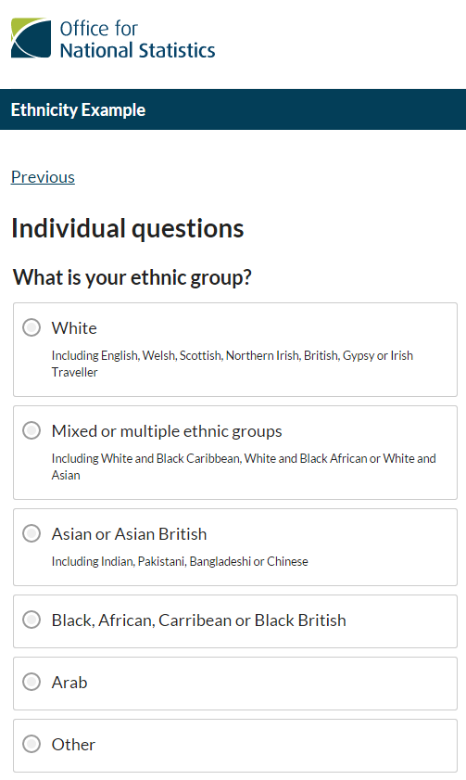
New
Condensed
design
Helping hand!

Slide 42
5. Next steps…
Our journey continues!

Slide 43
Materials
Focus Groups
Experimental quantitative testing

Slide 44
Questionnaire
Cognitive testing
Usability testing

Slide 45
Thank you for listening!
Contact Details:
laura.wilson@ons.gsi.gov.uk

Slide 46
Abstract
Like many other National Statistical Institutes around the world, the Office for National Statistics (ONS) is taking
forward an ambitious programme of work to transform its entire statistical operation for business and social
survey data collection. The two key strategic features of this programme include a commitment to using existing
administrative data sources within the data collection process (from sampling to survey content) as well as
introducing online data collection as the default mode.
For social surveys this vision of a future data collection model presents substantial research and survey
response challenges. All social surveys in the UK are voluntary and achieving response is heavily reliant upon
the rapport built between an interviewer and a potential respondent in a face-to-face interaction. ONS is
investing heavily in researching how best we can create this strong connection with a respondent in an online
self complete approach.
We are taking a mixed approach to address the challenges whereby we are combining traditional research
methods such as in-depth interviewing and focus group with novel methods such as guerrilla pop-up testing to
learn what engages and motivates respondents; our previous research has highlighted the importance of
considering this through the whole respondent journey, from letter to questionnaire. We are also considering
the value of taking a behavioural economic approach, promoted with considerable success of the UK's
Behavioural Insight team. In doing this we are applying four main principles to any interaction - make it Easy,
Attractive, Social and Timely. Today’s society is very much transactional therefore we are focusing on the
reciprocity technique with the aim of ‘giving back’ to the respondent to enhance their experience and harness a
commitment from them to take part in our surveys. This talk focuses on the work being done by ONS' Survey
Data Collection Research team to develop a respondent focused experience.

Slide 47

Video

Slide 48
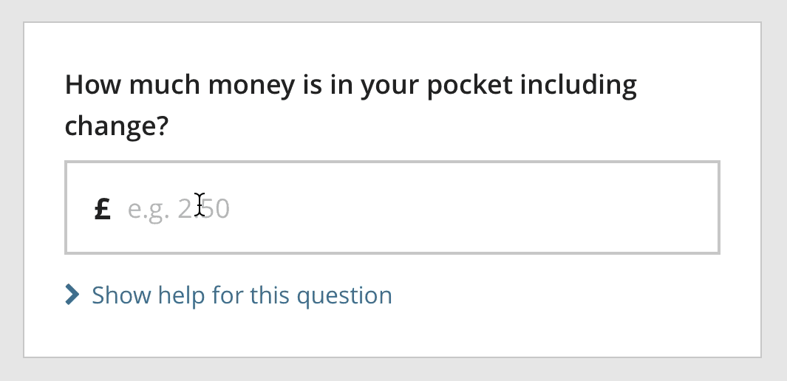
.gif

