Slide 1
Developing Instruments for All-Electronic Data Collection from Business Establishments: Pretesting Methods and Processes for Re-engineering the
2017 Economic Census
Amy Anderson Riemer
Jennifer Beck
Alfred Tuttle
U.S. Census Bureau
Any views expressed on statistical, methodological, or technical issues are those of the authors and not necessarily those of the U.S. Census Bureau.
Notes:
The Economic Census, conducted every 5 years by the U.S. Census Bureau, collects detailed business data for approximately 4 million establishments nationwide. Until now, data were collected using multiple self-administered modes. Electronic instruments were offered in addition to paper questionnaires, with design and content tailored by size and industry. Due to special reporting requirements for companies with many locations, larger companies were required to download software to their computers and use it to enter and upload data. Small companies were offered a simpler Web-based application because they did not need the same types of functionality that facilitated reporting and reduced burden for larger companies.
For the 2017 Economic Census, we are re-engineering the electronic instruments and consolidating them into one application on the Web for all respondents, regardless of size. In addition, paper questionnaires will no longer be available. Given the magnitude of this change, and the potential impact on respondents, we developed a multi-year, multi-method/stage research plan to identify system requirements and test early versions.
In addition, the 2017 Economic Census must introduce a new framework for collecting details about sales of products, according to the North American Product Classification System (NAPCS). Implementing the new NAPCS structure presents additional challenges for the new electronic instrument, yet takes advantage of electronic design features well suited for presenting and collecting long detailed lists that may contain more than a hundred items.
This paper will provide an overview of these various research endeavors, along with a discussion of the benefits and drawbacks associated with this research plan. We will discuss the methodological and practical challenges faced in creating and conducting this research, including lessons learned.

Slide 2
Outline
Background
Re-engineering process
Challenges

Slide 3
Developing Instruments for All-Electronic Data Collection from Business Establishments: Pretesting Methods and Processes for
Re-engineering the 2017 Economic Census
Notes:
Let me start by breaking down the title of this presentation to give you background about my goals.

Slide 4
Developing Instruments for All-Electronic Data Collection from Business Establishments: Pretesting Methods and Processes for
Re-engineering the 2017 Economic Census
Notes:
My presentation is going to focus on the pretesting methods that we used

Slide 5
Developing Instruments for All-Electronic Data Collection from Business Establishments: Pretesting Methods and Processes for
Re-engineering the 2017 Economic Census
Notes:
The focus is on the 2017 Economic Census and the PROCESS for re-engineering

Slide 6
Developing Instruments for All-Electronic Data Collection from Business Establishments: Pretesting Methods and Processes for
Re-engineering the 2017 Economic Census
Notes:
Which is an establishment survey

Slide 7
Developing Instruments for All-Electronic Data Collection from Business Establishments: Pretesting Methods and Processes for
Re-engineering the 2017 Economic Census
Notes:
As we are developing the final instrument.

Slide 8
Developing Instruments for All-Electronic Data Collection from Business Establishments: Pretesting Methods and Processes for
Re-engineering the 2017 Economic Census
Notes:
And, it’s going to be 100% electronic for the first time.

Slide 9
Economic Census
Conducted every 5 years
Over 4 million establishments
Snapshot of the U.S. economy
Input to key economic reports such as the GDP
Data collection across a variety of industries
Collection of establishment level data
  Employment and payroll
  Sales, receipts, revenue
  Shipments
  Operating expenses
Notes:
Nearly 4 million businesses
In addition to the Economic Census I’m going to mention two other related surveys that are collected annually between census years. I will explain in a minute how all three are related.

Slide 10
Company Organization Survey (COS)
Collected annually
Obtain current organizational and operating information on multi-establishment firms
  Operating status
  Payroll and employment
Used to maintain company affiliation and location information in the Business Register

Slide 11
Annual Survey of Manufactures (ASM)
Collected annually
Provide input/output measures between census years of manufacturing activity at the establishment level
  Payroll and employment and hours
  Cost of materials
  Selected operating expenses
  Capital expenditures
  Inventories
Updates various economic statistics (e.g., GNP, I/O tables, PPI)

Slide 12
How are these three surveys connected?
They are all establishment based collections
  Establishment based collection is at the physical location
  Other economic surveys are collected at a company level
The COS/ASM collect a subset of the same information collected during the Economic Census
  Census of Manufactures is the ASM PLUS additional questions
Notes:
We definitely collect other economic data annually, quarterly and monthly, but those are mostly company level collection

Slide 13
Electronic Data Collection
Same tool used to collect data from all three surveys
  Implement major changes to the instrument or collection strategy during non-census years
  Allows for adjustments and preparation before the economic census

Slide 14



Electronic Data Collection Method
Software via CD
Software
via Web
Web Survey –
Small companies
Web Survey –
ALL companies
1997
2000
2012
2016

Slide 15
Electronic Reporting History
1997 – Census of Retail offered a CD-Rom
1998 – 50 companies invited to download COS from the Web
2000 – All COS companies could download from the Web
2002 – Economic Census download from the Web
2007 – Economic Census download from the Web
2012 – Single-location companies could complete their form on the Web; multi-location companies had to download software from the web
2015 – No paper option
2016 – COS/ASM only on the Web
2017 – All Economic Census on the Web
Notes:
In 2012 we made a big change and allowed single-location businesses to respond via Web. We knew that these companies were very interested in getting away from downloading software. They wanted to access the forms quickly and they didn’t need all of the features that were built into the software.
Starting in 2016, all respondents will be moving to the web
Collection year versus reference year

Slide 16
Outline
Background
Re-engineering process
Challenges

Slide 17
Re-engineering Process
Requirements Analysis
Design
Test
Implement
Evaluate
Notes:
User experience lifecycle

Slide 18
Re-engineering Process
Requirements Analysis

Slide 19
Requirements Analysis
Internal – gather list of changes & features to keep
  Past experience w/ instrument (good & bad)
  Recommended improvements
External – Task Analysis with respondents
Notes:
Internal – key stakeholders such as analysist and developers

Slide 20
Response Process Model for Establishment Surveys
Willimack and Nichols (2010)
Encoding in Memory/Record Formation
Selection / Identification of Respondent(s)
Assessment of Priorities (Motivation)
Comprehension
Retrieval (from memory and/or records)
Judgement
Communication
Release of the Data
Notes:
During our task analysis we took into account the Response process model.
Cantor and Edwards

Slide 21
Response Process Model for Establishment Surveys
Willimack and Nichols (2010)
Encoding in Memory/Record Formation
Selection / Identification of Respondent(s)
Assessment of Priorities (Motivation)
Comprehension
Retrieval (from memory and/or records)
Judgement
Communication
Release of the Data
Notes:
We focused on these parts of the model and how an electronic instrument affects each piece.

Slide 22
Comprehension
Do you need to preview the questions in order to orient you to the survey?
When do you need to see this information?
What format do you want this?
  A form?
  A worksheet?
  A list of questions?
Notes:
Comprehension – understanding the request; interpreting the meaning of the questions;

Slide 23
Retrieval
Where do you go to gather the information?
  Records / others
Do you have access to all of the information that you need?
How are you gathering information from others?
  Sending spreadsheets, exact copies of the questions/instructions, summary of the question
What format are your records in?
Can the electronic survey help this process?
  Delegate function
Notes:
Retrieval – this is the act of knowing where in the organization or their records the right information is at along with identifying their ability to access that information.
During a task analysis we want to know how R’s would go about their records retrieval task in order to identify how they may or may not be using the electronic instrument, paper form, or other materials to assist in this task. We are also looking for what we COULD build to help with this task.

Slide 24
Communication
How are you inputting the data into the instrument?
  Do you gather the data outside of the instrument and then input the data when it’s complete?
  Do you input the data as you go through the form?
Notes:
Communication –reporting the response. Identify if they are entering data directly into the electronic form as they move through it. Are they doing a preview of the questions? How? Do they jot down answers on a worksheet or the paper form first and then just do data entry of their data?

Slide 25
Release of the Data
What steps do you need to go through before submission?
  Reviewing data?
  Reconciling to aggregate totals?
  Supervisory review?
How can the instrument help you with these tasks?
Do you need to keep copies for your records?
  What format do you want (paper/electronic)?
Notes:
Release – review/verification/ reconciliation – how are they doing a review of their data in the instrument. Do they have to involve managers? How do they do that with their instrument. Are they using any other tools do a reconciliation?

Slide 26
Re-engineering Process
Design

Slide 27
Design
Prototypes were built using early requirements
Semi-functioning instruments

Slide 28
Developing Prototypes
Goal
  Visually display design ideas for testing with respondents
  Could get early feedback from respondents
  Developers didn’t need to spend time mocking up early designs
  Provide a visual along with written requirements

Slide 29
Prototype Challenges
Prototypes aren’t always reflective of the final system
Limited functionality
Require repondents to“pretend”
Time consuming for researchers to develop

Slide 30
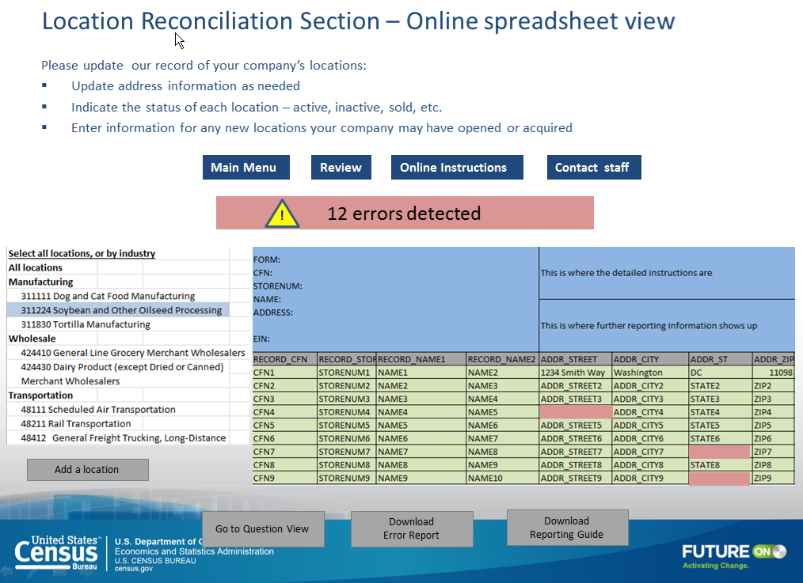
Prototype Example
Nov 2014
Notes:
Testing placement of features

Slide 31
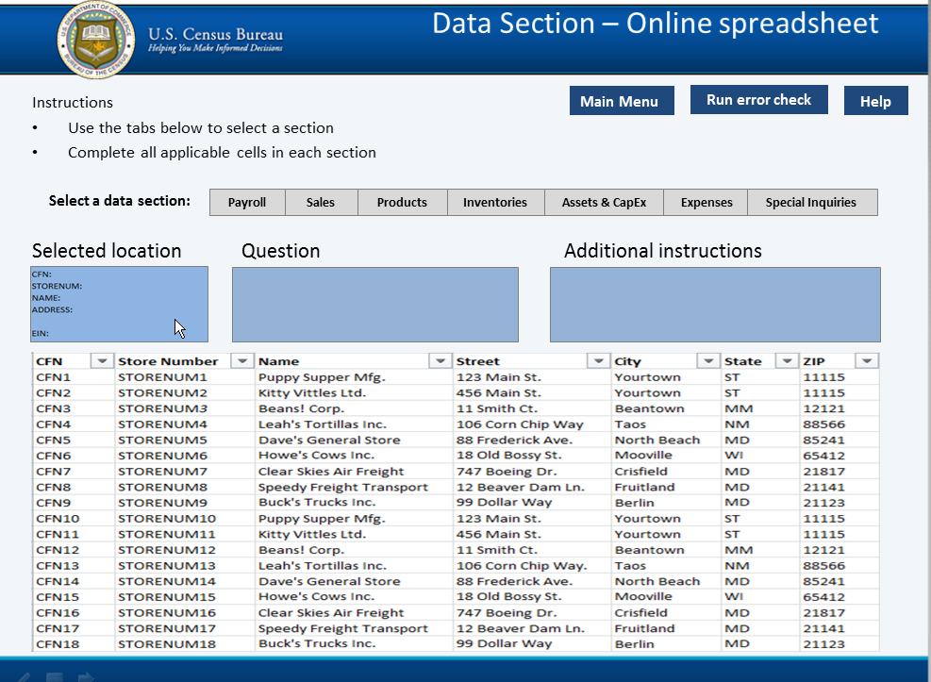
Prototype Example
May 2015

Slide 32
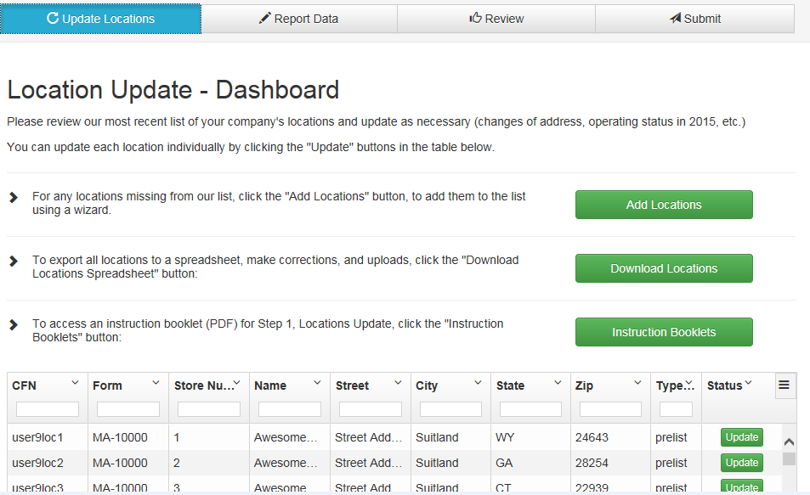
Prototype Example
September 2015
Notes:
In SharePoint!!! Limited interaction

Slide 33
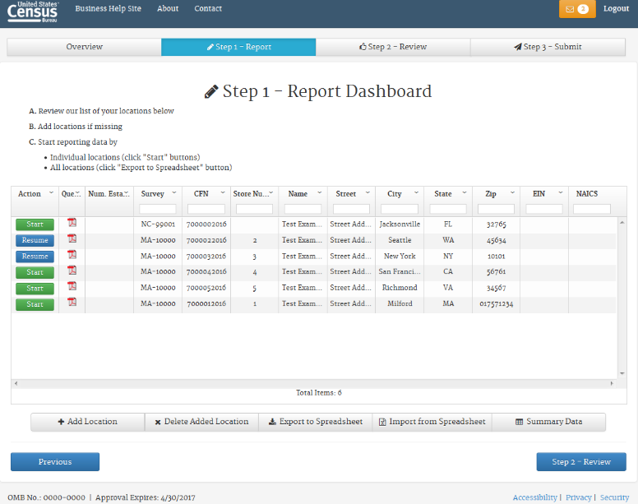
Semi-functioning Instrument
July & October 2016
Notes:
In the system

Slide 34
Re-engineering Process
Test

Slide 35
Test
Usability Testing
  Multiple rounds
  Separate testing with single-location and multi-location companies
  Tested at the respondents location
    Prototypes on laptops
    Instruments on respondents PC

Slide 36
Re-engineering Process
Implement

Slide 37
Implement
2015 ASM/COS - Updated Web design for single-location companies launched
2016 ASM/COS – All web collection
2017 Economic Census – All web collection

Slide 38
Re-engineering Process
Evaluate

Slide 39
Evaluate
Paradata Analysis
Respondent Debriefings

Slide 40
Evaluate
Paradata Analysis
  Reviewed 2015 single location web activity
    Troublesome screens/questions, indicators of burden, use of features/functions
  Reviewed use of software features from 2015 ASM software
    Frequency of screens and features used
  Plans for analyzing data from 2016 COS/ASM and 2017 Economic Census

Slide 41
Evaluation
Respondent Debriefings
  Debriefings conducted after 2015 ASM/COS collection
  Debriefings planned after 2016 ASM/COS and 2017 Economic Census
  Goals
    Evaluate overall experience
    Target specific features

Slide 42
Outline
Background
Re-engineering process
Challenges

Slide 43
Challenges
Large survey = lots of stakeholders
  Multiple teams
  Movement on and off teams
  Keeping open communication
Scheduling far enough in advance, but not too far
  Dependent on programmers’ schedules
  Adjusting for delays

Slide 44
Challenges
Establishment respondents aren’t one-size-fits all
Not all stakeholders or respondents were ready to give up certain features
Fitting research into a production environment
Resources
Get out there and test!
Notes:
There is a reason that we developed a web instrument for single locations separately from multi-locations.
We could sit and tinker with the instrument forever, but at some point you have to take what you have and get out there even if it has problems or bugs. Waiting just delays getting that valuable feedback from Rs.

Slide 45
Developing Instruments for All-Electronic Data Collection from Business Establishments: Pretesting Methods and Processes for Re-engineering the
2017 Economic Census
Amy Anderson Riemer
Amy.E.Anderson.Riemer@census.gov
Any views expressed on statistical, methodological, or technical issues are those of the authors and not necessarily those of the U.S. Census Bureau.
Notes:
The Economic Census, conducted every 5 years by the U.S. Census Bureau, collects detailed business data for approximately 4 million establishments nationwide. Until now, data were collected using multiple self-administered modes. Electronic instruments were offered in addition to paper questionnaires, with design and content tailored by size and industry. Due to special reporting requirements for companies with many locations, larger companies were required to download software to their computers and use it to enter and upload data. Small companies were offered a simpler Web-based application because they did not need the same types of functionality that facilitated reporting and reduced burden for larger companies.
For the 2017 Economic Census, we are re-engineering the electronic instruments and consolidating them into one application on the Web for all respondents, regardless of size. In addition, paper questionnaires will no longer be available. Given the magnitude of this change, and the potential impact on respondents, we developed a multi-year, multi-method/stage research plan to identify system requirements and test early versions.
In addition, the 2017 Economic Census must introduce a new framework for collecting details about sales of products, according to the North American Product Classification System (NAPCS). Implementing the new NAPCS structure presents additional challenges for the new electronic instrument, yet takes advantage of electronic design features well suited for presenting and collecting long detailed lists that may contain more than a hundred items.
This paper will provide an overview of these various research endeavors, along with a discussion of the benefits and drawbacks associated with this research plan. We will discuss the methodological and practical challenges faced in creating and conducting this research, including lessons learned.

