Slide 1
Balancing Utility and Confidentiality in Designing Survey Data Collections and Reporting Systems
  Yan Wang and Miles Painter
    American Institutes for Research
November 2016

Slide 2
ED School Climate Surveys (EDSCLS)
In response to a 2013 White House initiative to provide schools, districts, and states with the reliable, actionable data that are needed to foster positive school climates, the Office of Safe and Healthy Students (OSHS) provided funding to the National Center for Education Statistics (NCES) to produce EDSCLS - a school climate measurement and reporting system.
EDSCLS consists of four surveys for students in grades 5-12, their parents, instructional staff, and noninstructional staff (including principals).
EDSCLS covers 3 domains – Engagement, Safety, and Environment
EDSCLS platform is open-source and has an automated security updating function.

Slide 3
EDSCLS Development Priorities
The development priorities were to:
allow schools and school systems to implement their own school climate information collection
help schools and school systems adhere to high data collection and reporting standards
enable automated data processing and reporting procedures
provide a means for schools and school systems to obtain statistically sound and useful information

Slide 4
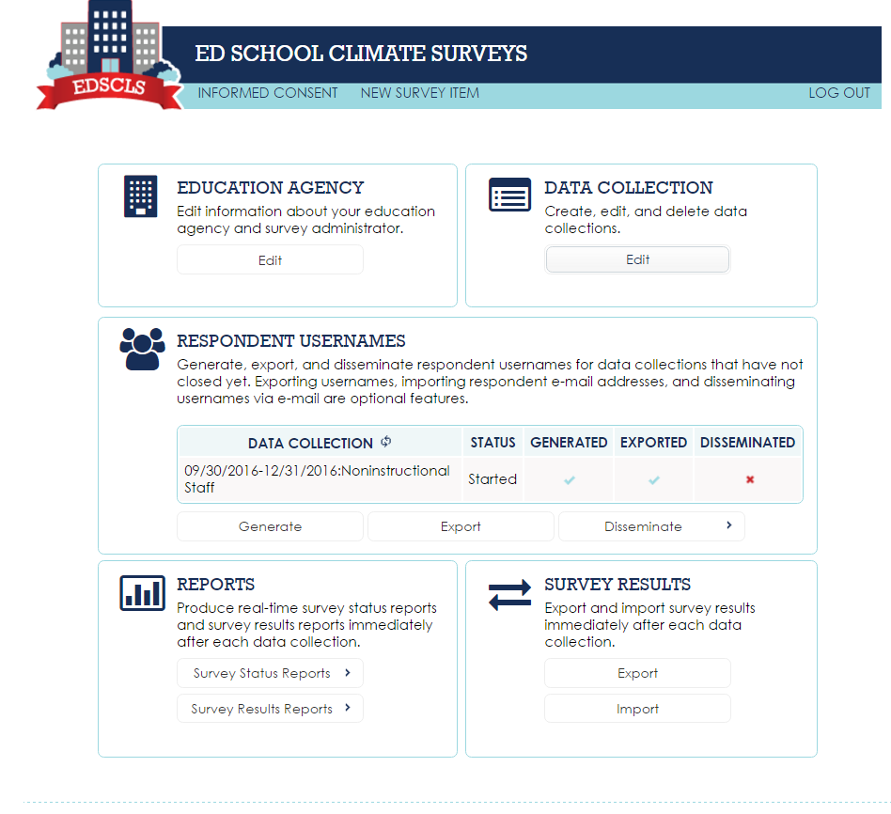
Administrator Dashboard
Education Agency: edit information about the education agency and the Survey Administrator
Data Collection: create, edit, and delete data collections
Respondent Usernames: generate, export, and disseminate random usernames
Reports: produce various types of reports
Survey Results: export and import survey results.

Slide 5
Trade-offs Between Utility and Confidentiality

Slide 6
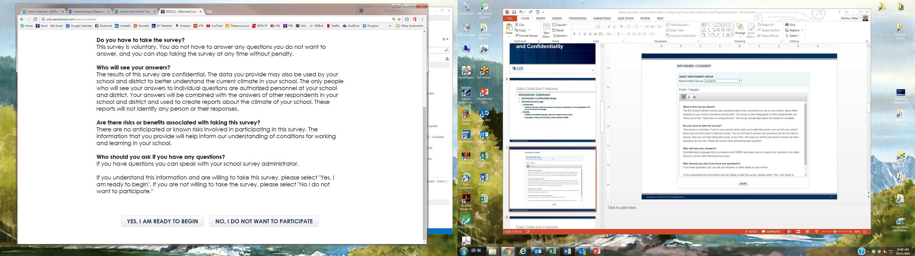
Data Collection Features
Administrator’s Dashboard
  Administrator’s confidentiality pledge
  Informed consent page
    Confidentiality
      Students, teachers, staff, and parents can choose to participate or not to participate
    Flexibility
      Prefilled, but editable language, about the content of the surveys
      Language on data use to be filled by data collection entities

Slide 7
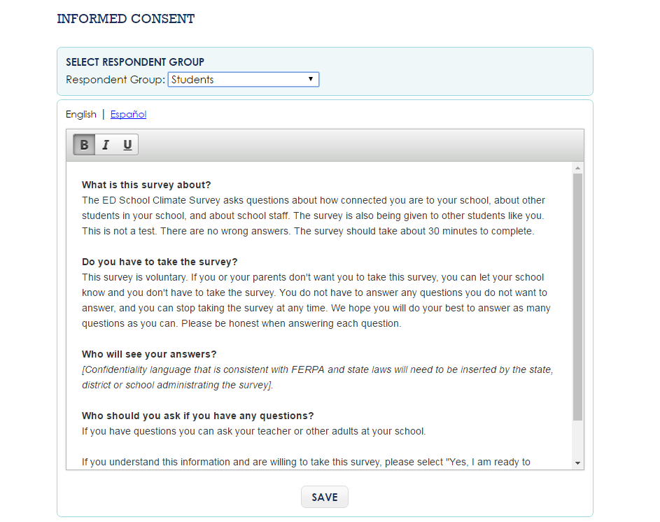

Slide 8
Data Collection Features
  Generate usernames
    Confidentiality
      Usernames are randomly generated alphanumeric codes
      Doesn’t allow predetermined usernames
    Flexibility
      usernames can be generated at any time when the data collection is open
      Students, teachers, staff, and parent usernames start with their unique letters “S”, “T”, “N”, and “P”

Slide 9
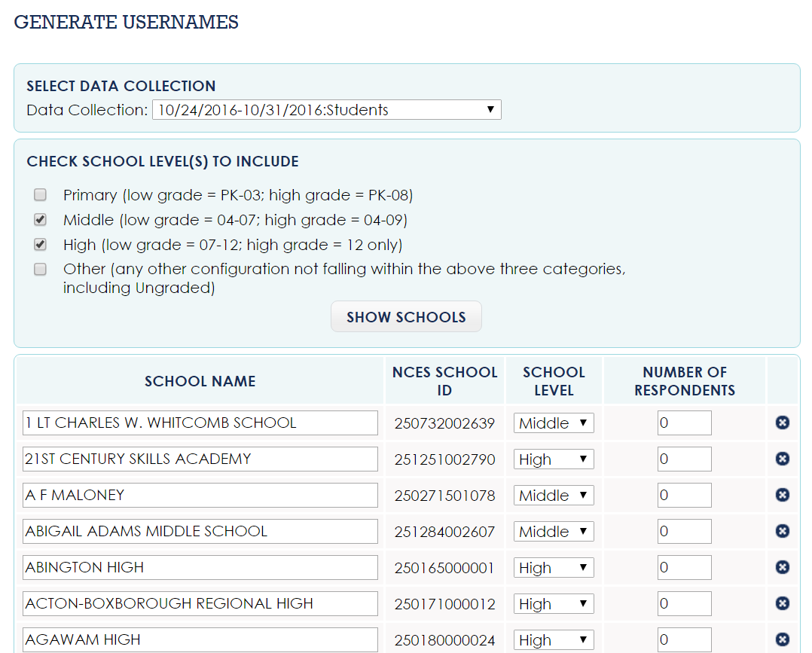

Slide 10
Data Collection Features
  Disseminate usernames
    Confidentiality
      Option to export usernames to disseminate manually
    Flexibility
      Email dissemination through EDSCLS system after adding participants’ emails

Slide 11
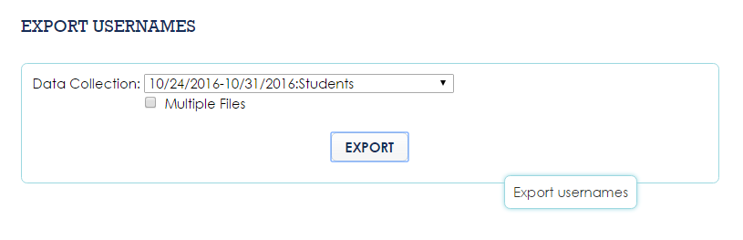
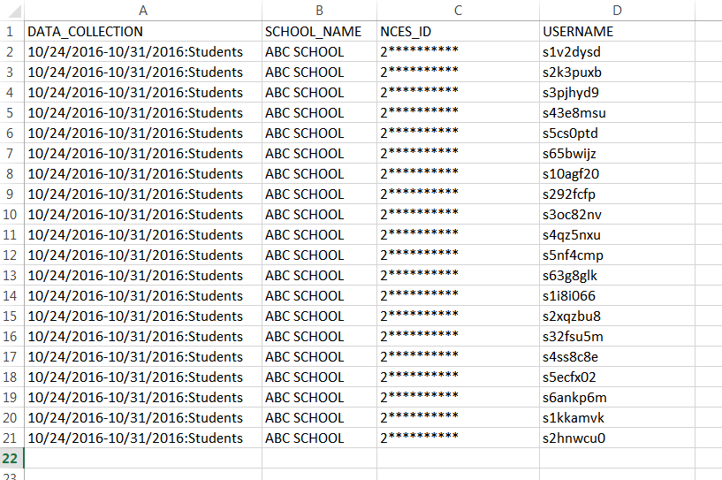

Slide 12
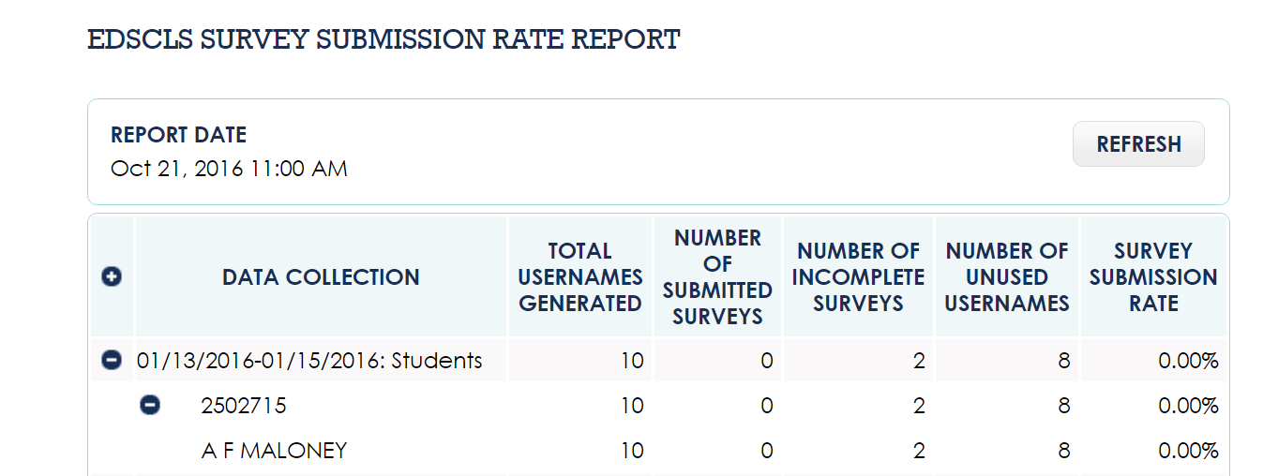
Data Collection Features
  Monitor Data Collection
    Confidentiality
      In addition to usernames, each participant receives a pin when they log in to the survey for re-entry if necessary. The pins are not accessible to administrators.
      After re-entry, the survey starts from the one question after the last answered question and there is no navigation back to the earlier questions to protect responses.
    Flexibility
      Submission rate is provided based on usernames, and incomplete usernames are identified for general or targeted follow up.
****
****

Slide 13
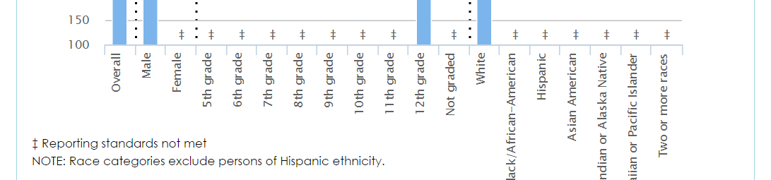
Data Reporting Features
  Survey results reports
    Flexibility
      Item frequency reports provide item by item response distributions
      Crosstab tabulations allow for nonresponse bias analysis on background variables (e.g., race, ethnicity, and grade)
      Scale score reports provide a holistic view of how respondents perceive one aspect of school climate (e.g., by topics or domains)
      Reports can be exported to EXCEL, CVS, and PDF
    Confidentiality
      For any reporting categories, if the number of respondents is less than 10, the results will be suppressed.

Slide 14
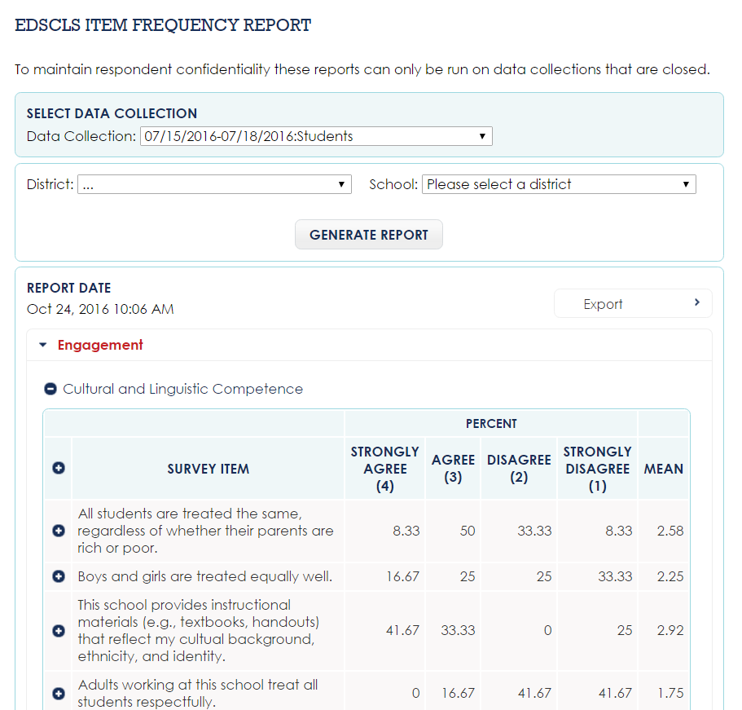
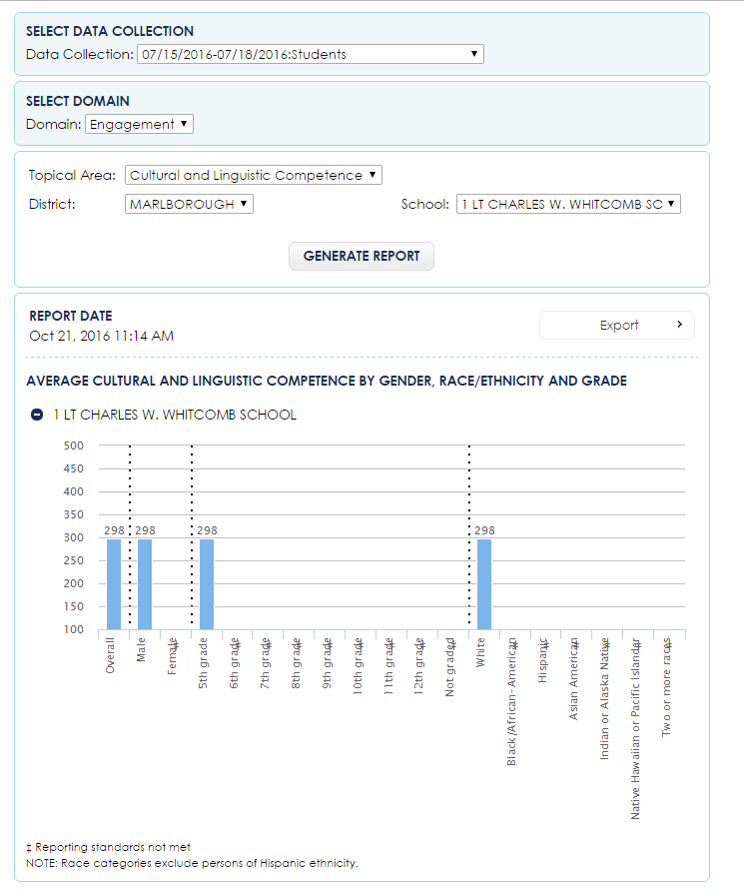
****
****

Slide 15
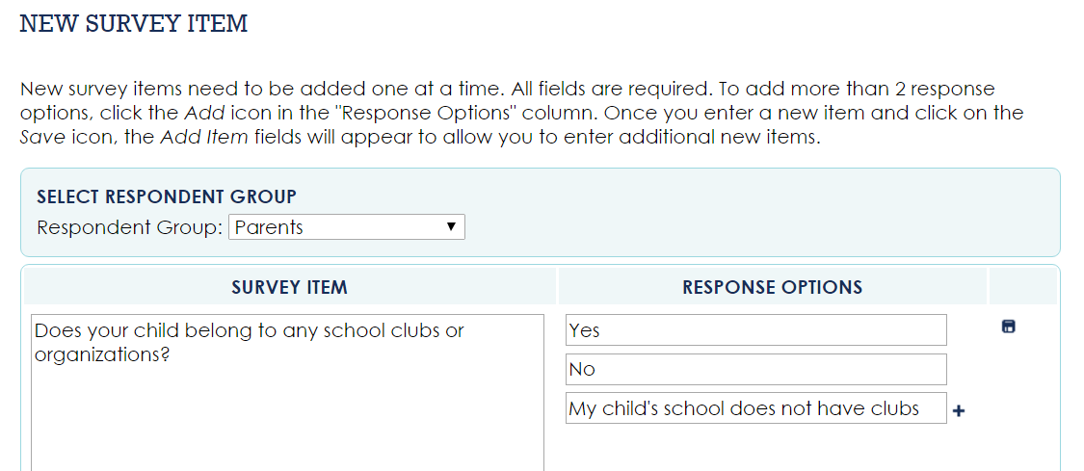
Data Reporting Features
  Add new items
    Confidentiality
      Only contains limited background questions – race, gender, grade (student only), and years of experience (teacher and staff only)
    Flexibility:
      Additional items can be added before the start of a data collection

Slide 16
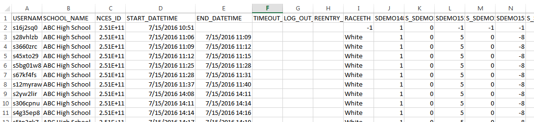
Data Reporting Features
  Export survey data
    Flexibility
      Agencies can further analyze the data or analyze data over the years
      Students data can be linked if linkage to the usernames is maintained outside of the platform
    Confidentiality
      Responses from teachers, staff, and parents are not linked to their usernames or emails even if usernames are disseminated through EDSCLS system. New random IDs are generated for each response.

Slide 17

Released Platform and User Support
  EDSCLS platform has been released. For more details on survey items, reporting features, administration guides, and other resources, please visit: https://safesupportivelearning.ed.gov/edscls

Slide 18
Thank You!
Yan Wang and Miles Painter
202-403-6568
ywang@air.org and mpainter@air.org
1000 Thomas Jefferson Street NW
Washington, DC 20007-3835
General Information: 202-403-5000
www.air.org

