Slide 1
Sample Adequacy Criteria: A Quality Assessment of Community involvement in Core Activities Related to Certification and Maintenance of Certification Examination Development
Gerald Arnold, Robin Guille (ret.), & Rebecca Lipner
2016 International Conference on Questionnaire Design, Development, Evaluation, and Testing (QDET2)
CS12 - Sample Design and Incentive Considerations
in Pretesting and Development
Miami, Florida
Thursday, November 10, 2016

Slide 2
What is the problem?
Certification by secure exam is time-limited
Community engagement Diplomates in exam blueprints reviews (previously 6-10 committee members).
Initial certification (eligibility) versus maintenance of certification (keeping up)
Exam blueprints have hundreds of testing points
Response sufficiency and representativeness

Slide 3
Testing Construct
Maintain competence and currency in the knowledge and judgment required for practice.
Diagnosis and management of prevalent conditions, focus on practice changes.
Rare conditions, limit to physician interventions with important patient consequences.
For conditions usually managed by other specialists, focus on recognition rather than on management.

Slide 4
Relative frequency in practice; then rate the relative importance of tasks
  Making diagnosis (P)
  Ordering and interpreting test results (Q)
  Recommending treatment (R)
  Assessing risk and principles from epidemiologic studies (S)
  Understanding pathophysiology of disease and basic science knowledge of care (T)

Slide 5
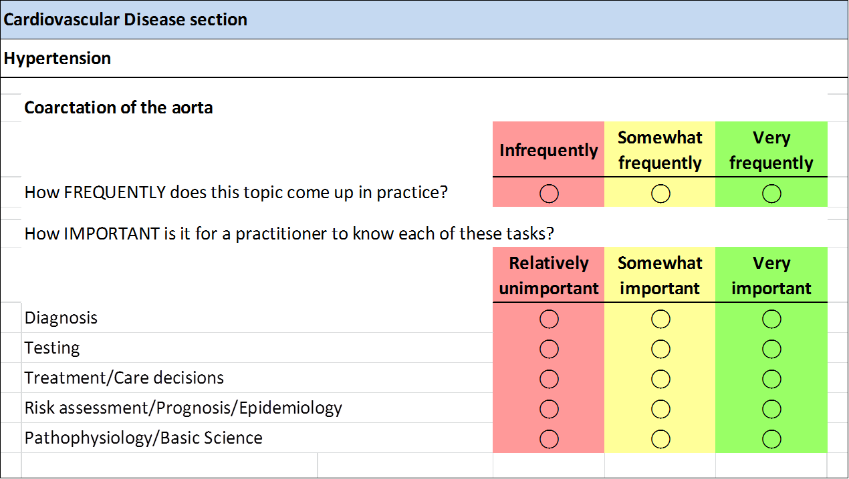
Background: Review Format
Notes:
Coarctation of the aorta is a birth defect in which a part of the aorta is narrower than usual.If the narrowing is severe enough and if it is not diagnosed, the baby may have serious problems and may need surgery or other procedures soon after birth. For this reason, coarctation of the aorta is often considered a critical congenital heart defect(http://www.cdc.gov/ncbddd/heartdefects/screening.html). Detection of the defect is often made during a physical exam. In infants and older individuals, the pulse will be noticeably weaker in the legs or groin than it is in the arms or neck, and a heart murmur—an abnormal whooshing sound caused by disrupted blood flow—may be heard through a doctor’s stethoscope. Older children and adults with coarctation of the aorta often have high blood pressure in the arms.
(CDC) estimates that about 4 out of every 10,000 babies are born each year in the United States with coarctation of the aorta
No matter what age the defect is diagnosed, the narrow aorta will need to be widened once symptoms are present. This can be done with surgery or a procedure called balloon angioplasty.

Slide 6
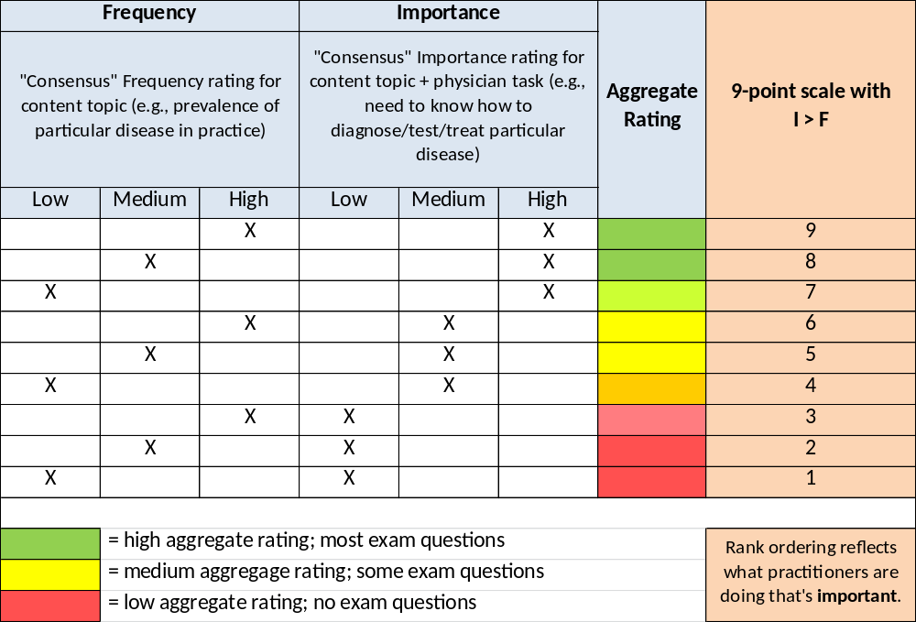
Background: Aggregated (9-point) Rating Scale
9-pt Scale = 3*Importance + Frequency - 3

Slide 7
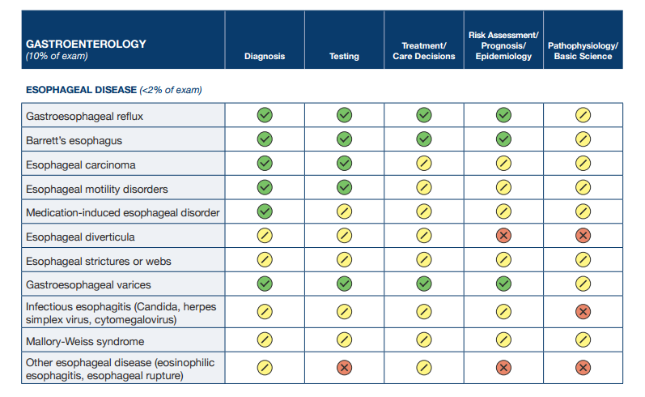
Background: Published Blueprint Format
– High Importance: Most exam questions will address topics in these categories
– Medium Importance: Some exam questions will address topics in these categories
– Low Importance: No exam questions will address topics in these categories

Slide 8
What has been done before?
“statistical inference from responses from a sample to a larger target population”
Strategy | Example
Convenience samples | Opt-in samples
Weighting | Post-stratification
Experiments | 2-group RCT
Large sample inference | Web-scraping
Observational studies | Case-control, cohort studies
Matched samples | Propensity Matching
Quality indices | R index: 1-2*sd(p)

Slide 9
Is the Sample Adequate?
  Are there enough reviewers to assess representativeness with 80% power using α =.05?
  Yes: sample ≥ 290, proceed to 2
  No: keep inviting Diplomates
Are there enough reviews per section?
  Yes: ≥ 12/section, proceed to 3
  No: keep inviting Diplomates & ask raters to do more sections
Is the sample representative? (At this point: sample ≥ 290, 12/section)
  Yes: Sample characteristics similar to population, sample shows little bias – may stop sampling and use unweighted sample ratings for blueprint review
  No: sample ≥ 290 but sample characteristics differ from population and sample shows evidence of bias – may stop sampling but use weights to correct for biases
Notes:
Notes: Rationales for Sample sizes:
290 provides a sample precision of ± 10% points with 90% confidence or provides 81% % power to detect a differences between 220 volunteer reviewers and a random sample of equal size from the non-respondents to the review invitation on the four auxiliary variables using a Chi-squared test with a significance criterion of alpha = .05
12 reviewers per section gives a rater reliability of .80 per section
220 provides 78% power to detect a differences between 220 volunteer reviewers and a random sample of equal size from the non-respondents to the review invitation on the four auxiliary variables using a Chi-squared test with a significance criterion of alpha = .10. The tests assess whether respondents and non-respondents differ significantly.
Average standardized mean differences between MOC population and sample on 4 auxiliary variables < .15 indicates the sample is similar to the population
Representativeness and Bias indices suggest that the samples have minimal bias when Representativeness Index, R and Balance Index, B are > .9, R or B indices ≤ .8 suggest serious bias. Maximum Bias index, CV(I) < .1

Slide 10
What happened?
Specialty | Eligible Pool | Sample
Cardiology | 14,081 | 441
Gastroenterology | 8,297 | 377
Critical Care | 7,916 | 303
Oncology | 6,641 | 354
Nephrology | 5,893 | 336
Endocrinology | 3,536 | 257
Rheumatology | 2,888 | 232

Slide 11
What happened?
Specialty | Propensity Score | C
Cardiology | .04 (.01) | .68
Gastroenterology | .05 (.02) | .70
Critical Care | .04 (.02) | .65
Oncology | .07 (.02) | .69
Nephrology | .08 (.03) | .67
Endocrinology | .09 (.04) | .69
Rheumatology | .10 (.04) | .72

Slide 12
Is Sample Representative of Population?
NO, weights needed
MOC Population: 5,893
Sample: 336
Characteristic |  | %
Age in years | <44 yrs. | 42%
 | ≥44 yrs. | 58%
Sex | Female | 28%
 | Male | 72%
%Time direct patient care | <50% | 8%
 | 50-99% | 71%
 | 100% | 21%
Regions | NE/MW | 41%
 | S/W | 57%
 | Other | 2%
Characteristic |  | % | δ | Δ’
Age in years | <44 yrs. | 37% | .18 | .07
 | ≥44 yrs. | 63%
Sex | Female | 21% | .18 | .01
 | Male | 79%
%Time direct patient care | <50% | 14% | .33 | .19
 | 50-99% | 71%
 | 100% | 15%
Regions | NE/MW | 46% | .14 | .00
 | S/W | 50%
 | Other | 3%
12
Notes:
Sample Size ≥ 290? No, emergency count ≥ 220? Yes
Note: N=336 with 288 from MOC population , 4.8% response rate
Average Distance (δ) for four auxiliary variables ≤ .15? Yes, average distance = .21, after weighting the Average Distance (Δ’) reduced to .067 (68%)
Note: All variables are biased after weighting only DPC remains biased
Does the sample need to be weighted to correct for biases? Yes, unweighted ratings are insufficient.
Notes: The P-values for the bias studies are based on comparing the respondent sample to 1000 unrestricted random samples of non-respondents (sampled with replacement). Each auxiliary variable from the respondents is compared to the same variable in the non-respondent samples. A median and 90% coverage range are estimated. The goal is to see whether the p-values are greater than or equal to .025. Other criteria Representativeness Index (R) > .9, Balance Index (B) > .9, Maximal Bias Index (CV(I)) < .1
P-values – Median (5% to 95%): Sex .04 (.0008 to .499); age .25 (.016 to .922); dpc .028 (.0004 to .389); region .23 (.011 to .777)
R = .948; B = .987; CV(i) = .46 – biases from all variables.

Slide 13
Is Weighted Sample Representative of GAST Population? Yes!
Sample: 377
MOC Population: 8,297
Characteristic |  | %
Age in years: | <44 yrs. | 31%
 | ≥44 yrs. | 69%
Sex: | Female | 18%
 | Male | 82%
%Time direct patient care: | <50% | 4%
 | 50-99% | 55%
 | 100% | 41%
Regions: | NE/MW | 45%
 | S/W | 54%
 | Other | 1%
Characteristic* |  | % | Δ
Age in years: | <44 yrs. | 37% | .13
 | ≥44 yrs. | 63%
Sex: | Female | 17% | .03
 | Male | 83%
%Time direct patient care: | <50% | 6% | .12
 | 50-99% | 49%
 | 100% | 45%
Regions: | NE/MW | 44% | .02
 | S/W | 55%
 | Other | 1%
13
Notes:
Sample Size ≥ 290? yes
Note: N=377, 4.5% response rate
Average Distance (δ) for four auxiliary variables ≤ .15? Yes, average distance = .09
Does the sample need to be weighted to correct for biases? yes, unweighted ratings are insufficient.
Notes: The P-values for the bias studies are based on comparing the respondent sample to 1000 unrestricted random samples of non-respondents (sampled with replacement). Each auxiliary variable from the respondents is compared to the same variable in the non-respondent samples. A median and 90% coverage range are estimated. The goal is to see whether the p-values are greater than or equal to .025. Other criteria Representativeness Index (R) > .9, Balance Index (B) > .9, Maximal Bias Index (CV(I)) < .1
P-values – Median (5% to 95%): Sex .63 (.15 to .93); age .26 (.03 to .87); dpc .00002 (.000000002 to .003); region .16 (.012 to .66)
R = .96; B = .98; CV(i) = .66 – bias from % time in direct patient care

Slide 14
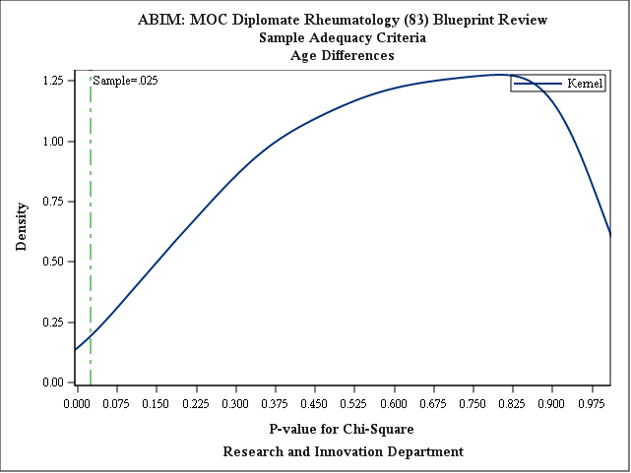
Rheumatology Age

Slide 15
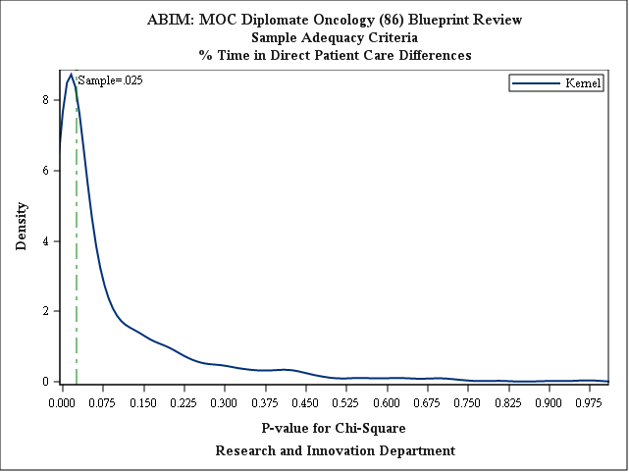
Oncology Time with Patients

Slide 16
Nephrology: Reliability of Importance Ratings
Rules of Thumb:
  Reliability of 0.85 or higher considered good
  12 or more raters yield reliable result
 | Sample
Content Areas | Reliability | N
Sodium and Water Abnormalities | .90 | 76
Acid-Base and Potassium Disorders | .93 | 73
Calcium, Phosphorus, and Magnesium Disorders and Stones | .93 | 80
Chronic Kidney Disease | .89 | 78
Hypertension | .90 | 78
Tubular, Interstitial, and Cystic Disorders | .89 | 69
Glomerular and Vascular Disorders | .86 | 72
Kidney Transplantation | .93 | 80
Pharmacology | .91 | 74
Acute Kidney Injury and Intensive Care Unit Nephrology | .85 | 85

Slide 17
Conclusion: SAC Fit for Use
Qualities | Status
Relevance | Yes
Accuracy | Unknown - benchmarks
Timeliness | Yes
Accessibility | Yes
Interpretability | Yes
Coherence | Yes

Slide 18
References
Austin, PC. 2009 Balance diagnostics for comparing the distribution of baseline covariates between treatment groups in propensity-score matched samples. Statist. Med. 28:3083–3107
Bland, JM & Altman, DG (1986) Statistical Methods for Assessing Agreement between two Methods of Clinical Measurement. Lancet, 1986; 307-310
Baker, B. Brick, MJ. Bates, NA. Battaglia, M. Couper, MP. Dever, J.A. Gile, KJ. & Tourangeau, R. (2013). Report of the AAPOR Task Force on Non-probability Sampling. American Association of Public Opinion Research, 97-101
Brick, M 2013 Unit Nonresponse and Weighting Adjustments: A Critical Review. J, of Official Statistics, 29, No. 3 pp 329-353
Cochran W. 1977 Sampling Techniques, 3rd ed. New York Wiley, pp 12-15.
Cohen, Jacob. (1988). Statistical Power Analysis for the Behavioral Sciences, Lawrence Erlbaum Associates, Hillsdale, New Jersey. pp. 215-271
Lee JSJ. 2012 The Empirical Properties of Survey Quality Indicators Under Non-ignorable Nonresponse, Section on Survey Research Methods, Proceedings from the Joint Statistical Meetings
National Research Council. (2013). Nonresponse in Social Science Surveys: A Research Agenda. Roger Tourangeau and Thomas J. Plewes, Editors. Panel on a Research Agenda for the Future of Social Science Data Collection, Committee on National Statistics. Division of Behavioral and Social Sciences and Education. Washington, DC: The National Academies Press.
Practical Tools for Nonresponse Bias Studies, Jill M. Montaquila, Westat and the Joint Program in Survey Methodology & Kristen M. Olson, University of Nebraska-Lincoln, SRMS/AAPOR Webinar, April 24, 2012
Schouten B & Cobben F. 2012 Does Balancing of Survey Response Reduce Nonresponse Bias? Statistics Netherlands, Henri Faasdreef 312 2492 JP The Hague/Heerlen
Walter, SD., Eliasziw, M., and Donner, A. (1998). 'Sample Size and Optimal Designs For Reliability Studies.' Statistics in Medicine, 17, 101-110.
Winer, B.J. (1991). Statistical Principles in Experimental Design (Third Edition). McGraw-Hill. New York, NY.

Slide 19
Thank You!
Questions?
Gerald Arnold, Sr. Statistician,
American Board of Internal Medicine,
510 Walnut Street, Philadelphia, PA 19106
215.446.3568, GARNOLD@ABIM.ORG

