Slide 1


Balancing Respondent Burden and Data Needs in Question Design:
Reducing Respondent Burden in the American Community Survey (ACS)
Elizabeth Poehler (Elizabeth.Poehler@census.gov), Todd Hughes, Karen Stein
U.S. Census Bureau, UCLA Center for Health Policy Research, Westat
Identifying Burden
In 2014, each ACS question was scored to determine burden based on the following factors:
  Response Time
  Allocation Rate
  Complaints
  Identified as sensitive, difficult, or cognitively burdensome, based on a survey of 1,100 ACS telephone and field interviewers
29% of the ACS questions were determined to have a high burden
Research Question:
Do modified versions of high burden questions reduce respondent burden?
Cognitive Testing
Comparison of two new versions
    Year Residence Built
    Year of Naturalization
    Year of Entry
Conducted by Westat
72 interviews in June in the Washington D.C. metro area
Select Items with High Burden
Question | Issue
Year Residence Built | Cognitive Burden
Number of Weeks Worked Last Year | Cognitive Burden
Time Left for Work | Sensitivity
Total Income Last Year | Sensitivity, Allocation Rates, Complaints
Year of Naturalization and Year of Entry | Moderate issues on all measures except difficulty
Place of Work – County | Response Time
Disclaimer: Any views expressed are those of the authors and not necessarily those of the U.S. Census Bureau. Presented at QDET2, November 11, 2016, Miami, FL

Slide 2
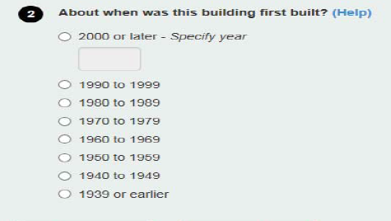
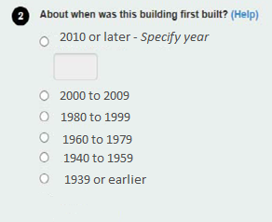
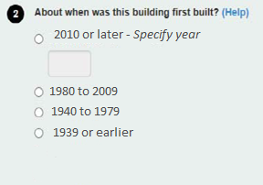
Balancing Respondent Burden and Data Needs in Question Design:
Reducing Respondent Burden in the American Community Survey
Year Residence Built: Cognitive Testing Results
Current Version
mostly 10 year ranges
Tested Version 1 –
mostly 20 year ranges
Tested Version 2 –
mixed-length ranges based on federal regulations
Accurate Categorical Response - Most respondents were able to provide an accurate range for when their home was built
Version Preference - Respondents were evenly split between the two tested versions
Auditory Processing Difficulties - Some respondents found the forward-backward reading of year ranges confusing and not intuitive
Recommendations and Conclusions
  Order the intervals from oldest to newest, for oral administration
  When the respondent is not sure of the answer, categorical options are preferred, with wider ranges of dates.

Slide 3


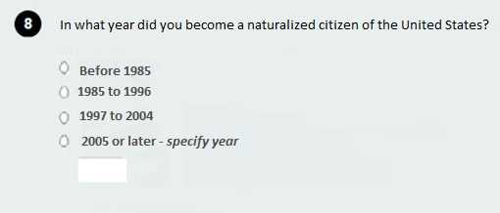

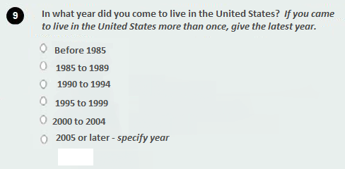
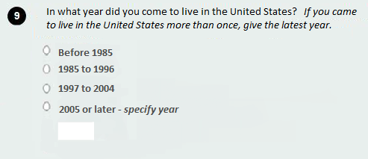
Balancing Respondent Burden and Data Needs in Question Design:
Reducing Respondent Burden in the American Community Survey
Year of Naturalization / Year of Entry: Cognitive Testing Results
Current Version – Write-in
Tested Version 1 – Categorical, 5-year ranges
Tested Version 2 – Categorical,
wider, mixed-length ranges
Self-Reporting - Easy to answer, preferred write-in over categories
Proxy Reporting –
  Year of Naturalization - Respondents had difficulty answering for other household members; wider categorical preferred
  Year of Entry - More accurate than Year of Naturalization and had little trouble answering
Recommendation: In automated modes, allow write-in with an option for categorical. For paper, use the wider categorical version.

