Slide 1
Managing Questionnaire Development for a National HIV Surveillance Survey, Medical Monitoring Project
Division of HIV/AIDS
Jennifer L Fagan, Health Scientist/Interview Lead
for Amy Baugher, Alejandro Pérez, Mark Freedman, Mabel Padilla, and R. Luke Shouse
International Conference on Questionnaire Design, Development, Evaluation, and Testing (QDET2)
Saturday, November 12, 2016

Slide 2

Project Description

Slide 3
Medical Monitoring Project (MMP)
National surveillance system focusing on adults living with HIV
Collaboration between Centers for Disease Control (CDC) and state and local health departments
Personal interview and corresponding medical record abstraction
  Behavioral and demographic characteristics
  Clinical outcomes

Slide 4

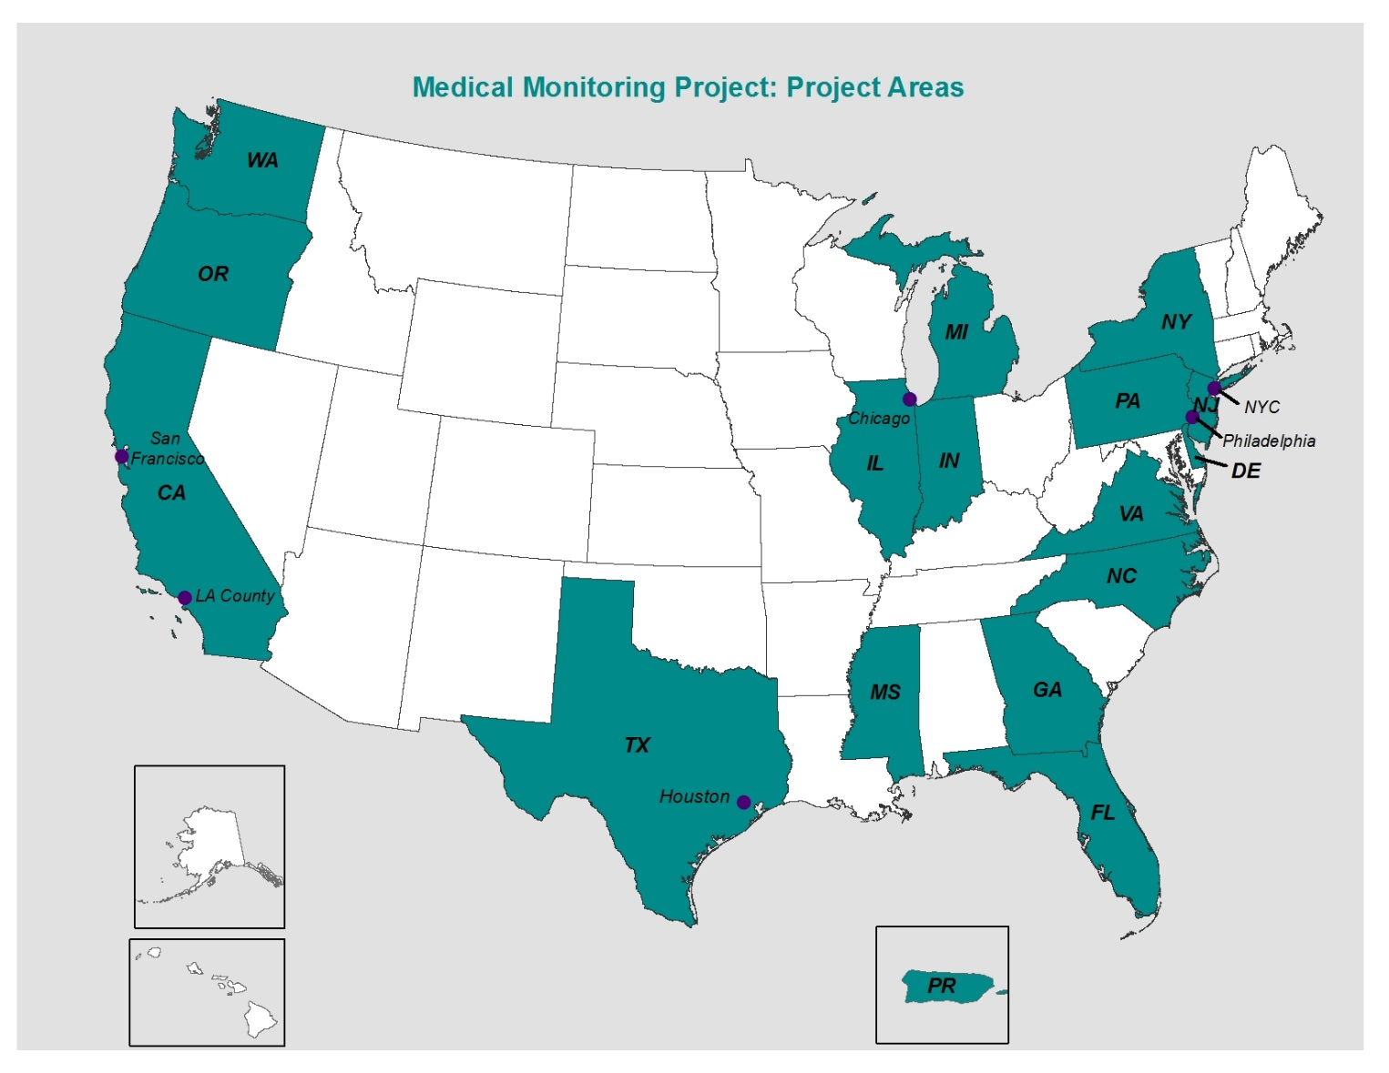

Slide 5
MMP Interview
45-minute structured, computer-assisted personal interview
Face-to-face or by telephone
English and Spanish versions of the questionnaire
  Administered in most languages via an interpreter
Referrals to HIV medical care and HIV-related ancillary services and prevention messages

Slide 6
Details about MMP
Additional information about MMP such as sampling, weighting, and publications may be found at: http://www.cdc.gov/hiv/statistics/systems/mmp/
Notes:
Focus is on the MMP interview.

Slide 7
Questionnaire Management

Slide 8
Complexity of MMP Interview
Different questionnaires for each annual data collection cycle
  English and Spanish versions
  Standard, proxy, and short versions in English and Spanish for previous cycles
  2015–current, variables renamed the same, but coding and translations were modified
Detailed information on a wide-range of health topics
  2015–2017, 23 modules and 876 variables
  Extensive skip logic and edit checks

Slide 9

Questionnaire Management Needs
Manage comprehensive metadata related to questionnaire development
Develop a system that is easily adaptable
Use materials or software that are readily available and do not require extensive informatics and programming knowledge

Slide 10

Questionnaire Management
Capture survey topic information
Manage and document questionnaire design process
Create audience-specific questionnaires using the report function

Slide 11
Survey Topic Information

Slide 12
Survey Topic Information
Capture background information related to each topic or variable
  Research questions and justification for inclusion
    Whether the topic is used as a performance measure or key indicator
  Question source and link to relevant articles
  Whether cognitive testing or other pre-testing was completed with a link to findings
Generate reports for internal and external use

Slide 13
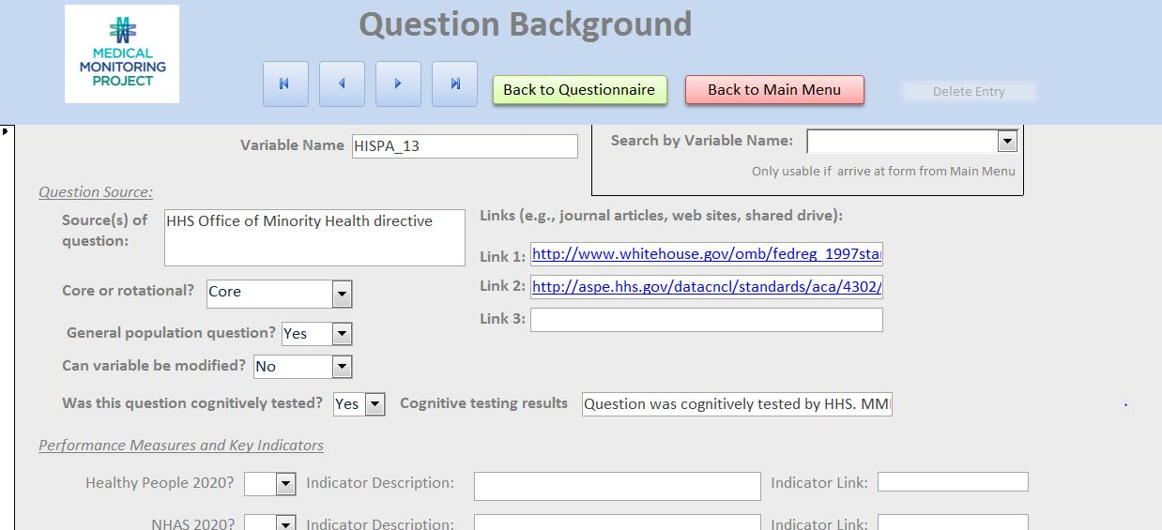
Sample Background Information Form

Slide 14
Questionnaire Design

Slide 15

Suggested Edits for Questionnaire Revisions
Receive ongoing stakeholder input from over 200 stakeholders via SurveyMonkey® and export into Access®
  Nearly 900 suggestions for the 2018 cycle
Capture details related to a suggested edit
  Person suggesting edit and their affiliation
  Type of edit, description of edit, related document links
  Information about final decisions and date edits were made
Run reports to ensure all suggested edits are addressed

Slide 16
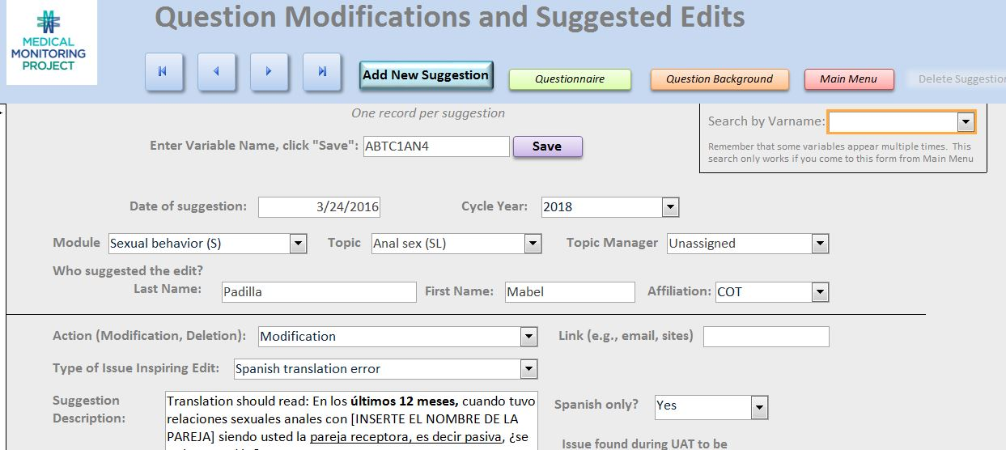
Sample Suggested Edits Form

Slide 17
Variable Metadata
Use for design, programming, and data management
  Variable name and label
  Questions, response options, and response range
  Hard edit and soft edit error checks
  Skip logic
  Calculations
Run reports to identify erroneous or missing information and to generate questionnaires

Slide 18
Questionnaire Creation

Slide 19
Audience-Specific Questionnaires
Interviewer: for field use if electronic survey device is unavailable
  E.g., intro statements, questions, skip logic, interviewer guidance
Programmer: for electronic survey application
  E.g., calculated variables, hard edit and soft edit logic, and skip patterns
Office of Management and Budget (OMB): to assess burden
  E.g., all elements read to a respondent, justification for questions
Data analyst: for analysis
  E.g., variable names, response codes, research questions

Slide 20
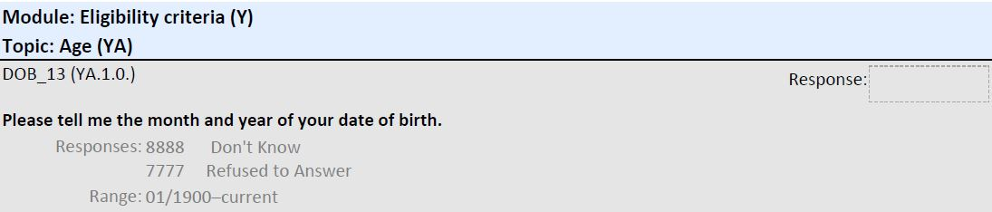
Sample Question for Field Use

Slide 21
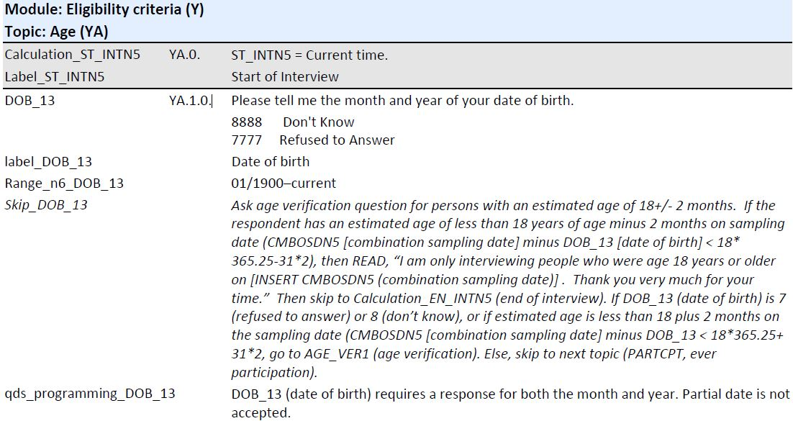
Sample Question for Programming

Slide 22






Version Control
Database to create different questionnaires ensures version control
  A cover page with the most recent version number in Access
Every data collection cycle has a distinguishable cover page

Slide 23
Discussion

Slide 24
Discussion
A database addressed our needs to
  Design and create questionnaires
  Systematically capture questionnaire metadata
Solutions may not be generalizable to all surveys
  MMP questionnaires are comprehensive and complex
  Questionnaires are finalized prior to programming due to OMB review; some surveys may program directly into a survey software application
Surveillance and other large survey-based studies may consider using a database to improve survey development.

Slide 25
Acknowledgements
CDC/DHAP Clinical Outcomes Team
MMP project area staff*
People living with HIV who participate in the MMP interview
*Staff names may be found at: http://www.cdc.gov/hiv/statistics/systems/mmp/projectareas.html

Slide 26
Conflict of interest
The authors have no real or apparent conflicts of interest to report

Slide 27
Additional questions?
Jennifer Fagan
jfagan@cdc.gov

