Slide 1



Testing the web mode
for collecting data on income and wealth
in the Italian Household Budget Survey
Manuela Murgia
(Istat, Directorate of Data Collection)
  Romina Gambacorta, Andrea Neri, Giuseppina Papadia, Francesca Zanichelli
  Bank of Italy
  Laura Capparucci, Massimiliano Degortes, Martina Lo Conte, Loredana Mazza
  Manuela Murgia ISTAT – Italian Statistics Institute
  QDET2 – Questionnaire Design for Sensitive Topics and Confidentiality Miami, Florida - November 12, 2016

Slide 2
Outline
Istat - Bank of Italy research project
The Web Survey on Italian Households
Research questions
Some results
Conclusions and next steps

Slide 3
Istat - Bank of Italy research project
The research project aims at evaluating whether the adoption of CAWI can enhance respondents cooperation and improve data quality.
Bank of Italy carries out the Survey of Italian Household Income and Wealth (SHIW) since the Sixties using face to face interviews (CAPI technique).
It is well known how the presence of an interviewer can affect the propensity to respond to a survey, especially when dealing with sensitive topics such as income and wealth.
For this reason, Istat and Bank of Italy carried out a web survey on households’ economic situation using a short form of the SHIW questionnaire.

Slide 4
The Web Survey on Italian Households
A sample of 10,030 households was selected from the population register in the same municipalities used for the SHIW CAPI survey.
An incentive to respond was given to about 80% of the sample, in order to assess the effect on survey participation:
  to 8,024 households was proposed to enter a competition to win an iPad (five iPads);
  the remaining households was not given any incentive

Slide 5
The Web Survey on Italian Households
In the web survey we also included some experiments:
The presence/absence of ‘don’t know’ option
Inverse order for long list of items
Different scale presentation
Different question wording for the same question
A usability test for an automatic coding system for the variable Occupation

Slide 6
Aim of the presentation
In this presentation we will address three research questions:
Has the incentive an effect in boosting survey participation?
Have the “don’t know” option, the items order and the scale presentation an effect on responses?
Does response behavior relating to sensitive topics differ in the CAPI and CAWI surveys?

Slide 7
Research Question 1
Has the incentive an effect in boosting survey participation?

Slide 8
Research Question 1: Incentive
Questionnaires compilation
Answer to research Question 1
The incentive has a moderate effect in boosting survey participation and in reducing break-offs.
Response Rates
Total 8.2
Incentive 8.3
No incentive 7.9

Slide 9
Focus on response rate and break-offs
Response rate per sections
Break-offs happened mostly in income section

Slide 10
Research Question 2
Have the “don’t know” option, the item order, the scale presentation an effect on responses?

Slide 11
Research Question 2: “Don’t know”
“Q. Referring to the total income of your household, would you say that
at the end of 2015 it was higher, lower or substantially equal
to the one of the end of 2014?”
WEB1:
Compulsory question
Absence of ‘Don’t know’ item
WEB2:
Compulsory question
Presence of ‘Don’t know’ and ‘No answer’ items
- 7,8 p.p.

Slide 12
Research Question 2: “Don’t know”
  “Q. In your opinion, at the end of 2016, the value of your house
  will be.. Higher, Equal or Lower?”
WEB1:
Compulsory question
Absence of ‘Don’t know’ item
WEB2:
Compulsory question
Presence of ‘Don’t know’ and ‘No answer’ items
-21,6 p.p

Slide 13
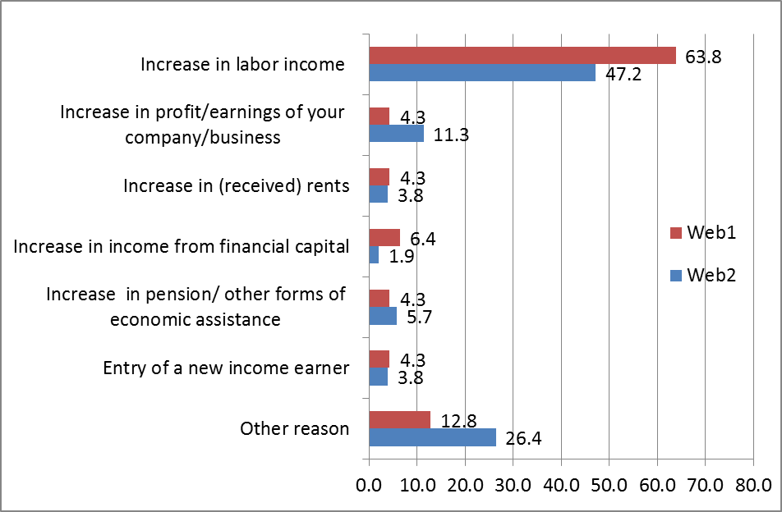
Research Question 2: Item Order
  Q. Can you specify the main reason of the increase in total hh
  income in 2015 (compared to 2014)?
Original variable
WEB1: (n=47)
Items are ordered as shown
WEB2: (n=53)
Inverse item order (“other, that is..” always last position)
(*)

Slide 14
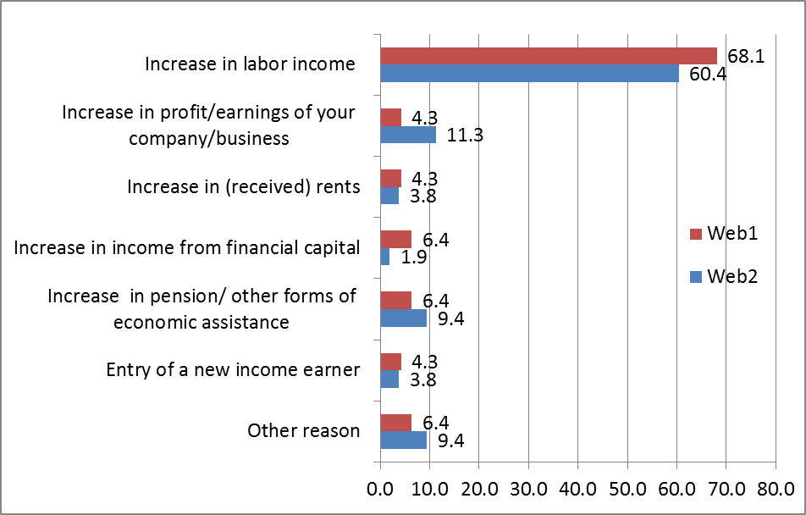
Research Question 2: Item Order
Original variable
Recoded variable

Slide 15
Research Question 2: Scale presentation
Q. The disposable income of your household, allows to get to the end of the month … (degree of difficulty)?
Vertical scale
Horizontal scale
  Using the vertical scale, fewer people choose the last item, while with the horizontal scale, the distribution seems smoother.

Slide 16
Answers to research Question 2
Don’t know: when there is not the possibility to answer don’t know, respondents seem to choose the «neutral» item.
Items order: when the main item is the last, many respondents choose «Other». It seems they don’t read all the items
A different scale layout seems to make the distribution smoother and to give the last item a higher chance to be selected.

Slide 17
Research Question 3
Does response behavior relating to sensitive topics differ in the CAPI and CAWI surveys?

Slide 18
Research Question 3
Among sensitive topics we choose those that might have been affected by the social desirability effect. Two examples are shown in this presentation:
Bonus Renzi (a monthly amount of money – 80 euros - the Italian Government gives to people with low income – from 8,000 to 26,000 gross annual income)
Employment Income

Slide 19
Research question 3:
Comparing CAPI and CAWI data on sensitive topics
The two surveys show different results
Potential causes:
Selection effect
Technique effect
First stage: to try to understand differences, a sub-group of potential CAWI respondents has been selected among CAPI respondents: those that use a computer or a smartphone
              Not disentangled yet

Slide 20
Research question 3: Comparing CAPI and CAWI data on Bonus Renzi
Q. Did someone of your family receive the Bonus Renzi in 2015? And which was the total monthly amount?
 | CAWI | CAPI Eligible* | CAPI
Yes | 40,4% | 32,2% | 23,7%
No | 59,6% | 67,8% | 76,3%
Total | 100% | 100% | 100%
Amount (euros values)
Mean | 124 | 86 | 86
Median v. | 80 | 80 | 80
Modal v. | 80 | 80 | 80
CAPI survey: fewer people declare they received the Bonus Renzi and with lower amounts.
*Respondents who use a computer or a smartphone

Slide 21
Research question 3:
Comparing CAPI and CAWI data on income
Employment Yearly Net Income (Head of the family)
euro values | CAWI | CAPI eligible* | CAPI
Mean | 24,825 | 18,324 | 18,005
Median value | 21,357 | 18,000 | 18,000
Modal value | 20,000 | 15,000 | 15,000
*Respondents who use a computer or a smartphone
CAPI survey shows lower levels of income

Slide 22
Research question 3: Income Admin Archive (IAD) as a benchmark
Are respondents confident with the web mode?
Do they feel comfortable in declaring their income?
Employment income
 | CAWI
IAD | Don’t declare an income | Declare an income | Total
Don’t declare an income | 216 | 53 | 269
Declare an income | 33 | 403 | 436
Total | 249 | 456 | 705
 | 4,7 | Potential Under reporting
Web respondents seem confident with the web mode: low level of income under reporting

Slide 23
Research question 3: Income Admin Archive (IAD) as a benchmark
Comparison of income distributions
euro values | CAWI | IAD
Mean | 24,825 | 25,395
Median value | 21,357 | 22,688
Modal value | 20,000 | 20,939
CAWI seems to slightly underestimate the employment income

Slide 24
Research question 3: Income Admin Archive (IAD) as a benchmark
Under estimation
CAWI seems to slightly underestimate the households’ income. Under estimation is mostly between 0 and 15%.
If IAD as benchmark CAPI might underestimate income even more

Slide 25
Conclusions and next steps
Incentive seems slightly help in improving response rate and break-offs, but other forms of incentive should be evaluated;
The ways questions are asked do influence responses: a test should always been run when any changes occur in questionnaires:
  The ‘Don’t know’ option should be used for ‘difficult’ questions;
  Q: The item order should be “rotated” or reflect the importance of each item in explaining a phenomenon?;
Next steps:
  To disentangle selection effect from mode effect;
  To measure the mode effect for sensitive topics;

Slide 26
THANKS

